Slide 1
CIS 5100 – Data Structures
Project 17-2 : Student Registration
GUI Application

Slide 2
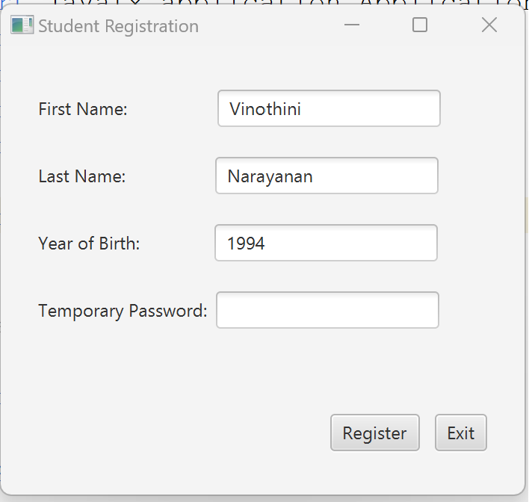
This code invokes the GUI application for the student to enter the information – FirstName, LastName, YearOfBirth.
When user click on the Register button, the application will generate temporary password

Slide 3
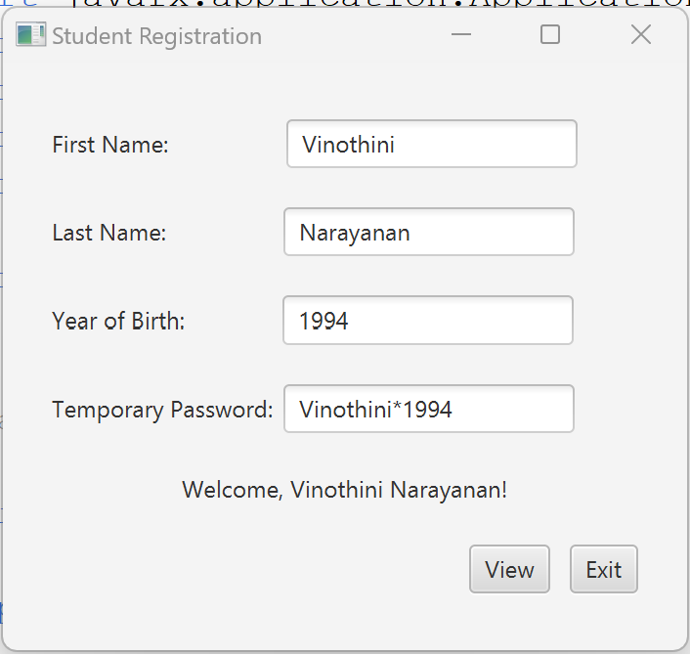

Temporary password is generated and it shows Welcome message to user
Register button is changed to View button

Slide 4
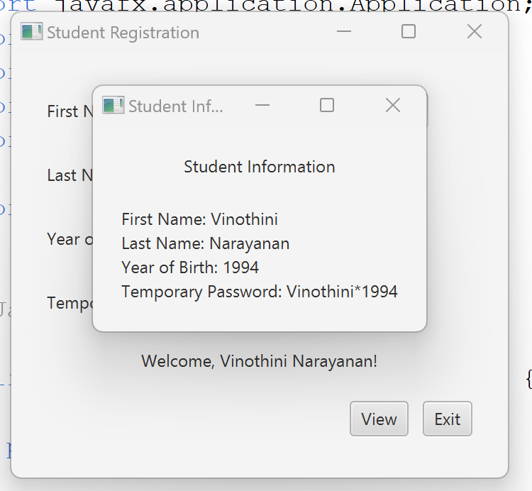
View button to display the student information
Exit button – To close the application
“X” will close the pop-up box

Slide 5
Functionalities:
App Class:
Main entry point for JavaFX application.
Sets up the GUI using FXML and handles scene transitions.
StudentInterface Interface:
Defines methods for accessing and setting student information.
studentregister.fxml:
Describes the structure of the GUI
StudentRegisterController Class:
Controller for studentregister.fxml.
Implements StudentInterface and manages user interactions.
Generates temporary passwords and handles UI transitions.
“register” – Validates input, generate temporary password and update the UI.
“viewStudentInfo” – Displays Student information in a new stage
“exit” – Exits the Application
studentdisplay.fxml:
Describes the structure of the GUI for displaying student information.
Includes a title label and a dynamic label (studentInfoLabel) for showing student details.
StudentDisplayController class:
Controller for studentdisplay.fxml.
Uses @FXML to link the studentInfoLabel with the corresponding element.
Provides a method, setStudentInfo, to dynamically set the text of the studentInfoLabel.

Slide 6
The code follows the Model-View-Controller (MVC) pattern, separating concerns between the data (Model), the user interface (View), and the logic (Controller).
The FXML files define the structure and layout of the GUI.
The controller (StudentRegisterController) handles user input, updates the UI, and manages the overall flow of the application.
The application demonstrates basic UI interaction, temporary password generation, and transitioning to another view to display student information.
The controller (StudentDisplayController) to display the student information

Slide 7
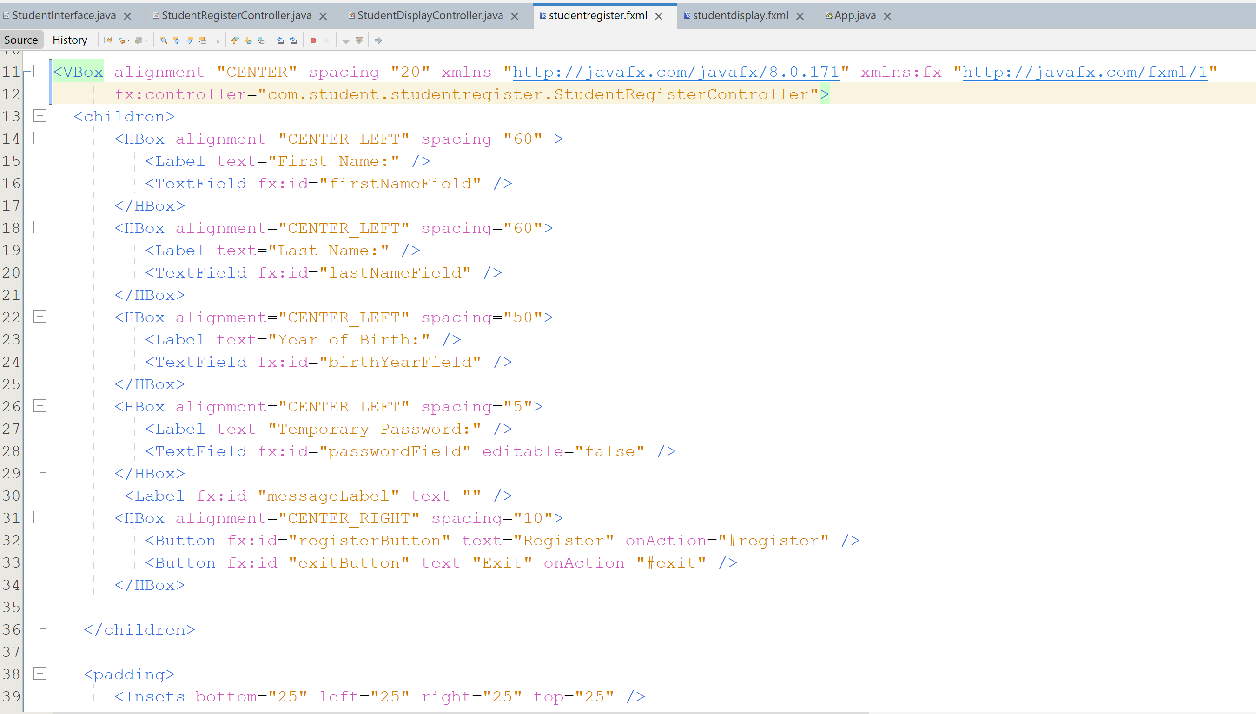
Studentregister.fxml

Slide 8
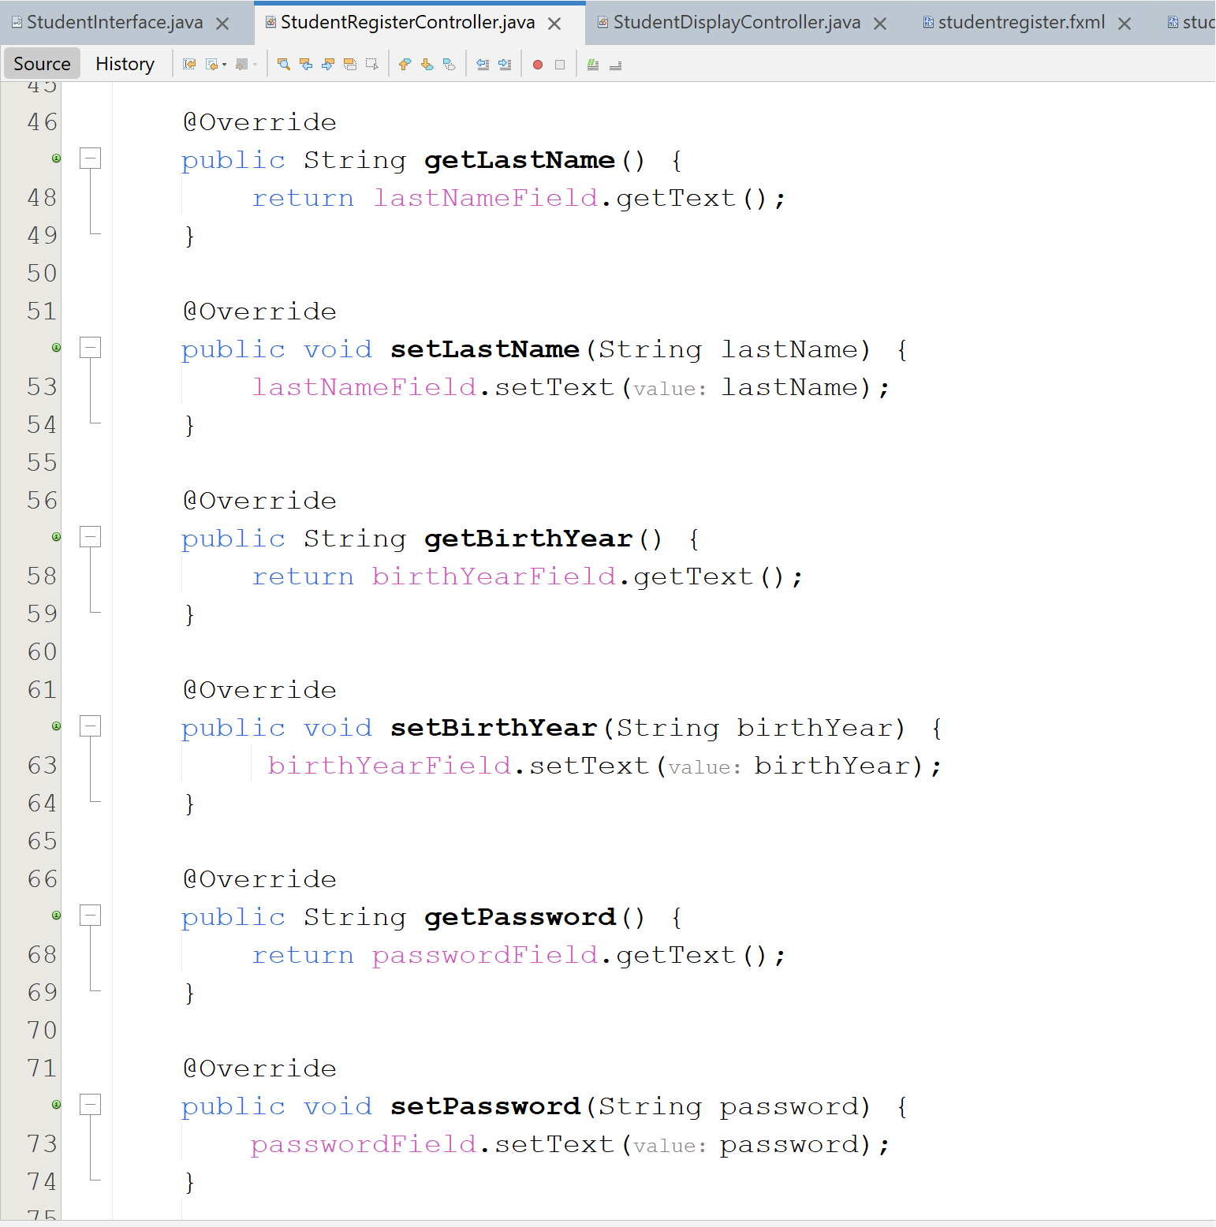
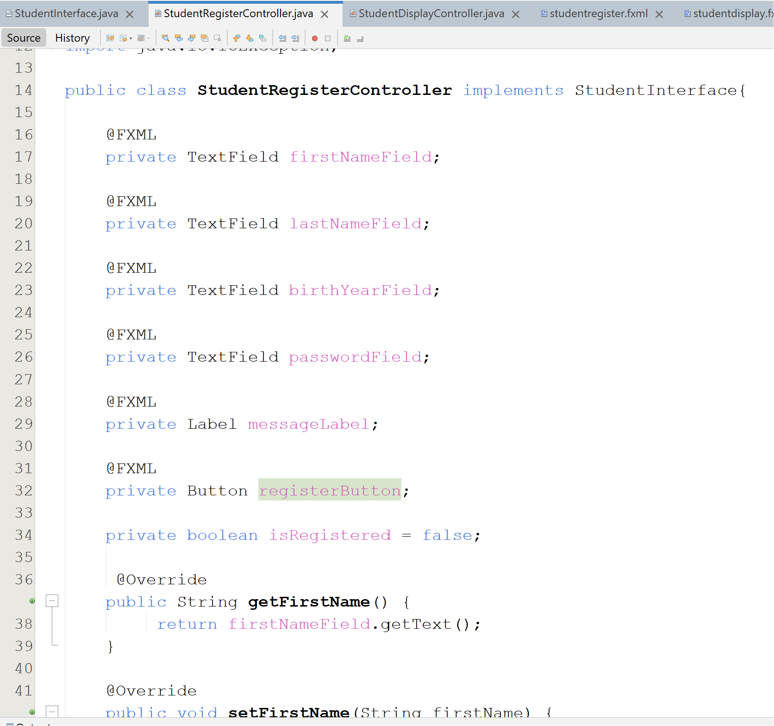
StudentRegisterController.java

Slide 9
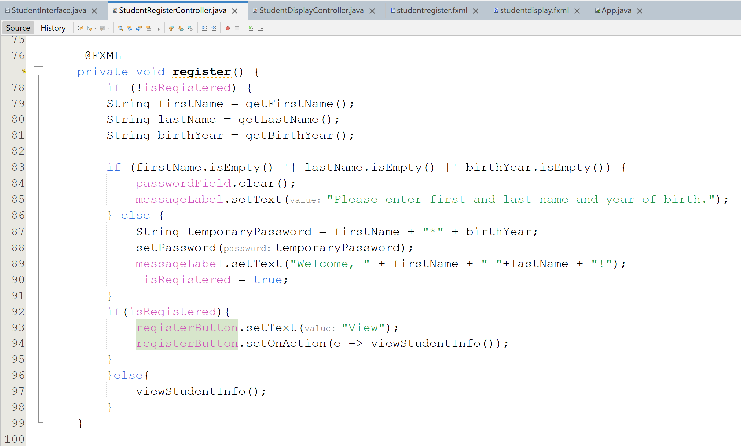

Slide 10
