Slide 1
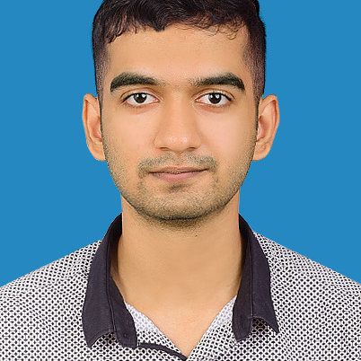
Vinroy Miltan Dsouza
Sr Analyst/Software Engineer
Bachelor of Engineering
Computer Science: 2018 - 2022
Mumbai
Skills
vinroy.miltan-dsouza@capgemini.com
Java 8 /J2EE | Java Basics, OOPS, Generics, Collections, Arrays, Loops, Lambda Exp, Stream API Junit, Mockito, Servlets
Spring core | IOC & Dependency Injection, Autowire
Spring REST | REST controllers, Implementation of GET, POST, PUT & DELETE,, Exception Handling, Testing Services, Controller & Repository layer
Spring Boot Microservices | Spring Boot Starters, annotations,
Spring Cloud | Eureka server and discovery client
Angular | Components, Services, Modules, Routing, Forms & Validation, Testing using Jasmine & Karma
Database | MongoDB
UI Tech | HTML 5 & CSS 3,JavaScript, Angular
Tools | Git, Postman, Maven, IDE
+91 7022086860
A5
Full Stack Developer
Proficient in creating microservices using Spring boot, Spring security, Eureka server.
Proficient in creating Single Page Web Applications in Angular framework with Angular forms, angular routing.
Proficient in unit testing using Junit and Mockito.
Proficient in creating databases using MongoDB.
Doctor Appointment System
Completed case study of Doctor Appointment with Java Spring boot, Jwt authentication, mongoDb database and unit testing using Junit and Mockito. Used Angular in creating the user interface.

