Slide 1
TENSOR TIME SERIES MODELING
PROJECT OVERVIEW
UPCOMING WORK
The overall goal of this project is to develop a method using VARMA models to model multilinear time series.
Research further into transform-based time series analysis
Develop model to predict future frames in a cartoon (Spongebob) using VAR
Later incorporate VARMA into the model
An example of what we can predict is future frames in a video.
CURRENT RESULTS
OUTLINE
Gained an in-depth understanding of VARMA models
Developed Python library to handle VARMA modeling
Able to handle order selection of model using hypothesis testing compared doing graphically
Research further into transform-based timeseries analysis (2 weeks)
Develop model to predict future frames of a cartoon using VAR (8 weeks)
Later incorporate VARMA into the model (2 week)

Slide 2
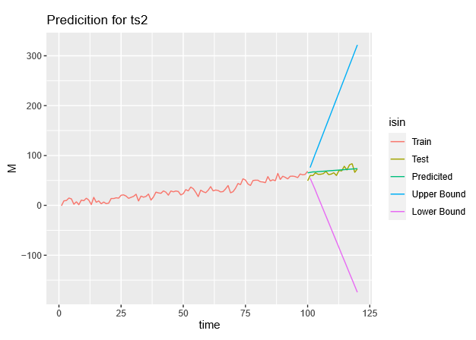
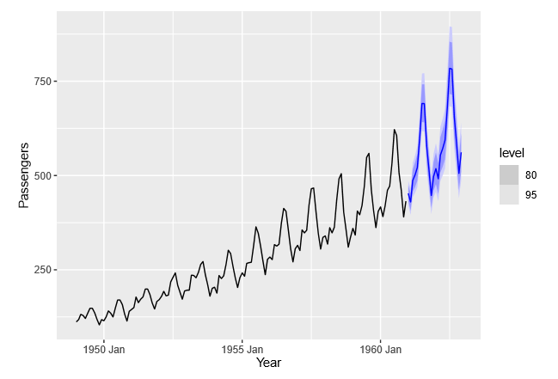
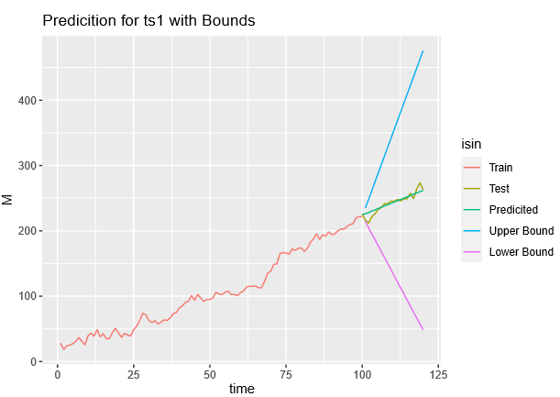

Slide 3
