Slide 1


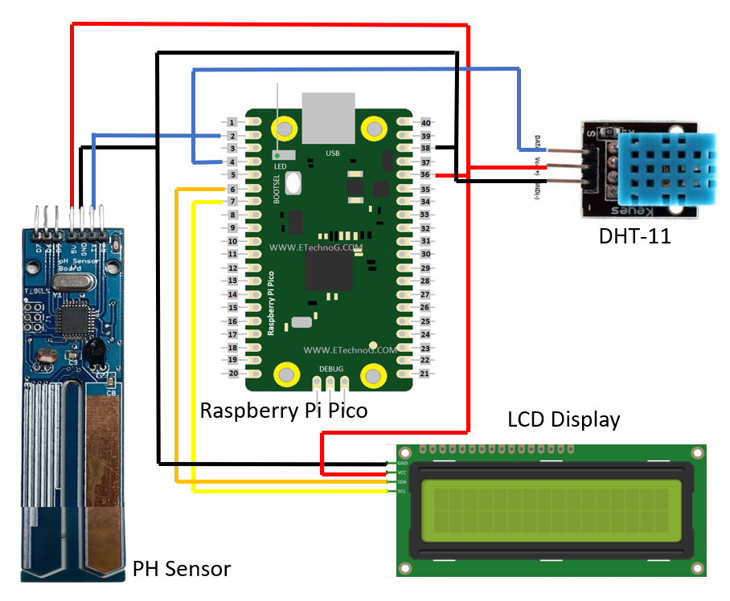
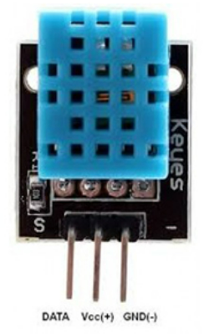
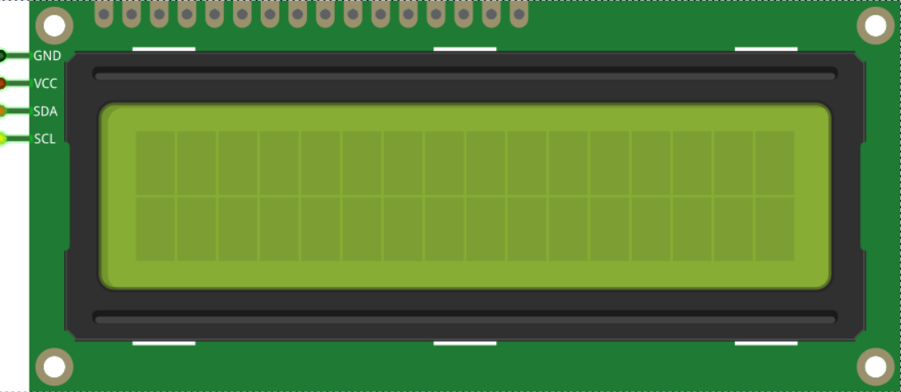
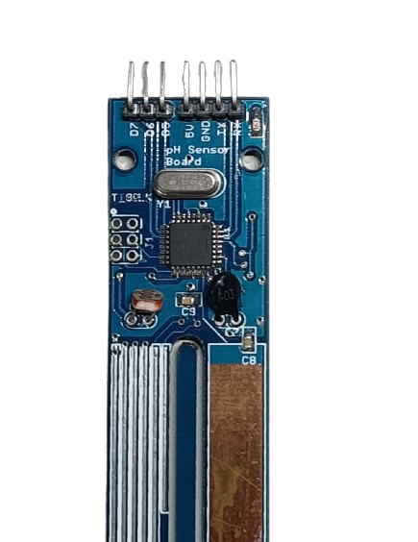
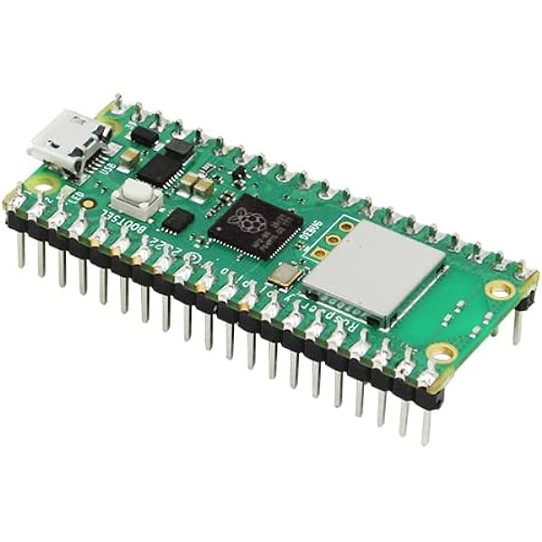

Crop Prediction system, using machine learning
Develop a smart agriculture system leveraging the Raspberry Pi Pico microcontroller to monitor soil pH, ambient temperature, and humidity. The system aims to predict the most suitable crop for the given soil conditions and display the outcome on an LCD screen for user convenience.
Summary
This project leverages the capabilities of the Raspberry Pi Pico microcontroller to deploy a machine learning model for real-time crop prediction. Utilizing DHT11 temperature and humidity sensors, alongside a pH sensor, the system collects essential soil data. The on-board machine learning model processes this data, providing instantaneous crop predictions tailored to the specific soil conditions. The outcomes of these predictions are prominently displayed on an LCD screen.
The seamless communication between sensors and the Raspberry Pi Pico, managed through GPIO pins, ensures a continuous and reliable flow of data. The Cortex-M4 processor within the Pico efficiently handles complex calculations, contributing to the swift and accurate generation of crop predictions. The LCD display interface provides users with immediate insights into optimal crop choices based on the machine learning analysis.
By prioritizing efficiency, accessibility, and adaptability, this methodology optimizes the development process for a reliable and user-friendly smart agriculture system. The resulting solution enables real-time monitoring and analysis of crop suitability data, enhancing precision in agricultural decision-making
LCD Display
DHT11 Sensor
Temperature and Humidity
Components
Circuit Diagram
PH Sensor
Raspberry Pi Pico
Methodology :
Integration of a trained machine learning model within the Raspberry Pi Pico microcontroller.
Connection of DHT11 temperature and humidity sensors, along with a pH sensor, to the Pico for measuring soil parameters.
Transmission of collected data to the preloaded machine learning model for crop prediction.
Displaying real-time information on an LCD screen, presenting the recommended crop and corresponding parameters as outcomes of the prediction.
Team :
Faculty Mentor :
Dr . Vishnu S
P Abhiram
C Sahithee Vaibhav
K Ammi Reddy
K Mahammad Sami
Vinayakan V S

