Slide 1

Forgery Localization in Images and Scanned Documents
Forgery Localization in Images and Scanned Documents
B.Tech Project Review
Guide: Dr. Aarthi R, Assistant Professor (Sl.Gr.) , Amrita School of Computing, Coimbatore
SL NO. | NAME | Roll No
1 | Sahithee Vaibhav Cheruvu | CB.EN.U4CSE21414
2 | Mahammad Sami Khaji | CB.EN.U4CSE21430
3 | Sahithee Vaibhav Cheruvu | CB.EN.U4CSE21440
4 | Vinayakan VS | CB.EN.U4CSE21467
Team: Group 31

Slide 2
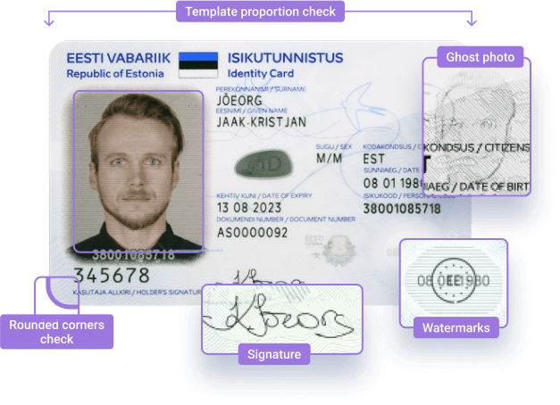
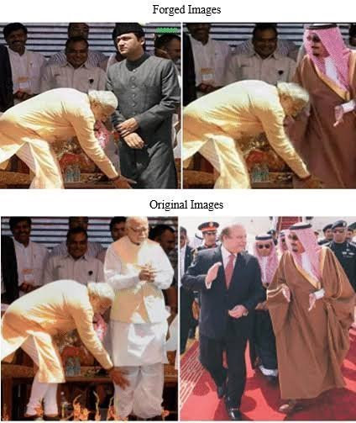
Forgery Localization in Images and Scanned Documents
INTRODUCTION
In today’s world, images and videos are shared everywhere from news and social media to official reports. This makes it important to check whether such content is real or edited. With powerful editing tools and AI, spotting fake visuals has become more difficult.
Key Areas Affected:
Crime Investigations: Edited images or videos can mislead legal processes.
Insurance and Journalism: Fake visuals can affect claims and reduce public trust.
Survey Findings: According to a LocalCircles report, 30% of people say that 1 in every 4 videos they see is fake.
Major Consequences:
Politics: Misinformation can affect elections and public thinking.
Social Harm: Fake content is used to spread hate and cause harm, especially through deepfakes and gender-based violence.
Team: Group 31

Slide 3


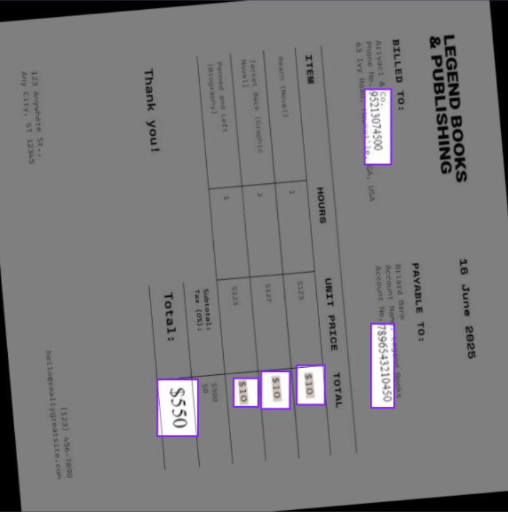
Forgery Localization in Images and Scanned Documents
PROBLEM STATEMENT & MOTIVATION
Image forgeries pose significant threats to public trust and safety.
To build an AI model for accurate forgery localization in images and documents, addressing critical impacts like misinformation, social harm, and public trust..
Team: Group 31

Slide 4
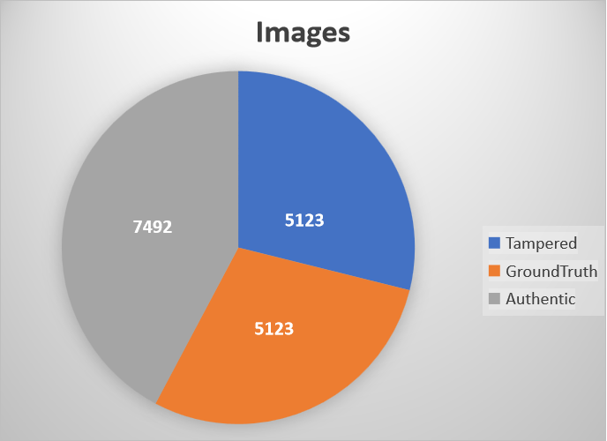
Forgery Localization in Images and Scanned Documents
DATASET DESCRIPTION - CASIA.V2.0
Two different datasets were chosen the first dataset is CASIAv2.0
Au (Authentic): Original, unaltered images. ​
​
Tp (Tampered): Images that have undergone some form of manipulation. ​
​
Gt (Ground Truth): Binary masks highlighting tampered regions. ​
Team: Group 31

Slide 5
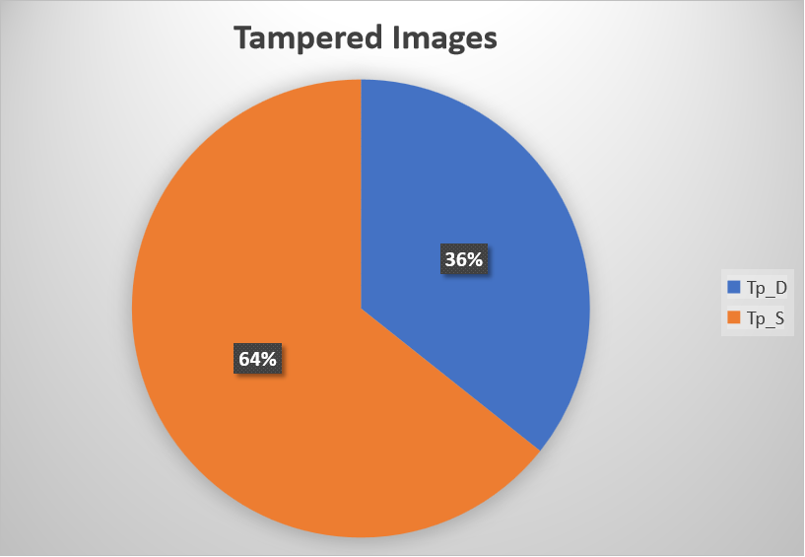
Forgery Localization in Images and Scanned Documents
DATASET DESCRIPTION - CASIA.V2.0
Tp_D: Image splicing tampering (content taken from a different source image).
Tp_S: Copy-move tampering (content copied and moved within the same image).
Team: Group 31

Slide 6
Forgery Localization in Images and Scanned Documents
DATASET DESCRIPTION - CASIA.V2.0
Tp_D: Image splicing tampering (content taken from a different source image).
Tp_S: Copy-move tampering (content copied and moved within the same image).
Team: Group 31

Slide 7
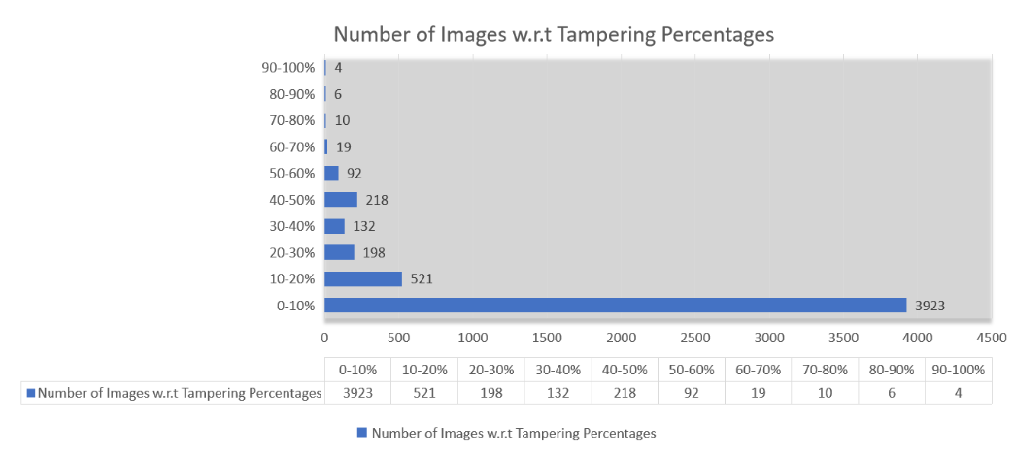
Forgery Localization in Images and Scanned Documents
DATASET DESCRIPTION - CASIA.V2.0
Team: Group 31 ​

Slide 8
Forgery Localization in Images and Scanned Documents
Scanned document DATASET
Dataset - Document Forgery detection Computer Vision Project
Collected from roboflow
https://universe.roboflow.com/document-forgery-detection/document-forgery-detection
It consists of
Train images-887
Validation images-85
Test images-25
A model was deployed by roboflow with
mAP - 55.8%
Precision - 72.1%
Recall - 51.9%
Team: Group 31

Slide 9
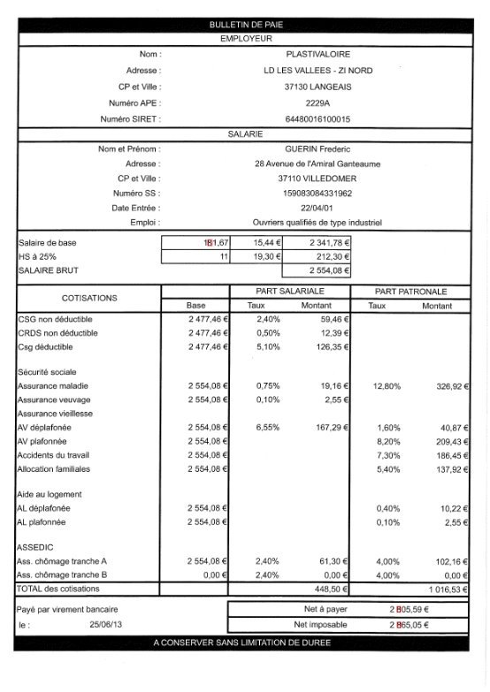
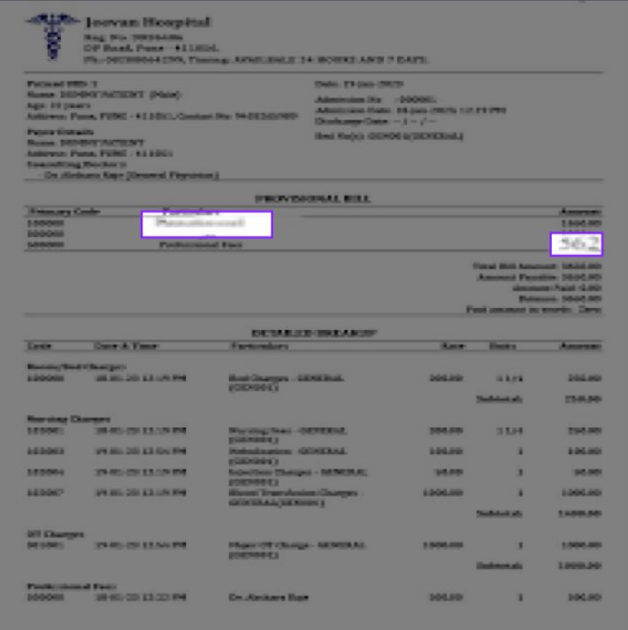
Forgery Localization in Images and Scanned Documents
Sample Images
Team: Group 31

Slide 10
Forgery Localization in Images and Scanned Documents
LITERATURE SURVEY
Ref # & Year | Title | Problem Statement | Dataset | Methodology | Performance Metrics | Scope for Improvement
[1] 2022 | Image Forgery Detection Using Deep Learning by Recompressing Images | Traditional CNN-based methods are limited in detecting one type of forgery and lack speed and accuracy. | CASIAv 2.0 | Detects forgery by recompressing images and comparing differences, highlighting tampered regions for classification using a lightweight CNN. | AUc: 92.23, Precision: 0.85, Recall: 0.97, F-measure: 91.08 | Extending the technique for forgery localization.
[2] 2024 | Fusion Transformer with Object Mask Guidance for Image Forgery Analysis | Existing methods struggle with real-world images and multiple forgery clues, ignoring object information. | CASIA v1+, Columbia, Coverage, NIST16, OpenForensics, CocoGlide, DID | Fuses multiple forensic signals and object data using a transformer guided by object masks for enhanced detection and localization. | F1: 83.2, AUC: 89.5 | Optimizing for speed and lightweight deployment, incorporating scene-level context for better robustness.
Team: Group 31

Slide 11
Forgery Localization in Images and Scanned Documents
LITERATURE SURVEY
Ref # & Year | Title | Problem Statement | Dataset | Methodology | Performance Metrics | Scope for Improvement
[3] 2024 | Detecting Image Manipulation with ELA-CNN Integration | Traditional methods fail to catch common forgeries due to easily manipulated editing tools. | CASIAv 2.0 | Combines Error Level Analysis (ELA) with a lightweight CNN to detect tampered regions and classify images as forged or authentic. | Accuracy: 94.14, Precision: 94.1, Recall: 94.07 | Future work could focus on pinpointing specific forged regions and distinguishing between different forgery types.
[4] 2021 | Fake Region Identification in an Image Using Deep Learning Segmentation Model | Existing methods struggle to localize forged regions accurately in diverse images. | NIST, COMOFOD, Dresden, CASIA 2, IEEE IFS | Modifies U-Net with identity blocks and batch normalization for better forgery localization, processing images pixel-wise. | Performance: Precision: 0.9980, Recall: 0.9950, Acc: 0.9940, Specificity: 0.9570, Miss Rate: 0.0045, Critical Success Index: 0.9930, F1: 0.9970 | Improving handling of scanned reports.
Team: Group 31

Slide 12
Forgery Localization in Images and Scanned Documents
NOVELTY
Existing methods often stop at detection, if an image is forged or not. Our system provides forgery localization, marking the exact altered regions.
Unlike many state-of-the-art approaches, this work supports both digital images and scanned documents.
Achieves a practical balance between AUC and F1-score, unlike existing methods that prioritize only one metric or require heavy computation.
Team: Group 31

Slide 13
Forgery Localization in Images and Scanned Documents
WORK PLAN
Module 1: Literature Survey & Model Trials
Explore existing methods and test baseline models.
Module 2: ELA-CNN on CASIA Images
Train lightweight CNN on ELA-transformed general images.
Module 3: Extension to Scanned Documents
Apply ELA-CNN; shift approach due to low performance.
Module 4: YOLO for Document Forgery
Use YOLO model for scanned documents.
Module 5: UI Integration
Combine both models into a single web-based application.
Team: Group 31

Slide 14
Forgery Localization in Images and Scanned Documents
ELA-CNN Model
Team: Group 31

Slide 15
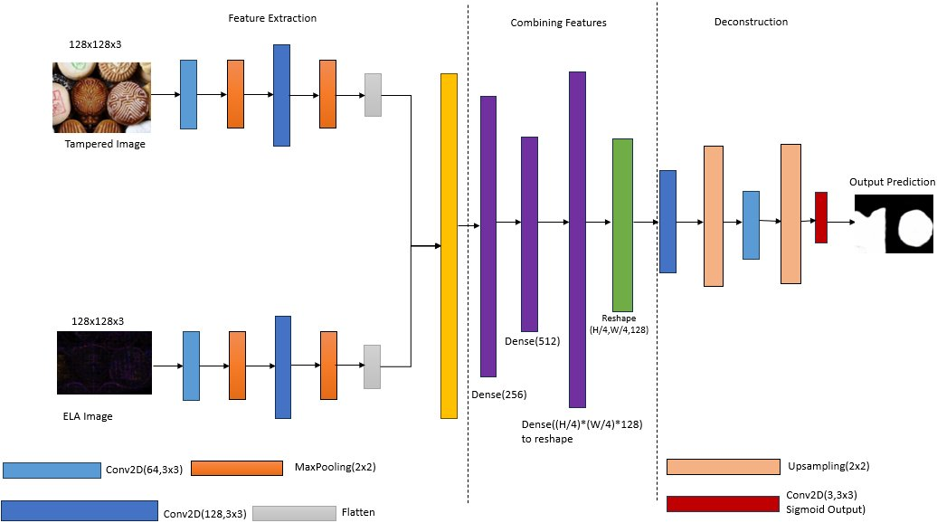
Forgery Localization in Images and Scanned Documents
ARCHITECTURE DIAGRAM
Team: Group 31

Slide 16
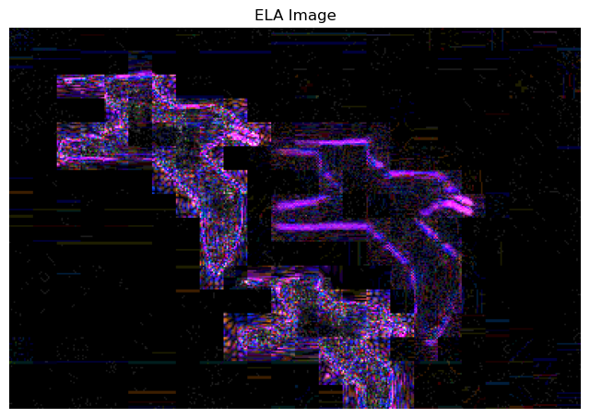

Forgery Localization in Images and Scanned Documents
Error Level Analysis
ELA detects image manipulation by highlighting differences in compression levels, revealing tampered regions with distinct artifacts.​
It provides critical evidence of forgery, making invisible manipulations detectable and aiding in identifying edited areas.​
Using the tampered image (X1) and the ELA image (X2) together enhances the model's ability to detect and localize forgeries effectively.​
X1 provides important visual features, while X2 highlights editing artifacts like compression differences, improving training and localization.​
X1(Tampered Image)
X2(ELA Image)
Ground Truth Image
Team: Group 31

Slide 17
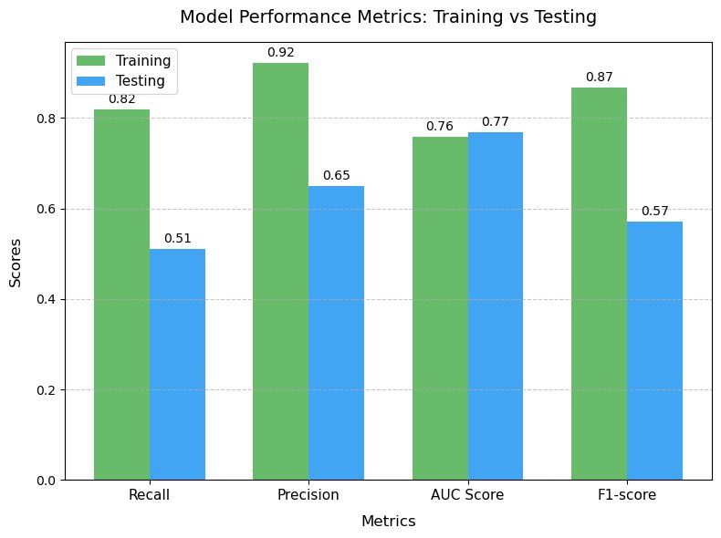
Forgery Localization in Images and Scanned Documents
Model Performance
Team: Group 31

Slide 18
Forgery Localization in Images and Scanned Documents
Why F1-Score is a good metric?
Accuracy Limitation:
Black pixels dominate ground truth masks.Predicting all black yields high accuracy but misses tampered regions.
F1-Score Advantages:
Balances Precision and Recall
Precision: Accuracy in predicting non-tampered regions (black pixels, labeled 0).
Recall: Effectiveness in identifying tampered regions (white pixels, labeled 1).
F1-score ensures better evaluation by focusing on both false positives and false negatives.
AUC Score is also considered for comparison as Measures how well the model separates classes (positive vs. negative).
 | Train Data - F (Pred) | Train Data - R (Pred) | Test Data - F (Pred) | Test Data - R (Pred)
F (Act) | 49428117 | 616338 | 11556637 | 689399
R (Act) | 1625380 | 7312565 | 1224817 | 1274747
Team: Group 31

Slide 19
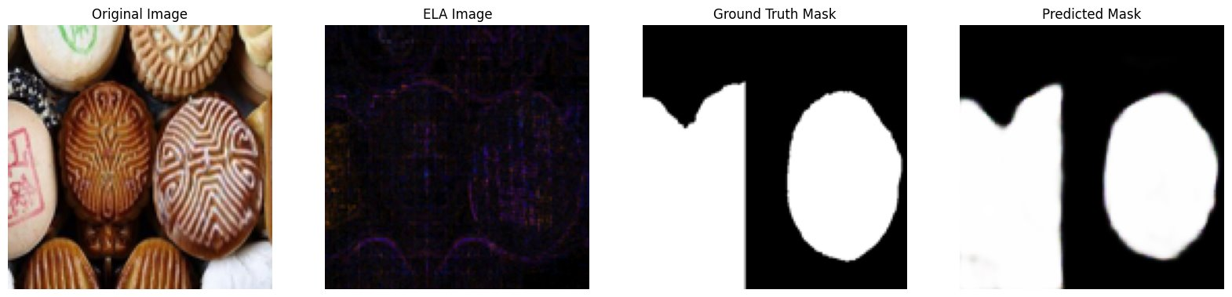
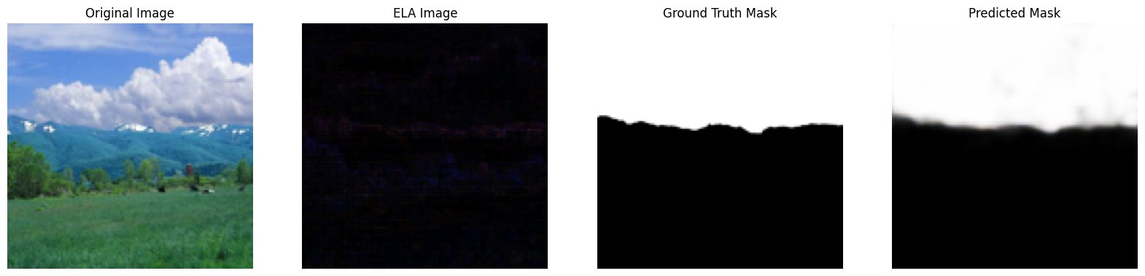
Forgery Localization in Images and Scanned Documents
Model Results on Tampered and Real images
Team: Group 31

Slide 20
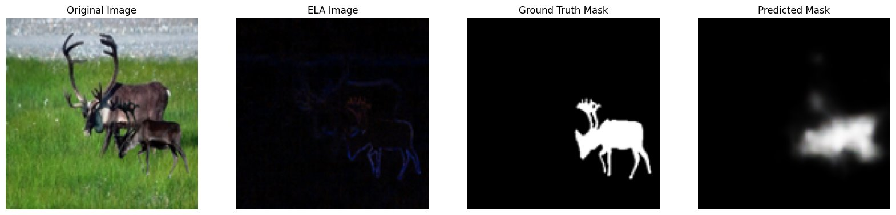
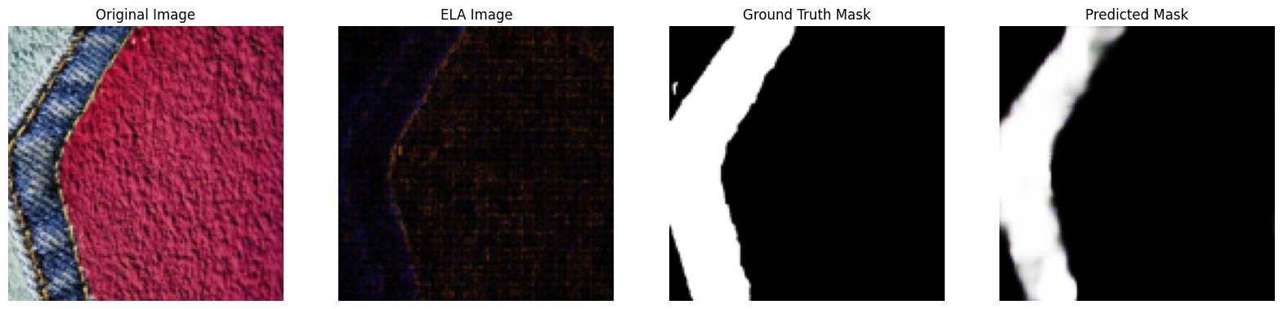
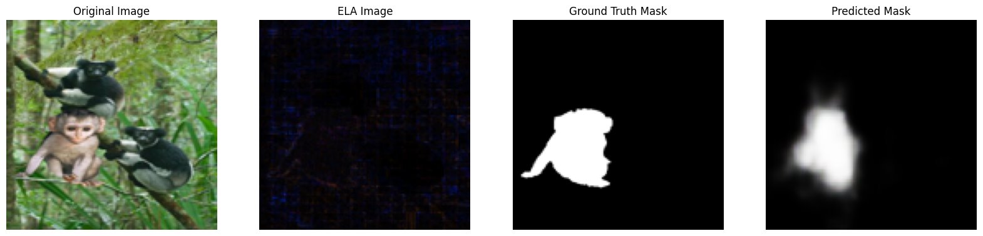
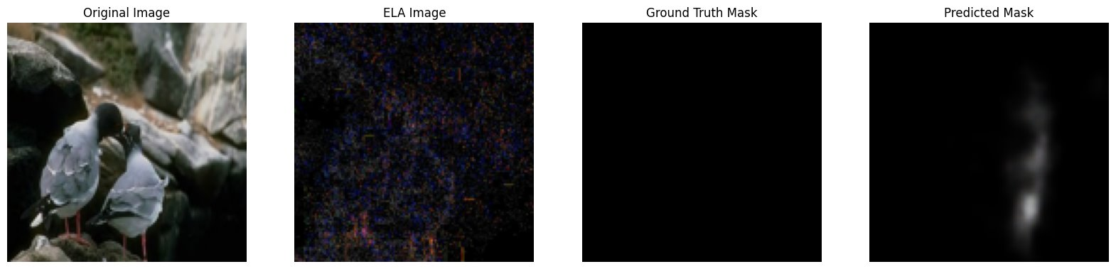
Forgery Localization in Images and Scanned Documents
Team: Group 31

Slide 21
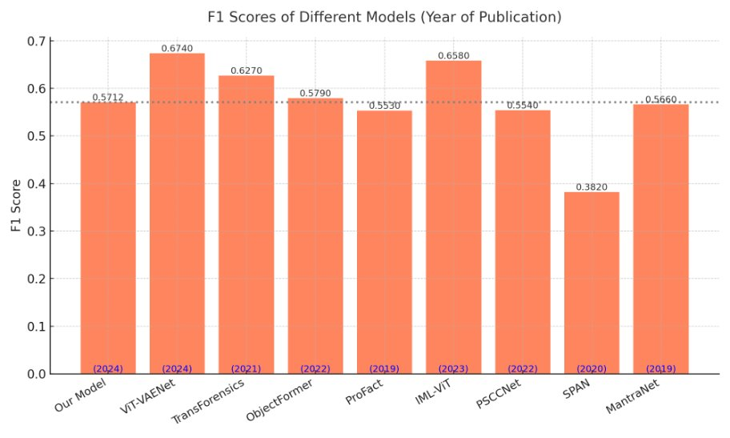
Forgery Localization in Images and Scanned Documents
Comparison with State of the Art Models
Team: Group 31

Slide 22
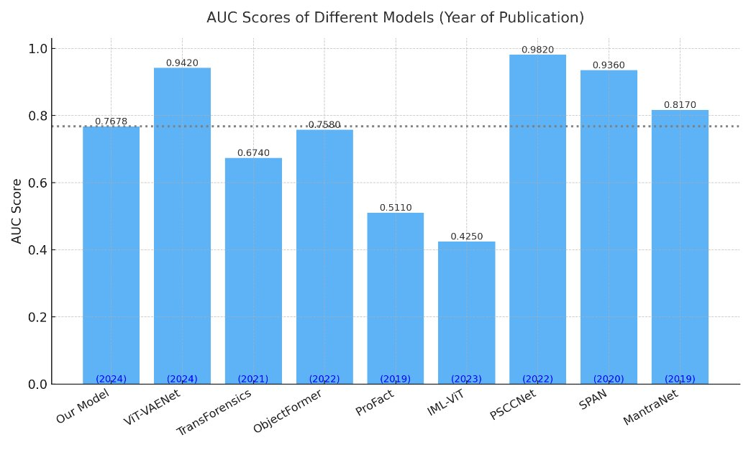
Forgery Localization in Images and Scanned Documents
Comparison with State of the Art Models
Team: Group 31

Slide 23
Forgery Localization in Images and Scanned Documents
Comparison with State of the Art Models
Team: Group 31

Slide 24
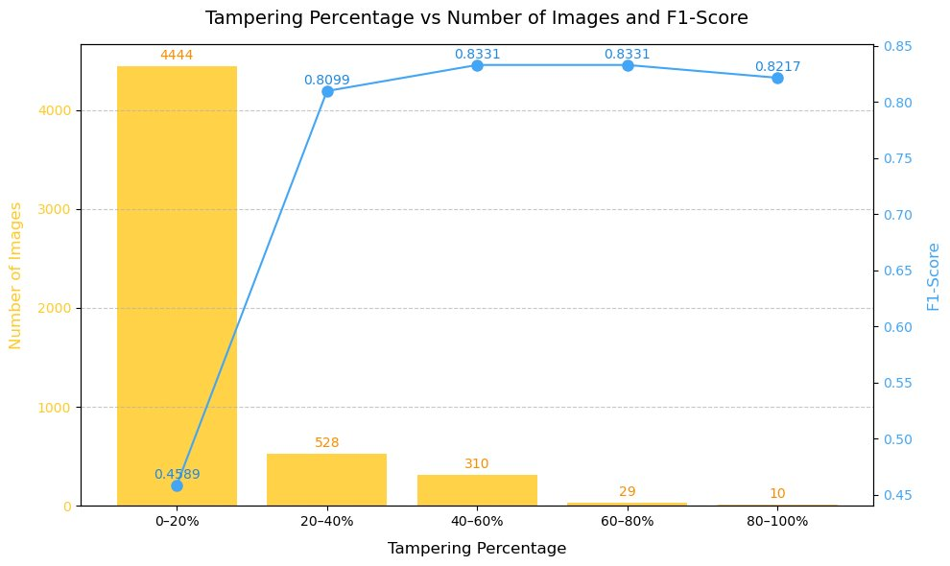
Forgery Localization in Images and Scanned Documents
Performance Evaluation of Model 1(ELA+CNN)
Team: Group 31

Slide 25
Forgery Localization in Images and Scanned Documents
Inferences from proposed work 1
The ELA-CNN model's F1-score significantly improves when tampering exceeds 20%, indicating better localization performance for larger forged regions.
As shown, the F1-score rises from 0.4789 (0–20%) to 0.8099+ for higher tampering levels.
However, the same model underperforms on scanned documents, likely due to:
Different feature characteristics in scanned data.
Most tampered regions in scanned documents fall within the 10–20% range.
A dedicated model was developed using YOLOv8, specifically optimized for detecting small, localized tampering in scanned documents, ensuring enhanced adaptability discussed in proposed work 2
Team: Group 31

Slide 26
Forgery Localization in Images and Scanned Documents
Fine Tuned YOLOv8 Model
Team: Group 31

Slide 27
Forgery Localization in Images and Scanned Documents
PROPOSED SYSTEM ARCHITECTURE
Pre trained YOLOv8
Training on dataset
weights
Experimenting the model with different set of configurations
Best Model
Evaluation
Hyperparameter tuning
Team: Group 31

Slide 28
Forgery Localization in Images and Scanned Documents
Why YOLO?
What is YOLO?:
YOLO(You Only Look Once) is a state-of-the-art object detection algorithm that performs real-time detection and localization.
Known for its speed and accuracy.
Why YOLO for this Project?:
Its ability to perform both object detection and localization in one forward pass.
Pre-trained weights that can be fine-tuned to our custom dataset.
Proven Performance in this field
Team: Group 31

Slide 29
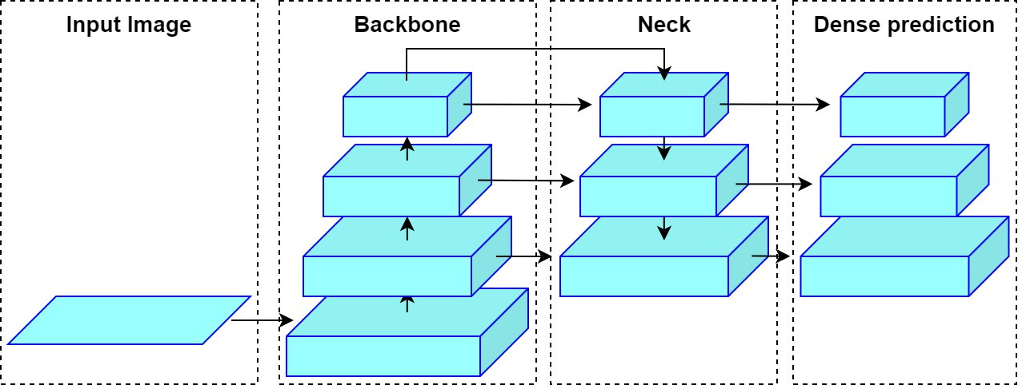
Forgery Localization in Images and Scanned Documents
YOLOv8 Architecture
Backbone extracts features, Neck enhances them, and Head makes final predictions!
Team: Group 31

Slide 30
Forgery Localization in Images and Scanned Documents
Fine Tuning Pre trained Model
• Pre-Trained Model: –
Utilized YOLOv8l.pt, pre-trained on the COCO dataset with 80 classes.
• Fine-Tuning Strategy: –
Training the model on our dataset to adapt the weights accordingly.
– Customizing the final layers for better alignment with our specific data.
– Modified various hyperparameters (learning rate, batch size, etc.) to enhance accuracy.
• Experimented with eight different configurations to refine performance.
Team: Group 31

Slide 31
Forgery Localization in Images and Scanned Documents
Configurations Used
Key Hyperparameters | Reason for Choosing These Settings
epochs=100, batch=16, imgsz=320, optimizer=AdamW | Standard settings for balanced datasets. Provides stable training without aggressive tuning.
imgsz=640, iou=0.8, lr0=0.005, optimizer=SGD | Larger image size & IoU improve small object detection, SGD ensures stability.
batch=32, epochs=50, augment=false, optimizer=AdamW | AdamW speeds up training, reducing augmentation improves training speed.
lr0=0.005, dropout=0.2, weight_decay=0.001, optimizer=SGD | SGD with weight decay prevents overfitting, dropout improves generalization.
imgsz=1024, iou=0.85, batch=4, optimizer=AdamW | Large image size captures fine text details, AdamW helps stable training.
hsv_v=0.5, auto_augment=true, optimizer=AdamW | Auto augmentation & brightness adjustments enhance robustness.
mosaic=1.2, mixup=0.5, scale=0.6, optimizer=SGD | SGD stabilizes aggressive augmentations, improving adaptability across datasets.
Team: Group 31

Slide 32
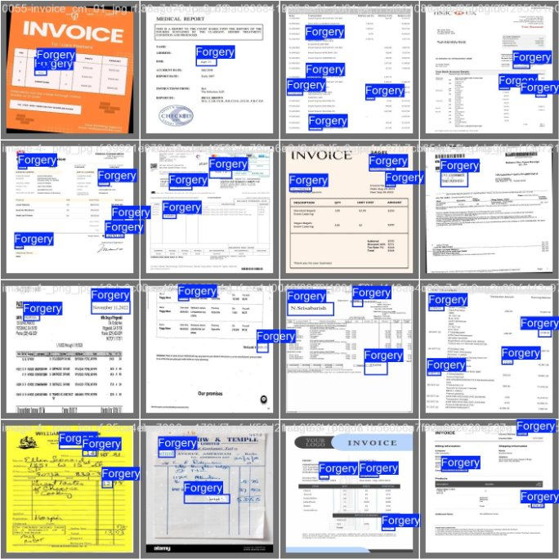
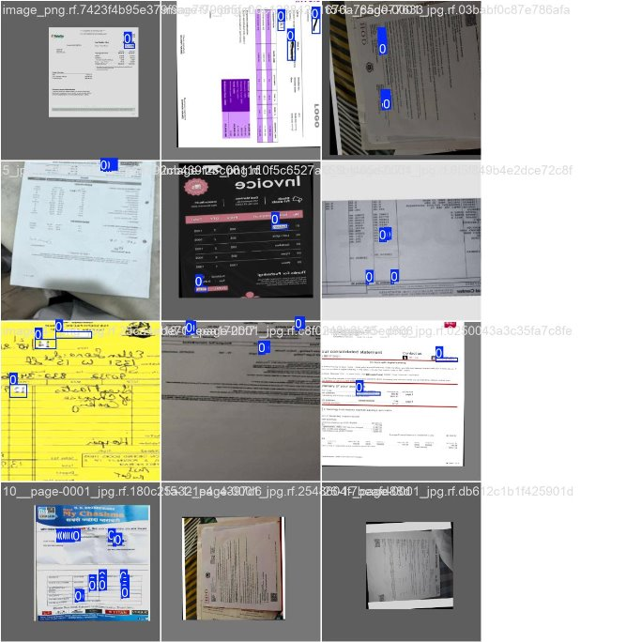
Forgery Localization in Images and Scanned Documents
Test Results
Team: Group 31

Slide 33
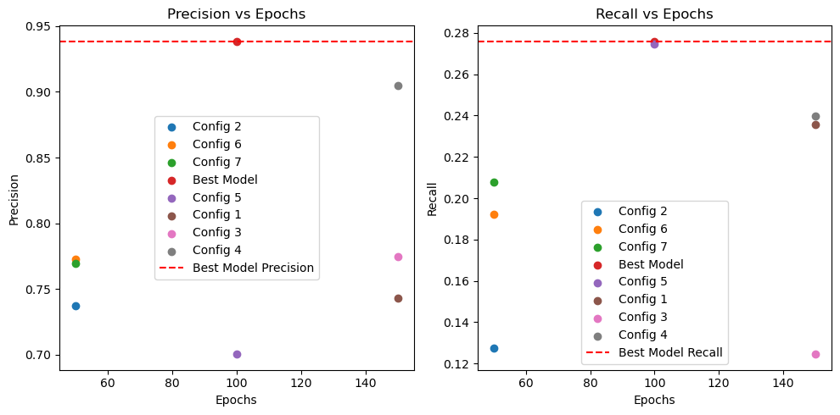
Forgery Localization in Images and Scanned Documents
Performance Metrics
Out of all models the best model got a Precision: 0.93 and Recall: 0.29
Team: Group 31

Slide 34
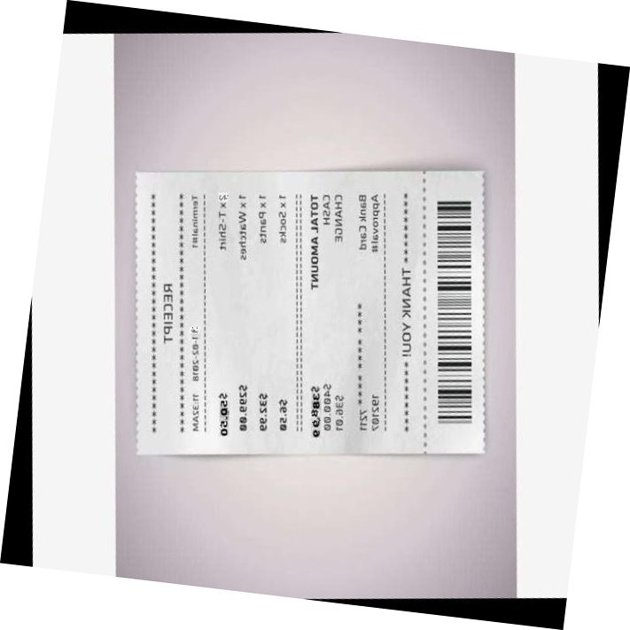
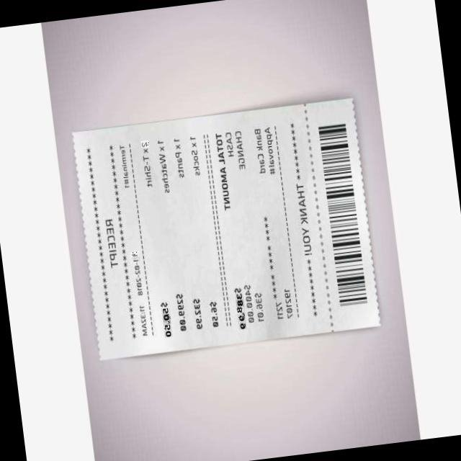
Forgery Localization in Images and Scanned Documents
Performance Metrics
Among all models the best model was effectively detecting tampered areas and key elements in documents like invoices, even with challenging dataset conditions.
Limitations:
Struggles with extremely blurred images, especially when details are unreadable even to the human eye.
Despite lower performance metrics, it visually highlights tampered regions well for images such as invoices with different colours rather than grayscale.
Performance:
Precision: 0.93
Recall: 0.29
Team: Group 31

Slide 35
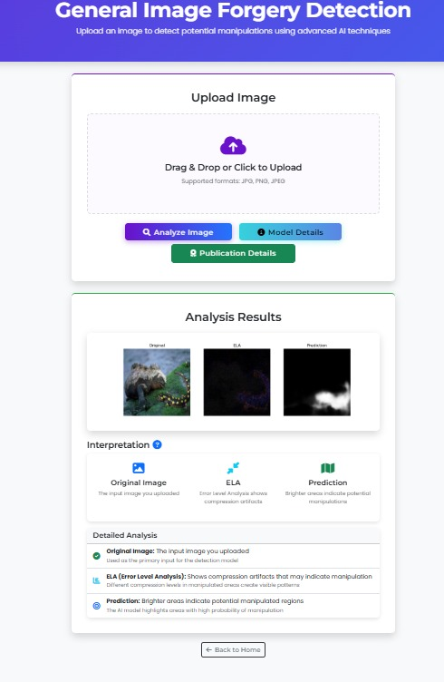
Forgery Localization in Images and Scanned Documents
Model Combination UI
Team: Group 31

Slide 36
Forgery Localization in Images and Scanned Documents
CONCLUSION
Proposed two separate models for forgery localization in digital and scanned images.
Developed a lightweight ELA-CNN model for tampering detection in natural images using ELA features.
Achieved a balanced F1-score of 0.5712 and AUC of 0.7678 on the CASIA v2.0 dataset.
Designed a YOLOv8-based model for scanned document forgery detection, reaching a precision of 0.93.
Both models worked well and computationally efficient and adaptable to real-world scenarios.
The system shows strong potential for applications in media, legal, forensic, and document verification.
Both models were deployed into an integrated user interface, providing a seamless experience .
Team: Group 31

Slide 37
Forgery Localization in Images and Scanned Documents
FUTURE ENHANCEMENT
Improve ELA-CNN’s detection performance for low-percentage tampering (<20%).
Extend compatibility beyond JPEG format to include lossless image types.
Enhance document model's recall while maintaining high precision.
Integrate Explainable AI (XAI) to increase trust and interpretability in predictions.
Research and Publications
Cheruvu, S. V., Nadimpall, U. S. V., Khaji, M. S., Vs, V., & Aarthi, R. (2025). Region-wise image forgery localization using CNNs and error level analysis. In Proceedings of the 3rd International Conference on Power Engineering and Intelligent Systems (PEIS2025).
Team: Group 31

Slide 38
Forgery Localization in Images and Scanned Documents
REFERENCES
[1] Document forgery detection, "Document Forgery Detection Dataset," Roboflow Universe, Apr. 2024. [Online]. Available: https://universe.roboflow.com/document-forgery-detection/document-forgery-detection. [Accessed: Mar. 6, 2025].
[2] M. Sohan, T. Sai Ram, R. Reddy, and C. Venkata, "A review on YOLOv8 and its advancements," in International Conference on Data Intelligence and Cognitive Informatics, Springer, 2024, pp. 529–545.
[3] G. Jocher, A. Chaurasia, and J. Qiu, Ultralytics YOLOv8, version 8.0.0, 2023. [Online]. Available: https://github.com/ultralytics/ultralytics.
[4] E. Xie, W. Wang, Z. Yu, A. Anandkumar, J. M. Alvarez, and P. Luo, "SegFormer: Simple and efficient design for semantic segmentation with transformers," Advances in Neural Information Processing Systems, vol. 34, pp. 12077–12090, 2021.
[5] T. R. Hayes and J. M. Henderson, "Deep saliency models learn low-, mid-, and high-level features to predict scene attention," Scientific Reports, vol. 11, no. 1, p. 18434, 2021.
[6] D. N. Raković, "Error level analysis (ELA)," Tehnika, vol. 78, no. 4, pp. 445–451, 2023.
[7] Hrudya, P., Nair, L. S., Adithya, S., Unni, R., & Poornachandran, P., et al. (2013). Digital image forgery detection on artificially blurred images. In 2013 International Conference on Emerging Trends in Communication, Control, Signal Processing and Computing Applications (C2SPCA) (pp. 1–5). IEEE.
[8] Jaiswal, A. K., & Srivastava, R. (2023). Fake region identification in an image using deep learning segmentation model. Multimedia Tools and Applications, 82(25), 38901–38921.
[9] Kasim, O. (2024). Deep learning-based efficient and robust image forgery detection. Multimedia Tools and Applications, 1–20.
[10] Kumar, A. A., Priyangha, S. D., Meghana, P., Dheeraj, M., & Aarthi, R. (2024). XAI–empowered ensemble deep learning for deepfake detection. In 2024 15th International Conference on Computing Communication and Networking Technologies (ICCCNT) (pp. 1–7). IEEE.
[11] Liu, Y., Guan, Q., Zhao, X., & Cao, Y. (2018). Image forgery localization based on multiscale convolutional neural networks. In Proceedings of the 6th ACM workshop on information hiding and multimedia security (pp. 85–90).
Team: Group 31

Slide 39
Forgery Localization in Images and Scanned Documents
REFERENCES
[12] Liu, Y., Lv, B., Jin, X., Chen, X., & Zhang, X. (2023). Tbformer: Two-branch transformer for image forgery localization. IEEE Signal Processing Letters, 30, 623–627.
[13] Menon, S. S., Mary, N., & Saana, J. (2019). Image forgery detection using hash functions. International Journal of Recent Technology and Engineering (IJRTE), 8(1).
[14] Nagm, A. M., Moussa, M. M., Shoitan, R., Ali, A., Mashhour, M., Salama, A. S., & AbdulWakel, H. I. (2024). Detecting image manipulation with ELA-CNN integration: A powerful framework for authenticity verification. PeerJ Computer Science, 10, e2205.
[15] Narayanan, S. S., & Gopakumar, G. (2020). Recursive block based keypoint matching for copy move image forgery detection. In 2020 11th International Conference on Computing, Communication and Networking Technologies (ICCCNT) (pp. 1–6). IEEE.
[16] Niloy, F. F., Bhaumik, K. K., & Woo, S. S. (2023). CFL-Net: Image forgery localization using contrastive learning. In Proceedings of the IEEE/CVF Winter Conference on Applications of Computer Vision (pp. 4642–4651).
[17] Pham, N. T., Lee, J. W., Kwon, G. R., & Park, C. S. (2019). Hybrid image-retrieval method for image-splicing validation. Symmetry, 11(1), 83.
[18] Raković, D. N. (2023). Error level analysis (ELA). Tehnika, 78(4), 445–451.
[19] Shi, Z., Shen, X., Kang, H., & Lv, Y. (2018). Image manipulation detection and localization based on the dual-domain convolutional neural networks. IEEE Access, 6, 76437–76453.
[20] Shinde, V., Dhanawat, V., Almogren, A., Biswas, A., Bilal, M., Naqvi, R. A., & Rehman, A. U. (2024). Copy-move forgery detection technique using graph convolutional networks feature extraction. IEEE Access.
[21] Varshni, I., & Sathyalakshmi, S. (2024). Fine–grained forgery localization in images using CNN-SVM approach. In 2024 International Conference on Advances in Data Engineering and Intelligent Computing Systems (ADICS) (pp. 1–5). IEEE.
Team: Group 31

Slide 40
Forgery Localization in Images and Scanned Documents
REFERENCES
[22] Vijayalakshmi, K. N., Sasikala, J., & Shanmuganathan, C. (2024). Copy-paste forgery detection using deep learning with error level analysis. Multimedia Tools and Applications, 83(2), 3425–3449.
[23] Wu, Y., AbdAlmageed, W., & Natarajan, P. (2019). ManTra-Net: Manipulation tracing network for detection and localization of image forgeries with anomalous features. In Proceedings of the IEEE/CVF Conference on Computer Vision and Pattern Recognition (pp. 9543–9552).
[24] Xia, X., Su, L. C., Wang, S. P., & Li, X. Y. (2024). DMFF-Net: Double-stream multilevel feature fusion network for image forgery localization. Engineering Applications of Artificial Intelligence, 127, 107200.
[25] Yang, Z., Liu, B., Bi, X., Xiao, B., Li, W., Wang, G., & Gao, X. (2024). D-Net: A dual-encoder network for image splicing forgery detection and localization. Pattern Recognition, 155, 110727.
[26] Yao, H., Xu, M., Qiao, T., Wu, Y., & Zheng, N. (2020). Image forgery detection and localization via a reliability fusion map. Sensors, 20(22), 6668.
[27] Fault detection and quality inspection of printed circuit board using YOLO-v7 algorithm of deep learning - Scientific figure on ResearchGate. (n.d.). ResearchGate. Retrieved April 14, 2025, from https://www.researchgate.net/figure/b-Shows-the-architecture-of-the-Yolo-v7-Model-18_fig1_372431932.
[28] Document forgery detection. (2024, April). Document forgery detection dataset [Open source dataset]. Roboflow Universe. Roboflow. Retrieved April 14, 2025, from https://universe.roboflow.com/document-forgery-detection/document-forgery-detection.
[29] Han, B., Han, X., Zhang, H., Li, J., & Cao, X. (2021). Fighting fake news: two stream network for deepfake detection via learnable SRM. IEEE Transactions on Biometrics, Behavior, and Identity Science, 3(3), 320-331.
Team: Group 31

Slide 41
Forgery Localization in Images and Scanned Documents
QUESTIONS
Team: Group 31

Slide 42
Forgery Localization in Images and Scanned Documents
THANK YOU
Team: Group 31

