Slide 1

Machine Learning Project: Breast Cancer Detection

Slide 2
Objective: Develop a machine learning model to accurately detect breast cancer from mammogram image data. Problem Domain: Breast cancer detection using machine learning techniques on image data. The goal is to classify images as benign or malignant.

Slide 3
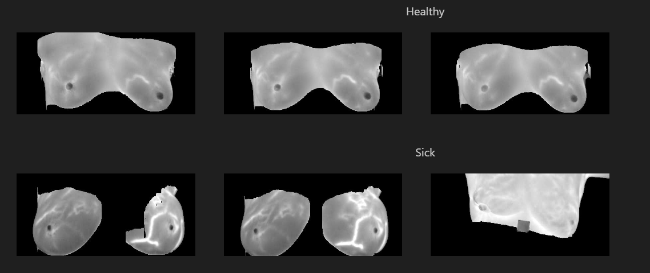
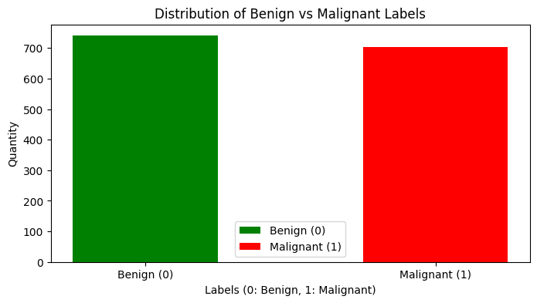
Data Overview: The Original Data

Slide 4
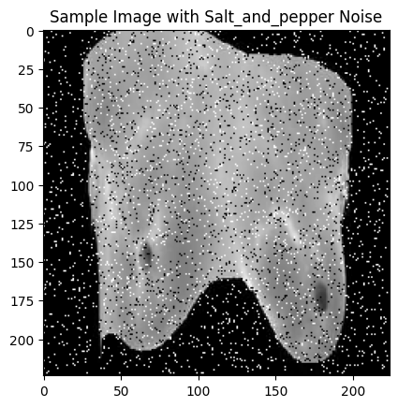
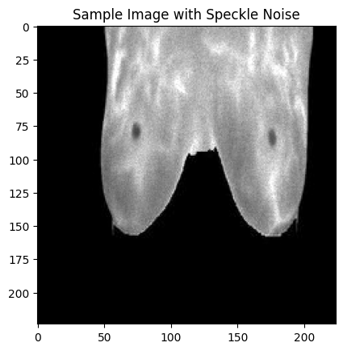
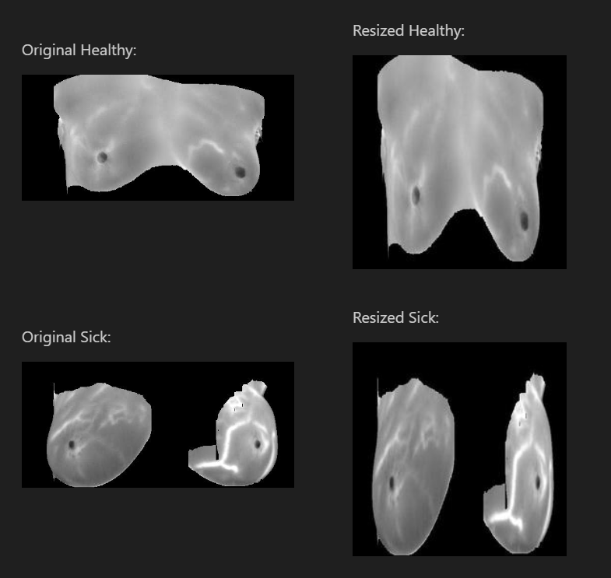
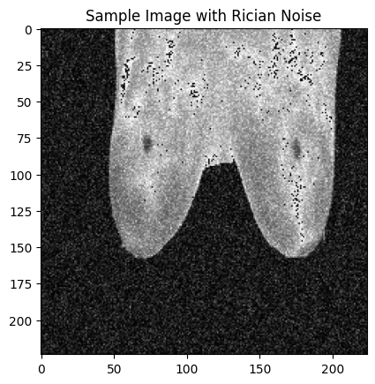
Resizing and Augmented Data:
Resized
Augmented with Noise

Slide 5
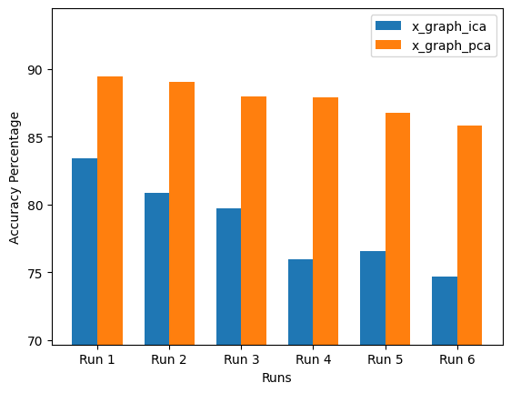
Comparison Between PCA and ICA
PCA works better than ICA in all cases.

Slide 6
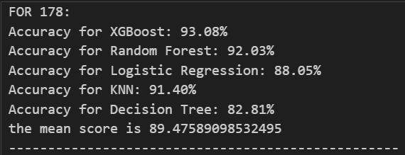
The models we have used:
Hyper-Parameter Tuning Methods used:
Grid Search
Bayesian Optimization
XGBOOST
K Nearest Neighbour Classification
Random Forest
Logistic Regression
Decision Tree
Convolutional Neural Network
Naïve Bayes
Hierarchical Clustering

Slide 7
Xgboost – Best Models
Best Algorithm: Bayesian Optimization
Fitting 5 folds for each of 10 candidates, totalling 50 fits RandomizedSearchCV - Best parameters: {'n_estimators': 150, 'max_depth': 4, 'learning_rate': 0.2, 'gamma': 0.3, 'colsample_bytree': 0.8} RandomizedSearchCV - Best cross-validation score: 0.910020832220501
Fitting 5 folds for each of 108 candidates, totalling 540 fits GridSearchCV - Best parameters: {'colsample_bytree': 0.8, 'gamma': 0.2, 'learning_rate': 0.2, 'max_depth': 4, 'n_estimators': 100} GridSearchCV - Best cross-validation score: 0.9131189573206561
Bayesian Optimization - Best parameters: {'colsample_bytree': 1.0, 'gamma': 0.014906365052275626, 'learning_rate': 0.23267643725728093, 'max_depth': 8.0, 'n_estimators': 174.9230034254178}

Slide 8
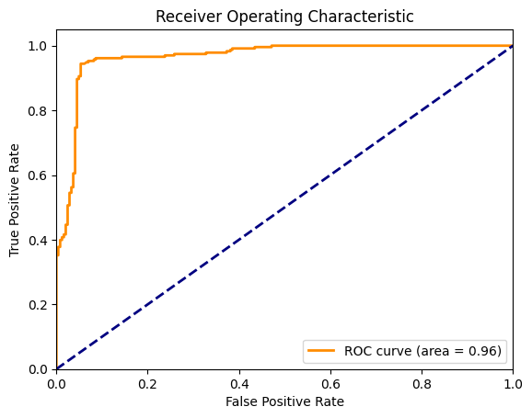
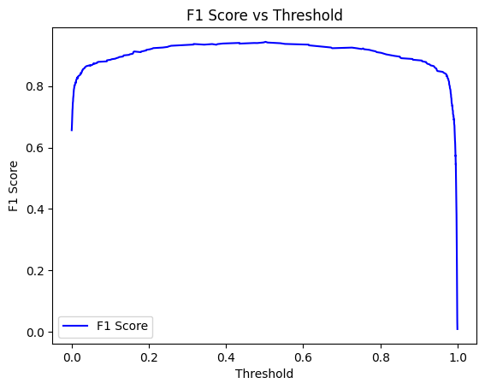
Best Model:

Slide 9
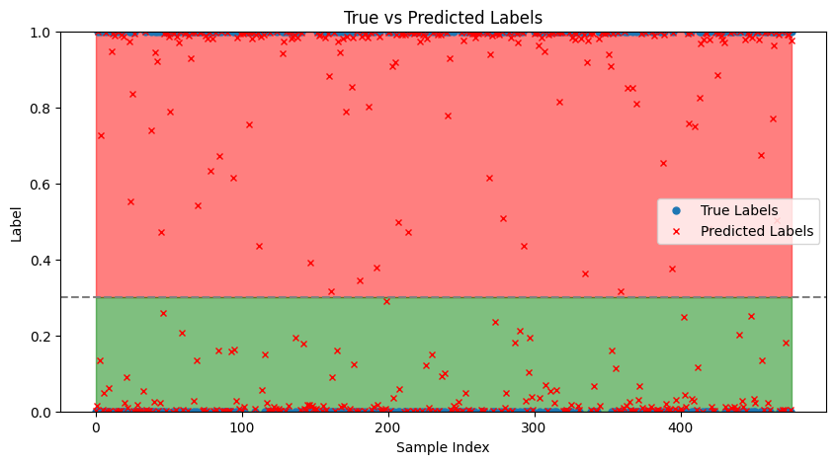
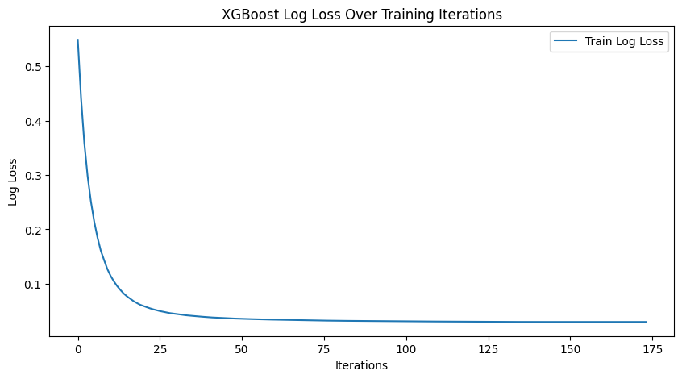
Predicted Outputs
Log Loss Curve
Threshold reduced to increase FalsePositives

Slide 10
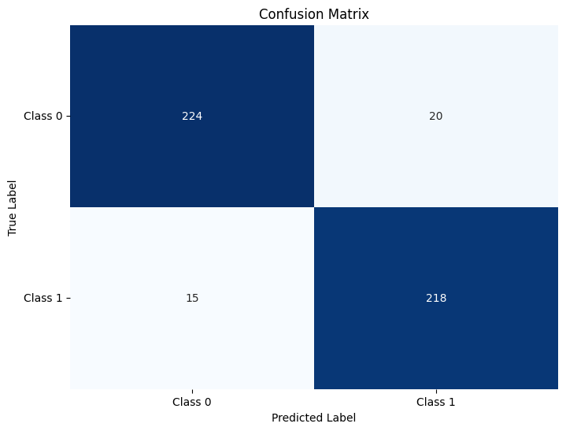
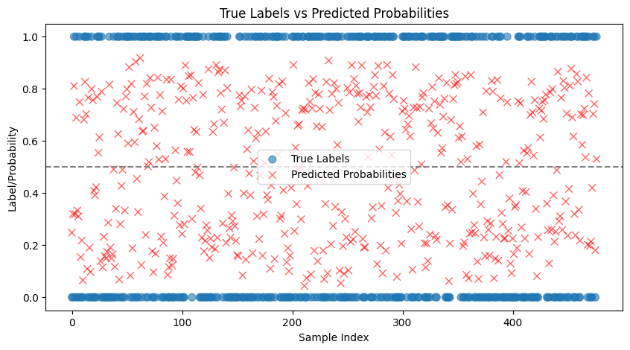
Random Forest:
Grid Search:
Best Parameters: {'max_depth': 10, 'min_samples_leaf': 1, 'min_samples_split': 5, 'n_estimators': 150} Best Cross-Validation Score: 0.9203621601410182
Randomized Search:
Randomized Search - Best Parameters: {'n_estimators': 150, 'min_samples_split': 5, 'min_samples_leaf': 2, 'max_depth': 30} Randomized Search - Best Cross-Validation Score: 0.9182949628759148
Bayesian
Bayesian Optimization - Best Parameters: {'max_depth': 30, 'min_samples_leaf': 1, 'min_samples_split': 2, 'n_estimators': 144} Bayesian Optimization - Best Cross-Validation Score: 0.9141605683457081

Slide 11
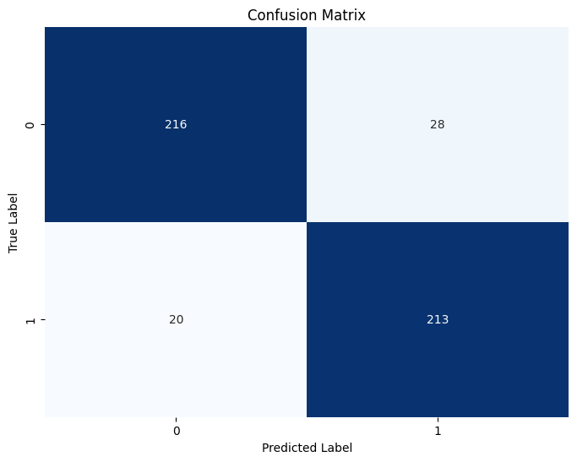
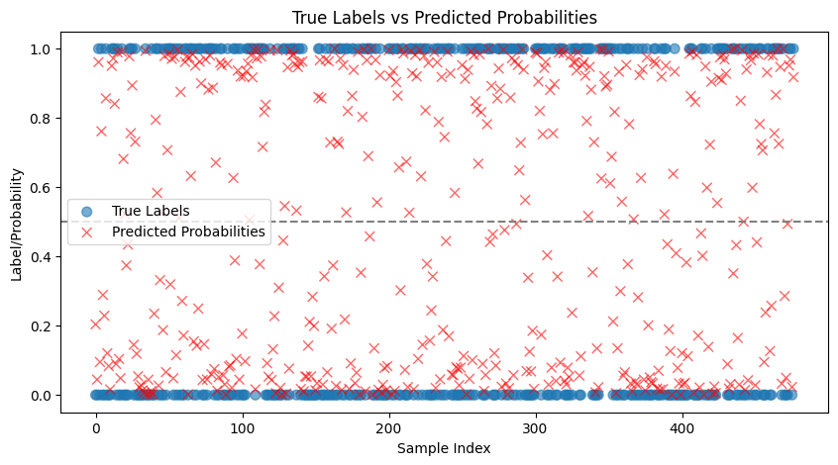
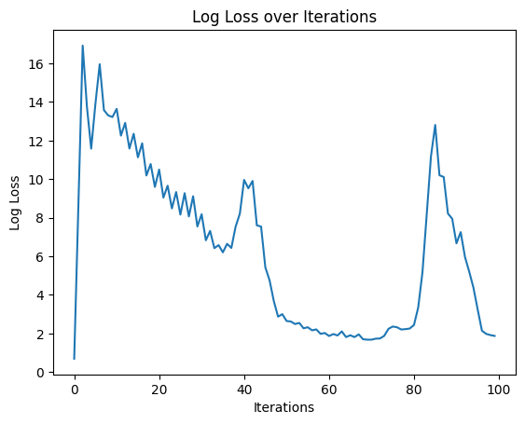
Logistic Regression:
Grid Search:
Grid Search - Best Parameters: {'C': 0.001, 'penalty': 'l2', 'solver': 'liblinear'} Grid Search - Best Score: 0.8976283318198813
Randomized Search:
Randomized Search - Best Parameters: {'solver': 'liblinear', 'penalty': 'l2', 'C': 0.001} Randomized Search - Best Score: 0.8976283318198813
Bayesian
Bayesian Optimization - Best Parameters: {'C': 10.748032925464157} Bayesian Optimization - Best Score: 0.8624859783131242

Slide 12
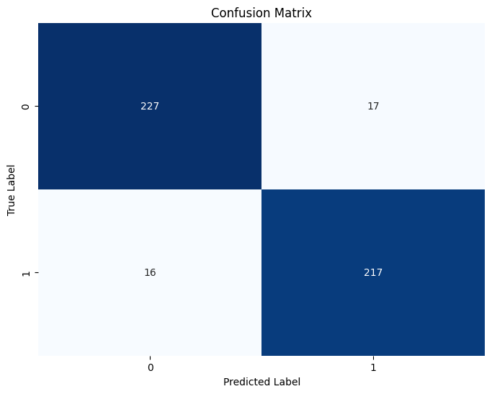
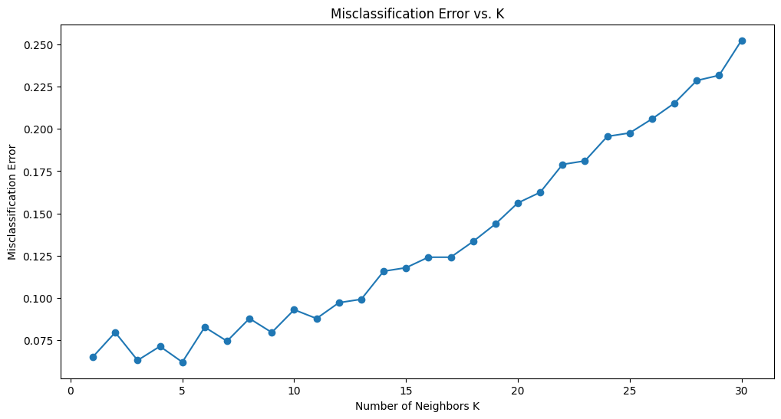
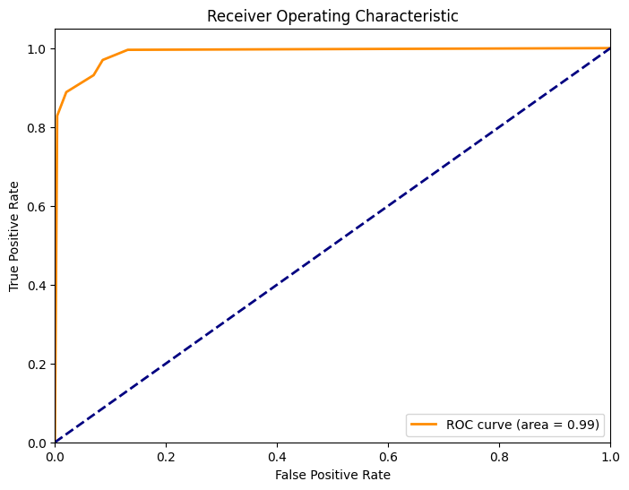
KNN:

Slide 13
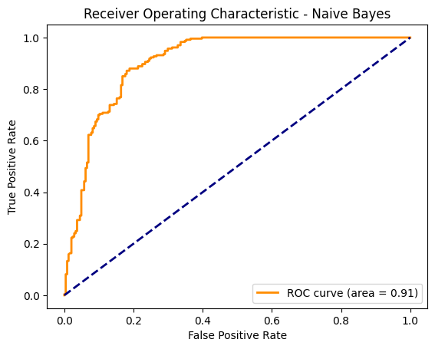
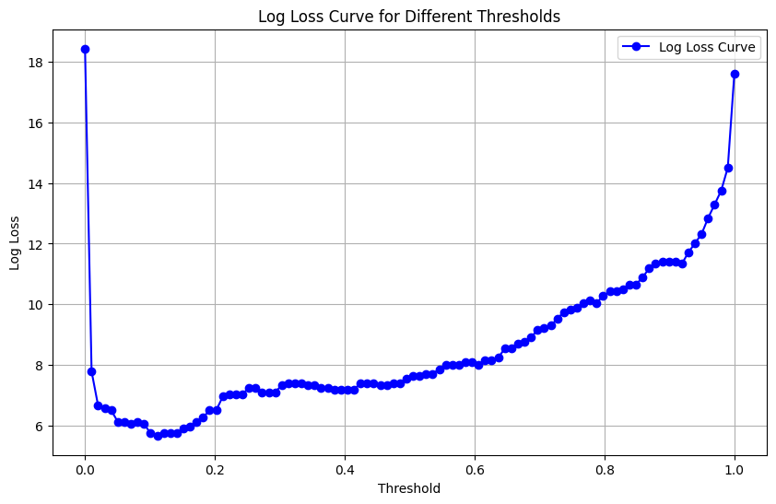
Naïve Bayes:

Slide 14
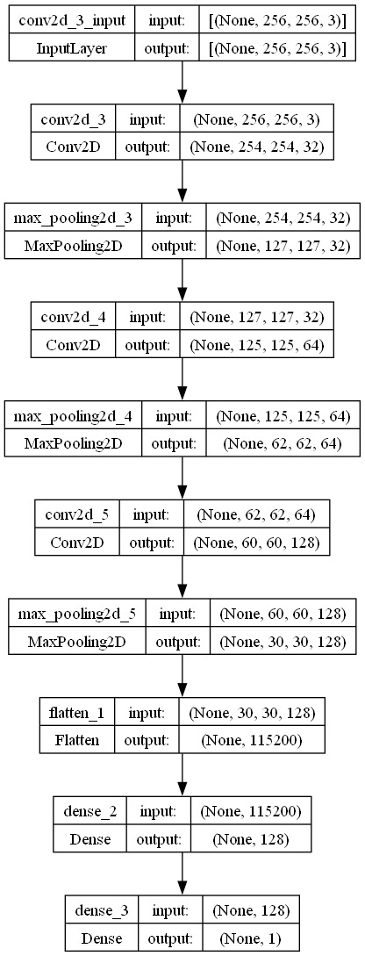
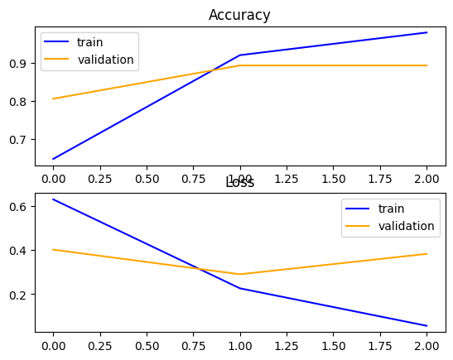
CNN:
CNN Architecture:

Slide 15
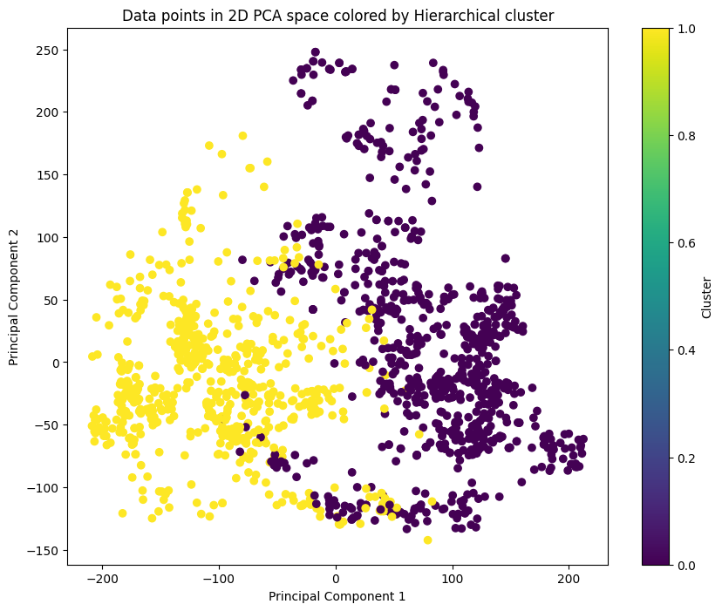
Hierarchical Clustering:

