Slide 1

Result Analysis Using Python

Slide 2
Abstract
This project aims to develop a tool that takes a PDF file as input and performs an analysis on student data, specifically their marks.The application generates an Excel file containing the analyzed results. The user has the flexibility to choose the location where the file will be downloaded, allowing for easy access and further manipulation of the data.


Slide 3
Introduction
Project result analysis plays a crucial role in understanding the outcomes and effectiveness of a project. By analyzing project results, we can gain valuable insights, identify patterns, and make data-driven decisions for future improvements. Python, with its rich ecosystem of libraries and tools, provides a powerful platform for conducting project result analysis efficiently.
In this project, we will explore how Python can be used to analyze project results. We will leverage various Python libraries PyPDF2,Pandas to perform data manipulation,data cleaning,data filtration,etc.

Slide 4
Requirement Specification
-Software specification:
Python
-
Pandas - Data analysis library
-
PyPDF2
-
Tkinter
Hardware Specifications
Processor Intel®Pentium®1.60GHz
RAM 4GB
System type 64-bit Operating System
Output Monitor
Input deviceKeyboard , Mouse

Slide 5

Objective
Streamlining Workflow
Automating data analysis and visualization, reducing manual errors
To make a system which will read data from PDF uploaded and generate an excel file which contains all exam related data of students with analysed academic details

Slide 6
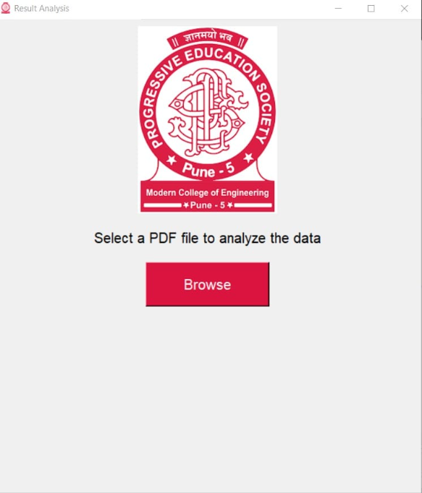
Screen Input

Slide 7
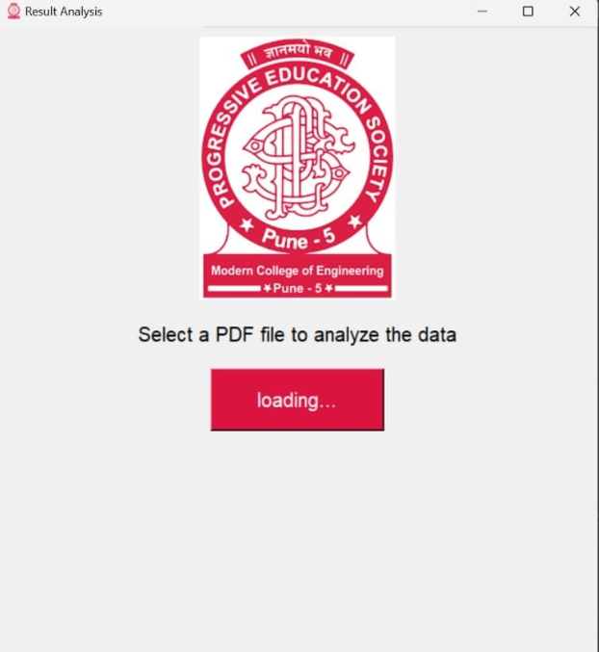
Screen Input

Slide 8
Screen Input

Slide 9
Working
The application takes a PDF file as input and performs an analysis of student data, specifically theiutilizes string manipulation techniques in Python to clean and extract relevant information from the PDF document. Once the data is extracted and cleaned,relevant formulas are applied to perform analysis on the student marks.
The process begins with parsing the PDF file and identifying the necessary sections containing student data. By employing string manipulation techniques, the relevant data is extracted and formatted to ensure consistency and accuracy. Cleaning the data involves removing any unnecessary characters, correcting formatting issues, and addressing missing or erroneous entries.
Once the data is cleaned, the project employs predefined formulas to analyze the student marks. The analysis aims to provide insights into the performance and distribution of marks among the students.

Slide 10
Working
Finally, the project generates an Excel file containing the analyzed results. The user has the flexibility to choose the download location, allowing easy access and further manipulation of data. The Excel file includes formatted tables that present the analyzed data in a clear and comprehensive manner.
Overall, this project provides a robust and efficient solution for analyzing student data from PDF files. By leveraging string manipulation techniques, predefined formulas, and Excel file generation, it simplifies the process of marks entry and applying formulas manually for analysis of student's marks which saves time and efforts.

Slide 11
CONCLUSION

Slide 12
LIMITATION
Processing speed: Python is an interpreted language, which means it can be slower than compiled languages like C or Java. When dealing with large datasets or complex calculations, Python may not offer the same level of performance.
Memory usage: Python can consume a significant amount of memory, especially when working with large datasets. This can become a limitation when analyzing data that exceeds the available memory on your machine
we can convet only pdf file.

Slide 13
References
https://docs.python.org/3/library/tkinter.html
https://pypdf2.readthedocs.io/en/3.0.0/
https://www.youtube.com

