Slide 1
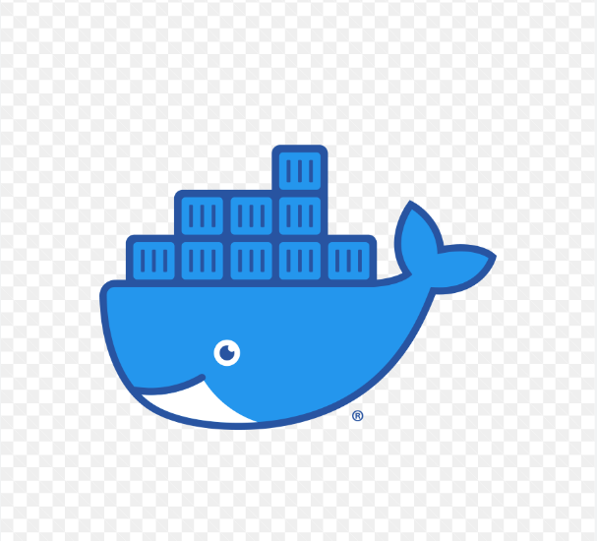
DOCKER

Slide 2
1) What is Docker?
2) Why use Docker?

Slide 3
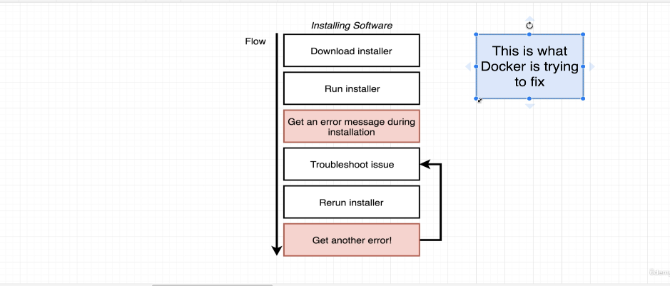

Slide 4
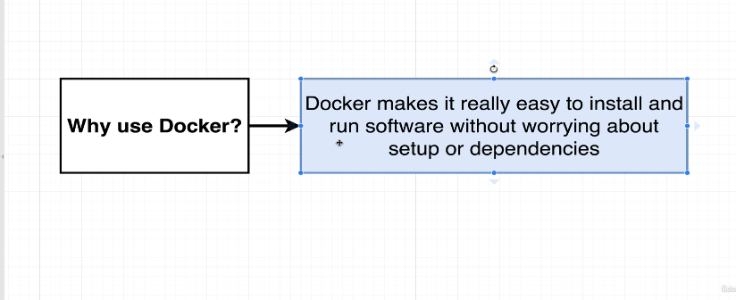

Slide 5
What is Docker ?
Docker is an open-source platform that allows you to automate the deployment and management of applications within lightweight, isolated containers. Containers provide a consistent and portable environment for running software, ensuring that applications and their dependencies work consistently across different computing environments.
Docker enables you to separate your applications from your infrastructure so you can deliver software quickly.

Slide 6
Installing Docker in Windows
Register for a Docker Hub account so that we can pull images and push the images we will build.
Link to install Docker Desktop
https://docs.docker.com/desktop/install/windows-install

Slide 7
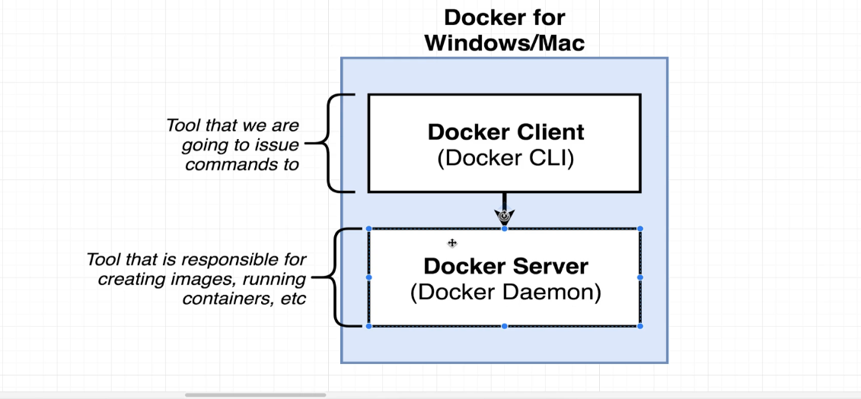

Slide 8
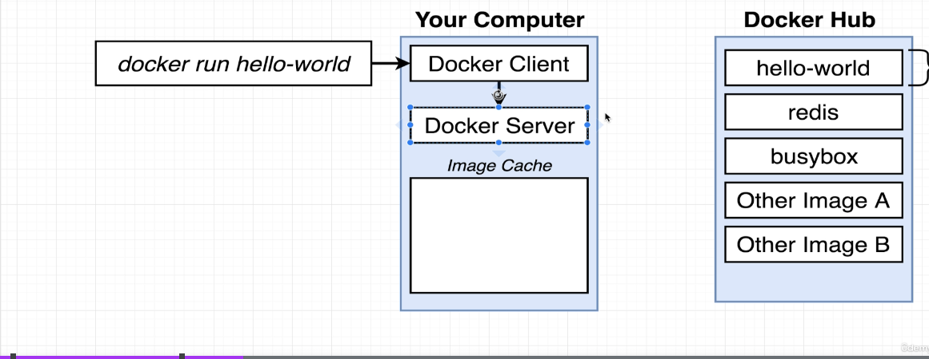

Slide 9
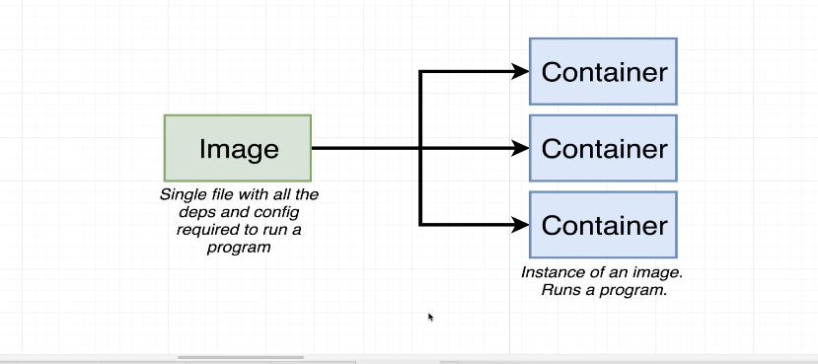
For example: when we run docker command , it will download the image file which is a
Single file that gets stored on hard drive and u can use this image to create a container.
Container is a program with its own set of isolated hardware resources its sole purpose is to run one specific program i.e. it has its own set of memory, networking technologies

Slide 10
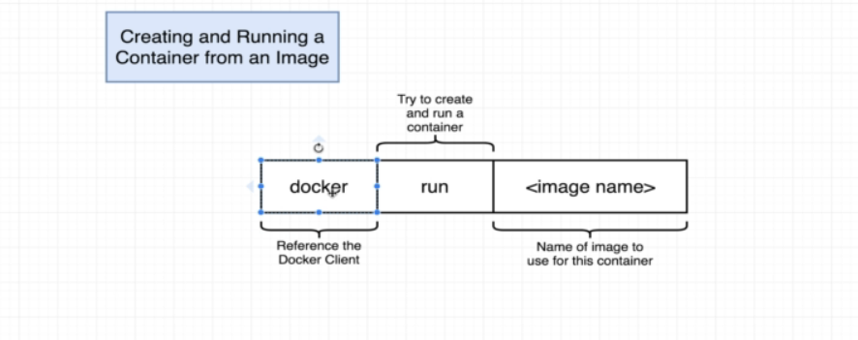
Docker run = Docker create + Docker start

Slide 11
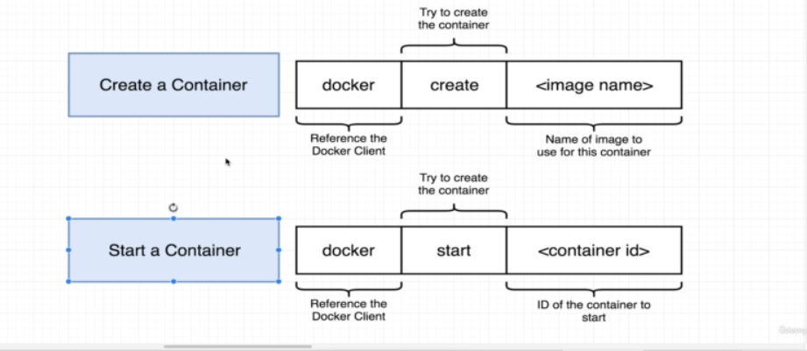

Slide 12
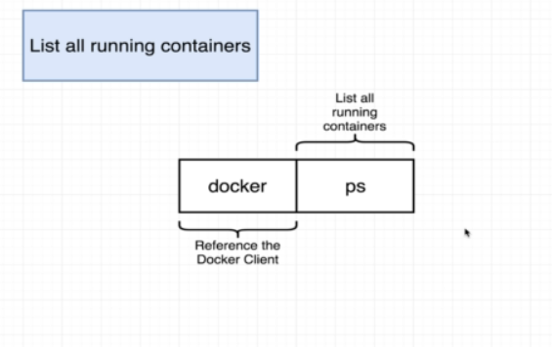
Docker ps –all :: to get the list of all available containers

Slide 13
Retrieving log outputs ::
docker create busybox echo hi there
docker start –a id
docker logs id
Removing Stopped Containers ::
docker system prune
Stopping the Container::
docker stop id
docker kill id

Slide 14
Creating our own Dockerfile

Slide 15
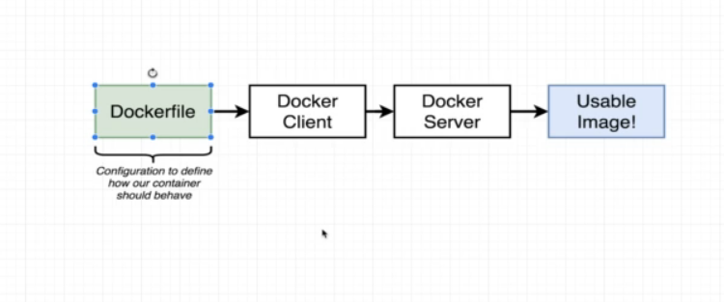
Steps:

Slide 16
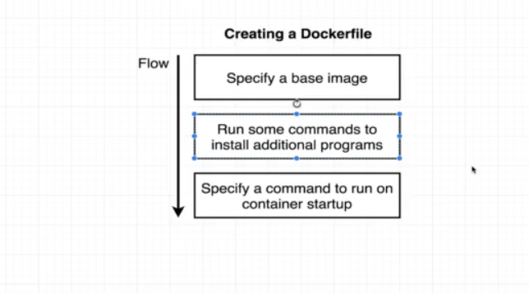
Flow Chart :

Slide 17
GOAL : Create an Image that runs redis server

Slide 18
Tagging an Image:
Docker build –t our_docker_id /folder_name:verison

Slide 19
Thank You

