Slide 1
Bank Customer Segmentation
Vinu Karthek
29 March 2024

Slide 2
Problem Statement
In the competitive banking industry, understanding the diverse customer base & their financial behaviors is critical for providing tailored services and improving customer satisfaction.
However, with the vast amounts of customer data generated daily, manual segmentation is not feasible
Objective
The objective is to use machine learning to segment customers to Affluent & Normal
This can be done based on their relevant banking data attributes such as account balances, transaction volumes, sources of funds, investment portfolios, credit ratings, and more
Motivation & Business Relevance
The success full classification of the customer segments allows for,
Personalized Marketing
Improved Customer Service
Product Development

Slide 3
Agenda
Data Analysis
Model Development
Deployment
Challenge 1
Challenge 2
Challenge 3
Exploratory Analysis
Statistical Analysis
Data Cleaning
Feature Engineering
Model Architecture
Decision Tree
Random Forest/xGBoost
RUSBoost
Data Flow
Performance
Business Summary
Solution Architecture
Serve Model

Slide 4
Data Analysis
NOTE: Plotted using Tableau & some using Seaborn

Slide 5
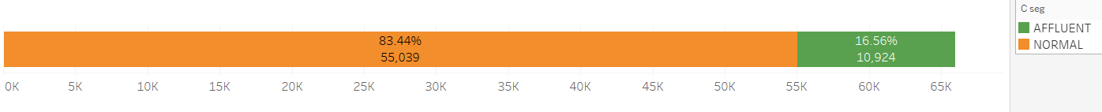
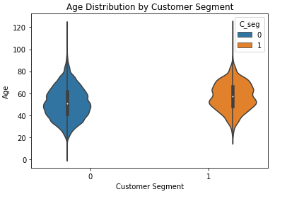
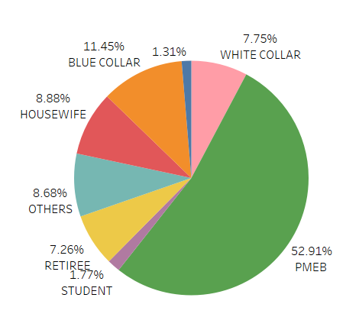
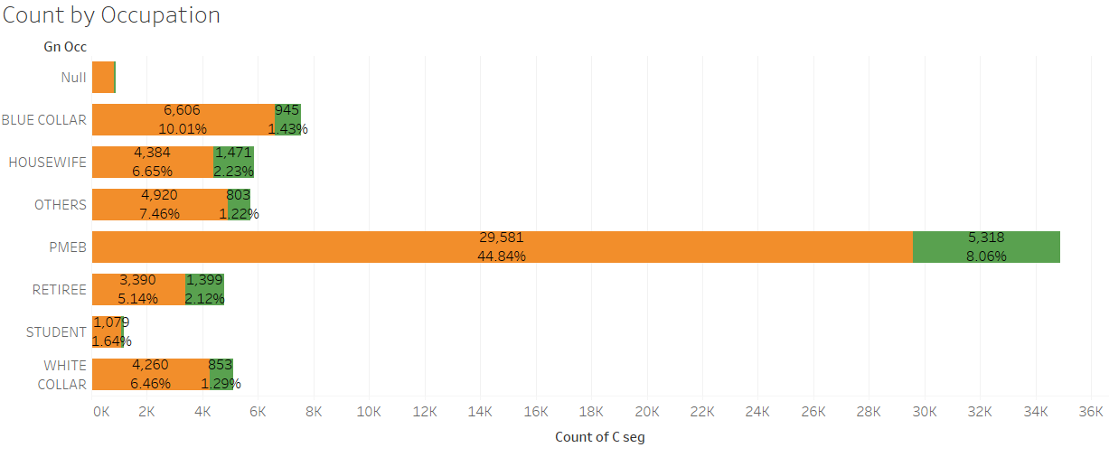
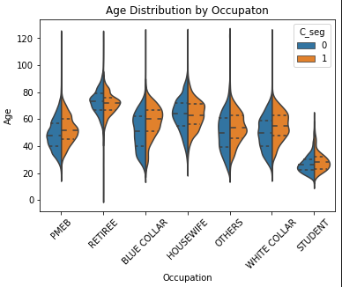
Data Demographics
Normal/Affluent Ratio → ~4:1
Distribution by Age (Affluent Median > Normal Median)
Normal/Affluent Ratio by Occupation
The Normal/Affluent Ratio across occupation is ~15%, while the majority of occupation is PMEB
And outliers Age >100 exists for all occupation (which can be removed as they are > 3 Sigma)
Distribution by Age

Slide 6
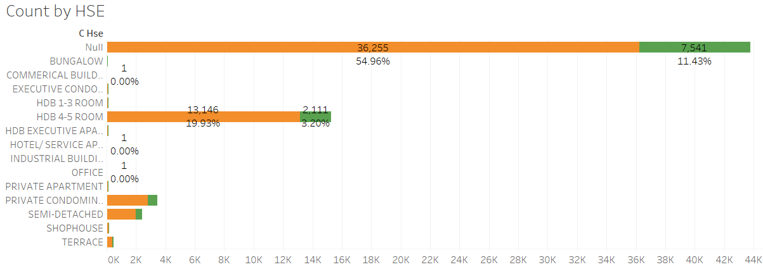
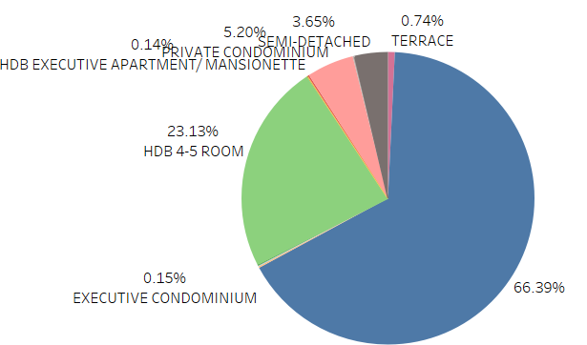
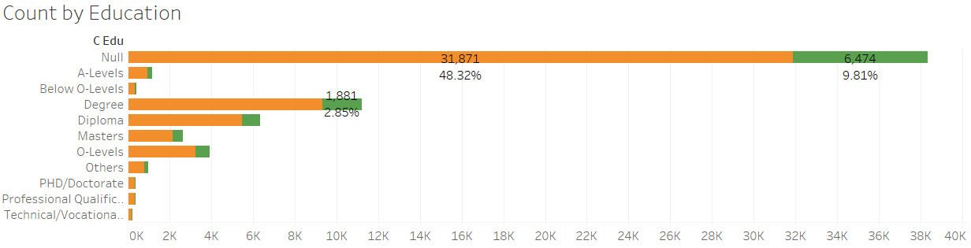
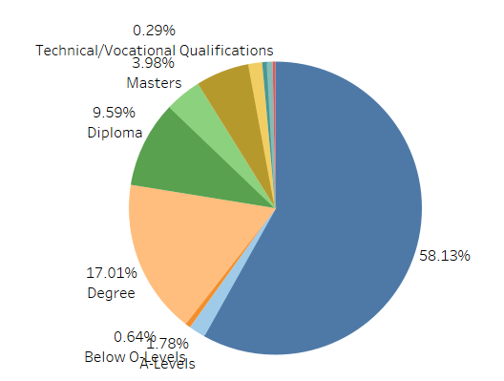
Data Demographics

Slide 7
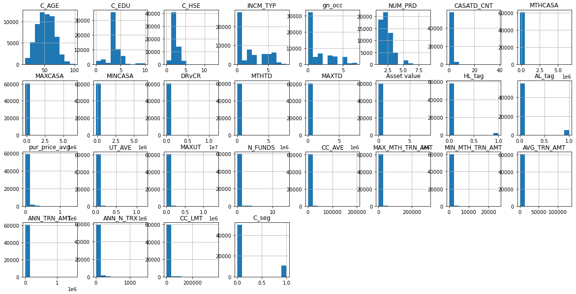
Data Distribution (Histogram)
Every numerical features except for the 1st six in the plot below are heavily skewed as show by the histogram
This could mean that most of the other numerical features are empty for majority of the rows
NOTE: All the categorical features are factorized to numbers

Slide 8
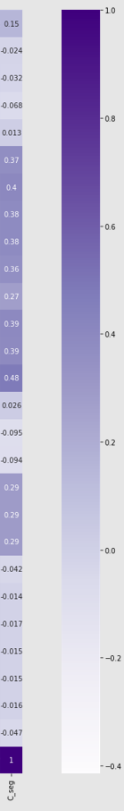
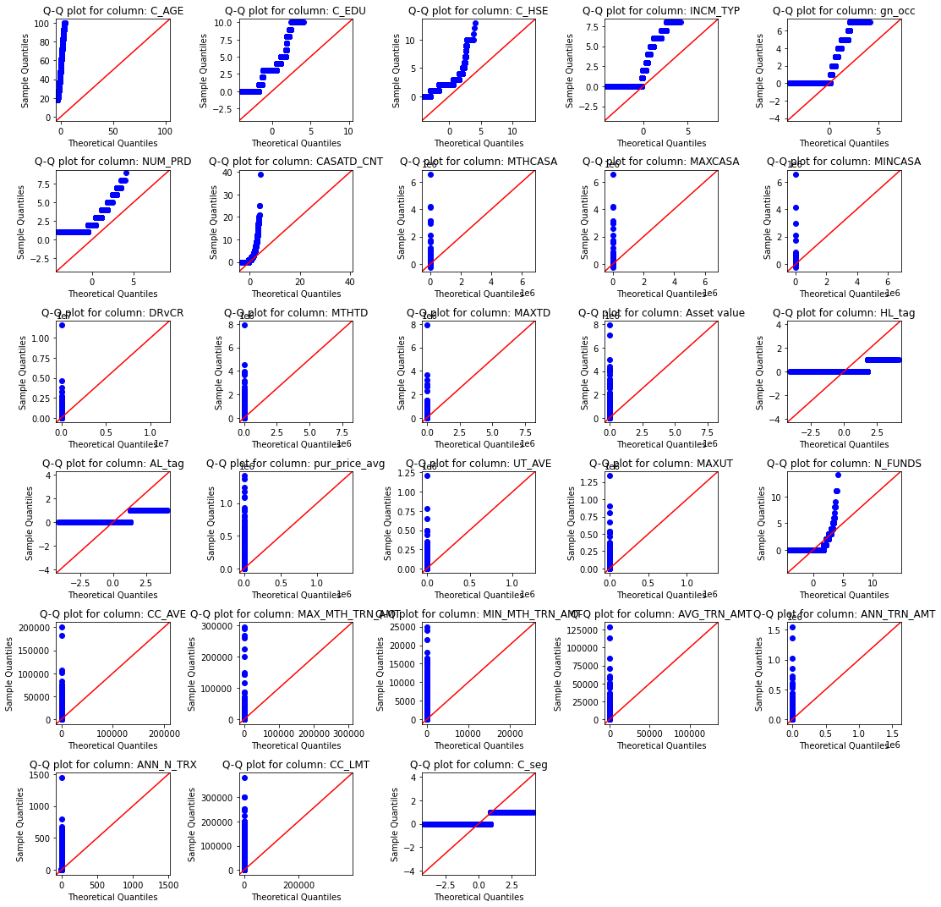

Statistical Analysis
Q-Q Plot shows that none of the features have Normal Distribution
Pearson’s Linear Correlation cannot be performed
Spearman’s Correlation shows very low correlation for the features with unscrewed histogram (from prev. slide)
Kendal Tau’s correlation (less sensitive to outliers) also yields similar results

Slide 9
Data Cleaning & Engineering
Cleaning
As discussed earlier Ages >100 were removed to remove outliers
Filled empty values with 0 (for numerical) & NA (for categorical)
Removed ID (as its irrelevant for modelling)
Feature Engineering
Added two now columns Has_TD & Has_CC based on the existing categorical columns
If CC/TD numerical Columns are empty, then Has_TD & Has_CC are 0 respectively
Convert Categorical to numeric by factorizing them

Slide 10
Model Development

Slide 11
Model Architecture
The following models where chosen since the data is tabular & has numerical/categorical features
Once we attain the optimum model we can go with the hyper parameter tuning (for optimized performance)
Optuna (Hyperparameter Tuning)
Customer Bank Data (24 features & 1 segment label) for 6600+ Customers
Data Cleaning/ Engineering
Classifier
Decision Tree
Random Forest
xGBoost (Gradient Boosting)
RUSBoost (Random Under Sample Boosting)
Modelling
NOTE: The same architecture to be used for several models

Slide 12
Test: If Model learned the pass/fail pattern
Validation: If the pass/fail pattern can be applied across FE mother lots
Model Development (Data flow)
Data flow during model training process, the split ratio can be 20% or 30% depending on the dataset
Once the model is trained on train dataset & evaluated on test dataset, a k-fold cross validation is done to check the robustness of the model
Customer Bank Data (27 features & 1 segment label) for 6600+ Customers
Train Test
Train Dataset
~80% of rows
80% of rows
Train Model
20% of rows
Model
~20% of rows
Test
Dataset
Evaluate Test Result
Validation Lots
Evaluate Validation Result
NOTE: The ratio of Normal to Affluent was maintained across all splits (Stratify = True)

Slide 13
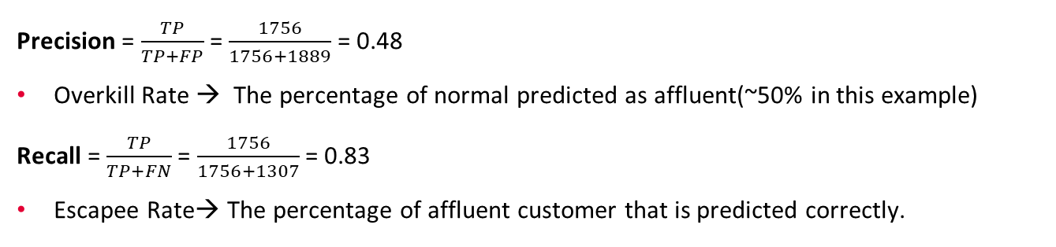
Business Analysis Definition
 | Predicted Normal (0’) | Predicted Affluent (1’)
Normal (0) | 9119 (TN) | 1889 (FP)
Affluent (1) | 1307 (FN) | 1756 (TP)
Precision = $\frac{TP}{TP+FP}$ = $\frac{1756}{1756+1889}$ = 0.48
Overkill Rate → The percentage of normal predicted as affluent(~50% in this example)
Recall = $\frac{TP}{TP+FN}$ = $\frac{1756}{1756+1307}$ = 0.83
Escapee Rate→ The percentage of affluent customer that is predicted correctly.

Slide 14
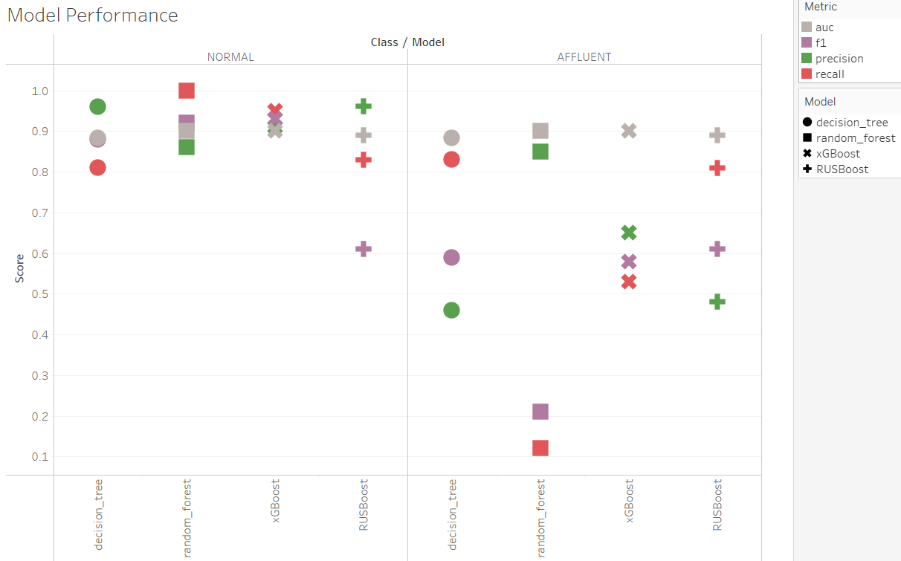
Model Performance & Business Summary
From the performance chart we can see that all models have very low precision for Class = ‘Affluent’. This could mean any of the following
Class Imbalance:
Cause: If class 0 instances significantly outnumber class 1 instances, machine learning algorithms may become biased towards the majority class and may not perform well on the minority class.
Observation: In this situation, under sampling & class weighting was tried and the performance could not be improved
Noise & Outliers
Cause: Noise & outliers in the class 1 instances can also lead to poor precision as the model struggles to correctly classify these instances
Observation: In this case, removing the outlier did not improve the model performance significantly
Suggestion: Understand the False Negative cases (Affluent predicted as Normal), to understand what is causing the noise
Feature Selection/Engineering:
Cause: The features used to train the model might not include enough information to correctly classify class 1 instances.
Suggestion: With the help of Domain Expert, explore the data further & see if new features can be engineered that could help improve the classification performance.
Prediction Threshold:
Observation: All the analysis was done with threshold 50%, changing this might slight improve the precision at the cost of recall
Suggestion: With the help of Domain Expert, determine the optimum threshold for which a prediction can be classified as affluent

Slide 15
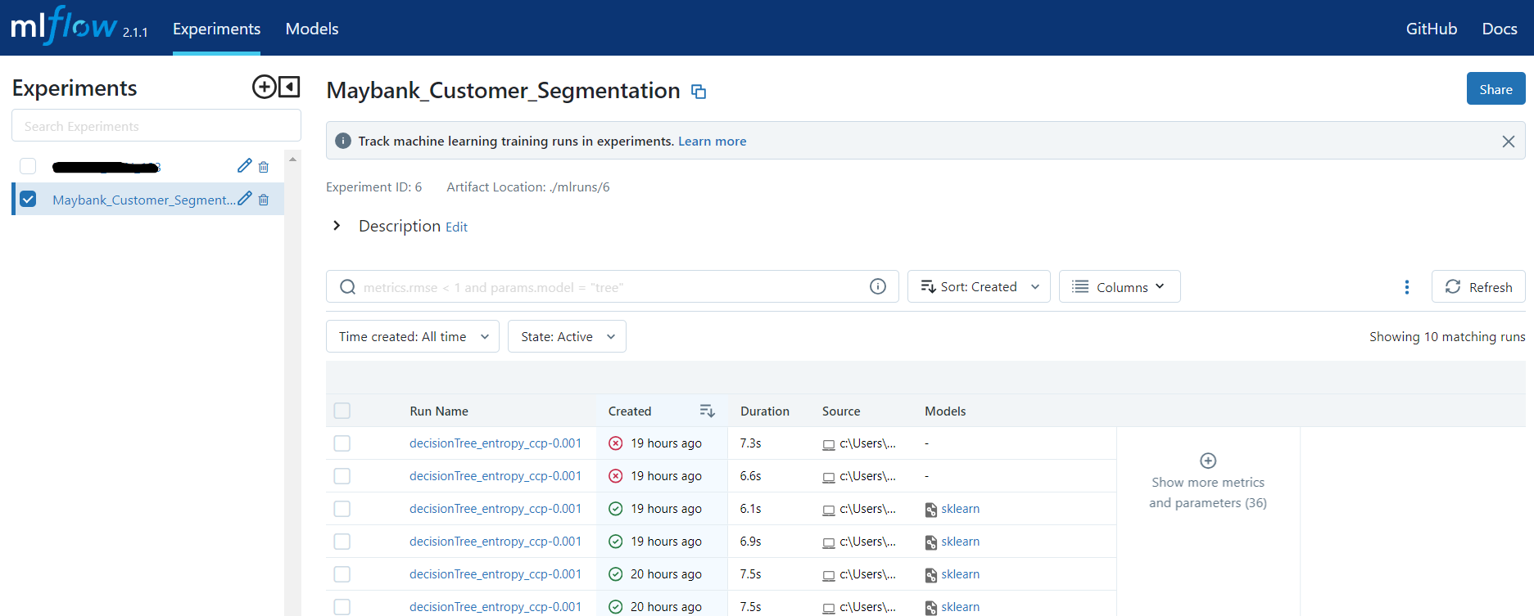
MLFlow Tracking Server
Experiments & Runs logged on MLFlow use case using Decision Tree Classifier

Slide 16
Deployment

Slide 17






Solution Architecture
as of 12 Jan 2024
Docker Hub
S3 Bucket
High Level ML Ops Framework
Webhook
Kubernetes Cluster
Artifact Storage
GET API
Model Pool
MLFlow Tracking Server (Staging/Production)
Model Development
Data Scientist
Get Model
Get Data
Database
Users
Execute
Results / Metadata
Result
Analytical / MLOPS Dashboard (Grafana/ Prometheus)
Monitor / Sustain
ML Engineer
POST API
NOTE: Refer Slide Notes (V)
Notes:
STEP1: Data Scientist Trains the model & uploads the model / artifacts to MLFlow Tracking Server
STEP2: ML Engineer Packages/Containerizes the model & deploys it in the Kubernetes Cluster or any other server
STEP3: User uses API to get inferencing Results from the model
STEP4: ML Engineer Uses Dashboard to Monitor & Sustain the model

Slide 18
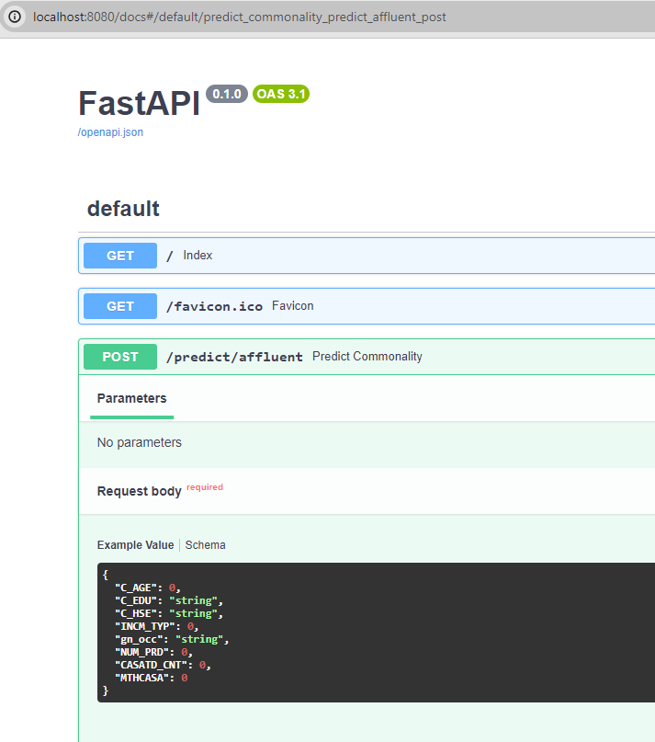
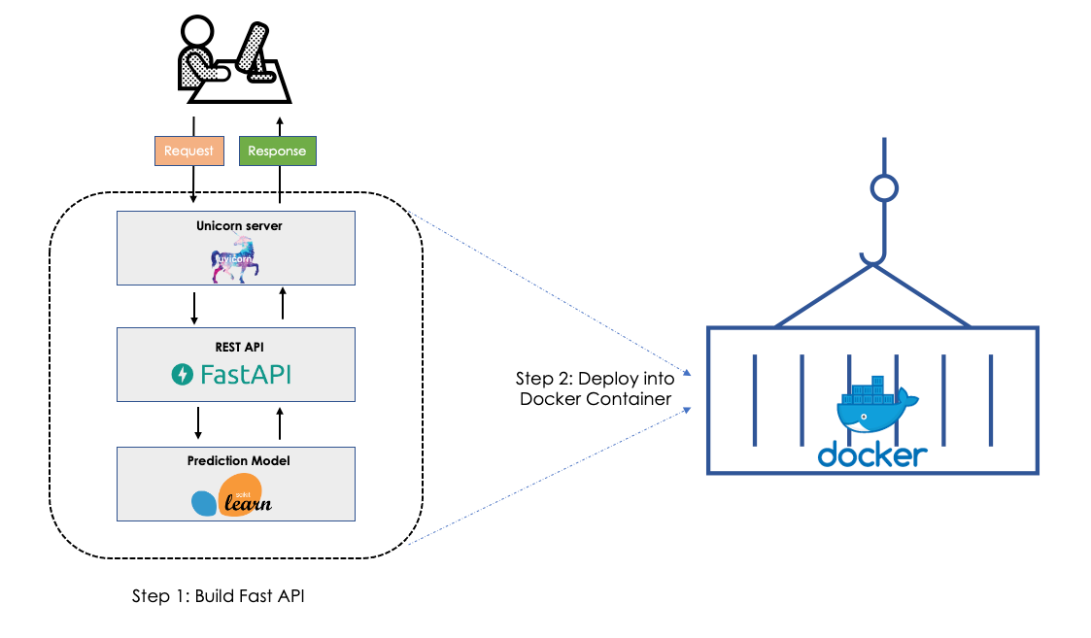
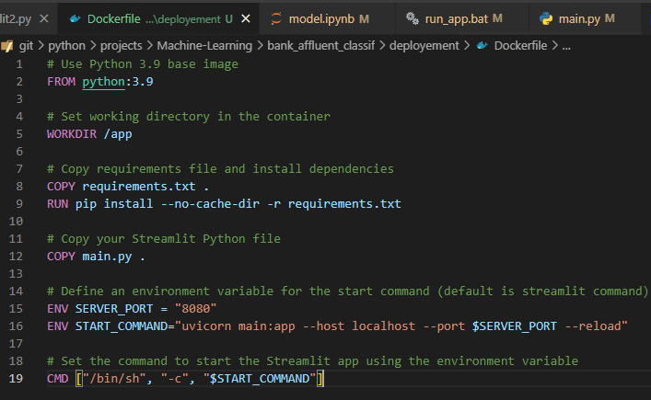
Model Serving (Fast API)
The Model Can be served using several methods like Seldon Core/Bento ML/Streamlit/Django/FastAPI. For this use case FastAPI was chosen
The Code can be containerized in to a docker image & uploaded to a docker hub
This can then be used in any Kubernetes Cluster or just as a container in any Docker Engine
STEP1
STEP2

Slide 19
Thanks for the Opportunity ☺

