Slide 1
COMPUTER NETWORKS — COURSE PROJECT PRESENTATION
KRYPSIS
Federated Learning–based Network Intrusion Detection with a
Custom Communication Protocol
Rithika K · CB.SC.U4AIE25126 Pradhaniya S · CB.SC.U4AIE25148
Sathya K · CB.SC.U4AIE25154 Vinudharshini PP · CB.SC.U4AIE25161

Slide 2
01 INTRODUCTION
Why this project, and what it is
WHY WE CHOSE IT
WHAT THE PROJECT IS
▪ Cyberattacks are growing faster than networks can be secured, and most detection systems assume traffic can be pooled onto one central server.
▪ That pooling is often unsafe or illegal — traffic reveals internal structure, and privacy regulations restrict sharing it across organizations.
▪ We wanted a project connecting course networking concepts — protocols, layers, distributed communication — to a live research problem in AI and security.
▪ A Network Intrusion Detection System (NIDS) — watches network connections and classifies each as normal or attack.
▪ Trained using Federated Learning: 10 routers train one shared detector without ever sending raw traffic anywhere.
▪ Model updates travel over our own security-fused protocol — integrity tag + fingerprint — instead of plain HTTP/gRPC.

Slide 3
02 APPLICATION
Where this matters, and what we did
REAL-WORLD APPLICATION
WHAT WE ACTUALLY BUILT
▪ Hospitals, banks, universities jointly training a shared intrusion detector without exposing internal network layouts to each other.
▪ IoT / edge networks — routers and smart devices each contributing local learning (the “fog computing” pattern from Unit 3).
▪ Cross-border threat intelligence sharing between organizations bound by different data-protection laws.
▪ Used FLNET2023: traffic captured at 10 real (emulated) routers — each router is one federated client with its own mix of attacks.
▪ Trained one shared detection model across all 10 using Federated Averaging (FedAvg).
▪ Built and attacked our custom protocol: poisoned updates, tampered messages, backdoors — and repeated it on NSL-KDD.

Slide 4
03 TOOLS USED
The toolchain behind it
A machine-learning implementation project, not a network-topology simulation — so the tools are a data-science stack, not Mininet/Packet Tracer. A deliberate distinction, not a gap.
Python
TensorFlow / Keras
scikit-learn
Core implementation language
Building & training the neural network
Preprocessing, metrics, evaluation
pandas / NumPy
FLNET2023 + NSL-KDD
Git & GitHub
Data handling & arrays
Router flow captures + classic benchmark
Version control, full project history

Slide 5
04 METHODOLOGY
How it was built, step by step
STEP 1
STEP 2
STEP 3
STEP 4
Preprocess FLNET2023: 66 flow features, drop IP/port/time identifiers
One client per router — real non-IID data (19%–92% attack per router)
Define the model: MLP, 256→128→64→1 neurons
Run FedAvg over the Krypsis protocol: train → verify → filter → average
THE FEDAVG LOOP, IN WORDS
▪ Server sends the current shared model to all 10 router clients.
▪ Each client trains it further on its own data only — nothing else moves.
▪ Clients send back only the updated weights, never raw traffic — wrapped in a Krypsis message (tag + fingerprint).
▪ Server verifies each message, filters suspicious ones, then combines the rest weighted by data size (capped per client).
▪ Repeat for 15 rounds, checking accuracy after every round.

Slide 6
05 STATUS & RESULTS
What's done, and the real numbers
100.0%
99.93%
99.999%
105/105
Centralized accuracy (FLNET2023)
FedAvg, 10 real router clients
FedAvg, IID control split
Tampered messages rejected
Dataset switch: NSL-KDD → FLNET2023 (real router clients)
Complete
Preprocessing, router split, MLP, FedAvg
Complete
Custom protocol: HMAC tag + fingerprint + anomaly filter
Complete
Global vs. Mondrian thresholds (research question)
Answered
Weight cap + second check, backdoor attack, NSL-KDD replication
Complete
Robustness: client dropout, traffic shift, 10–40 clients
Complete
Multi-class detection (11 traffic types)
Complete

Slide 7
06 THE KRYPSIS PROTOCOL
What one update message looks like
LENGTH
HEADER + FINGERPRINT
PAYLOAD
TAG
4 B
client, round, L2 norms, 64-number sketch
model update, 233,476 B
HMAC-SHA256, 32 B
Protocol overhead: +1,559 B (0.67%) per update — the same update as plain HTTP/JSON is 5.6x larger.
WHAT THE SERVER DOES, BEFORE AVERAGING
▪ 1. Check the HMAC tag — any change in transit → reject.
▪ 2. Recompute the fingerprint from the payload — a client cannot lie about it.
▪ 3. Score the update vs. the other clients this round: size, direction vs. consensus, change vs. its own last update.
▪ 4. Over the calibrated threshold → flagged → second check against a trimmed-mean reference (rescue or drop).
▪ 5. Average the accepted updates, with no client weighted above 15%.

Slide 8
07 PROTOCOL RESULTS
Does it stop the attacks?
2 of 10 clients attack after 5 clean rounds. Mean over random seeds; v1 = protocol drops flagged updates, v2 = + weight cap + second check.
Dataset / attack
Metric
No defense
Protocol v1
Protocol v2
FLNET2023 · label flip
Accuracy ↑
92.4%
99.4%
96.7%
NSL-KDD · label flip
Accuracy ↑
68.8%
78.6%
79.2%
FLNET2023 · backdoor (failed)
Backdoor success ↓
0.0%
0.0%
0.0%
NSL-KDD · backdoor
Backdoor success ↓
34.1%
10.8%
8.7%
Research question — global vs. Mondrian thresholds (15 seeds): Mondrian caught 57.6% vs 53.3% of poisoned updates and wrongly flagged 4.6% vs 2.7% of honest ones — neither difference is statistically significant.

Slide 9
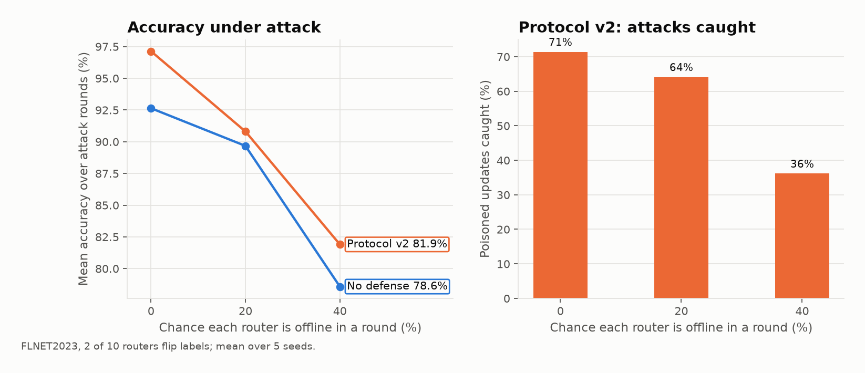
08 ROBUSTNESS
Dropout, traffic shift, more clients
FLNET2023 router split, protocol v2, 5 seeds per setting.
CLIENT DROPOUT
Still helps at every level, but catches only 36% of poisoned updates when routers are offline 40% of the time.
TRAFFIC SHIFT
A router suddenly seeing new DDoS traffic was wrongly excluded 0% of the time.
10 → 20 → 40 CLIENTS
Catches 71% → 89% → 84%; server time 24 → 37 → 73 ms per round.
More clients make the protocol stronger; heavy dropout makes it weaker. Mondrian thresholds still showed no significant gain over a global threshold, even at 40 clients.

Slide 10
09 LEARNING
How this connects to our syllabus
Every unit of this course shows up somewhere in this project — intrusion detection is fundamentally a networking problem.
UNIT 1 — NETWORK EDGE, OSI LAYERS, PACKET SWITCHING
Every FLNET2023 record is a network flow captured at a router: ports, packet counts and sizes, TCP flags, inter-arrival times. Our federated clients ARE routers — network edge nodes.
UNIT 2 — APPLICATION LAYER, TRANSPORT LAYER, SOCKETS, ROUTING
Our custom protocol design is application-layer protocol design (vs. HTTP/gRPC). Client-server exchange mirrors socket-based communication. dst_host_count ties to routing/host addressing.
UNIT 3 — IOT, FOG/CLOUD COMPUTING, SDN
Federated Learning's architecture IS fog computing: local processing at the edge, summarized results to a central aggregator. Our custom protocol mirrors SDN/OpenFlow — customizing behavior beyond fixed defaults.

Slide 11
10 FINDINGS
What we learned — including what didn't work
1
Binary detection on FLNET2023 is too easy — naming the attack is not
One feature alone scores 97.5% on attack vs normal. Asked for the exact attack type, federated training on real routers reaches macro-F1 0.39 vs 0.76 with IID data: attacks seen at only one router are never learned.
2
The first protocol design flagged honest clients
Once training converges, every update looks noisy: 65–96% of honest updates were flagged. Fixed by scoring each update relative to the other clients in the same round.
3
Mondrian thresholds did not significantly beat a global threshold
Our research question, answered honestly: with 10 clients and 5 calibration rounds, each cluster has too little data for reliable thresholds.
4
A fixed weight cap is not a free fix
Capping a large router stops it dominating when it attacks — but when it is honest, its lost weight partly goes to the attackers (one FLNET2023 seed: 97.3% → 83.8%).

