Slide 1
COMPUTER NETWORKS · FINAL PROJECT REVIEW
Krypsis
Federated network intrusion detection over real router clients,
with a security-fused update protocol
Rithika K
CB.SC.U4AIE25126
Pradhaniya S
CB.SC.U4AIE25148
Sathya K
CB.SC.U4AIE25154
Vinudharshini PP
CB.SC.U4AIE25161
Notes:
Introduce the team and the project in one sentence: Krypsis trains one intrusion detector across 10 routers without moving their traffic, and protects the model updates with our own protocol.

Slide 2
INTRODUCTION
Intrusion detection without sharing traffic
THE PROBLEM
An intrusion detection system (NIDS) learns to tell normal flows from attacks, so it needs varied traffic. But traffic logs reveal hosts, services and internal structure, so organisations cannot simply pool them.
Aggregation server
FedAvg
FEDERATED LEARNING
Each router trains the shared model on its own traffic and sends back only the change in weights. The server averages the changes (FedAvg). Raw traffic never leaves a router.
Router 1
Router 2
· · ·
Router 10
THE NEW RISK
The updates become the attack surface: they can be tampered with in transit or poisoned by a compromised router (label flipping, backdoors). And honest routers with unusual traffic (non-IID) can look like attackers.
↓ global model ↑ weight update only
Our approach Krypsis builds security into the update protocol itself: every update carries an integrity tag and a verifiable fingerprint, and suspicious updates are filtered cheaply before aggregation.
Research question Does one global anomaly threshold wrongly flag honest non-IID routers, and do per-cluster (Mondrian) thresholds reduce those false alarms?
Krypsis · Final Review
2
Notes:
Detection needs varied traffic, but traffic is sensitive. Federated learning keeps traffic on the routers and only shares weight updates, as in the diagram. That moves the risk to the updates themselves: tampering, poisoning, and honest routers that simply look different. Krypsis protects the updates, and our research question asks whether one global threshold is unfair to unusual honest routers.

Slide 3
OBJECTIVES
Objectives
1
Federated detector
Train one intrusion detector across 10 router clients without centralizing raw traffic.
Met · FedAvg over 10 routers: 99.93%
2
Security-fused protocol
Design an update message with an integrity tag and a fingerprint, and filter bad updates before aggregation.
Met · HMAC, verifiable fingerprint, 3 anomaly scores
3
Detection quality
Measure accuracy, precision, recall and F1, for binary and 11-class detection.
Met · two datasets, binary and 11-class
4
Communication cost
Measure the protocol's overhead against a generic HTTP/JSON transfer.
Met · +0.67% overhead; JSON is 5.6× larger
5
Robustness and the research question
Test poisoning, dropout, traffic shift and global vs Mondrian thresholds, over repeated seeds with significance tests.
Met · 235 federated runs; Mondrian not better
Krypsis · Final Review
3
Notes:
Five objectives. The right column shows how far each was met; every number comes from our result files.

Slide 4
METHODOLOGY · 1 / 6
System architecture and dataset
Router client
local flows → local training → update Δw
Krypsis message
header · fingerprint · payload · HMAC
Server checks
verify tag and fingerprint → score → threshold → second check
Capped FedAvg
weighted average, ≤ 15% per client
new global model sent to every router, next round
DATASET · FLNET2023 (KUMAR ET AL., 2023)
564,007
training flows
79,491
test flows
Built for federated learning: flows recorded at 10 routers of an emulated 40-node network.
10 routers = 10 clients, each with its own mix of attacks.
Labels: Normal or one of 10 attacks (DDoS, DoS, web attacks, MITM).
NSL-KDD is used as a second dataset to repeat the results.
66
features per flow
66%
of training flows are attacks
Krypsis · Final Review
4
Notes:
One round, left to right: the router trains on its own flows and wraps the weight change in a Krypsis message; the server verifies, scores and filters it, then averages the accepted updates with a 15% cap per client, and sends the new model back. The data is FLNET2023, a dataset made for federated intrusion detection: traffic from 10 routers, so each router is one client.

Slide 5
METHODOLOGY · 2 / 6
Preprocessing: from raw flows to model input
1
Tag and sample
Each flow gets its router number; each file is sampled to 10% (4.8 M flows is too many to train repeatedly).
src/preprocess.py (excerpt)
DROP_COLUMNS = ["src_ip", "dst_ip", "src_port", "timestamp"]
def sample_file(path, rng): # 10%, at least 2,000 rows
df = pd.read_csv(path, low_memory=False)
keep = min(len(df), max(2000, round(len(df) * 0.10)))
...
df["router"] = int(ROUTER_PATTERN.search(name).group(1))
features = features.replace([np.inf, -np.inf], np.nan)
df = df.loc[~features.isna().any(axis=1)]
def signed_log1p(x): # values span 1 to 1e9
return np.sign(x) * np.log1p(np.abs(x))
scaler = MinMaxScaler() # fitted on TRAIN only
X_train = scaler.fit_transform(signed_log1p(train))
X_test = np.clip(scaler.transform(signed_log1p(test)), 0, 1)
2
Remove identifiers
IPs, source port and timestamp dropped, so the model learns behaviour, not addresses.
3
Clean
Rows with inf / NaN values and 12 constant columns removed.
4
Scale
Signed log for huge ranges, then min-max to [0, 1], fitted on training data only.
5
Label
Normal = 0, any attack = 1; the attack name is kept for the 11-class model.
Krypsis · Final Review
5
Notes:
Five steps, left, and the code that does them, right. Each flow is tagged with its router so we can give it to the right client. We sample 10% to keep training fast. We drop IP addresses, the source port and timestamps, otherwise the model could memorise the attacker's address. Then we clean and scale; the scaler is fitted on training data only, so the test set stays unseen.

Slide 6
METHODOLOGY · 3 / 6
Clients: why uneven (non-IID) data matters
IID = every client has a similar mix of traffic. Non-IID = each client sees different traffic, as in real networks.
FLNET2023 · 10 REAL ROUTERS · ATTACK %
src/preprocess_nslkdd.py
83
92
def split_non_iid_dirichlet(labels, num_clients, alpha, seed):
rng = np.random.default_rng(seed)
assignment = np.full(len(labels), -1, dtype=int)
for category in np.unique(labels):
idx = np.where(labels == category)[0]
rng.shuffle(idx)
share = rng.dirichlet(alpha * np.ones(num_clients))
sizes = (share * len(idx)).astype(int)
sizes[-1] += len(idx) - sizes.sum()
start = 0
for client_id, size in enumerate(sizes):
assignment[idx[start:start + size]] = client_id
start += size
return assignment
76
66
72
68
56
51
42
19
R1
R2
R3
R4
R5
R6
R7
R8
R9
R10
NSL-KDD · DIRICHLET SPLIT, ALPHA 0.5 · ATTACK %
100
99
98
84
54
40
40
28
18
12
Each attack type is shared out with random Dirichlet proportions; smaller α means more uneven clients.
C1
C2
C3
C4
C5
C6
C7
C8
C9
C10
Krypsis · Final Review
6
Notes:
IID means every client has a similar mix; non-IID means each one is different. FLNET2023 is naturally non-IID: router 3 sees 19% attack traffic, router 4 sees 92%. For NSL-KDD we created uneven clients with a Dirichlet split: each attack type is divided among the 10 clients with random proportions, alpha 0.5. Some clients end up almost all attack, others almost all normal. This matters because an honest client with unusual data can look like an attacker, which is our research question. We also ran an IID split of FLNET2023 as a control.

Slide 7
METHODOLOGY · 4 / 6
Model and federated training (FedAvg)
Input
66 features
256
Dense
128
Dense
64
Dense
Output
normal / attack
ReLU + dropout + L2 · 58,369 parameters · Adam, binary cross-entropy · 15 rounds × 2 local epochs · centralized baseline uses the same model
src/model.py (layers = tf.keras.layers)
src/federated_training.py (FedAvg)
def build_model(input_dim):
l2 = tf.keras.regularizers.l2(1e-4)
model = tf.keras.Sequential([
layers.Input(shape=(input_dim,)),
layers.Dense(256, activation="relu", kernel_regularizer=l2),
layers.Dropout(0.3),
layers.Dense(128, activation="relu", kernel_regularizer=l2),
layers.Dropout(0.3),
layers.Dense(64, activation="relu", kernel_regularizer=l2),
layers.Dropout(0.2),
layers.Dense(1, activation="sigmoid")])
model.compile(optimizer="adam", loss="binary_crossentropy")
return model
def federated_average(weight_list, sample_counts):
total = sum(sample_counts)
averaged = []
for layer_idx in range(len(weight_list[0])):
layer_sum = sum(weight_list[i][layer_idx]
* (sample_counts[i] / total)
for i in range(len(weight_list)))
averaged.append(layer_sum)
return averaged
for round_num in range(1, num_rounds + 1):
for client_id in range(num_clients): # local training
local_model.set_weights(global_weights)
local_model.fit(X_client, y_client, epochs=2)
global_weights = federated_average(local_weights, counts)
Krypsis · Final Review
7
Notes:
The model is a small multilayer perceptron: 66 inputs, three hidden layers, one output for normal or attack. Left is the code. Right is FedAvg: every round each client starts from the global model and trains on its own data; the server then averages each layer, weighting clients by how much data they have. The same model trained on all data in one place is our centralized baseline, the best accuracy we can hope for.

Slide 8
METHODOLOGY · 5 / 6
Federated round and the Krypsis message
LENGTH
4 B
HEADER + FINGERPRINT
client · round · samples · L2 norm · layer norms · 64-number sketch
PAYLOAD
update Δw · 233,476 B (float32)
TAG
HMAC-SHA256 · 32 B
src/demo.py · one federated round
src/protocol.py (excerpt)
for rnd in range(1, ROUNDS + 1):
for c in clients: # on each router
local.set_weights(unflatten(g, like))
local.fit(X[a == c], y[a == c], epochs=1,
batch_size=256)
d = flatten(local.get_weights()) - g # update Δw
msg = pack(c, rnd, n[c], d, keys[c], fp) # → server
header, d, reason = unpack(msg, keys, fp)
... # score, filter (next slide)
w = capped_weights(counts, 1.5)
g = g + sum(accepted[c] * w[c] for c in accepted)
def compute(self, delta): # the fingerprint
return {"l2": norm(delta),
"layer_l2": [norm(delta[s]) for s in self.layer_slices],
"sketch": (self.projection @ delta).tolist()}
def pack(client_id, round_num, num_samples, delta, key, fp):
header = json.dumps({"client": client_id, "round": round_num,
"n": num_samples, "fp": fp.compute(delta)},
separators=(",", ":")).encode()
payload = delta.astype(np.float32).tobytes()
tag = hmac.new(key, header + payload, hashlib.sha256).digest()
return len(header).to_bytes(4, "big") + header + payload + tag
The sketch is a fixed random projection (public seed 2023) of the update to 64 numbers. Whole message: +1,559 B (0.67%) over the bare update.
Krypsis · Final Review
8
Notes:
The strip on top is one message on the wire. Left: one federated round. Each router starts from the global model g, trains one epoch on its own flows, computes its update d, and packs it. The server unpacks, filters, and averages with capped weights. Right: pack builds the header with the fingerprint (overall size, size per layer, and a 64-number sketch), appends the raw float32 update, and signs everything with HMAC-SHA256 using the router's own key.

Slide 9
METHODOLOGY · 6 / 6
Server checks before aggregation
Verify tag
reject
Verify fingerprint
reject
Score
3 scores
Standardize
robust z
Threshold
conformal
Second check
trimmed mean
Capped FedAvg
≤ 15% each
src/protocol.py · step 1-2
src/protocol.py · steps 3-7 (condensed)
def unpack(message, keys, fp):
... # split header/payload/tag
expected = hmac.new(key, header_bytes + payload,
hashlib.sha256).digest()
if not hmac.compare_digest(tag, expected):
return header, None, "bad_tag" # tampered
delta = np.frombuffer(payload, dtype=np.float32)
actual = fp.compute(delta) # recompute, never trust
if not np.allclose(actual["sketch"], header["fp"]["sketch"],
rtol=1e-3, atol=1e-5):
return header, None, "fingerprint_mismatch"
return header, delta, None
consensus = np.median(sketches, axis=0) # attackers can't drag it
scores[c] = {
"norm": abs(log(l2[c] / median_norm)),
"consensus": 1 - cosine(sketch[c], consensus),
"history": 1 - cosine(sketch[c], prev_sketch[c]),
}
z = (score - median) / (1.4826 * MAD) # within this round
flagged = any(z[s] > threshold[s] for s in SCORE_NAMES)
# threshold = ceil((n+1)(1-alpha))-th calibration score, alpha=0.05
rescued = second_check(passed, flagged, 0.2)
w = capped_weights(counts, 1.5) # 1.5 x 1/10 = 15%
Thresholds come from 5 clean calibration rounds: one for all clients (global), or one per k-means cluster of similar clients (Mondrian, k = 3).
Krypsis · Final Review
9
Notes:
Seven steps. Left: the hard checks. A wrong HMAC means the message was changed in transit; the server also recomputes the fingerprint from the payload, so a client cannot send a fake innocent-looking one. Right: three cheap scores from the fingerprint only: is the update unusually large or small, does it point away from the median of the other routers, and does it differ from this router's last update. Scores are standardized within the round, compared with conformal thresholds, flagged updates get a second check against a trimmed mean, and no client gets more than 15% of the average.

Slide 10
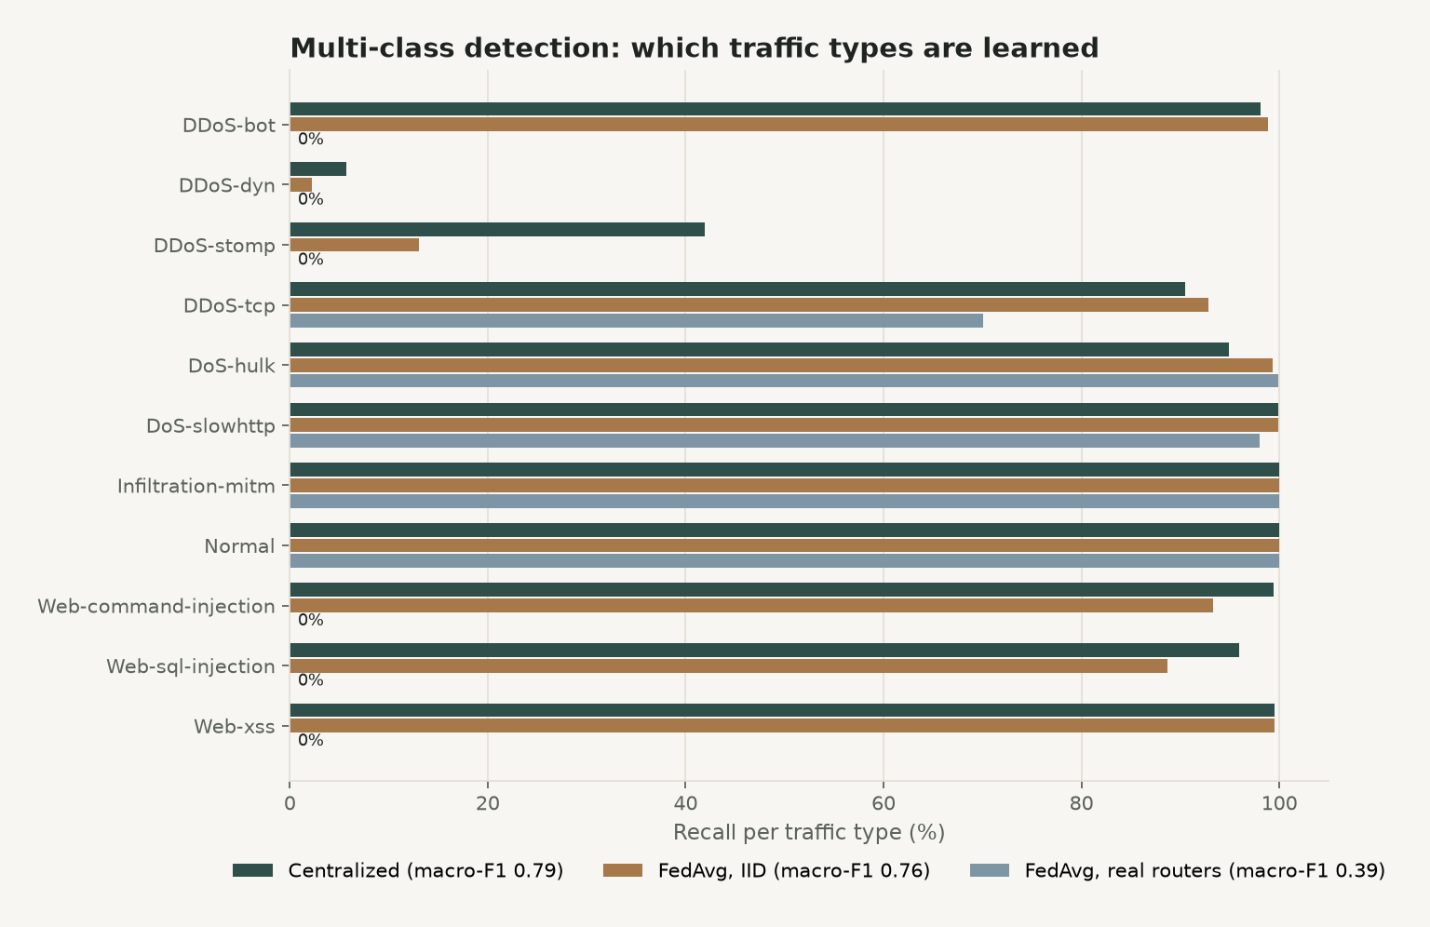
RESULTS · 1 / 2
Detection: binary is easy, naming the attack is not
BINARY ACCURACY · FLNET2023 TEST SET
100.0%
centralized
99.93%
FedAvg · 10 real routers
99.999%
FedAvg · IID split
MULTI-CLASS MACRO-F1 · 11 TYPES
0.79 central 0.76 IID 0.39 routers
We checked the 100%: one feature alone scores 97.5%, so binary accuracy cannot separate setups. With 11 classes, attack types seen at only one or two routers are averaged away: the non-IID cost.
Krypsis · Final Review
10
Notes:
Federated training over the real routers matches centralized training on the binary task. But we checked the perfect score: the emulated traffic is separable by one feature, so we also trained an 11-class model. There, macro-F1 drops from 0.76 with an IID split to 0.39 with the real routers: attack types held by one router are averaged away. The chart shows recall per attack type.

Slide 11
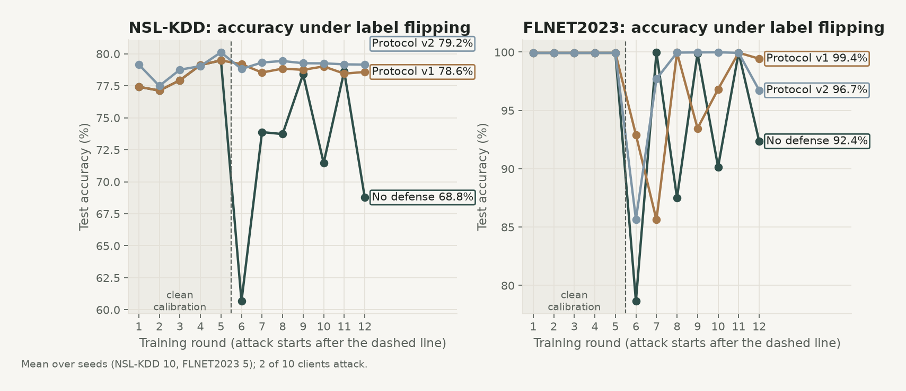
RESULTS · 2 / 2
The protocol under attack
NO DEFENSE → KRYPSIS
Tampered messages rejected
105 / 105
Label flip · FLNET2023
92.4% → 99.4%
Label flip · NSL-KDD
68.8% → 79.2%
Backdoor success · NSL-KDD
34.1% → 8.7%
40% routers offline
78.6% → 81.9%
Attack setup: 2 of 10 clients flip their labels (attack ↔ normal) from round 6 of 12; rounds 1–5 calibrate the thresholds. NSL-KDD gain is significant (p = 0.009, 10 seeds); FLNET2023 points the same way (5 seeds).
40 clients · caught
84% · 73 ms/round
Shifted honest router excluded
0%
Krypsis · Final Review
11
Notes:
Left: accuracy round by round. Without protection the poisoned rounds drag accuracy down; with Krypsis it stays near the clean level. Right: every tampered message was rejected, label flipping and backdoors lose most of their effect, the protocol still helps when 40% of routers drop out, it scales to 40 clients in milliseconds, and an honest router whose traffic changed was never excluded. On FLNET2023 the backdoor failed even without a defense.

Slide 12
COMPARISON
Comparison with existing approaches and our setups
Approach
Tamper check
Filters poisoned updates
When / cost
Evidence here
Plain FedAvg (McMahan 2017)
No
No
—
Label flip: 92.4% FLNET, 68.8% NSL
HTTP + JSON transfer
Channel only (TLS)
No
5.6× message size
Measured: 1,316 KB / update
Krum (Blanchard 2017)
No
Yes, every round
After full receipt · O(n²·d)
Literature (not implemented)
Trimmed mean (Yin 2018)
No
Yes, every round
After full receipt · O(n·d·log n)
Used inside our second check
Krypsis (ours)
Per-client HMAC
Yes, cheap filter first
Before aggregation · +0.67%
Label flip: 99.4% FLNET, 79.2% NSL
Our setups
No defense
Protocol v1
Protocol v2
v2 Mondrian
FLNET2023 · label flip accuracy ↑
92.4%
99.4%
96.7%
96.7%
NSL-KDD · label flip accuracy ↑
68.8%
78.6%
79.2%
78.7%
NSL-KDD · backdoor success ↓
34.1%
10.8%
8.7%
8.7%
NSL-KDD · honest excluded ↓
—
5.4%
1.1%
1.8%
v1 drops every flagged update · v2 adds the second check and the 15% weight cap · FLNET2023 5 seeds, NSL-KDD 10 seeds, means shown.
Krypsis · Final Review
12
Notes:
Top: plain FedAvg has no protection; HTTP with TLS protects the channel but not against a malicious client; Krum and trimmed mean filter updates only after receiving everything, every round. Krypsis adds a per-client integrity tag and a cheap filter first. Bottom: our own setups. Both protocol versions beat no defense; v2 excludes fewer honest routers; Mondrian is never clearly better. On FLNET2023 the weight cap has a downside in one seed.

Slide 13
CONCLUSION
Conclusion
Research question · answer: no. Mondrian caught 57.6% vs global 53.3% (p = 0.21, 15 seeds), and no other test was significant (all p ≥ 0.11). With per-round standardization, one global threshold is enough.
CONCLUSIONS
LIMITATIONS AND FUTURE WORK
Federated training over 10 real routers matches centralized binary detection.
Naming the attack exposes the non-IID cost: macro-F1 0.39 vs 0.76 IID.
Krypsis rejects every tampered message and raises accuracy under attack, for under 1% extra message size.
A global threshold is enough; Mondrian brought no significant gain.
Simulated in one process on emulated traffic; attackers do not adapt.
The weight cap can shift weight from an honest large router to attackers.
At 40% dropout only about a third of poisoned updates are caught.
Next: protocol on the 11-class task, a trust-based cap, a real network (Mininet / SDN), more FLNET2023 seeds.
Krypsis · Final Review
13
Notes:
We tested the research question three ways and Mondrian was never significantly better: a negative answer, tested properly. Then the four conclusions, and honestly what did not work and what comes next.

Slide 14
REFERENCES
References
[1] Kumar, P., Liu, J., et al. (2023). FLNET2023: Realistic Network Intrusion Detection Dataset for Federated Learning. MILCOM 2023.
https://doi.org/10.1109/MILCOM58377.2023.10356272
[7] Tolpegin, V., et al. (2020). Data Poisoning Attacks Against Federated Learning Systems. ESORICS.
https://arxiv.org/abs/2007.08432
[2] FLNET2023 dataset and documentation (nsol-nmsu / FML-Network).
https://github.com/nsol-nmsu/FML-Network
[8] Hsu, T.-M. H., Qi, H., Brown, M. (2019). Measuring the Effects of Non-Identical Data Distribution for Federated Visual Classification.
https://arxiv.org/abs/1909.06335
[3] McMahan, B., et al. (2017). Communication-Efficient Learning of Deep Networks from Decentralized Data. AISTATS.
https://arxiv.org/abs/1602.05629
[9] Angelopoulos, A., Bates, S. (2021). A Gentle Introduction to Conformal Prediction.
https://arxiv.org/abs/2107.07511
[4] Blanchard, P., et al. (2017). Machine Learning with Adversaries: Byzantine Tolerant Gradient Descent (Krum). NeurIPS.
https://arxiv.org/abs/1703.02757
[10] Tavallaee, M., et al. (2009). A Detailed Analysis of the KDD CUP 99 Data Set (NSL-KDD). CISDA.
https://www.unb.ca/cic/datasets/nsl.html
[5] Yin, D., et al. (2018). Byzantine-Robust Distributed Learning: Towards Optimal Statistical Rates (trimmed mean). ICML.
https://arxiv.org/abs/1803.01498
[11] Khraisat, A., et al. (2024). Survey on Federated Learning for Intrusion Detection System. ACM Computing Surveys 57(1).
https://doi.org/10.1145/3687124
[6] Bagdasaryan, E., et al. (2020). How To Backdoor Federated Learning. AISTATS.
https://arxiv.org/abs/1807.00459
[12] Krawczyk, H., Bellare, M., Canetti, R. (1997). HMAC: Keyed-Hashing for Message Authentication. RFC 2104.
https://www.rfc-editor.org/rfc/rfc2104
Thank you · questions welcome
Code and results: github.com/Vinudharshini18/Krypsis-A-network-intrusion-detection-system
Krypsis · Final Review
14
Notes:
All links are clickable. The GitHub repository has the code, every result file and the full README. Thank the panel and open for questions.

