Slide 1


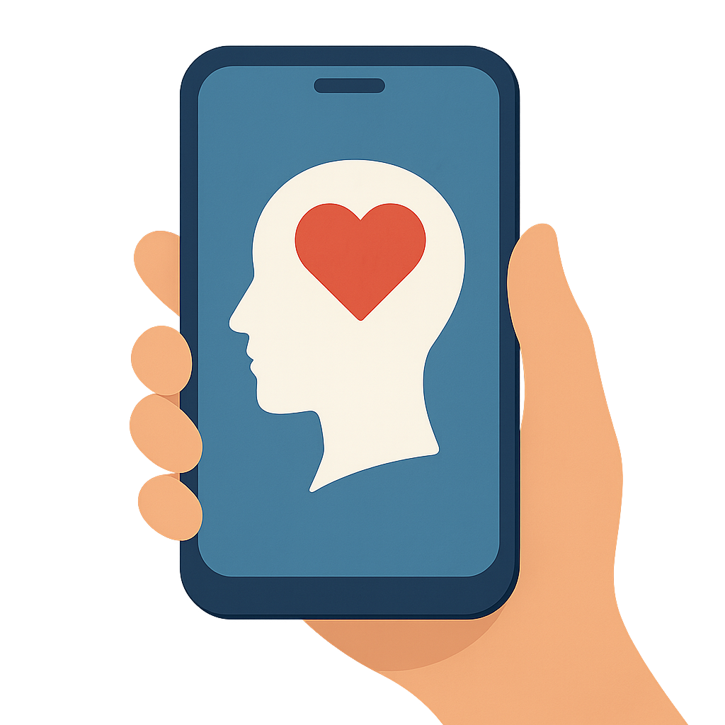
Student Mental Health
Mobile App

Slide 2





Introduction
— What is mental health and why is it important ?

Slide 3

Research Objectives
1 – Early Mental Health Prediction Model
To develop temporal deep-learning models (LSTM, TCN) that predict individualized "windows of vulnerability" using multimodal behavioral and speech data.
2 – Real-Time Emotion Detection & Personalized Intervention
To design a system integrating facial expressions, physiological signals, and clinician feedback that delivers proactive, personalized interventions based on emotion forecasting.

Slide 4
Research Objectives
3 – On-Device Multimodal Summarization
To build a lightweight, privacy-preserving AI framework that summarizes behavioral and textual signals locally on the device for early stress/anxiety/depression insights.
4 – Burnout Detection & ML-Driven Support System
To classify burnout risk using NLP + behavioral analytics and generate personalized intervention strategies validated against standard burnout measures.

Slide 5

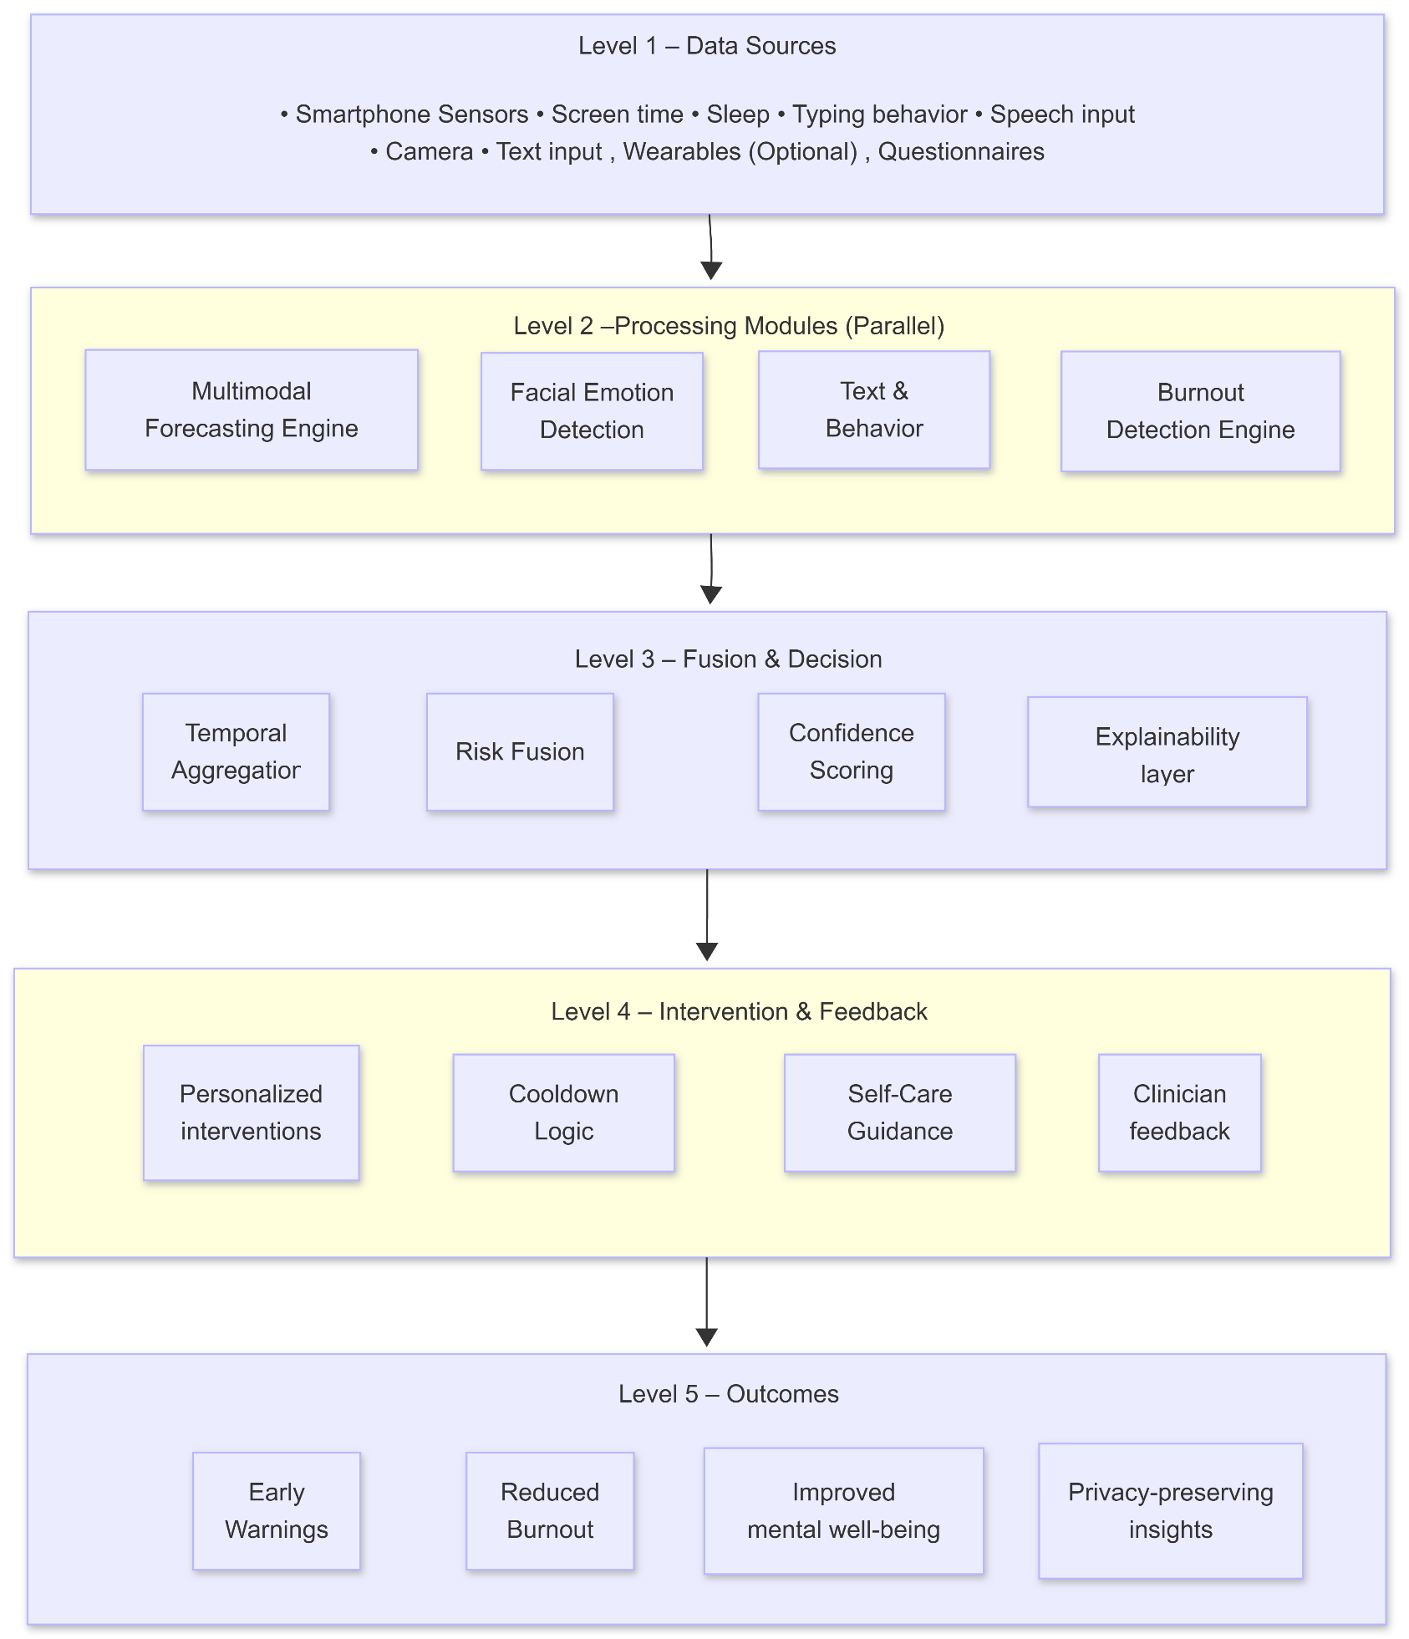
Overall System Diagram

Slide 6
IT22917898 | Indrapala W.V.H.
Student Burnout Detection and Intervention System using Machine Learning
Specialization:
IT22917898 | Indrapala W.V.H.| 25-26J-278

Slide 7
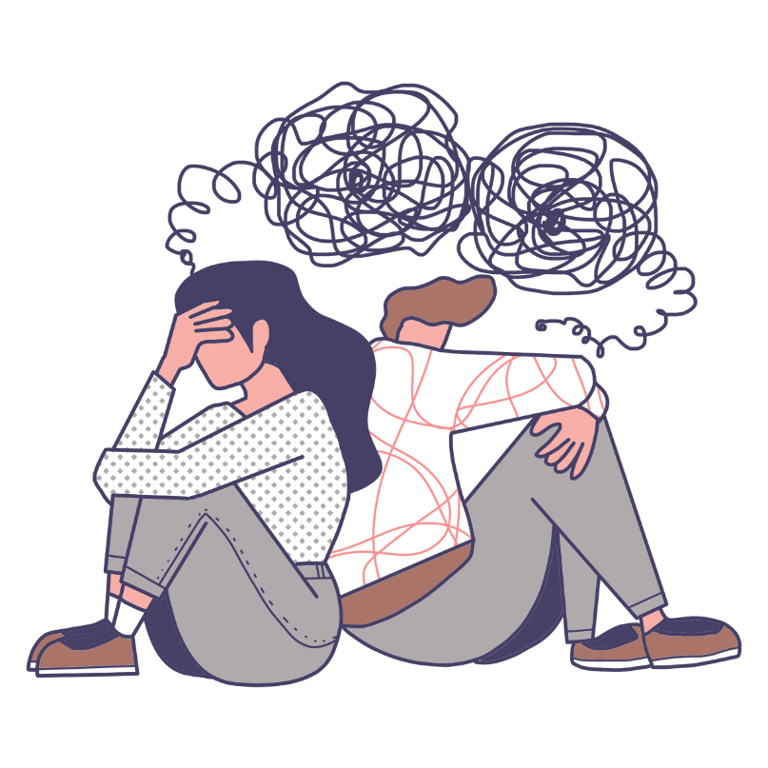
Addressing Sub Problem
Detects early burnout using student text and behavioral patterns.
Identifies subtle emotional and engagement changes before burnout escalates.
Replaces reactive questionnaires with continuous AI-based monitoring.
Provides early warnings instead of post-burnout assessment.
User Requirements Addressed
Early identification of stress, anxiety, and burnout.
Non-intrusive monitoring without wearables.
Real-time insights via a mobile app.
Privacy-safe handling of sensitive mental-health data
IT22917898 | Indrapala W.V.H.| 25-26J-278

Slide 8
Design Excellence / Contribution
Combines NLP-based text analysis with behavioral data (multimodal approach).
Uses lightweight AI models suitable for mobile deployment.
Integrates personalized intervention recommendations.
Improves accessibility compared to counselor-dependent systems.
User Feedback on Prototype
Students found text-based mood logging easy and comfortable.
Early alerts were perceived as helpful rather than intrusive.
Personalized suggestions increased engagement with the app.
Users preferred AI guidance as a supplement to counseling, not a replacement.
IT22917898 | Indrapala W.V.H.| 25-26J-278

Slide 9
IT22032560 | De Silva A.H.H
ON-DEVICE AI SUMMARIZATION OF TEXT AND BEHAVIOR
Specialization:
IT22032560 | De Silva A.H.H | 25-26J-278

Slide 10

Addressing Sub Problem
Summarizes text and behavioral data directly on the device.
Detects early signs of stress, anxiety, and depression in real time.
Eliminates cloud dependency to reduce latency and privacy risks.
Provides clear mental-health insights instead of raw data.
User Requirements Addressed
Strong privacy through fully on-device processing.
Low latency and offline usability.
Lightweight AI suitable for mobile devices.
Easy-to-understand mental-health summaries.
IT22032560 | De Silva A.H.H | 25-26J-278

Slide 11
Design Excellence / Contribution
Introduces a multimodal on-device AI summarization framework.
Efficient fusion of text and behavioral data.
Optimized models for memory and battery constraints.
Advances privacy-preserving AI for mental-health applications.
User Feedback on Prototype
Users trusted the system due to local data processing.
Summarized insights were clearer than raw analytics.
Low latency improved overall user experience.
Users valued privacy over cloud-based accuracy trade-offs.
IT22032560 | De Silva A.H.H | 25-26J-278

Slide 12
IT22321268 | Kumarasinghe K.D.K.Y
Early Mental Health Prediction Model
Specialization:
IT22321268 | Kumarasinghe K.D.K.Y | 25-26J-278

Slide 13
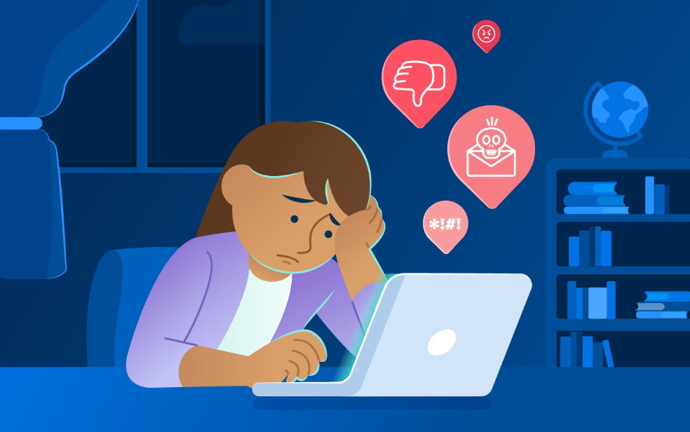
Addressing Sub Problem
Predicts early mental-health decline using multimodal behavioral data.
Identifies risk trends days or weeks before symptoms worsen.
Moves from detection to forecasting of mental-health risks.
Enables proactive rather than reactive interventions.
User Requirements Addressed
Early warning alerts before severe mental-health issues.
Personalized predictions based on individual behavior patterns.
Continuous monitoring without manual input.
Privacy-preserving on-device data processing.
IT22321268 | Kumarasinghe K.D.K.Y | 25-26J-278

Slide 14
Design Excellence / Contribution
Uses temporal deep-learning models (Attention-LSTM, TCN).
Introduces risk-window forecasting instead of static classification.
Provides explainable AI-based alerts for user trust.
Improves prevention-focused mental-health support.
User Feedback on Prototype
Users appreciated advance warnings over instant detection.
Predictive alerts helped users plan breaks and self-care.
Explainable alerts increased confidence in predictions.
Users preferred forecasting-based support over passive monitoring.
IT22321268 | Kumarasinghe K.D.K.Y | 25-26J-278

Slide 15
IT22888334 | Ranathunga A.K.M
FACIAL EMOTION DETECTION WITH PERSONALIZED INTERVENTIONS FOR STUDENT MENTAL HEALTH PLATFORM
Specialization:
IT22888334 | Ranathunga A.K.M | 25-26J-278

Slide 16
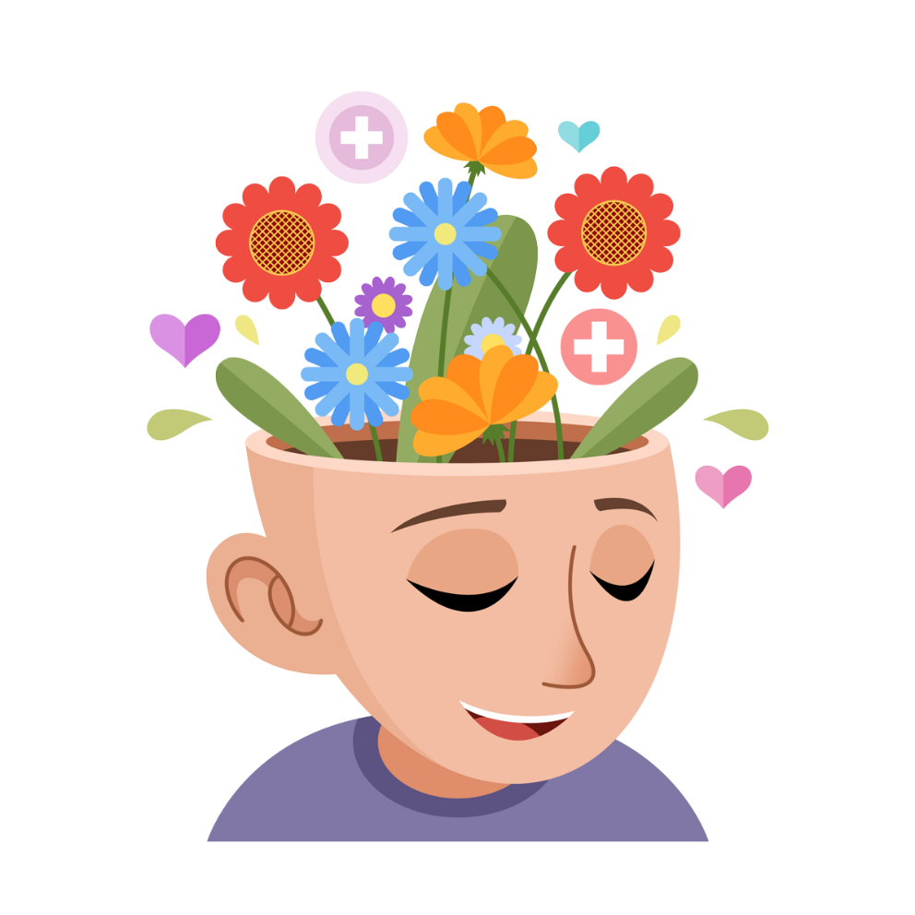
Addressing Sub Problem
Detects emotions using facial expressions and heart-rate signals.
Forecasts stress before it escalates using sequence models.
Delivers real-time, personalized interventions.
Integrates clinician feedback for safer decision-making.
User Requirements Addressed
Timely support during high-stress moments.
Personalized intervention type, timing, and intensity.
Human-in-the-loop (clinician-guided) reliability.
Secure handling of sensitive emotional data.
IT22888334 | Ranathunga A.K.M | 25-26J-278

Slide 17
Design Excellence / Contribution
Combines emotion detection, forecasting, and intervention in one system.
Uses Transformers for proactive stress prediction.
Introduces clinician-in-the-loop adaptive learning.
Supports culturally sensitive student mental-health care.
User Feedback on Prototype
Students felt interventions were timely and relevant.
Clinicians valued the feedback-driven personalization.
Proactive alerts reduced stress escalation.
Users trusted the system due to expert involvement.
IT22888334 | Ranathunga A.K.M | 25-26J-278

Slide 18
(Project Title)
Customer Persona • University students (18–25) facing stress, anxiety, or burnout • Universities and counseling centers seeking scalable mental-health tools
Market Size • Growing student mental-health app market in Sri Lanka and South Asia • Universities, private institutes, NGOs, and wellness platforms
What Is Unique in the Solution • Multimodal AI (text, behavior, speech, facial, physiological data) • Early detection + forecasting + personalized interventions • Privacy-first, on-device processing with clinician-in-the-loop support
Cost Recovery Model • Subscription plans for universities and institutions • Freemium model for students with premium features • Licensing the platform to educational and healthcare organizations

Slide 19
(Project Title)
Customer Persona
Market Size
• University students (18–25) facing stress, anxiety, or burnout • Universities and counseling centers seeking scalable mental-health tools
• Growing student mental-health app market in Sri Lanka and South Asia • Universities, private institutes, NGOs, and wellness platforms
What Is Unique in the Solution
Cost Recovery
• Multimodal AI (text, behavior, speech, facial, physiological data) • Early detection + forecasting + personalized interventions • Privacy-first, on-device processing with clinician-in-the-loop support
• Subscription plans for universities and institutions • Freemium model for students with premium features • Licensing the platform to educational and healthcare organizations

Slide 20

Thank You

