Slide 1
IoT Based Pothole Detection & Alert System

Slide 2
Abstract:
This project proposes an IoT-based Pothole Detection System designed for real-time monitoring and alerting of road potholes. Employing two ultrasonic sensors and GPS technology, the system ensures accurate detection and precise location tracking. Alerts are relayed to drivers through a mobile app using a buzzer and handle vibrator. Additionally, the integration of the ESP32-CAM module allows for the capture of pothole images, which are transmitted to a Telegram channel along with GPS and ultrasonic data. The algorithm for pothole detection operates in real-time, and recorded data can be accessed by authorized individuals and drivers through a dedicated app or webpage. This system offers a comprehensive approach to road safety and maintenance, enhancing driver awareness and facilitating timely interventions.

Slide 3
Introduction:
Road infrastructure is crucial for transportation, but potholes pose a significant threat to both vehicles and pedestrians. Traditional methods of pothole detection and reporting are often manual and time-consuming. The proposed system utilizes IoT technology to automate this process, ensuring swift and accurate detection of potholes.

Slide 4
Existing System:
In the existing system, pothole detection is primarily reliant on visual inspections or reports from individuals, leading to delays in repairs and increased risks on the roads. This manual approach may overlook hidden or newly formed potholes, compromising road safety.

Slide 5
Proposed System:
The IoT-based Pothole Detecting and Alert System integrates smart sensors and cameras along roadways. These devices continuously monitor road conditions and detect potholes automatically. The system then sends real-time alerts to relevant authorities and drivers, enabling prompt repairs and reducing the likelihood of accidents.

Slide 6
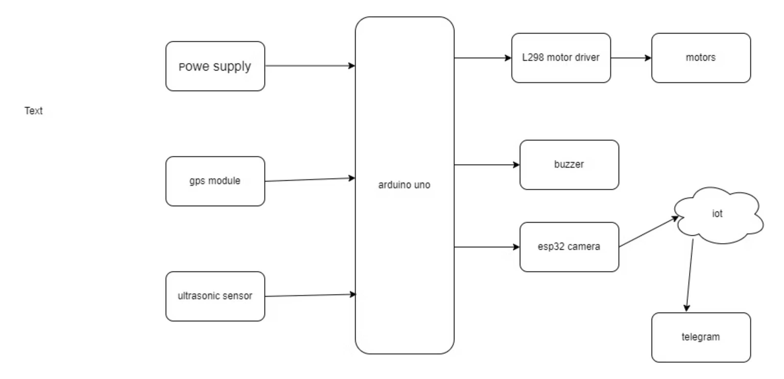
Proposed system:

Slide 7
Hardware components:
Arduino uno
Ultrasonic sensor
Gps module
Motor driver
Motors
Esp8266 wifi module
Jumper wires etc

Slide 8
Software components
Arduino Software
Arduino c language

Slide 9
Advantages:
Real-time Detection: Swift identification of potholes as they form.
Automated Reporting: Immediate alerts to authorities for timely repairs.
Enhanced Safety: Minimization of accidents caused by road hazards.
Efficient Maintenance: Proactive approach to road maintenance.

Slide 10
Disadvantages:
Initial Costs: Implementation may require a significant upfront investment.
Maintenance Challenges: Ensuring the proper functioning of sensors and devices.
Privacy Concerns: Addressing potential privacy issues related to continuous monitoring

Slide 11
Applications:
Urban Roads: Monitoring and maintenance of city streets.
Highways: Ensuring long-distance road safety.
Rural Areas: Extending the system to improve road conditions in less populated regions

Slide 12
Conclusion:
The IoT-based Pothole Detecting and Alert System offers a technologically advanced and automated solution to the persistent issue of potholes in road infrastructure. By addressing detection delays and streamlining the repair process, the system contributes to overall road safety and maintenance.

Slide 13
Future Scope:
Integration with Autonomous Vehicles: Enhancing safety features in self-driving cars.
Data Analytics for Predictive Maintenance: Utilizing collected data to predict potential road issues.
Global Implementation: Expanding the system to address pothole concerns on a larger scale

Slide 14
Project Budget
An estimated budget plan for the development and implementation of the IoT-based Pothole Detection & Alert System.
Arduino Uno / ESP32-CAM
1500
Ultrasonic Sensors (2)
400
GPS Module
600
Motor Driver & Motors
700
Jumper Wires & Breadboard
200
Power Supply (Battery/Power Bank)
500
Enclosure/Casing
400
Miscellaneous Components
300
Testing & Calibration
400
Contingency (10%)
500
Total Estimated Cost (rupees)
5500

Slide 15
Team Members
1. Sampath Srinivas [23bce7414]
2. Vaishnavi [23BCE9869]
3. K. Rama Ganesh [23BCE7277]
4. Sk Rizwana [23BEC7373]
5. I.Vinusha [23BEC7371]
6. Tejesh Madanwad [23BCE7365]

