Slide 1
AWS Ninja
As a Cloud Engineering Team we take care of AWS environment and make sure it is in compliance with organizational policies. We use AWS cloud watch in combination with AWS Lambda to govern the resources according to the policies. For example : we trigger a lambda function when an Amazon Elastic Block Store (EBS) volume is created . We use Amazon cloud watch event that allows us to monitor and respond to EBS volumes that are of type gp2 and convert them to type gp3.

Slide 2
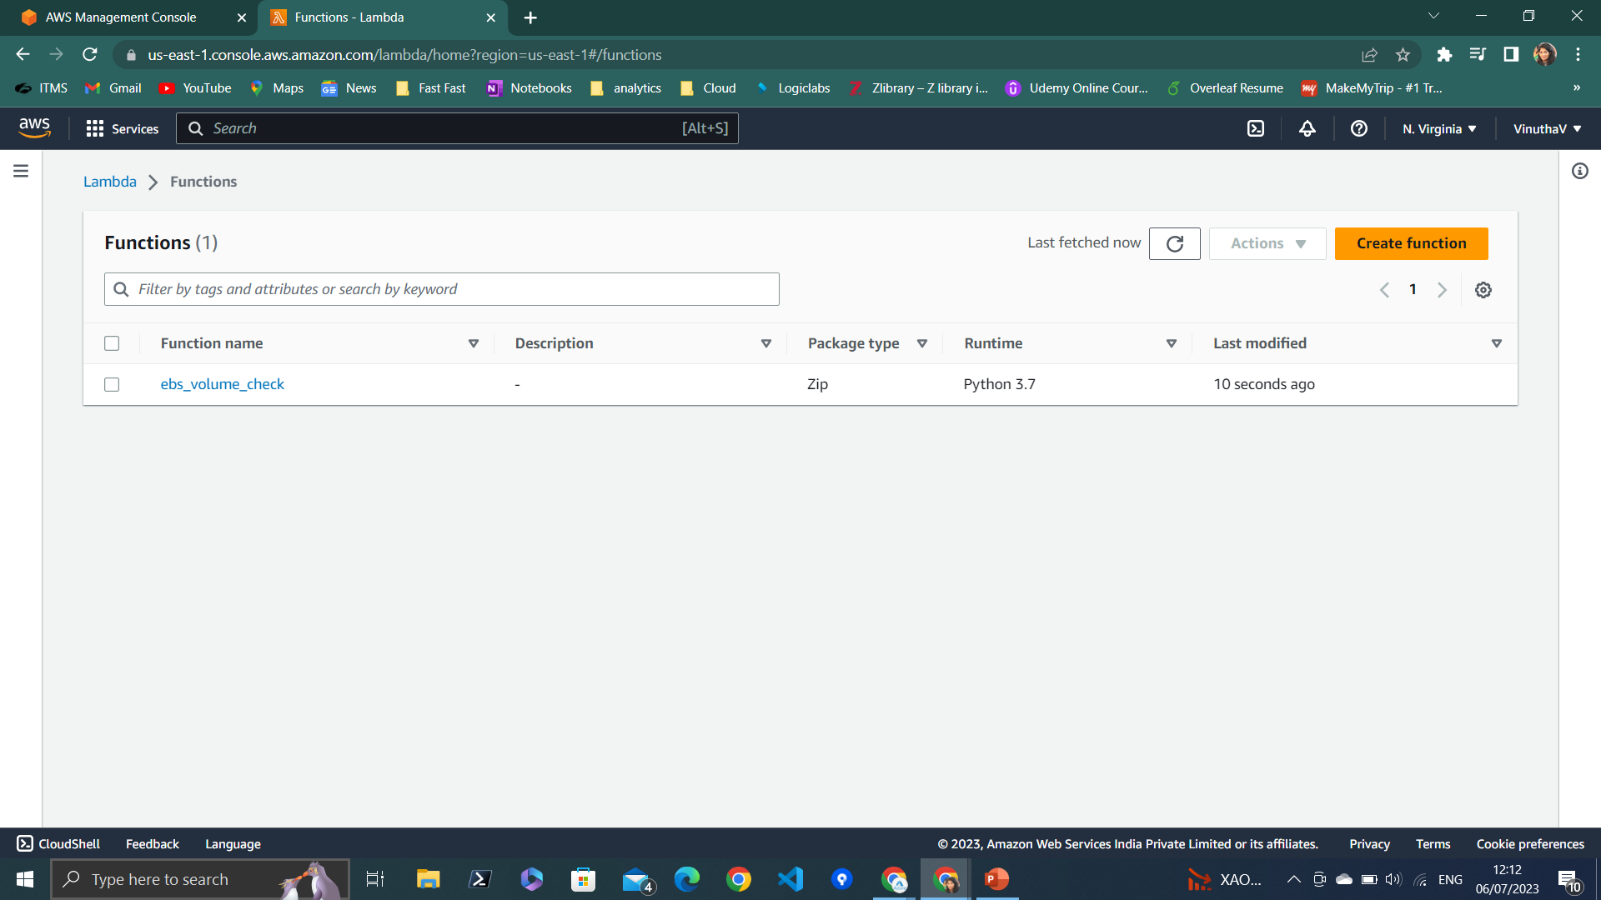
Create Basic Lambda Function

Slide 3
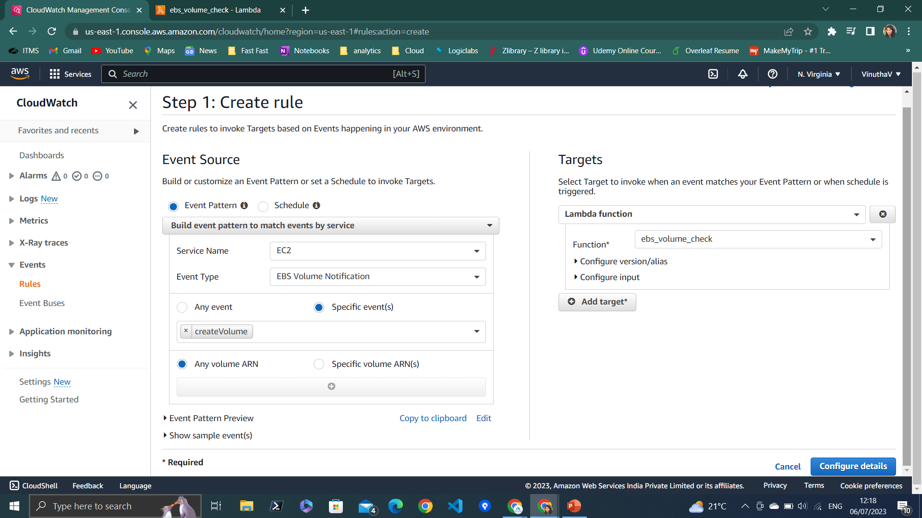
Create Cloudwatch event to trigger Lambda function.

Slide 4
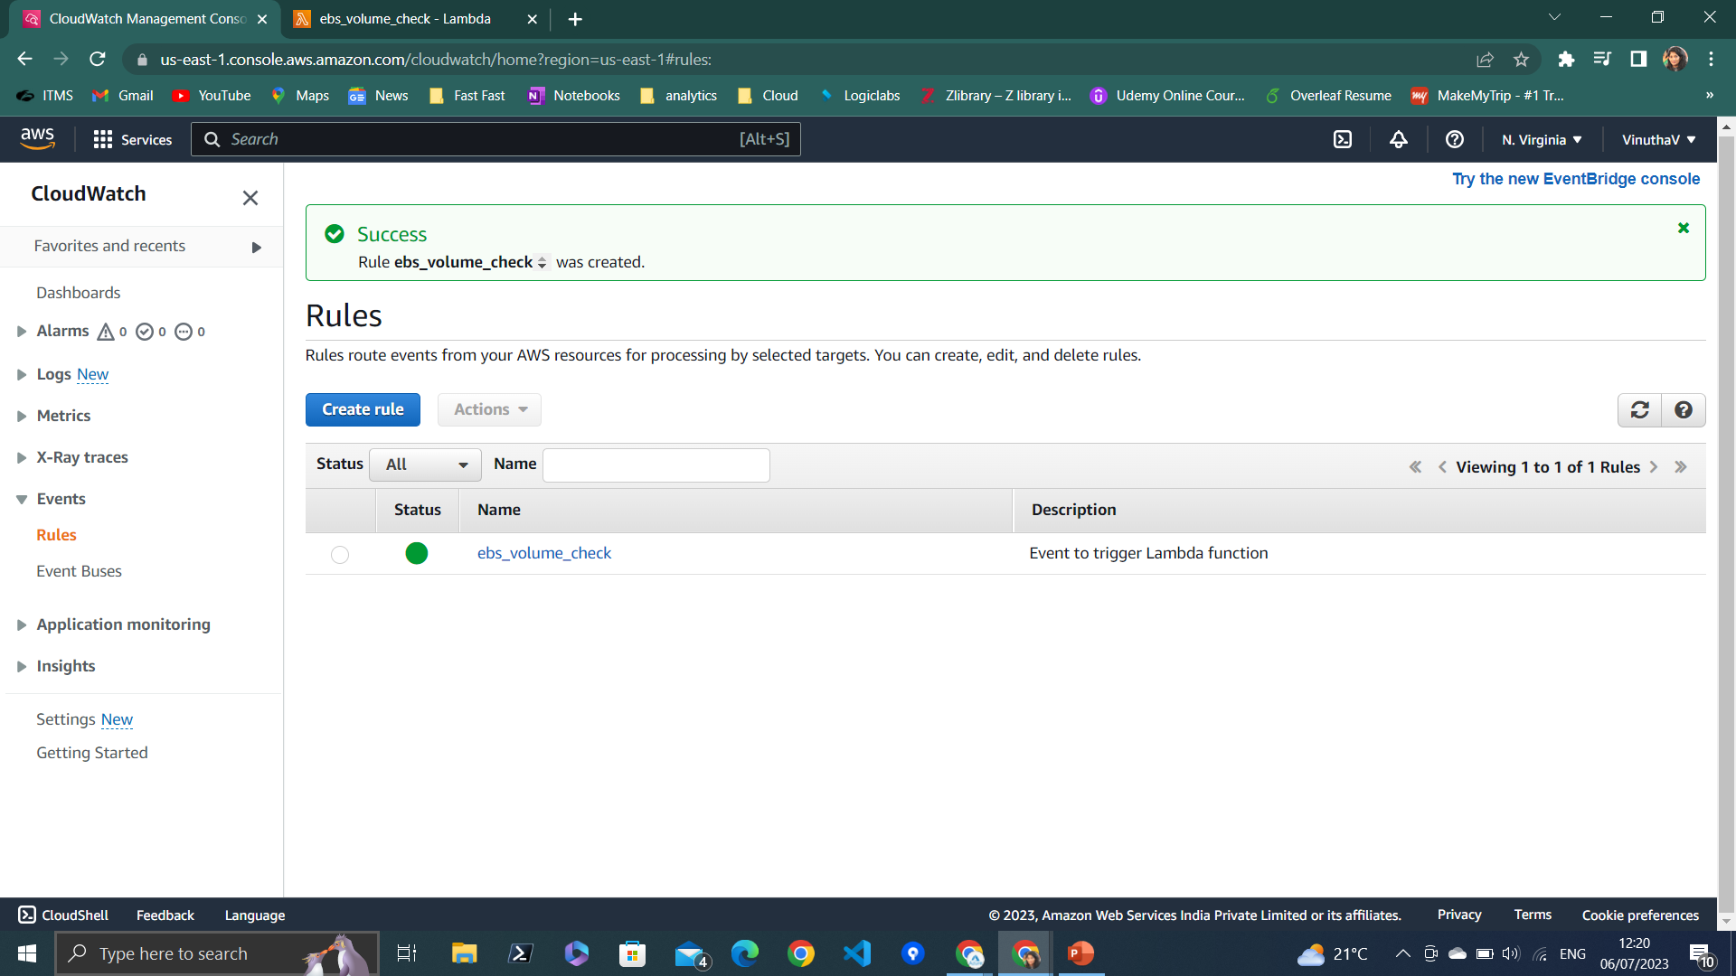
Cloudwatch event

Slide 5
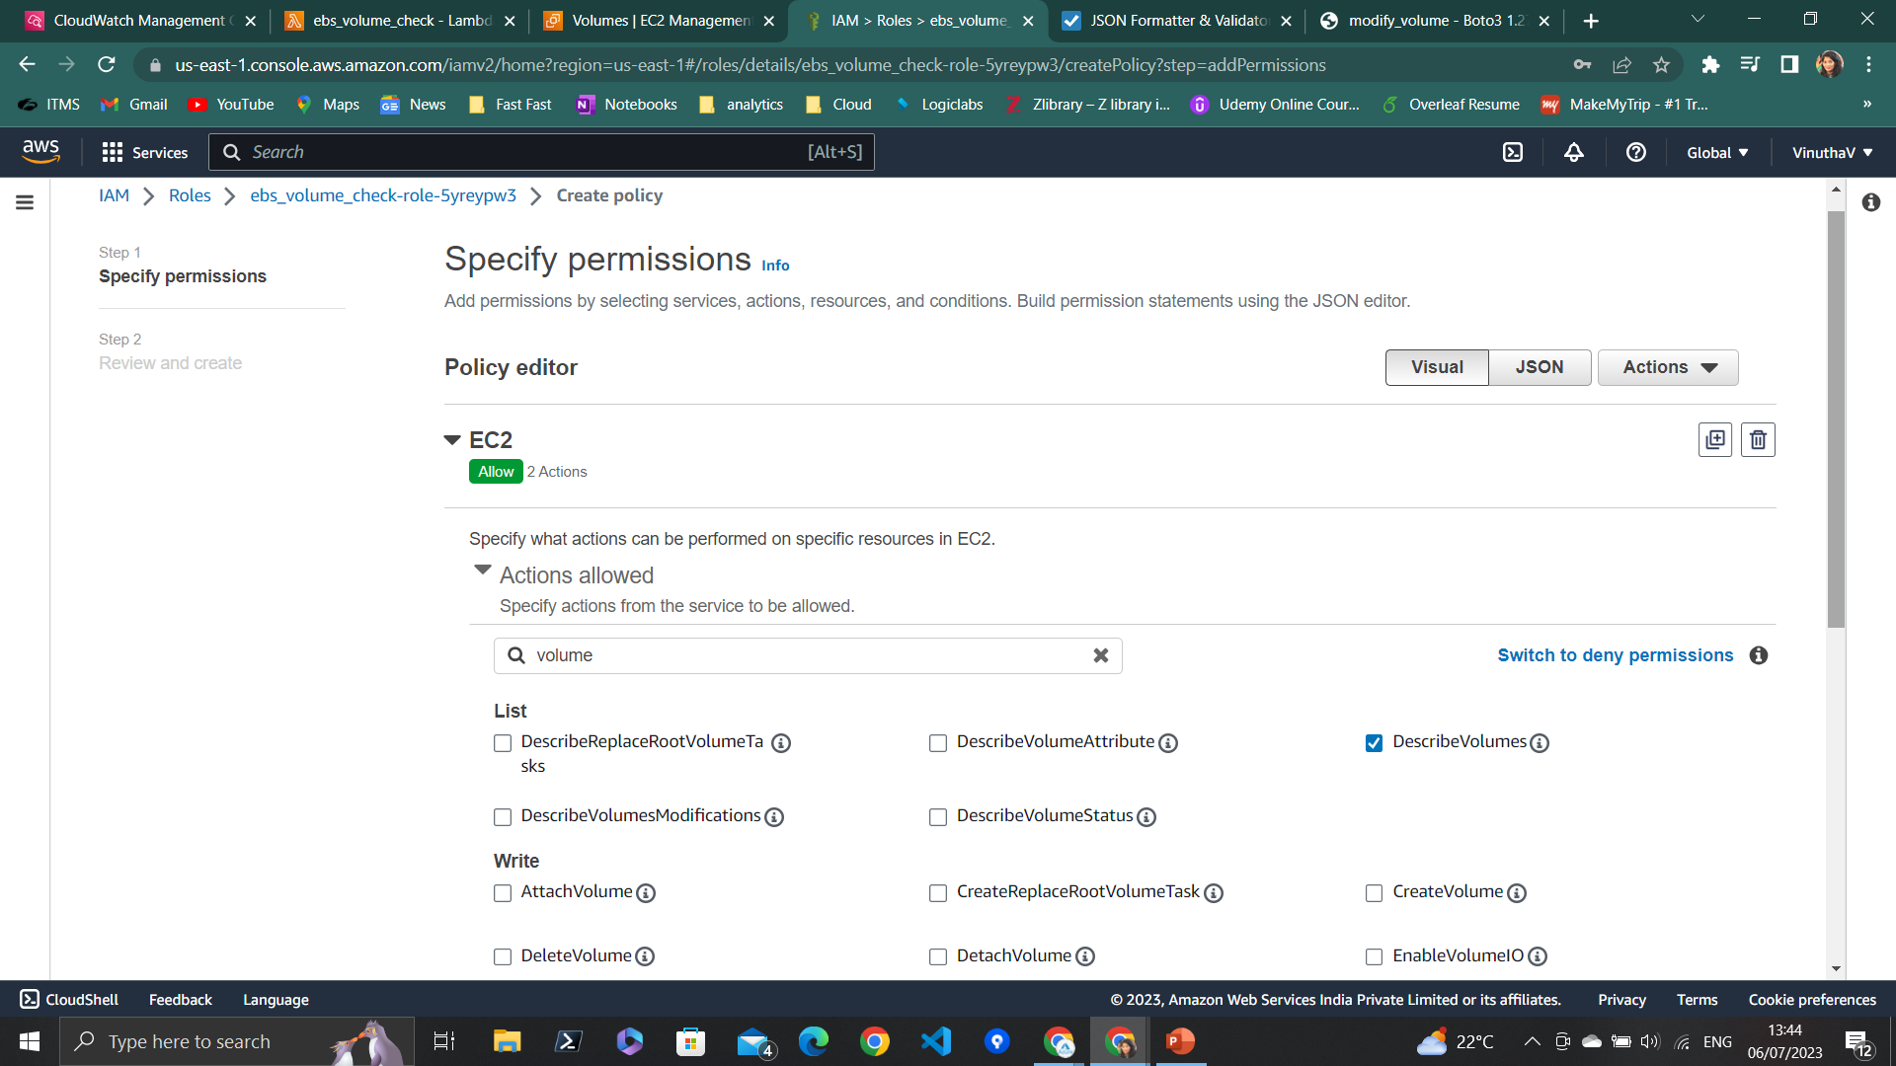
Add permissions to IAM policy (Describe volume , Modify volume)

Slide 6
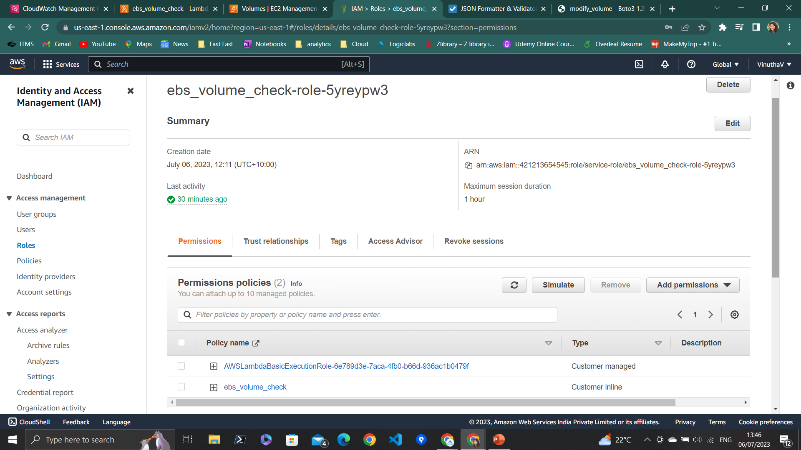
Modified Iam policy

Slide 7
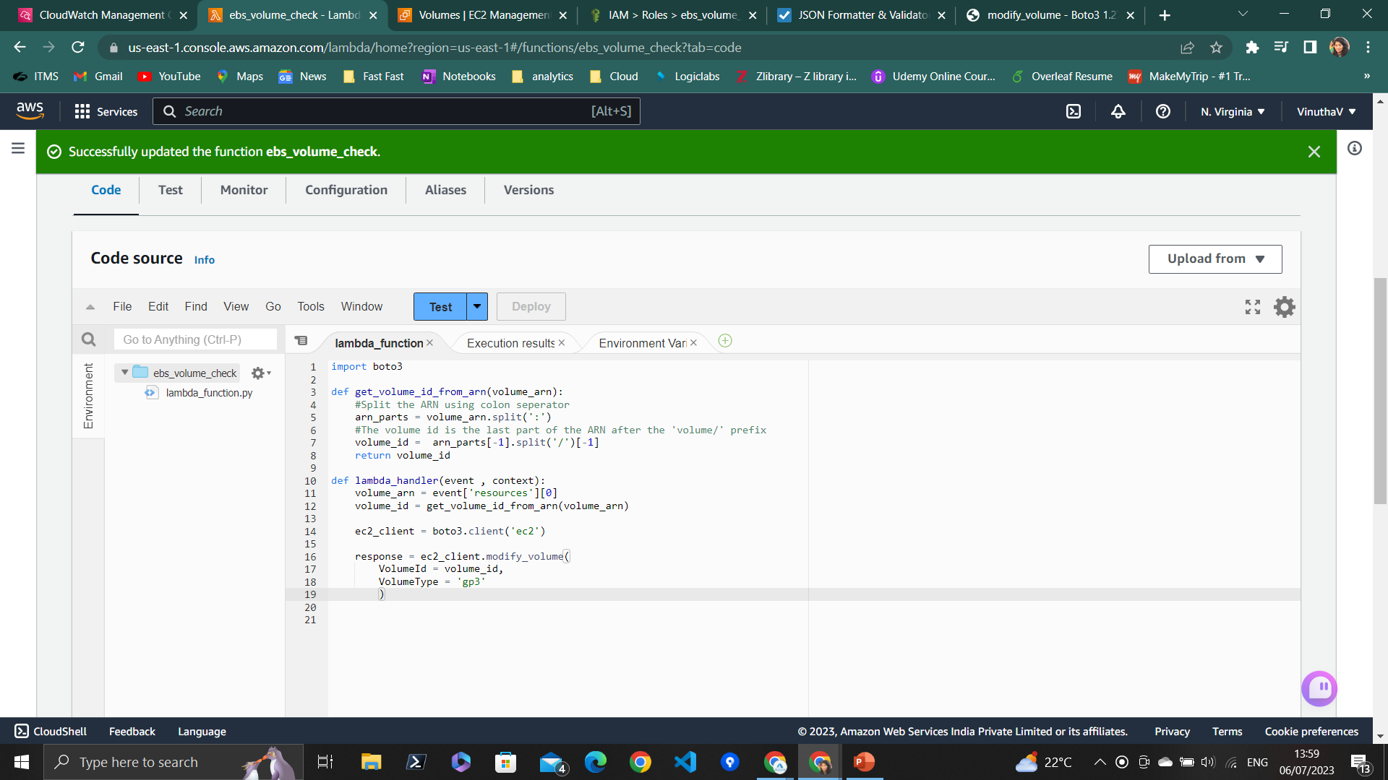
Final Lambda function to convert the gp2 volume to gp3 volume.
-----------------------------------------
import boto3
def get_volume_id_from_arn(volume_arn):
#Split the ARN using colon seperator
arn_parts = volume_arn.split(':')
#The volume id is the last part of the ARN after the 'volume/' prefix
volume_id = arn_parts[-1].split('/')[-1]
return volume_id
def lambda_handler(event , context):
volume_arn = event['resources'][0]
volume_id = get_volume_id_from_arn(volume_arn)
ec2_client = boto3.client('ec2')
response = ec2_client.modify_volume(
VolumeId = volume_id,
VolumeType = 'gp3'
)

Slide 8
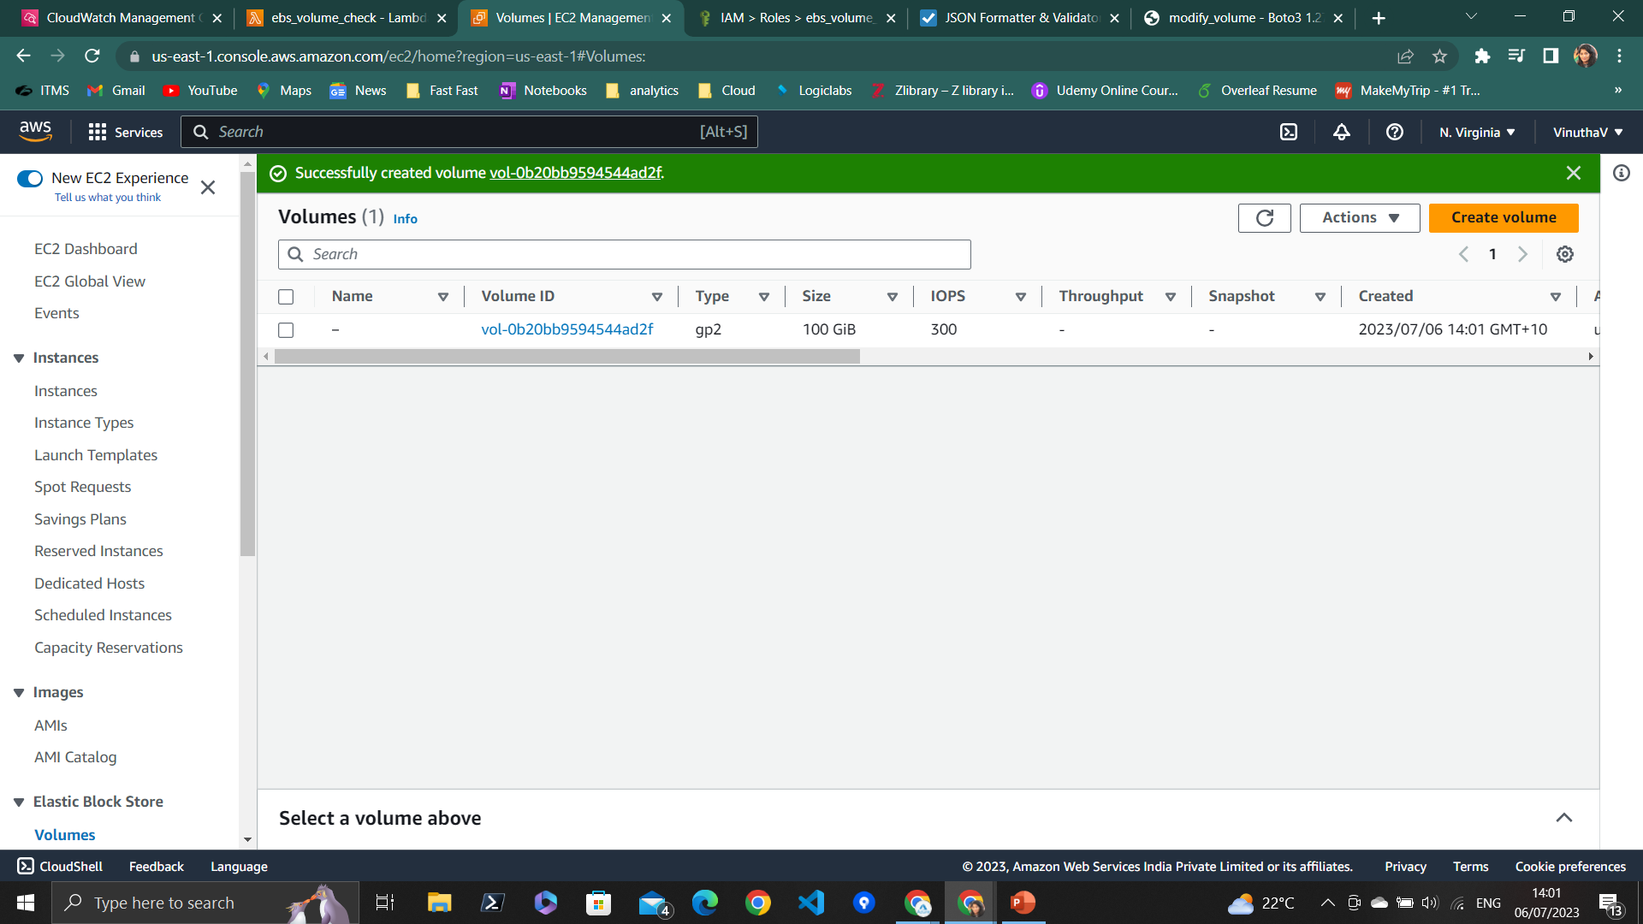
Created volume of type ‘gp2’.

Slide 9
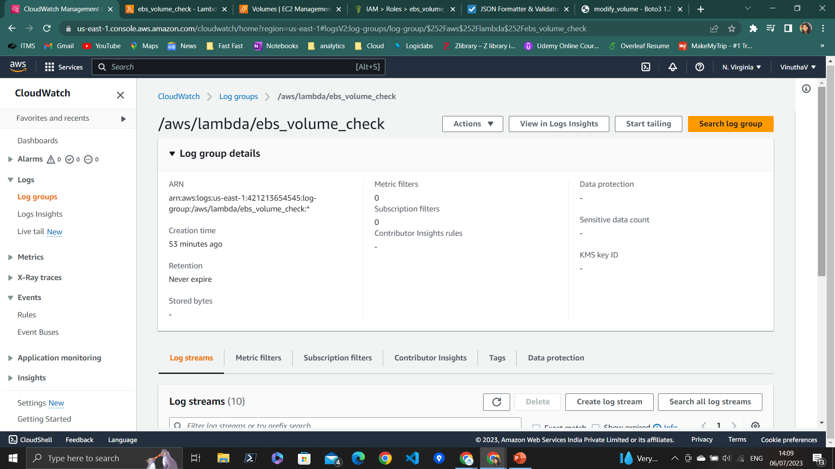
Cloudwatch successfully triggered Lambda to convert the volume of gp2 to gp3.

Slide 10
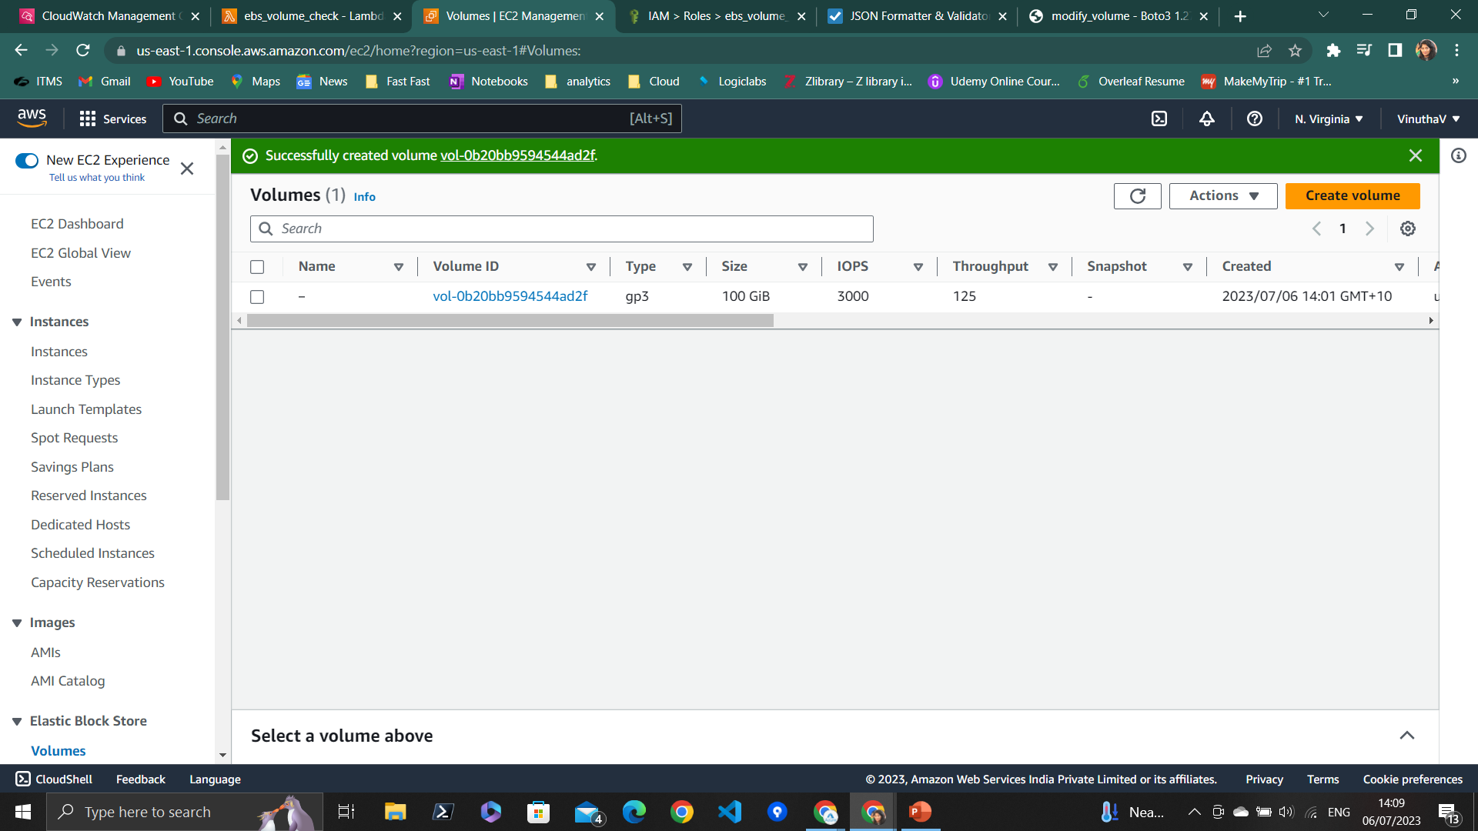
Volume got converted to gp3 successfully.

