Slide 1
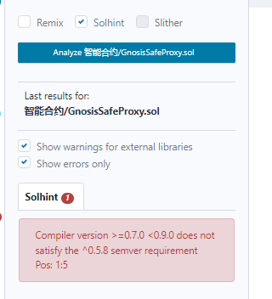
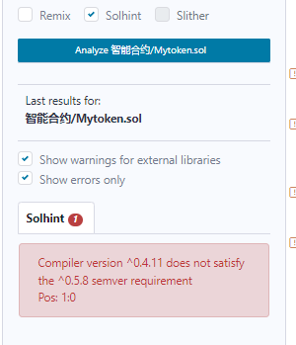
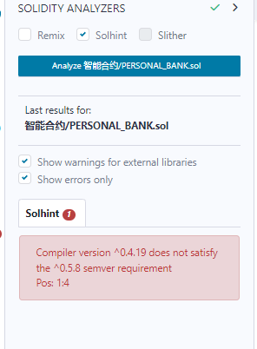
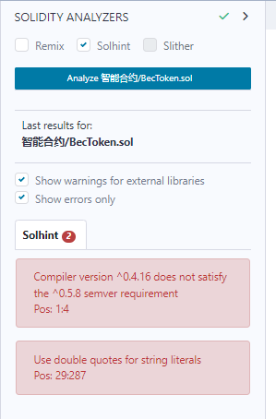
solhint

Slide 2
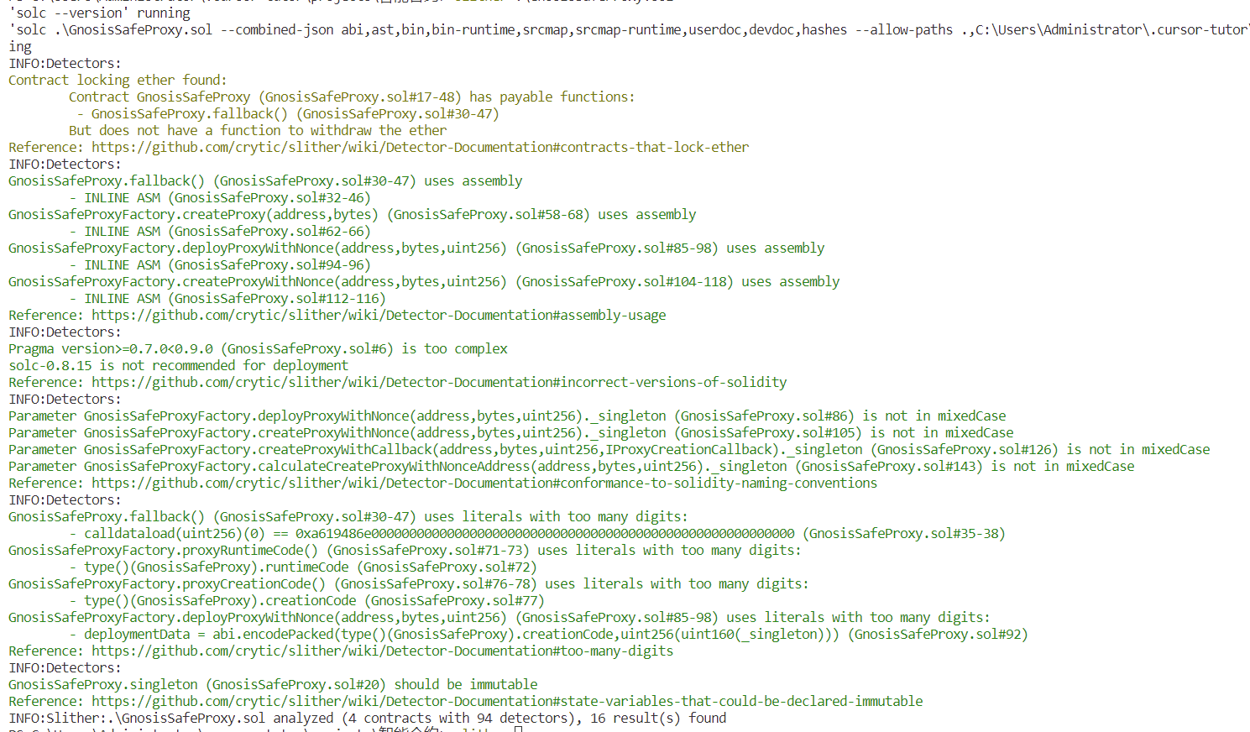
slither

Slide 3
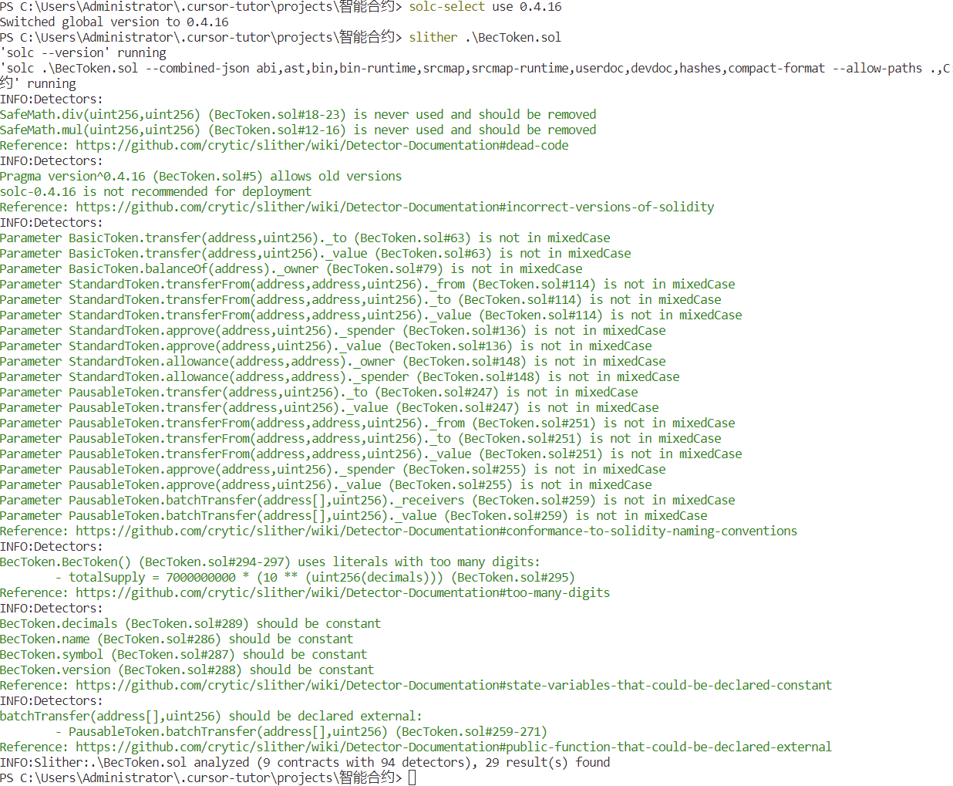
slither

Slide 4
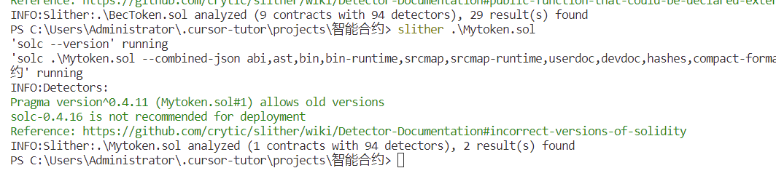
slither

Slide 5
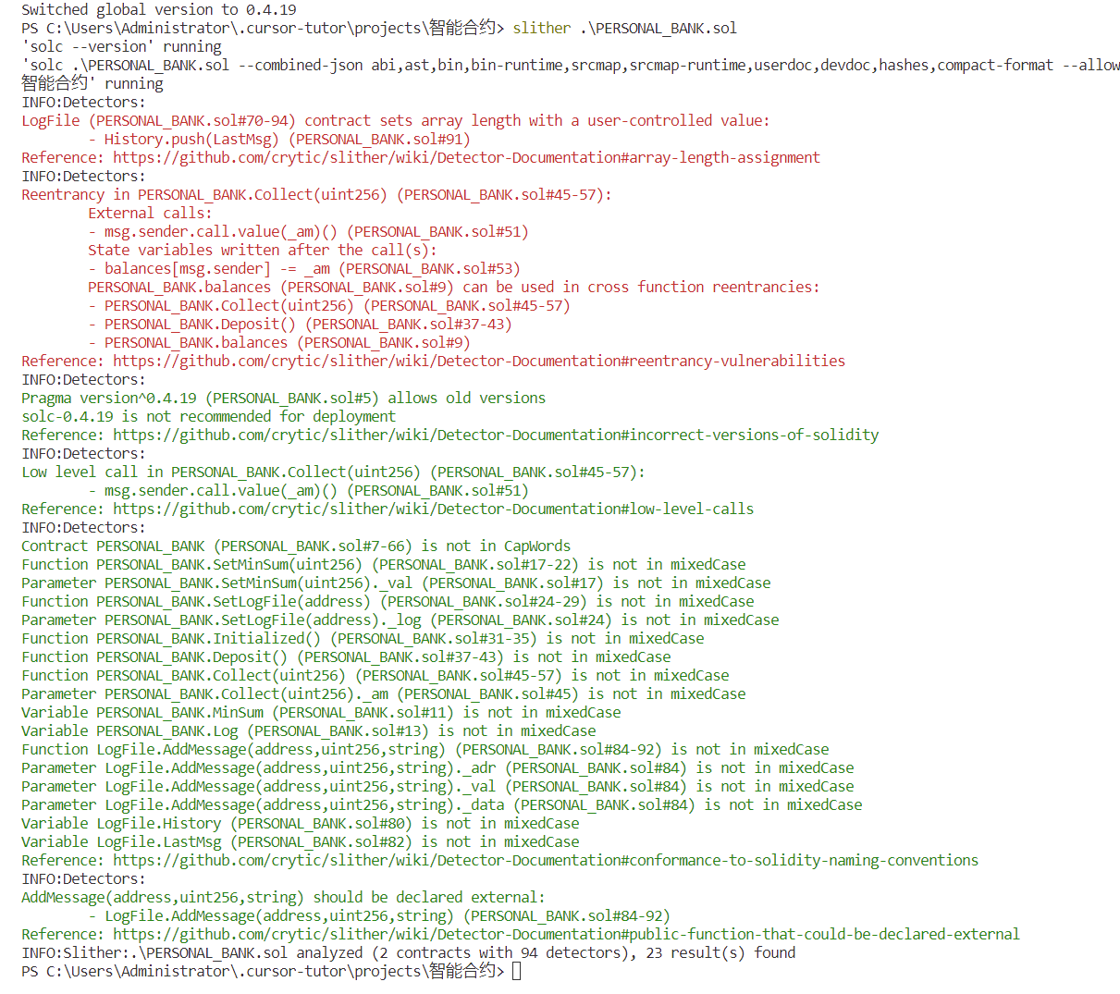
slither

Slide 6
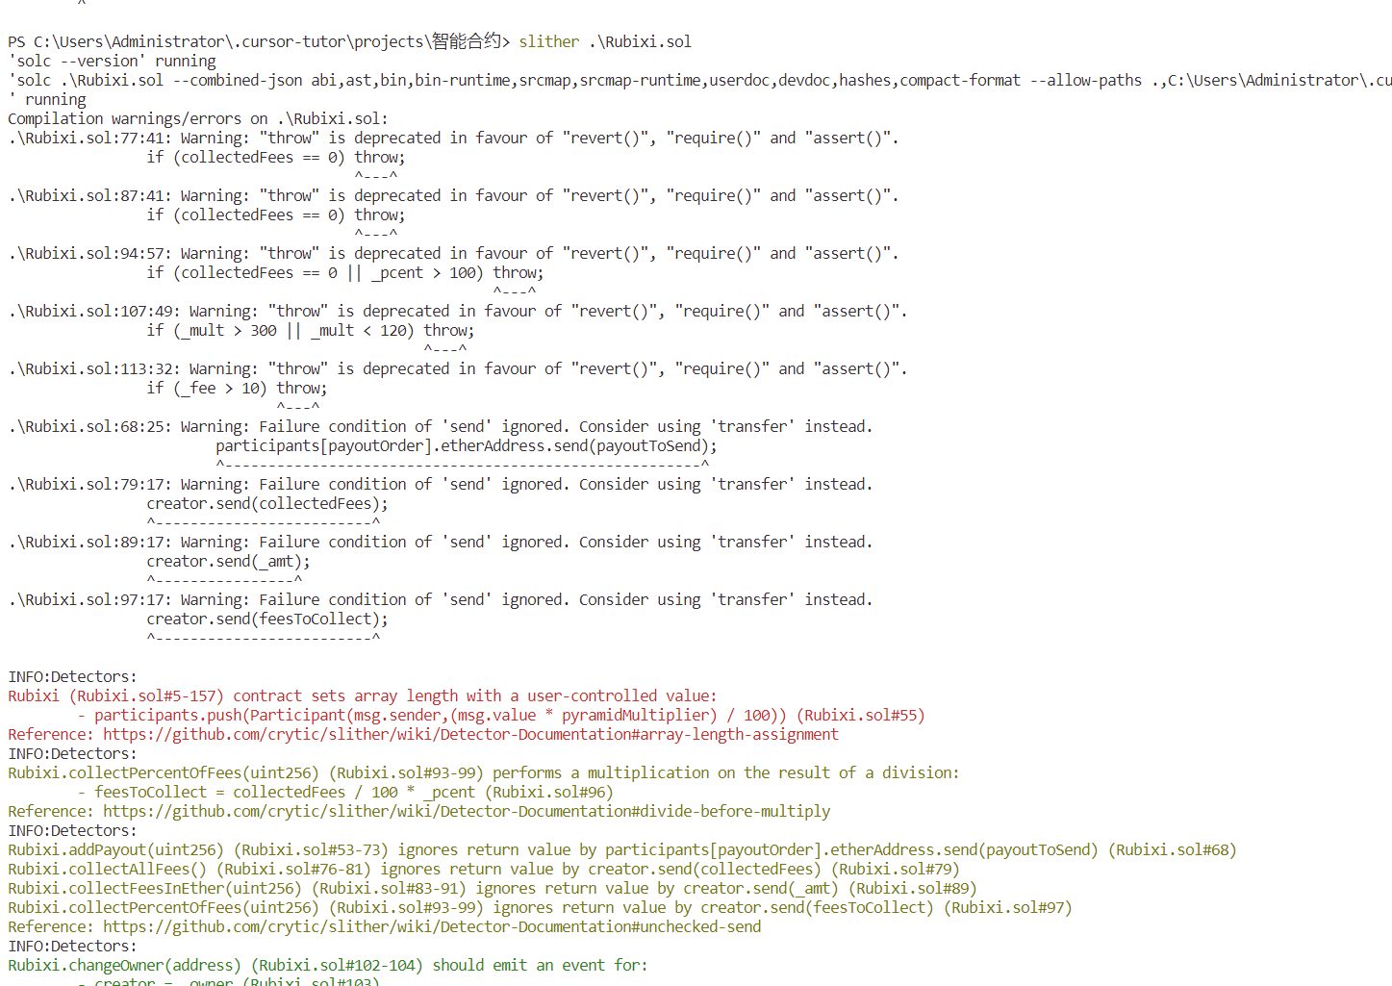
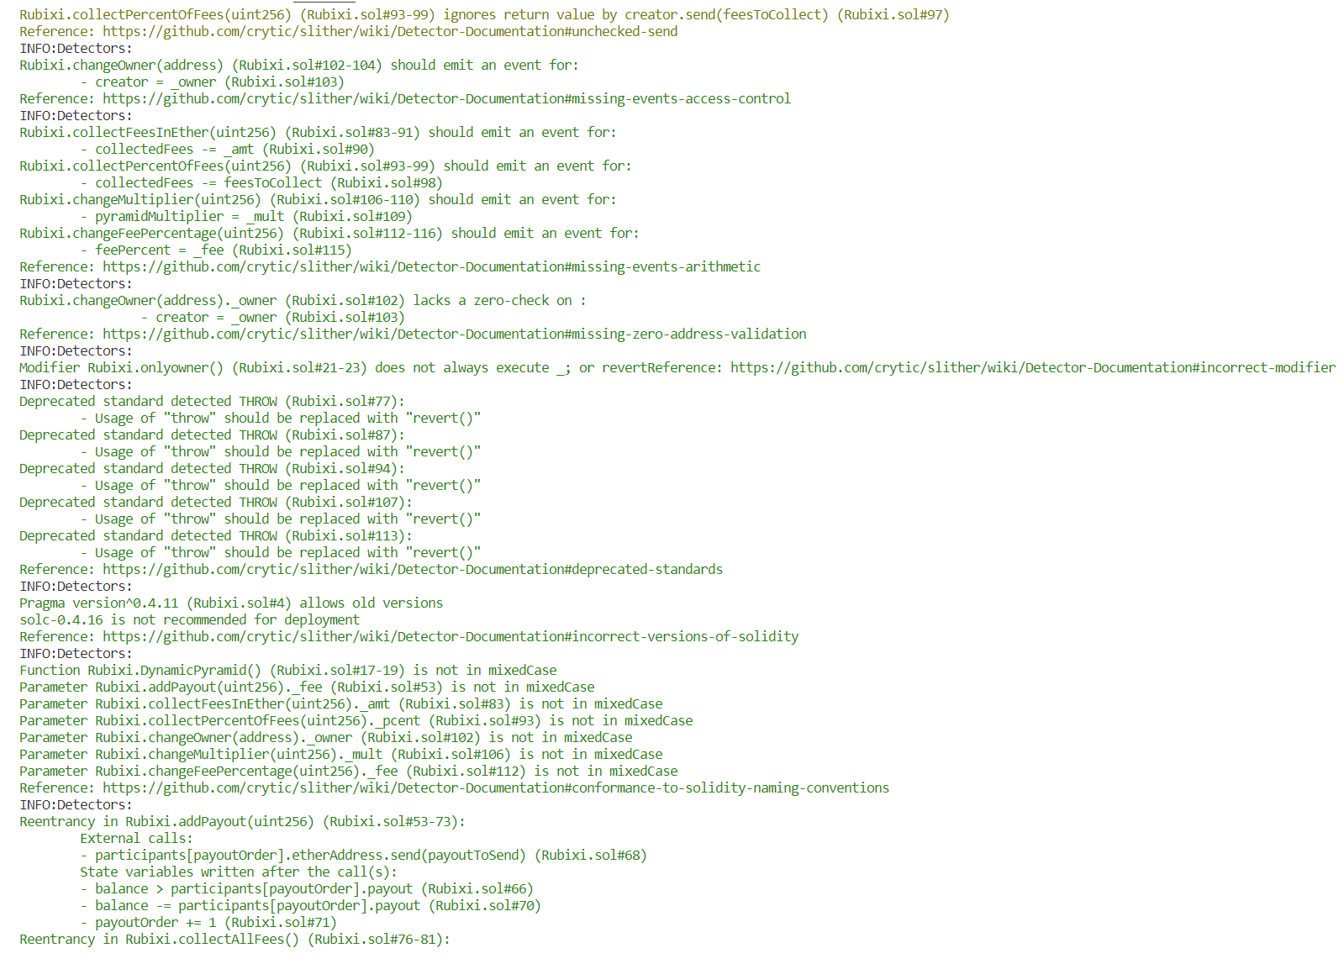
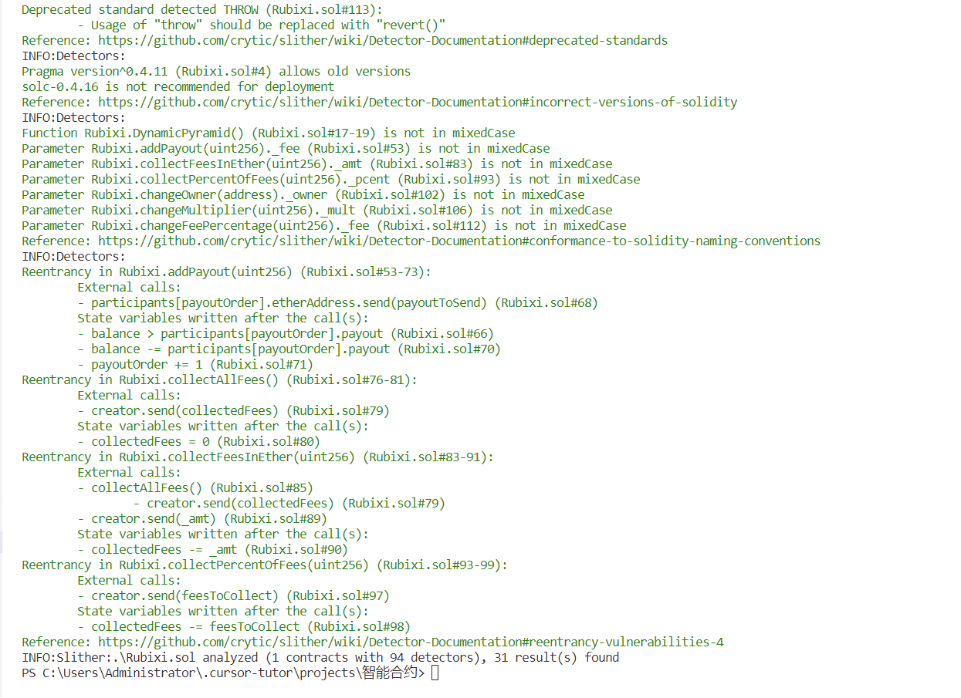

Slide 7
 | METBSF | 面向漏洞 | slither | solhint
MyToken | 2 | 0 | 1 | 1
Rubixi | 2 | 1 | 2 | 0
BecToken | 2 | 1 | 1 | 2
GnosisSafeProxy | 1 | 0 | 0 | 1
PERSONAL_BANK | 1 | 1 | 2 | 1

Slide 9
MyToken | short_address
Rubixi | acess control:23,24
BecToken | arithmetic:264
GnosisSafeProxy | 无
PERSONAL_BANK | reentrancy:54

