Slide 1
Welcome @
Notes:
4/20/16

Slide 2


Thursday 21 April
Visitors
Harry Verbunt – HPE
Sebastiaan Alves – HPE
Hylke Kingma – VsapGZ
Rens Gielleit – VsapGZ
Rob van Mechelen - NVVC
Notes:
4/20/16

Slide 3
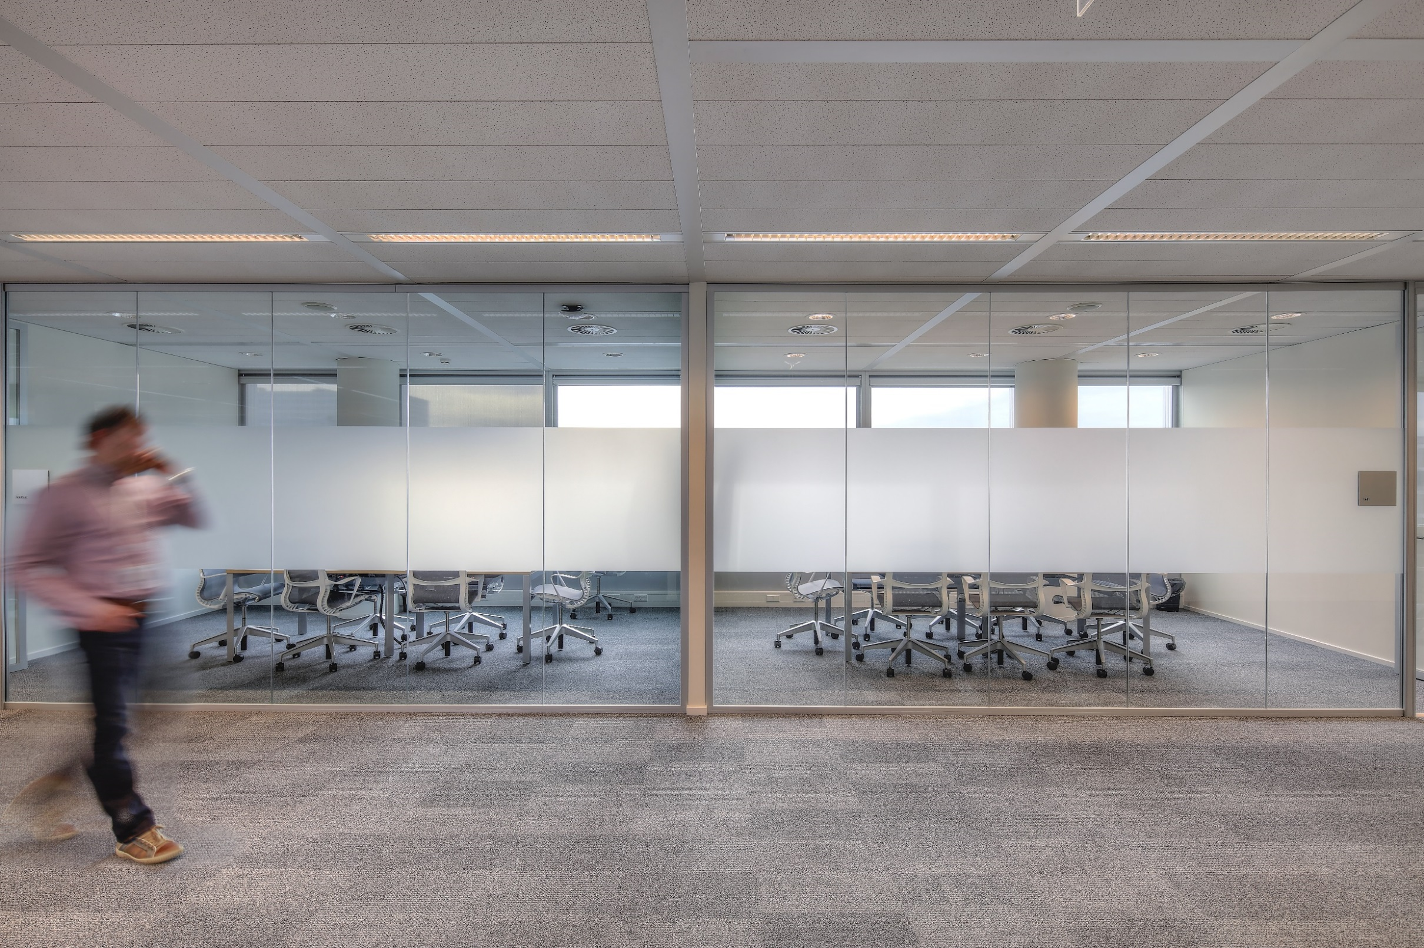

Thursday 21 April
News
New Notice board
UZA demo
Notes:
4/20/16

Slide 4
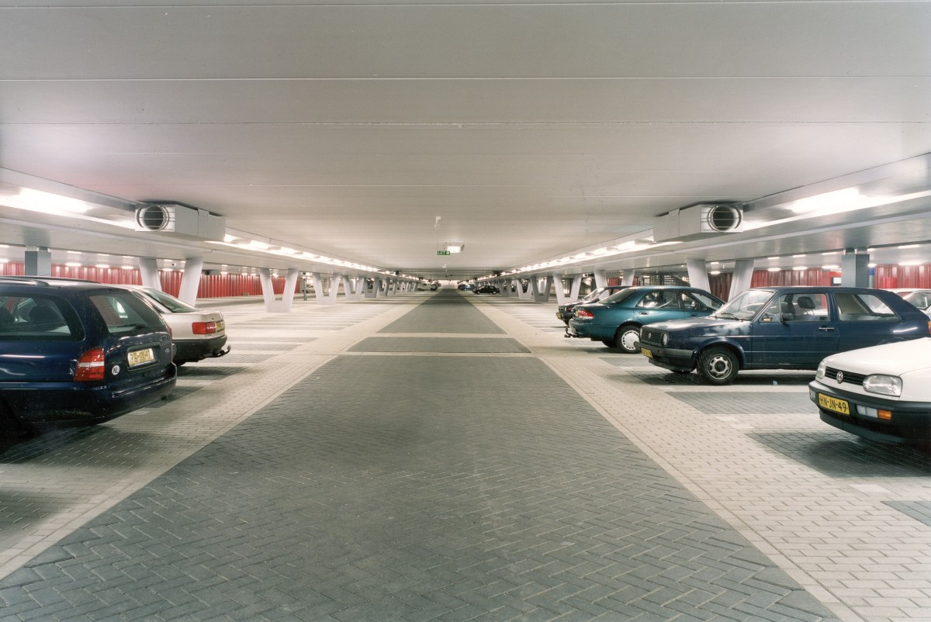

Thursday 21 April Parking
-2/72
Serge de Ruiter
-2/73
Vincent van Beek
-2/74
Ruud Bongers
buiten
Jelle Kooij
-2/75
Jacoline Demkes
buiten
Karin Bissels
-2/76
Chantal Kempers
buiten
HPE
-3/107
Ronald Hoogland
buiten
VsapGZ
-3/108
Tessa Malipaard
buiten
NVVC
Notes:
4/20/16

Slide 5
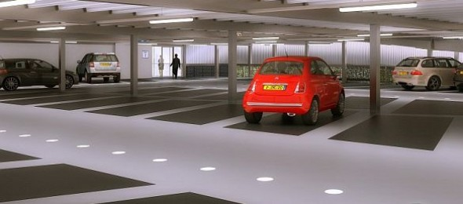
Friday 22 April Parking
-2/72
Jeroen Pol
-2/73
Serge de Ruiter
-2/74
buiten
-2/75
Jacoline Demkes
buiten
-2/76
Ruud Bongers
buiten
-3/107
Chantal Kempers
buiten
-3/108
Richard Francken
buiten
Notes:
4/20/16

Slide 6
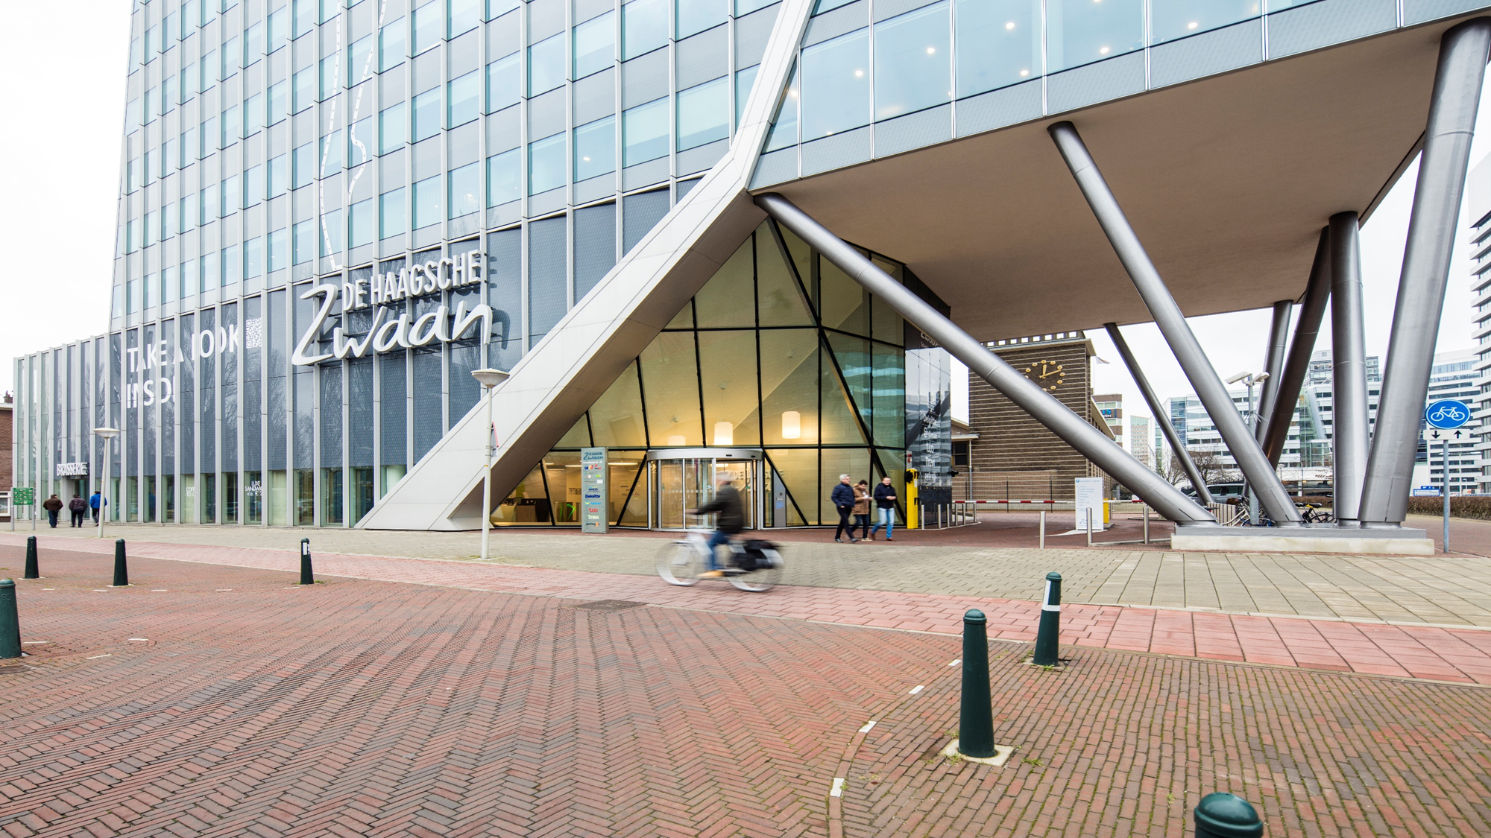
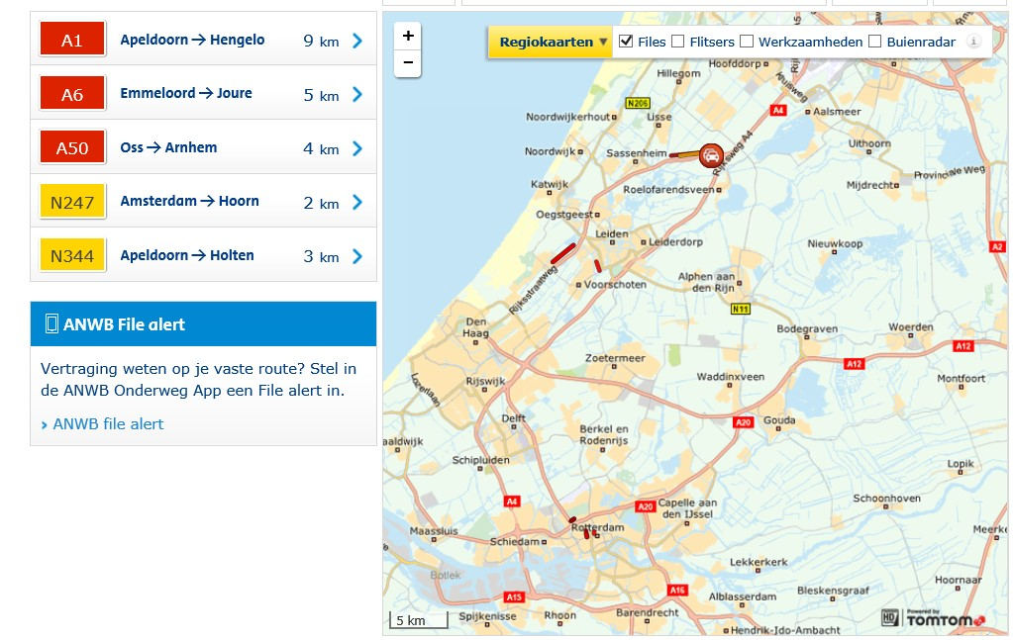

Work in Progress....
Traffic
Notes:
4/20/16

Slide 7
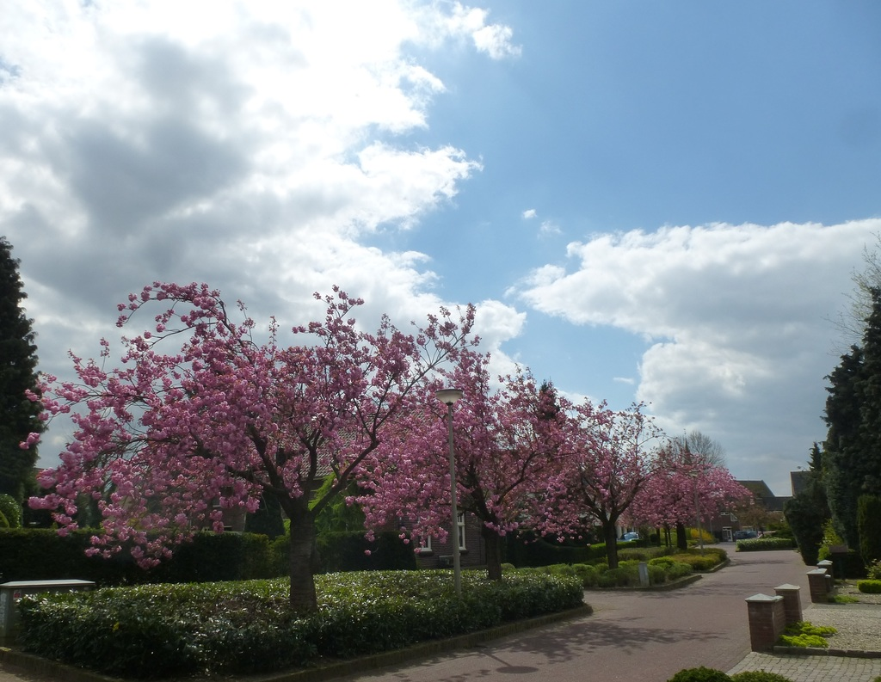
Weather
Notes:
4/20/16

Slide 8

Rain
Notes:
4/20/16

