Slide 1
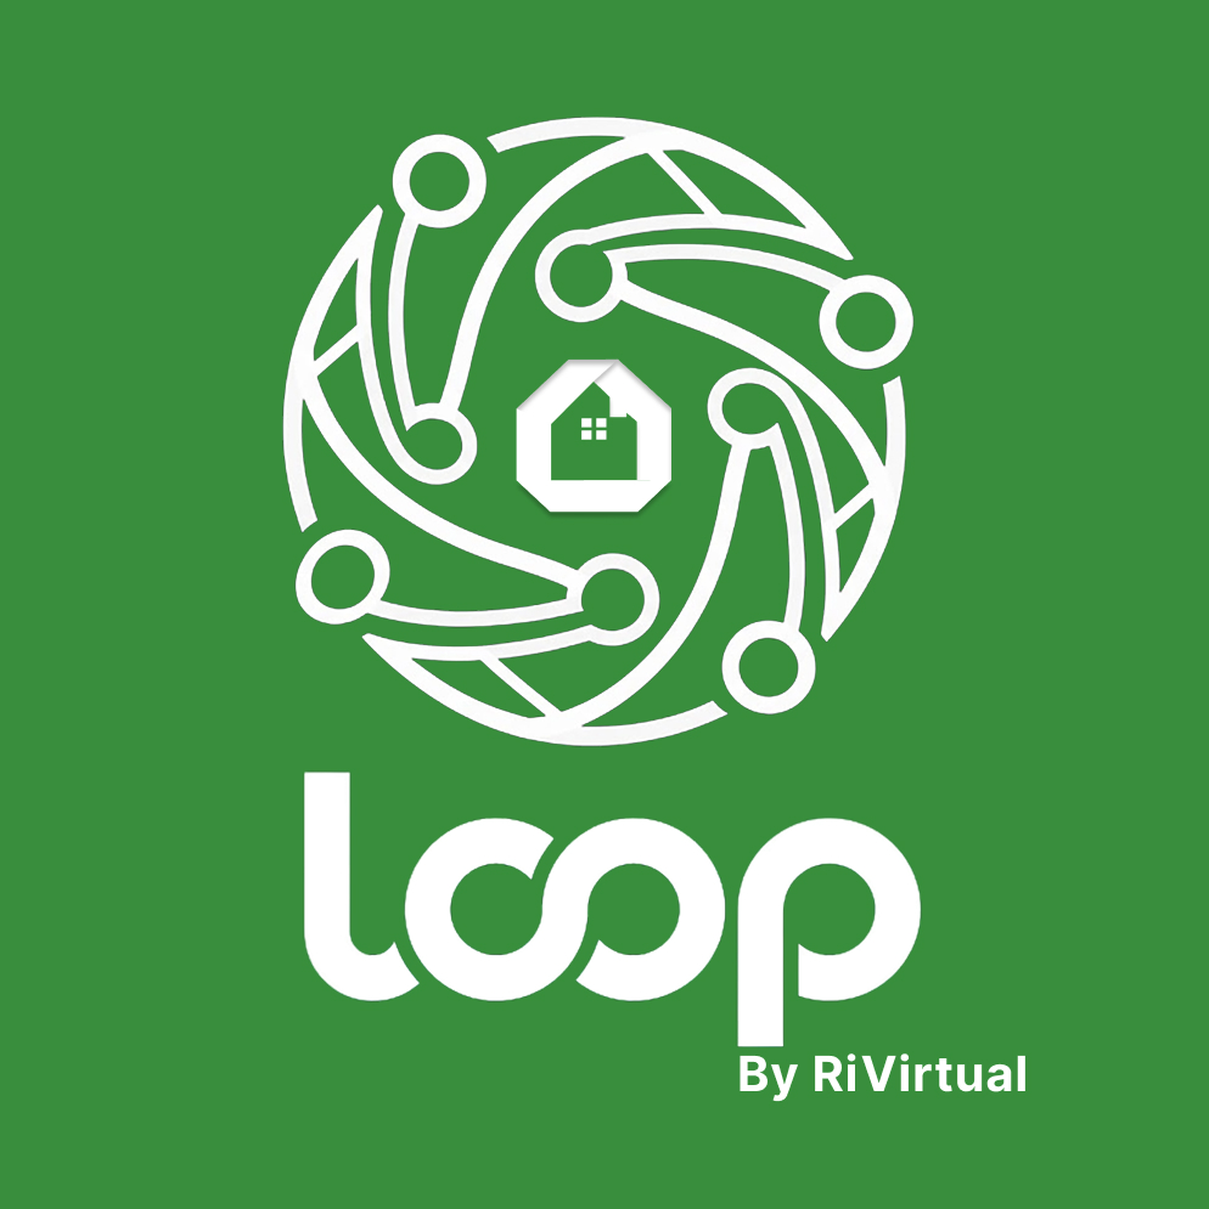
Loop Community Application
for the Connected Age
From fragmented WhatsApp villages to a thriving digital community — smart society management powered by RiVirtual.
1.5 months | 34+ screens | 6 disciplines
Product Architect · UX Strategist · UI Designer · PRD Author

Slide 2
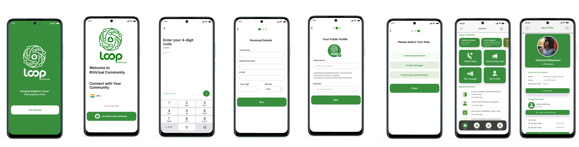
Executive Summary
The Vision: A Community That Knows You're Home
Gated societies weren't broken because people didn't care — the tools didn't match the stakes. Loop Community unifies security, presence, and community life into one coherent mobile experience.
"Security should feel invisible. Community should feel alive."
Hi-Fi screens — Onboarding & Login flow
Digital Visitor Passes
Geofencing Presence
QR + NFC validation
Ambient home detection
NFC Access Control
Community Hub
Tap-to-enter at gates
Events, polls, classifieds
Role Dashboards
Resident · Admin · Security
Loop Community | Powered by RiVirtual | PropTech Case Study
2

Slide 3
The Challenge
Beautiful Walls, Broken Systems
BEFORE
AFTER — LOOP
WhatsApp Chaos — 47 unread msgs, approvals buried in memes
Digital passes — 30-second visitor approval
Paper Logbooks — illegible, unsearchable, zero audit trail
Cryptographic QR/NFC validation at gate
Manual Visitors — phone tag with guards, guests in the sun
100% digital, timestamped audit trail
No Presence — society blind to who's in, out, expecting
Ambient geofence presence detection
Scattered Community — notice boards no one reads
Unified Community Hub with push alerts
"I already approved him on WhatsApp!"
Fragmented villages → Thriving digital community
Loop Community | Powered by RiVirtual | PropTech Case Study
3

Slide 4
My Role & Approach
One Designer, Three Worlds, Zero Room for Guesswork
Product Architect
UX Strategist
Information Architect
System map: geofencing, NFC, visitor flows, hub
Jobs-to-be-done across 3 user types
Role-based IA, navigation, hierarchy
Product Designer
UI Designer
PRD Author
End-to-end flows, wireframes, interactions
Visual language, 34+ hi-fi screens
Specs, acceptance criteria, edge cases
Approach: Design as Infrastructure — map the ecosystem, design for the gate moment, build trust through transparency, ship a PRD not just pixels.
Loop Community | Powered by RiVirtual | PropTech Case Study
4

Slide 5
Research & Insights
Listening at the Gate, Not Just in the Boardroom
Research Methods
1
The Gate Is a Stage
3-second, one-handed guard interactions
Stakeholder interviews with admins & facility managers
Contextual inquiry with security at peak hours
2
Control, Not Complexity
Approve Rajesh in two taps
Resident journey mapping (visitor, delivery, entry)
3
Accidental Technologists
Competitive audit of society management apps
Dashboards surface what matters
Workflow shadowing of logbook + WhatsApp approvals
Community = Trust
4
Fragmented UX feels untrustworthy
5
Silent Presence
Geofencing magic only works when invisible
Key Insight: "Users don't want three apps — they want one community that adapts to who they are."
Loop Community | Powered by RiVirtual | PropTech Case Study
5

Slide 6
Key Design Decisions
Where Creativity Met Constraint
Role-Based Dashboards
Visitor Pass as Living Object
Silent Geofencing
One app, three lenses — Resident, Admin, Security
Boarding pass meets event ticket — QR + NFC
Soft green aura — protective, not surveillance
NFC Tap Signature
Community Hub = Living Room
Green Trust Palette
Ripple animation in trust green on access
Card feed with content-type color coding
Safety psychology — green=go, red=alert only
Loop Community | Powered by RiVirtual | PropTech Case Study
6

Slide 7
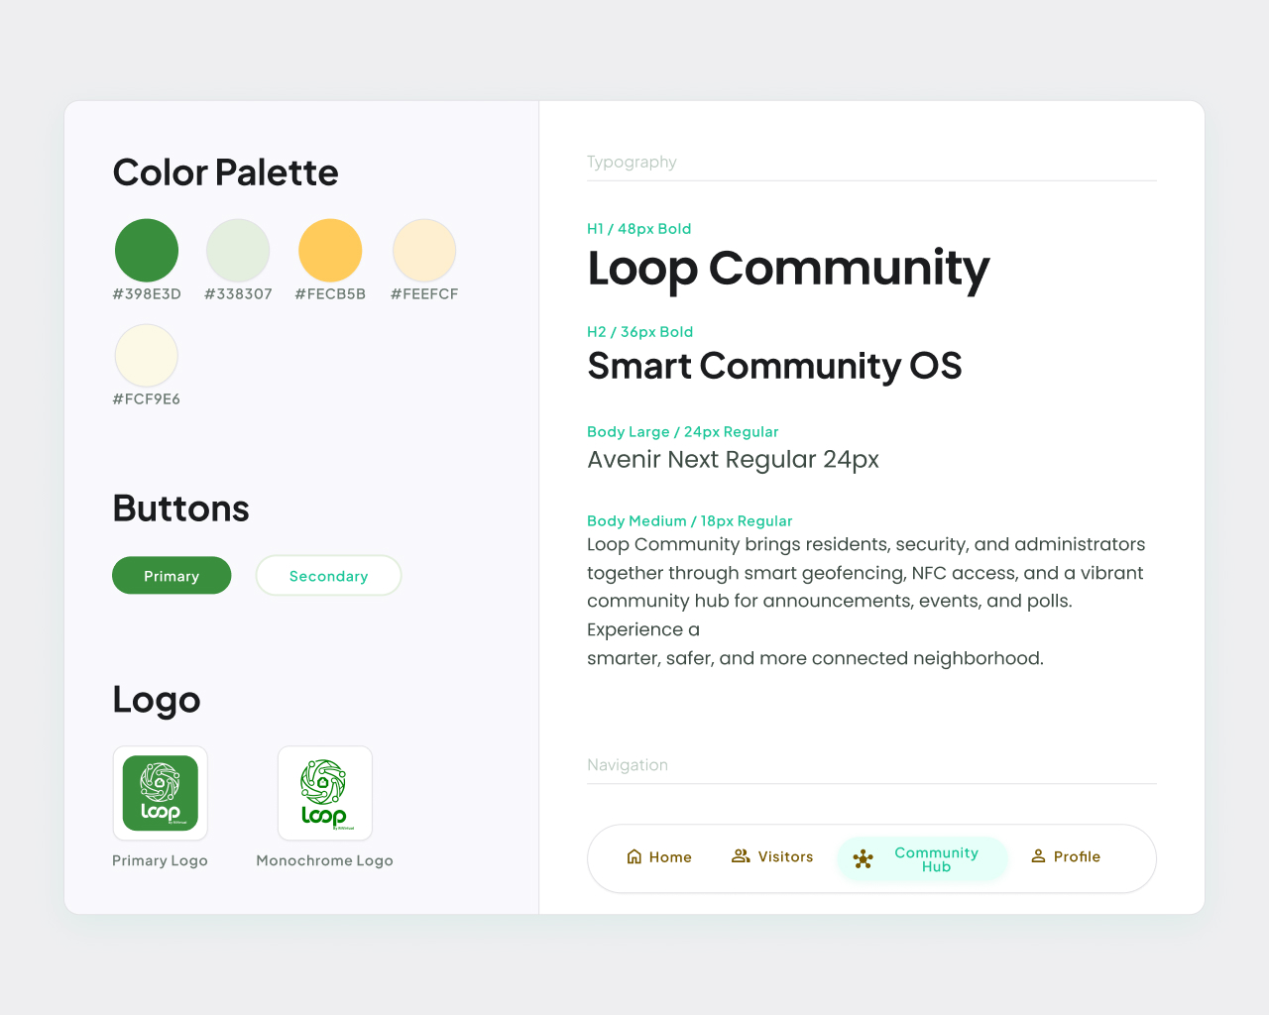
Design System
Building a Cohesive Visual Language
Before high-fidelity screens, I established a design system to ensure consistency across 34+ screens — color tokens, typography, components, and navigation patterns.
Primary palette: Forest green, mint, gold accent
Typography: Avenir Next hierarchy (H1–Body)
Components: Primary/Secondary buttons, nav bar
Logo variants: Primary & monochrome lockups
Loop Application Design System
Loop Community | Powered by RiVirtual | PropTech Case Study
7

Slide 8
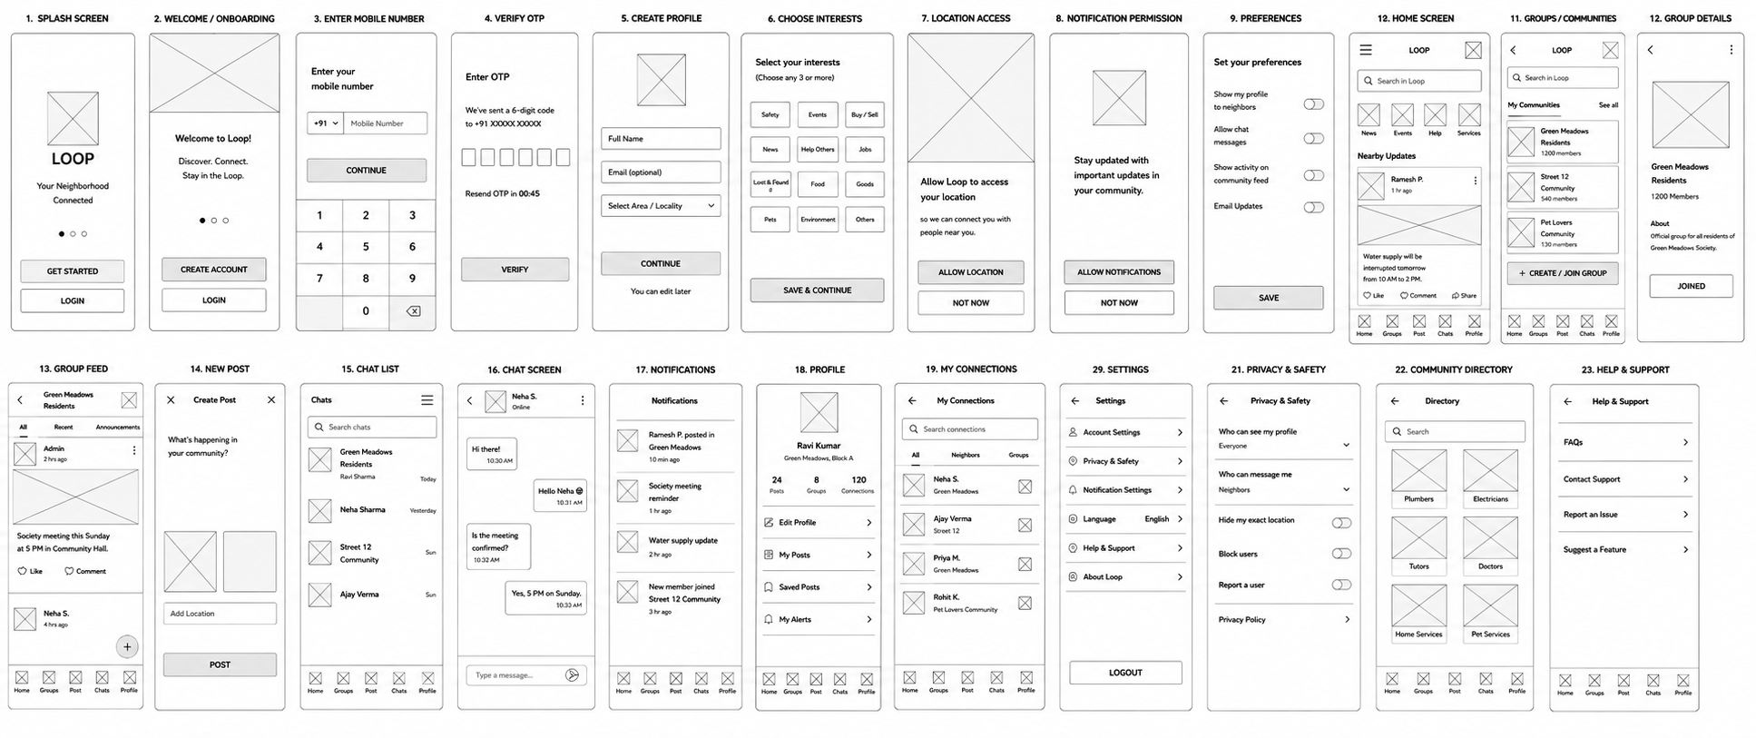
Low Fidelity Wireframes
Structuring the Experience — 23 Core Screens
Low-fidelity wireframes mapped the complete user journey: onboarding, home, groups, chat, notifications, profile, settings, and community directory — validating IA before visual design.
Wireframe flows: Splash → Onboarding → Home → Groups → Chat → Profile → Settings → Community Directory
Low-fidelity wireframe screens — full app inventory
Loop Community | Powered by RiVirtual | PropTech Case Study
8

Slide 9
From Wireframe to Pixel
The Design Evolution — Lo-Fi → Hi-Fi
Low Fidelity
High Fidelity
→
Each wireframe screen was translated into polished hi-fi UI with the Loop design system — maintaining flow logic while elevating visual trust and usability.
Process: Wireframe → Design System → Hi-Fi Mockups → PRD Handoff | 34+ screens in 1.5 months
Loop Community | Powered by RiVirtual | PropTech Case Study
9

Slide 10
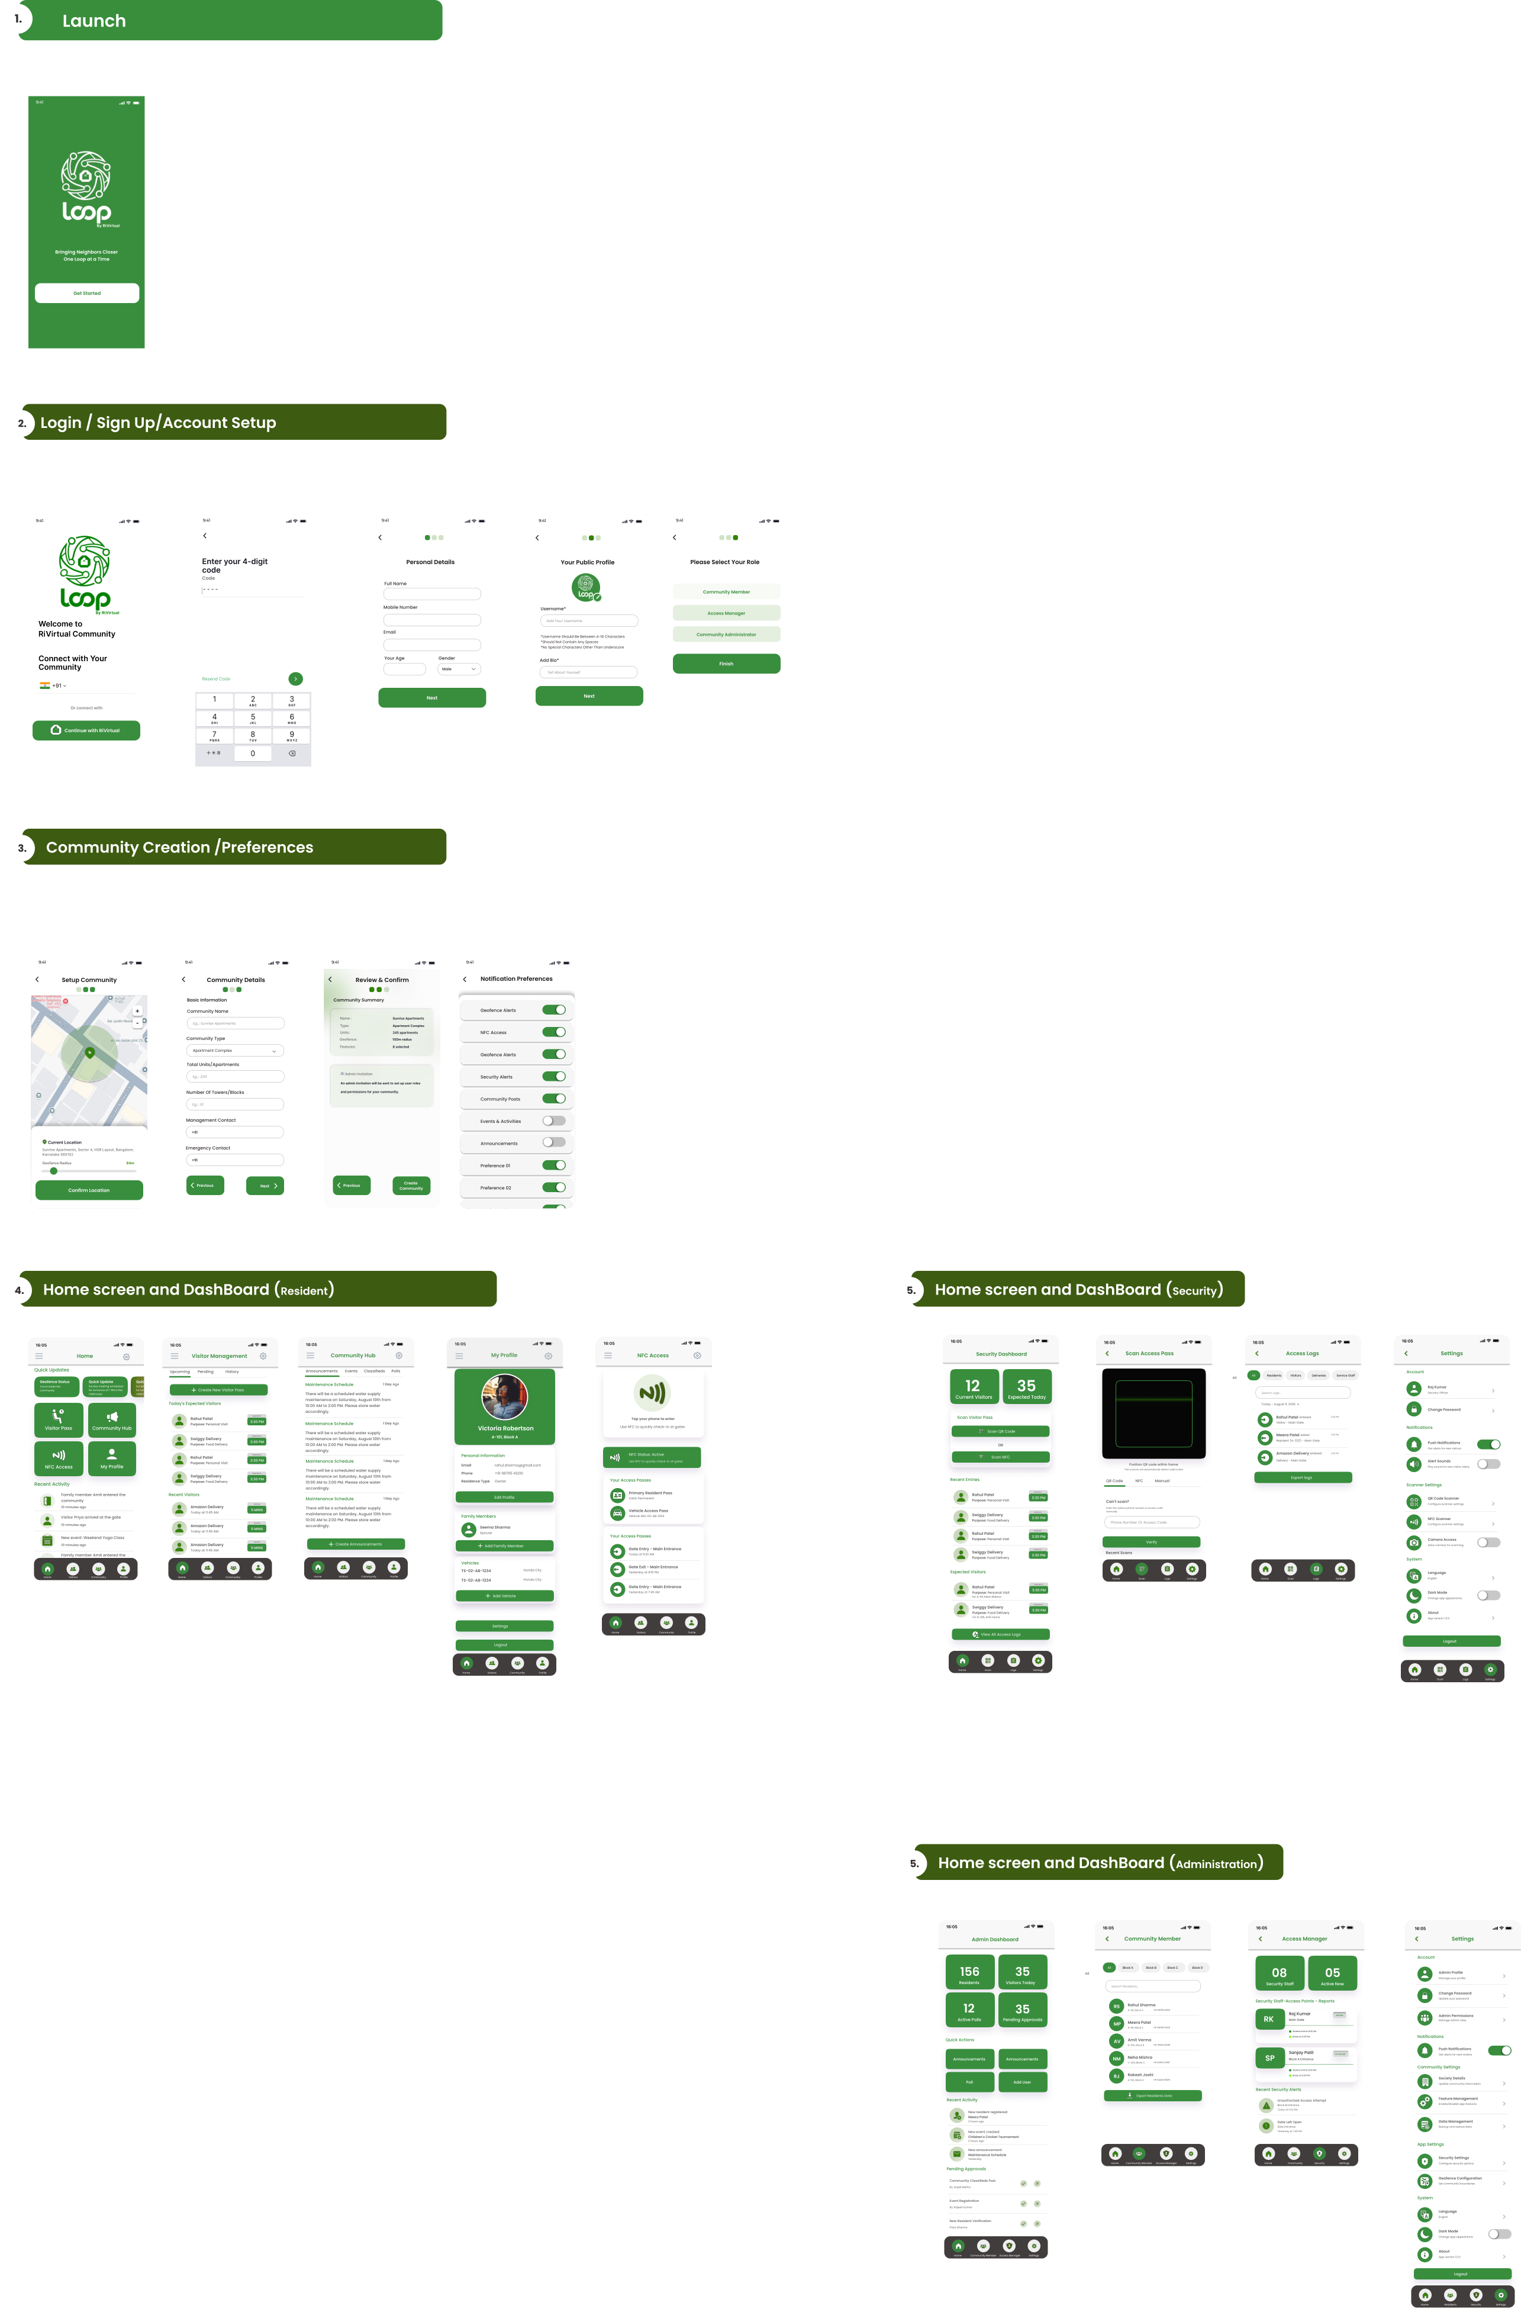
Complete Screen Inventory
Loop Application Screens — Launch, Onboarding, Resident, Security & Admin
Source: Loop Application Screens.pdf — 34+ hi-fi screens across 6 user journeys
Loop Community | Powered by RiVirtual | PropTech Case Study
10

Slide 11
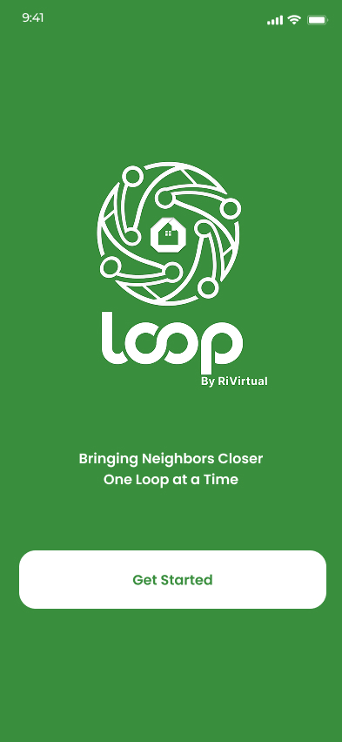
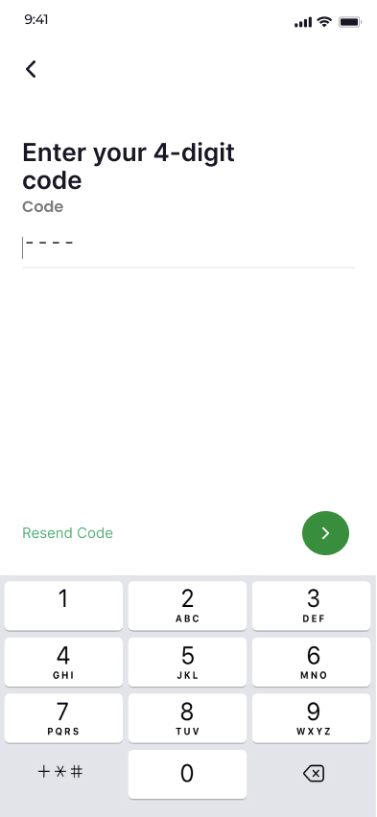
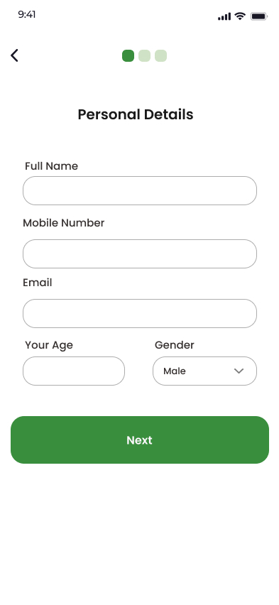
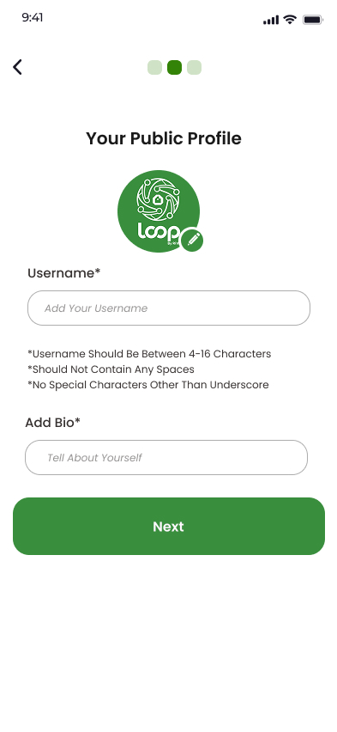
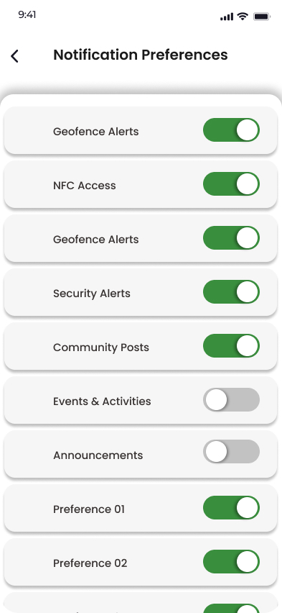
Hi-Fi Screens — Onboarding
Login / Sign Up / Account Setup — from Loop Application Full Screens
Login
OTP Verify
Personal Details
Public Profile
Notifications
Loop Community | Powered by RiVirtual | PropTech Case Study
11

Slide 12
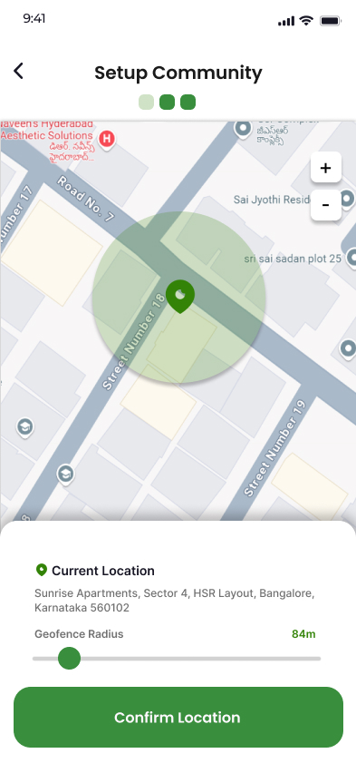
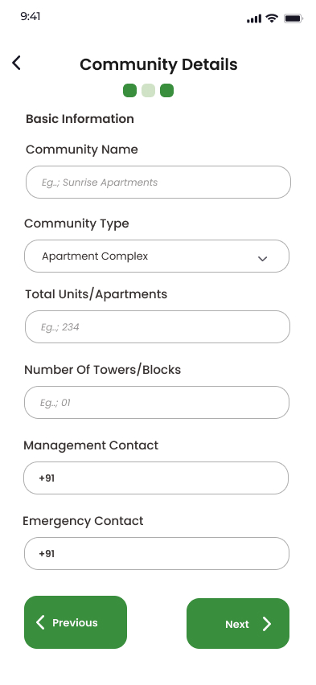
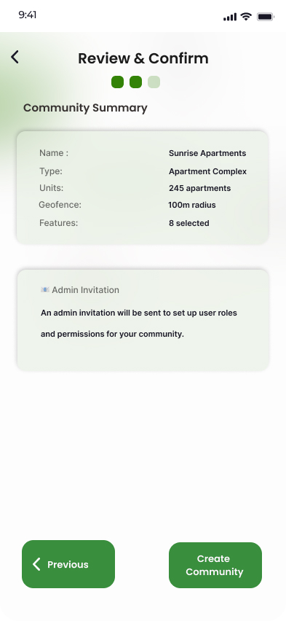
Hi-Fi Screens — Community Setup
Community Creation & Preferences — geofencing, details, confirmation
Set Community
Community Details
Confirm Community
Loop Community | Powered by RiVirtual | PropTech Case Study
12

Slide 13
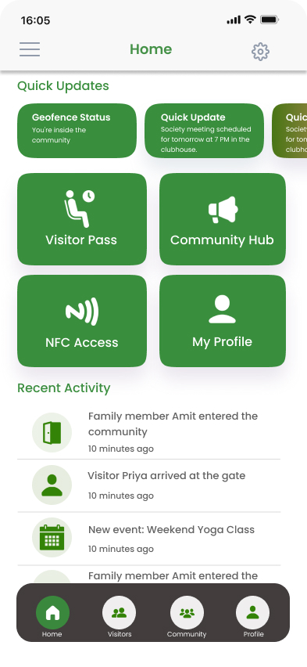
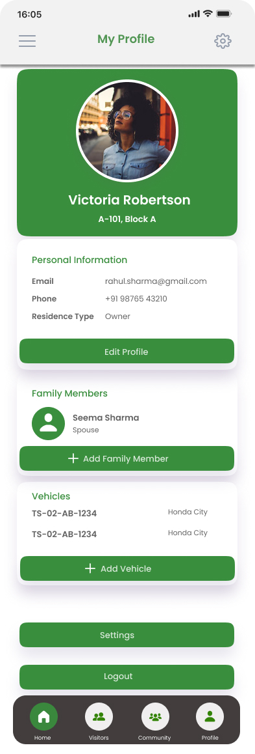
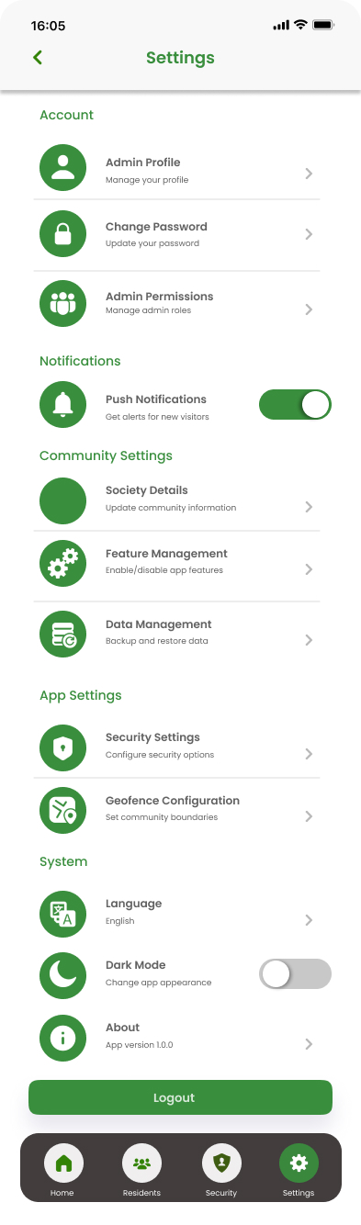
Hi-Fi Screens — Resident Dashboard
Home screen and Dashboard (Resident) — quick actions, profile, settings
Home Dashboard
My Profile
Settings
Loop Community | Powered by RiVirtual | PropTech Case Study
13

Slide 14
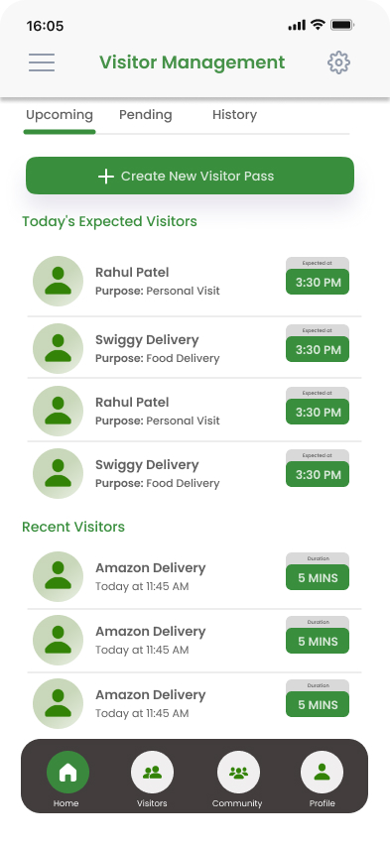
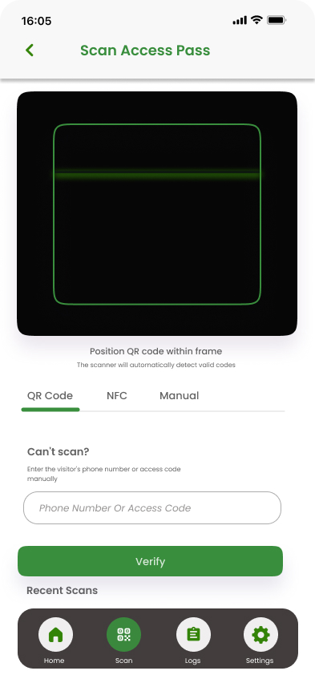
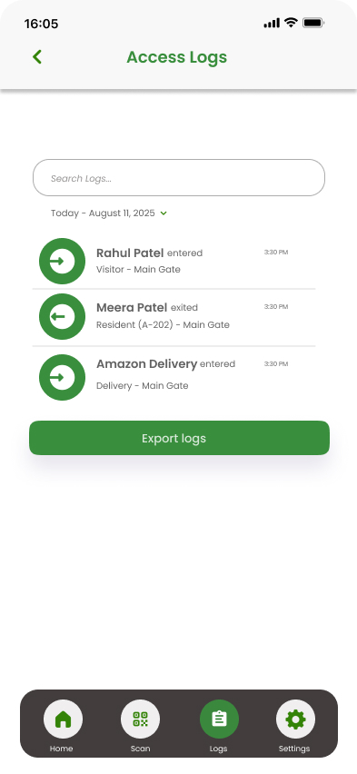
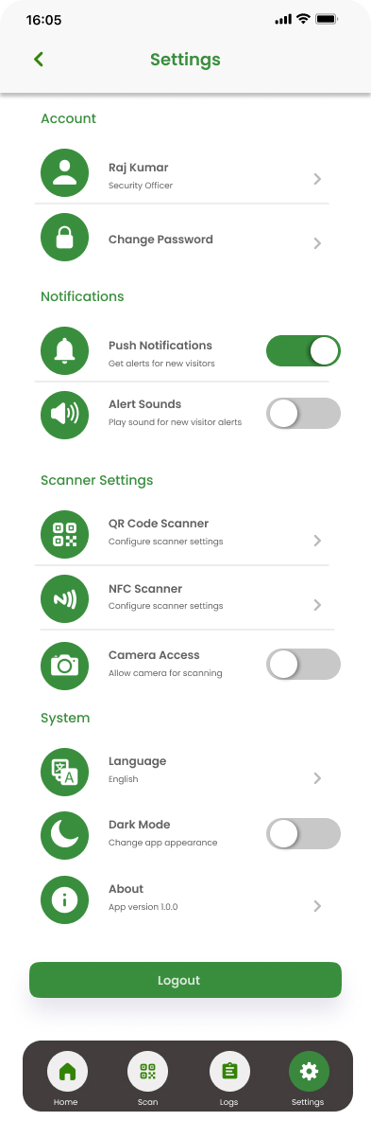
Hi-Fi Screens — Visitor Management
Digital visitor passes, QR/NFC scan, and access logs
Visitors
Scan Access Pass
Access Logs
Access History
Loop Community | Powered by RiVirtual | PropTech Case Study
14

Slide 15
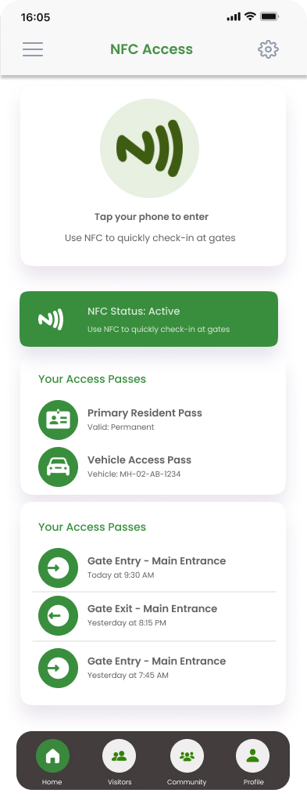
Hi-Fi Screens — NFC Access
Tap-to-enter access control at gates and common areas
NFC Access Gate
Scan Pass (Security)
Create Visitor Pass
Loop Community | Powered by RiVirtual | PropTech Case Study
15

Slide 16
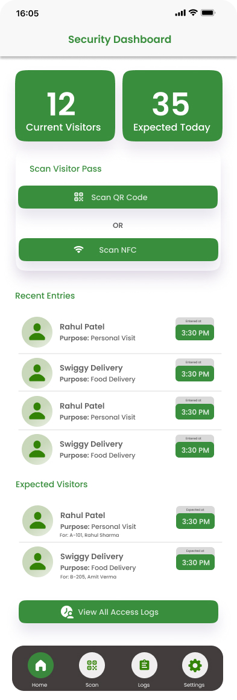
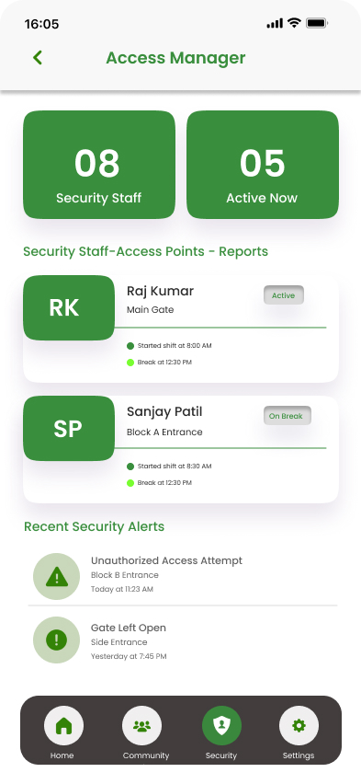
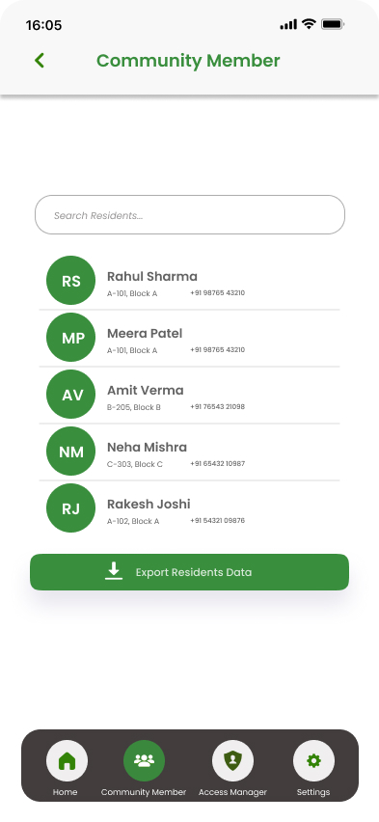
Hi-Fi Screens — Security & Admin
Home screen and Dashboard (Security & Administration)
Security Dashboard
Security Management
Residents
Loop Community | Powered by RiVirtual | PropTech Case Study
16

Slide 17
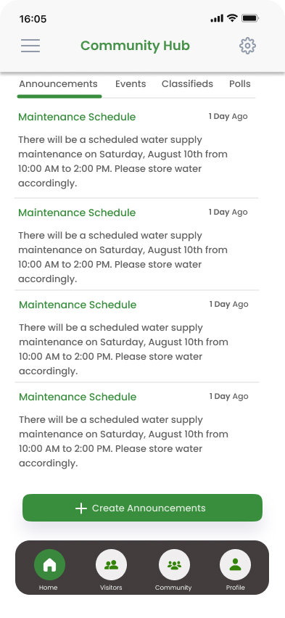
Hi-Fi Screens — Community Hub
Announcements, events, classifieds, and polls — the digital living room
Home Feed
Community Hub
My Profile
Loop Community | Powered by RiVirtual | PropTech Case Study
17

Slide 18
Solution Highlights
Four Pillars of a Digital Community
Visitor Management
Digital passes with QR/NFC — 30-sec approval
Geofencing Presence
Ambient home detection — invisible intelligence
NFC Access Control
Tap-to-enter at gates — cryptographic validation
Community Hub
Announcements, events, polls, classifieds
34+ mobile screens across onboarding, dashboards, visitor flows, access control & hub
Loop Community | Powered by RiVirtual | PropTech Case Study
18

Slide 19
User Flows & Architecture
The Blueprint: How It All Connects
Resident
creates pass
Guest receives
link
Security scans
QR/NFC
System
validates
Entry logged
& notified
→
→
→
→
Primary Flow: The Visitor Journey
System Architecture
Information Architecture
Experience Layer
Loop Community
Role UI · NFC/QR · Hub Feed
Role Gateway (Resident / Admin / Security)
Intelligence Layer
Home Dashboard — Quick Actions + Status + Hub Feed
Geofence · Pass Validation · Presence
Visitor Management — Create → Share → Track → Scan
Access Control — NFC Tap · QR Fallback · Audit Log
Data Layer
Community Hub — Announcements · Events · Polls · Classifieds
Visitors · Access Logs · Content · Roles
Loop Community | Powered by RiVirtual | PropTech Case Study
19

Slide 20
Impact & Results
From Chaos to Coherence
<30s
100%
34+
3
Visitor approval
(was 5–15 min)
Digital audit trail
(was paper logbook)
Mobile screens
designed
Role dashboards
in one app
Qualitative Transformation
Residents regained control without added complexity
"We didn't digitize a logbook. We gave a community its nervous system."
Administrators gained a command center, not a chaos inbox
Security moved from guessing names to verified access
Society brand elevated — tech matching premium gated living
Loop Community | Powered by RiVirtual | PropTech Case Study
20

Slide 21
Key Learnings & Reflection
What This Project Taught Me
1
Design for the worst moment — the guard in midday heat, not the demo
2
Roles are lenses, not walls — shared reality, different permissions
3
Security UX is emotional UX — every color carries weight
4
Constraints breed clarity — 1.5 months forced ruthless prioritization
5
The PRD is part of the design — edge cases start on the design table
"Great society apps don't feel like software. They feel like someone thoughtful is watching the gate for you."

