Slide 1

CASE STUDY
Business Card Update
in RiVirtual
Digital Business Card Feature | UI/UX Design
Prepared by Vinay Kottapeta | July 2026

Slide 2
Executive Summary
Modernizing networking for real estate professionals
The RiVirtual Digital Business Card is a personalized virtual business card that lets real estate professionals manage digital profiles, share contact info, listings, and QR access through a mobile-first, clickable interface.
This feature replaces outdated paper cards with a dynamic, trackable digital solution that enhances lead generation and brand visibility across the RiVirtual platform.
10K+
Digital Cards
60K+
Businesses
100K+
Active Users
RiVirtual | Real Estate Intelligence
2

Slide 3
Problem Statement
Why traditional business cards fall short
Easily Lost
Quickly Outdated
!
?
Paper cards get misplaced after a single meeting
Contact details change but cards cannot update
No Analytics
Multi-Step Sharing
0
+
Zero visibility into engagement or follow-up
Sharing listings requires separate channels
Real estate professionals need instant, modern ways to exchange information and direct prospects to listings, websites, and social profiles.
RiVirtual | Real Estate Intelligence
3

Slide 4
My Role
UI/UX Designer & Product Specialist
1
User flow from dashboard to card page
2
Responsive templates (mobile & desktop)
End-to-End
Design
Contribution
3
CTA button functionality and layout
4
Edit profile social media integration
5
Visual design, mockups & prototypes
6
Requirements analysis & stakeholder alignment
RiVirtual | Real Estate Intelligence
4

Slide 5
Requirements & Scope
Feature specifications and user eligibility
Requirement Area | Details
Access | Free for agents, brokers, builders, community users, pro, lenders & property managers
Excluded Users | Customer user type — feature not available
Platforms | Responsive mobile and desktop card templates
Entry Point | Dashboard link: "Your RiVirtual Card Link"
Profile Integration | Social links (Facebook, LinkedIn, Instagram, YouTube) via Edit Profile
Downloads | Full card as PDF; QR code as JPEG format
Release 2 (Deferred) | Email Me, About Me, Send Card, RiVirtual Referrals CTAs
RiVirtual | Real Estate Intelligence
5

Slide 6
Design Process
Research-driven, mobile-first approach
01
02
03
04
Research
Wireframing
Design Decisions
Validation
→
→
→
Analyzed user needs for quick sharing, mobile usage & profile integration
Low & high-fidelity prototypes with scannable layouts
Prominent QR code, actionable CTAs & responsive templates
Stakeholder review against Figma specs & brand guidelines
RiVirtual | Real Estate Intelligence
6

Slide 7
User Flow
From dashboard to shareable digital card
1
2
3
4
5
Access Card Link
from Dashboard
View Personalized
Card Page
Interact with
CTAs & QR Code
Share / Download
Card
Edit Profile &
Social Links
Social media links configured in Edit Profile automatically appear on the business card for seamless brand presence.
RiVirtual | Real Estate Intelligence
7

Slide 8
Key Features
Built for instant connectivity and lead generation
QR Code Sharing
Clickable CTAs
Shareable link to full card page — scan to connect instantly
Text Me (WhatsApp), Call Me, My Site, My Listings actions
Social Integration
Download Options
Facebook, LinkedIn, Instagram & YouTube from profile
Export full card as PDF or QR code as JPEG
Responsive Design
Brand Consistency
Optimized templates for mobile and desktop views
RiVirtual-powered branding with customizable details
RiVirtual | Real Estate Intelligence
8

Slide 9
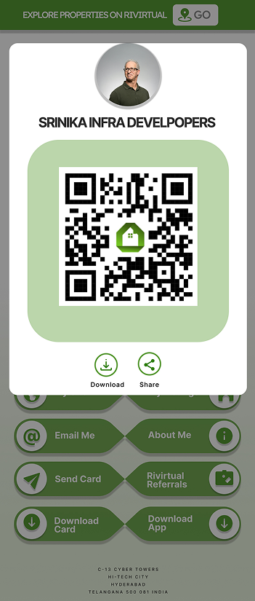
CTA Button Functionality
Direct actions for contact and property engagement
CTA Button | Action | Status
Text Me | Opens WhatsApp with pre-filled message | Release 1
Call Me | Triggers phone dialer with user number | Release 1
My Site | Links to personal website or RiVirtual profile | Release 1
My Listings | Links to user's property listings (customizable URL) | Release 1
Download Card | Exports PDF (full card) or JPEG (QR only) | Release 1
Email Me / About Me / Referrals | Deferred to Release 2 per scope decision | Release 2
RiVirtual | Real Estate Intelligence
9

Slide 10
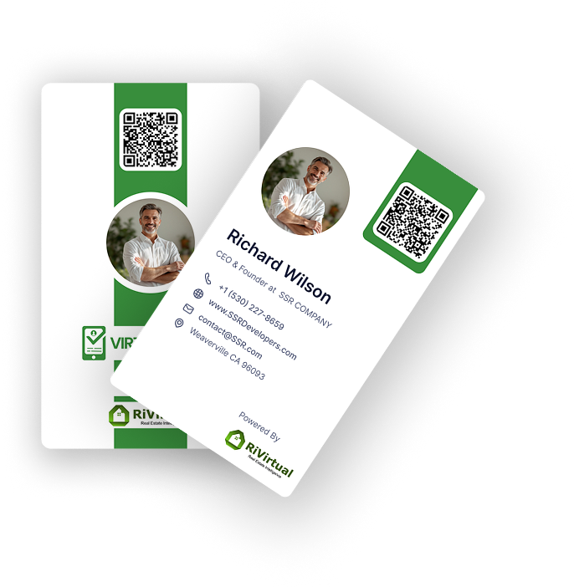
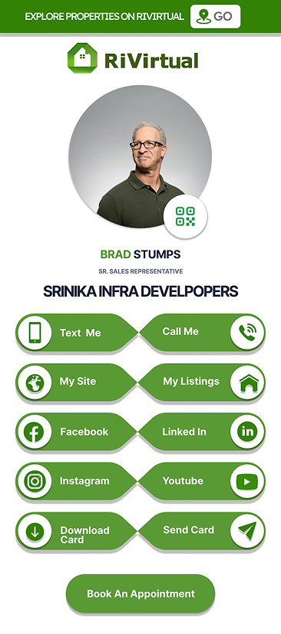
Visual Design
Clean, scannable card with prominent QR code
Design highlights: vertical green accent stripe, circular profile photo, branded QR code, and RiVirtual-powered footer.
RiVirtual | Real Estate Intelligence
10

Slide 11
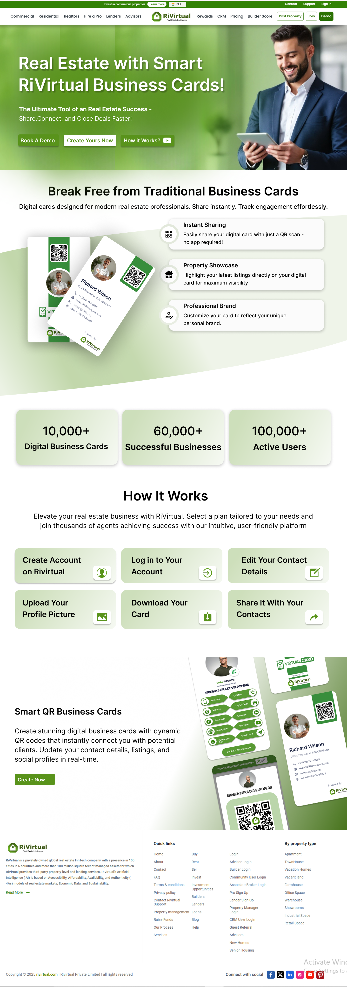
Platform Experience
Landing page and mobile-responsive card view
Landing Page
Marketing page showcasing instant sharing, property showcase, and professional branding.
Mobile View
Touch-optimized CTAs with download, share, and direct contact actions.
How It Works
Create account → Edit details → Upload photo → Download → Share
RiVirtual | Real Estate Intelligence
11

Slide 12
Impact & Benefits
Measurable value for real estate professionals
↑
Networking Efficiency
↑
Lead Generation
Instant QR sharing replaces manual card exchange
One-tap access to listings and contact channels
↑
Brand Consistency
↓
Physical Dependency
Unified RiVirtual branding across all touchpoints
Reduced reliance on paper cards and reprints
RiVirtual | Real Estate Intelligence
12

Slide 13
Learnings & Future Roadmap
Key takeaways and planned enhancements
Key Learnings
Future Enhancements
Mobile-first design is essential for on-the-go real estate professionals
QR codes enable instant connectivity without app downloads
Scoped releases (R1 vs R2) help deliver value faster
Profile integration reduces duplicate data entry
Release 2 CTAs: Email Me, About Me, Send Card, Referrals
Card view analytics and engagement tracking
Advanced card customization options
A/B testing for CTA conversion optimization
RiVirtual | Real Estate Intelligence
13

Slide 14
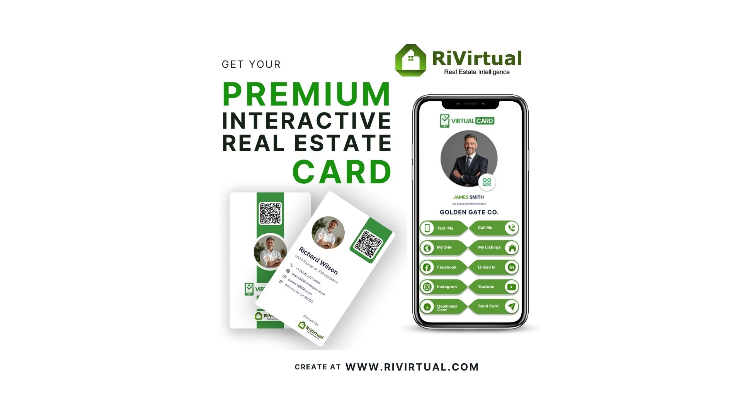
Conclusion
The RiVirtual Digital Business Card demonstrates how thoughtful UI/UX solves real-world pain points in real estate — replacing static paper with a dynamic, shareable, and brand-consistent digital identity.
Thank You
Vinay Kottapeta | UI/UX Designer & Product Specialist

