Slide 1

: An Arnis Web-based Scoring System with Mobile App Support

Slide 2
PROPONENTS ANGEL BERT G. TAUSA JOHN VINCE C. PADERNA JUSTIN VINCE C. VILLACAMPA

Slide 3
BACKGROUND OF THE STUDY

Slide 4
According to Mkrtchyan (2021), many things that surround us are products — the computer on your desk, the mailbox you use, the faucet on your kitchen sink, and the subway you take every day. They are indisputable parts of our lives, and we interact with them to satisfy our daily needs such as dining, communication, transportation, sanitation, healthcare, etc. The bigger the need, the more valuable and demanded the product that is designed to satisfy that need will be. This makes certain items more popular than others, and it's frequently one of the key elements determining whether a product will succeed or fail. Because of this, only those goods that successfully address significant customer needs and persistent difficulties have persisted on the market and continued to develop over time.

Slide 5
According to (Burnham, 2015), the continuous technological discoveries and advancements open new perspectives in terms of product offerings we see, as well as combine the old and new approaches such as the Internet of Things to solve already existing problems more efficiently. Several more people think that products have to be tangible objects. This was true decades ago, but nowadays this conception is not valid anymore. “Softwarization” is consuming the world, turning many of the tangible tools that were meant to solve specific business cases into software alternatives.

Slide 6
According to (Cols & di Milano, n.d), using software to record player information and scores allows for faster and more accurate data entry, reducing the chance of errors and saving time. The software can store and organize player information and scores in a central location, making it easy to access and analyze data. This can also provide an efficient way to communicate and share player information and scores between coaches, players, officials, and fans.

Slide 7
The Baston: An Arnis Web- Based Scoring System with Mobile App Support is proposed for digital automated scoring that will make it easier for them to track scores, create teams and bouts per Arnis Labanan categories and for the Arnis Anyo Competition. The proponents would like to help provide it so it could increase productivity for tournaments and lessen the manual recording of the organizers from creating a player profile with their information to assigning them to which categories they belong, formation of teams and the digital recording of the scores per match.

Slide 8
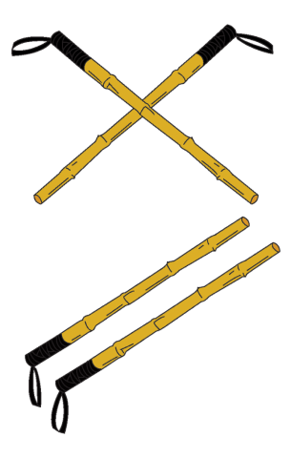
OBJECTIVES

Slide 9
Generally, our app aims to streamline Arnis sports and competitions by providing a user-friendly way to record player information and scores, and facilitating centralized organization and management. With a mobile or web-based platform, real-time match results and standings are easily accessible to players, coaches, officials, and fans, keeping everyone up-to-date on tournament progress.

Slide 10
Specifically, its ought to achieve the following:
To provide a fast and accurate way to record player information and scores for any San Carlos City Arnis tournaments and competitions
To facilitate the management and organization of player information and scores.

Slide 11
To provide real-time updates on match results and standings for players, coaches, officials.
To improve communication and collaboration between tournament organizers, players, coaches, officials, and fans.

Slide 12
SCOPE AND LIMITATIONS

Slide 13
The scope of the Baston app is to provide a user-friendly interface for recording player information and scores specifically for Arnis tournaments and competitions. The app will include features such as real-time updates on match results and standings, performance analysis, and a central location for storing and managing player information. It will be accessible from a mobile or web-based platform and the data collected can be used to improve tournament organization and management, and support the decision-making process.

Slide 14
However, one of the limitations of this app is that it will only be able to be used for Arnis tournaments and competitions and may not be applicable to other sports. Additionally, the app may require a reliable internet connection for real-time updates and data syncing, and a certain level of technical expertise to operate and manage the data. The app will only be accessible to those who have an account and have been granted access, and it may have limitations on scalability and integration to other systems, which may require further development to be able to do so.

Slide 15
REVIEW RELATED LITERATURE AND SYSTEMS (RRL)

Slide 16
Exploring the Accounting System and Recording Practices of Indigenous Entrepreneurs in Marilog District, Davao City, Philippines
According to (Patayon, 2016), this descriptive-correlational study determined the accounting and recording practices of indigenous entrepreneurs in Marilog District, Davao City, Philippines. The data gathered were analyzed and interpreted using graphs and descriptive statistics such as frequency counts, percentages, and mean; and inferential statistics, the Analysis of Variance (ANOVA,) and t-test. The research findings are based on a survey of the accounting system and recording practices of sixty (60) indigenous entrepreneurs in the district. The study revealed that most of the respondents fall within the age range of 45 years old and above, female, married, of high school education, from various ethnicities, provided their financing, with less than one year in business operations, and have not attended any seminars and training related to record keeping. The results of the analysis established that the accounting system and recording practices in terms of income, expenditures, collectibles, and payables were moderately adopted by the Indigenous Entrepreneurs in the district. Indigenous entrepreneurs do not use the underlying accounting books of accounts in recording their business transactions. The majority of them do not keep records on their collectibles and use notebooks as their main materials for recording income, expenditures, and payables.

Slide 17
This study proved the effectiveness of using manual recording is not as high as in current surveys and records. This study is a business-related study but considering San Carlos Jungle Fighters Martial Arts Club as an organization, the organization seems to be unproductive in recording player information and compiling players' scores and recording it. These pieces of information were as important elements of the organization's point as how indigenous businesses took care of their accounting records with different transactions either in terms of income, expenditures, collectibles, and payables as stated in the study.

Slide 18
Sports Governance: Issues, Challenges and Perspectives
According to (Blanco, 2017), it has been emphasized how sports are a reality. Physically, emotionally, socially, and economically, it helps people, families, and communities grow strong and healthy. Life would appear to be drab, monotonous, and uninteresting without athletic activities. With the advent of the globalization of sports, the need to value it as a way of life becomes even more challenging and perplexing among nation-states, local institutions, sports organizations, and other sports stakeholders and actors, particularly in the field of governance.
More importantly, sports governance enables national sports to achieve greater heights—a source of national pride, joy, and honor for the country and its people. Sports governance is an outstanding precondition and prerequisite for global prestige and reputation as sports excellence highly equates with social, economic, and political growth and development, even making countries a sports haven for tourism.
As sports organizations are required to become important for all students, researchers, and professionals working in sports to understand what governance is and how it should be achieved (O’Boyle & Bradbury, 2013)

Slide 19
Clearly, the importance of sports organizations adopting good governance, structures, and processes that are designed to ensure accountability, transparency, responsiveness, rule of law, stability, equity, and inclusiveness in which this project will be making one of the sports, Arnis, to adapt to it, in having good governance through this web-based scoring system that will make the organizations tournament flow more smooth, set and centralized.

Slide 20
8 Disadvantages of paper document management system
According to (Melo, 2019), the following are some disadvantages of using paper documents in recording information: lack of storage space, security issues, being prone to damage, editing problems, high cost, and limited communication and collaboration. Paper documents can take up a significant amount of space, and the quantity of paper will increase day by day. Furthermore, documents will typically need to be stored close to hand so that they can be accessed as quickly as possible.

Slide 21
Another objective of this project is to facilitate the management and organization of player information and scores in a central location, where researchers emphasize these disadvantages of the paper document management system which is currently used by the tournament organizers of SACAJUFIMAC in recording player information and scores.

Slide 22
PoloTrac: A Water Polo Tracking and Advanced Statistics Application
According to (Verlin, 2019), PoloTrac is a mobile, iOS application designed to allow coaches, players, and spectators to record play-by-play water polo game events as they happen in the pool. PoloTrac has the features that one might expect from a score-keeping app such as a functioning scoreboard and clock that can keep track of team fouls and timeouts remaining. However, PoloTrac also produces post-game reports that are designed to be useful in determining player performance, team performance, and the effectiveness of certain tactics. PoloTrac makes use of the touch interface of iOS devices (iPhones and iPads) to allow users, with a simple tap of the finger, to input specific locations in the pool from which players shoot as well as locations on the net at which they aim. Compiling and charting this data may provide useful insights to water polo players and coaches as to what positions and tactics are producing success in competitions. By utilizing the latest research and statistical models, PoloTrac is also the first application of its kind to bring advanced data analytics to the average water polo player, coach, and spectator.

Slide 23
The proposed study of Baston, a web-based app for Arnis sports management, shares a similar focus. Baston aims to simplify competition management through a centralized platform for score recording and player information. The app is accessible from both mobile and the web and provides real-time updates on match results and standings for all stakeholders, including players, coaches, officials, and fans. The study of Baston and PoloTrac both aim to improve the experience and analysis of sports through the use of technology.

Slide 24
DESIGN AND IMPLEMENTATION OF A MOBILE BASKETBALL SCOREBOARD
According to (Adelard, 2012), the newly developed Mobile Basketball Scoreboard application will be used to reduce or even solve problems experienced while using the paper-based point recording system as it helps in the quick generation of reports, referees, and fans. These reports can be used for monitoring the game in play and decision-making. In this project, the researcher created a mobile application called MOBSCOB for umpiring a basketball game. The game is developed for Java-enabled devices and is a standalone application. The objectives of this project were to develop a feature that will enable the fans, umpires, players, and coaches to record points in a basketball game.
The Mobile Basketball Scoreboard (MOBSCOB) application aims to solve issues with traditional paper-based point recording systems in basketball games. The app allows for quick generation of reports, which can be used for monitoring the game and decision-making. The researcher developed MOBSCOB as a standalone application for Java-enabled devices with the objectives of enabling fans, umpires, players, and coaches to record points in a basketball game.

Slide 25
Baston, a proposed study, shares a similar objective of improving sports management through technology. As a web-based app for Arnis sports management, Baston offers a centralized platform for recording scores and player information that can be accessed from both mobile and web. Both MOBSCOB and Baston aim to simplify sports management and enhance the experience for all involved. Thus, the proposed study of Baston is a crucial step in the direction of digitizing sports management and improving the overall experience for everyone involved.

Slide 26
Web-Based Records Management and Monitoring Application for a Tutorial Company
According to (Sabaricos & Golan-go, 2013), this study provides a medium for managing and monitoring records of an online English tutorial which is specified by the bIELTP. The application shall be web-based and shall be utilized by the administrators and authorized employees of the company. It is the aim of the proponents to come up with an application that has features that are fit for certain daily business processes done with IELTP. It is their aim to provide a means of organizing profiles and other essential details regarding the company’s employed tutors as well as their clients who are basically the students. Another aim of the web application would be to make data retrieval, student endorsement, and report management more convenient. It should also be able to provide central data storage for all records that are within the scope of the study. Before his study, there was no means of being able to integrate records and data within IELTP.
They had computerized means of keeping and managing records but it was not easy to monitor and generate certain reports since there was no central storage of their data. To make the development of this web application possible, certain tools were used by the proponents. The programming language used was Coldfusion MX 7. The database management system used for the centralized data storage was Microsoft SQL Server 2000. Other web development tools such as JavaScript and Cascading Style Sheet or CSS were also used. The web application was coded in the Dreamweaver MX7.

Slide 27
This study demonstrates the necessity for a medium that this tutorial company has, just as our client did. It is a web-based system, and they have computerized record-keeping and management tools, but since there was no central repository for their data, it was difficult to monitor and produce some reports. Their goal is to offer a system for organizing the clientele, who are essentially the students, and the company's employed tutors' profiles and other pertinent information which is similar to what our aims with our capstone project as well.

Slide 28
SYSTEM PROGRESS

Slide 29
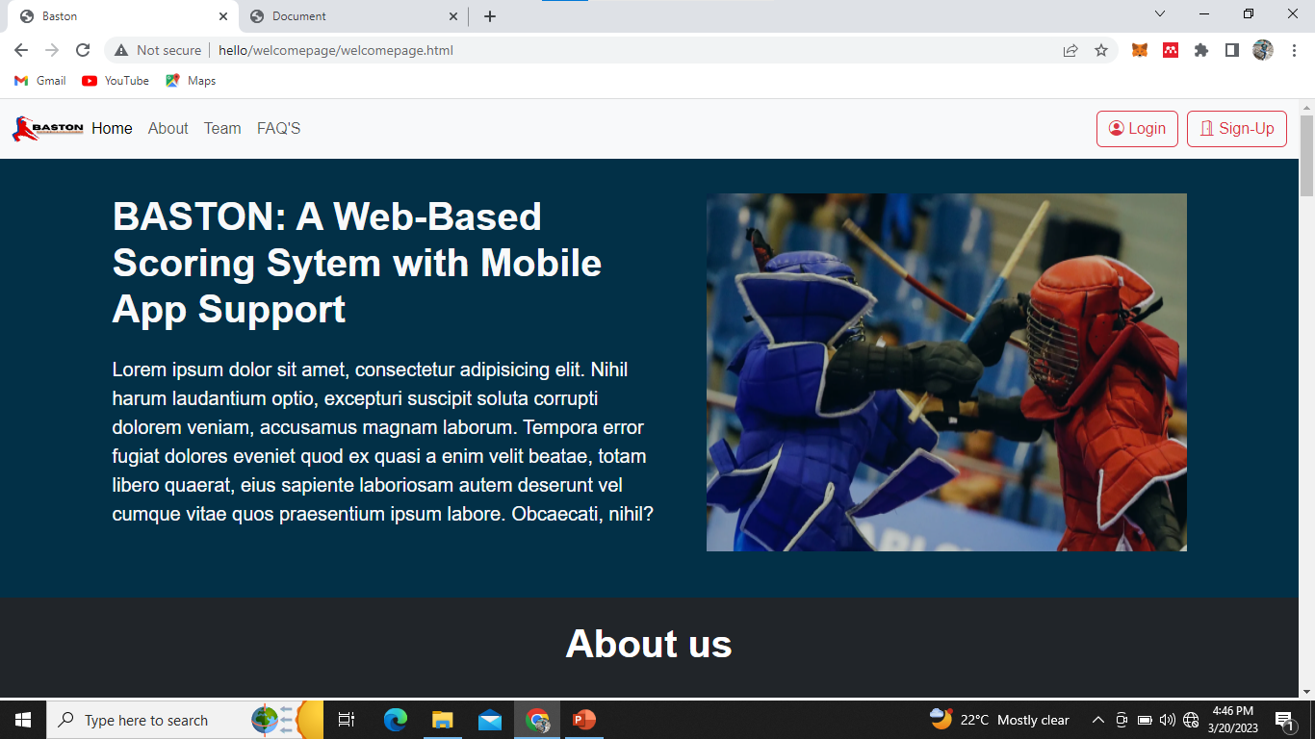
Figure 1: Home Page

Slide 30
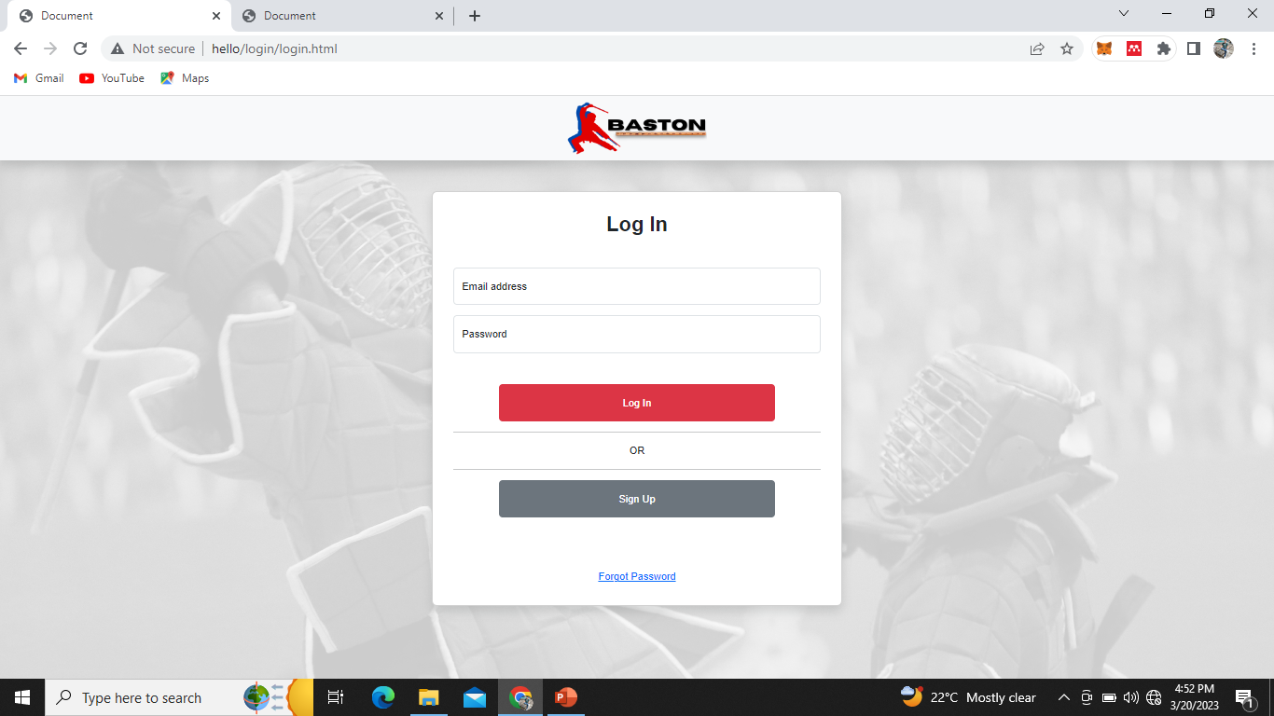
Figure 2. Log in Page

Slide 31
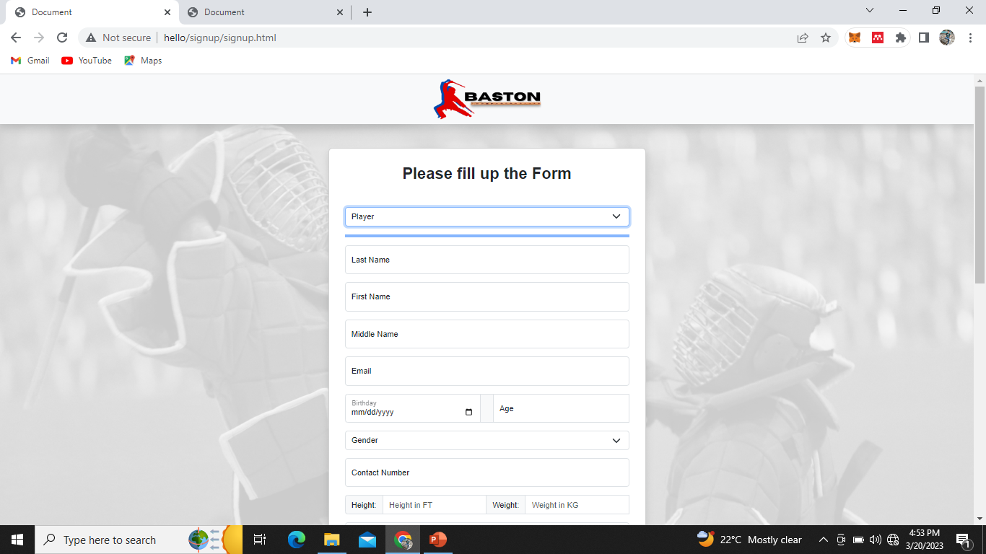
Figure 3. Sign Up Page

Slide 32
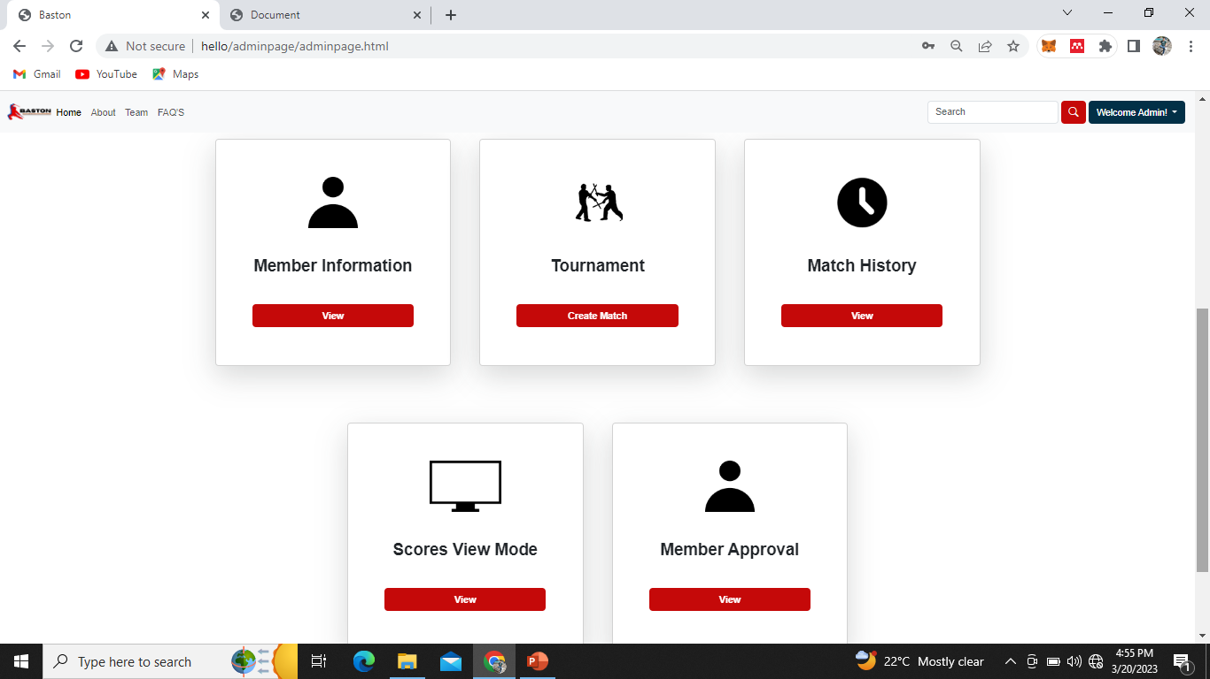
Figure 4. Admin Page

Slide 33
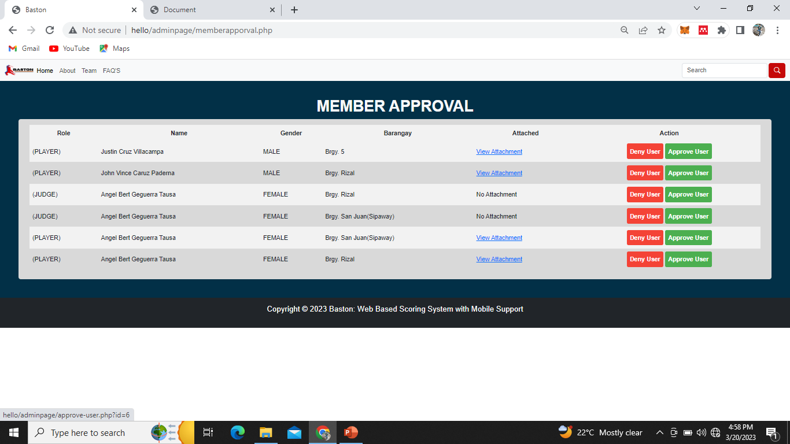
Figure 5. Member Approval: Current Function

Slide 34
THANK YOU AND GOD BLESS!

