Slide 1
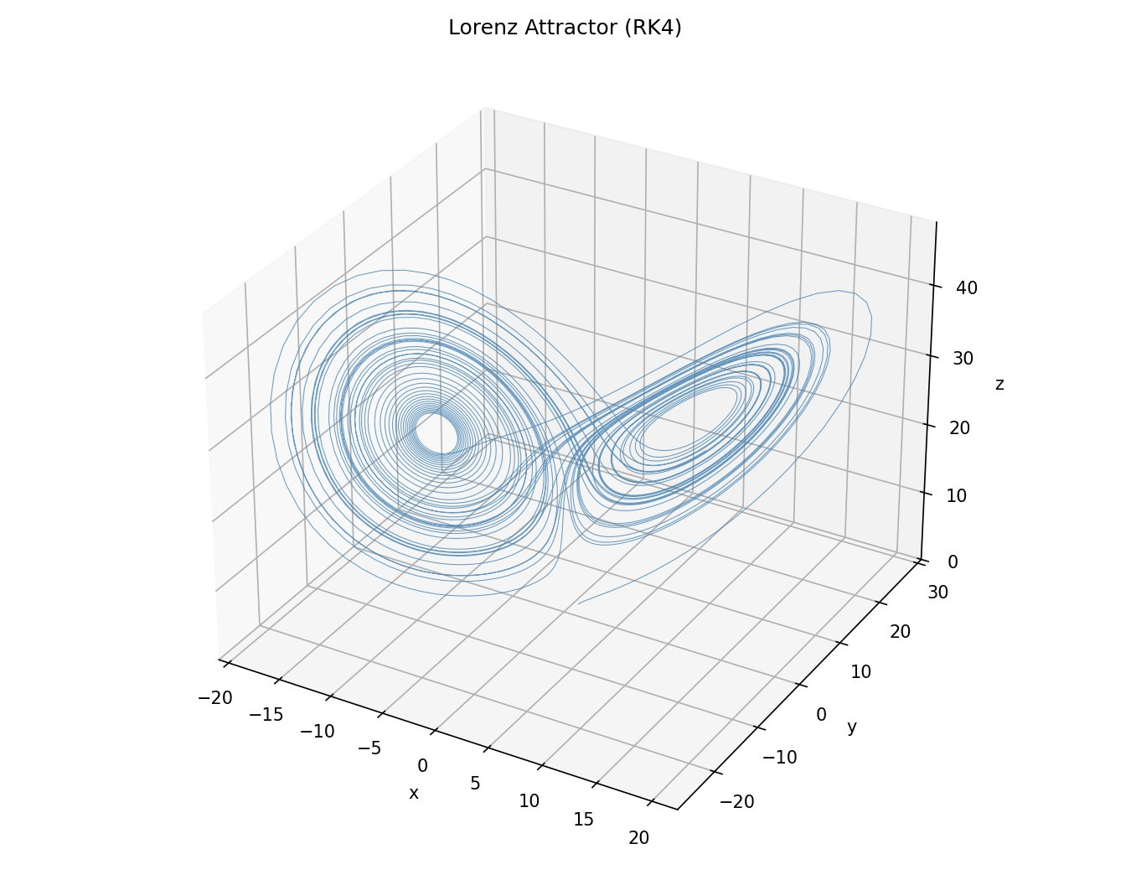
Learning and Predicting
Chaotic Dynamics
of the Lorenz System
Scientific Machine Learning · Final Project
RK4 Simulation
Data-Driven MLP
Neural ODE
PINN

Slide 2
Why the Lorenz System?
Motivation & Problem Statement
🌀 Atmospheric Model
Originally derived by Edward Lorenz (1963) as a simplified model of convective airflow — directly analogous to weather forecasting.
🦋 Chaotic Dynamics
Tiny perturbations in initial conditions lead to exponentially diverging trajectories — the butterfly effect.
🧪 Benchmark for SciML
A well-studied testbed to evaluate how well ML methods can learn and predict physically governed systems.
❓ Key Question
Can neural networks learn the underlying dynamics — and how far into the future can they predict?
Lorenz Attractor — RK4 Ground Truth

Slide 3
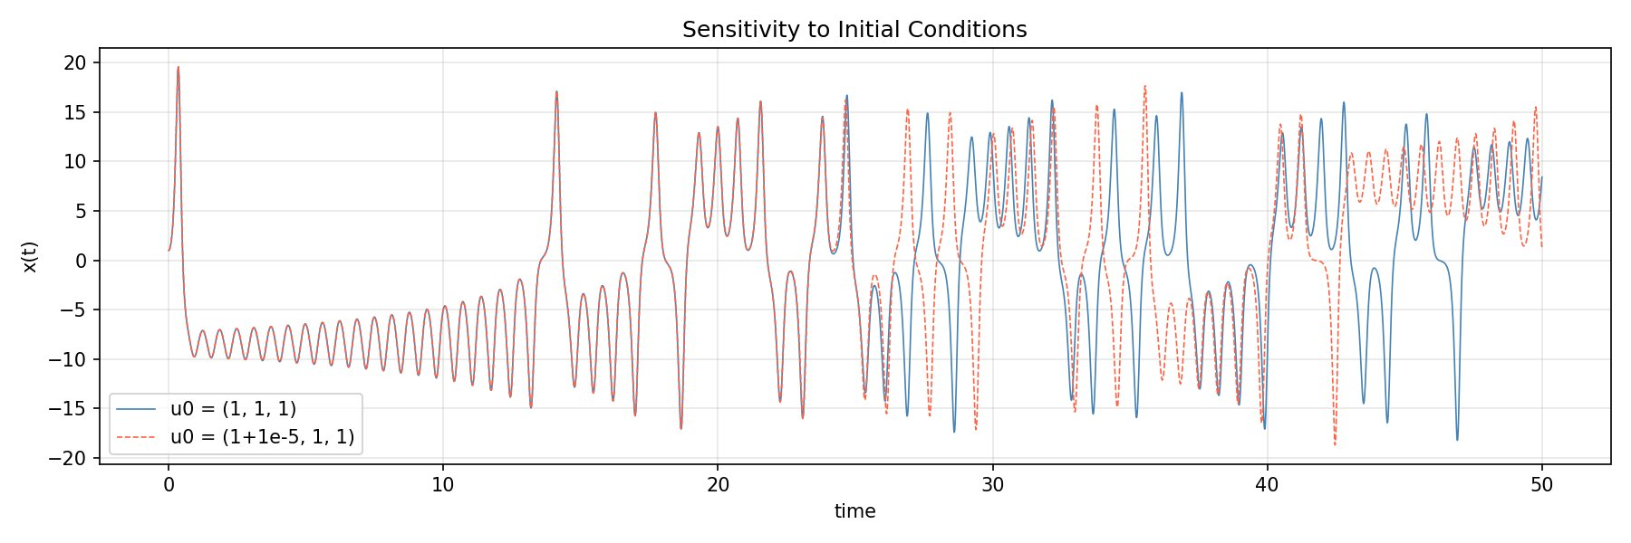
The Lorenz System
Governing Equations & Parameters
Governing Equations
dx/dt = σ(y − x)
dy/dt = x(ρ − z) − y
dz/dt = xy − βz
Standard Parameters
σ = 10
ρ = 28
β = 8/3
Butterfly Effect: two trajectories starting 10⁻⁵ apart diverge after t ≈ 20
Prandtl number
Rayleigh number
Geometry factor
x
y
z
Convective intensity
Horizontal ΔT
Vertical ΔT

Slide 4
Four Approaches Compared
From numerical simulation to physics-informed learning
01
02
03
04
RK4
MLP
Neural ODE
PINN
Numerical Simulation
Data-Driven Regression
Continuous Dynamics
Physics-Informed
Classical 4th-order Runge-Kutta. Solves ODEs exactly given known equations. Provides the ground truth trajectory.
Neural network trained on (state → next state). No physics knowledge. Tests whether raw data is enough.
Learns dU/dt = fθ(U) and integrates forward. More principled — learns the vector field, not just transitions.
Embeds Lorenz equations into the loss. Penalises physics violations. Uses Fourier features + two-stage training.
Each method reveals a different aspect of learning chaotic dynamics.

Slide 5
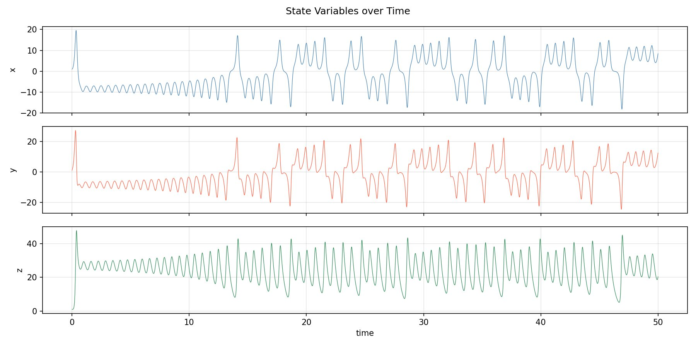
RK4: Establishing Ground Truth
Numerical simulation with known equations
METHOD 01
Initial condition
(x₀, y₀, z₀) = (1, 1, 1)
Time span
t ∈ [0, 50]
Step size
Δt = 0.01
Total steps
5,000
The RK4 trajectory serves as the reference for all ML methods.
x, y, z over t ∈ [0, 50] — chaotic switching between lobes

Slide 6
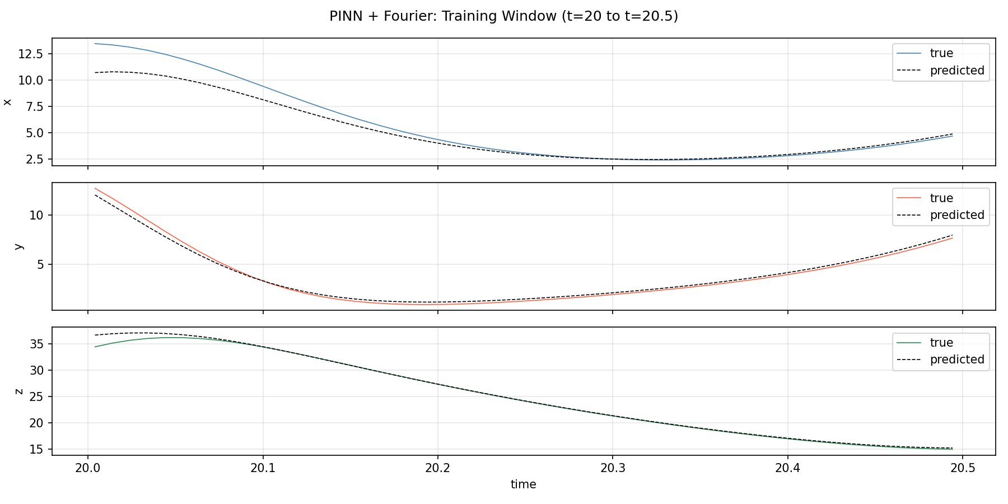
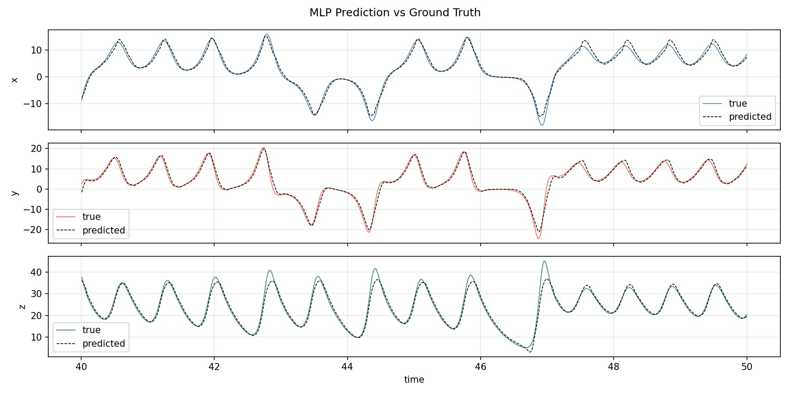
Data-Driven MLP: Two Formulations
What framing of the problem actually works?
METHOD 02
❌ t → (x, y, z) [FAILED]
✅ (x,y,z)ₙ → (x,y,z)ₙ₊₁ [WORKS]
Map scalar time directly to state.
Model collapses to predict the mean — chaotic mapping t ↦ (x,y,z) is not a learnable function.
One-step prediction: predict next 3 steps from current state.
Architecture: 3 hidden layers, 64 nodes, tanh — trained 2000 epochs.
Key insight: framing matters more than architecture.

Slide 7
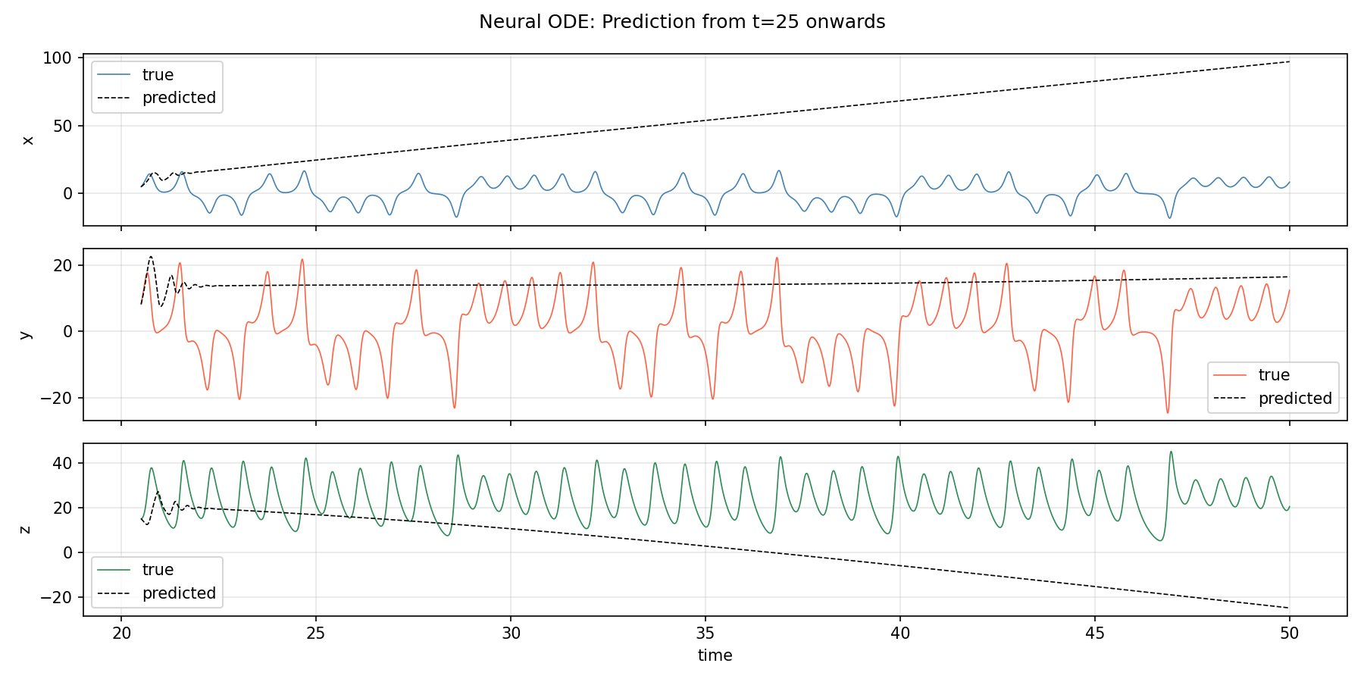
Neural ODE: Learning the Vector Field
Learns dU/dt = fθ(U), then integrates forward
METHOD 03
Core idea:
Instead of memorising transitions, learn the continuous dynamics. Given U(t₀), recover U(t₁) by integrating fθ numerically with RK45.
Setup
Architecture: 3 hidden layers [64, 256, 128], tanh
Input: state (x, y, z) → Output: (ẋ, ẏ, ż)
Training window: t ∈ [0, 0.49] (50 steps)
Solver: torchdiffeq RK45
Epochs: 3000, Adam lr = 10⁻³
✓ Learns dynamics inside training window perfectly ✗ Diverges rapidly outside — error amplification during integration

Slide 8
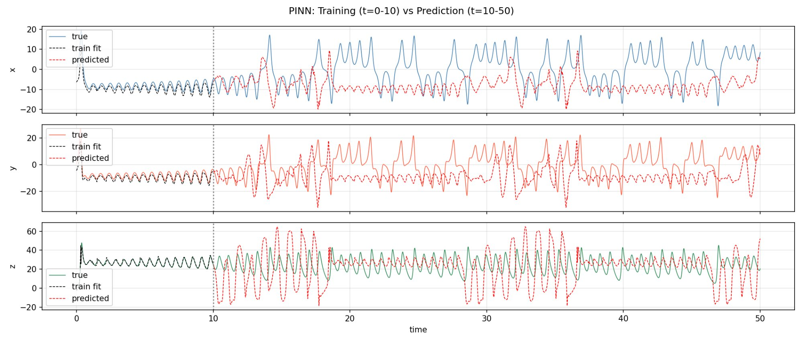
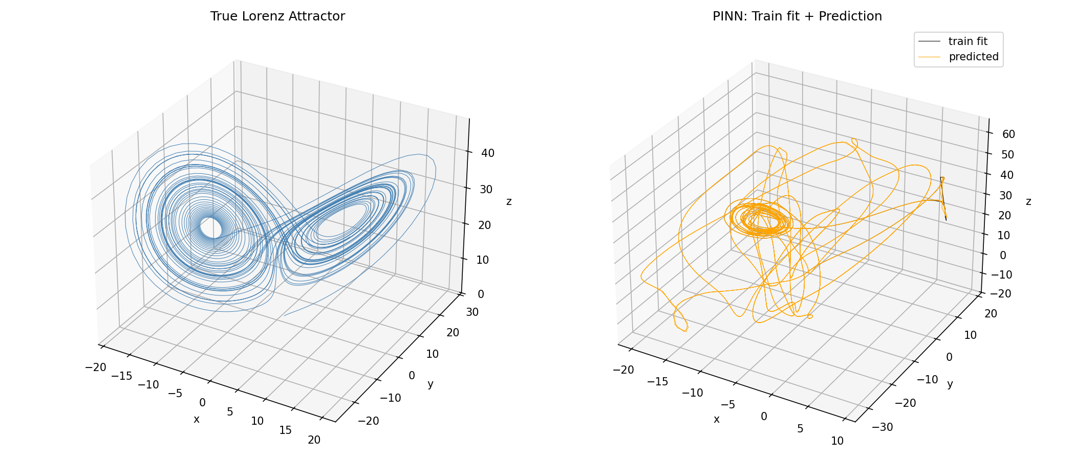
PINN: Physics-Informed Neural Network
Embedding the Lorenz equations into the training loss
METHOD 04
Loss Function
𝓛 = 𝓛_data + λ · 𝓛_physics
λ = 0.0001 · derivatives via torch.autograd
Two-Stage Training (key to convergence)
Stage 1
Data loss only — 5000 epochs, lr = 10⁻³ with StepLR scheduler
Stage 2
Data + Physics loss — 5000 epochs, lr = 10⁻⁴
Joint training causes loss conflicts → sequential approach solves this.
Train t∈[0,10] → Predict t∈[10,50]

Slide 9
Results at a Glance
Comparing all four approaches
Method
Task
Short-term
Long-term
Key Limitation
RK4
Numerical integration
✓ Exact
✓ Exact
Requires known equations
MLP (t → xyz)
Long-term regression
△ Not the main idea
✗ Failed
Chaotic mapping unlearnable
MLP (one-step)
State prediction
✓ Excellent
△ Degrades
Error accumulation in rollout
Neural ODE
Vector field learning
✓ Good (in window)
✗ Diverges
Short training window only
PINN
Physics-constrained
✓ Good
△ Partial
Butterfly effect still limits
No method achieves reliable long-term prediction — this is a fundamental property of chaotic systems.

Slide 10
Discussion
Insights across methods
🎯 Problem framing is decisive
⚙️ Continuous dynamics ≠ long-term accuracy
MLP fails completely when asked to map t → state, but succeeds locally with one-step prediction. The choice of input/output matters more than architecture depth.
Neural ODE is conceptually principled — it learns the vector field directly. But chaotic error amplification during integration still causes rapid divergence outside the training window.
🔬 Physics constraints improve structure, not perfection
🦋 The fundamental limit
PINN partially recovers attractor geometry beyond training data — something neither MLP nor Neural ODE achieves. But the butterfly effect cannot be eliminated by any method.
The constraint is the system itself, not the model choice. Any method that accumulates even microscopic errors in a chaotic regime will eventually diverge exponentially.

Slide 11
Conclusion
Short-term prediction of chaotic systems is tractable with the right method.
Long-term trajectory prediction remains fundamentally limited by the butterfly effect.
Physics-informed methods (PINN) recover more structure beyond training data.
The two-stage training strategy and Fourier features were key engineering choices.
Data-driven flexibility vs. physical consistency is the central trade-off.
Thank you

