Slide 1
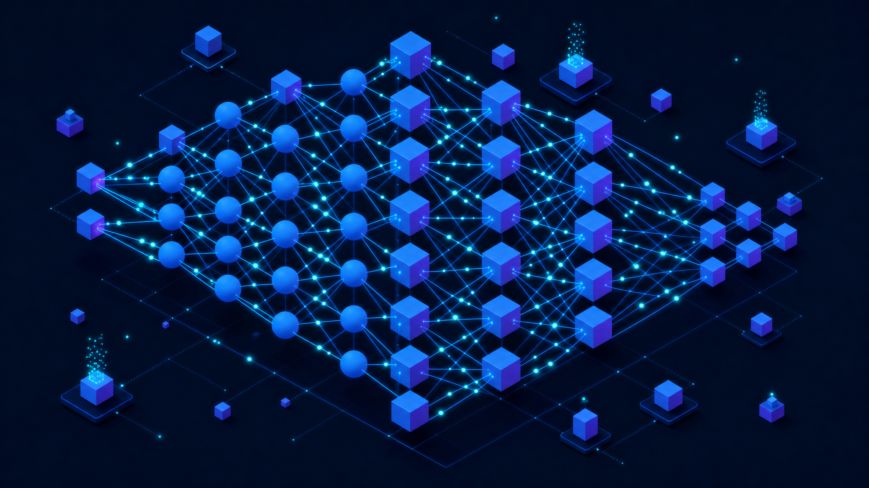
Back Propagation
Neural Network
CCS3600 Artificial Intelligence — Enhanced Teaching Materials
01
Notes:
Hello everyone, and welcome to this lecture on Back Propagation Neural Networks, part of our CCS3600 Artificial Intelligence course. Over the next several minutes we are going to unpack one of the most important algorithms in machine learning. Backpropagation is the engine that makes modern deep learning possible. By the end of this session, you will understand what it is, why it works, how the mathematics fits together, and where it is used in the real world. Let's get started.

Slide 2
What You Will Learn
Learning objectives for this module
Fundamentals
Algorithm
Applications
Evaluation
Understand the
Master the back-
Explore real-world
Understand the
architecture and
propagation algorithm,
uses: pattern
history, key points,
mechanics of feed-
its mathematical
recognition, face
advantages, and
forward neural
foundation including
recognition with
limitations of
networks and how
loss functions, chain
CNNs, and speech
backpropagation
information flows
rule, and gradient
recognition systems
in modern AI
through layers
computation
02
Notes:
Let me set out a roadmap for what you will take away from this presentation. First, we will build a solid understanding of feed-forward neural networks, the architecture that backpropagation operates on. Second, we will master the backpropagation algorithm itself, including the loss function and the chain rule that ties everything together. Third, we will explore real-world applications: pattern recognition, face recognition, and speech recognition. And finally, we will look at the history of backpropagation, along with its advantages and its limitations. Every slide connects back to one of these four goals.

Slide 3
What is Backpropagation?
Fine-tuning Neural Network Weights
Adjusts weights based on error rates from
previous iterations (epochs) to reduce errors
Gradient Calculation
Calculates the gradient of the loss function
with respect to each weight in the network
Short for
"Backward Propagation
Supervised Learning Foundation
of Errors"
Key component for training feedforward neural
Forward Pass
networks using stochastic gradient descent
Individual Weight Updates
Each weight updated individually to gradually
Backward Pass (Error)
reduce the loss function over training iterations
Deep Learning Enabler
Enabled the surge in popularity of deep learning
algorithms since the early 2000s
Backpropagation proceeds backwards through the network, from the last layer to the first.
03
Notes:
So what exactly is backpropagation? At its core, it is a method for fine-tuning the weights of a neural network based on the error rate from the previous training iteration. The name is short for backward propagation of errors, and that phrase captures the essential idea. When the network makes a prediction, we measure how wrong it was, then send that error signal backward through the network to find how each weight contributed to the mistake. It is a key component of supervised learning, and what it actually computes is the gradient of the loss function with respect to every weight. That gradient is then used by an optimization method like stochastic gradient descent to nudge the weights in the direction that reduces the error.

Slide 4
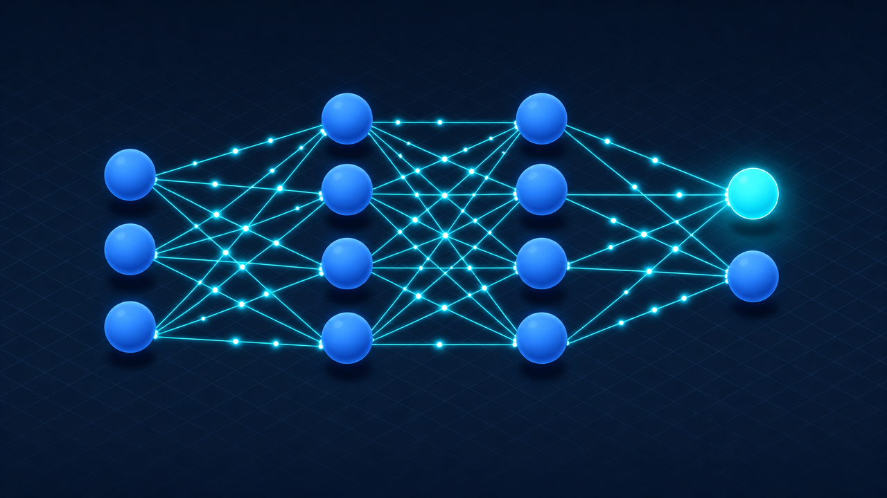
Feed Forward Neural Networks
The foundation architecture for backpropagation
Key Characteristics
No Cycles
Connections between nodes do
not form a cycle
One Direction Only
Data always moves forward,
never backwards
Simplest Form
Foundation model: single layer
perceptron for classification
Feed Forward
Recurrent
Directed acyclic graph
VS
Contains cycles
One-way data flow
Feedback loops
Static input → output
Sequential / time-series
04
Notes:
Now let's look at the architecture backpropagation operates on, the feed-forward neural network. The defining characteristic is in the name: information flows forward, and only forward. The connections never form a cycle. Data enters at the input layer, passes through one or more hidden layers, and emerges at the output, always moving in one direction. The simplest form is the single-layer perceptron. This matters because backpropagation was designed specifically to train these networks. Look at the comparison at the bottom: feed-forward networks have clean one-way data flow, while recurrent networks deliberately contain cycles and feedback loops to handle sequential data. We will return to that distinction later.

Slide 5
How Feed Forward Networks Work
Single Layer Perceptron Model
Process:
x1
w1
1. Inputs multiplied by weights
2. Weighted values summed
w2
3. Activation function applied
x2
∑
f(x)
y
4. If sum > threshold: output = 1
If sum < threshold: output = -1
w3
x3
Delta Rule
Multi-Layer Perceptrons
Compare outputs with intended values
Each hidden layer adjusted according
to adjust weights through training.
to output values from the final layer.
This produces a form of gradient descent.
Weight updating follows the same
In multi-layered perceptrons, this process
principle but propagates error backward
is defined as backpropagation.
through all intermediate layers.
05
Notes:
Let's walk through how a feed-forward network processes information. It begins with a series of inputs. Each input is multiplied by an associated weight, and all those weighted values are summed into a single number. That sum is compared against a threshold, usually zero. If the sum exceeds the threshold, the neuron fires with an output of positive one; if it falls below, the output is negative one. How does the network learn the right weights? Through the delta rule: we compare the actual output against the intended target, and that difference, the error, tells us how to adjust the weights. When we extend this from a single neuron to multi-layered perceptrons, this weight-updating process is exactly what we call backpropagation.

Slide 6
Applications of Feed Forward Networks
Mild
Intermediary
Independent
Synthesized
Networks
Output
Parallel
Processing
Like the Human Brain
Multiple independent neurons handle and process larger tasks. Individual networks
perform their tasks independently, and results are combined at the end to produce
a synthesized, cohesive output — mimicking biological neural parallel processing.
06
Notes:
Feed-forward networks are versatile, and one powerful pattern is to combine many of them together. Imagine a series of independent networks, each specializing in a sub-task, with a mild intermediary coordinating between them. This is similar to how the human brain works: individual groups of neurons handle pieces of a larger task, and the brain integrates them into coherent thought. In the same way, these independent networks perform their tasks separately and in parallel, and their results are combined at the end to produce a single cohesive output. This parallel processing is part of what makes feed-forward networks practical for complex, real-world problems.

Slide 7
Types of Backpropagation Networks
1
Static
2
Recurrent
3
BP Through
Backpropagation
Backpropagation
Time (BPTT)
Maps static input to
Processes input until a
Handles time-series data
static output.
fixed value is reached.
by unrolling recurrent
Used for static classification
Used for sequence-dependent
networks into feedforward
tasks like optical character
tasks where order matters
form for training. Each
recognition (OCR).
and output feeds back.
timestep = a network copy.
Classification Tasks
Sequence-Dependent Tasks
Time-Series Data
Input
NN
Output
NN
t1
t2
t3
...
07
Notes:
There are three main types of backpropagation networks, each suited to a different kind of problem. The first is static backpropagation, which maps a static input directly to a static output, with no notion of time. A classic example is optical character recognition. The second is recurrent backpropagation, where the network is fed forward repeatedly until it reaches a stable fixed value, making it suited to tasks that settle into a stable state. The third is backpropagation through time, abbreviated BPTT, designed for time-series and sequential data. It works by unrolling a recurrent network across its time steps, turning it into an equivalent feed-forward network that can be trained with standard backpropagation. We will look at this third type in more detail shortly.

Slide 8
Backpropagation Formula
Layer Output Equations
Symbol Reference
Layer 1:
h
=
f
(
W
·
x
+
b
)
h
Output of hidden layer i
1
1
1
1
i
f
Activation function (sigmoid, ReLU, tanh)
i
Layer 2:
h
2
=
f
2
(
W
2
·
h
+
b
)
W
Hidden weights matrix in layer i
1
2
i
x
Input vector to the neural network
Layer N:
h
N
=
f
N
(
W
N
·
h
N-1
+
b
N
)
N
Number of layers in the network
b
Bias matrix in layer i
i
How It All Connects
Each layer receives the previous layer's output as input. The entire network is a composition
of functions: the output of each layer feeds into the next. This chained structure is what
makes backpropagation possible — the chain rule can be applied to compute gradients
efficiently, layer by layer, from the output back to the input.
08
Notes:
Let's make the mathematics concrete, layer by layer. Consider the first hidden layer. It takes the input vector x, multiplies it by a weight matrix W one, adds a bias b one, and passes the result through an activation function f one, producing an output we call h one. Here is the crucial pattern: the second layer does the same thing, but instead of the raw input it takes h one as its input, producing h two. This continues through the network, each layer feeding its output forward as the input to the next, until the final layer output, denoted h N. To clarify the symbols: the subscript i indexes the layer, h i is the output of layer i, f i is its activation function, W i is its weight matrix, b i is its bias, x is the input vector, and N is the number of layers. This nested chain of functions is exactly what backpropagation will need to differentiate.

Slide 9
Loss Function for Backpropagation
Training Behavior
Forward Propagation
Loss
Start: high loss
Input x passes through layers to produce
output. Information flows forward.
x
Network
output
Trained: low loss
Training iterations
Loss Function C
Measures how far predictions are
from true labels:
Common Loss Functions
C = Loss( output , label )
Cross-Entropy
Cosine Similarity
Low C = good prediction
Hinge Loss
Mean Squared Error
High C = poor prediction
Objective: reduce C by adjusting network weights
09
Notes:
The loss function is central to understanding why backpropagation works. During forward propagation, an input x passes through all the layers and produces an output. We then compare that output against the known correct answer, the label vector. The loss function, which we call C for cost, measures exactly how far off the prediction was. A low value of C means the output is close to the label, which is good; a high value means it is far off, which is bad. At the start of training, when the weights are essentially random, the loss is very large. As training proceeds, a fully trained model settles at a small loss. There are many loss functions to choose from depending on the problem, including cross-entropy loss, cosine similarity, and hinge loss.

Slide 10
Computing the Loss Gradient
Must calculate derivative of C with respect to every weight:
∂C / ∂w
i,j,k
C
w
i,j,k
Loss Function
Network Weight
Minimize C
Weight Notation
w
i,j,k
= weight from node j in layer (i-1) to node k in layer i. Each weight is updated individually to reduce C.
10
Notes:
Here is the central computational challenge. To reduce the loss, we need to know how the cost function C changes when we tweak each weight. In other words, we must calculate the partial derivative of C with respect to every weight in the network. Let me decode the weight notation, because it appears throughout the rest of this lecture. The symbol w with subscripts i, j, k refers to a specific connection: the weight from node j in layer i minus one, going to node k in layer i. So the three indices pin down which layer, which source node, and which destination node. By computing all of these partial derivatives, we learn precisely how much each weight contributes to the total error, and that tells us exactly how to adjust it. During training, every weight is updated individually to drive the cost downward.

Slide 11
Chain Rule for Gradient Calculation
The Chain Rule
Key Efficiency Advantage
C depends on weight values via a chain of
Derivatives at layer N calculated first.
many functions. For z depending on y,
These are ingredients for layer N-1.
where y depends on x:
Save and reuse derivative calculations
via the chain rule — avoids duplicate
dz/dx = (dz/dy) · (dy/dx)
calculations across all layers.
Backward Computation Flow
Layer N
Layer N-1
Layer N-2
…
Layer 1
Calculate ∂C/∂w
Reuse N results
Reuse N-1 results
All gradients done
Start here
End here
← Direction of gradient computation (backward through the network)
Each layer's derivatives are an ingredient in the chain rule formula for the previous layer.
11
Notes:
The chain rule from calculus is the engine that makes backpropagation efficient. The cost function C depends on the weights, but not directly. It depends on them through a long chain of nested functions, one for each layer the signal passes through. The chain rule handles exactly this kind of nested dependency: if z depends on y, and y depends on x, then the derivative of z with respect to x equals the derivative of z with respect to y times the derivative of y with respect to x. Here is the key efficiency advantage. The derivatives at the last layer, layer N, are calculated first. Those become reusable ingredients for computing the derivatives at layer N minus one. We work backward through the network, saving and reusing the derivative calculations from the layer behind us. This avoids an enormous amount of duplicate computation. Without this reuse, training deep networks would be hopelessly expensive.

Slide 12
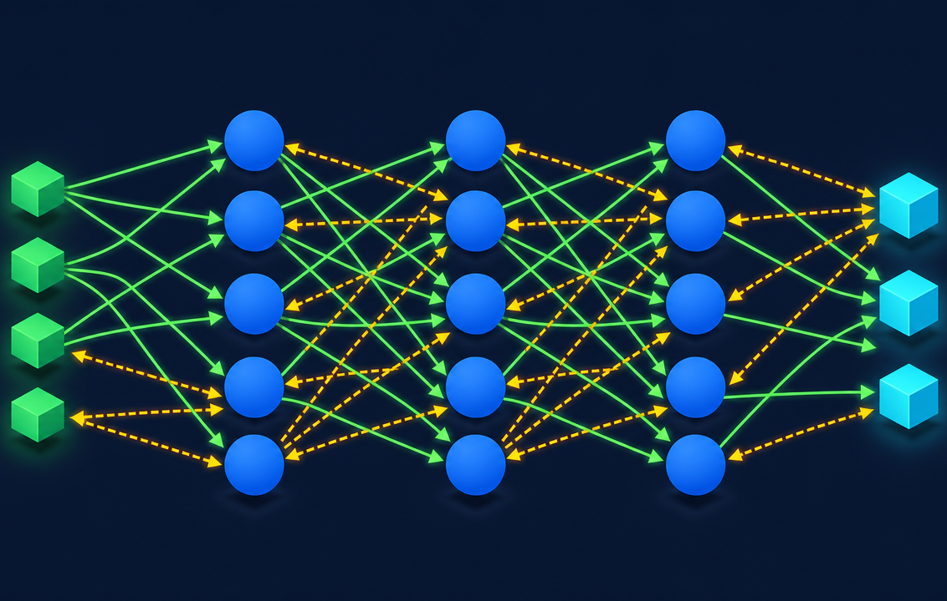
How Backpropagation Algorithm Works
Algorithm Steps
1
Inputs X arrive through pre-connected path
2
Input modeled using randomly selected weights W
3
Calculate output for every neuron layer by layer
4
Calculate error in the outputs
5
Travel back, adjust weights to decrease error
6
Repeat until desired output is achieved
Error Calculation
Error = Actual Output - Desired Output
Computes gradient via chain rule
Does not define gradient usage
Generalizes the delta rule
One layer at a time, efficiently
Separate from optimization method
Works with any number of outputs
12
Notes:
Now let's put everything together and walk through the complete algorithm. Step one, the inputs arrive at the network through a pre-connected path. Step two, these inputs are modeled using weights, which at the beginning are selected randomly. Step three, we perform the forward pass, calculating the output for every neuron, moving layer by layer from input to output. Step four, we calculate the error at the output by comparing the actual output against the desired output. Step five, the backward pass that gives the algorithm its name: we travel back from the output toward the hidden layers, adjusting the weights in the direction that decreases the error. Step six, we repeat this cycle over and over until the output is close enough to the desired result. The formula at the bottom captures the essence: error equals actual output minus desired output, and our goal is to drive that toward zero.

Slide 13
Standard BP vs Backpropagation Through Time
Standard Backpropagation
Backpropagation Through Time
Applies to feedforward networks (directed acyclic graph)
"Unrolls" recurrent neural network across time steps
Chain rule applied recursively through layers
Treats unrolled RNN as feedforward for training
Static input-output mapping, no temporal dependency
Handles sequential, time-dependent data
In
H
Out
t1
t2
t3
...
BPTT Challenges
Vanishing Gradient Problem
Large unrolled networks become difficult to train
Distant interactions produce diminishingly small gradients
Easily trapped in local optima during optimization
Makes learning long-range dependencies very difficult
Solutions
ReLU Activation
Regularization Techniques
LSTM / GRU Architectures
13
Notes:
It is important to clearly distinguish standard backpropagation from backpropagation through time. Standard backpropagation applies to feed-forward networks, which are directed acyclic graphs with no loops. The chain rule is applied recursively through the layers, mapping a static input to a static output. Backpropagation through time is built for recurrent networks that process sequences. The trick it uses is to unroll the recurrent network across its time steps, so that what was a loop becomes a long feed-forward chain we can train normally. But this power comes with challenges: the unrolled network can become very large and difficult to train, it is easy to get trapped in local optima, and there is the famous vanishing gradient problem, where interactions between distant time steps produce gradients that shrink toward zero. Fortunately, there are solutions, including ReLU activation functions, regularization, and specialized architectures like LSTM and GRU.

Slide 14
Why We Need Backpropagation
The essential algorithm that makes deep learning possible
Simplifies Structure
Reveals Relationships
Assesses Impact
Removes least-effective weighted
Uncovers the relationship between
Measures how each input variable
links, streamlining the network
input layers and hidden unit layers
influences the final network
for better performance
during training
output accuracy
Deep Network Essential
Mathematical Elegance
Computational Necessity
Critical for deep neural networks
Leverages chain and power rules
Without backpropagation, training
in error-prone and complex
for efficient gradient computation
deep networks would be
real-world projects
across any number of outputs
computationally infeasible
14
Notes:
So why do we actually need backpropagation? First, it simplifies network structure, because during training it effectively reduces the influence of the least-effective weighted links. Second, it reveals the relationship between the input layer and the hidden layers, giving insight into what the network has learned. Third, it lets us assess the impact of each input variable on the network's output. Fourth, it is essential for deep neural networks, especially in error-prone, high-stakes projects. And fifth, it takes full advantage of the chain rule and the power rule, so it scales gracefully to any number of outputs. Here is the bottom line: without backpropagation, training deep networks would be computationally infeasible. It is the practical foundation that makes modern deep learning possible.

Slide 15

PART III
Real-World Applications
Pattern Recognition, Face Recognition, and Speech Recognition
15
Notes:
Having covered the theory and the mathematics, let's turn to the real world. In this part of the lecture, we will examine three concrete domains where networks trained with backpropagation have made a measurable impact: pattern recognition, face recognition, and speech recognition. Watch for how the same core algorithm adapts to very different kinds of data.

Slide 16
Pattern Recognition
What is a Pattern?
Human Perception
Neural Network Approach
A set of objects or phenomena
Humans naturally find patterns
Neural networks trained via BP
where the elements share
even in completely random
excel at automated, consistent
similar traits or characteristics.
noise and visual data.
pattern recognition.
Biological Examples:
Pareidolia Effect
Objective and repeatable
Paramecium, Amoeba, Euglena
Perceiving meaningful shapes in
clouds, rock formations, noise
Scales to millions of samples
Celestial Examples:
Star constellations in night sky
Can lead to false positives
Subjective, inconsistent results
Learns features automatically
Real-time classification
16
Notes:
Pattern recognition is one of the most natural applications of neural networks. Let's define our terms: a pattern is a set of objects or phenomena whose elements share similar traits. Interestingly, human perception has an extremely strong tendency to find patterns, sometimes even in pure random noise, like seeing shapes in clouds. The natural world is full of patterns waiting to be classified, from constellations of stars to microscopic organisms like the Paramecium, the Amoeba, and the Euglena. Networks trained via backpropagation excel at exactly this kind of automated pattern recognition. The network learns to extract the distinguishing features directly from the training data, then generalizes to recognize new, unseen examples. This ability to learn features automatically, rather than having engineers hand-design them, is one of the great strengths of the approach.

Slide 17
Backpropagation in Face Recognition
CNN Architecture (VGGFace)
Triplet Loss Function
Parkhi, Vidaldi & Zisserman (2015)
Refinement technique for embedding learning
Positive
Same ID
Minimize distance to
Conv
Pool
Conv
FC
Output
Anchor
positive sample
x5
Face A
Negative
Maximize distance to
18 layers total | 2,622 identity classes | 2.6M face images
Diff ID
negative sample
18-layer Deep CNN
Celebrity face training data
L = max(d(a,p) - d(a,n) + margin, 0)
How Backpropagation Drives Face Recognition Training
1
Forward pass through CNN
2
Compute triplet loss
3
Backpropagate gradients
4
Repeat until convergence
Compute face embeddings
Penalize misclassifications
Update all 18 layer weights
High-accuracy embeddings
17
Notes:
Let's look at a concrete example: the face recognition system by Parkhi, Vidaldi, and Zisserman in 2015. They built a deep convolutional neural network with eighteen layers, trained entirely using backpropagation, in two phases. In the initial phase, batches of celebrity face images were passed through all eighteen layers, and backpropagation adjusted the weights throughout. Then came a refinement phase, applied to the final layer using a special objective called the triplet loss function. The triplet loss is an elegant idea: it penalizes the network whenever it classifies the same person as different people, or different people as the same person. The input is three face images at a time, for example two photos of Matt Damon and one of Brad Pitt. The network learns to pull the two Matt Damon images close together in its internal representation while pushing the Brad Pitt image far away. It is a great illustration of backpropagation combined with a cleverly designed loss function.

Slide 18
Backpropagation for Speech Recognition
Sony Corporation Research
English and Japanese speech recognition on embedded devices
Speech Processing Pipeline
Sound Input
Time Windows
FFT Analysis
Features
5-Layer Neural Network
Raw audio waveform
Segment into frames
Frequency domain
Frequency features
Softmax cross-entropy loss + BP
Network Architecture
Transfer Learning
BP Role in Training
5-layer deep neural network
Train on Japanese data first,
Backpropagation adjusts weights
optimized for embedded devices
then transfer learned features
across all 5 layers by computing
to English recognition model.
gradients of the cross-entropy
Loss = -sum(y * log(y_hat))
loss with respect to each weight.
Japanese
English
Softmax cross-entropy for multi-class output
Enables embedded device deployment
18
Notes:
Our second application comes from Sony Corporation, which used backpropagation to build speech recognition for English and Japanese on small embedded devices. Let's trace the pipeline. It starts with a raw sound signal, which is divided into short time windows. A Fast Fourier Transform is applied to each window to convert it from the time domain into the frequency domain, extracting the frequency features. Those features are fed into a five-layer neural network, trained using a softmax cross-entropy loss with backpropagation across all five layers. Here is the elegant part: they used transfer learning. The network was first trained on Japanese speech, then the learned features were adapted to recognize English commands. This demonstrates one of backpropagation's most valuable properties, the flexibility to carry knowledge across languages and domains, which matters when deploying on resource-constrained hardware.

Slide 19
History of Backpropagation
1847
1970
2000s+
Cauchy
Linnainmaa
Deep Learning
Invented
Reverse mode
Revolution in AI
gradient descent
auto differentiation
powered by BP
1960s
1986
Early AD
Rumelhart, Hinton
Automatic
& Williams
differentiation
Popularized BP for
neural networks
Over 170 Years of Mathematical Foundations
From Cauchy's gradient descent to modern deep learning, backpropagation stands on centuries of mathematical progress
19
Notes:
The history of backpropagation stretches back further than most people realize. The story arguably begins with Augustin-Louis Cauchy, the mathematician who lived from 1789 to 1857 and invented gradient descent, the optimization idea at the heart of the method. The nineteen sixties saw early foundational work on automatic differentiation. Then, in 1970, Seppo Linnainmaa developed the reverse mode of automatic differentiation, which is exactly the technique backpropagation uses. The algorithm entered the spotlight in 1986, when Rumelhart, Hinton, and Williams published their landmark paper that popularized backpropagation for training neural networks. And from the two thousands onward, efficient implementations running on powerful hardware became the driving force behind the deep learning revolution that continues to this day.

Slide 20
Key Points & Best Practices
1
Simplify Network Structure
2
Study Layer Relationships
3
Assess Input Variable Impact
Remove least-effective weighted links
Examine input and activation values
Measure how each input variable
to create a leaner, more efficient
to understand hidden relationships
influences the final network output
network architecture.
between layers.
and prediction accuracy.
4
Deep NN Applications
5
The "Shoe Lace" Analogy
Especially useful for deep neural
Like tying a shoe lace, backpropagation is an iterative process of adjustment.
networks in image recognition,
Each iteration fine-tunes the weights until the network produces the correct output.
speech processing, and NLP tasks.
The process repeats: forward pass, compute error, backward pass, update weights.
Forward
Error
Backward
Update
Summary
Backpropagation is the cornerstone of deep learning training. It enables efficient gradient computation across arbitrarily
deep networks, making modern AI applications in vision, speech, and language understanding possible.
20
Notes:
Let's consolidate the key points before we close. First, backpropagation simplifies network structure by effectively eliminating the least-effective weighted links during training. Second, studying the input and activation values helps you understand the relationships between the input layer and the hidden layers. Third, it lets you assess the impact of each input variable on the output, which supports interpretation and debugging. Fourth, it is especially powerful for deep networks in error-prone domains, with image and speech recognition as the textbook examples. And here is an analogy to carry away with you, the shoelace analogy: training a network with backpropagation is like tying your shoelaces. You do not get a perfect knot in one motion; you make an iterative series of small adjustments until everything fits. Backpropagation does exactly that with the weights, one small correction at a time.

Slide 21
Disadvantages of Backpropagation
Data Quality Dependency
Noise Sensitivity
Performance is heavily dependent on the quality of input
The algorithm is highly sensitive to noisy data.
data. Poor or biased training data leads to inaccurate
Noise in training samples can propagate through the
weight adjustments and unreliable models.
network and degrade overall learning effectiveness.
Batch Strategy Trade-offs
Vanishing / Exploding Gradients
Full matrix-based approach is preferred over mini-batch
Gradients can become vanishingly small or explosively
for accuracy, but requires significantly more memory
large in deep networks, making training unstable or
and computation per update step.
impossible for certain architectures.
Computational Expense
For large networks with millions of parameters, backpropagation becomes computationally expensive.
Each training iteration requires a full forward and backward pass, scaling with network depth and width.
21
Notes:
In the interest of a balanced picture, let's talk about the limitations, because no technique is without drawbacks. First, the performance of backpropagation is highly dependent on the quality of the input data. Second, it can be quite sensitive to noisy data, which can mislead the gradient and destabilize learning. Third, for certain use cases, a full matrix-based approach is preferred over mini-batch processing. Fourth, in very deep networks we run into the vanishing and exploding gradient problems, where gradients become either too small to make progress or too large to remain stable. And fifth, it can be computationally expensive for large-scale networks. That said, modern hardware, better activation functions, and improved optimization techniques continue to mitigate these challenges, which is why the algorithm remains dominant.

Slide 22
Thank You
Backpropagation in Neural Networks
References
DeepAI.org
deepai.org/machine-learning-glossary-and-terms/backpropagation
Guru99.com
guru99.com/backpropagation-neural-network.html
Original Lecture: Maslina @ SSK5603
Enhanced with AI tools for CCS3600 Mini Project
CCS3600 Artificial Intelligence
22
Notes:
That brings us to the end of our lecture. These are the key references if you would like to read further. The DeepAI machine learning glossary provides an accessible conceptual overview, while the Guru99 tutorial walks through the algorithm step by step. This presentation was originally developed for the SSK5603 course by Maslina, and it has been enhanced with AI-generated visuals and a modern design for this CCS3600 Mini Project. Thank you for your attention throughout this session. I hope you now have a clear and confident mental model of how backpropagation works, why it matters, and where it is applied. Thank you.

