Slide 1
CCS3101
OBJECT – ORIENTED PROGRAMMING Topic 1 Introduction (Objects and Classes)
Dr. Khairul Azhar Kasmiran
Department of Computer Science
Faculty of Computer Science and Information Technology
University Putra of Malaysia
Room No: C3-14

Slide 2
Learning Objectives
At the end of this chapter, you will be able to:
Describe classes and objects in OOP (A1, C1)
Analyze a problem using object-oriented analysis. (C4)
Construct a simple object-oriented program (P4)

Slide 3

Motivations
After learning the preceding chapters, you are capable of solving many programming problems using selections, loops, methods, and arrays. However, these Java features are not sufficient for developing graphical user interfaces and large scale software systems. Suppose you want to develop a graphical user interface as shown below. How do you program it?

Slide 4
OO Programming Concepts
Object-oriented programming (OOP) involves programming using objects.
An object represents or an abstraction of some entity in the real world that can be distinctly identified.
For example, a student, a desk, a circle, a button, a cow, a car, a loan, and etc.
An object may be physical, like a radio, or intangible, like a song.
Just as a noun is a person, place, or thing; so is an object
An object has a
Unique identity
State or characteristics or attributes (properties), and
Action or behaviors.
The state an object consists of a set of data fields (also known as properties or attributes) with their current values.
The behavior of an object is defined by a set of methods .

Slide 5
Objects
Class Name: Circle
A class templates
Data Fields:
radius is ______
Three objects of class Circle
Methods:
getArea()
Circle Object 1
Circle Object 2
Circle Object 3
Data Fields:
radius is 10
Data Fields:
radius is 25
Data Fields:
radius is 125
An object has both a state and behavior. The state defines the object, and the behavior defines what the object does.

Slide 6
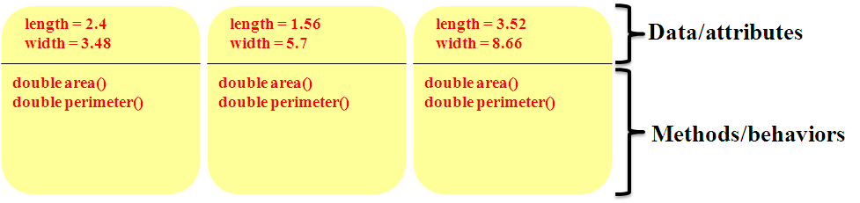
Objects
A rectangle is an object.
The attributes of a rectangle might be length and width, two floating point numbers; the methods compute and return area and perimeter.
Each rectangle has its own set of attributes; all share the same behaviors
The three rectangle objects

Slide 7
Classes
Classes are constructs that define objects of the same type.
A Java class uses variables to define data fields and methods to define behaviors.
Additionally, a class provides a special type of methods, known as constructors, which are invoked to construct objects from the class.

Slide 8
Classes

Slide 9
UML Class Diagram

Slide 10
Example: Defining Classes and Creating Objects
Objective: Demonstrate creating objects, accessing data, and using methods.
TestSimpleCircle
Run

Slide 11
Example: Defining Classes and Creating Objects
TV
TestTV
Run

Slide 12
Classes – Exercise 1
Rectangle Class
A Rectangle class might specify that every Rectangle object consists of two variables of type double:
double length, and
double width,
Every Rectangle object comes equipped with two methods:
double area(), and //returns the area, length x width,
double perimeter(), //returns the perimeter, 2(length + width).
Individual Rectangle objects may differ in dimension but all Rectangle objects share the same methods
Question:
Draw a UML class diagram of rectangle class
Create a rectangle class

Slide 13
Constructors
Constructors are a special kind of methods that are invoked to construct objects.
Circle() {
}
Circle(double newRadius) {
radius = newRadius;
}

Slide 14
Constructors, cont.
A constructor with no parameters is referred to as a no-arg constructor.
Constructors must have the same name as the class itself.
Constructors do not have a return type—not even void.
Constructors are invoked using the new operator when an object is created. Constructors play the role of initializing objects.

Slide 15
Creating Objects Using Constructors
new ClassName();
Example:
new Circle();
new Circle(5.0);

Slide 16
Default Constructor
A class may be declared without constructors.
In this case, a no-argument constructor with an empty body is implicitly declared in the class.
This constructor, called a default constructor, is provided automatically only if no constructors are explicitly declared in the class.

Slide 17
Declaring Object Reference Variables
To reference an object, assign the object to a reference variable.
To declare a reference variable, use the syntax:
ClassName objectRefVar;
Example:
Circle myCircle;

Slide 18
Declaring/Creating Objects in a Single Step
ClassName objectRefVar = new ClassName();
Example:
Circle myCircle = new Circle();
Assign object reference
Create an object

Slide 19
Accessing Object’s Member
Data field can be accessed and its methods invoked using the dot operator (.)
known as object member access operator.
Referencing the object’s data:
objectRefVar.data
e.g., myCircle.radius
Invoking the object’s method:
objectRefVar.methodName(arguments)
e.g., myCircle.getArea()

Slide 20
A Simple Circle Class
Objective:
Demonstrate creating objects, accessing data, and using methods.

Slide 21
1. public class TestCircle1 {
public static void main(String[] args) {
Circle myCircle = new Circle(5.0);
System.out.println("The area of the circle of radius " +
myCircle.radius + " is " +
myCircle.getArea());
Circle yourCircle = new Circle();
System.out.println("The area of the circle of radius "+
yourCircle.radius + " is " +
yourCircle.getArea());
yourCircle.radius = 100;
System.out.println("The area of the circle of radius " +
yourCircle.radius + " is " +
yourCircle.getArea());
}
}

Slide 22
class Circle {
double radius;
Circle( ) {
radius = 1.0;
}
Circle(double newRadius) {
radius = newRadius;
}
double getArea( ) {
return radius * radius * radius * Math.PI;
}
}

Slide 23
Trace Code
animation
Declare myCircle
Circle myCircle = new Circle(5.0);
Circle yourCircle = new Circle();
yourCircle.radius = 100;
myCircle
no value

Slide 24
Trace Code, cont.
animation
Circle myCircle = new Circle(5.0);
Circle yourCircle = new Circle();
yourCircle.radius = 100;
myCircle
no value
Create a circle

Slide 25
Trace Code, cont.
animation
Circle myCircle = new Circle(5.0);
Circle yourCircle = new Circle();
yourCircle.radius = 100;
myCircle
reference value
Assign object reference to myCircle

Slide 26
Trace Code, cont.
animation
Circle myCircle = new Circle(5.0);
Circle yourCircle = new Circle();
yourCircle.radius = 100;
myCircle
reference value
yourCircle
no value
Declare yourCircle

Slide 27
Trace Code, cont.
animation
Circle myCircle = new Circle(5.0);
Circle yourCircle = new Circle();
yourCircle.radius = 100;
myCircle
reference value
yourCircle
no value
Create a new Circle object

Slide 28
Trace Code, cont.
animation
Circle myCircle = new Circle(5.0);
Circle yourCircle = new Circle();
yourCircle.radius = 100;
myCircle
reference value
yourCircle
reference value
Assign object reference to yourCircle

Slide 29
Trace Code, cont.
animation
Circle myCircle = new Circle(5.0);
Circle yourCircle = new Circle();
yourCircle.radius = 100;
myCircle
reference value
yourCircle
reference value
Change radius in yourCircle

Slide 30
Caution
Recall that you use
Math.methodName(arguments) (e.g., Math.pow(3, 2.5))
to invoke a method in the Math class. Can you invoke getArea() using SimpleCircle.getArea()? The answer is no. All the methods used before this chapter are static methods, which are defined using the static keyword. However, getArea() is non-static. It must be invoked from an object using
objectRefVar.methodName(arguments) (e.g., myCircle.getArea())
More explanations will be given in the section on “Static Variables, Constants, and Methods.”

Slide 31
Reference Data Fields
The data fields can be of reference types. For example, the following Student class contains a data field name of the String type.
public class Student {
String name; // name has default value null
int age; // age has default value 0
boolean isScienceMajor; // isScienceMajor has default value false
char gender; // c has default value '\u0000'
}

Slide 32
The null Value
If a data field of a reference type does not reference any object, the data field holds a special literal value, null.

Slide 33
Default Value for a Data Field
The default value of a data field is null for a reference type, 0 for a numeric type, false for a boolean type, and '\u0000' for a char type. However, Java assigns no default value to a local variable inside a method.
public class Test {
public static void main(String[] args) {
Student student = new Student();
System.out.println("name? " + student.name);
System.out.println("age? " + student.age);
System.out.println("isScienceMajor? " + student.isScienceMajor);
System.out.println("gender? " + student.gender);
}
}

Slide 34
Example
Java assigns no default value to a local variable inside a method.
public class Test {
public static void main(String[] args) {
int x; // x has no default value
String y; // y has no default value
System.out.println("x is " + x);
System.out.println("y is " + y);
}
}
Compilation error: variables not initialized

Slide 35
1. public class TestCircle1 {
public static void main(String[] args) {
double localVar;
Circle1 myCircle = new Circle1(5.0);
System.out.println(“The area of the circle of radius “ +
myCircle.radius + “ is “ +
myCircle.getArea());
Circle1 yourCircle = new Circle1();
System.out.println(“The default value for radius is “ +
yourCircle.radius);
System.out.println(“Default value for local variable is “ +
localVar);
yourCircle.radius = 100;
System.out.println(“The area of the circle of radius “ +
yourCircle.radius + “ is “ +
yourCircle.getArea());
}
}

Slide 36
class Circle1 {
double radius;
Circle1( ) {
radius = 1.0;
}
Circle1(double newRadius) {
radius = newRadius;
}
double getArea( ) {
return radius * radius * radius *
Math.PI;
}
}

Slide 37
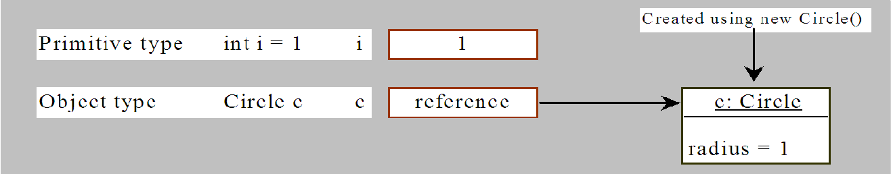
Differences between Variables of Primitive Data Types and Object Types

Slide 38
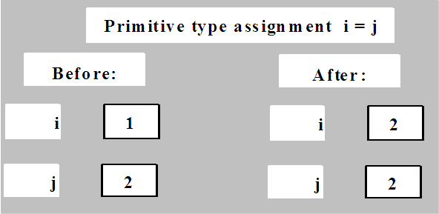
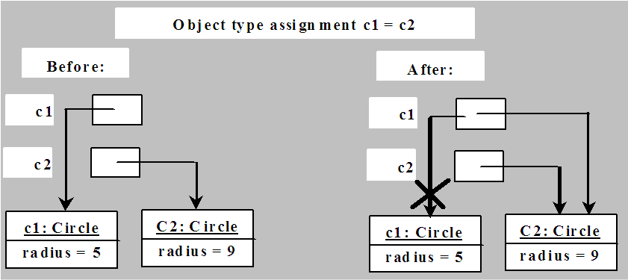
Copying Variables of Primitive Data Types and Object Types

Slide 39
Garbage Collection
As shown in the previous figure, after the assignment statement c1 = c2,
c1 points to the same object referenced by c2.
The object previously referenced by c1 is no longer referenced.
This object is known as garbage.
Garbage is automatically collected by Java Virtual Machine (JVM).
TIP:
If you know that an object is no longer needed, you can explicitly assign null to a reference variable for the object.
The JVM will automatically collect the space if the object is not referenced by any variable.

Slide 40
The Date Class
Java provides a system-independent encapsulation of date and time in the java.util.Date class. You can use the Date class to create an instance for the current date and time and use its toString method to return the date and time as a string.

Slide 41
The Date Class Example
For example, the following code
java.util.Date date = new java.util.Date();
System.out.println(date.toString());
displays a string like Sun Mar 09 13:50:19 EST 2003.

Slide 42
Instance Variables, and Instance Methods
Instance variables belong to a specific instance.
Instance methods are invoked by an instance of the class.

Slide 43
Static Variables, Constants, and Methods
Static variables are shared by all the instances of the class.
Static methods are not tied to a specific object.
Static constants are final variables shared by all the instances of the class.
To declare static variables, constants, and methods, use the static modifier.

Slide 44
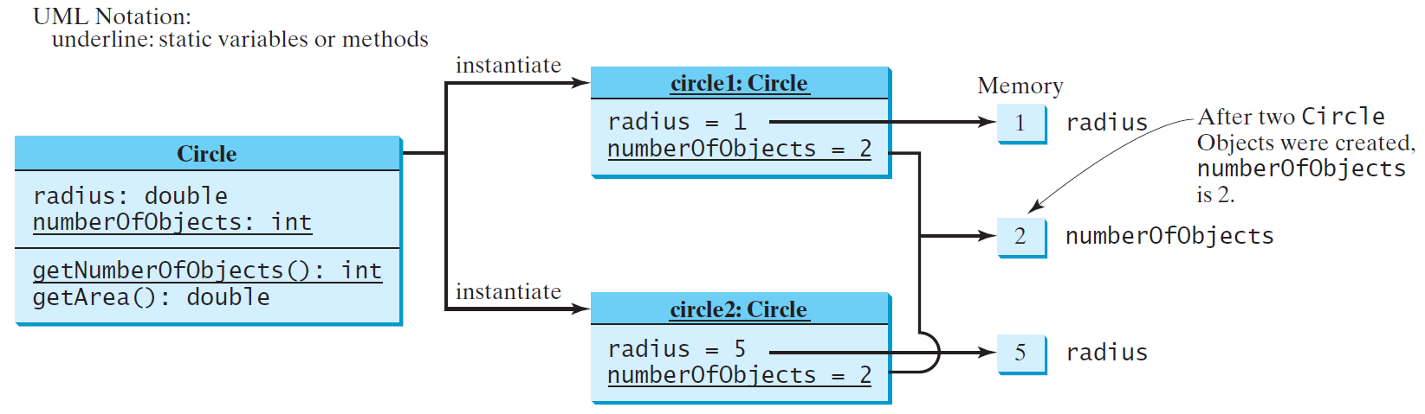
Static Variables, Constants, and Methods, cont.

Slide 45
Example of Using Instance and Class Variables and Method
Objective: Demonstrate the roles of instance and class variables and their uses. This example adds a class variable numberOfObjects to track the number of Circle objects created.
CircleWithStaticMembers
TestCircleWithStaticMembers
Run

Slide 46
Visibility Modifiers and Accessor/Mutator Methods
By default, the class, variable, or method can be accessed by any class in the same package.
public
The class, data, or method is visible to any class in any package.
private
The data or methods can be accessed only by the declaring class.
The get and set methods are used to read and modify private properties.

Slide 47
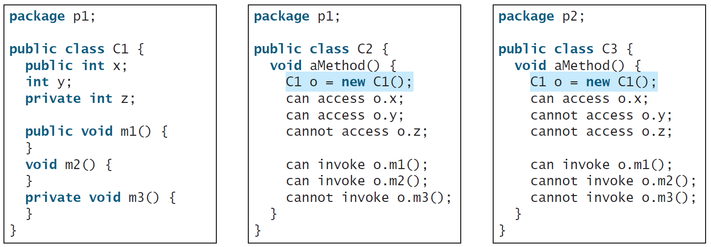
The private modifier restricts access to within a class, the default modifier restricts access to within a package, and the public modifier enables unrestricted access.

Slide 48
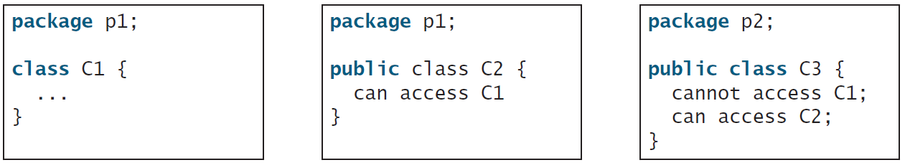
The default modifier on a class restricts access to within a package, and the public modifier enables unrestricted access.

Slide 49
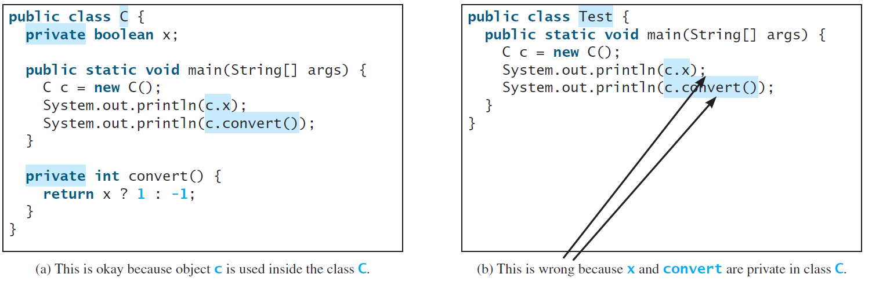
NOTE
An object cannot access its private members, as shown in (b). It is OK, however, if the object is declared in its own class, as shown in (a).

Slide 50
Why Data Fields Should Be private?
To protect data.
To make code easy to maintain.

Slide 51
Why Data Fields Should Be private?
Data field encapsulation: declare the data field as private to prevent direct modification of properties
Provide a get method to return the value of the data field. (getter/accessor)
Accessor method does not change the state of its implicit parameter.
Provide a set method to enable a private data field to be updated (setter/mutator)
Mutator method changes the state

Slide 52
Example of Data Field Encapsulation
CircleWithPrivateDataFields
TestCircleWithPrivateDataFields
Run

Slide 53
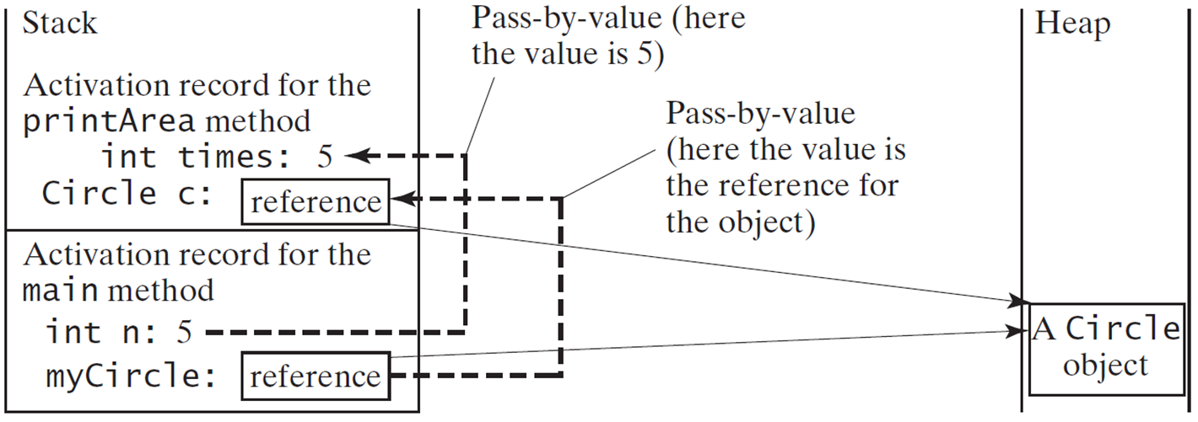
Passing Objects to Methods
Passing by value for primitive type value (the value is passed to the parameter)
Passing by value for reference type value (the value is the reference to the object)
TestPassObject
Run

Slide 54
Array of Objects
Circle[] circleArray = new Circle[10];
An array of objects is actually an array of reference variables. So invoking circleArray[1].getArea() involves two levels of referencing as shown in the next figure. circleArray references to the entire array. circleArray[1] references to a Circle object.

Slide 55
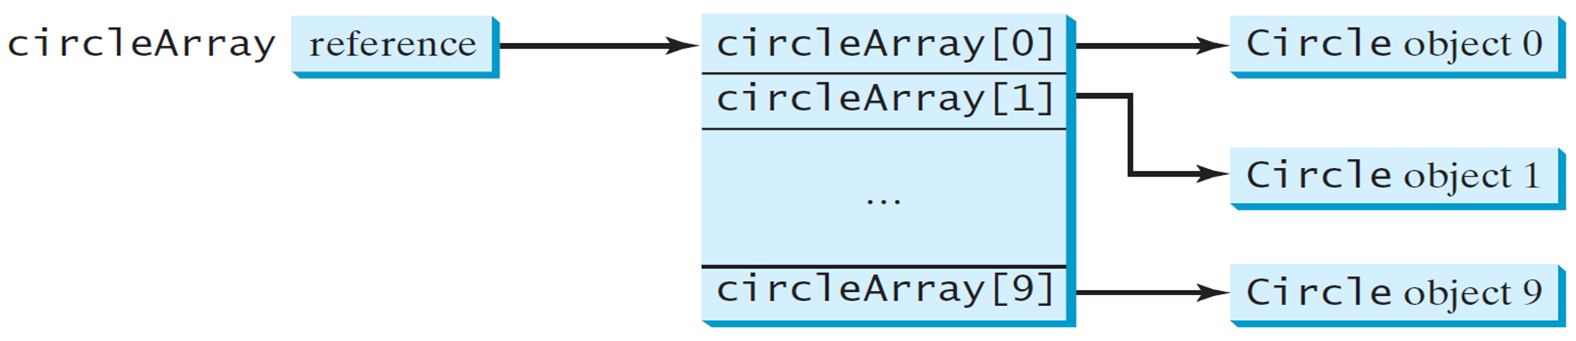
Array of Objects, cont.
Circle[] circleArray = new Circle[10];

Slide 56
Array of Objects, cont.
Summarizing the areas of the circles
TotalArea
Run

Slide 57
Immutable Objects and Classes
If the contents of an object cannot be changed once the object is created, the object is called an immutable object and its class is called an immutable class. If you delete the set method in the Circle class in Listing 8.10, the class would be immutable because radius is private and cannot be changed without a set method.
A class with all private data fields and without mutators is not necessarily immutable. For example, the following class Student has all private data fields and no mutators, but it is mutable.

Slide 58
Example
public class BirthDate { private int year; private int month; private int day; public BirthDate(int newYear, int newMonth, int newDay) { year = newYear; month = newMonth; day = newDay; } public void setYear(int newYear) { year = newYear; } }
public class Student { private int id; private BirthDate birthDate; public Student(int ssn, int year, int month, int day) { id = ssn; birthDate = new BirthDate(year, month, day); } public int getId() { return id; } public BirthDate getBirthDate() { return birthDate; } }
public class Test { public static void main(String[] args) { Student student = new Student(111223333, 1970, 5, 3); BirthDate date = student.getBirthDate(); date.setYear(2010); // Now the student birth year is changed! } }

Slide 59
What Class is Immutable?
For a class to be immutable, it must mark all data fields private and provide no mutator methods and no accessor methods that would return a reference to a mutable data field object.

Slide 60
Scope of Variables
The scope of instance and static variables is the entire class. They can be declared anywhere inside a class.
The scope of a local variable starts from its declaration and continues to the end of the block that contains the variable. A local variable must be initialized explicitly before it can be used.

Slide 61
The this Keyword
The this keyword is the name of a reference that refers to an object itself. One common use of the this keyword is reference a class’s hidden data fields.
Another common use of the this keyword to enable a constructor to invoke another constructor of the same class.

Slide 62
Reference the Hidden Data Fields

Slide 63
Calling Overloaded Constructor

Slide 64
Summary
Objects and classes
Data fields
Methods
Constructors
UML
private, public
Object reference variables
Array of objects
Passing objects to methods
Getters/accessors – get___()
Setters/mutators – set___()
instance and static

Slide 65
End of Chapter 1

