Slide 1
Communication and Computer Network CNS3200
Notes:
1

Slide 2
Learning outcome
Identify components in data communication (C4)
Topics
Introduction
Data communication
Components
Example of Protocol
Data Representation
Transmission Mode
Network

Slide 3
Introduction
Why Data Communications?
accessibility – to get accurate information.
data/information sharing?
Eg: From one pc – data copied onto a floppy disk and physically reloaded to another pc/remote computer – time consuming, inconveniences.
Revolution is occurred in telecommunications networks
Technological advances drive communication links to carry more and faster signals.
3

Slide 4
Data Communication
Definition:
Telecommunication= means communication at a distance (tele is Greek for far). E.g: telephony, telegraphy, and television.
Data =
Facts, concepts, and instructions presented in whatever form is agreed upon by the parties creating and using data.
In the context of computer IS, data are represented by binary information units (or bits) produced and consumed in the form of 0s and 1s.
Data communication
The exchange of data between two devices via some form of transmission medium (such as wire cable)
4

Slide 5
Data Communication
The effectiveness of a data communication system depends on 4
fundamental characteristics :
Delivery
The system must deliver data to the correct destination.
Accuracy
The system must deliver data accurately.
Timeliness
The system must deliver data in timely manner.
Jitter
Variation in arrival time.
5

Slide 6
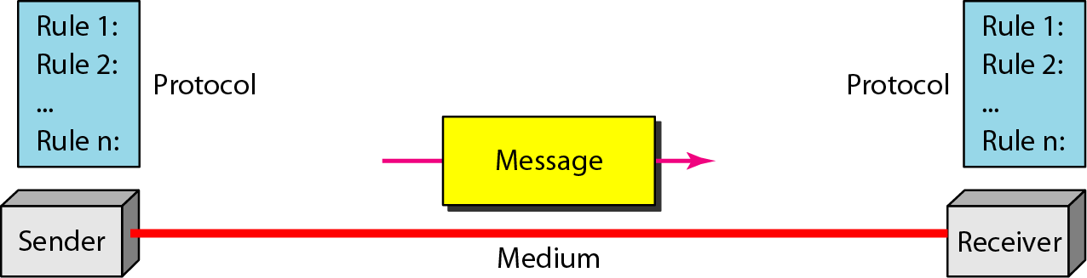
Data Communication
Data communication components
6

Slide 7
Data Communication Components
A data communication system consists of 5 components :
Message– The message is the information (data) to be communicated. Can consists of text, numbers, picture, audio, video.
Sender – the device that sends the data message. Can be a computer, workstation, mobile phone, video cam etc
Receiver – the device that receives the message. Can be a computer, workstation, mobile phone, tv etc.
Medium – the physical path by which a message travels from sender to receiver. UTP cable, coaxial, fiber optic, radio wave.
Protocol – A set of rules that govern data communication. Represent an agreement between the communicating devices.
7

Slide 8
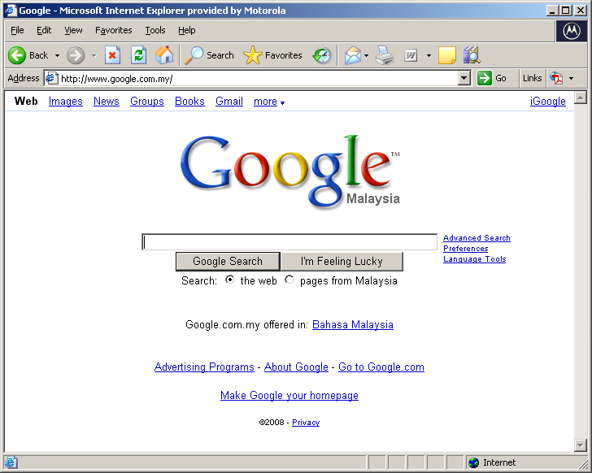
Example of Protocol
8

Slide 9
Data representation
Types of data representation
Text
In the bit format (“0”,”1”) – bit pattern
Known as code – a set of bit sequence
Ie: - Unicode
Numbers
Also represented by bit patterns
Images
Also represented by bit patterns associated with each pixels.
Ie: black pixel – all ‘1’s
Audio
Video
9

Slide 10
Transmission mode
Term transmission mode – the direction of signal flow between two linked devices.
There are three types:
Simplex
Half-duplex
Full-duplex
10

Slide 11
Transmission mode
Simplex
The communication is unidirectional. Only one of two stations on a link can transmit; the other can only receive
E.g: keyboards and traditional monitor
Half-Duplex
Each station can both transmit and receive, but not at the same time.
When one device is sending, the other can only receive, and vice versa
The entire capacity of a channel is taken over at the time
E.g: walkie-talkie
Full-Duplex
Both stations can transmit and receive simultaneously.
Like two way street, traffic flowing in both directions at the same time.
Sharing the capacity of the link.
E.g: telephone line, videoconferencing
11

Slide 12
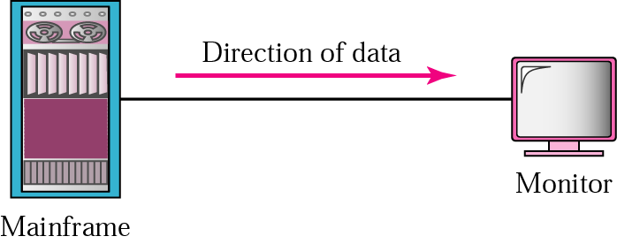
Simplex
12

Slide 13
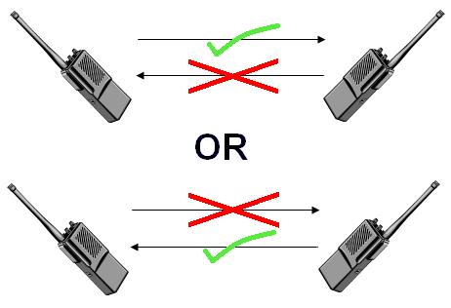
Half-Duplex
(Only 1 communication at a single time can be transmitted)
13

Slide 14

Half-Duplex
14

Slide 15

Full-Duplex
15

Slide 16
Networks
A network is a set of devices (often referred to as nodes) connected by communication links (channel).
A node can be a computer, printer, or any other device capable of sending and/or receiving data generated by other nodes on the network.
Networks use distributed processing, in which task is divided among multiple computers
Network criteria:
Performance – ie: transmit time and response time
Reliability – frequency of failure
Security – protecting data from unauthorized access and damage.
16

Slide 17
Computer Network and Communication SKR 3200

Slide 18
Learning outcome
Ilustrate/draw network topology and architecture (C4)
linking the importance of protocols and standards (C3)
Topics
Topology
Network models
Protocol and standard

Slide 19
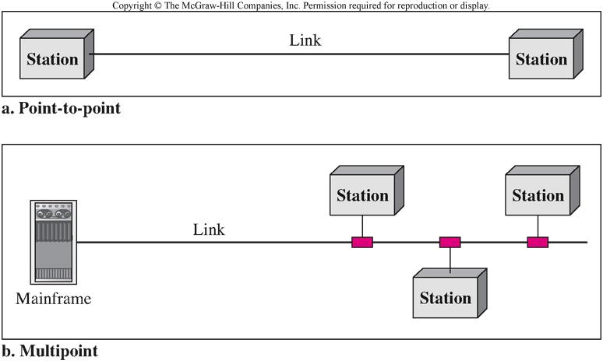
Physical Structure
Type of connection
Point-to-point
Multipoint
Physical Topology

Slide 20
Physical Topology
Physical topology – refers to how the network is laid out physically
4 basic topology
Mesh - dedicated point-to-point link to every other device (see figure 1.5 in the text book)
Star - dedicated point-to-point link only to a central controller (see figure 1.6 in the text book)
Bus – all devices are linked through a long cable acts as a backbone (see figure 1.7 in the text book)
Ring – dedicated point-to-point to its adjacent devices (see figure 1.9 in the text book)
Hybrid topology
A collection of any two or more basic topology
Ie: a star backbone + three bus network (fig 1.9)

Slide 21
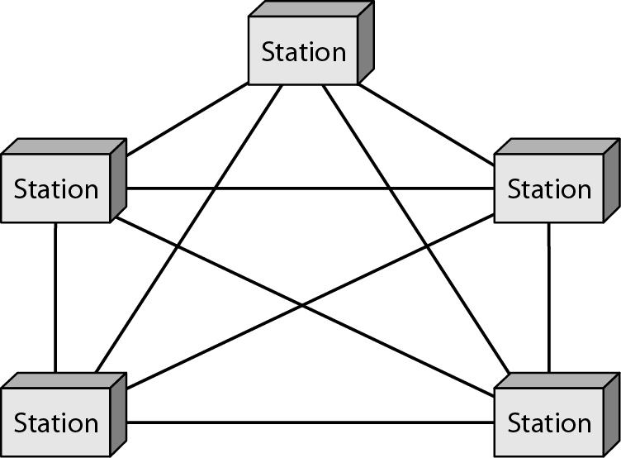
Nodes/Station (n)
> full duplex – n(n-1)/2
5(5-1)/2
= 10 links
Require a dedicated link
A fully connected mesh topology (five devices)
Notes:
1.#

Slide 22
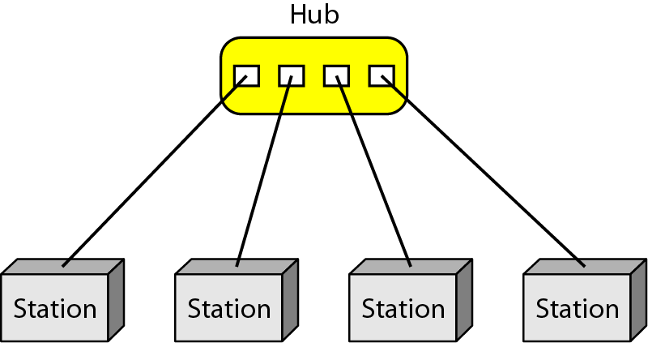
Central controller
All communication are through the hub
Is used in Local-Area Network (LAN)
Robustness – when a link fail- only the link is affected
Single point of failure
Less expensive compared to mesh topology
A star topology connecting four stations
Notes:
1.#

Slide 23
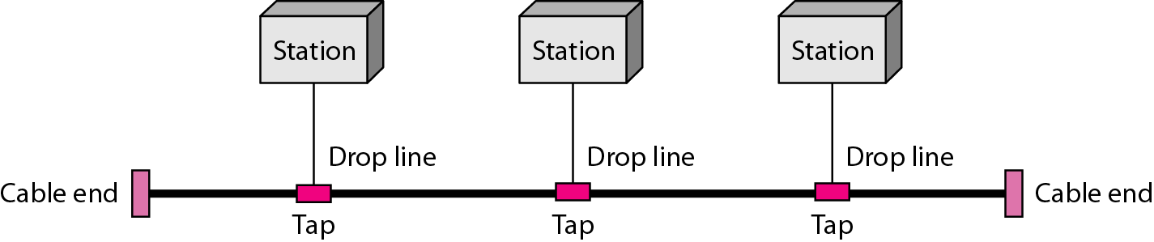
A bus topology connecting three stations
Connected by drop line and tap
Signal travel through cable = energy are converted to heat
Therefore it become weaker with the distance
Notes:
1.#

Slide 24
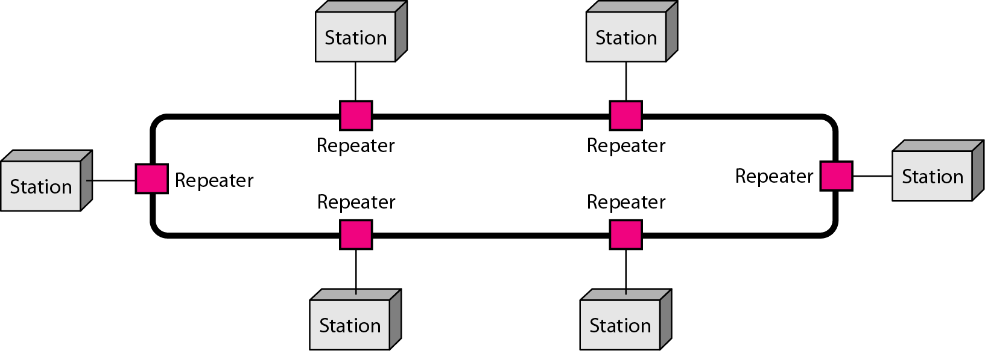
Connected to it immediate neighbours
Add/delete device require two connections
A ring topology connecting six stations
Notes:
1.#

Slide 25
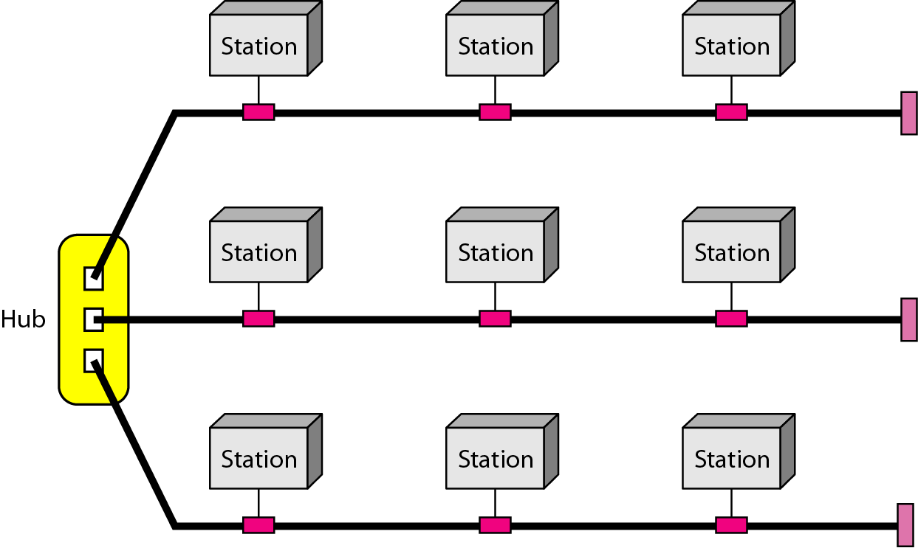
A hybrid topology: a star backbone with three bus networks
Notes:
1.#

Slide 26
Categories of Networks
Is based on size, ownership, the distance it covers and physical architecture.
LAN
Privately owned
Link the devices in a single office, building, or campus
Limited to a few kilometer
Resource sharing between PC/workstation
Other factor: transmission media and topology
Most common topologies: bus, ring, star
Data rate/speed up to 100Mbps
MAN
Designed to extend over an entire city
Ex: cable TV network, LAN to LAN resource sharing
Operates as private company or public company -maxis
26

Slide 27
Categories of Networks
WAN
Provides long distance transmission of data, voice, image, video conference over large geographic areas
May utilize as public, leased or private communication equipment.
Enterprise network – refer to WAN that wholly owned and used by a single company.

Slide 28
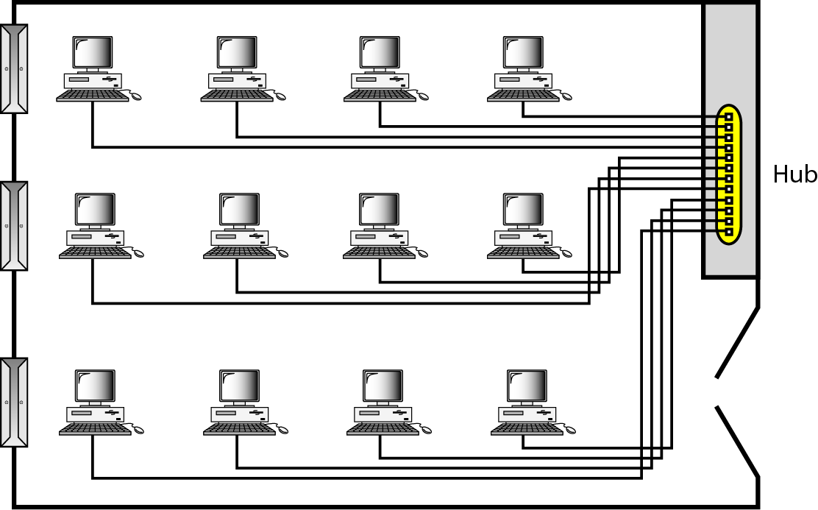
An isolated LAN connecting 12 computers to a hub in a closet
Notes:
1.#

Slide 29
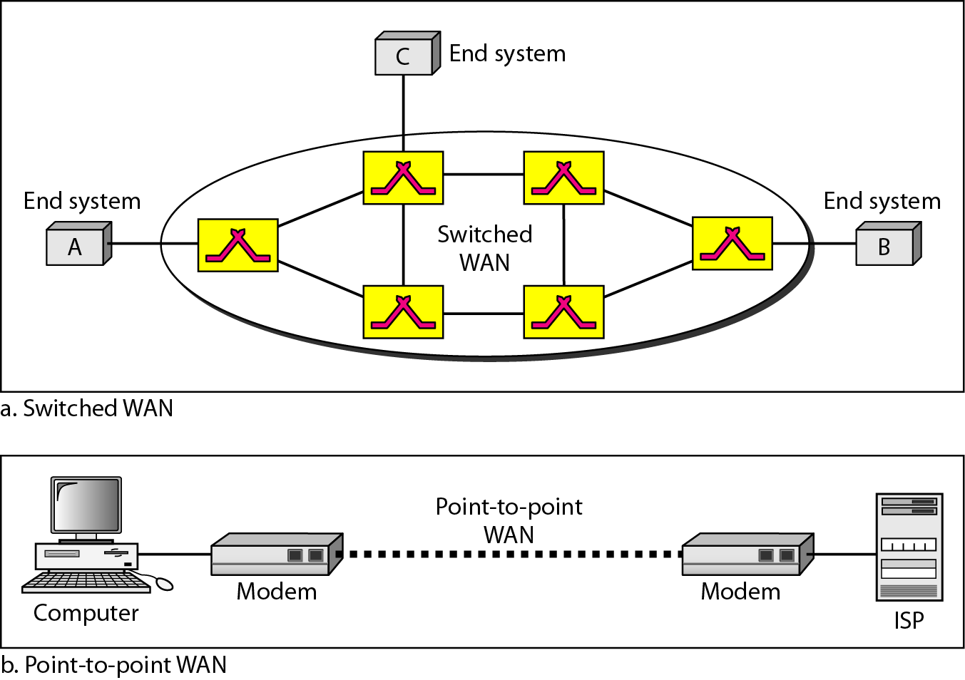
WANs: a switched WAN and a point-to-point WAN
Notes:
1.#

Slide 30
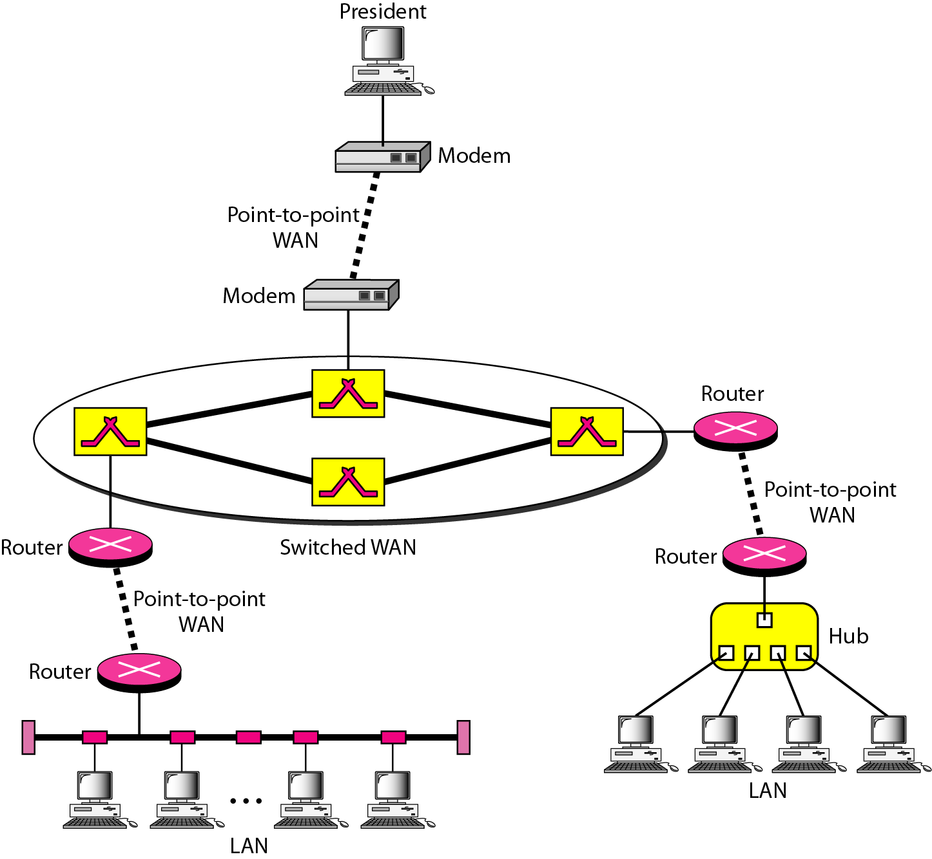
A heterogeneous network made of four WANs and two LANs
Notes:
1.#

Slide 31
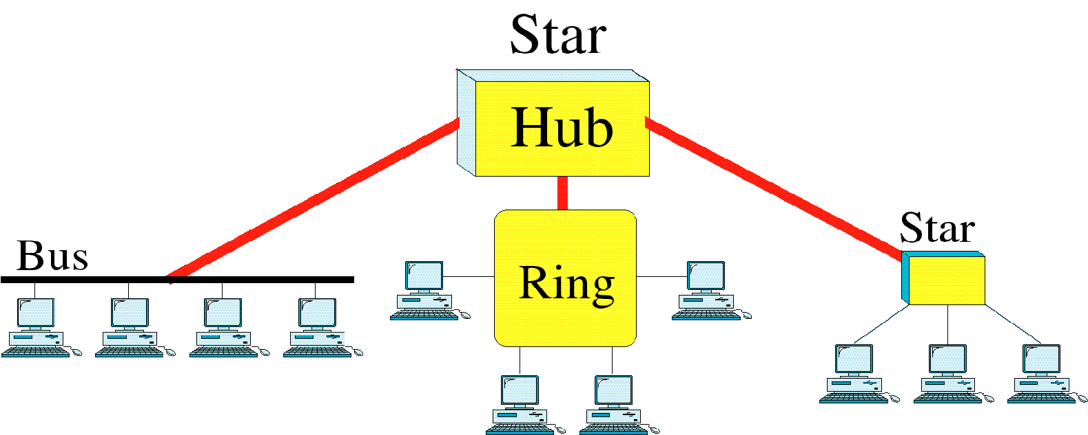
Topology
Hybrid Topologies
Often a network combines several topologies as subnetworks linked together in a larger topology
Several topology can be connected to each other via a central controller in a star topology
31

Slide 32
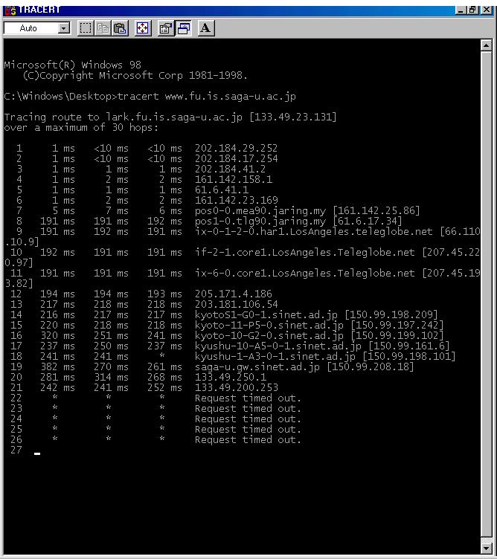
WAN Connection (tracert www.fu.is.saga-u.ac.jp)
FSKTM, UPM
IDEC, UPM
JARING MIMOS (MALAYSIA)
TELEGLOBE
(LOS ANGELES, USA)
KYOTO, JAPAN
KYUSHU, JAPAN
SAGA, JAPAN

Slide 33
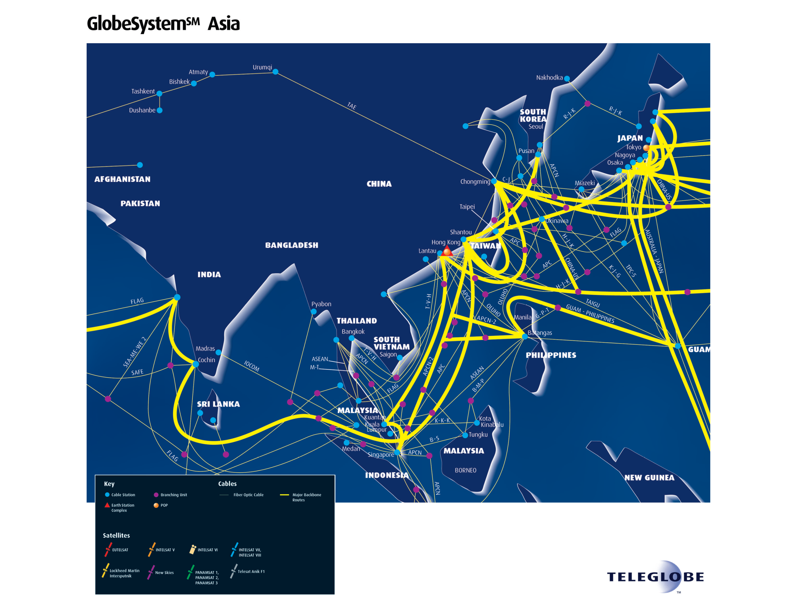

Slide 34
Internetworks
Internetwork/internet – two or more networks are connected
Internetworking devices – routers, gateways
internet – a generic term used to mean an interconnection of networks
Internet – a specific worldwide network

Slide 35
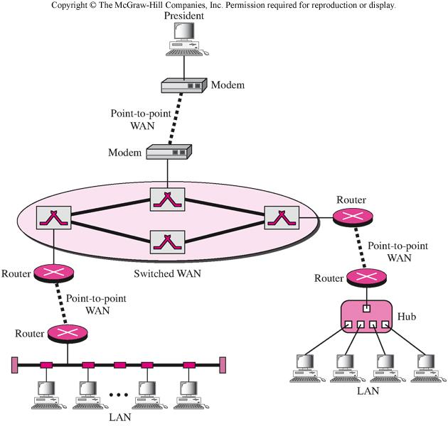

Slide 36
The Internet
The Internet has revolutionized many aspects of our daily lives. It has affected the way we do business as well as the way we spend our leisure time. The Internet is a communication system that has brought a wealth of information to our fingertips and organized it for our use.
Topics discussed in this section:
A Brief History
The Internet Today (ISPs)
Notes:
1.#

Slide 37
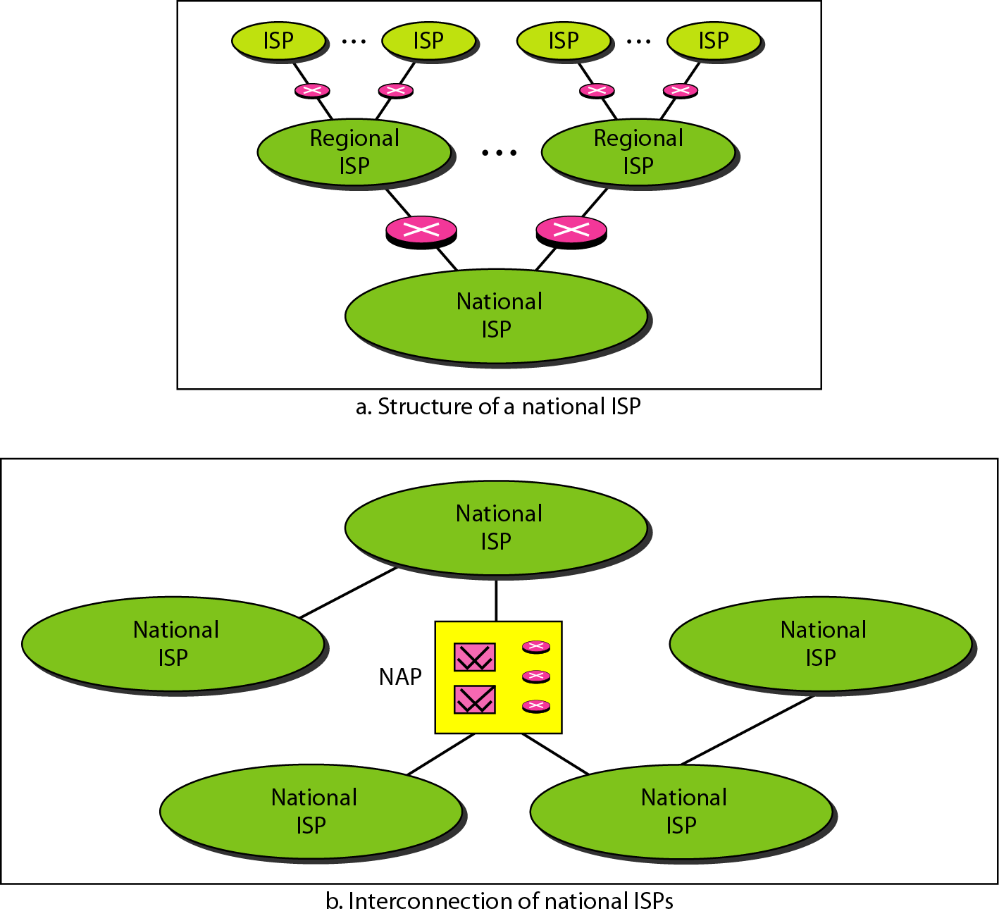
Hierarchical organization of the Internet
Notes:
1.#

Slide 38
Protocols and Standards
In this section, we define two widely used terms: protocols and standards. First, we define protocol, which is synonymous with rule. Then we discuss standards, which are agreed-upon rules.
Topics discussed in this section:
Protocols Standards
Standards Organizations Internet Standards
Notes:
1.#

Slide 39
Protocol & Standard
Protocol – set of rules that govern data communication.
For the simplicity -the protocol is the collection of rules- definition on what, how and when it is communicated.
Key element of a protocol are:
Syntax – refers to the structure or format of the data, the order in which they are presented.
Semantics – refers to the meaning of each section bits.
Timing – refers to two characteristic: when data should be sent, and how fast they can be sent
Standard –provides a model for development that makes it possible for a product to work regardless of individual manufacturer
When no standards, difficulties arise. Example: automobile

Slide 40
Cont..
Standard – creating and maintaining an open and competitive market for equipment manufacturers, guaranteeing national/international interoperability of data and telecommunications tech process
Data com standard can be categorized to 2:
De jure (by law/regulation)
Legislated by an officially recognized body
De facto (by fact/convention)
Proprietary, nonproprietary

Slide 41
Standards Organization
Standard are developed by cooperation among standards creation committees, forums, and government regulatory agencies.
Standards Creation Committees:
ISO – International Standards Organization
ITU-T – International Telecommunications Union –Telecommunication Standards Sector
ANSI – American National Standard Institute
IEEE- Institute of Electrical and Electronic Engineers
EIA – Electronic Industries Association
Telcorda
ISO – multinational body whose membership is drawn mainly from the standards creation committees of various governments throughout the world.
Aim – to facilitate the international exchange of goods and services by providing models for compatibility

Slide 42
Standard Organization
ISO – International Standards Organization
This organization contributes to the standardization of large networks, such as Internet standard. ISO developed the OSI model. This model describes the principles of networks, constructing a simple and clear architecture for computer network.
ITU-T – International Telecommunications Union –Telecommunication
ITU is committed to standardizing large telecom networks, such as X.25 and frame relay.
ANSI – American National Standard Institute
This organization defined the standards of FDDI (fiber distributed data interface). It is a voluntary organization.
IEEE- Institute of Electrical and Electronic Engineers
This organization provides standard of network hardware. Based on the standards, hardware manufacturers produce compatible product. IEEE formulated 802. project for LAN including ethernet,token ring,WLAN etc
EIA – Electronic Industries Association
This association defines the standard of network cables, such as cAT5, RS232 etc

Slide 43
Standards Organization
ITU-T
formerly known CCITT – Consultative Committee for International Telecommunication Union
Related to UN which developed standards for telecommunications
Two popular standards – V series and X series
ANSI
US non-profit organization
US representative to both the ISO and the ITU-T
IEEE
The largest professional engineering society in the world
Develops standards for computing, communication, electrical engineering and electronics
Sponsored an important standard for LAN called Project 802

Slide 44
Standards Organization
EIA
Association of electronics manufacturers in US
Responsible for developing the EIA-232-D and EIA-530 standards – define serial transmission between two digital devices. (computer to modem)
Telcordia
Provides R&D resources for the advancement of telecommunication technology.
Important source of draft standard to ANSI
Forums
Telecommunications technology development is moving faster than the ability of standard committee to ratify standards
Standards committee are procedural bodies and by nature slow moving

Slide 45
Standards Organization
The forums work with universities and users to test, evaluate and standardize new technologies
At the end, the forums present their conclusion to standards bodies
Example – Frame Relay Forum, ATM Forum, Internet Society (ISOC), Internet Engineering Task Force(IETF)
Regulatory Agencies
All communication technology is subject to regulation by government agencies such as the Federal Communication Commission (FCC) in US.
Internet Standard
Tested specification to be used for Internet
Being published in Internet draft as Request for Comment(RFC) document

Slide 46
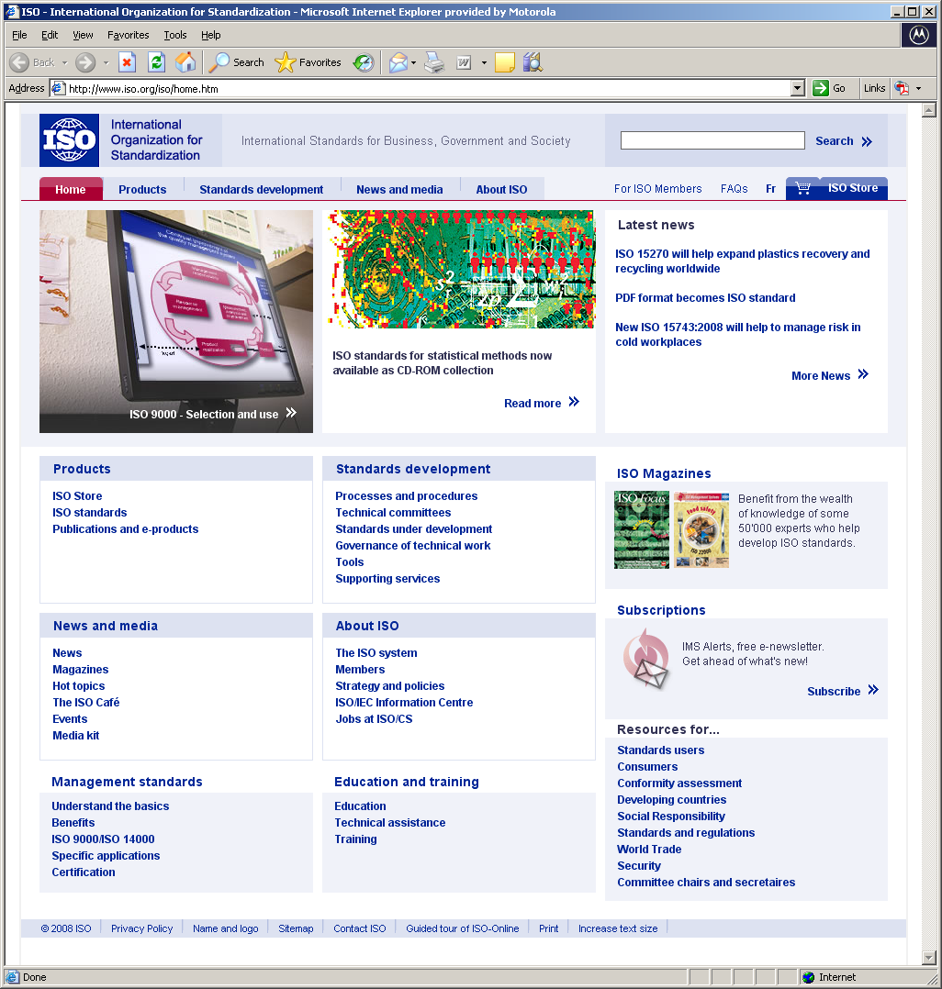
Examples of ISO standard

Slide 47
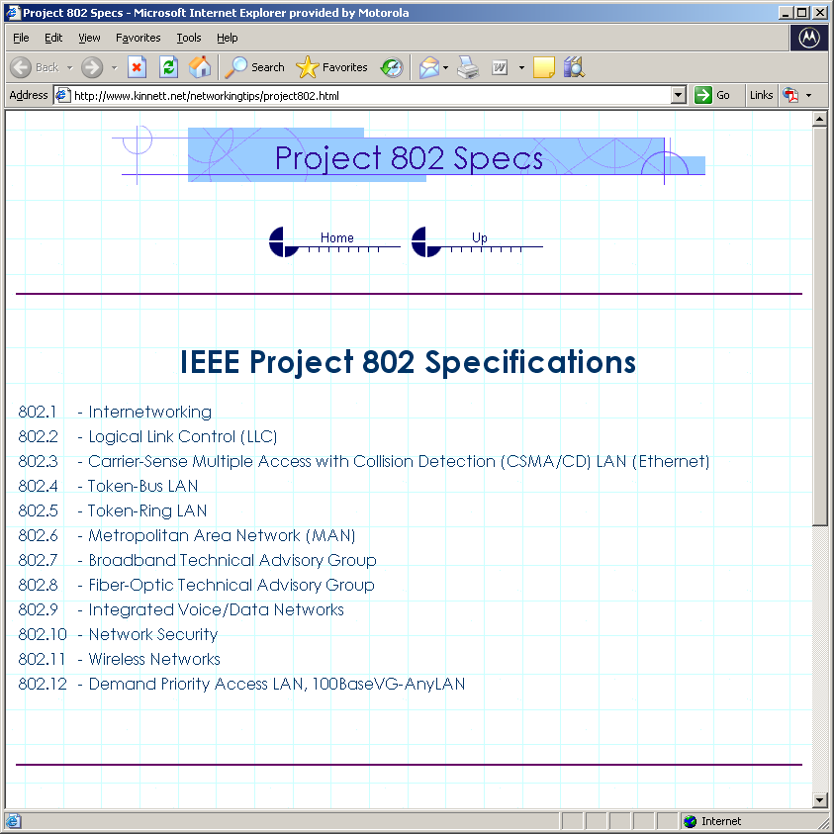
IEEE Specification

