Slide 1
To reflect and....
act.

Slide 2
The difference between the poor countries and the rich ones is not the age of the country.

Slide 3
This can be shown by countries like India & Egypt, that are more than 2000 years old and are still poor.

Slide 4
On the other hand, Canada, Australia & New Zealand, that 150 years ago were inexpressive, today are developed countries and are rich.

Slide 5
The difference between poor & rich countries does not reside in the available natural resources.

Slide 6
Japan has a limited territory, 80% mountainous, inadequate for agriculture & cattle raising, but it is the second world economy.
The country is like an immense floating factory, importing raw material from the whole world and exporting manufactured products.

Slide 7
Another example is Switzerland, which does not plant cocoa but has the best chocolate of the world. In its little territory they raise animals and plant the soil during 4 months per year.
Not enough, they produce dairy products of the best quality. It is a small country that transmits an image of security, order & labor, which made it the world’s strong safe.

Slide 8
Executives from rich countries who communicate with their counterparts in poor countries show that there is no significant intellectual difference.

Slide 9
Race or skin color are also not important: immigrants labeled lazy
in their countries of origin are the productive power in rich European countries.

Slide 10
What is the difference then?

Slide 11
The difference is the ATTITUDE of the people, framed along the years by the education & the culture.

Slide 12
On analyzing the behavior of the people in rich & developed countries, we find that the great majority follow the following PRINCIPLES in their lives:

Slide 13
1. Ethics, as a basic principle.
2. Integrity.
3. Responsibility.
4. Respect to the laws & rules.
5. Respect to the rights of other
citizens.
6. Work loving.
7. Strive for saving & investment.
8. Will of super action.
9. Punctuality.

Slide 14
In poor countries, only a minority follow these basic principles in their daily life.

Slide 15
We are not poor because we lack natural resources or because nature was cruel to us.

Slide 16
We are poor because we lack ATTITUDE.
We lack the will to comply with and teach these functional principles of rich & developed societies.

Slide 17
I went to the west and I saw Islam, but no Muslims; I got back to the East and saw Muslim, but not Islam”
“Mohammad Abduh”

Slide 18
Common Unethical Acts
Lying and witholding needed information
Abusive or intimidating behaviour
Misreporting time worked
Discrimination and sexual harassment
Stealing
Breaking environmental and safely laws
Falsifying records
Drug or alcohol abuse
Giving or accepting bribes

Slide 19
Why ethical problems occur?
Personal gain
Individual values widely differ with organizational goals
Managers values and attitudes
Competitive pressures
Cross-cultural contradictions

Slide 20
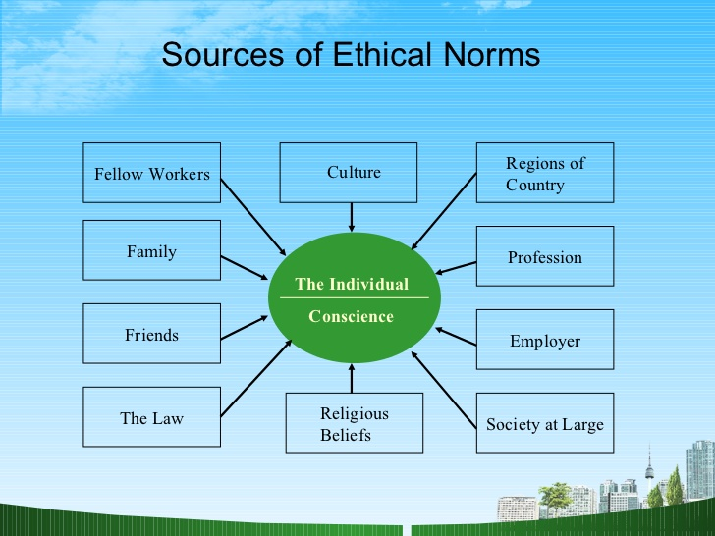

Slide 21
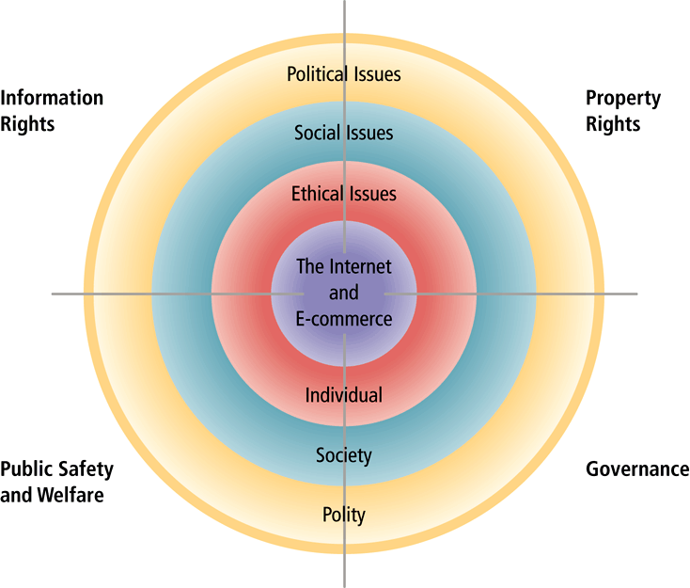
Moral Dimensions of an Internet Society
Moral Dimensions of an Internet Society
Figure 9.1, Page 498
Figure 9.1, Page 498
Pearson
Copyright © 2004 Pearson Education, Inc.
Slide 9-<number>

Slide 22
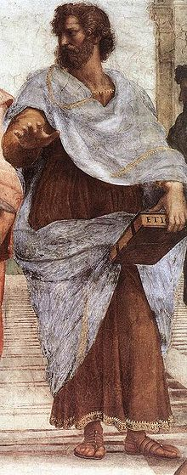
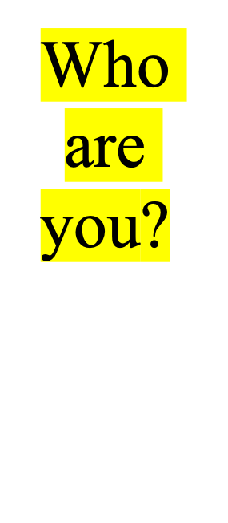
The moralist
My life view is superior
Other views are inferior
I have the answers
I need no other authority
The ethicist
My life view is based on reflection
I evaluate life views
I have questions
I respect other views
Aristotle (384-322)

Slide 23
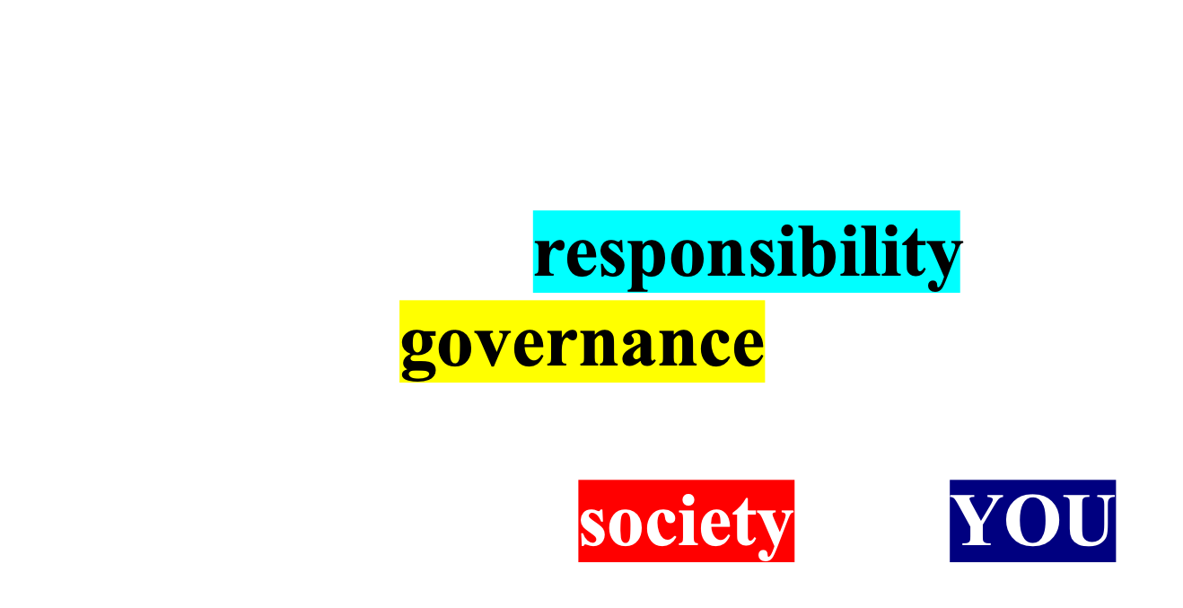

Slide 24
Class Ethics in Computing
Semester II 2024/2025
G1
All the Best
RNH, Nor

