Slide 1
Computer Network and Communication
CNS3200

Slide 2
Learning Outcome
Illustrate the layers involved in OSI model (C4)
Illustrate the layers involved in the Internet (TCP/IP) model (C4)

Slide 3
The OSI Model
Established in 1947, the ISO is a multinational body dedicated to worldwide agreement on international standard
ISO standard which covers all aspects of network communications – Open Systems Interconnection (OSI) model
Open System – a model that allows any two different systems to communicate regardless of their underlying architecture
OSI is not a protocol
Model for understanding and designing a network architecture that is flexible, robust, and interoperable
Notes:
Lecture notes

Slide 4

Figure 2.2 Seven layers of the OSI model
2.<number>

Slide 5
The model
OSI – a layered framework for design of network systems that allows for communication across all types of computer system
7 layer architecture
Intermediate nodes – involve only the first three layers
Peer-to-Peer Process?
  Layer n, use the services provided by layer n-1 and provides services for layer n+1
  The process on each machine that communicate at a given layer are called peer-to-peer process
  Use protocol

Slide 6
The model
At sending machine:
  headers added to the message at L6,5,4,3,2
  Trailer is added at only L2
At receiving machine
  The message is unwrapped layer by layer, received process and removing the data meant for it.(reverse of sending machine)
Interfaces between layers – control the passing of the data and network information down/up through the layers of sending/receiving machine

Slide 7
The model
The 7L can grouped into three subgroup
  L1,2,3 – the network support layer – deal with the physical aspects of moving data from one device to another
  L5,6,7 – the user support layer –allow interoperability among unrelated software systems
  L4 – ensures end-to-end reliable data transmission
After pass through L1 of sending machine, the data unit is changed into electromagnetic signal and transported along a physical link

Slide 8
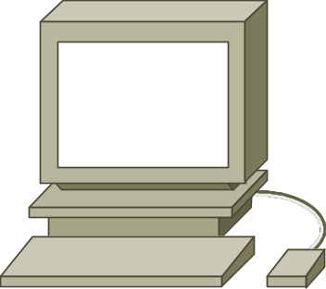

OSI REFERENCE MODEL
Application
Aplikasi Web, SMTP, FTP,Telnet,IRC,News dll
Presentation
Translation, Encryption and Compression
Session
Komunikasi yang selamat: Secure Socket Layer (SSL)
Transport
Connection/less, multiplex,flow dan error control
Network
Penghantaran paket ke destinasi
Data Link
Topologi Rangkaian,Pengalamatan, Error, flow control
Physical
FDDI,ATM, Ethernet, Token Ring, Dialup,wireless
Network card

Slide 9

The interaction Between Layers

Slide 10
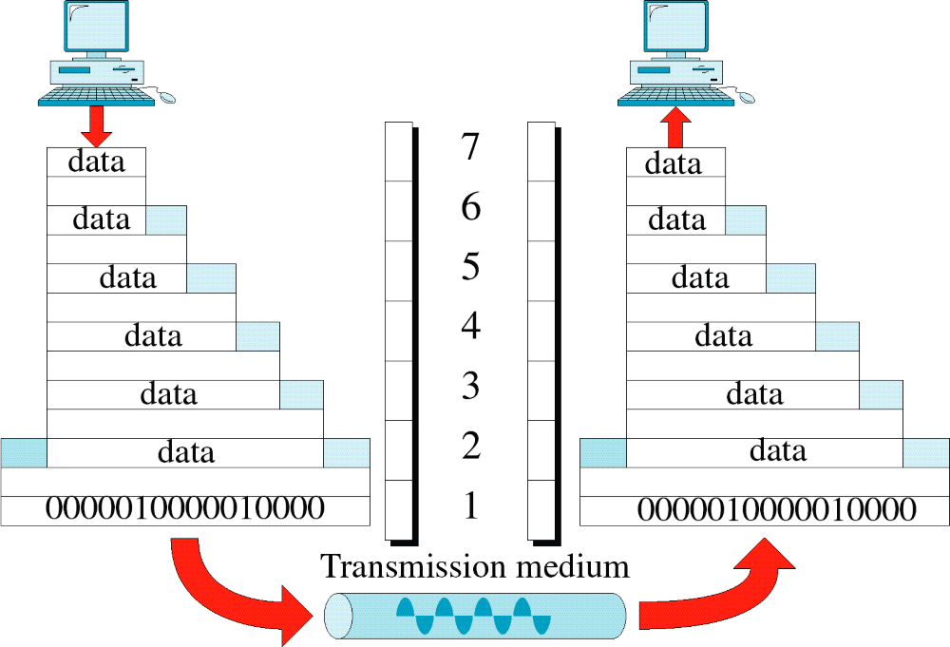
An Exchange Using the OSI Model

Slide 11
Function of Header in OSI and Internet
Pelayan
Pelanggan
data
Application
Application
segment
Presentation
Presentation
data
TCP
header
Session
Session
packet
Transport
Transport
data
TCP
header
IP
header
Network
Network
Data Link
frame
Data Link
data
TCP
header
IP
header
Ethernet
header
Physical
Physical
Network card

Slide 12
Computer Network and Communication
SKR 3200

Slide 13
3.2 Application Layer
Application Layer (L7)
  Enables user , whether human or software to access the network
  Provides user interfaces and support for services such as email, remote file access, shared database mgmt and transfer etc
  No trailer or header are added here
Specific services
  Network virtual terminal
  File transfer, access, and management (FTAM) –access/manage/control files in a remote computer
  Mail services - X.400 – store and forward email
  Directory services – X.500 – provides distributed database sources

Slide 14
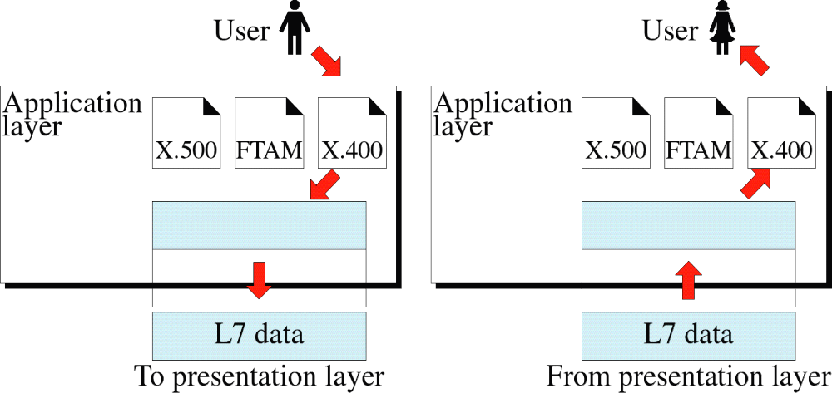
Application Layer

Slide 15

Note:
The application layer is responsible for providing services to the user.

Slide 16
3.2 Presentation Layer
Presentation Layer (L6)
  Concerned with the syntax and semantics of the information exchanged between two systems.
Responsibilities:
  Translation
    The process (running programs) in two systems are usually exchanging information
    Different computers use different encoding systems
    Responsible for interoperability between different encoding methods
    Sender machine change the information from its sender-dependent format into a common format
    Receiver machine change the common format into its receiver-dependent format

Slide 17
3.2 Presentation Layer
  Encryption
    Encryption - transform the original information to another form and sends it over the network
    Decryption - reverse process at the receiver side
    assure privacy - to carry a sensitive data/information
  Compression
    Reduces the number of bits to be transmitted
    multimedia data transmission – such as text, audio and video

Slide 18
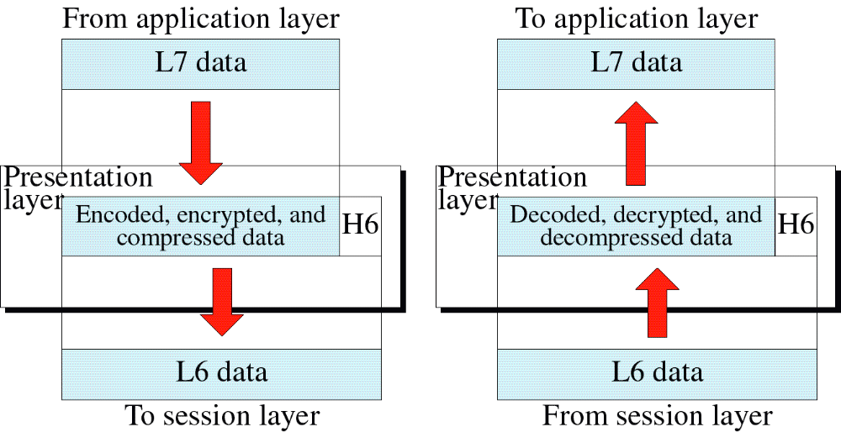
Presentation Layer

Slide 19
3.2 Session Layer
Session Layer (L5)
  The network dialog controller
  Establishes, maintains, and synchronizes the interaction between communicating systems
Responsibilities:
  Dialog control
    allows two systems to enter into a dialog
    communication between two process – half-duplex or full-duplex
  Synchronization
    allows a process to add checkpoints (synchronization points) into a stream of data
    E.g.: sending a file..

Slide 20
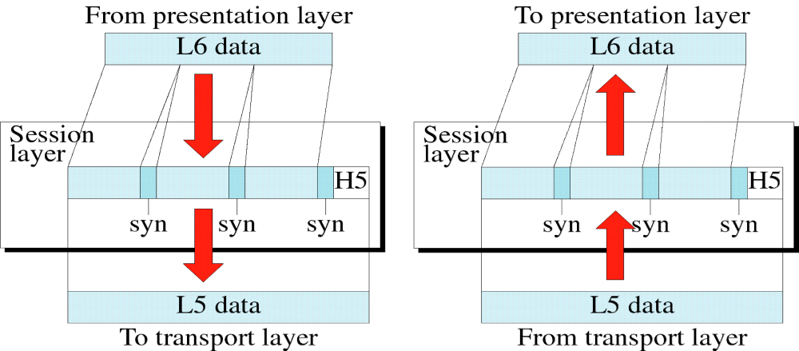
Session Layer

Slide 21
3.2 Transport Layer
Transport Layer (L4):
  Review of a network layer responsibility:
    Responsible for source-to-destination (end-to-end) delivery of the entire message
    Individual packet – treats each packet independently
  transport layer
    Ensures the whole (entire) message arrives intact and in order
    Oversee both error control and flow control at source-to-destination level
  To added security, transport layer create a connection between the two end ports
    Connection - Single logical path between the source and destination

Slide 22
3.2 Transport Layer
Creating connection involves 3 steps:
  Connection establishment
  Data transfer
  Connection release
Has more control over sequencing, flow, error correction and detection

Slide 23
3.2 Transport Layer
Specific responsibilities:
  Service-point addressing
    Computers often run several programs at the same time
    From a specific process (running program) on one computer to a specific process (running program) on the other
    TL header must include a service-point address or port address
  Segmentation and reassembly
    Segment – add a sequence number into message segment
  Connection control
    Can be either connectionless (independent packet) or connection oriented
  Flow control
    End-to-end flow control ( across multiple networks)
  Error control
    End-to-end error control ( across multiple networks)

Slide 24
Note:
The transport layer is responsible for delivery of a message from one process to another.

Slide 25
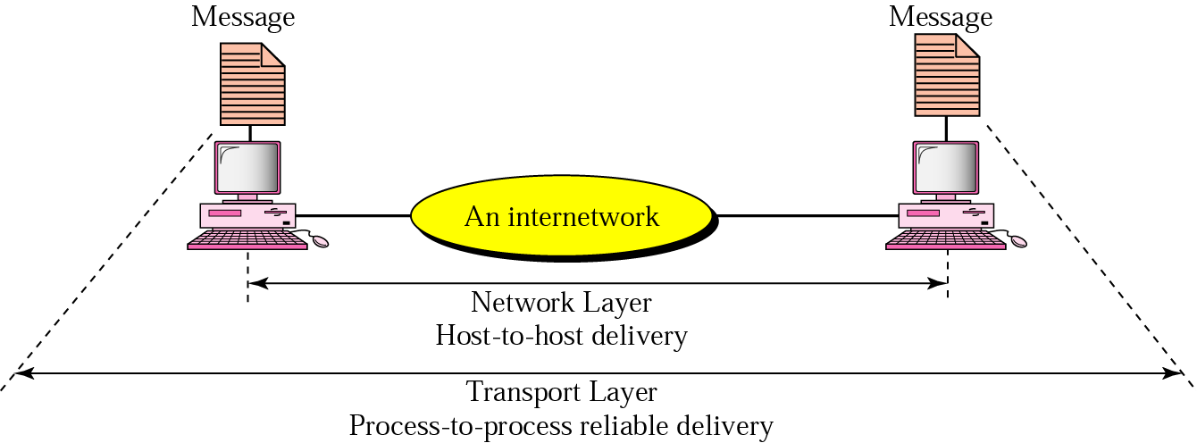
Figure : Reliable process-to-process delivery of a message
http daemon守护进程

Slide 26
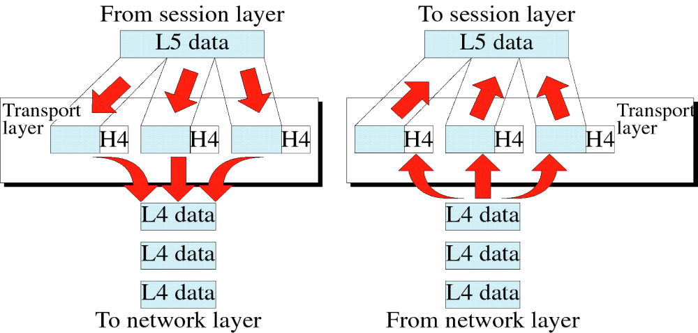
Transport Layer

Slide 27
3.2 Function of Each Layer
Network Layer (L3):
  Responsible for the source-to-destination delivery of a packet possibly across multiple networks (links)
  If two systems are attached to different networks, we need the network layer protocol to accomplish source-to-destination delivery
Specific responsibility:
  Logical addressing – to distinguish the source and destination systems when a packet passes the network boundary – also known network address
  Routing – internetwork/large network – route the packet to the final destination

Slide 28
Note:
The network layer is responsible for the delivery of packets from the original source to the
final destination.

Slide 29
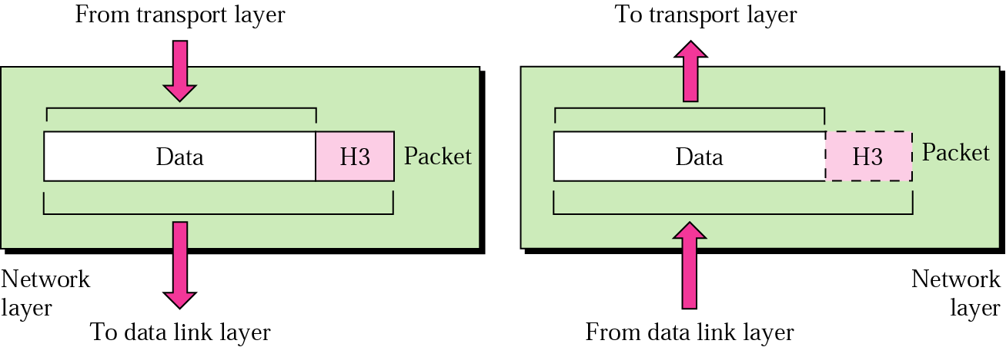
Network Layer

Slide 30
Function of Each Layer
Data Link Layer (L2):
  Responsible for node-to-node delivery
  Makes appear error free to the network layer
Responsibilities include:
    Framing – divides the stream data to manageable data units – frame
    Physical addressing – adds a header to the frame –to define the physical address of sender( source address) and receiver (destination address)
    Flow control – to prevent overwhelming at the receiver
    Error control – provides reliability – to detect and retransmit damaged or lost frames, also prevent duplication of frames -trailer
    Access control – require a protocol to determine which device has control over the link at any given time –> same link with two or more devices connected.

Slide 31
Note:
The data link layer is responsible for transmitting frames from
one node to the next.

Slide 32
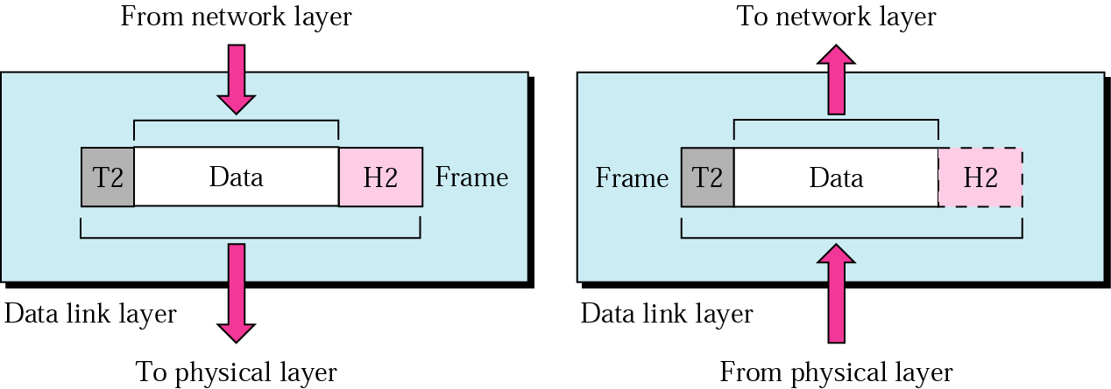
Data Link Layer

Slide 33
Network Layer Example
Example 1- if Dest is on different network
In the next figure, we want to send data from a node with network address A and physical address 10, located on one LAN, to a node with a network address P and physical address 95, located on another LAN. Because the two devices are located on different networks, we cannot use physical addresses only; the physical addresses only have local jurisdiction. What we need here are universal addresses that can pass through the LAN boundaries. The network (logical) addresses have this characteristic.

Slide 34
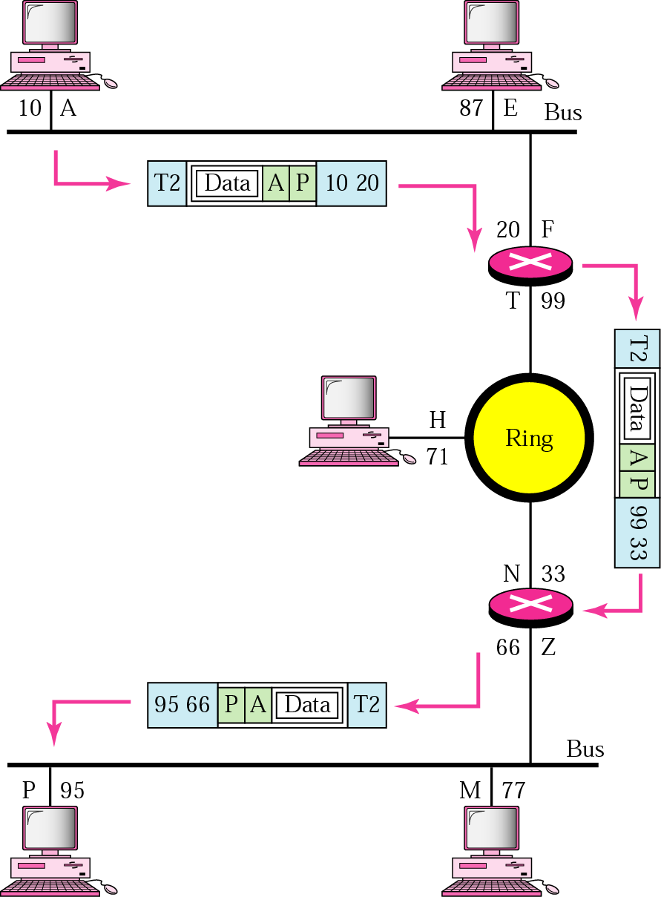
Network Layer Example

Slide 35
Example 1- if dest in same network
In the next figure, a node with physical address 10 sends a frame to a node with physical address 87. The two nodes are connected by a link. At the data link level this frame contains physical addresses in the header. These are the only addresses needed. The rest of the header contains other information needed at this level. The trailer usually contains extra bits needed for error detection

Slide 36
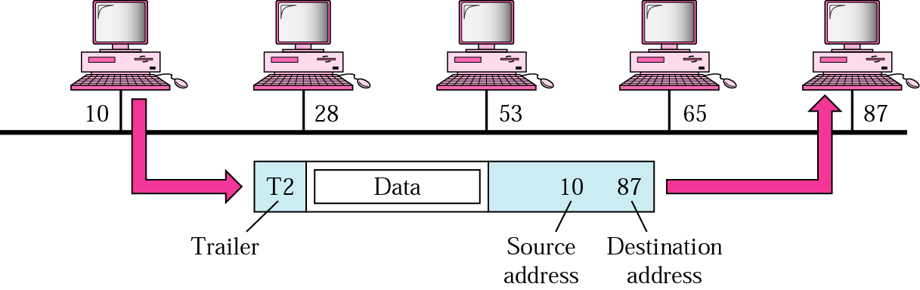
Data Link Layer Example

Slide 37
Function of Each Layer
Physical layer (L1)
  Coordinates the function required to transmit a bit stream over a physical medium
  Deal with the mechanical/electrical spec of the interface and transmission medium
  Defines the procedures and functions that physical devices and interfaces have to perform for transmission to occur
Concerned with:
  Physical characteristics of interfaces and media
  Representation of bits
    Bits must be encoded into signals –electrical or optic
  Data rate –the number of bits sent each second
  Synchronization of bits
  Line configuration – connection of devices to the medium

Slide 38
Function of Each Layer
Concerned with:
  Physical topology
    How devices are connected to form a network
  Transmission mode
    Direction of signal transmission between two devices

Slide 39
Note:
The physical layer is responsible for transmitting individual bits from one node to the next.

Slide 40
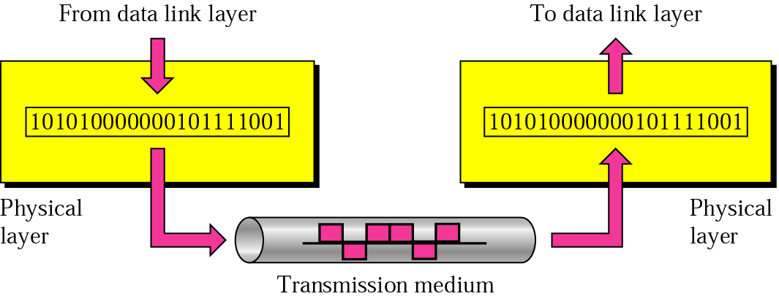
Physical Layer

Slide 41
An Exchange Using the OSI Model
Segment/User datagram
packet/datagram
frame
bit

Slide 42
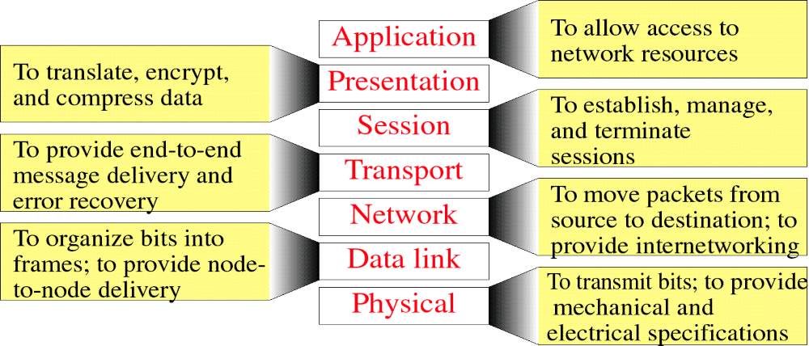
Summary of Layer Functions (OSI model)

Slide 43
3.3 TCP/IP Protocol Suite
Developed prior to the OSI model
5 layers – also known Internet model
The three topmost layers in the OSI model are represented in TCP/IP by a single layer – application layer
TCP/IP is a hierarchical protocol – the upper-level protocol is supported by one or more lower-level protocols
E.g.: @ TL – TCP, UDP; @NL - IP

Slide 44
TCP/IP
Physical layer
  Twisted pair, optical fibers, satellite
Data link layer
  Ethernet, WiFi
Network layer
  IP
Transport layer
  TCP, UDP, SCTP
Application Layer
  SMTP, FTP

Slide 45

Figure 2.16 TCP/IP and OSI model

Slide 46
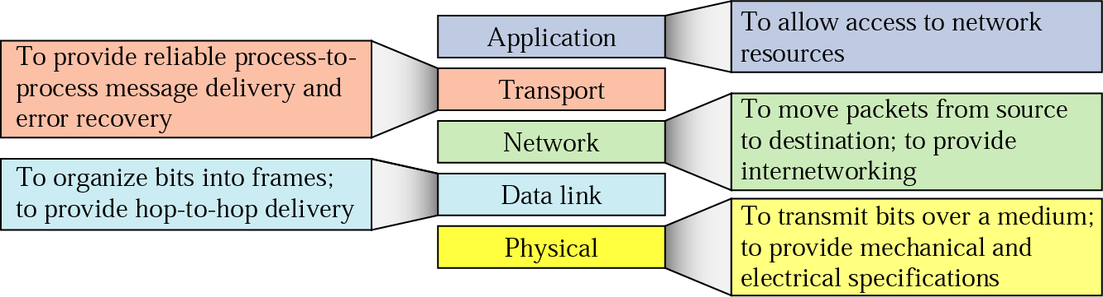
Summary of Layer Functions (TCP/IP)

Slide 47

Example of using TCP/IP
Prior to the example, you need to know the following terminologies in which will mapped to the TCP/IP model
Addresses in TCP/IP
2.<number>

Slide 48

Relationship of layers and addresses in TCP/IP

