Slide 1
Computer Network and Communication
CNS3200

Slide 2
Learning Outcome
Explain the data being sent in analog and digital signal (C4)
Explain the circuit switching in telephone and cellular network(C4)
Illustrates the unguided and guided transmission media(P2)

Slide 3
Analog and Digital Data
Analog data – continuous information
  Ie: analog clock – movement of hands are continous
  Human voice
Digital data – discrete state information
  Ie: digital clock – suddenly move from 8.05 – 8.06
  Computer memory

Slide 4
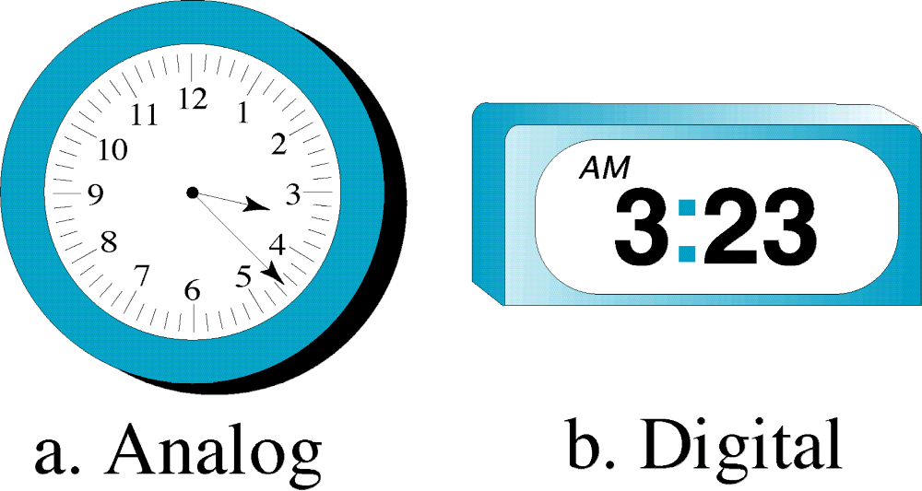
Analog and Digital Clocks
WCB/McGraw-Hill

Slide 5
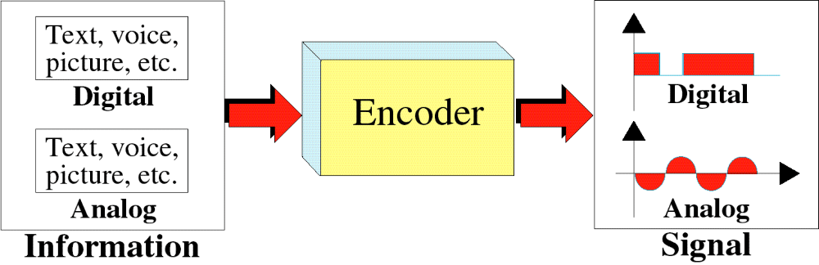
Figure 4-1
Transformation of Information
to Signals
WCB/McGraw-Hill

Slide 6

Analog and Digital Signal
Analog signal – infinite number of values
Digital signal – limited number of values

Slide 7
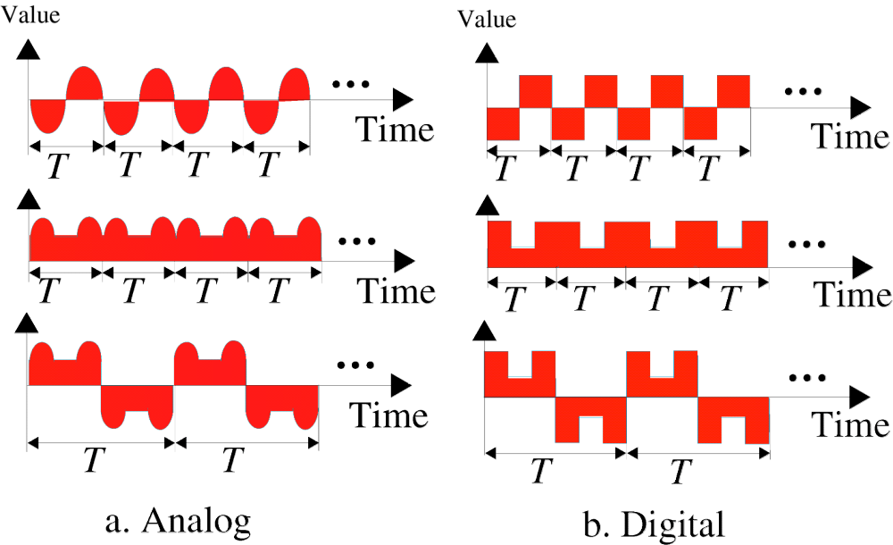
Figure 4-4
Periodic Signals
WCB/McGraw-Hill
© The McGraw-Hill Companies, Inc., 1998

Slide 8
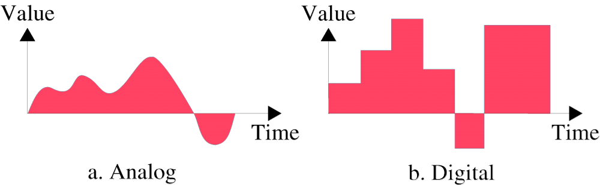
Figure 4-5
Aperiodic Signals
WCB/McGraw-Hill
© The McGraw-Hill Companies, Inc., 1998

Slide 9
In data communications, we commonly use periodic analog signals and nonperiodic digital signals.
Periodic analog signals can be classified as simple or composite. A simple periodic analog signal, a sine wave, cannot be decomposed into simpler signals.
A composite periodic analog signal is composed of multiple sine waves.
Topic to be discussed:
Sine Wave
Phase
Time and Frequency Domain
Composite Signals
Bandwidth

Slide 10
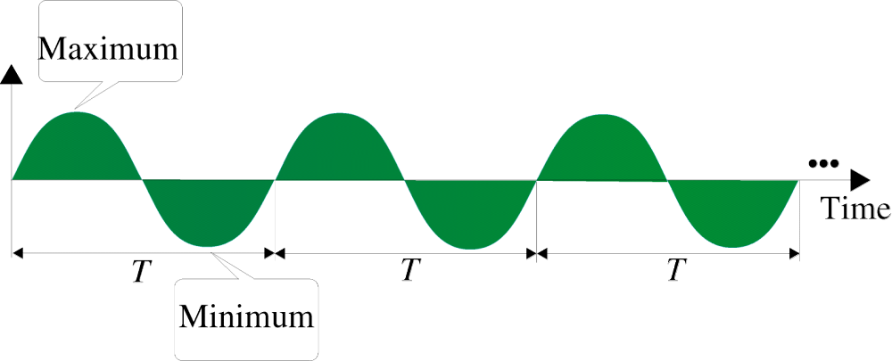
Figure 4-6
Sine Wave
WCB/McGraw-Hill
© The McGraw-Hill Companies, Inc., 1998

Slide 11
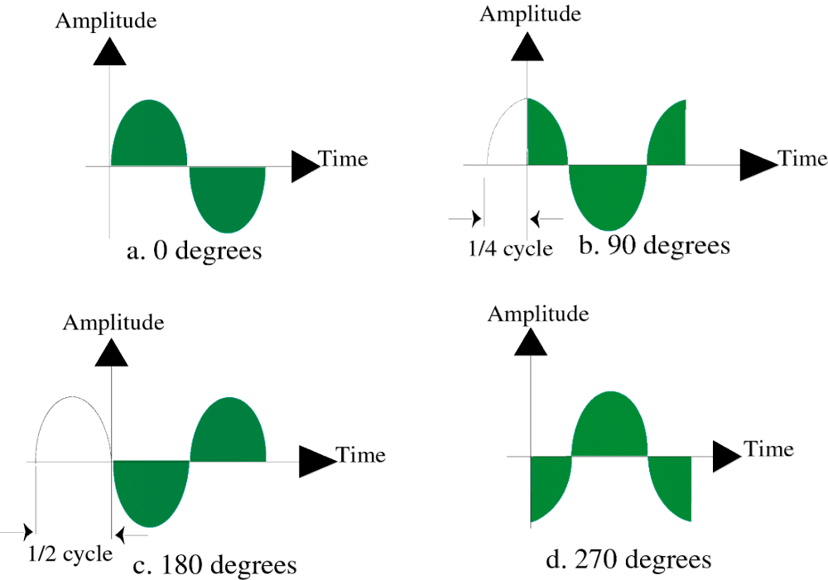
Figure 4-7
Phases
WCB/McGraw-Hill
© The McGraw-Hill Companies, Inc., 1998

Slide 12
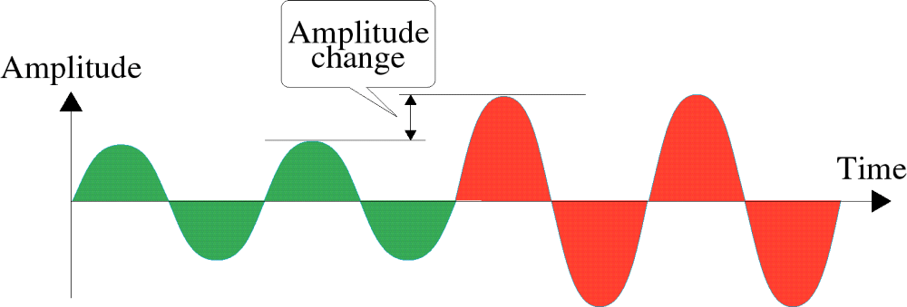
Figure 4-8
Amplitude Change
WCB/McGraw-Hill
© The McGraw-Hill Companies, Inc., 1998

Slide 13

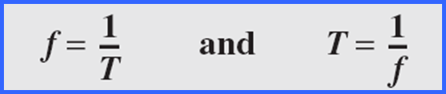
Period and Frequency
Period – amount of time (in second) a signal need to complete 1 cycle
Frequency – the number of cycles in 1 s
Period, T = 1/12 s
Period, T = 1/6 s

Slide 14
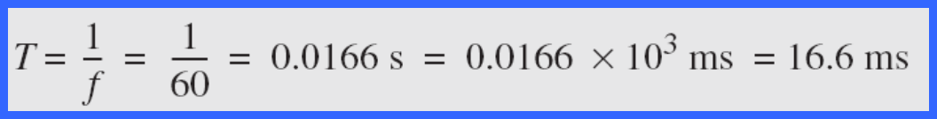
Example
The power we use at home has a frequency of 60 Hz.
The period of this sine wave?

Slide 15
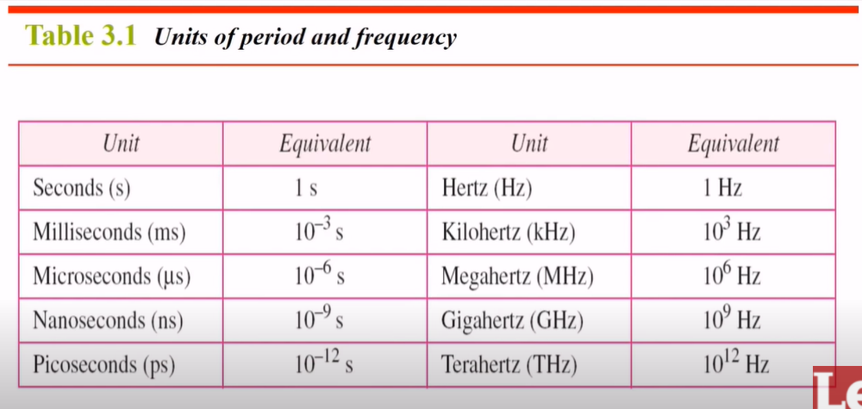
Units of period & frequency

Slide 16
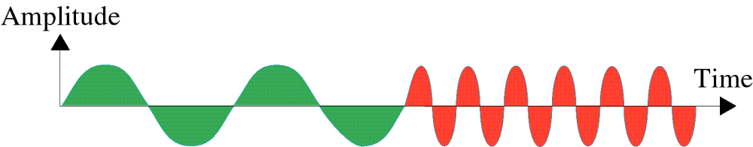
Figure 4-9
Frequency Change
WCB/McGraw-Hill

Slide 17
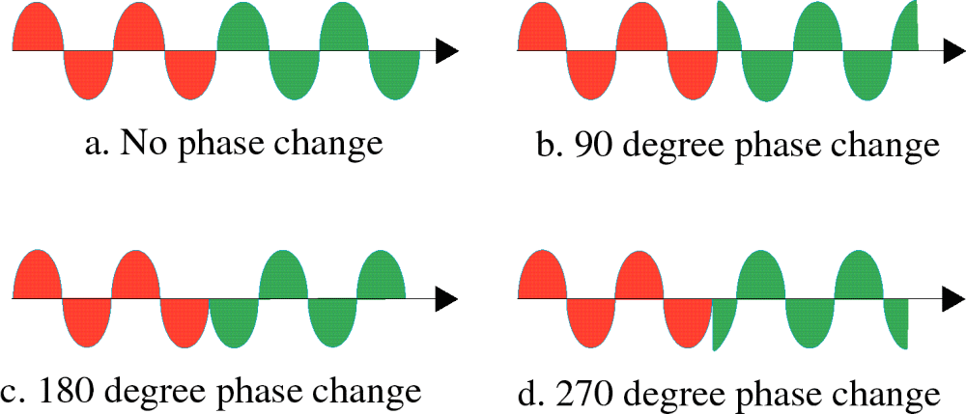
Figure 4-10
Phase Change
WCB/McGraw-Hill

Slide 18
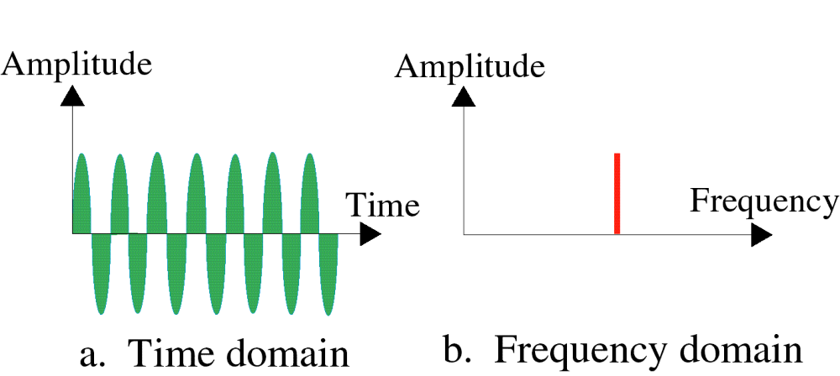
Figure 4-11
Time and Frequency Domain
WCB/McGraw-Hill

Slide 19
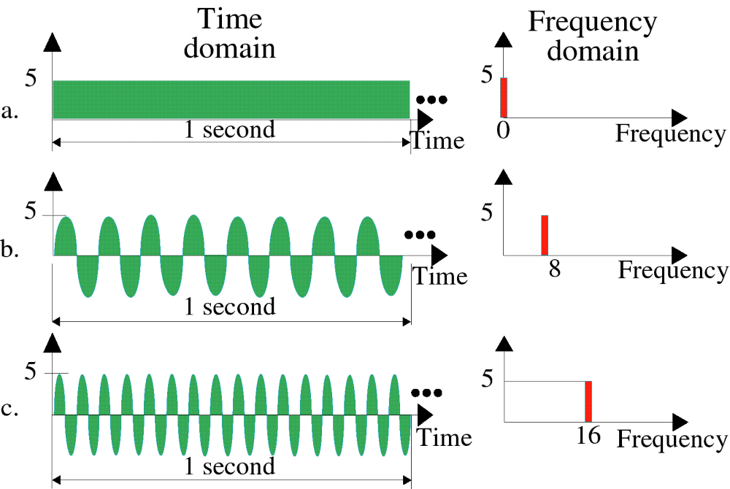
Figure 4-12
Examples
WCB/McGraw-Hill

Slide 20
Frequency
Frequency is the rate of change with respect to time.
Change in a short span of time means high frequency.
Change over a long span of
time means low frequency.
3.<number>

Slide 21

Example 3.1
The power we use at home has a frequency of 60 Hz. The period of this sine wave can be determined as follows:
3.<number>

Slide 22

Example 3.1
Express a period of 100 ms in microseconds.
3.<number>

Slide 23

Example 3.2
The period of a signal is 100 ms. What is its frequency in kilohertz?
Solution
First we change 100 ms to seconds, and then we calculate the frequency from the period (1 Hz = 10⁻³ kHz).
3.<number>

Slide 24
Example
The voltage of a battery is a constant; this constant value can be considered a sine wave, as we will see later. For example, the peak value of an AA battery is normally 1.5 V.
3.<number>

Slide 25

Note
Frequency and period are the inverse each other.
3.<number>

Slide 26
Note
If a signal does not change at all, its frequency is zero.
If a signal changes instantaneously, its frequency is infinite.
3.<number>

Slide 27
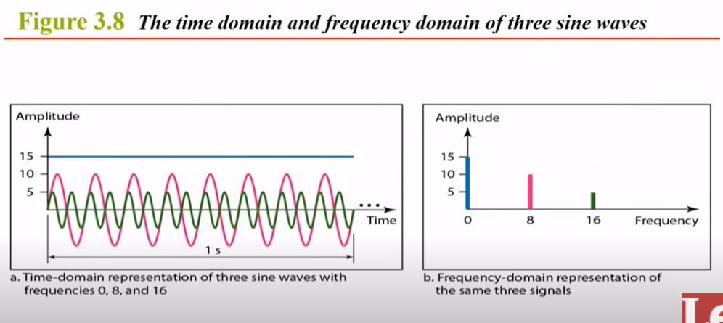

Slide 28
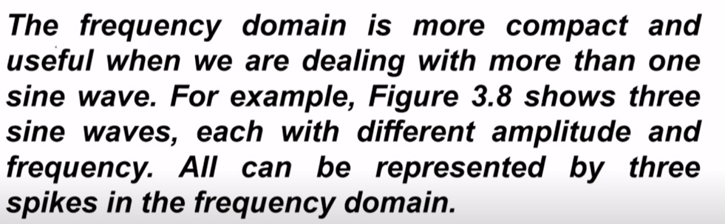

Slide 29
Note
According to Fourier analysis, any composite signal is a combination of simple sine waves with different frequencies, amplitudes and phases.
Fourier analysis is discussed in Appendix C.
3.<number>

Slide 30

Bandwidth
The bandwidth of a composite signal is the difference between the highest and the lowest frequencies contained in that signal.
See example 3.10 and 3.11 in the text book

Slide 31
Signals and Communication
A single-frequency sine wave is not useful in data communications
We need to send a composite signal, a signal made of many simple sine waves.
According to Fourier analysis, any composite signal is a combination of simple sine waves with different frequencies, amplitudes, and phases.
3.<number>

Slide 32
Composite Signals and Periodicity
If the composite signal is periodic, the decomposition gives a series of signals with discrete frequencies.
If the composite signal is nonperiodic, the decomposition gives a combination of sine waves with continuous frequencies.
3.<number>

Slide 33

Figure 3.9 A composite periodic signal
3.<number>

Slide 34

Figure 3.10 Decomposition of a composite periodic signal in the time and
frequency domains
3.<number>

Slide 35
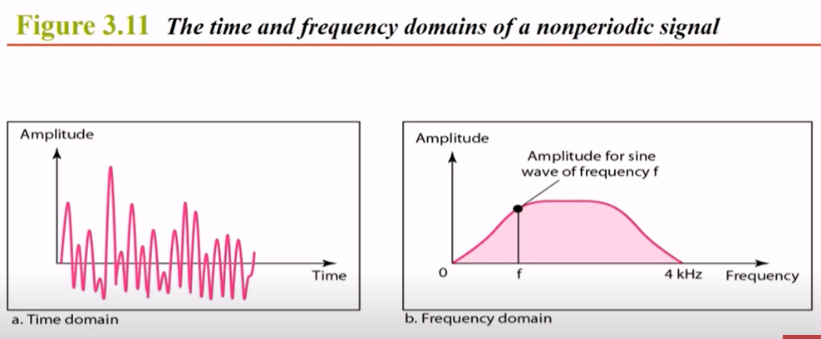
3.<number>

Slide 36
Note
If the composite signal is periodic, the decomposition gives a series of signal discrete frequencies;
If the composite signal is nonperiodic, the decomposition gives a combination of sine waves with continuous frequencies.
3.<number>

Slide 37
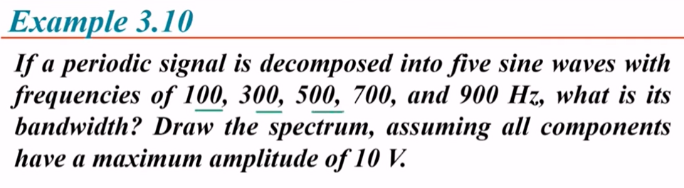
Exercise
3.<number>

Slide 38

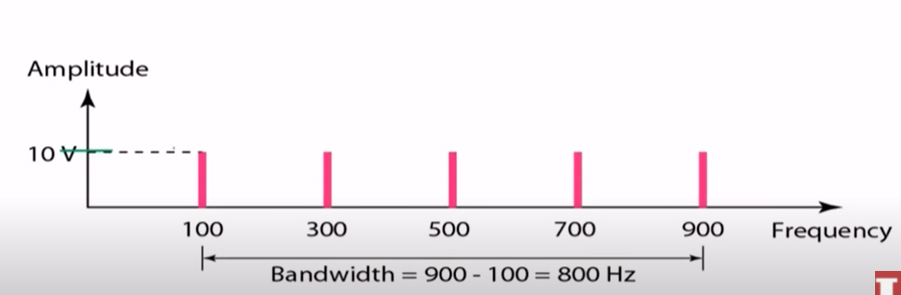
Solution
3.<number>

Slide 39
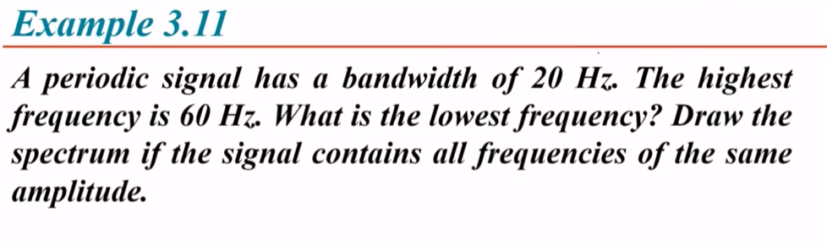
Exercise
3.<number>

Slide 40
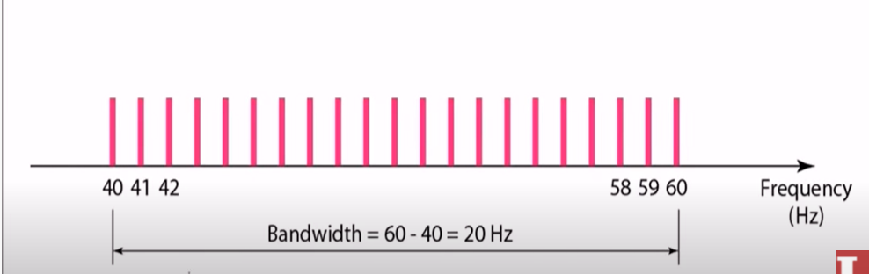
Solution
3.<number>

Slide 41
Exercise
3.<number>

Slide 42
DIGITAL SIGNALS
In addition to being represented by an analog signal, information can also be represented by a digital signal. For example, a 1 can be encoded as a positive voltage and a 0 as zero voltage. A digital signal can have more than two levels. In this case, we can send more than 1 bit for each level.
Topics discussed in this section:
Bit Rate
3.<number>

Slide 43

Digital Signal
Bit rate :Number of bits in 1s (bit per second, bps)
Multilevel signalling
Use formula log2 L bits to check for how many level required to send certain bits
Let level =8
How many bits per level?

Slide 44
Example 3.16
A digital signal has eight levels. How many bits are needed per level? We calculate the number of bits from the formula
Each signal level is represented by 3 bits.
3.<number>

Slide 45
Example 3.17
A digital signal has nine levels. How many bits are needed per level? We calculate the number of bits by using the formula. Each signal level is represented by 3.17 bits. However, this answer is not realistic. The number of bits sent per level needs to be an integer as well as a power of 2. For this example, 4 bits can represent one level.
3.<number>

Slide 46
Example 3.18
1. Assume we need to download text documents at the rate of 100 pages per sec. What is the required bit rate of the channel?
Hint:
A page is an average of 24 lines with 80 characters in each line. If we assume that one character requires 8 bits (ascii), the bit rate is
100 x 24 x 80 x 8 = 1,536,000 bps = 1.54Mbps
3.<number>

Slide 47
Example 3.18
2. Assume we need to download text documents at the rate of 200 pages per min. What is the required bit rate of the channel?
3. Assume your ISP downloading rate is 55Mbps. How many pages your device able to download in a minute?
4. Assume your ISP downloading rate is only 10Mbps. How many pages your device able to download in a second if the encoding system is is UNICODE?
03 DATA COMMUNICATIONS AND NETWORKING Data and Signals Part 2 - YouTube
3.<number>

Slide 48
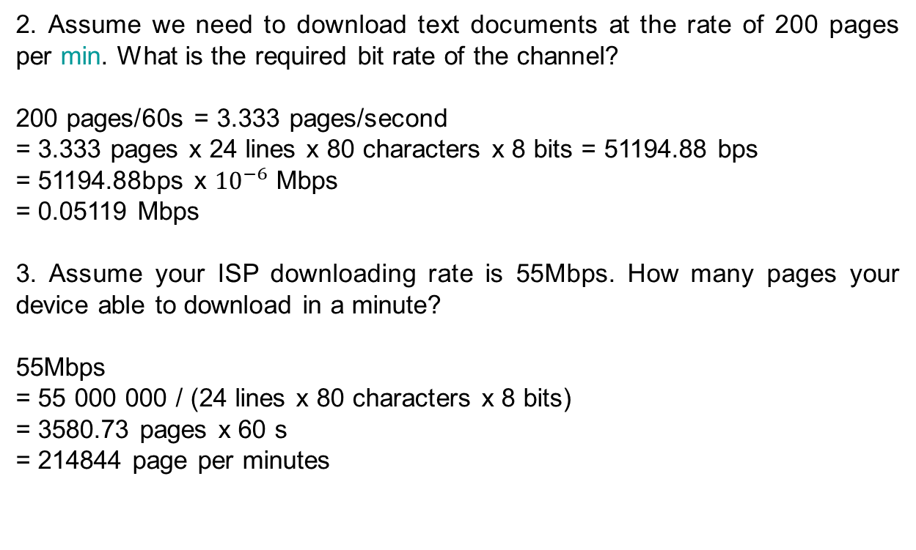
Example 3.18 (Answer)
3.<number>

Slide 49
Example 3.18 (Answer)
4. Assume your ISP downloading rate is only 10Mbps. How many pages your device able to download in a second if the encoding system is UNICODE? (Unicode is 16 bits)
3.<number>

Slide 50
Transmission Impairment
Signals travel through transmission media, which are not perfect.
The imperfection causes signal impairment.
This means that the signal at the beginning of the medium is not the same as the signal at the end of the medium. What is sent is not what is received.
Three causes of impairment are attenuation, distortion, and noise

Slide 51

Attenuation
Loss of energy- due to resistance of the medium
Energy, converted to heat
Measured in decibel (dB) = 10log10 (P2/P1)
See example 3.26 – 3.30 for self study

Slide 52

Example 3.26
Suppose a signal travels through a transmission medium and its power is reduced to one-half. This means that P2 is (1/2)P1. In this case, the attenuation (loss of power) can be calculated as
A loss of 3 dB (–3 dB) is equivalent to losing one-half the power.
3.<number>

Slide 53


Example 3.27
A signal travels through an amplifier, and its power is increased 10 times. This means that P₂ = 10P₁ . In this case, the amplification (gain of power) can be calculated as
3.<number>

Slide 54

Example 3.28
One reason that engineers use the decibel to measure the changes in the strength of a signal is that decibel numbers can be added (or subtracted) when we are measuring several points (cascading) instead of just two. In Figure 3.27 a signal travels from point 1 to point 4. In this case, the decibel value can be calculated as
3.<number>

Slide 55

Figure 3.27 Decibels for Example 3.28
3.<number>

Slide 56

Example 3.29
Sometimes the decibel is used to measure signal power in milliwatts. In this case, it is referred to as dB_{m} and is calculated as dB_{m} = 10 log10 P_{m} , where P_{m} is the power in milliwatts. Calculate the power of a signal with dB_{m} = −30.
Solution
We can calculate the power in the signal as
3.<number>

Slide 57

Example 3.30
The loss in a cable is usually defined in decibels per kilometer (dB/km). If the signal at the beginning of a cable with −0.3 dB/km has a power of 2 mW, what is the power of the signal at 5 km?
Solution
The loss in the cable in decibels is 5 × (−0.3) = −1.5 dB. We can calculate the power as
3.<number>

Slide 58
EXERCISES:
1If the signal at the end of a cable with −0.2 dB/km has a power of 100 mW for 10km, what is the power of the signal at :
3 km
0 km
1 km
log ₁₀ P2/P1

Slide 59
2. A signal that has been transmitted to the user has experienced attenuation in the network causing loss of signal strength. If the signal at the beginning of a cable has a power of 25W and signal at the receiving end has a power of 500mW with a distance of 30km between each other, calculate:
a. loss of power for every kilometer.
b. power of signal at first 1km.
Note: Show your calculations.
Signal Loss in dB = 10 log₁₀ (P2/P1)
3. Attenuation occurs on networks caused a loss of signal strength. If the signal at the beginning of a cable has a power of 50W and signal at the receiving end has a power of 200mW with a loss of power for every km is -0.5 dB , calculate:
How long the distance between beginning of node and receiving node.
power of signal at first 3km

Slide 60

Distortion
Signal changes its form or shape
Due to different frequency of composite signal

Slide 61

Noise
There are different types of noise
  Thermal - random noise of electrons in the wire creates an extra signal
  Induced - from motors and appliances, devices act are transmitter antenna and medium as receiving antenna.
  Crosstalk - same as above but between two wires.
  Impulse - Spikes that result from power lines, lightning, etc.

