Slide 1
Computer Network and Communication
CNS3200

Slide 2
Learning Outcome
DIFFERENTIATE CELLULAR & TELEPHONE NETWORKS (C4)
DIFFERENTIATE TYPES OF HIGH SPEED DIGITAL ACCESS (C4)
EXPLAIN METHOD OD MODULATION AND DEMODULATION IN SWITCHING NETWORK (C4)

Slide 3
TELEPHONE NETWORK
Telephone networks use circuit switching. The telephone network had its beginnings in the late 1800s. The entire network, which is referred to as the plain old telephone system (POTS), was originally an analog system using analog signals to transmit voice.

Slide 4
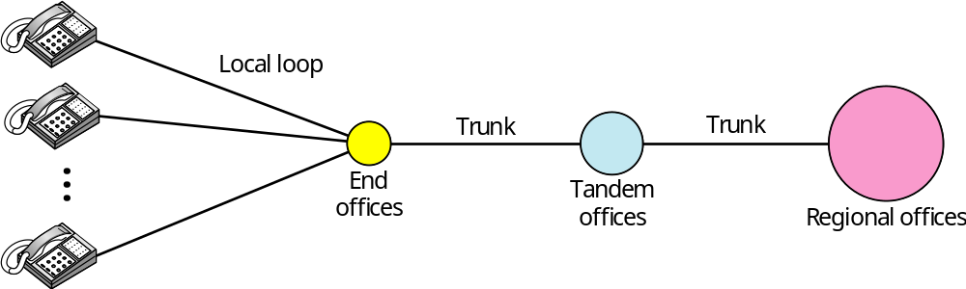
A telephone system
Local loops - use twisted-pair cable
- bandwidth of 4kHz
Trunks - use optical fiber/satellite link
- handle 100-1000 connection through multiplexing
Switching office - connection to other subscribers
- connect several local loops and trunks

Slide 5
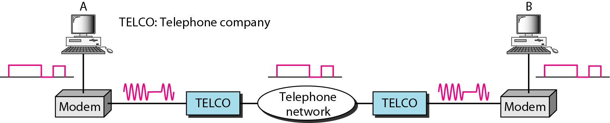
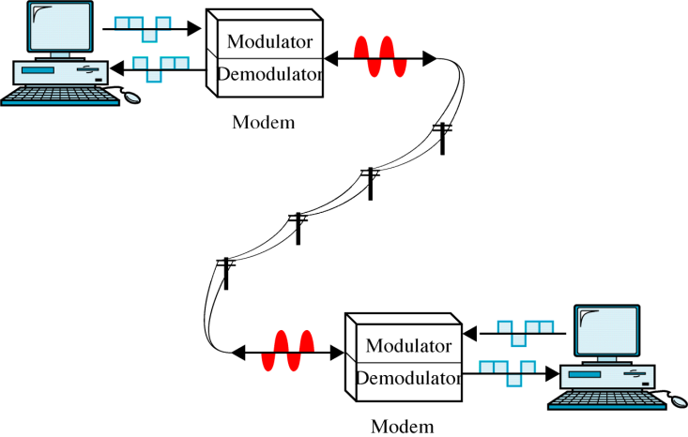
Modulation/demodulation

Slide 6
HIGH SPEED DIGITAL ACCESS
After traditional modems reached their peak data rate, telephone companies developed another technology, DSL, to provide higher-speed access to the Internet.
Digital subscriber line (DSL) technology is one of the most promising for supporting high-speed digital communication over the existing local loops.
Types – ADSL, VDSL, HDSL, SDSL

Slide 7
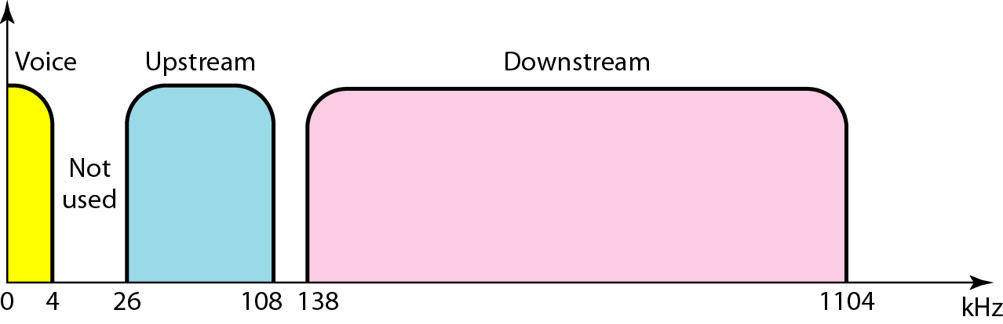
ADSL (Asymmetric DSL)
ADSL is an asymmetric communication technology designed for residential users;
The existing local loops can handle bandwidths up to 1.1 MHz.

Slide 8
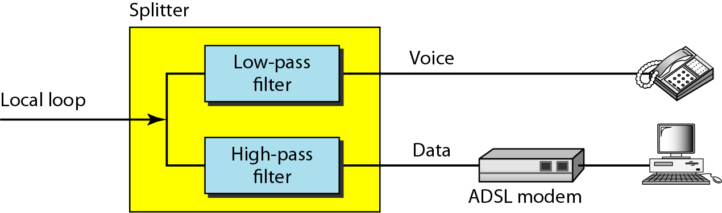
ADSL modem

Slide 9
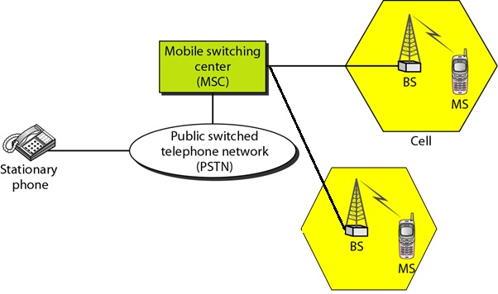
CELLULAR TELEPHONY
Cellular telephony is designed to provide communications between two moving units, called mobile stations (MSs), or between one mobile unit and one stationary unit, often called a land unit.

Slide 10
The Core Idea: Cellular Concept
The core idea that led to today’s system was the cellular concept.
The cellular concept: multiple lower-power base stations that service mobile users within their coverage area and handoff users to neighboring base stations as users move.

Slide 11
Cellular Concept
Thus, instead of one base station covering an entire city, the city was broken up into cells, or smaller coverage areas.
Each of these smaller coverage areas had its own lower-power base station.
User phones in one cell communicate with the base station in that cell.

Slide 12
A group of local base stations are connected (by wires) to a mobile switching center (MSC). MSC is connected to the rest of the world (normal telephone system).
MSC
Public (Wired)
Telephone
Network
MSC
MSC
MSC

Slide 13
Handoffs
A crucial component of the cellular concept is the notion of handoffs.
Mobile phone users are by definition mobile, i.e., they move around while using the phone.
Thus, the network should be able to give them continuous access as they move.
This is not a problem when users move within the same cell.
When they move from one cell to another, a handoff is needed.

Slide 14
Handoff
At some point, the user’s signal is weak enough at B₁ and strong enough at B₂ for a handoff to occur.
Specifically, messages are exchanged between the user, B₁, and B₂ so that communication to/from the user is transferred from B₁ to B₂.

Slide 15
How is the difference between telephone & cellular network ?

