Slide 1
CCS3101
OBJECT-ORIENTED PROGRAMMING
Topic 4 Polymorphism

Slide 2
Learning Objectives
At the end of this chapter, you will be able to:
Explain polymorphism, dynamic binding and generic programming concepts (P2, C2, A3)
Construct an object-oriented program using generic programming (P4)

Slide 3
Polymorphism
Polymorphism means that a variable of a supertype can refer to a subtype object.
A class defines a type. A type defined by a subclass is called a subtype, and a type defined by its superclass is called a supertype. Therefore, you can say that Circle is a subtype of GeometricObject and GeometricObject is a supertype for Circle.
PolymorphismDemo
Run

Slide 4
Polymorphism, Dynamic Binding and Generic Programming
public class PolymorphismDemo {
public static void main(String[] args) {
m(new GraduateStudent());
m(new Student());
m(new Person());
m(new Object());
}
public static void m(Object x) {
System.out.println(x.toString());
}
}
class GraduateStudent extends Student {
}
class Student extends Person {
public String toString() {
return "Student";
}
}
class Person extends Object {
public String toString() {
return "Person";
}
}
Method m takes a parameter of the Object type. You can invoke it with any object.
An object of a subtype can be used wherever its supertype value is required. This feature is known as polymorphism.
When the method m(Object x) is executed, the argument x’s toString method is invoked. x may be an instance of GraduateStudent, Student, Person, or Object. Classes GraduateStudent, Student, Person, and Object have their own implementation of the toString method. Which implementation is used will be determined dynamically by the Java Virtual Machine at runtime. This capability is known as dynamic binding.
DynamicBindingDemo
Run

Slide 5
Dynamic Binding
Dynamic binding works as follows: Suppose an object o is an instance of classes C₁, C₂, ..., C_{n-1}, and C_{n}, where C₁ is a subclass of C₂, C₂ is a subclass of C₃, ..., and C_{n-1} is a subclass of C_{n}. That is, C_{n} is the most general class, and C₁ is the most specific class. In Java, C_{n} is the Object class. If o invokes a method p, the JVM searches the implementation for the method p in C₁, C₂, ..., C_{n-1} and C_{n}, in this order, until it is found. Once an implementation is found, the search stops and the first-found implementation is invoked.

Slide 6
Method Matching vs. Binding
Matching a method signature and binding a method implementation are two issues.
The compiler finds a matching method according to parameter type, number of parameters, and order of the parameters at compilation time.
A method may be implemented in several subclasses.
The Java Virtual Machine dynamically binds the implementation of the method at runtime.

Slide 7
Generic Programming
public class PolymorphismDemo {
public static void main(String[] args) {
m(new GraduateStudent());
m(new Student());
m(new Person());
m(new Object());
}
public static void m(Object x) {
System.out.println(x.toString());
}
}
class GraduateStudent extends Student {
}
class Student extends Person {
public String toString() {
return "Student";
}
}
class Person extends Object {
public String toString() {
return "Person";
}
}
Polymorphism allows methods to be used generically for a wide range of object arguments. This is known as generic programming.
If a method’s parameter type is a superclass (e.g., Object), you may pass an object to this method of any of the parameter’s subclasses (e.g., Student or String).
When an object (e.g., a Student object or a String object) is used in the method, the particular implementation of the method of the object that is invoked (e.g., toString) is determined dynamically.

Slide 8
What is Generics?
Generics is the capability to parameterize types. With this capability, you can define a class or a method with generic types that can be substituted using concrete types by the compiler. For example, you may define a generic stack class that stores the elements of a generic type. From this generic class, you may create a stack object for holding strings and a stack object for holding numbers. Here, strings and numbers are concrete types that replace the generic type.

Slide 9
Why Generics?
The key benefit of generics is to enable errors to be detected at compile time rather than at runtime. A generic class or method permits you to specify allowable types of objects that the class or method may work with. If you attempt to use the class or method with an incompatible object, a compile error occurs.

Slide 10
Generic Type
Generic Instantiation
Runtime error
Improves reliability
Compile error

Slide 11
Casting Objects
You have already used the casting operator to convert variables of one primitive type to another. Casting can also be used to convert an object of one class type to another within an inheritance hierarchy. In the preceding section, the statement
m(new Student());
assigns the object new Student() to a parameter of the Object type. This statement is equivalent to:
Object o = new Student(); // Implicit casting
m(o);
The statement Object o = new Student(), known as implicit casting, is legal because an instance of Student is automatically an instance of Object.

Slide 12
Why Casting Is Necessary?
Suppose you want to assign the object reference o to a variable of the Student type using the following statement:
Student b = o;
A compilation error would occur. Why does the statement Object o = new Student() work and the statement Student b = o doesn’t?
This is because a Student object is always an instance of Object, but an Object is not necessarily an instance of Student.
Even though you can see that o is really a Student object, the compiler is not so clever to know it.
To tell the compiler that o is a Student object, use an explicit casting.
The syntax is similar to the one used for casting among primitive data types. Enclose the target object type in parentheses and place it before the object to be cast, as follows:
Student b = (Student)o; // Explicit casting

Slide 13
Casting from Superclass to Subclass
Explicit casting must be used when casting an object from a superclass to a subclass. This type of casting may not always succeed.
Apple x = (Apple)fruit;
Orange x = (Orange)fruit;

Slide 14
The instanceof Operator
Use the instanceof operator to test whether an object belongs to a particular type.
Syntax:
object instanceof TypeName
Return true if the object is an instance of TypeName (or one of its subtypes), and false otherwise.
For example:
Object myObject = new Circle();
// Some lines of code
/** Perform casting if myObject is an instance of
Circle */
if (myObject instanceof Circle) {
System.out.println("The circle diameter is " +
((Circle)myObject).getDiameter());
}

Slide 15
instanceof
Circle c1 = new Circle(5, "red");
GeometricObject g1 = new GeometricObject("blue");
True or False?
c1 instanceof Circle
c1 instanceof GeometricObject
g1 instanceof GeometricObject
g1 instanceof Circle
GeometricObject g2 = new Circle(5, "red");
True or False?
g2 instanceof Circle
g2 instanceof GeometricObject

Slide 16
TIP
To help understand casting, you may also consider the analogy of fruit, apple, and orange with the Fruit class as the superclass for Apple and Orange.
An apple is a fruit, so you can always safely assign an instance of Apple to a variable for Fruit.
However, a fruit is not necessarily an apple, so you have to use explicit casting to assign an instance of Fruit to a variable of Apple.

Slide 17
Example: Demonstrating Polymorphism and Casting
This example creates two geometric objects: a circle, and a rectangle, invokes the displayGeometricObject method to display the objects. The displayGeometricObject displays the area and diameter if the object is a circle, and displays area if the object is a rectangle.
CastingDemo
Run

Slide 18
The equals Method
The equals() method compares the contents of two objects. The default implementation of the equals method in the Object class is as follows:
public boolean equals(Object obj) {
return (this == obj);
}
public boolean equals(Object o) {
if (o instanceof Circle) {
return radius == ((Circle)o).radius;
}
else
return false;
}
For example, the equals method is overridden in the Circle class.

Slide 19
NOTE
The == comparison operator is used for comparing two primitive data type values or for determining whether two objects have the same references.
The equals method is intended to test whether two objects have the same contents, provided that the method is modified in the defining class of the objects.
The == operator is stronger than the equals method, in that the == operator checks whether the two reference variables refer to the same object.

Slide 20
The ArrayList Class
You can create an array to store objects. But the array’s size is fixed once the array is created. Java provides the ArrayList class that can be used to store an unlimited number of objects.

Slide 21
Generic Type
ArrayList is known as a generic class with a generic type E. You can specify a concrete type to replace E when creating an ArrayList. For example, the following statement creates an ArrayList and assigns its reference to variable cities. This ArrayList object can be used to store strings.
ArrayList<String> cities = new ArrayList<String>();
ArrayList<String> cities = new ArrayList<>();
TestArrayList
Run

Slide 22
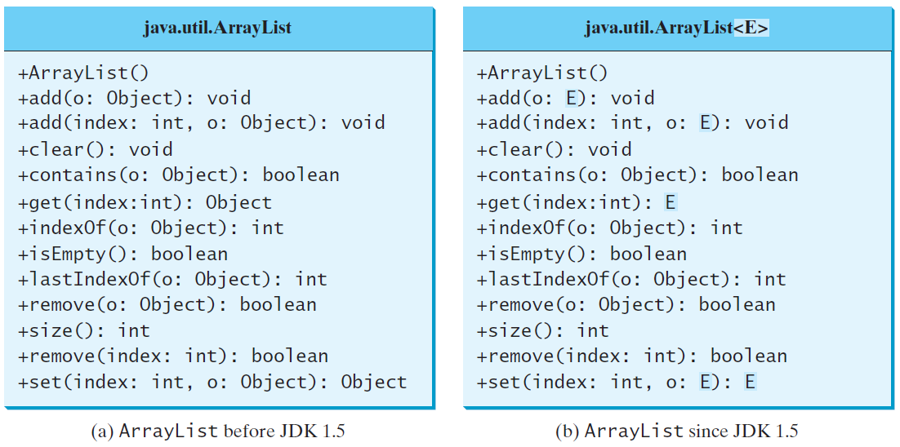
Generic ArrayList in JDK 1.5

Slide 23
No Casting Needed
ArrayList<Double> list = new ArrayList<>();
list.add(5.5); // 5.5 is automatically converted to new Double(5.5)
list.add(3.0); // 3.0 is automatically converted to new Double(3.0)
Double doubleObject = list.get(0); // No casting is needed
double d = list.get(1); // Automatically converted to double

Slide 24
Differences and Similarities between arrays and ArrayList
DistinctNumbers
Run

Slide 25
ArrayLists from/to arrays
Creating an ArrayList from an array of objects:
String[] array = {"red", "green", "blue"};
ArrayList<String> list = new
ArrayList<>(Arrays.asList(array));
Creating an array of objects from an ArrayList:
String[] array1 = new String[list.size()];
list.toArray(array1);

Slide 26
max and min in an ArrayList
String[] array = {"red", "green", "blue"};
System.out.pritnln(java.util.Collections.max(
new ArrayList<String>(Arrays.asList(array)));
String[] array = {"red", "green", "blue"};
System.out.pritnln(java.util.Collections.min(
new ArrayList<String>(Arrays.asList(array)));

Slide 27
Shuffling an ArrayList
Integer[] array = {3, 5, 95, 4, 15, 34, 3, 6, 5};
ArrayList<Integer> list = new
ArrayList<>(Arrays.asList(array));
java.util.Collections.shuffle(list);
System.out.println(list);

Slide 28
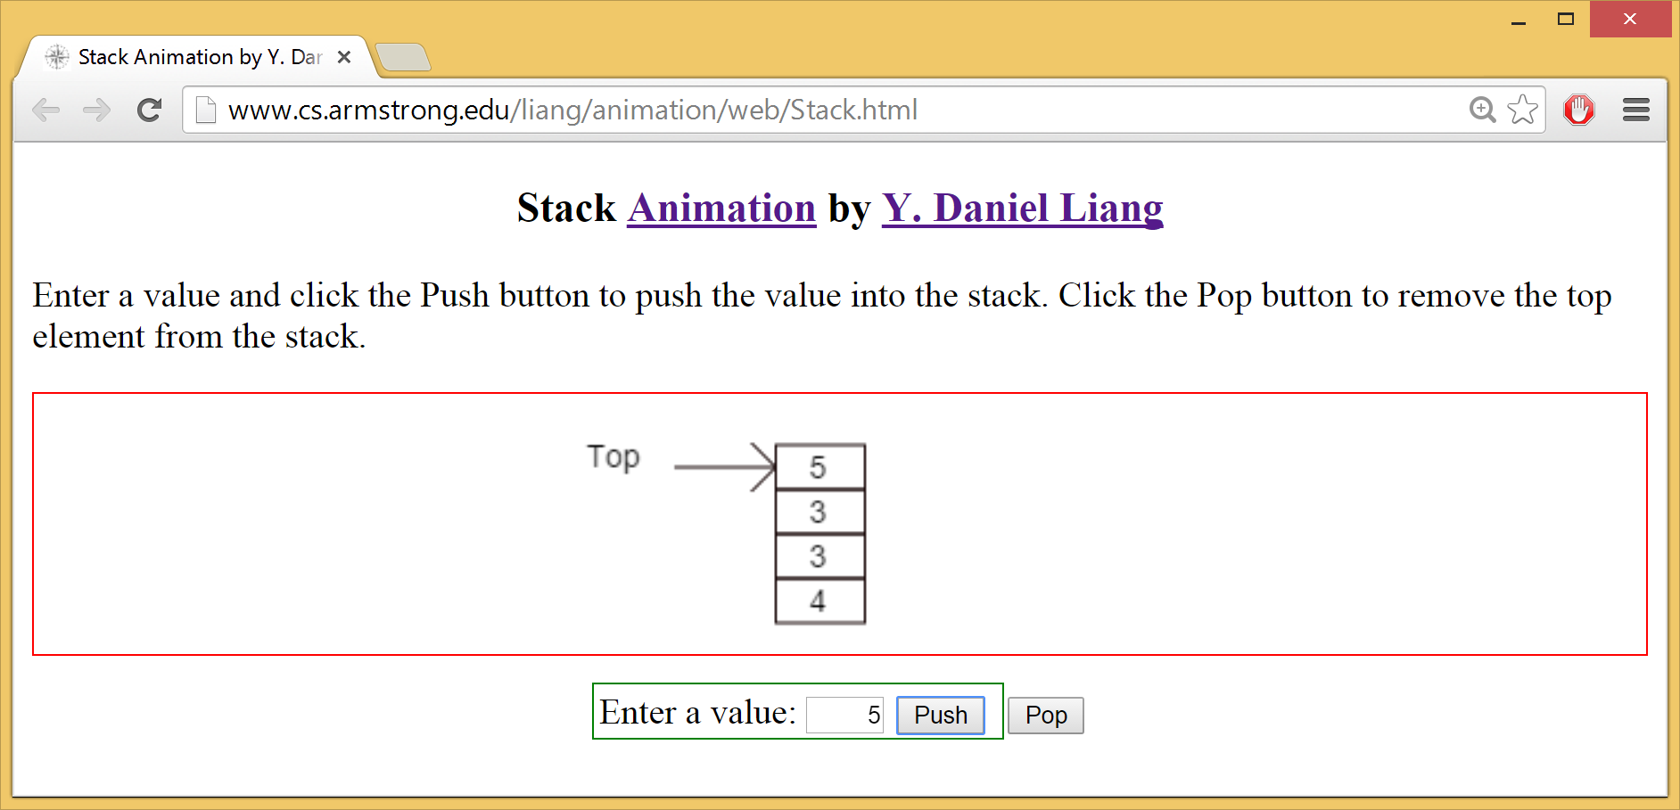
Stack Animation
https://liveexample.pearsoncmg.com/dsanimation/StackeBook.html

Slide 29
The MyStack Classes
A stack to hold objects.
MyStack

Slide 30

The protected Modifier
The protected modifier can be applied on data and methods in a class.
A protected data or a protected method in a public class can be accessed by
any class in the same package or
its subclasses, even if the subclasses are in a different package.
private, default, protected, public

Slide 31
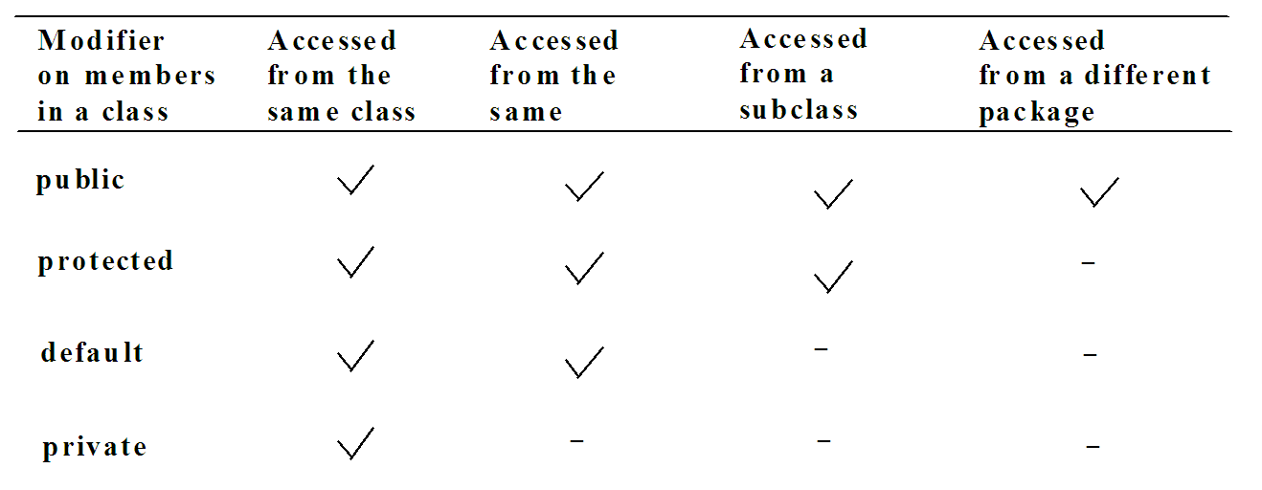
Accessibility Summary
A field or method that is not declares as public, private, or protected can be accessed by all classes in the same package, which is usually not desirable

Slide 32
Visibility Modifiers

Slide 33
A Subclass Cannot Weaken the Accessibility
A subclass may override a protected method in its superclass and change its visibility to public.
However, a subclass cannot weaken the accessibility of a method defined in the superclass.
For example,
if a method is defined as public in the superclass, it must be defined as public in the subclass.

Slide 34
NOTE
The modifiers are used on classes and class members (data and methods), except that the final modifier can also be used on local variables in a method.
A final local variable is a constant inside a method.

Slide 35
The final Modifier
The final class cannot be extended:
final class Math {
...
}
The final variable is a constant:
final static double PI = 3.14159;
The final method cannot be overridden by its subclasses.

Slide 36
Preventing Extending and Overriding
Use final modifier to indicate a class is final and cannot be a parent class.
Math class is an example of final class.
String, StringBuilder, and StringBuffer and all wrapper classes for primitive data types are also final classes.
public class Test{
...
public final void m(){
…
}
}
Method m is final and cannot be overridden by its subclasses

Slide 37
Summary
Polymorphism
Dynamic binding
Generic types
Casting & instanceof
Difference between == and equals()
ArrayList
protected, final

Slide 38
End of Chapter 4

