Slide 1
CCS3101
OBJECT-ORIENTED PROGRAMMING Topic 3 Inheritance

Slide 2
Learning Objectives
At the end of this chapter, you will be able to:
Explain subclass from a super class through inheritance (C2)
Differentiate between overriding and overloading (P1, A3)
Construct an object-oriented program using inheritance (P4)

Slide 3
Motivations
Suppose you will define classes to model circles, rectangles, and triangles. These classes have many common features. What is the best way to design these classes so to avoid redundancy? The answer is to use inheritance.

Slide 4
Class Inheritance
Inheritance models the is-an-extension-of relationship between two classes.
Class inheritance is a mechanism for enhancing existing classes by adding fields and methods.
Inheritance makes it possible to build new classes from existing classes thus facilitating the reuse of methods and data from one class in another.
A programmer can use a class, along with its function and data, to create a subclass, which saves time and coding.
If you need to implement a new class and a class representing a more general concept is already available, then the new class can inherit from the existing class.

Slide 5
Class Inheritance
Inheritance allows data of one type to be treated as data of a more general type.
If you let a subclass inherit from a superclass, it automatically will have all the data and methods of the superclass.
For example:
Just as horses inherit the attributes and behaviors associated with mammals and vertebrates, a Java subclass inherits the attributes and behaviors of its superclasses.

Slide 6
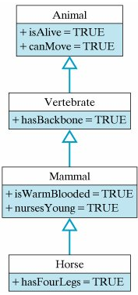
A class hierarchy for horses
Animal is
superclass
Vertebrate inherit
from Animal
Mammal inherit
from Vertebrate
Horse inherit
from Mammal

Slide 7
Class Inheritance
Syntax
public class SuperclassName{
instance fields
methods
}
public class SubclassName extends SuperclassName{
instance fields
methods
}
A subclass has no access to private fields of its superclass

Slide 8
Superclasses and Subclasses
GeometricObject
Circle
Rectangle
TestCircleRectangle
Run

Slide 9
The more general class is called a superclass.
The more specialized class that inherits from the superclass is called the subclass
For example:
Circle and Rectangle class inherits all accessible data fields and methods from GeometricObject class.
Therefore,
the GeometricObject class is the superclass for Circle and Rectangle.
The Circle and Rectangle are subclass.
Every class extends the Object class either directly or indirectly.

Slide 10
Are superclass’s Constructor Inherited?
No. They are not inherited.
They are invoked explicitly or implicitly.
Explicitly using the super keyword.
A constructor is used to construct an instance of a class.
Unlike properties and methods, a superclass's constructors are
not inherited in the subclass.
can only be invoked from the subclasses' constructors, using the keyword super.
If the keyword super is not explicitly used, the superclass's no-arg constructor is automatically invoked.

Slide 11
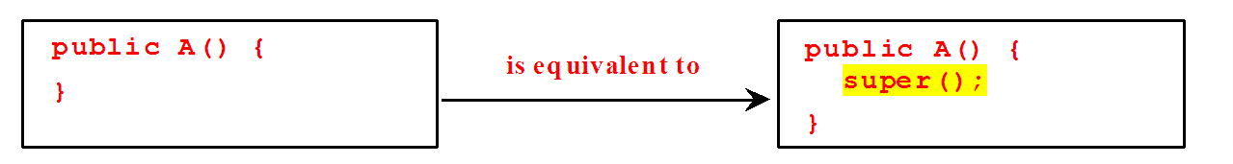
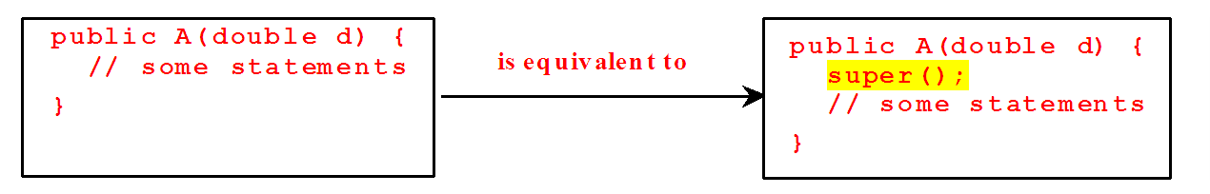
Superclass’s Constructor Is Always Invoked
A constructor may invoke an overloaded constructor or its superclass’s constructor.
If none of them is invoked explicitly, the compiler puts super() as the first statement in the constructor.
For example,

Slide 12
Using the Keyword super
The keyword super refers to the superclass of the class in which super appears.
This keyword can be used in two ways:
To call a superclass constructor
You use the super keyword in the first statement of the subclass constructor
To call a superclass method

Slide 13
CAUTION
You must use the keyword super to call the superclass constructor.
Invoking a superclass constructor’s name in a subclass causes a syntax error.
Java requires that the statement that uses the keyword super appear first in the constructor.

Slide 14
Constructor Chaining
Constructing an instance of a class invokes all the superclasses’ constructors along the inheritance chain. This is called constructor chaining.
public class Faculty extends Employee {
public static void main(String[] args) {
new Faculty();
}
public Faculty() {
System.out.println("(4) Faculty's no-arg constructor is invoked");
}
}
class Employee extends Person {
public Employee() {
this("(2) Invoke Employee’s overloaded constructor");
System.out.println("(3) Employee's no-arg constructor is invoked");
}
public Employee(String s) {
System.out.println(s);
}
}
class Person {
public Person() {
System.out.println("(1) Person's no-arg constructor is invoked");
}
}

Slide 15
Trace Execution
public class Faculty extends Employee {
public static void main(String[] args) {
new Faculty();
}
public Faculty() {
System.out.println("(4) Faculty's no-arg constructor is invoked");
}
}
class Employee extends Person {
public Employee() {
this("(2) Invoke Employee’s overloaded constructor");
System.out.println("(3) Employee's no-arg constructor is invoked");
}
public Employee(String s) {
System.out.println(s);
}
}
class Person {
public Person() {
System.out.println("(1) Person's no-arg constructor is invoked");
}
}
1. Start from the main method

Slide 16
public class Faculty extends Employee {
public static void main(String[] args) {
new Faculty();
}
public Faculty() {
System.out.println("(4) Faculty's no-arg constructor is invoked");
}
}
class Employee extends Person {
public Employee() {
this("(2) Invoke Employee’s overloaded constructor");
System.out.println("(3) Employee's no-arg constructor is invoked");
}
public Employee(String s) {
System.out.println(s);
}
}
class Person {
public Person() {
System.out.println("(1) Person's no-arg constructor is invoked");
}
}
2. Invoke Faculty constructor

Slide 17
public class Faculty extends Employee {
public static void main(String[] args) {
new Faculty();
}
public Faculty() {
System.out.println("(4) Faculty's no-arg constructor is invoked");
}
}
class Employee extends Person {
public Employee() {
this("(2) Invoke Employee’s overloaded constructor");
System.out.println("(3) Employee's no-arg constructor is invoked");
}
public Employee(String s) {
System.out.println(s);
}
}
class Person {
public Person() {
System.out.println("(1) Person's no-arg constructor is invoked");
}
}
3. Invoke Employee’s no-arg constructor

Slide 18
public class Faculty extends Employee {
public static void main(String[] args) {
new Faculty();
}
public Faculty() {
System.out.println("(4) Faculty's no-arg constructor is invoked");
}
}
class Employee extends Person {
public Employee() {
this("(2) Invoke Employee’s overloaded constructor");
System.out.println("(3) Employee's no-arg constructor is invoked");
}
public Employee(String s) {
System.out.println(s);
}
}
class Person {
public Person() {
System.out.println("(1) Person's no-arg constructor is invoked");
}
}
4. Invoke Employee(String) constructor

Slide 19
public class Faculty extends Employee {
public static void main(String[] args) {
new Faculty();
}
public Faculty() {
System.out.println("(4) Faculty's no-arg constructor is invoked");
}
}
class Employee extends Person {
public Employee() {
this("(2) Invoke Employee’s overloaded constructor");
System.out.println("(3) Employee's no-arg constructor is invoked");
}
public Employee(String s) {
System.out.println(s);
}
}
class Person {
public Person() {
System.out.println("(1) Person's no-arg constructor is invoked");
}
}
5. Invoke Person() constructor

Slide 20
public class Faculty extends Employee {
public static void main(String[] args) {
new Faculty();
}
public Faculty() {
System.out.println("(4) Faculty's no-arg constructor is invoked");
}
}
class Employee extends Person {
public Employee() {
this("(2) Invoke Employee’s overloaded constructor");
System.out.println("(3) Employee's no-arg constructor is invoked");
}
public Employee(String s) {
System.out.println(s);
}
}
class Person {
public Person() {
System.out.println("(1) Person's no-arg constructor is invoked");
}
}
6. Execute
println

Slide 21
public class Faculty extends Employee {
public static void main(String[] args) {
new Faculty();
}
public Faculty() {
System.out.println("(4) Faculty's no-arg constructor is invoked");
}
}
class Employee extends Person {
public Employee() {
this("(2) Invoke Employee’s overloaded constructor");
System.out.println("(3) Employee's no-arg constructor is invoked");
}
public Employee(String s) {
System.out.println(s);
}
}
class Person {
public Person() {
System.out.println("(1) Person's no-arg constructor is invoked");
}
}
7. Execute
println

Slide 22
public class Faculty extends Employee {
public static void main(String[] args) {
new Faculty();
}
public Faculty() {
System.out.println("(4) Faculty's no-arg constructor is invoked");
}
}
class Employee extends Person {
public Employee() {
this("(2) Invoke Employee’s overloaded constructor");
System.out.println("(3) Employee's no-arg constructor is invoked");
}
public Employee(String s) {
System.out.println(s);
}
}
class Person {
public Person() {
System.out.println("(1) Person's no-arg constructor is invoked");
}
}
8. Execute println

Slide 23
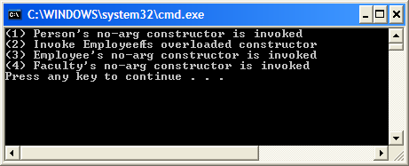
public class Faculty extends Employee {
public static void main(String[] args) {
new Faculty();
}
public Faculty() {
System.out.println("(4) Faculty's no-arg constructor is invoked");
}
}
class Employee extends Person {
public Employee() {
this("(2) Invoke Employee’s overloaded constructor");
System.out.println("(3) Employee's no-arg constructor is invoked");
}
public Employee(String s) {
System.out.println(s);
}
}
class Person {
public Person() {
System.out.println("(1) Person's no-arg constructor is invoked");
}
}
9. Execute
println

Slide 24
Example on the Impact of a Superclass without no-arg Constructor
Find out the errors in the program:
public class Apple extends Fruit {
}
class Fruit {
public Fruit(String name) {
System.out.println("Fruit's constructor is invoked");
}
}
Since no constructor is explicitly defined in Apple.
Apple’s default no-arg constructor is declared implicitly
Fruit does not has no-arg constructor because Fruit has an explicit constructor.
Therefore, the program cannot be compiled.

Slide 25
Defining a Subclass
A subclass inherits from a superclass. You can also:
Add new properties
Add new methods
Override the methods of the superclass

Slide 26
Defining a Subclass, cont.
When defining the methods for subclass, there are three possibilities:
You can change/override methods from the superclass
You can inherit methods from the superclass
You can define new methods
When defining the fields in a subclass, there are only two cases:
The subclass inherits all fields from the superclass
Any new instance fields that you define in the subclass are present only in subclass objects.

Slide 27
Calling Superclass Methods
Syntax:
super.method(parameters);
You could rewrite the printCircle() method in the Circle class as follows:
public void printCircle() {
System.out.println("The circle is created " +
super.getDateCreated() + " and the radius is " + radius);
}

Slide 28
Overriding Methods in the Superclass
A subclass inherits methods from a superclass. Sometimes it is necessary for the subclass to modify the implementation of a method defined in the superclass. This is referred to as method overriding.
public class Circle extends GeometricObject {
// Other methods are omitted
// Override the toString method defined in
// GeometricObject
public String toString() {
return super.toString() + "\nradius is " + radius;
}
}

Slide 29
NOTE
Java supports method overriding. Method overriding means replacing the implementation of an inherited method with another implementation.
To override a method, we simply redefine the method in the subclass
An instance method can be overridden only if it is accessible.
Thus, a private method cannot be overridden, because it is not accessible outside its own class.
If a method defined in a subclass is private in its superclass, the two methods are completely unrelated.
Like an instance method, a static method:
can be inherited.
cannot be overridden.
If a static method defined in the superclass is redefined in a subclass, the method defined in the superclass is hidden.

Slide 30
Overriding vs. Overloading

Slide 31
The Object Class and Its Methods
Every class in Java is descended from the java.lang.Object class.
If no inheritance is specified when a class is defined, the superclass of the class is Object.

Slide 32
The toString() method in Object
The toString() method returns a string representation of the object. The default implementation returns a string consisting of a class name of which the object is an instance, the at sign (@), and a number representing this object.
Loan loan = new Loan();
System.out.println(loan.toString());
The code displays something like Loan@15037e5 . This message is not very helpful or informative. Usually you should override the toString method so that it returns a digestible string representation of the object.

Slide 33
Benefits of Inheritance
Reduces redundant code and code modifications
A base class defines attributes and methods which are inherited by all of its subclasses. This leads to a reduction of redundant code and code modifications.
Makes your program easier to extend
When adding a new subclass, we only need to define attributes and methods which are specific to objects of that class.
Increases code reuse
Example: The Java Library has a Button class. We can create a subclass of the Button class to define objects which are like Button objects but with additional attributes and methods.
This is possible even though we do not have access to the source code for the Button class.

Slide 34
Summary
Inheritance
Constructor chaining
‘this’ keyword
Overriding & overloading
‘super’ keyword
The Object class

Slide 35
End of Chapter 3

