Slide 1
Computer Network and Communication
CNS3200

Slide 2
Learning Outcome
EXPLAIN THE MECHANISM & SHOW THE CALCULATION OF ERROR CONTROL AND THE RELATED PROTOCOLS (NS)

Slide 3
Contents
Data Link Layer
Types of Error
  Single bit error
  Burst error
Error Detection
  Parity Check
  CRC
  Checksum
Error Correction
  Hamming Code

Slide 4
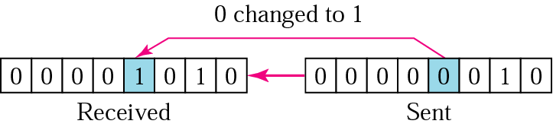
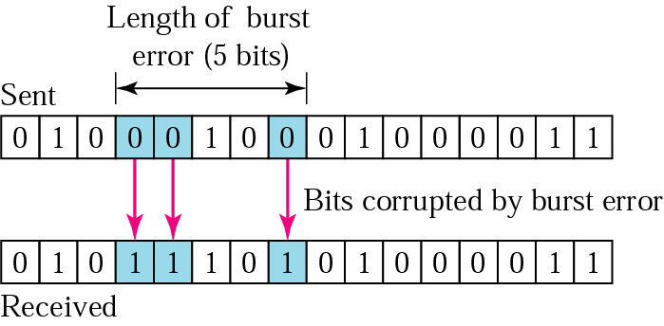
Types of Errors
Single bit error – only one bit is changed from 1 to 0 or from 0 to 1.
Burst error – two or more bits in the data unit have changed.

Slide 5
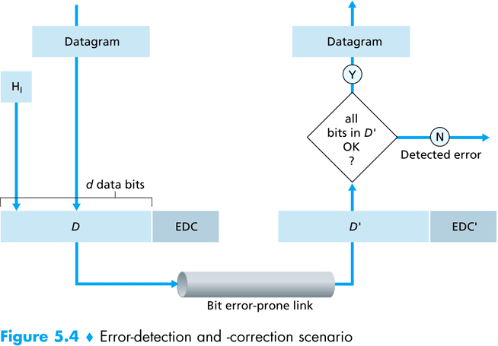
Error Detection
Error detection uses the concepts of redundancy, which means adding extra bits detecting errors at the destination.

Slide 6
3 common error detection techniques
Parity Check
Checksum
(most basic)
(used primarily by upper layers)
Cyclic Redundancy Check (CRC)
(normally implemented in link layer)

Slide 7
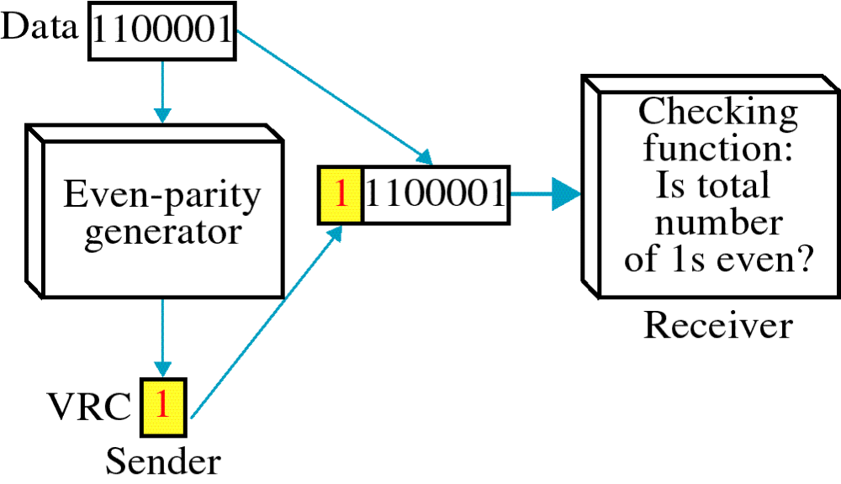
Parity Check
Simplest technique.
A redundant bit (parity bit), is appended to every data unit.
Even parity - the total number of 1's in the data plus parity bit must be an even number.

Slide 8
Even Parity Generator
Data #1's in data P Total # 1's (data and P)
0110110 4 (Even) 0 4 (Even)
0011111 5 (Odd) 1 6 (Even)
0000000 0 (Even) 0 0 (Even)
1010100 3 (Odd) 1 4 (Even)
1111111 7 (Odd) 1 8 (Even)

Slide 9
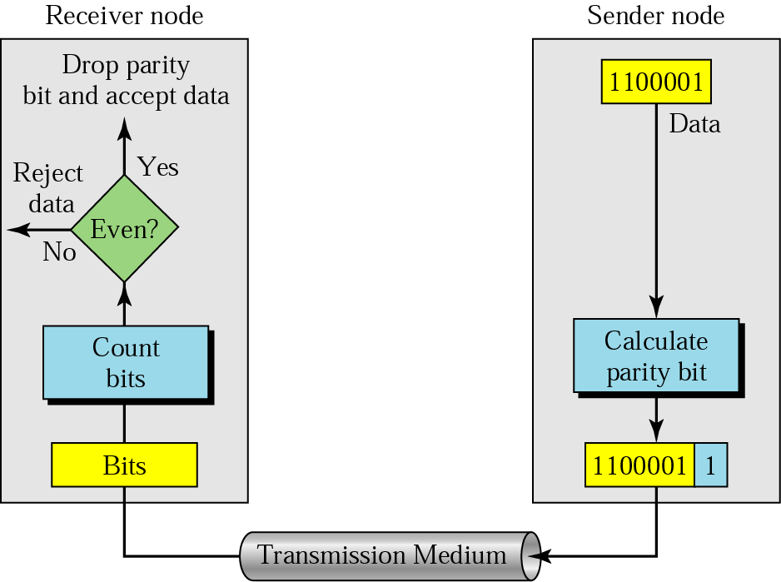

Slide 10
Example 1
Even Parity
Suppose the sender wants to send the word world. In ASCII the five characters are coded as
1110111 1101111 1110010 1101100 1100100
The following shows the actual bits sent
11101110 11011110 11100100 11011000 11001001

Slide 11
Example 2
Even Parity
Now suppose the word world in Example 1 is received by the receiver without being corrupted in transmission.
11101110 11011110 11100100 11011000 11001001
The receiver counts the 1s in each character and comes up with even numbers (6, 6, 4, 4, 4). The data are accepted.

Slide 12
Example 3
Even Parity
Now suppose the word world in Example 1 is corrupted during transmission.
11111110 11011110 11101100 11011000 11001001
The receiver counts the 1s in each character and comes up with even and odd numbers (7, 6, 5, 4, 4). The receiver knows that the data are corrupted, discards them, and asks for retransmission.

Slide 13
CRC
XOR Truth Table
The most powerful of the redundancy checking technique.
Based on binary division.
The redundancy bits used by CRC are derived by dividing the data unit by a predetermined divisor; the remainder is the CRC.
A CRC must:
  have exactly one less bit than the divisor
  appending it to the end of the data string must make the resulting bit sequence exactly divisible by the divisor.

Slide 14
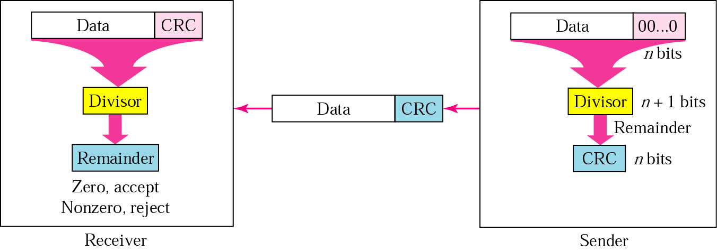
CRC generator and checker
Receive the frame.
Divide it by divisor.
Check the reminder.
Get the raw frame.
Left shift the raw frame by n bits and divide it by divisor.
The remainder is the CRC bit.
Append the CRC bit to the frame and transmit.

Slide 15
XOR Operation (Exculsive OR)
Input |  | Output
A | B
0 | 0 | 0
0 | 1 | 1
1 | 0 | 1
1 | 1 | 0

Slide 16

Division in CRC encoder

Slide 17

Division in the CRC decoder for two cases

Slide 18
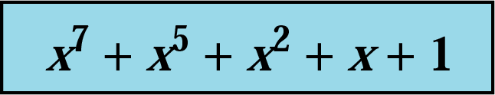
CRC
CRC generator – at the sending node.
CRC checker – at the receiving node.
Polynomial:
  The CRC generator (the divisor) is most often represented as an algebraic polynomial.
  e.g.

Slide 19
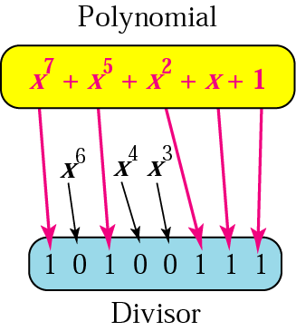
A polynomial representing a divisor

Slide 20
Standard polynomials
Name | Polynomial | Application
CRC-8 | x⁸ + x² + x + 1 | ATM header
CRC-10 | x¹⁰ + x⁹ + x⁵ + x⁴ + x ² + 1 | ATM AAL
ITU-16 | x¹⁶ + x¹² + x⁵ + 1 | HDLC
ITU-32 | x³² + x²⁶ + x²³ + x²² + x¹⁶ + x¹² + x¹¹ + x¹⁰ + x⁸ + x⁷ + x⁵ + x⁴ + x² + x + 1 | LANs

Slide 21

Checksum
The error detection used by the higher-layer protocols.
Check generator – in the sending node
Checksum checker – at receiving node
Ethernet frame

Slide 22
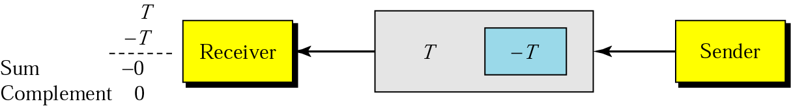
Data unit and checksum

Slide 23
Example 6
Suppose the following block of 16 bits is to be sent using a checksum of 8 bits.
10101001 00111001
The numbers are added using one’s complement
10101001
00111001
------------
Sum 11100010
Checksum 00011101
The pattern sent is 10101001 00111001 00011101

Slide 24
Example 7
Now suppose the receiver receives the pattern sent in Example 6 and there is no error.
10101001 00111001 00011101
When the receiver adds the three sections, it will get all 1s, which, after complementing, is all 0s and shows that there is no error.
10101001
00111001
00011101
------------
Sum 11111111
Complement 00000000 means that the pattern is OK.

Slide 25
Example 8
Now suppose there is a burst error of length 5 that affects 4 bits.
Original data 10101001 00111001 00011101
Corrupted data 10101111 11111001 00011101
When the receiver adds the three sections, it gets
10101111
11111001
00011101
Partial Sum 1 11000101
Carry 1
Sum 11000110
Complement 00111001 the pattern is corrupted.
Notes:
Other examples:-
1. For the given data value 11001100 10101010 11110000 11000011, perform the checksum method.
https://www.simplilearn.com/tutorials/cyber-security-tutorial/what-is-checksum
2. https://www.youtube.com/watch?v=Ig8t6MhroB8&t=282s

Slide 26
Error Correction
Hamming Code
Focus on a simple case: Single-Bit Error Correction
Use the relationship between data and redundancy bits
Developed by Richard Hamming

Slide 27
Data and redundancy bits
Number of data bits m | Number of redundancy bits r | Total bits m + r
1 | 2 | 3
2 | 3 | 5
3 | 3 | 6
4 | 3 | 7
5 | 4 | 9
6 | 4 | 10
7 | 4 | 11

Slide 28
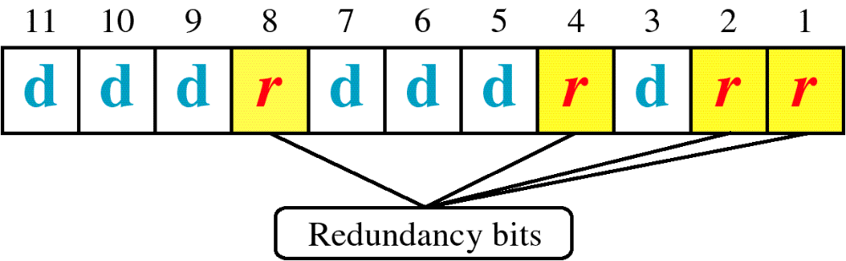
Positions of redundancy bits in Hamming code (11,7)
* Check bits occupy positions that are powers of 2

Slide 29
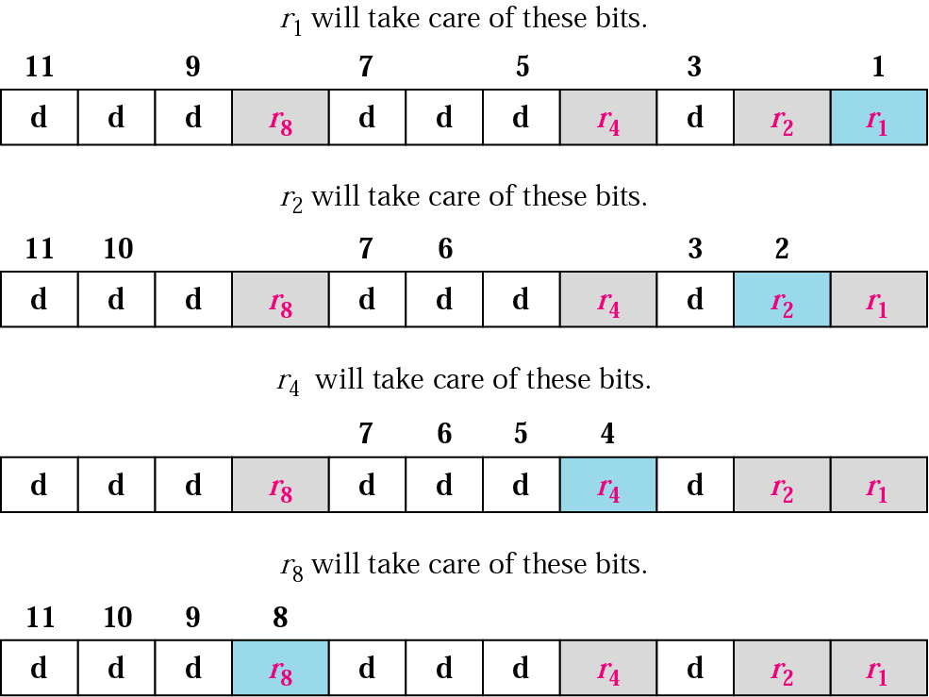
All bit positions that are powers of 2 are used as parity bits. (positions 1, 2, 4, 8…)
All other bit positions are for the data to be encoded. (positions 3, 5, 6, 7, 9, 10, 11…)
Each parity bit calculates the parity for some of the bits in the code word. The position of the parity bit determines the sequence of bits that it alternately checks and skips.
General rule for position n: skip n−1 bits, check n bits, skip n bits, check n bits...
Position 1 (n=1): skip 0 bit (0=n−1), check 1 bit (n), skip 1 bit (n), check 1 bit (n), skip 1 bit (n), etc. (1,3,5,7,9,11...)
Position 2 (n=2): skip 1 bit (1=n−1), check 2 bits (n), skip 2 bits (n), check 2 bits (n), skip 2 bits (n), etc. (2,3,6,7,10,11...)
Position 4 (n=4): skip 3 bits (3=n−1), check 4 bits (n), skip 4 bits (n), check 4 bits (n), skip 4 bits (n), etc. (4,5,6,7,12...)
Position 8 (n=8): skip 7 bits (7=n−1), check 8 bits (n), skip 8 bits (n), check 8 bits (n), skip 8 bits (n), etc. (8-15,24-31,40-47,...)
Notes:
Supplement materials:-
https://www.simplilearn.com/tutorials/networking-tutorial/what-is-hamming-code-technique-to-detect-errors-correct-data
https://www.geeksforgeeks.org/hamming-code-in-computer-network/

Slide 30
Redundancy bits calculation

Slide 31
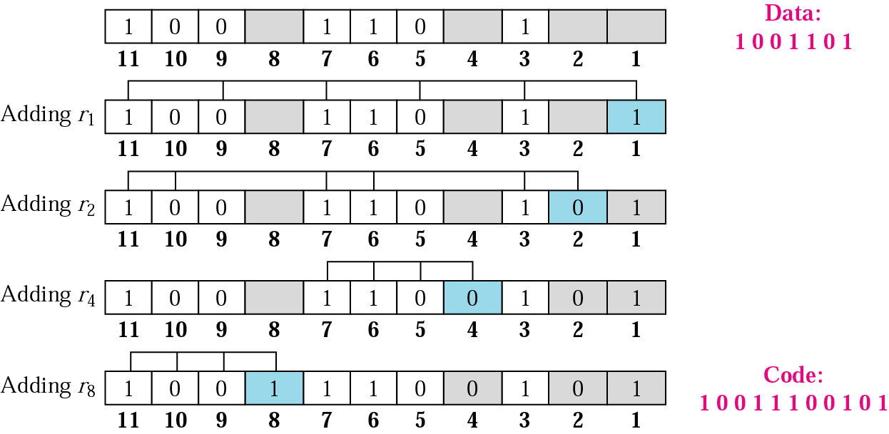
Example of redundancy bit calculation

Slide 32
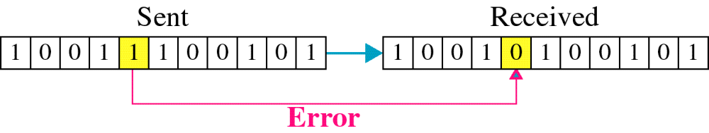
Single-Bit Error

Slide 33

Error detection using Hamming code
Error
Detection

Slide 34
Construct the even parity Hamming code word for a data byte 1001101.
The number (1001101) of bits is 7.
Notes:
Code Word = 011100101010
011100101010

Slide 35
Question
A 7 -bit Hamming code: 1011010 . Explain how to detect and correct errors in this code

Slide 36
Cont…
Data Link Control
Access Control
Flow Control

Slide 37
Learning Outcome
EXPLAIN THE ACCESS CONTROLS AND THEIR RELATED PROTOCOLS (C4)
EXPLAIN THE FLOW CONTROL MECHANISM AND THE RELATED PROTOCOL (C4)

Slide 38
Introduction
The most important functions in the data link layer are:
  Access Control – determines which who can send and when
  Flow control – coordinates the amount of data that can be sent
  Error control – perform error detection and correction
Notes:
Access Control
Purpose: Determines who can send data and when.
Function: Manages access to the shared transmission medium to avoid collisions (important in shared media networks like LANs).
Scenario: Two computers (A and B) are connected to a shared Ethernet network.
Example:
If both A and B try to send data at the same time, a collision may occur. Ethernet uses Carrier Sense Multiple Access with Collision Detection (CSMA/CD) to manage this:
Each device "listens" to the channel.
If it's free, it sends data.
If a collision happens, they wait for a random time before trying again.
Flow Control
Purpose: Coordinates the amount of data sent between sender and receiver.
Function: Ensures that a fast sender does not overwhelm a slow receiver by adjusting the flow rate.
Scenario: Computer A (sender) is transmitting data to Computer B (receiver), but Computer B processes data more slowly than Computer A sends it.
Example:
Without flow control, Computer A might send frames too quickly, causing Computer B’s buffer to overflow and lose data.
With flow control (e.g., Sliding Window Protocol):
Computer A is allowed to send a fixed number of frames (window size) before needing an acknowledgment.
Computer B acknowledges received frames and updates the window.
This controls the pace of data transmission, matching the receiver’s capacity.
Error Control
Purpose: Ensures reliable data transmission.
Function: Detects and corrects errors that occur during data transmission using methods like checksums, CRC, or acknowledgment/retransmission.
Error Control – Example
Scenario: Data is being transmitted over a noisy wireless link.
Example:
During transmission, a bit gets flipped (e.g., 1001 becomes 1000).
The Data Link Layer uses error detection techniques like Cyclic Redundancy Check (CRC).
The receiver detects the error.
It sends a Negative Acknowledgment (NAK) or no ACK.
The sender retransmits the data frame.

Slide 39
MAC Protocols: A taxonomy
Three broad classes:
Channel Partitioning
  divide channel into smaller “pieces” (time slots, frequency) using FDM,WDM or TDM
Random Access
  channel not divided, allow collisions
  “recover” from collisions
“Taking turns”/Polling
  nodes take turns, but nodes with more to send can take longer turns
MAC = Media access control
FDM = frequency division multiplexing
WDM = Wavelength Division Multiplexing
TDM = Time division multiplexing
Notes:
MAC Protocols:These are strategies used to decide who gets to use the shared communication channel and when, especially in multi-device environments like Ethernet or Wi-Fi. They prevent collisions and coordinate transmission.
🧠 In Simple Terms:
Access Control is the goal: Decide who sends data and when.
MAC Protocols are the methods used to achieve that goal.
Think of it like this:
You need rules (MAC protocols) to control how many people (devices) speak on a walkie-talkie (shared channel), or else no one will understand anything (collisions, noise).

Slide 40
Channel Partitioning
TDMA: time division multiple access
access to channel in "rounds"
each station gets fixed length slot (length = pkt trans time) in each round
unused slots go idle
example: 6-station LAN, 1,3,4 have pkt, slots 2,5,6 idle
6-slot
frame
3
3
4
1
4
1
Notes:
ANALOGY:🧠 TDMA in Simple Terms:
Think of a classroom where each student gets a turn to speak for exactly 10 seconds.
If it’s your turn but you have nothing to say, your time is wasted (goes idle).
In TDMA, each device gets a time slot to send data during every round, whether or not it has data.
🖼️ Example from the slide:
A 6-station LAN using TDMA.
Only stations 1, 3, and 4 have data.
Slots 2, 5, and 6 go idle since those stations have nothing to send.
TDMA is an organized way to avoid collisions by scheduling access — but it can be inefficient if many devices stay idle.

Slide 41
TDMA (Time Division Multiple Access) and TDM (Time Division Multiplexing) are closely related concepts — but used in slightly different contexts:
Aspect | TDM (Time Division Multiplexing) | TDMA (Time Division Multiple Access)
Purpose | Combine multiple signals onto one physical link | Allow multiple users/devices to share a communication channel
Focus | Signal/channel multiplexing | Access control among multiple devices
Used in | Lower layers (e.g., transmission systems, telecom) | MAC layer (Data Link Layer protocols)
Example | Telephone lines combining voice channels | 6-station LAN where each gets a time slot to send data
Notes:
Optional slide
📦 Analogy:
TDM: Like a train with fixed cars for each passenger's luggage. Even if one person has no luggage, the car is still there.
TDMA: Like a talk show where each guest has a fixed time to speak. If someone doesn’t speak, their time is skipped or wasted

Slide 42
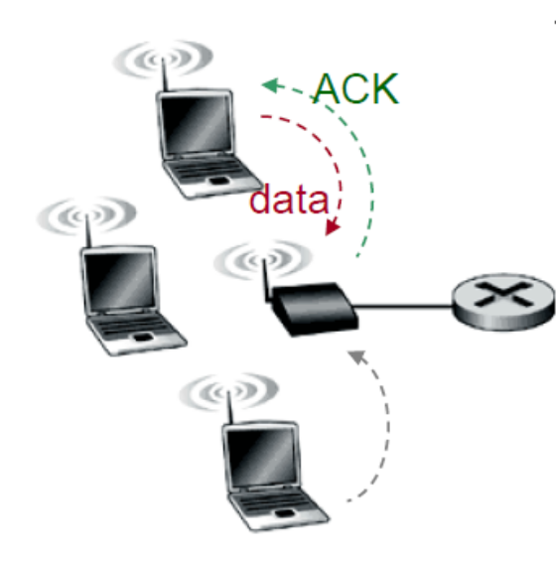
Random Access Protocols
When node has packet to send
  transmit at full channel data rate R.
  no a priori coordination among nodes
two or more transmitting nodes ➜ “collision”
random access MAC protocol specifies:
  how to detect collisions
  how to recover from collisions
  Examples protocols: slotted ALOHA, ALOHA, CSMA, CSMA/CD, CSMA/CA
Notes:
📡 Random Access MAC Protocols
When a node has data to send:
➔ It transmits immediately at the full channel data rate (R).
No prior coordination among nodes:
➔ Nodes do not reserve the channel beforehand.
Collision possibility:
➔ If two or more nodes transmit at the same time ➔ collision occurs.
Random Access Protocol specifies:
How to detect collisions.
How to recover from collisions (e.g., wait random times and retransmit).
Examples of Random Access protocols:
Slotted ALOHA
Pure ALOHA
CSMA (Carrier Sense Multiple Access)
CSMA/CD (Carrier Sense Multiple Access with Collision Detection — used in wired Ethernet)
CSMA/CA (Carrier Sense Multiple Access with Collision Avoidance — used in Wi-Fi)
🧠 In simple words:
Random Access protocols are like a group of people trying to talk at once.
If two talk at the same time (collision), they realize it (or assume it might have happened) and try again after waiting randomly.

Slide 43
ALOHA
Developed for packet radio nets
When station has frame, it sends
Then listens for a bit over max round trip time
  if receive ACK then fine
  if not, retransmit
  if no ACK after repeated transmissions, give up
frame may be damaged by noise or collision
Notes:
📡 Pure ALOHA Protocol (Random Access)
Origin: Developed for packet radio networks in Hawaii (AlohaNet).
How it works:
When a station has a frame, it sends immediately (no checking).
Then, it listens for a short time — typically just over the maximum round-trip delay.
If it receives an acknowledgment (ACK), the transmission was successful.
If no ACK is received, the frame is assumed lost (due to collision or noise), and:
It retransmits after a random delay.
After several failed attempts (with no ACK), it eventually gives up.
Why collisions happen:
Any overlapping transmissions (even partially) cause collisions.
No carrier sensing — nodes transmit blindly.
The earliest of these techniques, known as ALOHA, was developed for packet radio networks. However, it is applicable to any shared transmission medium. ALOHA, or pure ALOHA as it is sometimes called, specifies that a station may transmit a frame at any time. The station then listens for an amount of time equal to the maximum possible round-trip propagation delay on the network (twice the time it takes to send a frame between the two most widely separated stations) plus a small fixed time increment. If the station hears an acknowledgment during that time, fine; otherwise, it resends the frame. If the station fails to receive an acknowledgment after repeated transmissions, it gives up. A receiving station determines the correctness of an incoming frame by examining a frame check sequence field, as in HDLC. If the frame is valid and if the destination address in the frame header matches the receiver's address, the station immediately sends an acknowledgment. The frame may be invalid due to noise on the channel or because another station transmitted a frame at about the same time. In the latter case, the two frames may interfere with each other at the receiver so that neither gets through; this is known as a collision. If a received frame is determined to be invalid, the receiving station simply ignores the frame. ALOHA is as simple as can be, and pays a penalty for it. Because the number of collisions rises rapidly with increased load, the maximum utilization of the channel is only about 18%.

Slide 44

Figure 12.3 Frames in a pure ALOHA network
Notes:
See slotted Aloha and its comparison
https://www.youtube.com/watch?v=aqWTNk90zRA&t=413s

Slide 45

Figure 12.4 Procedure for pure ALOHA protocol

Slide 46
Slotted ALOHA
Slotted ALOHA –“improved ALOHA”, with reduced probability of collision
Assumptions:
all frames same size
time divided into equal size slots (time to transmit 1 frame)
nodes start to transmit only slot beginning
nodes are synchronized
if 2 or more nodes transmit in slot, all nodes detect collision
Operation:
when node obtains fresh frame, transmits in next slot
  if no collision: node can send new frame in next slot
  if collision: node retransmits frame in each subsequent slot with probability p
Notes:
Complete youtube video = https://www.youtube.com/watch?v=aqWTNk90zRA&t=428s
These assumptions outline a communication protocol where nodes attempt to transmit their data in discrete time slots. Here’s a breakdown of each assumption:
All frames are the same size: This means that every frame transmitted by the nodes is of equal length, simplifying the protocol because each node’s transmission duration is fixed. This also ensures that each time slot is optimized for this fixed-size frame.
Time divided into equal-sized slots: This suggests that time is partitioned into discrete intervals (slots), each of which is exactly long enough to accommodate the transmission of one frame. It is a form of time-division multiple access (TDMA).
Nodes start to transmit only at the beginning of a slot: This enforces synchronization between nodes, ensuring that each node begins transmitting at the same point in the time slot, preventing unnecessary overlap and confusion.
Nodes are synchronized: All nodes are aware of the time slots and are synchronized, meaning they agree on when a particular time slot begins. This eliminates issues related to unsynchronized transmissions.
If two or more nodes transmit in the same slot, all nodes detect a collision: This assumption describes the collision detection mechanism, where if multiple nodes transmit during the same time slot, a collision is detected by all nodes, prompting them to stop and retry.
Operation:-
a slotted ALOHA protocol, where nodes follow certain rules based on whether a collision occurs or not. Let’s break down the steps involved in this process:
When a node obtains a fresh frame, it transmits in the next available slot:
This means that once a node has data ready for transmission (a "fresh frame"), it waits for the next available time slot to send the frame.
The node does not start transmitting in the middle of a slot; it waits for the beginning of the next slot, in line with the previous assumption of synchronized nodes.
If no collision occurs:
If the node’s frame transmission is successful (i.e., no other node transmits in the same time slot), the node can proceed to transmit a new frame in the next available slot.
This represents a successful transmission with no interference, so the node continues operating in a predictable manner.
If a collision occurs:
When two or more nodes transmit simultaneously, a collision occurs and all nodes detect this.
After detecting a collision, the node retransmits the frame in each subsequent slot with probability p.
This means that after a collision, instead of immediately retransmitting, the node retries its transmission in a probabilistic manner. The node will attempt to retransmit its frame in each subsequent time slot, but with a probability of p (i.e., with some chance it might not try to retransmit in a particular slot). This randomness helps avoid repeated collisions.
Uses in satellite communication and RFID
Key Points:
Probabilistic Retransmission: The fact that the node retransmits with a probability p is a critical feature. This avoids the problem of multiple nodes attempting to retransmit at the exact same time in each slot, which would lead to continuous collisions.
Retransmission Timing: After a collision, the node does not always retransmit in the immediate next slot but randomly chooses when to retry. This reduces the chance of repetitive collisions, making the system more efficient over time.
This approach is common in protocols like ALOHA or slotted ALOHA with random backoff. The key idea is to manage collisions by introducing randomness in retransmissions to spread out the nodes' attempts, increasing the likelihood of successful transmissions.

Slide 47

Slotted ALOHA
Pros
single active node can continuously transmit at full rate of channel
highly decentralized: nodes decides independently
simple
Cons
collisions, wasting slots
idle slots
clock synchronization

Slide 48
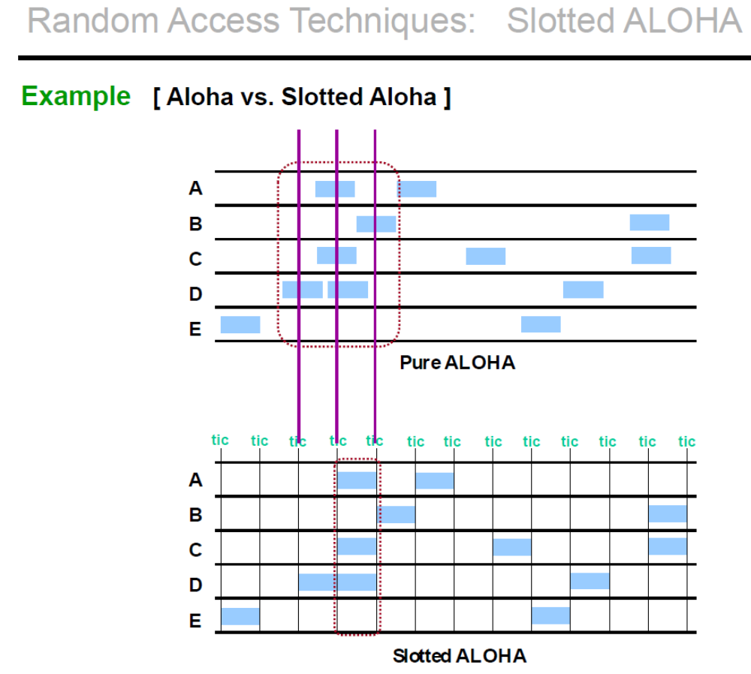
Aloha vs Slotted Aloha

Slide 49
CSMA (Carrier Sense Multiple Access)
stations soon know transmission has started
so first listen for clear medium (carrier sense)
if medium idle, transmit
if two stations start at the same instant, collision
  wait reasonable time
  if no ACK then retransmit
Notes:
The foregoing observations led to the development of carrier sense multiple access (CSMA). With CSMA, a station wishing to transmit first listens to the medium to determine if another transmission is in progress (carrier sense). If the medium is in use, the station must wait. If the medium is idle, the station may transmit. It may happen that two or more stations attempt to transmit at about the same time. If this happens, there will be a collision; the data from both transmissions will be garbled and not received successfully. To account for this, a station waits a reasonable amount of time after transmitting for an acknowledgment, taking into account the maximum round-trip propagation delay and the fact that the acknowledging station must also contend for the channel to respond. If there is no acknowledgment, the station assumes that a collision has occurred and retransmits. This strategy is effective for networks in which the average frame transmission time is much longer than the propagation time. Collisions can occur only when more than one user begins transmitting within a short time interval (the period of the propagation delay). If a station begins to transmit a frame, and there are no collisions during the time it takes for the leading edge of the packet to propagate to the farthest station, then there will be no collision for this frame because all other stations are now aware of the transmission. The maximum utilization achievable using CSMA can far exceed that of ALOHA or slotted ALOHA. The maximum utilization depends on the length of the frame and on the propagation time; the longer the frames or the shorter the propagation time, the higher the utilization.
📶 CSMA – Carrier Sense Multiple Access
Before transmitting, a station:
Listens to the medium (carrier sensing).
If the medium is idle, it transmits.
If the medium is busy, it waits until it's idle.
But:
If two stations sense the medium is idle at the same time, they may both transmit — causing a collision.
After sending, the station:
Waits for an ACK (acknowledgment).
If no ACK is received, it assumes a collision occurred, and:
Waits a random time before retransmitting (to avoid repeated collisions)
CSMA Variants:
CSMA/CD (Collision Detection):
Used in wired Ethernet — detects collisions while transmitting and immediately aborts.
CSMA/CA (Collision Avoidance):
Used in Wi-Fi — tries to avoid collisions before they happen (no collision detection due to wireless limits).

Slide 50
CSMA/CD Description
CSMA/CD rules:
  if medium idle, transmit
  if busy, listen for idle, then transmit
  if collision detected, transmit jam signal and then stop transmission, wait random time then retry
Notes:
CSMA, although more efficient than ALOHA or slotted ALOHA, still has one glaring inefficiency. When two frames collide, the medium remains unusable for the duration of transmission of both damaged frames. For long frames, compared to propagation time, the amount of wasted capacity can be considerable. This waste can be reduced if a station continues to listen to the medium while transmitting. This leads to the following rules for CSMA/CD:
1. If the medium is idle, transmit; otherwise, go to step 2.
2. If the medium is busy, continue to listen until the channel is idle, then transmit immediately.
3. If a collision is detected during transmission, transmit a brief jamming signal to assure that all stations know that there has been a collision and then cease transmission.
4. After transmitting the jamming signal, wait a random amount of time, referred to as the backoff, then attempt to transmit again (repeat from step 1).
steps of CSMA/CD (Carrier Sense Multiple Access with Collision Detection) — used in classic Ethernet (like 10Base-T).
⚡ CSMA/CD – Collision Detection (Used in Ethernet)
Sense the medium:
If the medium is idle → transmit immediately.
If the medium is busy → wait until it's idle, then transmit.
Collision detection during transmission:
While transmitting, the sender monitors the medium.
If a collision is detected (signal on the wire doesn't match what was sent):
The station immediately stops transmitting.
It sends a jam signal to inform all devices that a collision occurred.
Backoff and retry:
After sending the jam signal, the station waits a random time (using binary exponential backoff).
Then it tries again.
💡 Why this works:
CSMA/CD helps minimize wasted bandwidth by:
Stopping transmissions early during a collision.
Avoiding repeated collisions using random delays.
📌 Note:
CSMA/CD is not used in modern Ethernet (e.g., 100 Mbps or 1 Gbps and above) because:
Those networks are typically switched, not shared.
Each device gets a dedicated channel, so collisions don’t occur.
Would you like a timeline diagram showing the CSMA/CD process step by step?
4o

Slide 51
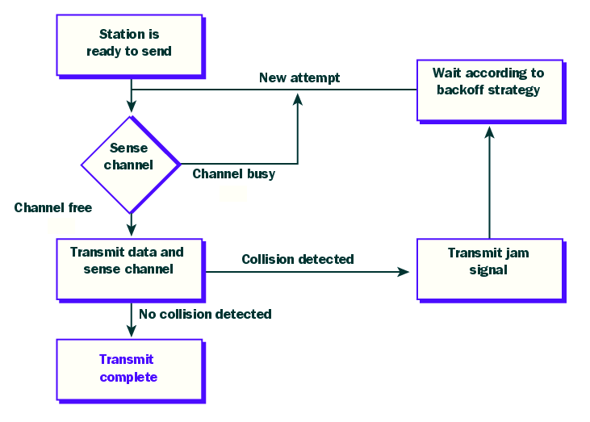
CSMA/CD
(2)
used in classic Ethernet (like 10Base-T).
(1)
(3)

Slide 52
CSMA/CA Description
CSMA/CA rules:
  Sense the medium, if medium idle, wait for some interframe space (IFS) time, then sense the channel
    If busy – go to step 2
    If still idle – transmit a frame
  if busy, wait until transmission end and then wait for some IFS time, then sense the channel again
    If busy – go to Step 2
    If idle – backoff/wait for some random time and transmit a frame
Notes:
CSMA, although more efficient than ALOHA or slotted ALOHA, still has one glaring inefficiency. When two frames collide, the medium remains unusable for the duration of transmission of both damaged frames. For long frames, compared to propagation time, the amount of wasted capacity can be considerable. This waste can be reduced if a station continues to listen to the medium while transmitting. This leads to the following rules for CSMA/CD:
1. If the medium is idle, transmit; otherwise, go to step 2.
2. If the medium is busy, continue to listen until the channel is idle, then transmit immediately.
3. If a collision is detected during transmission, transmit a brief jamming signal to assure that all stations know that there has been a collision and then cease transmission.
4. After transmitting the jamming signal, wait a random amount of time, referred to as the backoff, then attempt to transmit again (repeat from step 1).
📶 CSMA/CA – Collision Avoidance (Used in Wi-Fi)
Sense the medium:
If the medium is idle, wait for a short, fixed time called Interframe Space (IFS).
Sense the channel again after IFS:
If the medium is still idle:
Begin a random backoff timer (based on contention window).
After backoff expires without interruption, transmit the frame.
If the medium is busy during IFS:
Wait for the transmission to end, then:
Wait another IFS.
Sense again and repeat the steps above

Slide 53
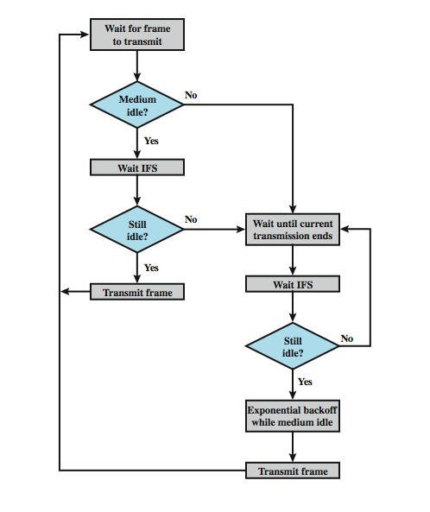
IEEE 802.11 MAC Protocol
CSMA/CA
IFS : Inter Frame Spacing

Slide 54

“Taking Turns” MAC protocols
Polling:
master node “invites” slave nodes to transmit in turn
data
poll
master
data
slaves
Notes:
Polling — one of the “Taking Turns” MAC protocols used for access control.
🧭 Polling Protocol
In Polling, there is a central controller called the master node.
The master node controls when each device (called a slave node) is allowed to transmit.
It does this by “inviting” each slave node one at a time to send data.
🔁 How It Works:
The master sends a poll message to a slave (e.g., "Node 2, do you have data to send?").
If the polled node has data, it transmits.
If not, the master moves on to poll the next node.
This continues in a cycle — giving each node a turn to speak.
✅ Advantages:
No collisions (since only one node sends at a time).
Works well when the master can handle control traffic efficiently.
❌ Disadvantages:
If many nodes are idle, polling wastes time.
If the master fails, entire communication may stop.
More overhead due to constant polling messages.
🧠 Analogy:
It’s like a teacher (master) calling on students (slaves) one by one to answer a question. No one speaks out of turn, and there’s no talking over each other.
Would you like to compare this with Token Passing, another "Taking Turns" method?

Slide 55
“Taking Turns”
MAC protocols
T
Token passing:
control token passed from one node to next sequentially.
(nothing
to send)
T
data
Notes:
Token Passing is another "Taking Turns" MAC protocol — similar in goal to Polling, but it works differently, without a central controller.
🔄 Token Passing Protocol
A special data packet called a "token" is passed from one node to the next in a fixed, logical order (like a circle).
Only the node holding the token is allowed to transmit.
After it finishes, it passes the token to the next node.
If a node has nothing to send, it just forwards the token.
🔁 How It Works:
Token circulates around the network.
A node that receives the token:
Sends data if it has any.
Passes the token after it's done (or immediately if no data).
This repeats endlessly, giving each node a turn.
✅ Advantages:
No collisions, since only one node can send at a time.
Fair access — all nodes get an equal chance to transmit.
❌ Disadvantages:
If the token is lost, communication stops until it's regenerated.
Slightly higher overhead (you need to manage the token and passing).
Delay in access if the token takes time to reach a node.
🧠 Analogy:
It’s like passing a microphone in a meeting — only the person holding the mic can speak. When they’re done, they pass it to the next person.

Slide 56
Summary of Access Control
channel partitioning, by time, frequency or code
  Time Division, Frequency Division
random access (dynamic),
  ALOHA, S-ALOHA, CSMA, CSMA/CD
  carrier sensing: easy in some technologies (wire), hard in others (wireless)
  CSMA/CD used in Ethernet(old) (10Base-T)
  CSMA/CA used in 802.11(wifi)
taking turns
  polling from central site, token passing
  Bluetooth, FDDI, IBM Token Ring
Notes:
Protocol How It Works Used In Pros Cons
Polling Central master invites each device to send Bluetooth (master-slave mode) No collisions Central controller is a single point of failure
Token Passing A token circulates; only token-holder can send FDDI, IBM Token Ring Fair, orderly Token can be lost or delayed

Slide 57
Flow Control
Procedures that tells the sender how much data to transmit.
Each receiving device has a block of memory.
Two methods
  Stop-and-wait
  Sliding window

Slide 58
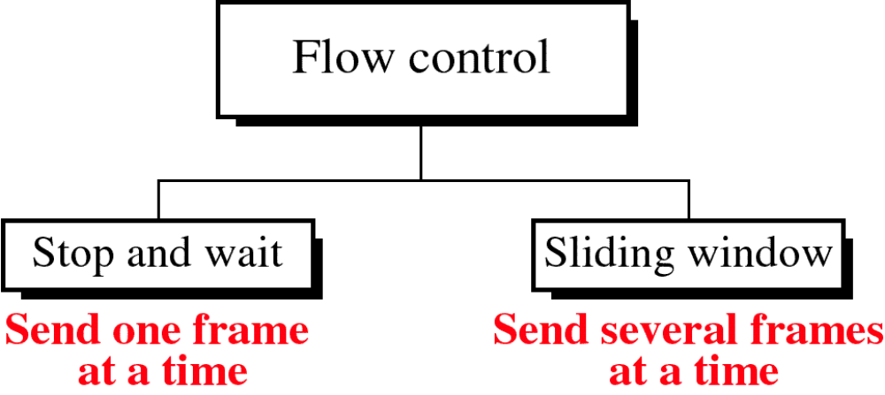

Slide 59
Stop and Wait
source transmits frame
destination receives frame and replies with acknowledgement (ACK)
source waits for ACK before sending next
destination can stop flow by not send ACK
works well for a few large frames
Stop and wait becomes inadequate if large block of data is split into small frames
Notes:
The simplest form of flow control, known as stop-and-wait flow control, works as follows. A source entity transmits a frame. After the destination entity receives the frame, it indicates its willingness to accept another frame by sending back an acknowledgment to the frame just received. The source must wait until it receives the acknowledgment before sending the next frame. The destination can thus stop the flow of data simply by withholding acknowledgment. This procedure works fine and, indeed, can hardly be improved upon when a message is sent in a few large frames. However, it is often the case that a source will break up a large block of data into smaller blocks and transmit the data in many frames (because of limited buffer size, errors detected sooner with less to resend, to prevent media hogging). With the use of multiple frames for a single message, the stop-and-wait procedure may be inadequate, mainly since only one frame at a time can be in transit.

Slide 60
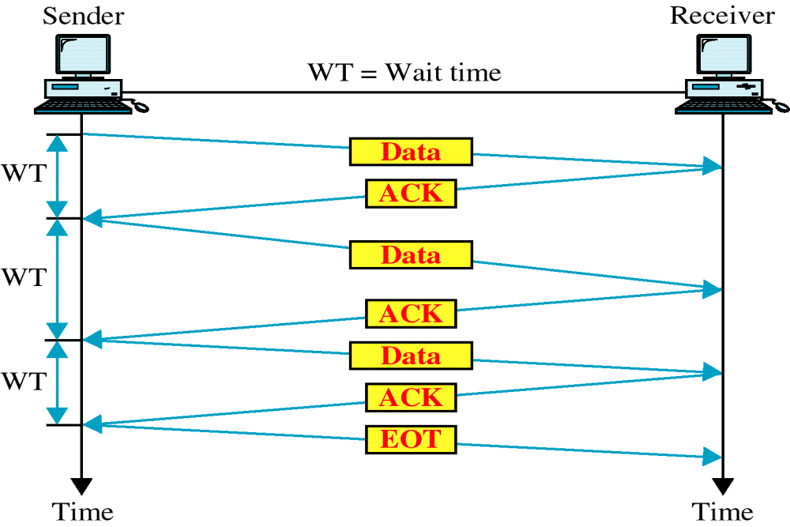
Stop and Wait
Link Utilization
Notes:
With the use of multiple frames for a single message, the stop-and-wait procedure may be inadequate, mainly since only one frame at a time can be in transit.
To show this, start by defining the bit length B of a link as the number of bits present on the link at an instance in time when a stream of bits fully occupies the link. In situations where the bit length of the link is greater than the frame length, serious inefficiencies result, as shown in Stallings DCC8e Figure 7.2. In the figure, the transmission time (the time it takes for a station to transmit a frame) is normalized to one, and the propagation delay (the time it takes for a bit to travel from sender to receiver) is expressed as the variable a = B / L (where L is the number of bits in the frame).
When a is less than 1, the propagation time is less than the transmission time. In this case, the frame is sufficiently long that the first bits of the frame have arrived at the destination before the source has completed the transmission of the frame. When a is greater than 1, the propagation time is greater than the transmission time. In this case, the sender completes transmission of the entire frame before the leading bits of that frame arrive at the receiver. Both parts of Figure 7.2 (a and b) consist of a sequence of snapshots, the first four show the process of transmitting a data frame, and the last shows the return of a small acknowledgment frame. Note that for a > 1, the line is always underutilized and even for a < 1, the line is inefficiently utilized. In essence, for very high data rates, for very long distances between sender and receiver, stop-and-wait flow control provides inefficient line utilization.

Slide 61
Sliding Windows
Flow Control
allows multiple numbered frames to be in transit
receiver has buffer W long
transmitter sends up to W frames without ACK
ACK includes number of next frame expected
sequence number is bounded by size of field (k)
  frames are numbered modulo 2^{k}
  giving max window size of up to 2^{k} - 1
receiver can ack frames without permitting further transmission (Receive Not Ready)
must send a normal acknowledge to resume
if have full-duplex link, can piggyback ACks
Notes:
The essence of the problem described so far is that only one frame at a time can be in transit. Efficiency can be greatly improved by allowing multiple frames to be in transit at the same time. Consider two stations, A and B, connected via a full-duplex link. Station B allocates buffer space for W frames. Thus, B can accept W frames, and A is allowed to send W frames without waiting for any acknowledgments. To keep track of which frames have been acknowledged, each is labeled with a a k-bit sequence number. This gives a range of sequence numbers of 0 through 2^{k} – 1, and frames are numbered modulo 2^{k}, with a maximum window size of 2^{k} – 1. The window size need not be the maximum possible size for a given sequence number length k. B acknowledges a frame by sending an acknowledgment that includes the sequence number of the next frame expected. This scheme can also be used to acknowledge multiple frames, and is referred to as sliding-window flow control. Most data link control protocols also allow a station to cut off the flow of frames from the other side by sending a Receive Not Ready (RNR) message, which acknowledges former frames but forbids transfer of future frames. At some subsequent point, the station must send a normal acknowledgment to reopen the window. If two stations exchange data, each needs to maintain two windows, one for transmit and one for receive, and each side needs to send the data and acknowledgments to the other. To provide efficient support for this requirement, a feature known as piggybacking is typically provided. Each data frame includes a field that holds the sequence number of that frame plus a field that holds the sequence number used for acknowledgment.

Slide 62
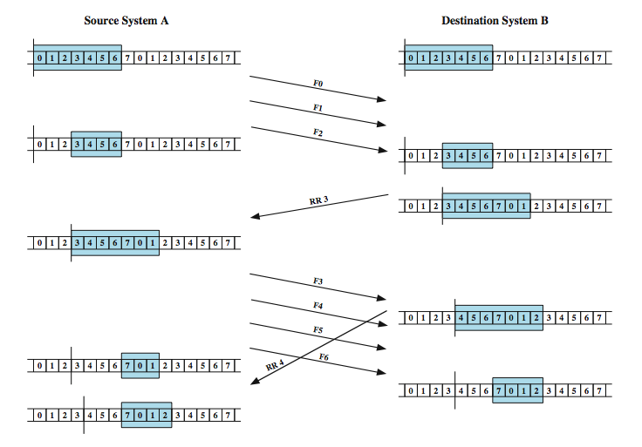
Sliding Window Example
Notes:
An example is shown in Stallings DCC8e Figure 7.4. The example assumes a 3-bit sequence number field and a maximum window size of seven frames. Initially, A and B have windows indicating that A may transmit seven frames, beginning with frame 0 (F0). After transmitting three frames (F0, F1, F2) without acknowledgment, A has shrunk its window to four frames and maintains a copy of the three transmitted frames. The window indicates that A may transmit four frames, beginning with frame number 3. B then transmits an RR (receive ready) 3, which means "I have received all frames up through frame number 2 and am ready to receive frame number 3; in fact, I am prepared to receive seven frames, beginning with frame number 3." With this acknowledgment, A is back up to permission to transmit seven frames, still beginning with frame 3; also A may discard the buffered frames that have now been acknowledged. A proceeds to transmit frames 3, 4, 5, and 6. B returns RR 4, which acknowledges F3, and allows transmission of F4 through the next instance of F2. By the time this RR reaches A, it has already transmitted F4, F5, and F6, and therefore A may only open its window to permit sending four frames beginning with F7.

Slide 63
Error Control
- Refers to methods of error detection and correction due to
  lost frames
  damaged frames
- common techniques use:
  error detection (CRC,checksum)
  positive acknowledgment
  retransmission after timeout
  negative acknowledgement & retransmission

Slide 64
Automatic Repeat Request (ARQ)
collective name for such error control mechanisms, including:
stop and wait
go back N
selective repeat (selective retransmission)

Slide 65
Stop and Wait
source transmits single frame
wait for ACK
if received damaged frame, discard it
  no ACK received
  if no ACK within timeout, retransmit
if ACK damaged, transmitter will not recognize it
  transmitter will retransmit
  receiver gets two copies of frame
  use alternate numbering and ACK0 / ACK1
Notes:
Stop-and-wait ARQ is based on the stop-and-wait flow control technique outlined previously. The source station transmits a single frame and then must await an acknowledgment (ACK). No other data frames can be sent until the destination station's reply arrives at the source station.
Two sorts of errors could occur. First, the frame that arrives at the destination could be damaged. The receiver detects this by using the error-detection technique referred to earlier and simply discards the frame. To account for this possibility, the source station is equipped with a timer. After a frame is transmitted, the source station waits for an acknowledgment. If no acknowledgment is received by the time that the timer expires, then the same frame is sent again. Note that this method requires that the transmitter maintain a copy of a transmitted frame until an acknowledgment is received for that frame.
The second sort of error is a damaged acknowledgment, which is not recognizable by A, which will therefore time out and resend the same frame. This duplicate frame arrives and is accepted by B. B has therefore accepted two copies of the same frame as if they were separate. To avoid this problem, frames are alternately labeled with 0 or 1, and positive acknowledgments are of the form ACK0 and ACK1. In keeping with the sliding-window convention, an ACK0 acknowledges receipt of a frame numbered 1 and indicates that the receiver is ready for a frame numbered 0.

Slide 66

Stop and Wait
see example with both types of errors
pros and cons
  simple
  inefficient
Notes:
Stallings DCC8e Figure 7.5 gives an example of the use of stop-and-wait ARQ, showing the transmission of a sequence of frames from source A to destination B. The figure shows the two types of errors just described. The third frame transmitted by A is lost or damaged and therefore B does not return an ACK. A times out and retransmits the frame. Later, A transmits a frame labeled 1 but the ACK0 for that frame is lost. A times out and retransmits the same frame. When B receives two frames in a row with the same label, it discards the second frame but sends back an ACK0 to each.
The principal advantage of stop-and-wait ARQ is its simplicity. Its principal disadvantage is that stop-and-wait is an inefficient mechanism.

Slide 67
Go-Back-N
based on sliding window
if no error, ACK as usual
use window to control number of outstanding frames
if error, negative acknowledgment
  discard that frame and all future frames until error frame received correctly
  transmitter must go back and retransmit that frame and all subsequent frames
Notes:
The sliding-window flow control technique can be adapted to provide more efficient line use, sometimes referred to as continuous ARQ. The form of error control based on sliding-window flow control that is most commonly used is called go-back-N ARQ. In this method, a station may send a series of frames sequentially numbered modulo some maximum value. The number of unacknowledged frames outstanding is determined by window size, using the sliding-window flow control technique. While no errors occur, the destination will acknowledge incoming frames as usual (RR = receive ready, or piggybacked acknowledgment). If the destination station detects an error in a frame, it may send a negative acknowledgment (REJ = reject) for that frame, as explained in the following rules. The destination station will discard that frame and all future incoming frames until the frame in error is correctly received. Thus, the source station, when it receives a REJ, must retransmit the frame in error plus all succeeding frames that were transmitted in the interim.

Slide 68
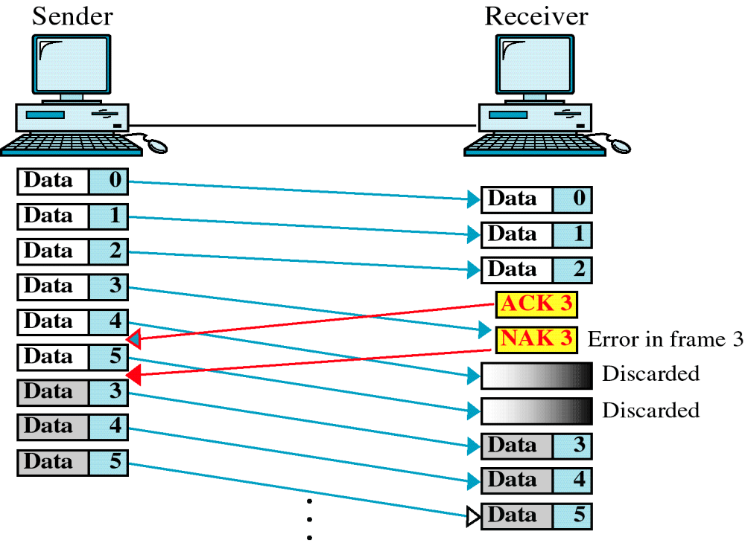
Damaged Frame

Slide 69
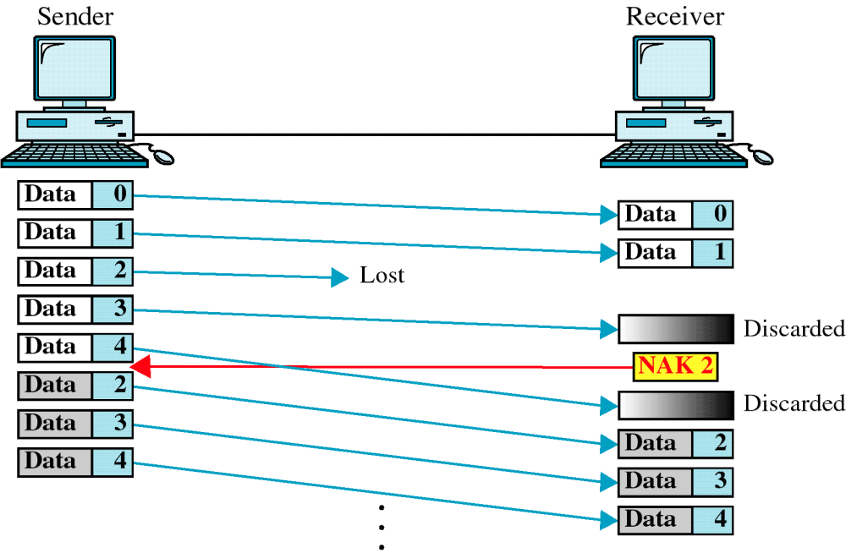
Lost Frame

Slide 70
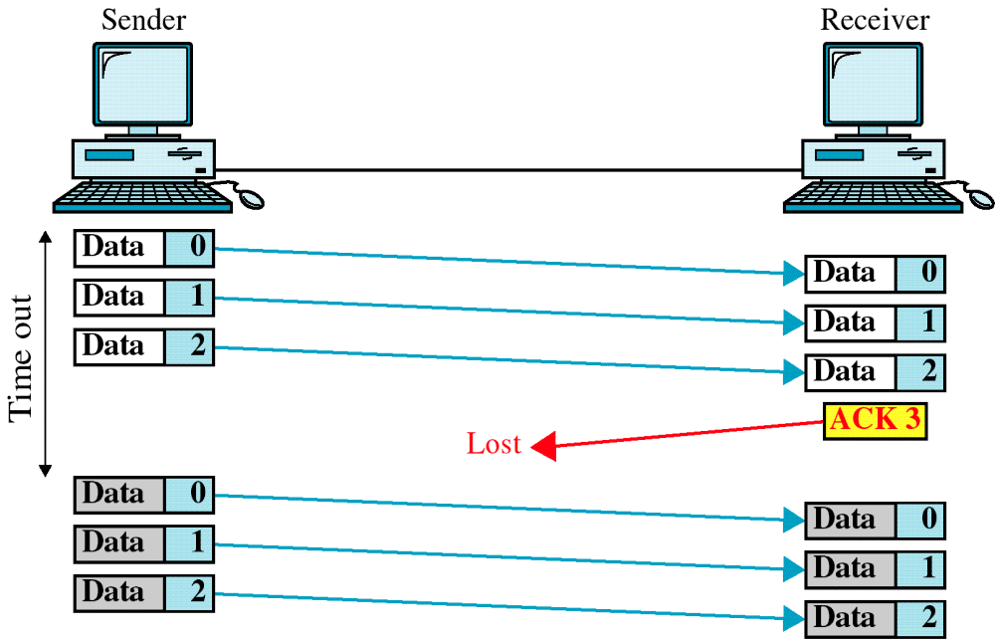
Lost ACK

Slide 71
Selective Repeat
only rejected frames are retransmitted
subsequent frames are accepted by the receiver and buffered
minimizes retransmission
receiver must maintain large enough buffer
more complex logic in transmitter
hence less widely used
useful for satellite links with long propagation delays
Notes:
With selective-reject ARQ, the only frames retransmitted are those that receive a negative acknowledgment, in this case called SREJ, or those that time out. Selective reject would appear to be more efficient than go-back-N, because it minimizes the amount of retransmission. On the other hand, the receiver must maintain a buffer large enough to save post-SREJ frames until the frame in error is retransmitted and must contain logic for reinserting that frame in the proper sequence. The transmitter, too, requires more complex logic to be able to send a frame out of sequence. Because of such complications, select-reject ARQ is much less widely used than go-back-N ARQ. Selective reject is a useful choice for a satellite link because of the long propagation delay involved.

Slide 72
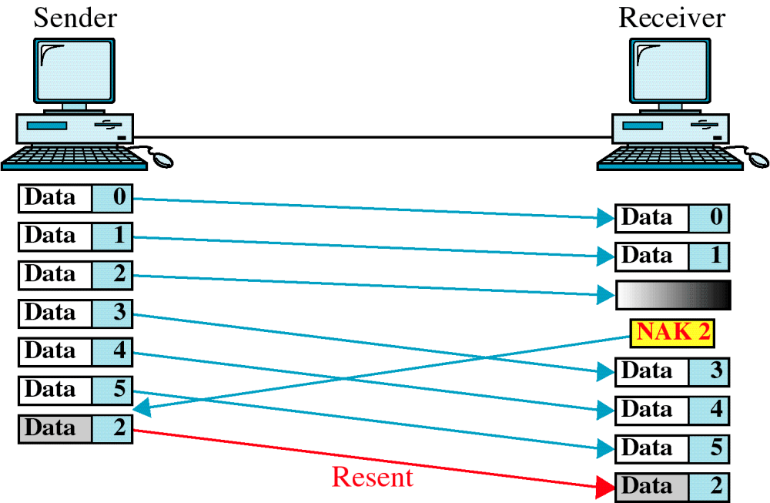
Selective Repeat
Notes:
Stallings DCC8e Figure 7.6a is an example of the frame flow for go-back-N ARQ. Because of the propagation delay on the line, by the time that an acknowledgment (positive or negative) arrives back at the sending station, it has already sent at least one additional frame beyond the one being acknowledged. In this example, frame 4 is damaged. Frames 5 and 6 are received out of order and are discarded by B. When frame 5 arrives, B immediately sends a REJ 4. When the REJ to frame 4 is received, not only frame 4 but frames 5 and 6 must be retransmitted. Note that the transmitter must keep a copy of all unacknowledged frames. Figure 7.6a also shows an example of retransmission after timeout. No acknowledgment is received for frame 5 within the timeout period, so A issues an RR to determine the status of B.
Stallings DCC8e Figure 7.6b illustrates selective-reject ARQ. When frame 5 is received out of order, B sends a SREJ 4, indicating that frame 4 has not been received. However, B continues to accept incoming frames and buffers them until a valid frame 4 is received. At that point, B can place the frames in the proper order for delivery to higher-layer software.

