Slide 1
Local Area Network
- Gigabit Ethernet (Wired LAN)
-Bluetooth ( Wireless LAN)
-Connecting LAN ( Devices)
-Virtual LAN

Slide 2
Learning Outcome
DIFFERENTIATE ACCESS CONTROL FOR LAN AND WAN I.E. CSMA/CD, TDMA (C4)
EXPLAIN TYPES OF LAN TECHNOLOGY I.E GIGABIT ETHERNET, BLUETOOTH (C2)
EXPLAIN TYPES OF WAN TECHNOLOGY I.E CELLULAR, SATELITE (C2)
EXPLAIN METHOD OF VIRTUAL LAN (C2)

Slide 3
What is LAN?
A local area network (LAN) is a network that interconnects computers and network devices over a relatively short distance. A networked office building, home or school usually contains a single LAN, though sometimes one building will contain a few small LANs (perhaps one per room), and occasionally a LAN will span a group of nearby buildings.
LANs are also typically owned, controlled, and managed by a single person or organization.
LAN can be generally divided into two medium; wired and wireless.
De facto wired LAN connectivity technologies usually are Ethernet and Token Ring. As with wireless LAN, Wi-Fi and Bluetooth are the most popular technologies.

Slide 4
LAN Protocols
In 1985, the Computer Society of the IEEE started a project, called Project 802, to set standards to enable intercommunication among equipment from a variety of manufacturers. Project 802 is a way of specifying functions of the physical layer and the data link layer of major LAN protocols.

Slide 5


IEEE Standards for LANs

Slide 6
Ethernet …
Most widely used LAN standard
The original Ethernet was created in 1976 at Xerox’s Palo Alto Research Center (PARC). Since then, it has gone through four generations (next slide)
It is a IEEE 802.3 standard
Used CSMA/CD access control

Slide 7
CSMA (Carrier Sense Multiple Access)
stations soon know transmission has started
so first listen for clear medium (carrier sense)
if medium idle, transmit
if two stations start at the same instant, collision
  wait reasonable time
  if no ACK then retransmit
Notes:
The foregoing observations led to the development of carrier sense multiple access (CSMA). With CSMA, a station wishing to transmit first listens to the medium to determine if another transmission is in progress (carrier sense). If the medium is in use, the station must wait. If the medium is idle, the station may transmit. It may happen that two or more stations attempt to transmit at about the same time. If this happens, there will be a collision; the data from both transmissions will be garbled and not received successfully. To account for this, a station waits a reasonable amount of time after transmitting for an acknowledgment, taking into account the maximum round-trip propagation delay and the fact that the acknowledging station must also contend for the channel to respond. If there is no acknowledgment, the station assumes that a collision has occurred and retransmits. This strategy is effective for networks in which the average frame transmission time is much longer than the propagation time. Collisions can occur only when more than one user begins transmitting within a short time interval (the period of the propagation delay). If a station begins to transmit a frame, and there are no collisions during the time it takes for the leading edge of the packet to propagate to the farthest station, then there will be no collision for this frame because all other stations are now aware of the transmission. The maximum utilization achievable using CSMA can far exceed that of ALOHA or slotted ALOHA. The maximum utilization depends on the length of the frame and on the propagation time; the longer the frames or the shorter the propagation time, the higher the utilization.

Slide 8
CSMA/CD Description
CSMA/CD rules:
  if medium idle, transmit
  if busy, listen for idle, then transmit
  if collision detected, transmit jam signal and then stop transmission, wait random time then retry
Notes:
CSMA, although more efficient than ALOHA or slotted ALOHA, still has one glaring inefficiency. When two frames collide, the medium remains unusable for the duration of transmission of both damaged frames. For long frames, compared to propagation time, the amount of wasted capacity can be considerable. This waste can be reduced if a station continues to listen to the medium while transmitting. This leads to the following rules for CSMA/CD:
1. If the medium is idle, transmit; otherwise, go to step 2.
2. If the medium is busy, continue to listen until the channel is idle, then transmit immediately.
3. If a collision is detected during transmission, transmit a brief jamming signal to assure that all stations know that there has been a collision and then cease transmission.
4. After transmitting the jamming signal, wait a random amount of time, referred to as the backoff, then attempt to transmit again (repeat from step 1).

Slide 9
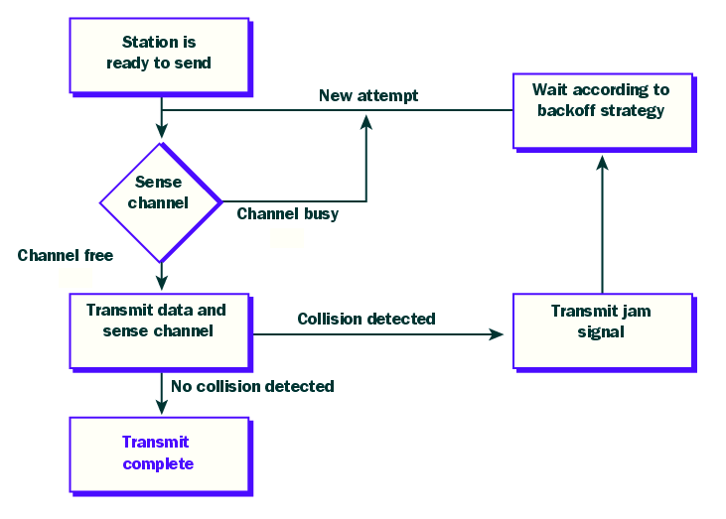
CSMA/CD
(2)
(1)
(3)

Slide 10

Ethernet Evolution
Figure 13.3 Ethernet evolution through four generations

Slide 11

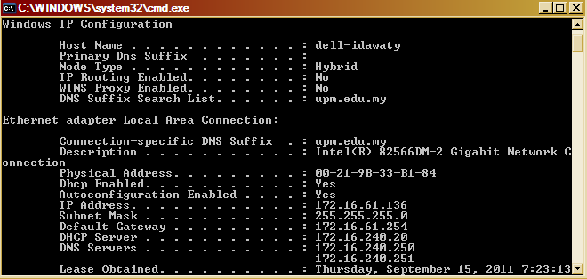
Figure 13.6 Example of an Ethernet address in hexadecimal notation
Ethernet Address

Slide 12

Figure 13.7 Unicast and multicast addresses
13.<number>

Slide 13

Note
The least significant bit of the first byte
defines the type of address.
If the bit is 0, the address is unicast;
otherwise, it is multicast.
13.<number>

Slide 14
Note
The broadcast destination address is a special case of the multicast address in which all bits are 1s.
13.<number>

Slide 15
Example 13.1
https://www.convertbinary.com/hexadecimal-to-binary/
Define the type of the following destination addresses:
a. 4A:30:10:21:10:1A b. 47:20:1B:2E:08:EE
c. FF:FF:FF:FF:FF:FF
Solution
To find the type of the address, we need to look at the second hexadecimal digit from the left. If it is even, the address is unicast. If it is odd, the address is multicast. If all digits are F’s, the address is broadcast. Therefore, we have the following:
a. This is a unicast address because A in binary is 1010.
b. This is a multicast address because 7 in binary is 0111.
c. This is a broadcast address because all digits are F’s.
13.<number>

Slide 16
Hexadecimal to binary
Split the hex number into individual values.
Convert each hex value into its decimal equivalent.
Next, convert each decimal digit into binary, making sure to write four digits for each value.
Combine all four digits to make one binary number.
Example - hex 28 to binary
2 = decimal 2 8 = decimal 8
2 = binary 0010 8 = binary 1000
Result - 00101000
Example - hex FC to binary
F = decimal 15 C = decimal 12
15 = binary 1111 12 = binary 1100
Result - 11111100
https://www.bbc.co.uk/bitesize/guides/zd88jty/revision/5

Slide 17
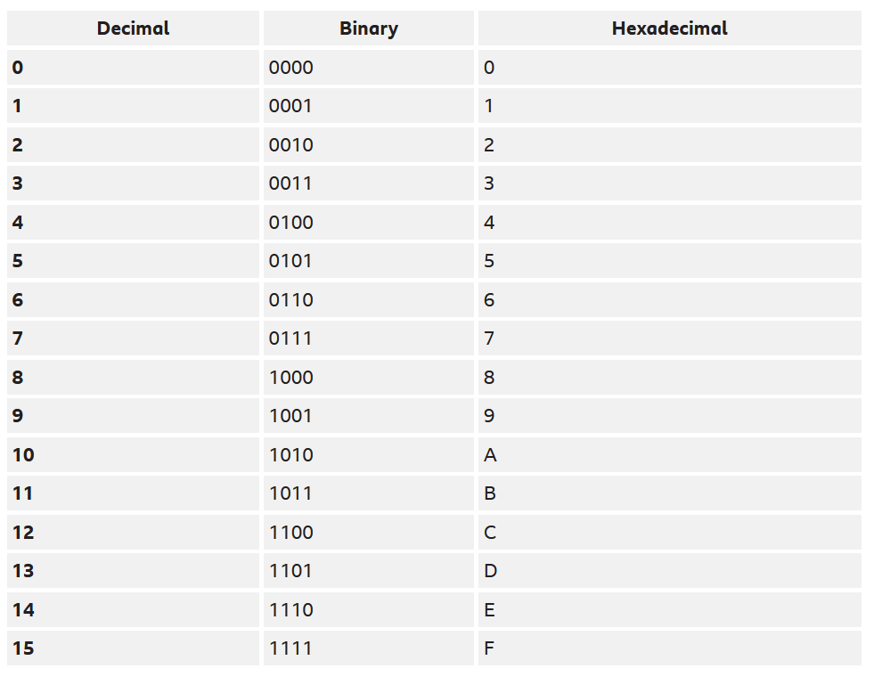

Slide 18
Example 13.2
Show how the address 47:20:1B:2E:08:EE is sent out on line.
Solution
The address is sent left-to-right, byte by byte; for each byte, it is sent right-to-left, bit by bit, as shown below:
13.<number>

Slide 19
WIRELESS LAN

Slide 20
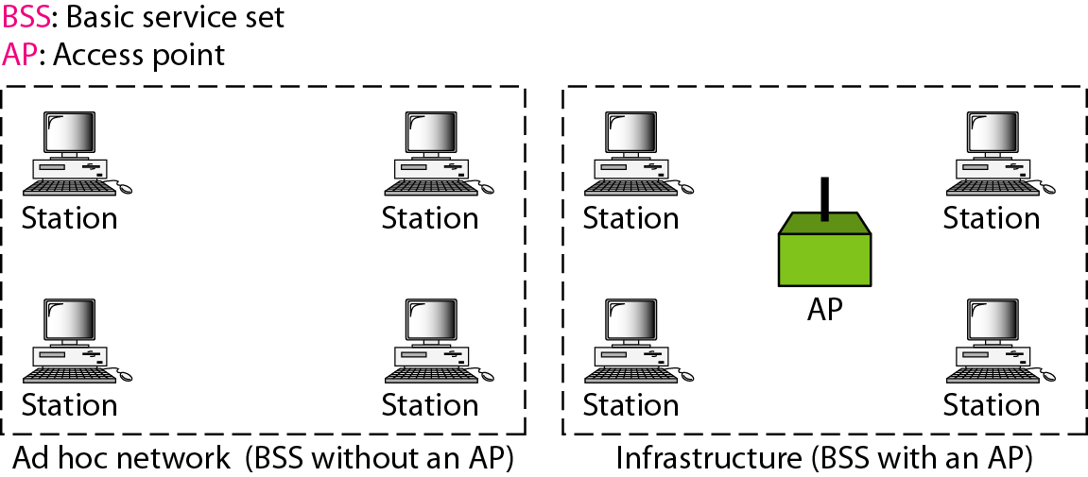
Figure 14.1 Basic service sets (BSSs) ( Wireless LAN)
A BSS without an AP is called an ad hoc network;
a BSS with an AP is called an infrastructure network.

Slide 21
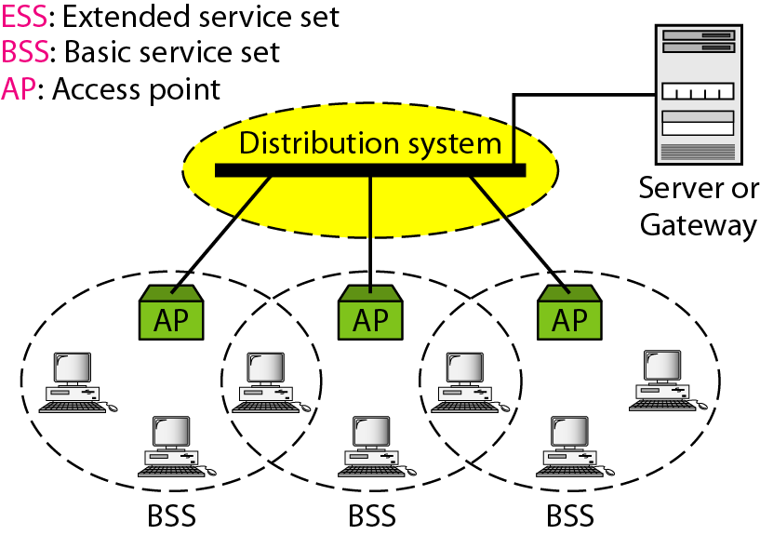
Figure 14.2 Extended service sets (ESSs)

Slide 22
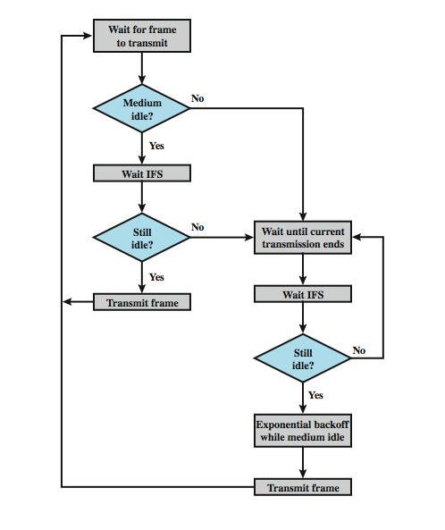
IEEE 802.11 MAC Protocol
CSMA/CA
IFS : Inter Frame Spacing

Slide 23
CSMA/CA Description
CSMA/CA rules:
  if medium idle, wait for some IFS time, then sense the channel
    If busy – go to step 2
    If still idle – transmit a frame
  if busy, wait until transmission end and then wait for some IFS time, then sense the channel again
    If busy – go to Step 2
    If idle – backoff/wait for some random time and transmit a frame
Notes:
CSMA, although more efficient than ALOHA or slotted ALOHA, still has one glaring inefficiency. When two frames collide, the medium remains unusable for the duration of transmission of both damaged frames. For long frames, compared to propagation time, the amount of wasted capacity can be considerable. This waste can be reduced if a station continues to listen to the medium while transmitting. This leads to the following rules for CSMA/CD:
1. If the medium is idle, transmit; otherwise, go to step 2.
2. If the medium is busy, continue to listen until the channel is idle, then transmit immediately.
3. If a collision is detected during transmission, transmit a brief jamming signal to assure that all stations know that there has been a collision and then cease transmission.
4. After transmitting the jamming signal, wait a random amount of time, referred to as the backoff, then attempt to transmit again (repeat from step 1).

Slide 24
Bluetooth
IEEE has defined the specifications for a wireless LAN, called IEEE 802.11, which covers the physical and data link layers.
Bluetooth is a wireless LAN technology designed to connect devices of different functions such as telephones, notebooks, computers, cameras, printers, coffee makers, and so on. A Bluetooth LAN is an ad hoc network, which means that the network is formed spontaneously.

Slide 25
What is Bluetooth?
Proprietary short range wireless technology.
  Intended to create PAN or Personal Area Network.
  Operate range of 10 meters
  1mW transmission power.
Operate in the free unlicensed ISM band from 2400-2480 MHz.
  The transceiver utilizes frequency hopping to reduce interference and fading.
  Can support both data (asynchronous) and voice (synchronous) communications, with total bandwidth of 1 Mb/sec
Provides multiple levels of security
  Spread spectrum frequency hopping
  Data encoding
  Authentication
  Data encryption

Slide 26
Basic usage of Bluetooth
As cable replacement.
Voice and data access points
  Notebook PC to mobile phone
  Notebook or PDA companion to LAN, email, Internet via shared access point (e.g. conference room)
Ad-hoc/temporary networking
  Up to 8 devices in a single Bluetooth network.
Advantages :Low cost wireless solution for short range distance.
Global technology specification – an universal radio interface in 2.4 GHz ISM frequency band.
Stationary and mobile environments.
No setup required – always in the background (dynamic configuration)

Slide 27
Bluetooth: Piconet
Bluetooth devices can interact with one or more devices in several different ways.
Only 2 devices → point-to-point piconet
More than 2 devices → point-to-multipoint piconet.
A piconet is any such Bluetooth network with one master and one or more slaves. Master controls entire piconet.
Maximum devices in a piconet:-
  1 master
  7 active slaves
  255 standby slaves
Devices can participate in more than 1 piconet.

Slide 28
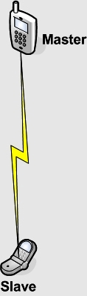
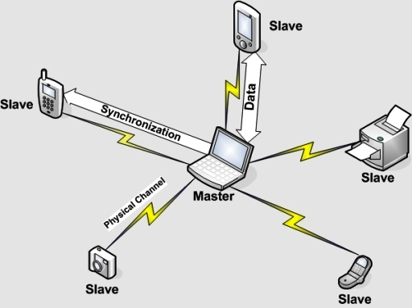
Bluetooth: Piconet
point-to-point
point-to-multipoint

Slide 29
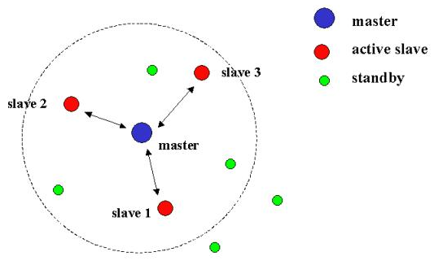
Bluetooth: Piconet

Slide 30
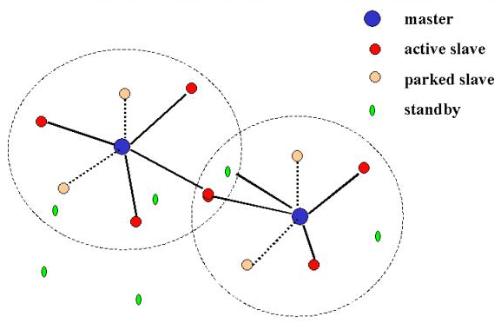
Bluetooth: Scatternet
A group of piconets with overlapping areas of coverage → scatternet
Each piconet is identified by different frequency hopping sequence
Slave to 1 piconet can be master to another
A device can only be Master to a single piconet.

Slide 31
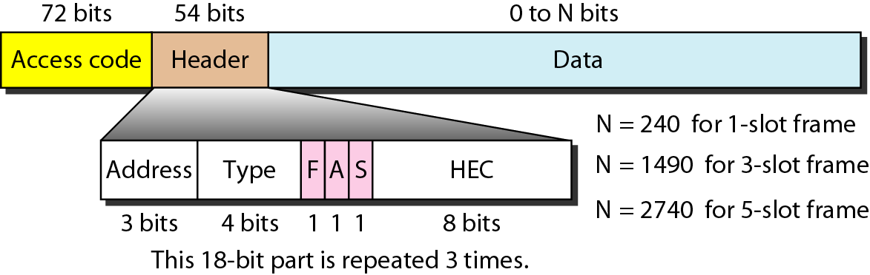
Figure 14.24 Frame format types
F: Flow control : 1 :buffer is full
A: Acknowledgment : Stop and wait ARQ
S: Sequence number for Stop and Wait ARQ
HEC: Header Error Correction
Address : For 7 secondaries
Header has 3 identical 18 bits sections to form forward error correction ( for header) using HEC

Slide 32
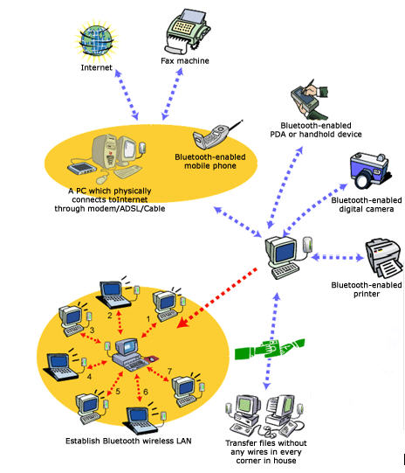
Bluetooth: Scatternet Example
One computer is master and accessing different slave Bluetooth devices, such as Bluetooth printer, Bluetooth digital camera, etc.
The master computer is also connected to another master computer.
The other master computer is slave to the 'central' master computer.
But, this slave computer is master to his Bluetooth networking slave computers.

