Slide 1
Computer Network and Communication
CNS3200

Slide 2
Learning Outcome
EXPLAIN THE FUNCTIONS OF NETWORK LAYER AND RELATED PROTOCOLS (C2)
EXPLAIN THE ADDRESSING & IP CLASSESS (C4)
SHOW THE CALCULATION OF THE IP ADDRESS USING THE SUBNET MASK (NS, P4)
EXPLAIN ROUTING ALGORITHMS (C4)

Slide 3
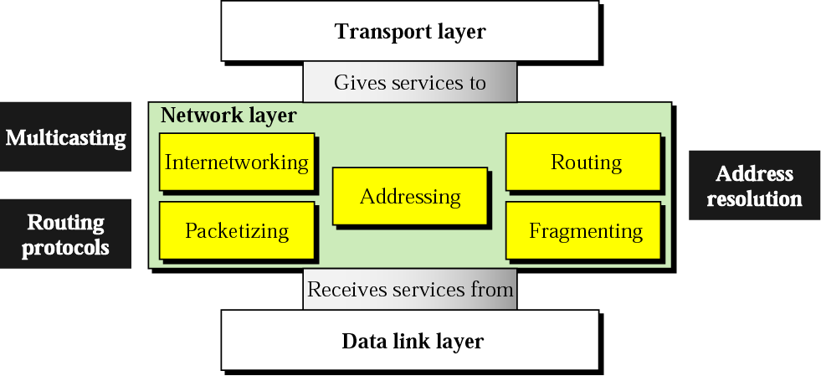
Functions of network layer

Slide 4
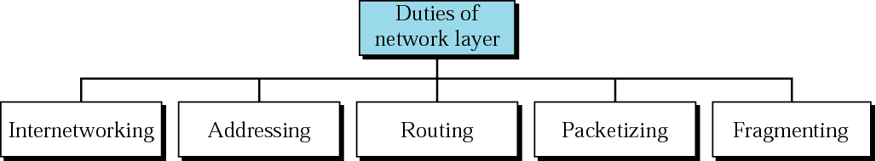
Network layer duties

Slide 5
Routing Algorithms
To find the best route to a destination
parameters :-
  a. minimize mean packet delay
  b. maximize the network throughput
  c. minimize the number of hops along the path

Slide 6
Internet Protocol (IP) v4
IP version 4
defined in RFC 791
part of TCP/IP suite
two parts
  specification of interface with a higher layer
    e.g. TCP
  specification of actual protocol format and mechanisms
will (eventually) be replaced by IPv6
Notes:
In this section, we look at version 4 of IP, officially defined in RFC 791. Although it is intended that IPv4 will ultimately be replaced by IPv6, it is currently the standard IP used in TCP/IP networks. The Internet Protocol (IP) is part of the TCP/IP suite and is the most widely used internetworking protocol. As with any protocol standard, IP is specified in two parts (see Stallings DCC8e Figure 2.9):
• The interface with a higher layer (e.g., TCP), specifying the services that IP provides
• The actual protocol format and mechanisms
In this section, we examine first IP services and then the protocol. This is followed by a discussion of IP address formats. Finally, the Internet Control Message Protocol (ICMP), which is an integral part of IP, is described.

Slide 7
IP Parameters
source & destination addresses
protocol
type of Service
identification
don’t fragment indicator
time to live
data length
option data
user data
Notes:
The parameters associated with the two primitives are:
• Source address: Internetwork address of sending IP entity.
• Destination address: Internetwork address of destination IP entity.
• Protocol: Recipient protocol entity (an IP user, such as TCP).
• Type of service indicators: Used to specify the treatment of the data unit in its transmission through component networks.
• Identification: Used in combination with the source and destination addresses and user protocol to identify the data unit uniquely. This parameter is needed for reassembly and error reporting.
• Don't fragment identifier: Indicates whether IP can fragment data to accomplish delivery.
• Time to live: Measured in seconds.
• Data length: Length of data being transmitted.
• Option data: Options requested by the IP user.
• Data: User data to be transmitted.

Slide 8
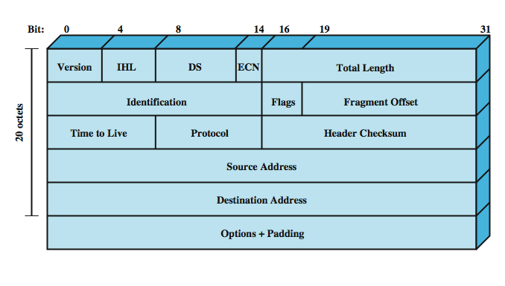
IPv4 Header
Notes:
The protocol between IP entities is best described with reference to the IP datagram format, shown in Figure Stallings DCC8e 18.6. The fields are discussed on the next few slides.

Slide 9
Header Fields (1)
Version
  currently 4
  IP v6 - see later
Internet header length
  in 32 bit words
  including options
DS/ECN (was type of service)
total length
  of datagram, in octets
Notes:
Version (4 bits): Indicates version number, to allow evolution of the protocol; the value is 4.
Internet Header Length (IHL) (4 bits): Length of header in 32-bit words. The minimum value is five, for a minimum header length of 20 octets.
DS/ECN (8 bits): Prior to the introduction of differentiated services, this field was referred to as the Type of Service field and specified reliability, precedence, delay, and throughput parameters. This interpretation has now been superseded. The first six bits of this field are now referred to as the DS (differentiated services) field, discussed in Chapter 19. The remaining 2 bits are reserved for an ECN (explicit congestion notification) field, currently in the process of standardization. The ECN field provides for explicit signaling of congestion in a manner similar to that discussed for frame relay (Section 13.5).
Total Length (16 bits): Total datagram length, including header plus data, in octets.

Slide 10
Header Fields (2)
Identification
  sequence number
  identify datagram uniquely with addresses / protocol
Flags
  More bit
  Don’t fragment
Fragmentation offset
Time to live
Protocol
  Next higher layer to receive data field at destination
Notes:
Identification (16 bits): A sequence number that, together with the source address, destination address, and user protocol, is intended to identify a datagram uniquely.
Flags (3 bits): Only two of the bits are currently defined. The More bit is used for fragmentation and reassembly, as previously explained. The Don't Fragment bit prohibits fragmentation when set. This bit may be useful if it is known that the destination does not have the capability to reassemble fragments. However, if this bit is set, the datagram will be discarded if it exceeds the maximum size of an en route network.
Fragment Offset (13 bits): Indicates where in the original datagram this fragment belongs, measured in 64-bit units. This implies that fragments other than the last fragment must contain a data field that is a multiple of 64 bits in length.
Time to Live (8 bits): Specifies how long, in seconds, a datagram is allowed to remain in the internet. Every router that processes a datagram must decrease the TTL by at least one, so the TTL is similar to a hop count.
Protocol (8 bits): Indicates the next higher level protocol that is to receive the data field at the destination; thus, this field identifies the type of the next header in the packet after the IP header. Example values are TCP = 6; UDP = 17; ICMP = 1.

Slide 11
Header Fields (3)
Header checksum
  reverified and recomputed at each router
  16 bit ones complement sum of all 16 bit words in header
  set to zero during calculation
Source address
Destination address
Options
Padding
  to fill to multiple of 32 bits long
Notes:
• Header Checksum (16 bits): An error-detecting code applied to the header only. Because some header fields may change during transit (e.g., time to live, fragmentation-related fields), this is reverified and recomputed at each router. The checksum is formed by taking the ones complement of the 16-bit ones complement addition of all 16-bit words in the header. For purposes of computation, the checksum field is itself initialized to a value of zero.
• Source Address (32 bits): Coded to allow a variable allocation of bits to specify the network and the end system attached to the specified network, as discussed subsequently.
• Destination Address (32 bits): Same characteristics as source address.
• Options (variable): Encodes the options requested by the sending user.
• Padding (variable): Used to ensure that the datagram header is a multiple of 32 bits in length.

Slide 12
Data Field
carries user data from next layer up
integer multiple of 8 bits long (octet)
max length of datagram (header plus data) is 65,535 octets
Notes:
• Data (variable): The data field must be an integer multiple of 8 bits in length. The maximum length of the datagram (data field plus header) is 65,535 octets.

Slide 13
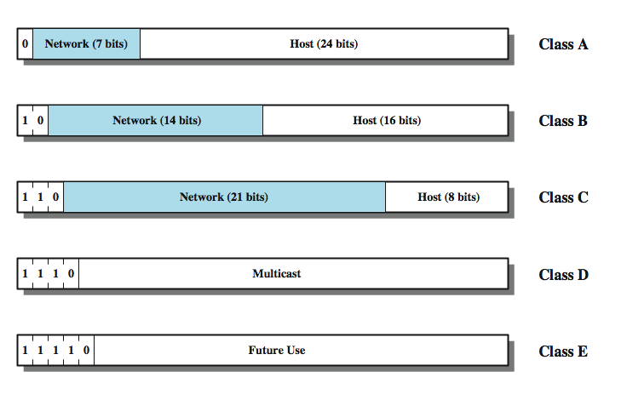
IPv4 Address Formats
Notes:
The source and destination address fields in the IP header each contain a 32-bit global internet address, generally consisting of a network identifier and a host identifier. The address is coded to allow a variable allocation of bits to specify network and host, as depicted in Figure 18.7. This encoding provides flexibility in assigning addresses to hosts and allows a mix of network sizes on an internet. The three principal network classes are best suited to the following conditions:
• Class A: Few networks, each with many hosts
• Class B: Medium number of networks, each with a medium number of hosts
• Class C: Many networks, each with a few hosts
In a particular environment, it may be best to use addresses all from one class. For example, a corporate internetwork that consist of a large number of departmental local area networks may need to use Class C addresses exclusively. However, the format of the addresses is such that it is possible to mix all three classes of addresses on the same internetwork; this is what is done in the case of the Internet itself. A mixture of classes is appropriate for an internetwork consisting of a few large networks, many small networks, plus some medium-sized networks.

Slide 14
Addressing (IPv4,IPv6)
IPv4 Notation
  Binary Notation
  Dotted Decimal Notation
IPv4 Addressing
  Classful Addressing
  Classless Addressing
https://www.tutorialspoint.com/classful-vs-classless-addressing
Notes:
Classful addressing is a technique of allocating IP addresses that divides them into five categories. Classless addressing is a technique of allocating IP addresses that is intended to replace classful addressing in order to reduce IP address depletion

Slide 15

Note:
An IP address is a 32-bit address.
The IP addresses are unique
and universal defines the connection to the Internet

Slide 16
Note:
The address space of IPv4 is 2³² or 4,294,967,296

Slide 17
IPv4 Notations
Binary Notation
- displayed in 32 bits
- each octet is often referred to as a byte
- Eg.
01110101 10010101 00011101 00000010
Dotted-Decimal Notation
- usually written in decimal form with a decimal point (dot) separating the byte
- Eg. 117.149.29.2

Slide 18
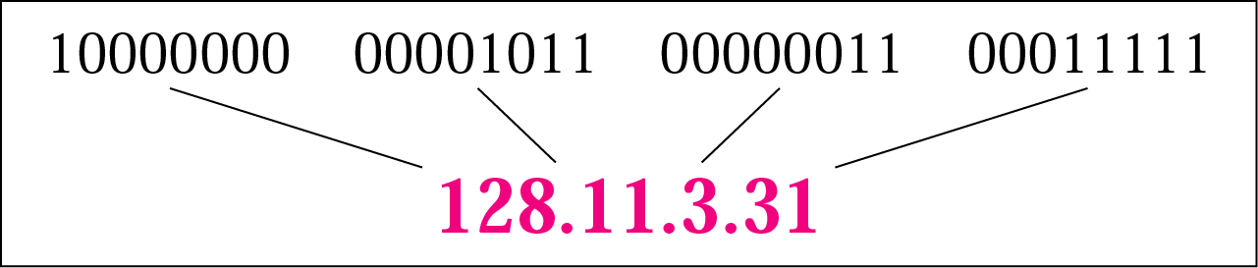
Figure. Dotted-decimal notation

Slide 19




128 | 64 | 32 | 16 | 8 | 4 | 2 | 1

Slide 20
Example 1
Change the following IP addresses from binary notation to dotted-decimal notation.
a. 10000001 00001011 00001011 11101111
b. 11111001 10011011 11111011 00001111
Solution
We replace each group of 8 bits with its equivalent decimal number and add dots for separation:
a. 129.11.11.239
b. 249.155.251.15

Slide 21
Example 2
Change the following IP addresses from dotted-decimal notation to binary notation.
a. 111.56.45.78
b. 75.45.34.78
Solution
We replace each decimal number with its binary equivalent
a. 01101111 00111000 00101101 01001110
b. 01001011 00101101 00100010 01001110

Slide 22
Note:
In classful addressing, the address space is divided into five classes: A, B, C, D, and E.

Slide 23

Finding the classes in binary and dotted-decimal notation

Slide 24
Example 3
Find the class of each address.
a. 00000001 00001011 00001011 11101111
b. 11000001 10000011 00011011 11111111
c. 14.23.120.8
d. 252.5.15.111
Solution
a. The first bit is 0. This is a class A address.
b. The first 2 bits are 1; the third bit is 0. This
is a class C address.
c. The first byte is 14; the class is A.
d. The first byte is 252; the class is E.

Slide 25

Table. Number of blocks and block size in classful IPv4 addressing

Slide 26

Note
In classful addressing, a large part of the available addresses were wasted.

Slide 27
Netid and Hostid
- IP address is divided into netid and hostid
- varying lengths, depend on the class of the address.
Mask (Default Mask)
A 32-bit address contiguous 1s and contiguous 0s
it can be also written as /n
n leftmost bits are 1s and (32-n) rightmost bits are 0s
Eg. 234.56.78.69/8
  11111111 00000000 00000000 00000000

Slide 28

Classless
Interdomain
Routing
Table. Default masks for classful addressing

Slide 29
Note
Classful addressing, which is almost obsolete, is replaced with classless addressing.

Slide 30
Classless Addressing
To overcome the address depletion
No classes
Addresses are granted in blocks (range)
Size of block varies based on the nature &
size of entity

Slide 31
Restriction
To simplify the handling addresses, the Internet authorities impose three restrictions:
The addresses in a block must be contiguous
The number of addresses in a block must be a power of 2 (1, 2, 4, 8, 16 …)
The first address must be evenly divisible by the number of addresses

Slide 32
Example
The next figure shows a block of addresses, in both binary and dotted-decimal notation, granted to a small business that needs 16 addresses.
We can see that the restrictions are applied to this block. The addresses are contiguous. The number of addresses is a power of 2 (16 = 2⁴), and the first address is divisible by 16. The first address, when converted to a decimal number, is 3,440,387,360, which when divided by 16 results in 215,024,210.

Slide 33

Figure. A block of 16 addresses granted to a small organization

Slide 34
Note
In IPv4 addressing, a block of
addresses can be defined as
x.y.z.t /n
in which x.y.z.t defines one of the addresses and the /n defines the mask.

Slide 35
Note
The first address in the block can be found by setting the rightmost
32 − n bits to 0s.

Slide 36
Example 4
A block of addresses is granted to a small organization. We know that one of the addresses is 205.16.37.39/28. What is the first address in the block?
The binary representation of the given address is
11001101 00010000 00100101 00100111
If we set 32−28 rightmost bits to 0, we get
11001101 00010000 00100101 0010000
or
205.16.37.32.
This is actually the block shown in Figure slide 24
Solution

Slide 37
Note
The last address in the block can be found by setting the rightmost
32 − n bits to 1s.

Slide 38
Example 5
Find the last address for the block in Example 4
The binary representation of the given address is
11001101 00010000 00100101 00100111
If we set 32 − 28 rightmost bits to 1, we get
11001101 00010000 00100101 00101111
or
205.16.37.47
This is actually the block shown in Figure slide 24
Solution

Slide 39
Note
The number of addresses in the block can be found by using the formula
2^{32−n}.

Slide 40
Example 6
Find the number of addresses in Example 4
Solution
The value of n is 28, which means that
Number of addresses is 2 ³²⁻²⁸ or 16.

Slide 41
Exercise
In a block of addresses, we know the IP address of one host is 25.34.12.56/16. What are the first address (network address) and the last address (limited broadcast address) in this block?
Write the following masks in slash notation (/n)
a. 255.255.255.0
b. 255.0.0.0
c. 255.255.224.0
d. 255.255.240.0
3) Find the range of addresses in the following blocks
a. 123.56.77.32/29 b. 17.34.16.0/23

Slide 42

IPv6
Despite all short-term solutions, address depletion is still a long-term problem for the Internet. This and other problems in the IP protocol itself have been the motivation for IPv6.
Figure 19.14 IPv6 address in binary and hexadecimal colon notation
An IPv6 address is 128 bits long.

Slide 43
Why Change IP?
Address space exhaustion
  two level addressing (network and host) wastes space
  network addresses used even if not connected
  growth of networks and the Internet
  extended use of TCP/IP
  single address per host
requirements for new types of service
Notes:
The driving motivation for the adoption of a new version of IP was the limitation imposed by the 32-bit address field in IPv4. With a 32-bit address field, it is possible in principle to assign 2³² different addresses, which is over 4 billion possible addresses. In the late 1980s it was perceived that there would be a problem, and this problem began to manifest itself in the early 1990s. Reasons for the inadequacy of 32-bit addresses include the following:
• The two-level structure of the IP address (network number, host number) is convenient but wasteful of the address space. Once a network number is assigned to a network, all of the host-number addresses for that network number are assigned to that network. The address space for that network may be sparsely used, but as far as the effective IP address space is concerned, if a network number is used, then all addresses within the network are used.
• The IP addressing model requires a unique network number be assigned to each IP network whether or not it is actually connected to the Internet.
• Networks are proliferating rapidly.
• Growth of TCP/IP usage into new areas will result in a rapid growth in the demand for unique IP addresses.
• Typically, a single IP address is assigned to each host. A more flexible arrangement is to allow multiple IP addresses per host. This of course increases the demand for IP addresses.

Slide 44

Figure 19.15 Abbreviated IPv6 addresses

Slide 45

Example 19.11
Expand the address 0:15::1:12:1213 to its original.
Solution
We first need to align the left side of the double colon to the left of the original pattern and the right side of the double colon to the right of the original pattern to find how many 0s we need to replace the double colon.
This means that the original address is.

Slide 46
Routing

Slide 47
Routing Algorithms
2 common methods of Adaptive Routing Methods:
  Distance Vector Routing (Bellman-Ford Algorithm)
  - Use only knowledge of attached links and neighbors
  Link State Routing (Dijkstra’s Algorithm)
  - Use global knowledge about topology and cost

Slide 48
Distance Vector (DV) Routing
Basic idea: each network node maintains a Distance Vector table containing the distance between itself and ALL possible destination nodes.
Information kept by DV router
1. Each router has an ID
2. Associated with each link connected to a router, there is a link cost (static or dynamic)
The metric issue!
Distances are based on a chosen metric:
  Metric: usually hops or delay

Slide 49
Distance Vector Routing
The DV calculation is based on minimizing the cost to each destination.
Distance Vector Table Initialization
Distance to itself = 0
Distance to ALL other routers = infinity number

Slide 50
Distance Vector Routing
1. Router transmits its distance vector to all of its neighbors.
2. Each router receives and saves the most recently received distance vector.

Slide 51
Distance Vector Routing
3. A router recalculates its distance vector when:
  It receives a distance vector from a neighbor containing different information.
  It discovers that a link to a neighbor has gone down (i.e., a topology change).
Each router uses complete information on the network topology to compute the shortest path route.

Slide 52
Distance Vector Algorithm
Basic idea:
Each node periodically sends its own distance vector estimate to neighbors
When a node x receives new DV estimate from neighbor, it updates its own DV.

Slide 53
Distance Vector Algorithm
Iterative, asynchronous: each local iteration caused by:
local link cost change
DV update message from neighbor
Distributed:
each node notifies neighbors only when its DV changes
  neighbors then notify their neighbors if necessary
Each node:
wait for (change in local link cost or msg from neighbor)
recompute estimates
if DV to any destination has changed, notify neighbors

Slide 54
D_{x}(y) = min{ c(x,y) + D_{y}(y), c(x,z) + D_{z}(y) }
= min{ 2+0 , 7+1 } = 2
D_{x}(z) = min{ c(x,y) + D_{y}(z), c(x,z) + D_{z}(z)}
= min{2+1 , 7+0} = 3
cost to
cost to
x y z
x y z
x
0 2 7
x
0
2
3
node x table
from
y
∞
∞
∞
from
y
2 0 1
z
∞
∞
∞
z
7 1 0
y
cost to
2
1
x y z
x
∞
∞
node y table
∞
2 0 1
x
z
from
y
z
∞
∞
∞
7
cost to
x y z
x
∞ ∞ ∞
node z table
from
y
∞
∞
∞
z
7
1
0
time

Slide 55
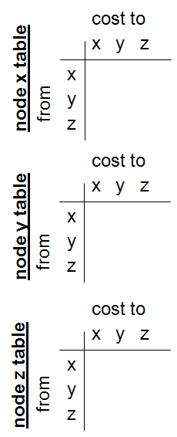

Slide 56
cost to
cost to
cost to
x y z
x y z
x y z
x
0 2 7
x
0 2 3
node x table
x
0 2 3
from
y
∞
∞
∞
from
y
2 0 1
from
y
2 0 1
z
∞
∞
∞
z
7 1 0
z
3 1 0
cost to
cost to
cost to
x y z
x y z
x y z
y
2
1
x
∞
∞
x
0 2 7
∞
2 0 1
x
0 2 3
x
z
node y table
from
y
from
y
2 0 1
from
y
7
2 0 1
z
∞
∞
∞
z
7 1 0
z
3 1 0
cost to
cost to
cost to
x y z
x y z
x y z
x
∞ ∞ ∞
x
0 2 7
x
0 2 3
node z table
y
y
2 0 1
from
y
∞
∞
from
2 0 1
from
∞
z
z
3 1 0
z
3 1 0
7
1
0
time

Slide 57
Link State Routing
Each node maintains the full graph by collecting the updates from all other nodes
The set of all links forms the complete graph
Routing is performed using shortest computations on the graph

Slide 58
A Link-State Routing Algorithm
Dijkstra’s algorithm
net topology, link costs known to all nodes
  accomplished via “link state broadcast”
  all nodes have same info
computes least cost paths from one node (‘source”) to all other nodes
  gives forwarding table for that node
iterative: after k iterations, know least cost path
Notation:
c(x,y): link cost from node x to y; = ∞ if not direct neighbors
D(v): current value of cost of path from source to dest. V
p(v): predecessor node
N': subset of nodes whose least cost path definitively known

Slide 59

Figure. Link state knowledge

Slide 60

Figure. Dijkstra algorithm

Slide 61
Permanent and Tentative List
Permanent
1. Empty
2. A(0)
3.A(0),C(2)
4. A(0),C(2),D(3)
5. A(0),C(2),D(3),B(5)
6.A(0),C(2),D(3),B(5),E(6 :C)
Tentative
1. A(0)
2.B(5),C(2),D(3)
3.D(3),B(5),E(6:C)
4. B(5),E(6 :C)
5. E(6 :C)
6. Empty

Slide 62
Permanent and Tentative List
Permanent
1. Empty
2.
3.
4.
5.
6.
Tentative
1. A(0)
2.
3.
4.
5.
6. Empty

Slide 63

Figure Example of formation of shortest path tree

Slide 64

Table . Routing table for node A

