Slide 1
Computer Network and Communication
CNS3200

Slide 2
Learning Outcome
EXPLAIN FUNCTION OF TRANSPORT LAYER AND RELATED PROTOCOLS (C4)
DIFFERENTIATE BETWEEN UDP AND TCP PROTOCOL (C4)
EXPLAIN SUITABLLE METHOD FOR TRAFFIC CONTROL (C3)

Slide 3
TCP and UDP Protocols
TCP and UPD are the transport layer protocols
The transport layer is responsible for process-to-process delivery—the delivery of a segment, part of a message, from one process to another. Two processes communicate in a client/server relationship, as we will see later.
These protocols use port numbers to accomplish this.
Port numbers provide end-to-end addresses at the transport layer and allow multiplexing and demultiplexing at this layer, just as IP addresses do at the network layer. Table 24.1 gives some common port numbers for all three protocols we discuss in this chapter.

Slide 4

Figure 23.1 Types of data deliveries

Slide 5

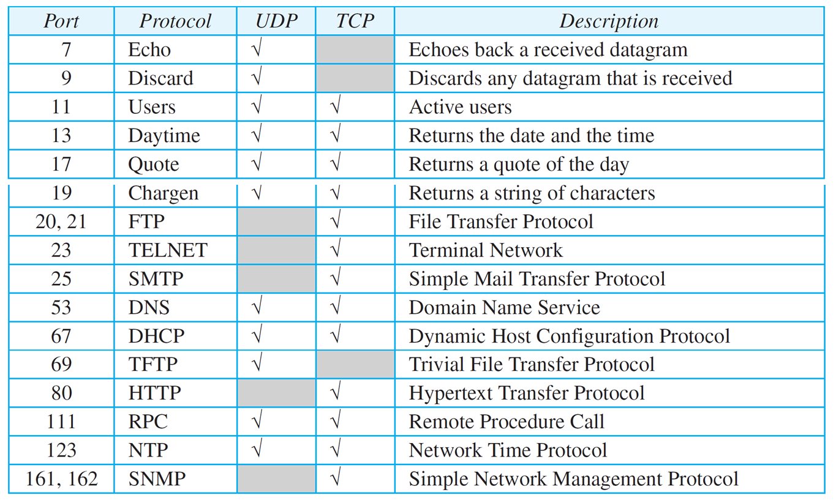
Table 24.1: Some well-known ports used with UDP and TCP
24.<number>

Slide 6

Figure 23.2 Port numbers

Slide 7

Figure 23.3 IP addresses versus port numbers

Slide 8

Figure 23.4 IANA ranges
IANA: Internet Assigned Number Authority

Slide 9

Figure 23.5 Socket address

Slide 10

Figure 23.6 Multiplexing and demultiplexing

Slide 11

Figure 23.7 Error control

Slide 12

Figure 23.8 Position of UDP and TCP in TCP/IP suite

Slide 13
TCP vs UDP
Transport Layer Functions | TCP (reliable) | UDP (unreliable)
Process to process delivery | √ | √
Connection control | Connection- Oriented | Connectionless
Flow control (Sliding window) | √ | -
Error Control (Retransmission) | √ | -

Slide 14
24.2.1 User Datagram
UDP packets, called user datagrams, have a fixed-size header of 8 bytes made of four fields, each of 2 bytes (16 bits). Figure 24.2 shows the format of a user datagram. The first two fields define the source and destination port numbers. The third field defines the total length of the user datagram, header plus data. The 16 bits can define a total length of 0 to 65,535 bytes. However, the total length needs to be less because a UDP user datagram is stored in an IP datagram with the total length of 65,535 bytes. The last field can carry the optional checksum (explained later).
24.<number>
Notes:
24.#

Slide 15
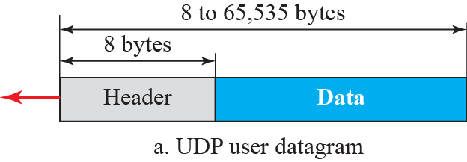
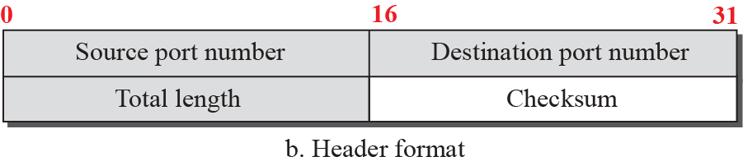
Figure 24.2: User datagram packet format
24.<number>
Notes:
24.#

Slide 16
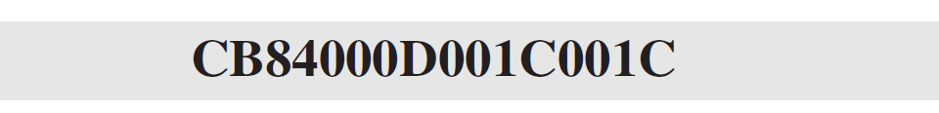
Example 24.1
The following is the contents of a UDP header in hexadecimal format.
a. What is the source port number?
b. What is the destination port number?
c. What is the total length of the user datagram?
d. What is the length of the data?
e. Is the packet directed from a client to a server or vice
versa?
f. What is the client process?
24.<number>

Slide 17
Example 24.1 (continued)
Solution
a. The source port number is the first four hexadecimal
digits (CB84)₁₆ or 52100
b. The destination port number is the second four
hexadecimal digits (000D)₁₆ or 13.
c. The third four hexadecimal digits (001C)₁₆ define the
length of the whole UDP packet as 28 bytes.
d. The length of the data is the length of the whole packet
minus the length of the header, or 28 − 8 = 20 bytes.
e. Since the destination port number is 13 (well-known
port), the packet is from the client to the server.
f. The client process is the Daytime (see Table 3.1).
24.<number>

Slide 18
    24-3 TCP
Transmission Control Protocol (TCP) is a connection-oriented, reliable protocol. TCP explicitly defines connection establishment, data transfer, and connection teardown phases to provide a connection-oriented service.
24.<number>
Notes:
24.#

Slide 19
24.3.8 Error Control
TCP is a reliable transport-layer protocol. This means that an application program that delivers a stream of data to TCP relies on TCP to deliver the entire stream to the application program on the other end in order, without error, and without any part lost or duplicated.

Slide 20
24.3.9 TCP Congestion Control
TCP uses different policies to handle the congestion in the network. We describe these policies in this section.
24.<number>
Notes:
24.#

Slide 21
Examples of application use the UDP service:
DNS
Trivial File Transfer Protocol
Multicasting
Simple Network Management Protocol
Routing Information Protocol
UDP: Anything where you don't care too much if you get all data always
Tunneling/VPN (lost packets are ok - the tunneled protocol takes care of it)
Media streaming (lost frames are ok)
Games that don't care if you get every update
Local broadcast mechanisms (same application running on different machines "discovering" each other)
TCP: Almost anything where you have to get all transmitted data
Web
SSH, FTP, telnet
SMTP, sending mail
IMAP/POP, receiving mail

Slide 22
    24-4 SCTP
Stream Control Transmission Protocol (SCTP) is a new transport-layer protocol designed to combine some features of UDP and TCP in an effort to create a protocol for multimedia communication.
24.<number>
Notes:
24.#

