Slide 1
Computer Network and Communication
CNS3200

Slide 2
Learning Outcome
EXPLAIN HOW DATA IS SECURED IN DATA COMMUNICATION (C4)
EXPLAIN POPULAR APPLICATION PROTOCOLS I.E DNS, SMTP, HTTP, HTTPS (C4)

Slide 3
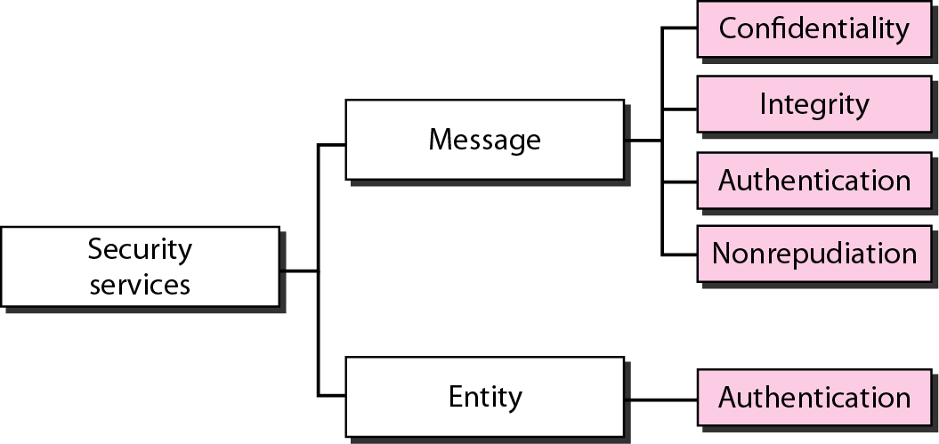
SECURITY SERVICES
Network security can provide five services.
Four of these services are related to the message exchanged using the network.
The fifth service provides entity authentication or identification.

Slide 4
Message Confidentiality
Message confidentiality or privacy means that the sender and the receiver expect confidentiality.
The transmitted message must make sense to only the intended receiver.
To all others, the message must be garbage.
The message must be encrypted at the sender site and decrypted at the receiver site.
This can be done using either symmetric-key cryptography or asymmetric-key cryptography.
Confidentiality with Symmetric-Key Cryptography
Confidentiality with Asymmetric-Key Cryptography

Slide 5
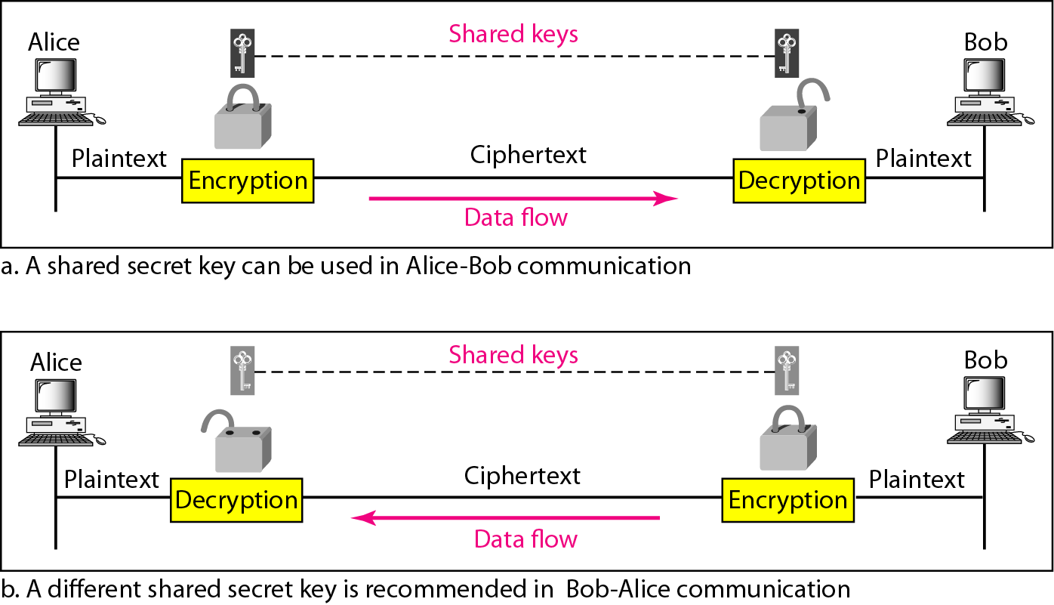
Message confidentiality using symmetric keys in two directions

Slide 6
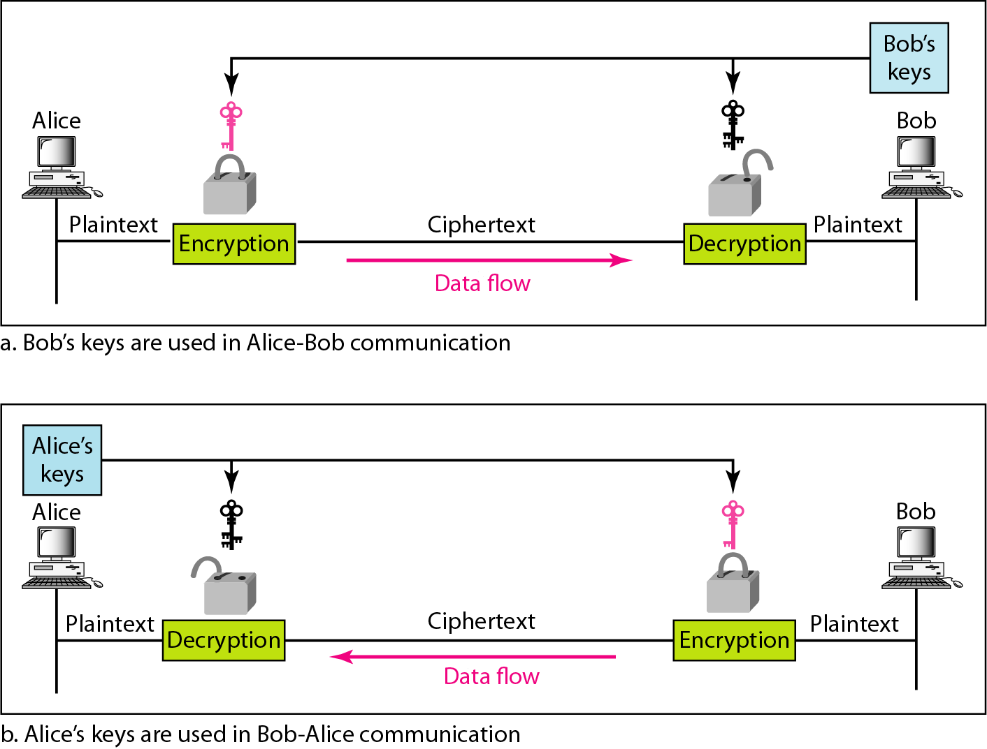
Message confidentiality using asymmetric keys

Slide 7
Message Integrity
Message integrity means that the data must arrive at the receiver exactly as they were sent.
Encryption and decryption provide secrecy, or confidentiality, but not integrity.
However, on occasion we may not even need secrecy, but instead must have integrity.
  Document and Fingerprint
  Message and Message Digest
  Creating and Checking the Digest
  Hash Function Criteria
  Hash Algorithms: SHA-1

Slide 8

Note
To preserve the integrity of a document,
both the document and the fingerprint are needed.

Slide 9
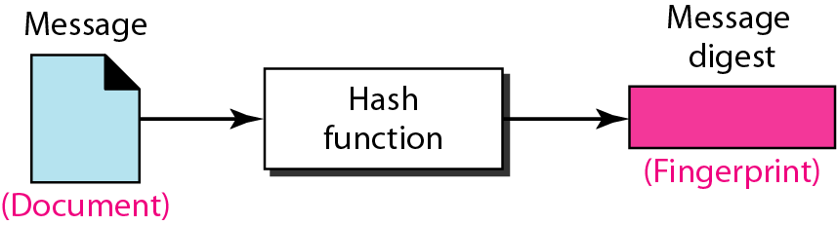
Message and message digest
Note
The message digest needs to be kept secret.

Slide 10
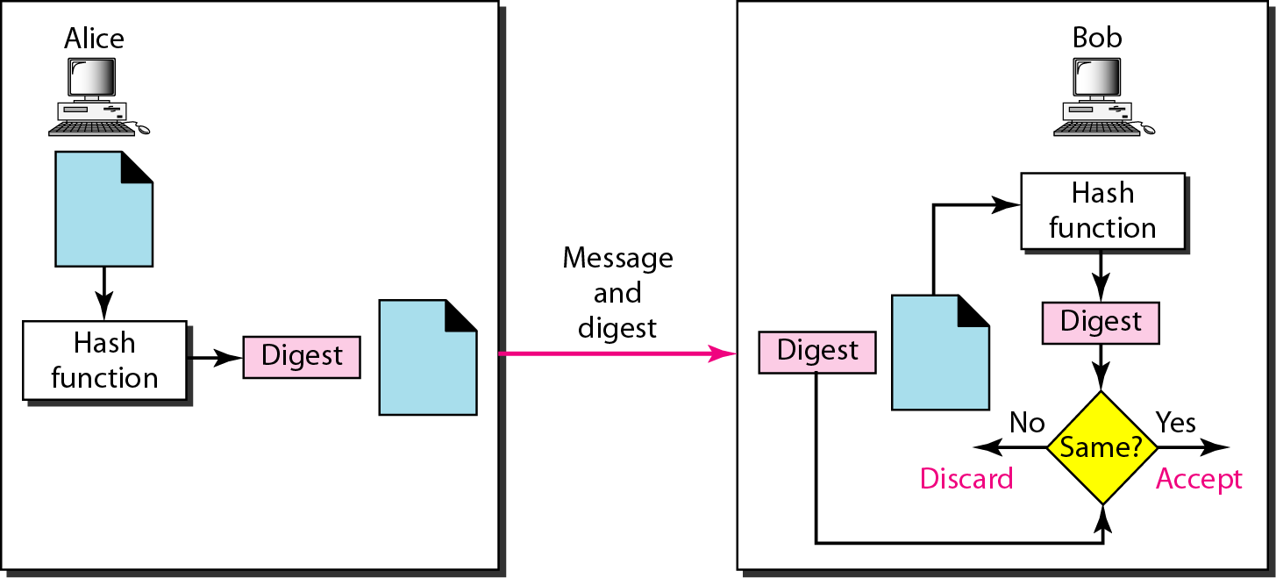
Checking integrity

Slide 11
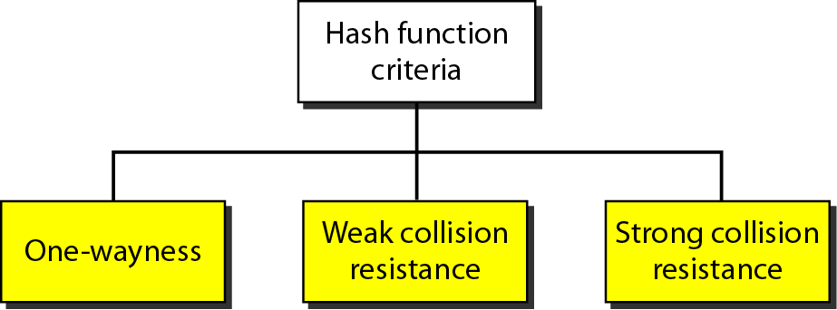
Criteria of a hash function
One wayness : Ensure a message digest is created by a one-way hashing function and must not be able to recreate the message from the digest
Weak collision resistance : Ensure that a message cannot be easily be forged
Strong collision resistance: Ensue that we cannot fine two messages that hash to the same digest.

Slide 12
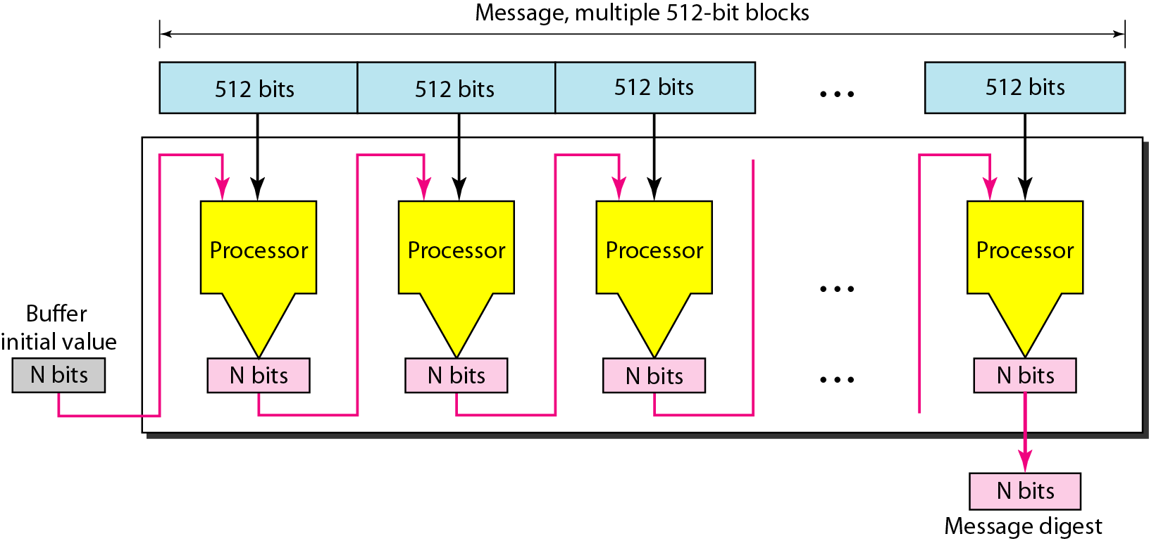
Message digest creation

Slide 13
Note
SHA-1 hash algorithms create an N-bit message digest out of a message of 512-bit blocks.
SHA-1 has a message digest of 160 bits
(5 words of 32 bits).

Slide 14
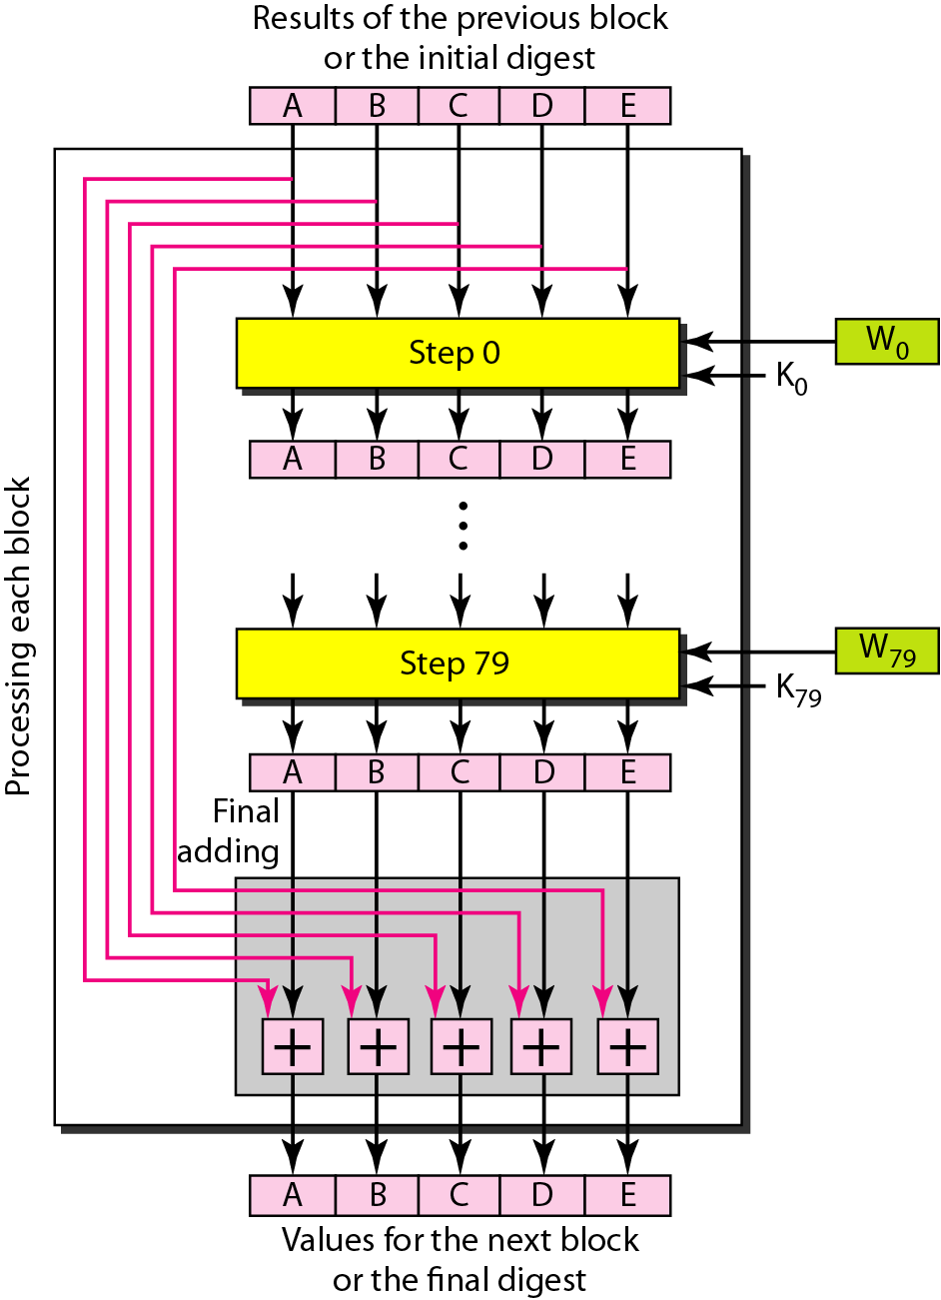
Processing of one block in SHA-1

Slide 15
Message Authentication
Message authentication is a service beyond message integrity.
In message authentication the receiver needs to be sure of the sender’s identity and that an imposter has not sent the message.
A hash function per se cannot provide authentication.
The digest created by a hash function can detect any modification in the message, but not authentication.
MAC: A keyed Message Authentication Code
HMAC: Hashed MAC uses keyless hash function such as SHA-1

Slide 16
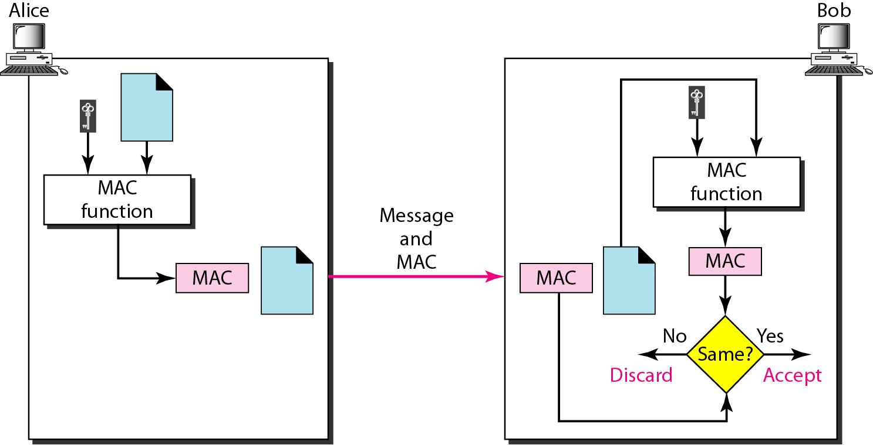
MAC, created by Alice and checked by Bob

Slide 17
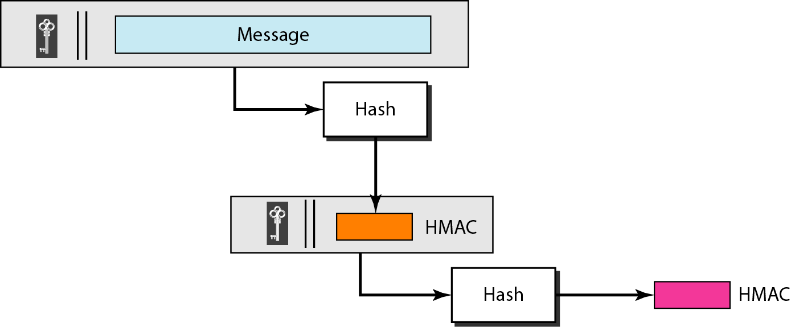
HMAC

Slide 18
Message Non-repudiation
Message non-repudiation means that a sender must not be able to deny sending a message that he or she, in fact, did send.
The burden of proof falls on the receiver.
Note
Non-repudiation can be provided using a trusted party.

Slide 19
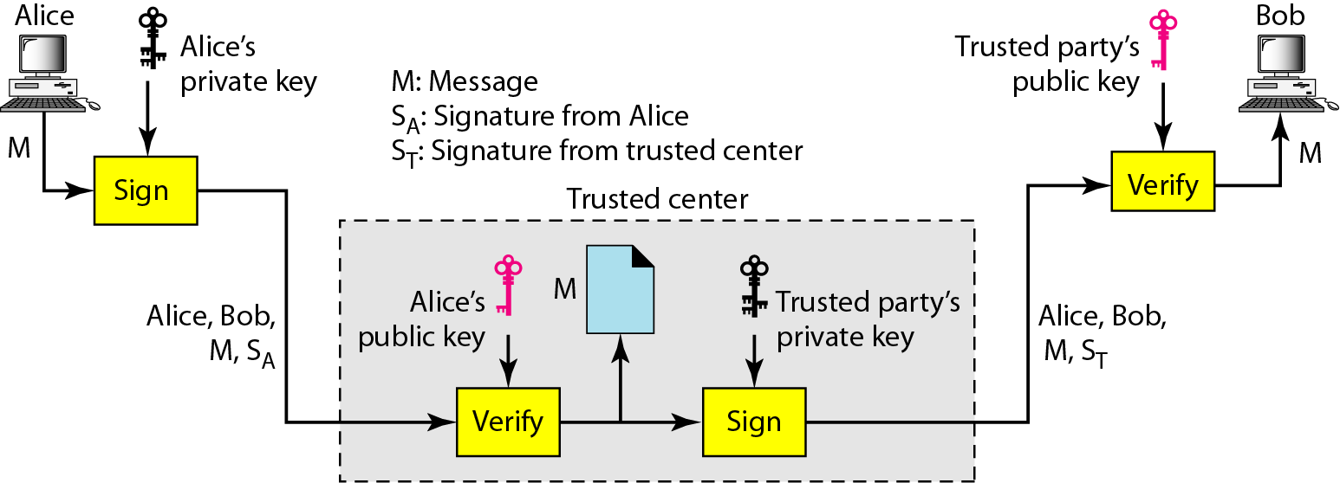
Using a trusted center for non-repudiation

Slide 20
Digital Signature
When Alice sends a message to Bob, Bob needs to check the authenticity of the sender; he needs to be sure that the message comes from Alice and not Eve.
Bob can ask Alice to sign the message electronically.
In other words, an electronic signature can prove the authenticity of Alice as the sender of the message.
We refer to this type of signature as a digital signature.
Note
A digital signature needs a public-key system.

Slide 21
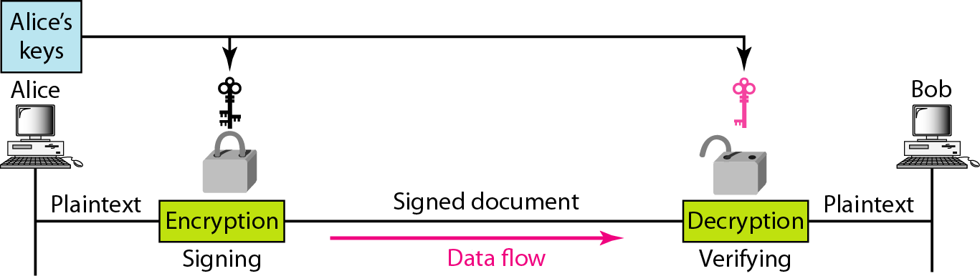
Signing the message itself in digital signature

Slide 22
Note
In a cryptosystem, we use the private and public keys of the receiver;
in digital signature, we use the private and public keys of the sender.

Slide 23
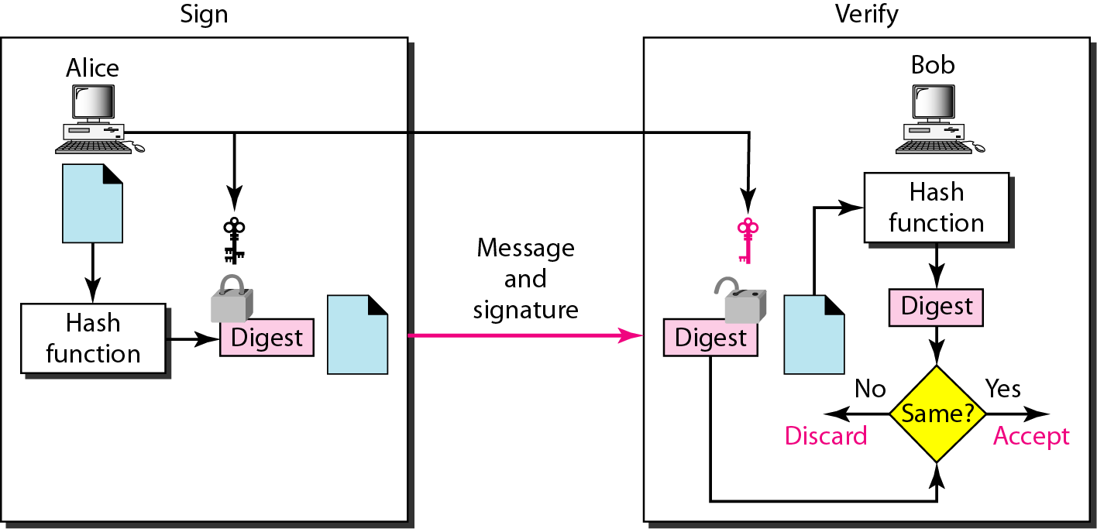
Signing the digest in a digital signature

Slide 24
Note
A digital signature today provides message integrity.
Digital signature provides message authentication.

Slide 25
Entity Authentication
Entity authentication is a technique designed to let one party prove the identity of another party.
An entity can be a person, a process, a client, or a server.
The entity whose identity needs to be proved is called the claimant; the party that tries to prove the identity of the claimant is called the verifier.

Slide 26
Entity Authentication
Passwords Authentication : fixed password and one-time password
Challenge Response Authentication:
  Using a symmetric-key cipher
  Using a Keyed hash function
  Using an symmetric –key cipher
  Using digital signature

Slide 27
Note
In challenge-response authentication,
the claimant proves that she knows a secret without revealing it.

Slide 28
Note
The challenge is a time-varying value sent by the verifier;
the response is the result of a function applied on the challenge.

Slide 29
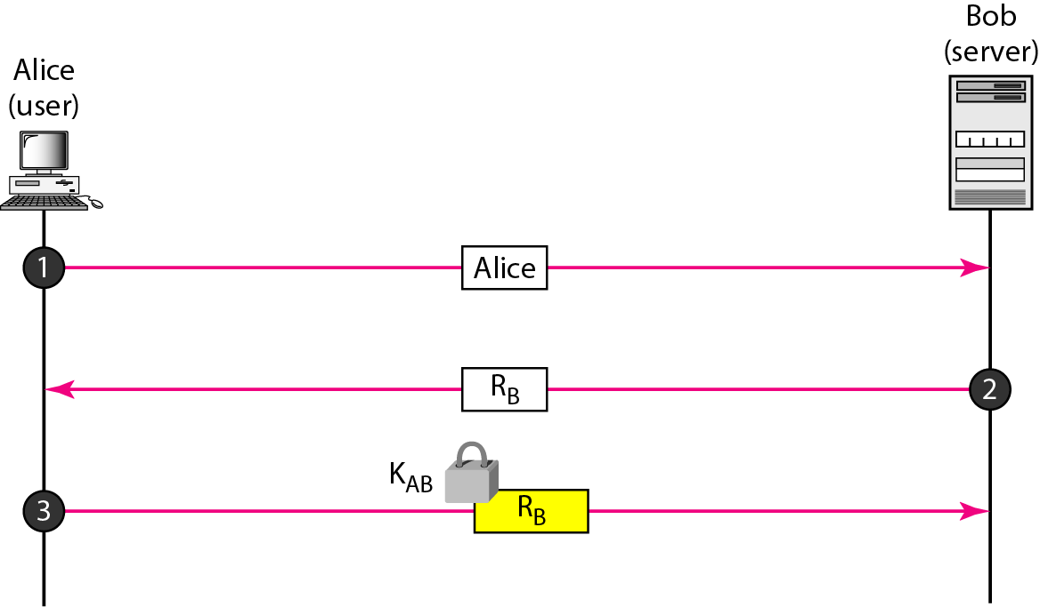
Challenge/response authentication using a nonce

Slide 30
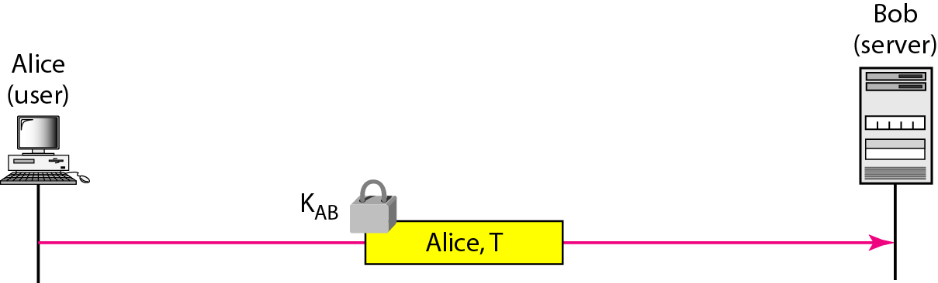
Challenge-response authentication using a timestamp

Slide 31
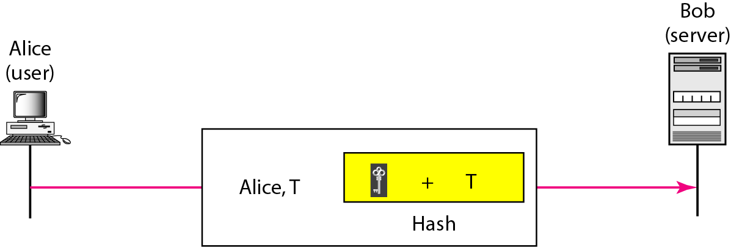
Challenge-response authentication using a keyed-hash function

Slide 32
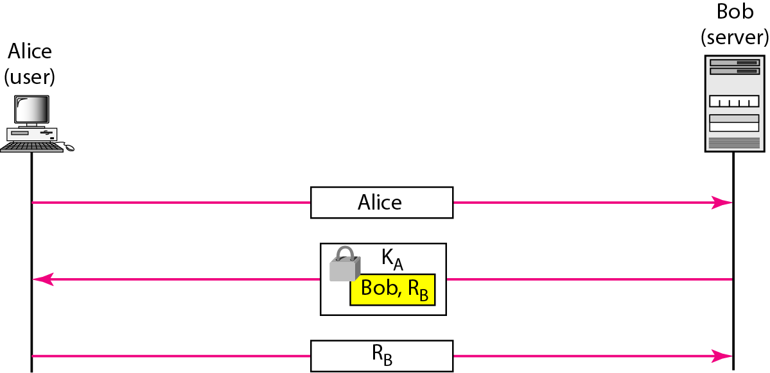
Authentication, asymmetric-key

Slide 33
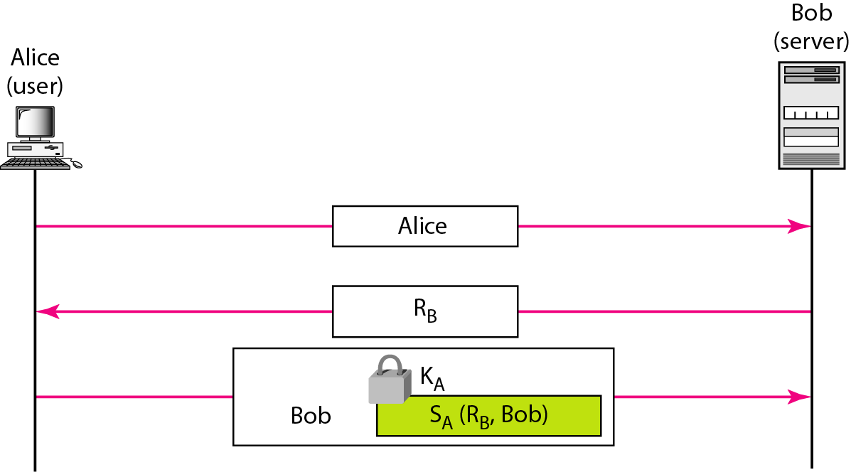
Authentication, using digital signature

Slide 34
HTTP
The WWW today is a distributed client/server service, in which a client using a browser can access a service using a server. However, the service provided is distributed over many locations called sites.

Slide 35
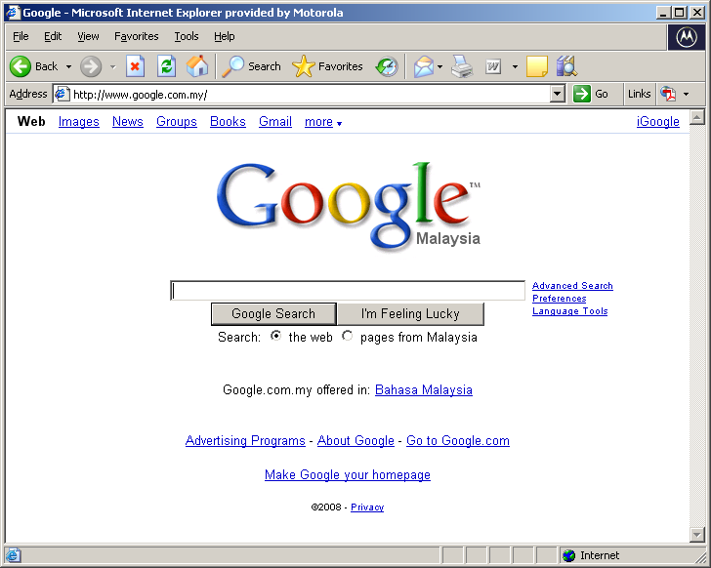
Web application

Slide 36
SMTP
One of the most popular Internet services is electronic mail (e-mail). The designers of the Internet probably never imagined the popularity of this application program..

Slide 37
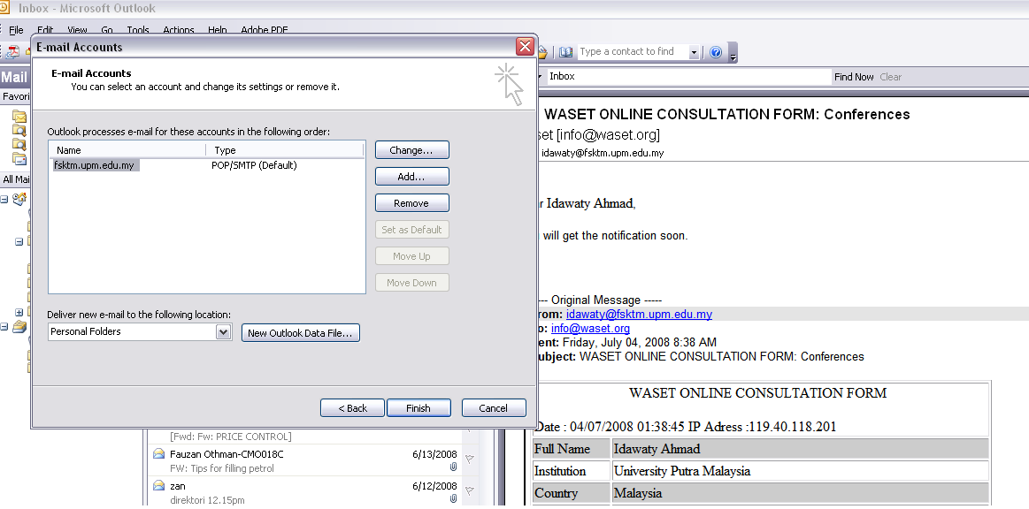

Email

Slide 38
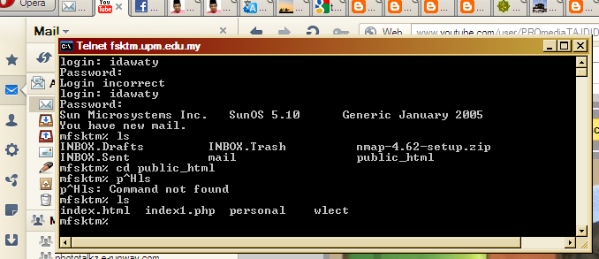
Remote Logging -Telnet
It would be impossible to write a specific client/server program for each demand. The better solution is a general-purpose client/server program that lets a user access any application program on a remote computer

Slide 39
Domain Name System (DNS)
The names assigned to machines must be carefully selected from a name space with complete control over the binding between the names and IP addresses
To have a hierarchical name space, a domain name space was designed. In this design the names are defined in an inverted-tree structure with the root at the top. The tree can have only 128 levels: level 0 (root) to level 127

Slide 40
DNS
DNS is a protocol that can be used in different platforms. In the Internet, the domain name space (tree) is divided into three different sections: generic domains, country domains, and the inverse domain

Slide 41

Figure 25.1 Example of using the DNS service

Slide 42

Figure 25.2 Domain name space

Slide 43

Figure 25.3 Domain names and labels

Slide 44

Figure 25.5 Domains

Slide 45

Figure 25.6 Hierarchy of name servers

Slide 46

Figure 25.7 Zones and domains

Slide 47
Note
A primary server loads all information from the disk file; the secondary server
loads all information from
the primary server.
When the secondary downloads
information from the primary, it is called zone transfer.

Slide 48

Figure 25.8 DNS IN THE INTERNET

Slide 49

Figure 25.9 Generic domains

Slide 50

Table 25.1 Generic domain labels

Slide 51

Figure 25.10 Country domains

Slide 52

Figure 25.11 Inverse domain

