Slide 1
Chapter 7
Interface Design

Slide 2
Learning Objectives
Describe user interface design process (C1)
Illustrate user interface design (C3)

Slide 3
PART 1

Slide 4
Designing Forms and Reports
In general, forms are used to present and collect information on a single item such as customer, product and order.
Reports, on the other hand, are used to convey information on a collection of items.
Form and report design is a key ingredient for successful systems as users often equate the quality of a system with quality of its input and output methods.

Slide 5
Designing Forms and Reports (Cont.)
Form: a business document that contains some predefined data and may include some areas where additional data are to be filled in
An instance of a form is typically based on one database record.

Slide 6
Designing Forms and Reports (Cont.)
Report: a business document that contains only predefined data
It is a passive document used solely for reading or viewing data.
A report typically contains data from many unrelated records or transactions.

Slide 7
Designing Forms and Reports (Cont.)
Common Types of Reports:
Scheduled: produced at predefined time intervals for routine information needs
Key-indicator: provides summary of critical information on regular basis
Exception: highlights data outside of normal operating ranges
Drill-down: provides details behind summary of key-indicator or exception reports
Ad-hoc: responds to unplanned requests for non-routine information needs

Slide 8
The Process of Designing Forms and Reports
Is user-focused activity.
Follows a prototyping approach.
First steps are to gain an understanding of the intended user and task objectives by collecting initial requirements during requirements determination.

Slide 9
The Process of Designing Forms and Reports
Requirements determination:
Who will use the form or report?
What is the purpose of the form or report?
When is the report needed or used?
Where does the form or report need to be delivered and used?
How many people need to use or view the form or report?

Slide 10
The Process of Designing Forms and Reports (Cont.)
A coding sheet is an “old” tool for designing forms and reports, usually associated with text-based forms and reports for mainframe applications.
Visual Basic and other development tools provide computer aided GUI form and report generation.

Slide 11
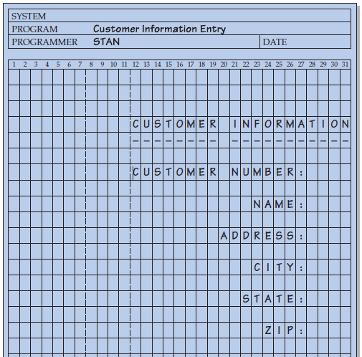
The Process of Designing Forms and Reports (Cont.)
FIGURE 10-2
The layout of a data input form
using a coding sheet

Slide 12
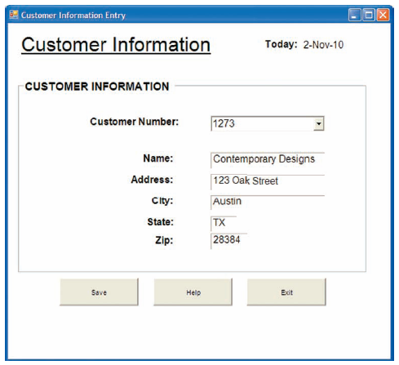
The Process of Designing Forms and Reports (Cont.)
FIGURE 10-3
A data input screen designed in
Microsoft’s Visual Basic .NET

Slide 13
Deliverables and Outcomes
Design specifications are the major deliverables and inputs to the system implementation phase.
Design specifications have three sections:
Narrative overview: characterizes users, tasks, system, and environmental factors
Sample design: image of the form (from coding sheet or form building development tool)
Testing and usability assessment: measuring test/usability results (consistency, sufficiency, accuracy, etc.)

Slide 14
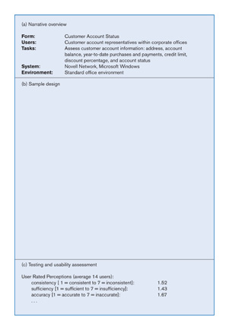
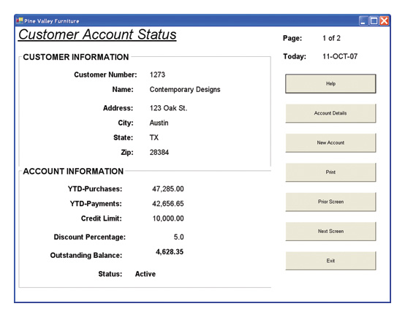
Deliverables and Outcomes (cont.)
Sample of Customer Account Status form design specification

Slide 15
Formatting Forms and Reports
Meaningful titles — use clear, specific, version information, and current date
Meaningful information — include only necessary information, with no need to modify
Balanced layout — use adequate spacing, margins, and clear labels
Easy navigation system — show how to move forward and backward, and where you are currently

Slide 16
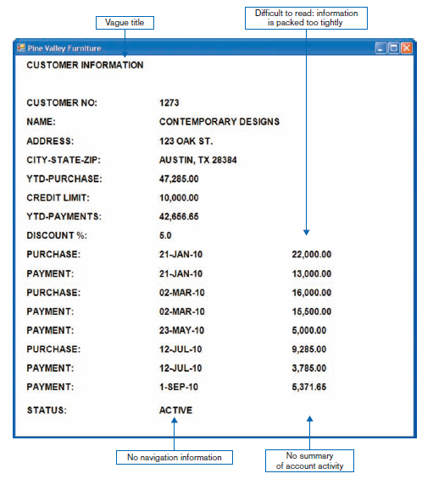
Formatting Forms and Reports (Cont.)
FIGURE 10-5
Contrasting customer information forms
(Pine Valley Furniture)
(a) Poorly designed form

Slide 17
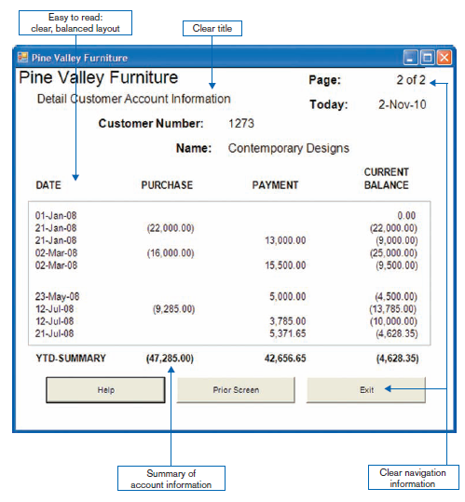
Formatting Forms and Reports (Cont.)
FIGURE 10-5 (continued)
(b) Improved design for form

Slide 18
Highlighting Information
Notify users of errors in data entry or processing.
Provide warnings regarding possible problems.
Draw attention to keywords, commands, high-priority messages, unusual data values.

Slide 19
Highlighting Information (Cont.)
Highlighting can include use of
upper case
bold
italics
underlining
boxing
size and color differences
all capital letters
blinking
reverse video
audible tones
intensity differences
offsetting nonstandard information

Slide 20
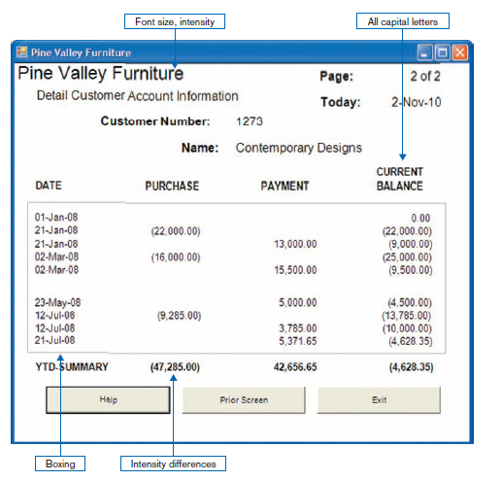
Highlighting Information (Cont.)
FIGURE 10-6
Customer account status display using various highlighting techniques
(Pine Valley Furniture)

Slide 21
Color vs. No Color
Benefits of Using Color
Soothes or strikes the eye.
Accents an uninteresting display.
Facilitates subtle discriminations in complex displays.
Emphasizes the logical organization of information.
Draws attention to warnings.
Evokes more emotional reactions.

Slide 22
Color vs. No Color (Cont.)
Problems from Using Color
Color pairings may wash out or cause problems for some users.
Resolution may degrade with different displays.
Color fidelity may degrade on different displays.
Printing or conversion to other media may not easily translate.

Slide 23
Displaying Text
Case: mixed upper and lower case, use conventional punctuation
Spacing: double spacing if possible, otherwise blank lines between paragraphs
Justification: left justify text, ragged right margins
Hyphenation: no hyphenated words between lines
Abbreviations: only when widely understood and significantly shorter than full text

Slide 24
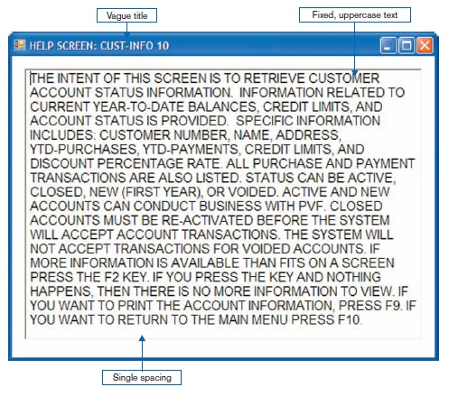
Displaying Text (Cont.)
FIGURE 10-7
Contrasting the display of textual help information
(a) Poorly designed help screen with many violations of the general guidelines for displaying text

Slide 25
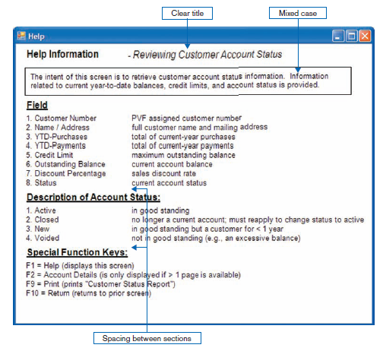
Displaying Text (Cont.)
FIGURE 10-7 (continued)
(b) An improved design for a help screen

Slide 26
Designing Tables and Lists
Labels
All columns and rows should have meaningful labels.
Labels should be separated from other information by using highlighting.
Redisplay labels when the data extend beyond a single screen or page.

Slide 27
Designing Tables and Lists (Cont.)
Formatting columns, rows and text:
Sort in a meaningful order.
Place a blank line between every five rows in long columns.
Similar information displayed in multiple columns should be sorted vertically.
Columns should have at least two spaces between them.

Slide 28
Designing Tables and Lists (Cont.)
Allow white space on printed reports for user to write notes.
Use a single typeface, except for emphasis.
Use same family of typefaces within and across displays and reports.
Avoid overly fancy fonts.

Slide 29
Designing Tables and Lists (Cont.)
Formatting numeric, textual and alphanumeric data:
Right justify numeric data and align columns by decimal points or other delimiter.
Left justify textual data. Use short line length, usually 30 to 40 characters per line.
Break long sequences of alphanumeric data into small groups of three to four characters each.

Slide 30
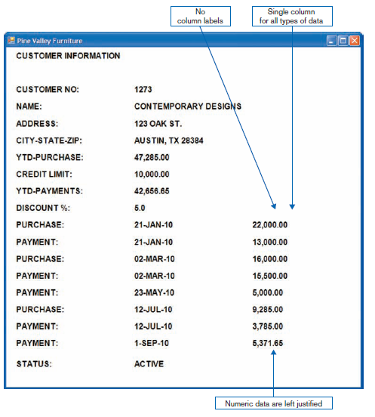
Designing Tables and Lists (Cont.)
FIGURE 10-8
Contrasting the display of tables and lists (Pine Valley Furniture)
(a) Poorly designed form

Slide 31
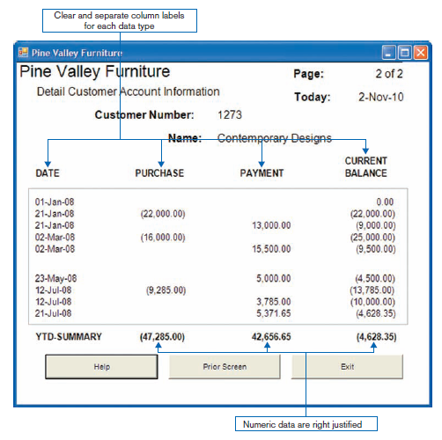
Designing Tables and Lists (Cont.)
FIGURE 10-8 (continued)
(b) Improved design for form

Slide 32
Designing Tables and Lists (Cont.)
Use tables for reading individual data values.
Use graphs for:
Providing quick summary.
Displaying trends over time.
Comparing points and patterns of variables.
Forecasting activity.
Simple reporting of vast quantities of information.

Slide 33
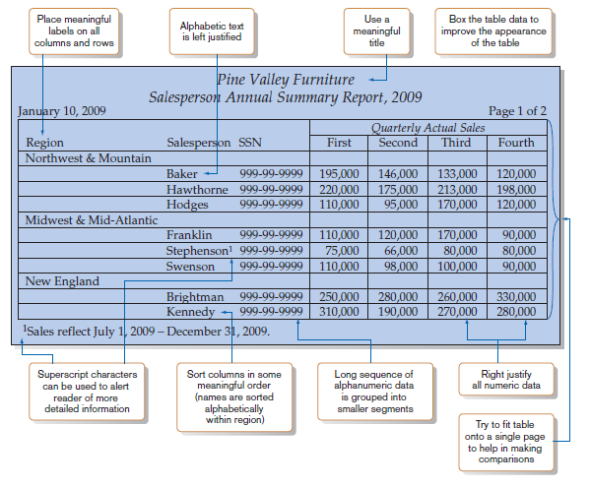
Designing Tables and Lists (Cont.)
FIGURE 10-9
Tabular report illustrating numerous design guidelines
(Pine Valley Furniture)

Slide 34
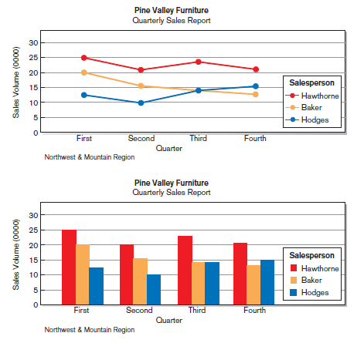
Designing Tables and Lists (Cont.)
FIGURE 10-10
Graphs for comparison
(a) Line graph
(b) Bar graph

Slide 35
Assessing Usability
Objective for designing forms, reports and all human-computer interactions is usability.
There are three characteristics:
Speed — Can you complete a task efficiently?
Accuracy — Does the output provide what you expect?
Satisfaction — Do you like using the output?

Slide 36
Assessing Usability (Cont.)
Usability: an overall evaluation of how a system performs in supporting a particular user for a particular task.

Slide 37
Usability Success Factors
Consistency — of terminology, formatting, titles, navigation, response time
Efficiency — minimize required user actions.
Ease — self-explanatory outputs and labels.
Format — appropriate display of data and symbols.
Flexibility — maximize user options for data input according to preference.

Slide 38
Electronic Commerce Application: Designing Forms and Reports for Pine Valley Furniture Web Store
General guidelines for rapid deployment of Internet Web sites have resulted
Three possible solutions to the problem:
Make it possible to design reasonably usable sites without having UI experience.
Train more people in good Web design.
Live with poorly designed sites that are hard to use.

Slide 39
Designing Forms and Reports at Pine Valley Furniture
PVF established the following guidelines:
Use lightweight graphics.
Establish forms and data integrity rules.
Use template-based HTML.

Slide 40
Lightweight Graphics
Lightweight Graphics: the use of small, simple images to allow a Web page to more quickly be displayed
Quick image download
Quick feedback from the Web site will help to keep customers at the PVF WebStore longer

Slide 41
Forms and Data Integrity Rules
All forms that request information should be clearly labeled and provide adequate room for input.
Specific fields requiring specific information must provide a clear example.
Must designate which fields are optional, required, and which have a range of values.

Slide 42
Template-Based HTML
Template-based HTML: templates to display and process common attributes of higher-level, more abstract items
Creates an interface that is very easy to maintain
Advantageous to have a “few” templates that could be used for entire product line
Not every product needs its own page

Slide 43
Summary
In Part 1, you learned how to:
Explain the process of designing forms and reports and the deliverables for their creation.
Apply the general guidelines for formatting forms and reports.
Use color and know when color improves the usability of information.

Slide 44
Summary (Cont.)
Format text, tables, and lists effectively.
Explain how to assess usability influence the usability of forms and reports.
Discuss guidelines for the design of forms and reports for Internet-based electronic commerce systems.

Slide 45
Exercise
Design ONE data entry screen for a library registration system by using data entry guidelines. Provide FOUR justifications in designing the data entry screen

Slide 46
PART 2

Slide 47
Introduction
Interface design focuses on how information is provided to and captured from users
Dialogue design focuses on the sequencing of interface displays.
Thus, the design of interfaces and dialogues is defining the manner in which humans and computer exchange information.
It complements the design of forms and reports which addressed design guidelines for the content of forms and reports.
Also, it includes navigation between forms, alternative ways to make forms or reports to appear, and how to supplement the content of forms and reports with user help and error messages

Slide 48
Deliverables and Outcomes
Creation of a design specification
A typical interface/dialogue design specification is similar to form design, but includes multiple forms and dialogue sequence specifications.
The specification includes:
Narrative overview
Sample design
Testing and usability assessment
Dialogue sequence
Dialogue sequence is the ways a user can move from one display to another.

Slide 49
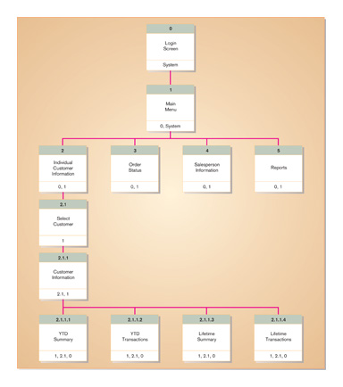
Deliverables and Outcomes (Cont.)
Sample of dialogue sequence

Slide 50
Interaction Methods and Devices
Interface: a method by which users interact with an information system.
All human-computer interfaces must:
have an interaction style; and
use some hardware device(s) for supporting this interaction.
Most popular styles of interacting
Command Line -- includes keyboard shortcuts and function keys.
Menu
Form
Object-based
Natural language

Slide 51
Command Language Interaction
Command language interaction: a human-computer interaction method whereby users enter explicit statements into a system to invoke operations
Example from MS DOS:
COPY C:PAPER.DOC A:PAPER.DOC
Command copies a file from C: drive to A: drive

Slide 52
Menu Interaction
Menu interaction: a human-computer interaction method in which a list of system options is provided and a specific command is invoked by user selection of a menu option
Pop-up menu: a menu-positioning method that places a menu near the current cursor position

Slide 53
Menu Interaction (Cont.)
Drop-down menu is a menu-positioning method that places the access point of the menu near the top line of the display.
When accessed, menus open by dropping down onto the display.
Visual editing tools help designers construct menus.

Slide 54
Menu Interaction (Cont.)
Guidelines for Menu Design
Wording — meaningful titles, clear command verbs, mixed upper/lower case
Organization — consistent organizing principle
Length — all choices fit within screen length
Selection — consistent, clear and easy selection methods
Highlighting — only for selected options or unavailable options

Slide 55
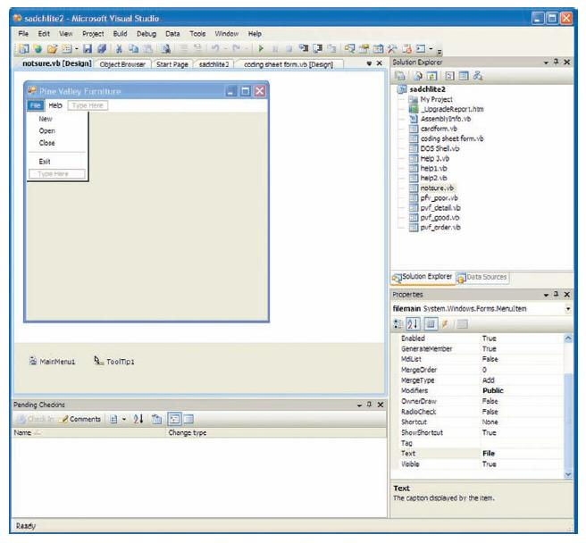
Menu Interaction (Cont.)
FIGURE 11-8
Menu building with Microsoft Visual Basic .NET

Slide 56
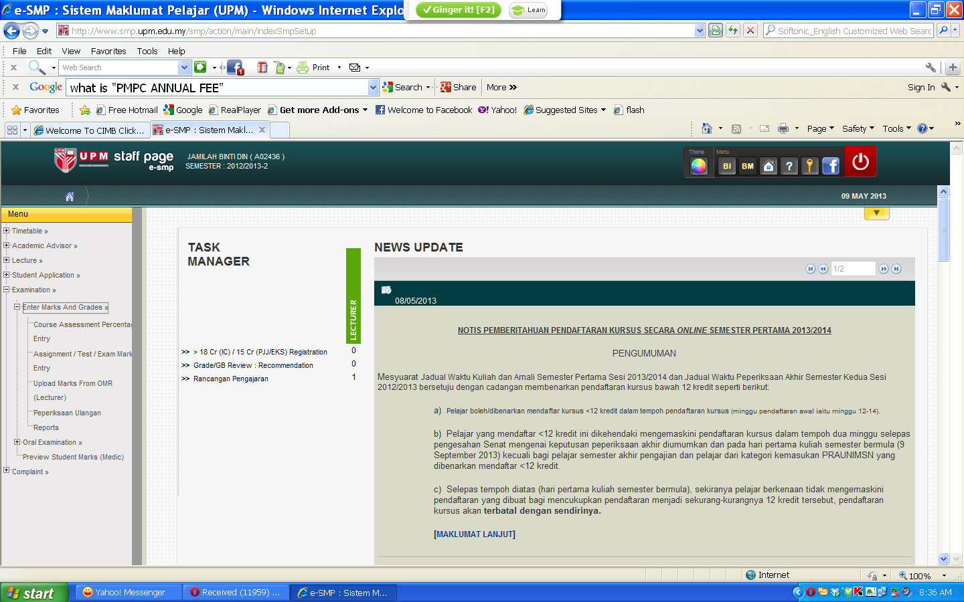

Slide 57
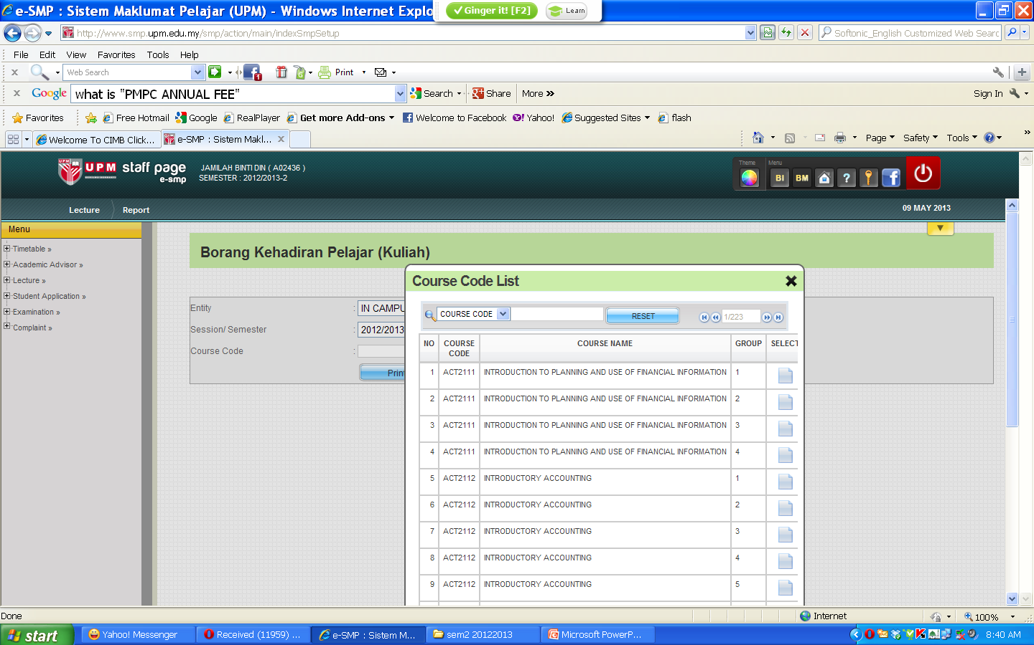

Slide 58
Form Interaction
Form interaction: a highly intuitive human-computer interaction method whereby data fields are formatted in a manner similar to paper-based forms
Allows users to fill in the blanks when working with a system.

Slide 59
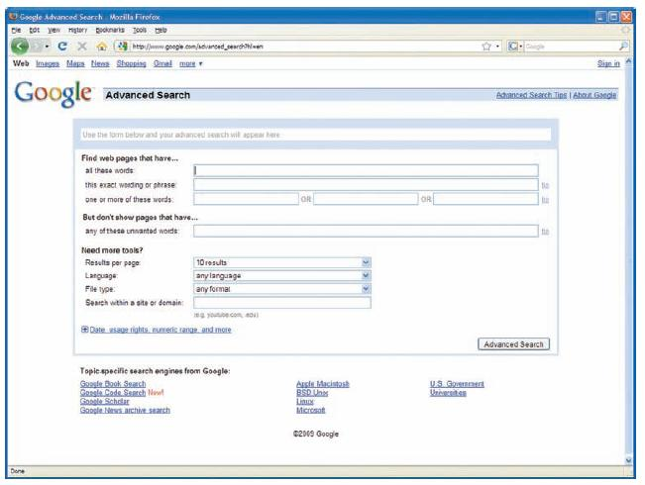
Form Interaction (Cont.)
FIGURE 11-9
Example of form interaction from the Google Advanced Search Engine
(Source: Google.)

Slide 60
Object-Based Interaction
Object-based interaction: a human-computer interaction method in which symbols are used to represent commands or functions
Icons: graphical pictures that represent specific functions within a system
Use little screen space and are easily understood by users

Slide 61
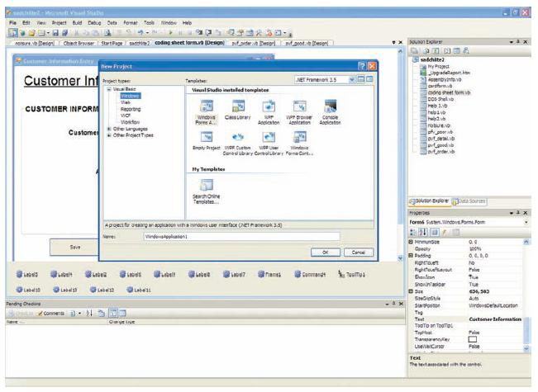
Object-Based Interaction (Cont.)
FIGURE 11-10
Object-based (icon) interface from Microsoft Visual Basic .NET

Slide 62
Natural Language Interaction
Natural language interaction: a human-computer interaction method whereby inputs to and outputs from a computer-based application are in a conventional spoken language such as English
Based on research in artificial intelligence.
Current implementations are tedious and difficult to work with, not as viable as other interaction methods.

Slide 63
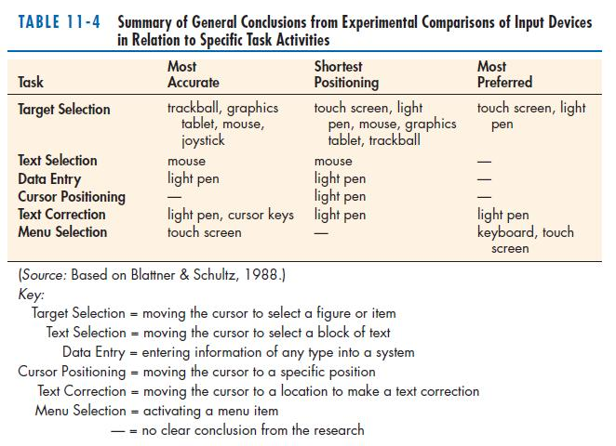
Hardware Options for System Interaction

Slide 64
Designing Interfaces
Designing Layout
Structuring Data Entry
Controlling Data Input
Providing Feedback
Providing Help

Slide 65
Designing Interfaces (cont.)
Structuring Data Entry
Entry | Never require data that are already online or that can be computed
Defaults | Always provide default values when appropriate
Units | Make clear the type of data units requested for entry
Replacement | Use character replacement when appropriate
Captioning | Always place a caption adjacent to fields
Format | Provide formatting examples
Justify | Automatically justify data entries
Help | Provide context-sensitive help when appropriate

Slide 66
Designing Interfaces (cont.)
Controlling Data Input
Objective: Reduce data entry errors
Common sources data entry errors in a field:
Appending: adding additional characters
Truncating: losing characters
Transcripting: entering invalid data
Transposing: reversing sequence of characters

Slide 67
Designing Interfaces (cont.)
Providing Feedback
Three types of system feedback:
Status information: keep user informed of what’s going on, helpful when user has to wait for response
Prompting cues: tell user when input is needed, and how to provide the input
Error or warning messages: inform user that something is wrong, either with data entry or system operation

Slide 68
Designing Interfaces (cont.)
Providing Help
Place yourself in user’s place when designing help.
Guidelines for designing usable help:
Simplicity — Help messages should be short and to the point.
Organize — Information in help messages should be easily absorbed by users.
Show — It is useful to explicitly show users how to perform an operation.

Slide 69
Designing Dialogues
Dialogues: the sequence of interaction between a user and a system
Dialogue design involves:
Designing a dialogue sequence.
Building a prototype.
Assessing usability.

Slide 70
Designing the Dialogue Sequence
Dialogue diagramming: a formal method for designing and representing human-computer dialogues using box and line diagrams

Slide 71
Designing the Dialogue Sequence (Cont.)
Three sections of the box are used as:
Top contains a unique display reference number used by other displays for referencing it.
Middle contains the name or description of the display.
Bottom contains display reference numbers that can be accessed from the current display.

Slide 72
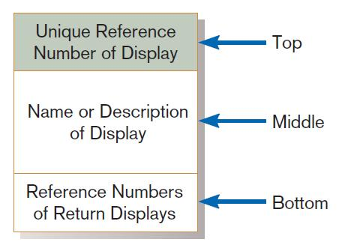
Designing the Dialogue Sequence (Cont.)
FIGURE 11-17
Sections of a dialogue diagramming box

Slide 73
Designing the Dialogue Sequence (Cont.)
Dialogue diagrams depict the sequence, conditional branching, and repetition of dialogues.

Slide 74
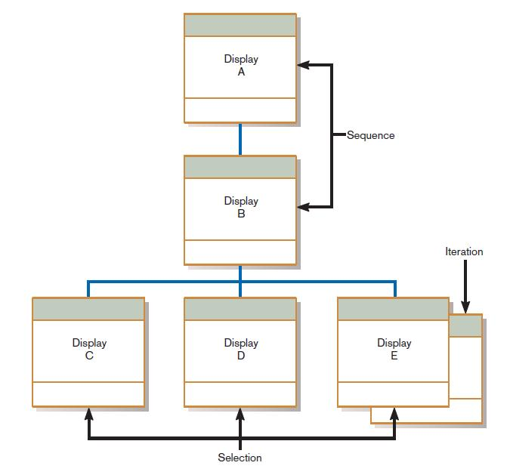
Designing the Dialogue Sequence (Cont.)
FIGURE 11-18
Dialogue diagram illustrating sequence, selection, and iteration

Slide 75
Building Prototypes and Assessing Usability
Optional activities
Building prototypes displays using a graphical development environment
Microsoft’s Visual Studio .NET
Borland’s Enterprise Studio
Easy-to-use input and output (form, report, or window) design utilities

Slide 76
Graphical Interface Design Issues
Become an expert user of the GUI environment.
Understand how other applications have been designed.
Understand standards.
Gain an understanding of the available resources and how they can be used.
Become familiar with standards for menus and forms.

Slide 77
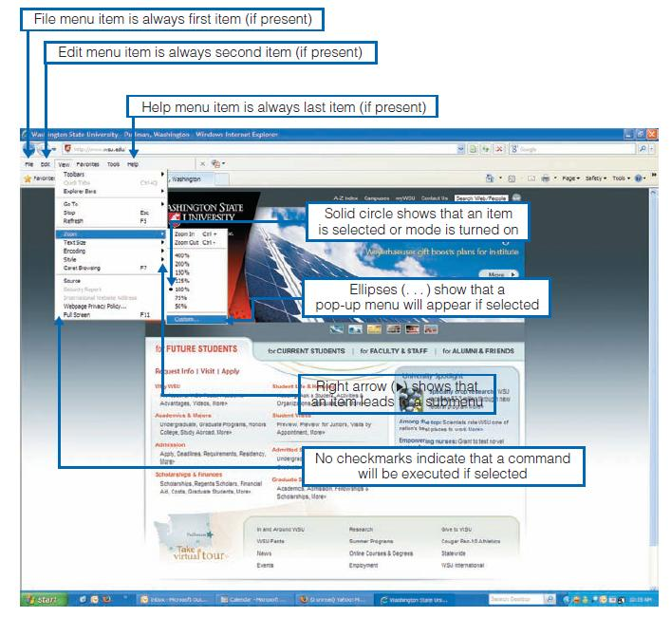
Graphical Interface Design Issues (Cont.)
FIGURE 11-20
Highlighting graphical user interface design standards

Slide 78
Electronic Commerce Application: Designing Interfaces and Dialogues for Pine Valley Furniture WebStore
Central and critical design activity
Where customer interacts with the company
Care must be put it design!
Prototyping design process is most appropriate to design the human interface.
Several general design guidelines have emerged.

Slide 79
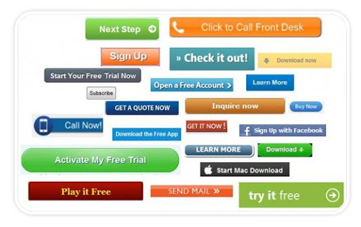
General Guidelines
Web’s single “click-to-act” method of loading static hypertext documents (i.e. most buttons on the Web do not provide click feedback).
Limited capabilities of most Web browsers to support finely grained user interactivity.

Slide 80
General Guidelines
Limited agreed-upon standards for encoding Web content and control mechanisms
Lack of maturity of Web scripting and programming languages as well as limitations in commonly used Web GUI component libraries

Slide 81
Designing Interfaces and Dialogues for Pine Valley Furniture
Key feature PVF wants for their WebStore is:
To incorporate into design an interface with “menu-driven navigation with cookie crumbs”.

Slide 82
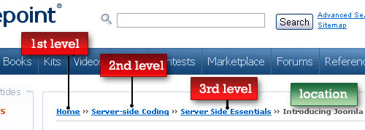
Menu-Driven Navigation with Cookie Crumbs
Cookie crumbs: the technique of placing “tabs” on a Web page that show a user where he or she is on a site and where he or she has been
Allow users to navigate to a point previously visited and will assure they are not lost
Clearly show users where they have been and how far they have gone from home

Slide 83
Summary
In this Part 2 you learned how to:
Explain the process of designing interfaces and dialogues and the deliverables for their creation.
Contrast and apply several methods for interacting with a system.
List and describe various input devices and discuss usability issues for each in relation to performing different tasks.
Describe and apply the general guidelines for designing interfaces and specific guidelines for structuring data entry fields, providing feedback, and system help.

Slide 84
Summary (Cont.)
Design human-computer dialogues and understand how dialogue diagramming can be used to design dialogues.
Design graphical user interfaces.
Discuss guidelines for the design of interfaces and dialogues for Internet-based electronic commerce systems.

Slide 85
Reference
Chapter 10: Designing Forms and Reports And
Chapter 11: Designing Interfaces and Dialogues
from
Modern Systems Analysis and Design Sixth Edition Jeffrey A. Hoffer Joey F. George Joseph S. Valacich

Slide 86
Exercise
Design dialogues in student registration system (esmp) used by UPM through the use of dialogue diagram.

Slide 87
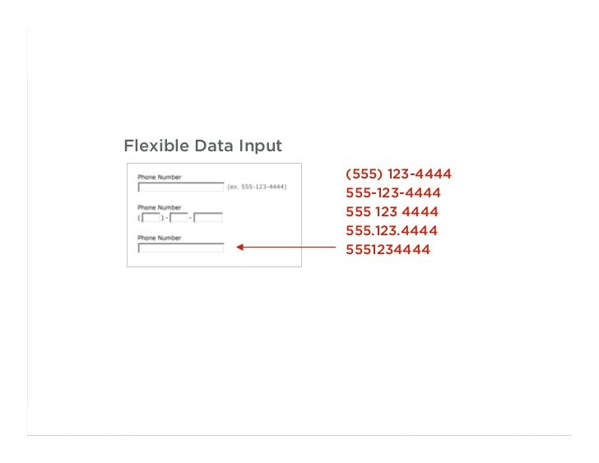

Slide 88
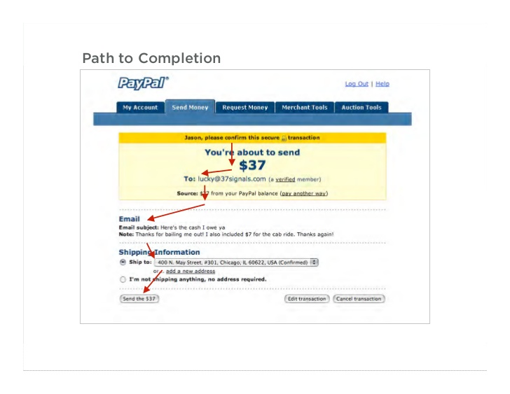

Slide 89
