Slide 1
Chapter 8 – Verification and Validation
Introduction

Slide 2
Learning Objectives
Explain the role of verification and validation in software quality
Describe the distinction between verification and validation
Describe the importance of verification and validation

Slide 3
Topics covered
Software verification
Software validation
V & V Techniques
Software Testing Levels

Slide 4
Introduction
Software engineering is a discipline that aims to produce high-quality software that is delivered on time, within budget and most importantly it satisfies the user’s need.
Software verification and validation (V&V) is one of the activities in software development process to ensure the delivered software meet the user’s need.
V&V is part of software testing process of a project.
.

Slide 5
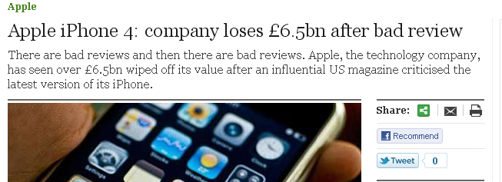
Why V&V?
13 July 2010
Share price fell by 4.2%
RM 32.5 billion wiped off its value
Recall will cost RM 5.1 billion
Apple just admitted that there's an issue with the iPhone 4's reception. Upon investigation, they were stunned to find that the formula that they use to calculate how many bars of signal strength to display is totally wrong. The formula, in many instances, mistakenly displays 2 more bars than it should for a given signal strength. For example, we sometimes display 4 bars when we should be displaying as few as 2 bars. Users observing a drop of several bars when they grip their iPhone in a certain way are most likely in an area with very weak signal strength, but they don't know it because we are erroneously displaying 4 or 5 bars. Their big drop in bars is because their high bars were never real in the first place.

Slide 6
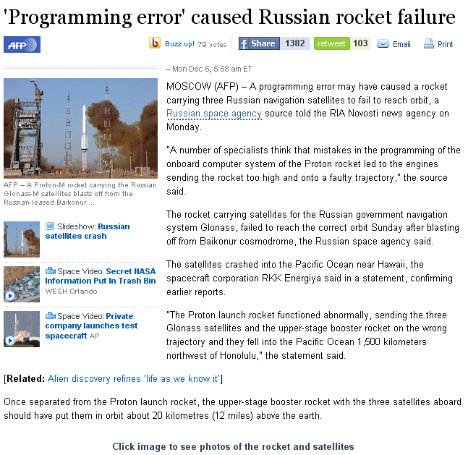
Why V&V
MOSCOW (AFP) – A programming error may have caused a rocket carrying three Russian navigation satellites to fail to reach orbit, a Russian space agency source told the RIA Novosti news agency on Monday. "A number of specialists think that mistakes in the programming of the onboard computer system of the Proton rocket led to the engines sending the rocket too high and onto a faulty trajectory," the source said. The rocket carrying satellites for the Russian government navigation system Glonass, failed to reach the correct orbit Sunday after blasting off from Baikonur cosmodrome, the Russian space agency said. The satellites crashed into the Pacific Ocean near Hawaii, the spacecraft corporation RKK Energiya said in a statement, confirming earlier reports. "The Proton launch rocket functioned abnormally, sending the three Glonass satellites and the upper-stage booster rocket on the wrong trajectory and they fell into the Pacific Ocean 1,500 kilometers northwest of Honolulu," the statement said.

Slide 7
Software Verification and Validation
Software Verification and Validation (V&V) is a software engineering practice that provides confidence that the system was built adequately and will meet the needs of the system.
In other words, V&V is the process of checking that a product, service, or system meets specifications and that it fulfills its intended purpose.
Verification and validation activities complement each other.
Verification takes place before validation, and not vice versa.

Slide 8
Software Verification
The process of evaluating software to determine whether the products of a given development phase satisfy the conditions imposed at the start of that phase. [IEEE-STD-610].
It is a quality control process that is used to evaluate whether or not a product, service, or system complies with regulations, specifications, or conditions imposed at the start of a development phase. It can be in development, scale-up, or production.
Are we building the product right?
This can be objective if the specification are sufficiently precise.
Three approaches to verification:
Experiment with the program (i.e. testing)
Inspect the program (i.e. review)
Reason about the program (i.e. formal specification)

Slide 9
Software Validation
The process of evaluating software during or at the end of the development process to determine whether it satisfies specified requirements. [IEEE-STD-610]
Does the software do what the user really required?
Are we building the right product?
Is a high-level checking activity.
This is difficult to determine and involves subjective judgments.
It includes usability testing and user acceptance test.

Slide 10
Verification or Validation?
It depends on the property.
For example: elevator response
…if a user press a request button at floor i, an available elevator must arrive at floor i soon…
[SOON is a subjective quantity]
Thus, it can only be validated, but not verified.
… if a user press a request button at floor i, an available elevator must arrive at floor i within 30 seconds…
[30 seconds is a precise quantity]
Thus, it can be verified.

Slide 11
The Role of V&V in Software Evolution
The evolution of a software can be done in many ways, depending on the development approach.
The development approach determines the specific intermediate documents/products to be created.
For any given project, V&V objectives must be identified for each of the products created.
Type of products:
Requirements
Specifications
Designs
Implementation
Changes

Slide 12
The Role of V&V in Software Evolution
V&V objectives:
Correctness
Consistency
Necessity
Sufficiency
Performance

Slide 13
The V&V Approach
Five categories of V&V approaches are:
technical reviews,
software testing,
proof of correctness (program verification),
simulation and prototyping and
requirements tracing.

Slide 14
The Process of Software V&V
Is a whole life-cycle process – V&V must be applied at each stage in the software process.
Has two principal objectives:
To discover the defects in a system;
To assess whether the system is useful and usable in an operational situation.

Slide 15
The Goal of Software V&V
V&V should establish confidence that the software is fit for purpose.
This does NOT mean completely free of defects.
Rather, it must be good enough for its intended use
the type of use will determine the degree of confidence that is needed.

Slide 16
The V&V Confidence
Depends on system’s purpose, user expectations and marketing environment
Software function
The level of confidence depends on how critical the software to an organisation.
User expectations
Users may have low expectations of certain kinds of software.
Marketing environment
Getting a product to market early is better than finding defects in the program.

Slide 17
Verification Technique
Verification techniques, basically fall into categories:
Static Testing
Dynamic Testing
Dynamic testing involves the execution of a system or component.
Steps in performing dynamic testing:
Test case selection – consists of test data
Executing the system under test using the data
Compare the expected output and actual output.
Dynamic testing can be further divided into three categories:
Functional testing, Structural testing and Random testing
.

Slide 18
Verification Technique
Static testing is testing that does not involve the operation of the system or component.
May be supplement by tool-based document and code analysis
Static testing can be further divided into two categories:
Consistency technique – technique that are used to ensure program properties such as correct syntax, correct parameter matching between procedures, correct typing and correct requirements and specification translations.
Measurement technique – technique that measure the properties such as error proneness, understandability, and well-structuredness.

Slide 19
Static and dynamic V&V
Software
inspections
Requirement
High-level
Formal
Detailed
Program
specification
design
specification
design
Prototype
Program
testing

Slide 20
Validation Technique
Numerous validation techniques, including formal methods, fault injection and dependability analysis. Validation usually take place at the end of the development life-cycle and look at the complete systems.
Formal methods is not only a verification technique but also a validation technique.
The use of mathematical and logical technique to express, investigate and analyze the specification, design, documentation and behaviour of both hardware and software.
Fault injection is to intentional activation of faults to observe the system operation under fault conditions.
Dependability analysis involves identifying hazards and then proposing methods that reduces the risk of hazard occurring.

Slide 21
Program Testing
Is it possible to find and fix all bugs in software before deliver it to the customer?
Can reveal the presence of errors NOT their absence.
The only validation technique for non-functional requirements as the software has to be executed to see how it behaves.
Should be used in conjunction with static verification to provide full V&V coverage.

Slide 22
Types of testing
Defect testing
Tests designed to discover system defects.
A successful defect test is one that can detect the defects in a system.
Validation testing
Intended to show that the software meets its requirements.
A successful test is one that prove requirements has been properly implemented.

Slide 23
Testing and debugging
Defect testing and debugging are distinct processes.
Verification and validation is concerned with establishing the existence of defects in a program.
Debugging is concerned with locating and repairing these errors.
Debugging involves formulating a hypothesis about program behaviour and test the hypotheses to find the system error.

Slide 24
The Debugging Process
Test
Specification
Test
results
cases
Locate
Design
Repair
Retest
error
error repair
error
program

Slide 25
The V-model of development
Concept
System
Develop tests
Capture
Requirements
Acceptance
Test
Develop tests
Design System
Integration / System
Test
Develop
tests
Implement
System
Component
Test

Slide 26
Software Testing Levels: A Generic View
System
Testing
Unit
Testing
Testing Strategy
Integration
Testing
Acceptance
Testing

Slide 27
Component (Unit) Test
Objective: Find bugs, build confidence and reduce risk in the individual pieces of the SUT prior to system integration.
Basis: Code, database, reqs/design, quality risks
Test types: Functionality, resource use, performance, structural
Item-under-test (IUT): Smallest independently testable item (function or class).
Harness and tools: API level (drivers and stubs), freeware and commercial
Responsible: Usually programmers

Slide 28
Unit/Component Test Process
It typically…
…involves access to the code,
…is run in a development environment,
…requires drivers, stubs and/or harness
…is done by the programmer who wrote the code
Often bugs are fixed upon being found without any reporting which reduces the transparency of the development process with respect to quality.

Slide 29
Integration Testing
Big Bang
Take all tested modules; put them all together; test.
Bottom up
Start with bottom layer modules; use appropriate drivers; test
Repeat process, replacing drivers with modules; until done
Good bug isolation, but what if nasty problems are at the top
Top down
Like bottom up, but start from top and use stubs
Good bug isolation, but what if the nasty problems are at the bottom?
Backbone
Start with critical modules; build initial backbone; use driver and stubs; test
Repeat process, replacing stubs and drivers with modules in risk order.
Good isolation and finds integration bugs in risk order

Slide 30
System Test
Objective: Find bugs, build confidence, and reduce risk in the overall and particular behaviors, functions and responses of the SUT as a whole.
Basis: Requirements, high-level design, use cases, quality risks, experience, checklists, environments
Test types: Functionality, security, performance, reliability, usability, portability, etc.
IUT: Whole system, in as realistic as possible test environment.
Harnesses and tools: API, CLI or GUI, freeware and commercial.
Responsible: Typically independent testers.

Slide 31
System Testing
System testing investigate both functional and non functional requirements of a system
Effective system testing needs to be executed without unit or integration defects
Testers need to deal with incomplete or undocumented requirements
System testing investigate both functional and non-functional requirements of system.
Functional Requirement Test
Specification-Based (black box) decision table
Security test : to detect threat from outside
Non-functional Requirement test
Structure based techniques – to assess the thoroughness of menu structure or web page navigation
Performance test, usability test, reliability test etc

Slide 32
Acceptance Test
Objective: Demonstrate that the product is ready for deployment.
Basis: Requirements, contracts, experience
Test types: Functional, portability, performance
IUT: Whole systems, sometime in the production or customer environment
Harnesses and tools: GUI usually
Responsibility: Often users or customers but also independent testers

Slide 33
Variations in Acceptance Testing
Typical forms of acceptance test
User acceptance testing
Operational (acceptance testing)‏
Testing of backup/restore, disaster recovery, user management, maintenance task, periodic checks of security vulnerabilities
Contract and regulation acceptance testing
Acceptance criteria should be defined when the contract is agreed
Regulation acceptance testing is performed against any regulations that must be adhered to, such as governmental, legal or safety regulations
Alpha Testing & Beta Testing
Factory acceptance testing (alpha) and site acceptance testing (beta)‏

Slide 34
Variations in Acceptance Testing
Alpha Testing
type of software testing performed to identify bugs before releasing the product to real users or to the public
involves both the white box and black box testing
performed at developer’s site.
Reliability and security testing are not checked
ensures the quality of the product before forwarding to beta testing
Beta Testing
performed by real users of the software application in a real environment
commonly uses black box testing.
performed at end-user of the product
Reliability, security and robustness are checked during beta testing

Slide 35
Testing Types

Slide 36
Comparing Test Types
Testing
Static
Static Analysis
Review
Dynamic
White-box
Black-box
Functional
Non-functional

Slide 37
Test Types
Functional Testing
Functional testing considers the external behavior of the software (i.e. black-box testing)‏
Non-Functional Testing
It is testing of “how” the system works. Such as performance testing, usability testing etc (ISO/IEC9126)‏
Structural Testing
It may be based on the architecture of software or the system (i.e. white-box testing)
Confirmation Testing and regression testing
After modification, to confirm that the original defect has been successfully removed and to discover any defects introduced or uncovered as a result of the change(s).

Slide 38
White-box vs. Black-box
White Box Testing
software testing method in which the internal structure/ design/ implementation of the item being tested is known to the tester.
mostly done by software developers
Knowledge of implementation is required
It is structural test of the software.
It is generally applicable to the lower levels of software testing.
test various paths through software; if exhaustive testing is impossible, test high-risk paths
Example: by input to check and verify loops

Slide 39
White-box vs. Black-box
Black Box Testing
is a software testing method in which the internal structure/ design/ implementation of the item being tested is not known to the tester
knowing functions to be performed and testing whether these are performed properly
test cases designed from user requirements
mostly done by software testers
No knowledge of implementation is needed
applicable to the higher levels of testing of software.
appropriate at Integration, Systems and Acceptance testing levels
Example: search by using keywords

Slide 40
Key Points
Software Verification and Validation (V&V) is a software engineering practice that provides confidence that the system was built adequately and will meet the needs of the system.
Software verification is a process of evaluating software to determine whether the products of a given development phase satisfy the conditions imposed at the start of that phase - Are we building the product right?
Software validation is a process of evaluating software during or at the end of the development process to determine whether it satisfies specified requirements - Are we building the right product?

Slide 41
Key Points
V&V must be applied at each stage in the software process.
There are 4 testing strategies:
Component (unit) testing
Integration testing
System testing
Acceptance testing
User acceptance testing
Operational testing
Contract and regulation acceptance testing
Alpha testing and beta testing

