Slide 1
Chapter 7
Sorting

Slide 2
OBJECTIVE
Introduces:
  Sorting Concept
  Sorting Types
  Sorting Implementation Techniques

Slide 3
CONTENTS
7.1 Introductions
7.2 Sorting Methods
7.2.1 Priority Queue Sorting Method
(Selection Sort and Heap Sort)
7.2.2 Insert and Keep Method (Insertion Sort and Tree Sort)
7.2.3 Divide and Conquer Method (Quick Sort and Merge Sort)
7.2.4 Diminishing Increment Sort Method (Shell Sort)

Slide 4
7.1 Introduction
One of the most common applications in computer science.
The process through which data are arranged in either ascending or descending order according to their values.
Sorts are generally classified as either internal or external:
  Internal Sort – all of the data are held in primary storage during the sorting process.
  External sort – uses primary storage for the data currently being sorted and secondary storage for any data that will not fit in primary memory.

Slide 5
Factors to consider in choosing sorting technique:
  Number of item and load
  Number of characters in item or record
  Average case and best case
  Average case and worst case
  Sorter stabilization especially for sorter that use two keys
There are a lot sorting techniques, which can be used, and every technique can be categorized according to their method group.

Slide 6
7.2 Sorting Methods
7.2.1 Priority Queue Sorting Method
Method :
  An array A is divided into sub-array P represents priority queue and sub-array Q represents output queue.
  The idea is to find the largest key among unsorted keys in P and place it at the end of queue of Q. This will result a sorted queue Q in increasing order.
Two sorting techniques, which use this method, are Selection Sort and Heap Sort.

Slide 7
Selection Sort
  Are among the most intuitive of all sorts.
  Suitable for a small table such as for a few hundreds item.
Approach:
Select the smallest item and exchanged with the item at the beginning of the unsorted list. These steps are then repeated until we have sorted all of the data.

Slide 8
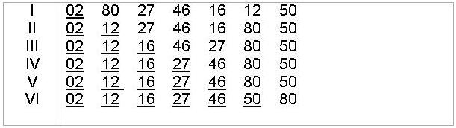
Example :
27 80 02 46 16 12 50
Path:
Brief Analysis:
  ~ The inner loop executes 1 + 2 + ... + N – 1 times which is equal to
  N (N – 1) ~ O(N²)
  2
  ~ The sorted input still need N(N-1)/2 comparisons, so it is not good and wasting time.

Slide 9
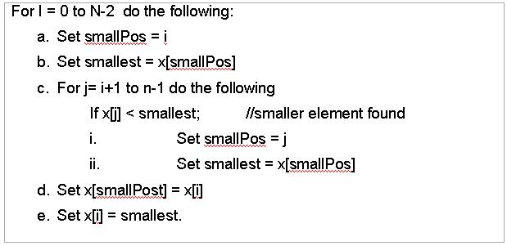
Algorithm:

Slide 10
Try this:
An array contains the elements shown below. The first two elements have been sorted using a straight selection sort. What would be the value of the elements in the array after three more path/passes of the selection sort algorithm?
7 8 26 44 13 23 98 57

Slide 11
2. Heap Sort
An improved version of the selection sort with computing time O(Nlog₂N) but not as quick as quick sort in average cases.
Heap sort is not using recursive so it saves memory space.
A Heap is a binary tree which almost complete that is each level of the tree is completely filled, except possibly the bottom level, and in this level, the nodes are in the leftmost positions.

Slide 12
Also, it satisfies the heap-order property: The data item stored in each node is greater than or equal to the data items stored in its children. Thus the root is the biggest value.

Slide 13
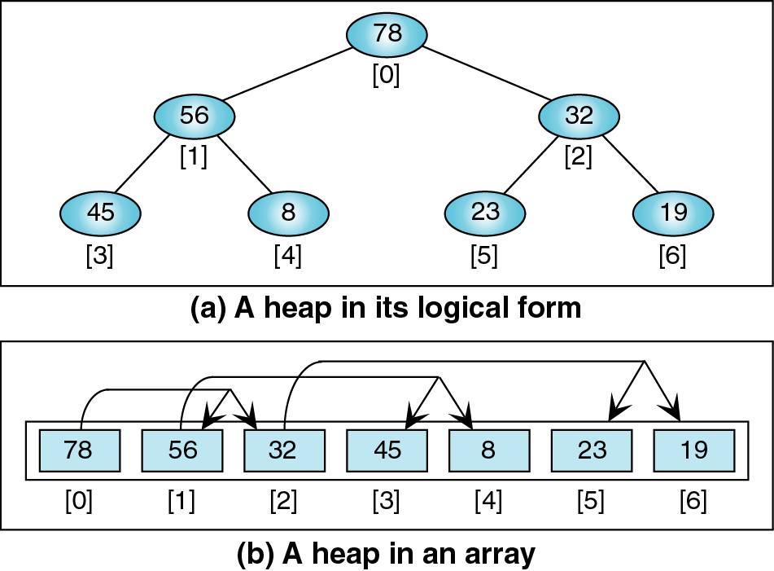
Fig. 1: Heap representations

Slide 14
A node may have one, or two or none of children. If it has one, the child must be on the left because heap is not BST.
The children of the node I is at 2I+1 and 2I+2.
There are two processes to build heap sort: -
  BuildHeap
  InsertHeap

Slide 15

Example :
1. Process I: Build heap
  insert 19
  Insert 02
  (heap? yes)
19
19
02

Slide 16
  Insert 46
  (heap? no pre-heap)
  Insert 16
  (heap? no pre-heap)
19
46
02
46
02
19
46
46
02
19
16
19
16
02

Slide 17
  Insert 12
  (heap? Yes)
  Insert 64
  (heap? no pre-heap)
46
16
19
02
12
54
64
16
46
16
54
02
12
19
64
02
12
19
46

Slide 18
  Insert 22
  (heap? no pre-heap)
64
64
16
54
22
54
02
12
19
46
16
12
19
46
22
02

Slide 19
  Insert 17
  (heap? no pre-heap)
64
64
22
54
22
54
16
12
19
46
17
12
19
46
02
17
02
16

Slide 20
  Insert 66
  (heap? no pre-heap)
64
66
22
54
64
54
17
12
19
46
17
22
19
46
02
16
66
02
16
12

Slide 21
  Insert 37
  (heap? no pre-heap)
66
66
64
54
64
54
17
22
19
46
17
37
19
46
02
16
12
37
02
16
12
22

Slide 22

  Insert 35
  (heap? no pre-heap)
  In array format :
66
66
64
54
64
54
17
37
35
46
17
37
19
46
02
16
12
22
19
02
16
12
22
35

Slide 23
Process II: Change to sorted array
66
64
54
17
37
35
46
02
16
12
22
19

Slide 24
  exchanging the root element and the rightmost leaf element
19
64
54
17
37
35
46
02
16
12
22
66

Slide 25
  exchanging the root with the largest child
64
37
54
17
22
35
46
02
16
12
19
66

Slide 26
  exchange the root element with the last leaf, which is not, yet highlighted
19
37
54
17
22
35
46
02
16
12
64
66

Slide 27
  then, do the all three processes until all nodes are sorted.
54
37
46
17
22
35
19
02
16
12
64
66

Slide 28
  exchange the root element and the rightmost leaf element.
12
37
46
17
22
35
19
02
16
54
64
66

Slide 29
  exchange root with the largest child.
46
37
35
17
22
12
19
02
16
54
64
66

Slide 30
  exchange the root element with the last leaf, which is not yet highlighted.
16
37
35
17
22
12
19
02
46
54
64
66

Slide 31
  Arrange so that parent > child without considering 46, 54, 64 and 66.
37
22
35
17
16
12
19
02
46
54
64
66

Slide 32
  exchange the root element and the rightmost leaf element
02
22
35
17
16
12
19
37
46
54
64
66

Slide 33
  exchange root with the largest child.
35
22
19
17
16
12
02
37
46
54
64
66

Slide 34
  exchange the root element with the last leaf which is not yet highlighted
02
22
19
17
16
12
35
37
46
54
64
66

Slide 35
  Arrange so that parent > child without considering 35, 37, 46, 54, 64 and 66.
22
17
19
02
16
12
35
37
46
54
64
66

Slide 36
  exchange the root element and the rightmost leaf element.
12
17
19
02
16
22
35
37
46
54
64
66

Slide 37
  exchange root with the largest child.
19
17
12
02
16
22
35
37
46
54
64
66

Slide 38
  exchange the root element with the last leaf which is not yet highlighted.
16
17
12
02
19
22
35
37
46
54
64
66

Slide 39
  Arrange so that parent > child without considering 19, 22, 35, 37, 46, 54, 64 and 66.
17
16
12
02
19
22
35
37
46
54
64
66

Slide 40
  exchange the root element and the rightmost leaf element.
02
16
12
17
19
22
35
37
46
54
64
66

Slide 41
  exchange root with the largest child.
16
02
12
17
19
22
35
37
46
54
64
66

Slide 42
  exchange the root element with the last leaf which is not yet highlighted.
12
02
16
17
19
22
35
37
46
54
64
66

Slide 43
  Arrange so that parent > child without considering 12, 16, 17, 19, 22, 35, 37, 46, 54, 64 and 66.
02
12
16
17
19
22
35
37
46
54
64
66

Slide 44
  exchange the root element and the rightmost leaf element.
02
12
16
17
19
22
35
37
46
54
64
66

Slide 45

In an array form:

Slide 46
BuildHeap() method
void buildHeap(int[] a, int i, int n) {
if (i >= n/2) return;
buildHeap (a, 2*i+1, n);
buildHeap (a, 2*i+2, n);
heapify (a, i, n);
}

Slide 47
Algorithm
The Heap Sort 1 void sort(int[] a) { 2 for (int i = (a.length-1)/2; i >= 0; i--) 3 heapify(a, i, a.length); 4 for (int j = a.length-1; j > 0; j--) { 5 swap(a, 0, j); 6 heapify(a, 0, j); 7 } 8 }

Slide 48
public void swap (int x, int y) {
int temp = 0;
temp = a[x];
a[x] = a[y];
a[y] = temp;
}

Slide 49
The heapify() Method
1 void heapify(int[] a, int i, int n) {
2 int ai = a[i];
3 while (i < n/2) { // a[i] is not a leaf
4 int j = 2*i + 1; // a[j] is ai’s left child
5 if (j+1 < n && a[j+1] > a[j]) ++j; // a[j] is ai’s larger child
6 if (a[j] <= ai) break; // a[j] is not out of order
7 a[i] = a[j]; // promote a[j]
8 i = j; // move down to next level
9 a[i] = ai;
10 }
11 }

Slide 50
7.2.2 Insert and Keep Method
Method :
  Done by inserting key from an unsorted array A into an empty holder C, doing the sorting as they are inserted. Thus, each keys in A that is entered, is placed in its correct sorted position in C from the start.
Two sorting techniques that are using this method are insertion sort and tree sort.

Slide 51
1) Insertion Sort
This technique uses less time as opposed to selection sort technique in comparison-based condition.
N – 1 path with less data movement.
Example:
27 80 02 46 16 12 54
Path 1: 27 80 02 46 16 12 54
Path 2: 02 27 80 46 16 12 54
Path 3: 02 27 46 80 16 12 54
Path 4: 02 16 27 46 80 12 54
Path 5: 02 12 16 27 46 80 54
Path 6: 02 12 16 27 46 54 80

Slide 52
Algorithm :
The Insertion Sort
1 void sort(int[] a) {
2 for (int i = 1; i < a.length; i++) {
3 int ai = a[i], j = i;
4 for (j = i; j > 0 && a[j-1] > ai; j--)
5 a[j] = a[j-1];
6 a[j] = ai;
7 }
8 }

Slide 53
2) Tree Sort
If we take a set of key values and insert them into the binary search tree (BST), an inorder traversal will print out the nodes in increasing order
  This is called treesort
Try this:
An array contains the elements shown below. The first two elements have been sorted using a straight insertion sort. What would be the value of the elements in the array after two more passes of the straight insertion sort algorithm?
3 13 7 26 44 23 98 57

Slide 54
7.2.3 Divide And Conquer Method
Method
  The unsorted list A is partitioned into two sublists, L and R. The two sublists are then sorted recursively. The sorted lists then combined into one list in such a way so that the combined list is sorted.
  Two sorting techniques that used this method are Quick Sort and Merge Sort.

Slide 55


1) Quick sort
Has a good performance in average case and using recursive method.
Partion the list (array-based list) into two sublists.
Then, partition the sublists into smaller sublists and so on.
Solve the left hand side first, then the right hand side

Slide 56

While partitioning the array, these conditions must be followed:
1. Item P (pivot) where in the right position of J, no need to be moved.
2. Items at the left of A[J], A[1..J-1]
Left < P => Left subfile

Slide 57

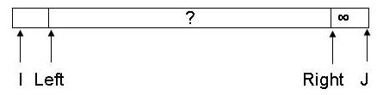
3. Items at the right of A[J+1]; A[J+1..N]
Right > P => Right subfile
After partitioning, it will look as follows :
First Quick Sort is called.

Slide 58


? – Not knowing the relationship among the elements or with P
Exchange A[I] with A[J]

Slide 59
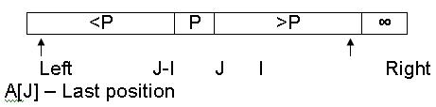
Then:
A[Left+1..J] < P
A[I..Right+1] > P
So, J < I => exchange A[Left] with A[J]

Slide 60
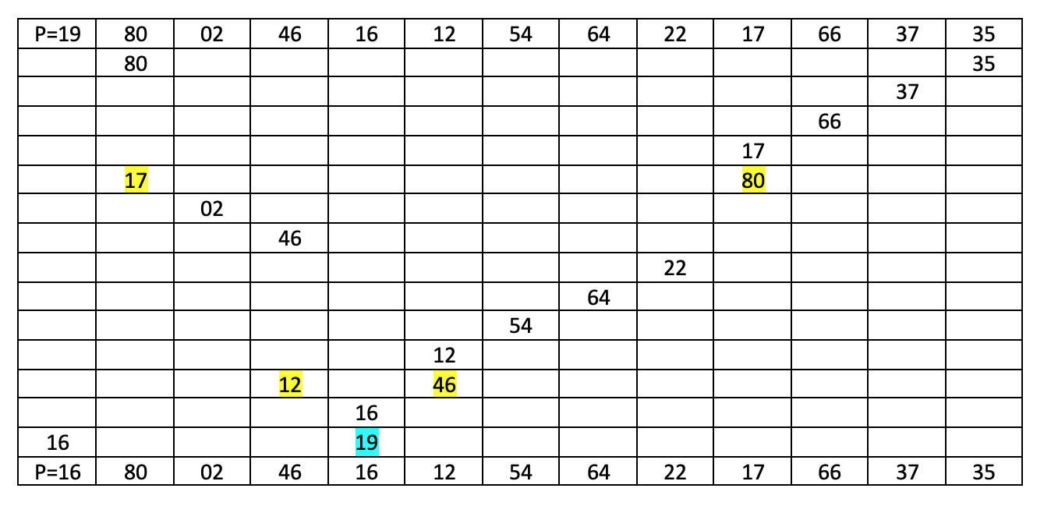
Example

Slide 61
The following figure shows the next steps of partitioning for the above input. Each underlined element has been at its last position. The shown subfiles are after partitioning has been done.

Slide 62
19 80 02 46 16 12 54 64 22 17 66 37 35
16 17 02 12 19 46 54 64 22 80 66 37 35
02 12 16 17
02
12
17
22 35 37 46 80 66 64 54
22 35 37
35
37
54 66 64 80
54
64 66
64

Slide 63
The Quick Sort
1 void sort(int[] a, int p, int q) {
2 // PRECONDITION: 0 <= p < q <= a.length
3 // POSTCONDITION: a[p..q-1] is in ascending order
4 if (q - p < 2) return;
5 int j = partition(a, p, q);
6 sort(a, p, j);
7 sort(a, j + 1, q);
8 }

Slide 64
The partition() Method
1 int partition(int[] a, int p, int q) {
2 // RETURNS: index j of pivot element a[j];
3 // POSTCONDITION: a[i] <= a[j] <= a[k] for p <= i <= j <= k < q;
4 int pivot=a[p], i = p, j = q;
5 while (i < j) {
6 while (j > i && a[--j] >= pivot)
7 ; // empty loop
8 if (j > i) a[i] = a[j];
9 while (i < j && a[++i] <= pivot)
10 ; // empty loop
11 if (i < j) a[j] = a[i];
12 }
13 a[j] = pivot;
14 return j;
15 }

Slide 65
2. Merge Sort
Can be used as both an internal and an external sort; used to sort large data.
Method: (as an external sort since it is most often used)
i) Three files needed F1, F2, F3. F1 and F2 are input data files. F3 is output data file.
ii) Original data is divided into F1 and F2 alternatively such that the first element in file F1, second in file F2, third back in file F1 and so on.
iii) Sorting is done by sorting the first one-element subfile of F1 with the first one-element subfile of F2 to give a sorted two-element subfile of F3. After one cycle, repeat the process with size of subfiles is the power of 2. (2, 4, 8, ....).

Slide 66
Example :
F : 75 55 15 20 85 30 35 10 60 40 50 25 45 80 70 65
F1: 75 | 15 85 35 60 50 45 70
F2: 55 | 20 30 10 40 25 80 65
F3: 55 75 | 15 20 | 30 85 | 10 35 | 40 60 | 25 60 | 45 80 | 65 70
F1: 55 75 | 30 85 | 40 60 | 45 80 |
F2: 15 20 | 10 35 | 25 50 | 65 70 |
F3: 15 20 55 75 | 10 30 35 85 | 25 40 50 60 | 45 65 70 80 |
F1: 15 20 55 75 | 25 40 50 60
F2: 10 30 35 85 | 45 65 70 80
F3: 10 15 20 30 35 55 75 85 | 25 40 45 50 60 65 70 80
F1: 10 15 20 30 35 55 75 85
F2: 25 40 45 50 60 65 70 80
F3: 10 15 20 25 30 35 40 45 50 55 60 65 70 75 80 85

Slide 67
Algorithm :
The Merge Sort
1 void sort(int[] a, int p, int q) {
2 // PRECONDITION: 0 <= p < q <= a.length
3 // POSTCONDITION: a[p..q-1] is in ascending order
4 if (q-p < 2) return;
5 int m = (p+q)/2;
6 sort(a, p, m);
7 sort(a, m, q);
8 merge(a, p, m, q);
9 }

Slide 68
The Merge() Method
1 void merge(int[] a, int p, int m, int q) {
2 // PRECONDITIONS: a[p..m-1] and a[m..q-1] are in ascending order;
3 // POSTCONDITION: a[p..q-1] is in ascending order;
4 if (a[m-1] <= a[m]) return; // a[p..q-1] is already sorted
5 int i = p, j = m, k = 0;
6 int[] aa = new int[q-p];
7 while (i < m && j < q)
8 if (a[i]<a[j]) aa[k++] = a[i++];
9 else aa[k++] = a[j++];
10 if (i < m) System.arraycopy(a, i, a, p+k, m-i); // shift a[i..m-1]
11 System.arraycopy(aa, 0, a, p, k); // copy aa[0..k-1] to a[p..p+k- 1];
12 }

Slide 69
7.2.4 Diminishing Increment Sort Method
Method :
  The array is sorted in smaller groups. By using the current value that gets larger, the groups will be sorted.
Technique that used this method is Shell Sort.

Slide 70
Shell Sort
Named after its discoverer
The technique is to sort items that are further apart on the first pass, and then to sort items that are closer and closer together on the later passes by dividing the items into subfiles.
Example:
27 80 02 46 16 12 54 64 22 17 66 37 35

Slide 71
Subfiles: (5-increment)
(27, 12, 66) ^ 12 80 02 46 16 27 54 64 22 17 66 37 35
(80, 54, 37) ^ 12 37 02 46 16 27 54 64 22 17 66 80 35
(02, 64, 35) ^ 12 37 02 46 16 27 54 35 22 17 66 80 64
(46, 22) ^ 12 37 02 22 16 27 54 35 46 17 66 80 64
(16, 17) ^ no changes

Slide 72
Subfiles: (2-increment)
(12, 02, 16, 54, 46, 66, 64) ^ 02 37 12 22 16 27 46 35 54 17 64 80 66
(37, 22, 27, 35, 17, 80) ^ 02 17 12 22 16 27 46 35 54 37 64 80 66
Subfiles: (1-increment)
02 17 12 22 16 27 46 35 54 37 64 80 66
02 12 16 17 22 27 35 37 46 54 64 66 80

Slide 73
Algorithm :
The iSort() Method
1 void iSort(int[] a, int c, int d) {
2 for (int i = c+d; i < a.length; i+=d) {
3 int ai = a[i], j = i;
4 while (j > c && a[j-d] > ai) {
5 a[j] = a[j-d];
6 j -= d;
7 }
8 a[j] = ai;
9 }
10 }

Slide 74
The Shell Sort
1 void sort(int[] a) {
2 for (int d = a.length/2; d > 0; d /= 2)
3 for (int c = 0; c < d; c++)
4 iSort(a, c, d); // applies insertion sort to the skip sequence
5 }

Slide 75
Exercise :
1. Show which of the structures in below figure is a heap and which is not.
(a) (b)
23
23
12
15
12
15
11
11

Slide 76
      (c) (d)
23
23
12
15
13
15
13
11
12
11

Slide 77
2. Given the following sequence of numbers, sort the data element using heap technique.
27 7 92 6 12 14 40
3. Draw a sequence diagram to illustrate quick sorting technique using the following sequence element.
E, A, F, D, C, B
4. Draw a diagram to show the stages of binary merge sort for the following list of numbers.
13, 57, 39, 85, 99, 70, 22, 48, 64

