Slide 1

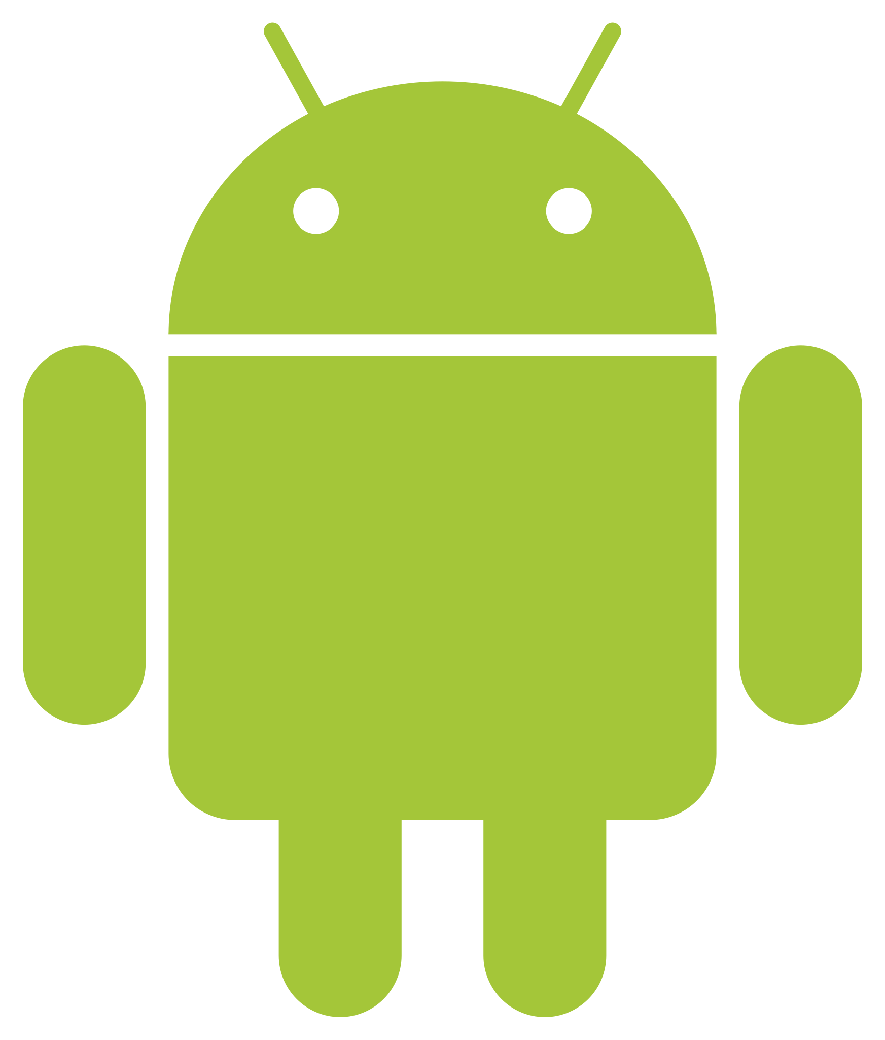
A selective and Restrictive Communication Model Based Mobile Application
Team Members :
SHAWETA KUMARI 21MCMC08
MANVENDER TOPPO 21MCMC19
Project Supervisor: : Prof. Siba K Udgata

Slide 2
Motivation for A Selective and restrictive communication model based mobile application to enable IoT device communications?
The arrival of smartphones and intelligent mapping platforms has put location awareness on human fingertips.
It is an objective of the present work to enable restrictive communications between selective set of authorized users.
We aim to provide a location retrieval and communication device, to record and transmit ambient sounds and voices to the authorized user on demand without intervention of the device user using a specially developed IoT device.

Slide 3
Objectives
Developing the android application “A Selective and restrictive communication model based mobile application to enable IoT device communications”.
To enable restrictive communications between selective and authorized devices using the developed App.
To provide a location retrieval and communication between the IoT device
To record and transmit ambient sounds and voices to the mobile App/ users on demand without intervention of the user of the IoT device
In this work, we developed a smart phone based mobile App as a supplement to an IoT device. This App contact another device (embedded with a GSM module) through its Email Id. This App will contact only one Email Id initially and we also the feature of increasing it to multiple phones/ devices.

Slide 4
Requirement Specifications for Mobile App:
Registration (While setting up the App)
Name
Mail-id
Email id to be contacted
Sending a message to the email
Commands like: LOC, LOC ON, LOC OFF, MIC ON, MIC OFF, AIRQ
(Note: LOC means Location, LOC on means Location On, AIRQ means Air quality)
Capability to receive a message from the predefined email id and decode the message which normally consists of an URL of the locations
Show the location of the device (contact email id) on Google Maps
Storing the log of interactions with the predefined email id.

Slide 5
ANDROID
Android is a Linux-based operating system for mobile devices
such as smart phones and tablet computers.
It is developed by the open Handset Alliance led by Google.
The Android platform includes an operating system based upon the Linux kernel, a GUI, a web browser and end-user applications that can be downloaded.
Although the initial demonstrations of Android featured a generic QWERTY smartphone and large VGA screen, the operating system was written to run on relatively inexpensive handsets with conventional numeric keypads.

Slide 6
Android Development Requirements
JAVA: Java is the programming language that underpins all Android development. For those who have gained most of their programming experience in languages like JavaScript and Ruby, there can be a learning curve when picking up the Java programming language for the first time.
UNDERSTANDING OF XML: XML was created as a standard way to encode data for internet-based mobile applications. It is a structured markup language, sharing many features in common with HTML – you may recognize the angled brackets, the <opening> and </closing> tag types, and the deep nesting of elements.
ANDROID SDK: SDK stands for Software Development Kit, which, though it may conjure up images of a briefcase full of spy tools, is actually just a fancy name for a set of pre-packaged code. The Android SDKs are modules of Java code that give developers access to mobile device functions like the camera and accelerometer.

Slide 7
Android Development Requirements
FIREBASE: Firebase is a Backend-as-a-Service(BaaS) which started as a YC11 startup. It grew up into a next-generation app-development platform on Google Cloud Platform. Firebase (a NoSQLjSON database) is a real-time database that allows storing a list of objects in the form of a tree. We can synchronize data between different devices.
Firebase Real-time Database was the first product of firebase. It is an API which syncs application data across Android, iOS, and Web devices. It gets stored on Firebase's cloud. Then the firebase real-time database helps the developers to build real-time, collaborative applications.

Slide 8
Building block of A Selective and Restrictive Communication Model Based Mobile Application
There are two main building blocks of Selective and restrictive communication model based mobile
Activity
Intents

Slide 9
WORKING FUNCTIONALITIES
This application lets user to say where is he the application says the best way of current location this app contain:-
Registration (While setting up the App)
Name
Mail-id
Email id to be contacted
Sending a message to the email id
Commands like: LOC, MIC ON ,AIR.
7. Show the location of the device on Google Maps

Slide 10
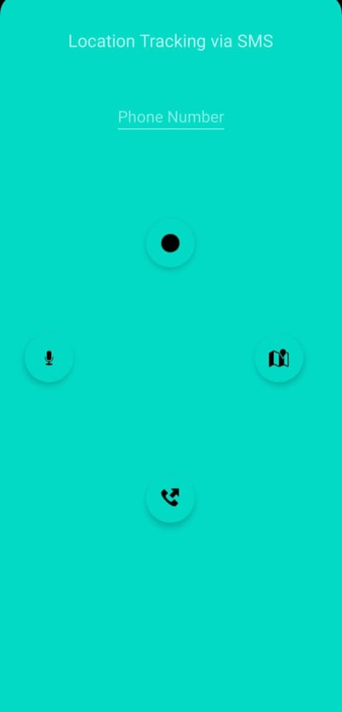
1. Air Quality Index(command)
The AQI is an index for reporting daily air quality. It tells how clean or polluted the air is, and what associated health effects might be a concern, especially for ground-level ozone and particle pollution.
Location tracking via email id
AQI
MIC
LOCATION
2. LOCATION (command)
Show the location of the device(contact phone number) on google maps.
CALL
3.CALL
Calling the phone number
4.MIC
Capability to decode a voice message

Slide 11
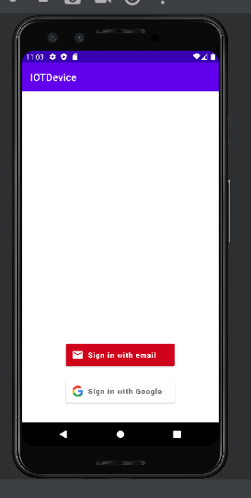
Execution Results of a Selective and restrictive communication Model based mobile application
Register Email id

Slide 12
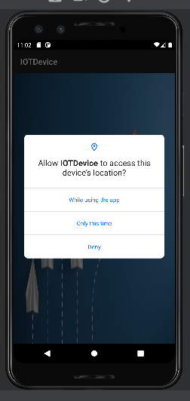
App permission

Slide 13
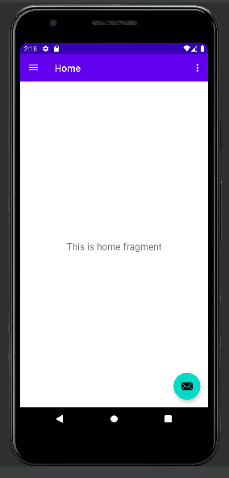
HomeActivity

Slide 14
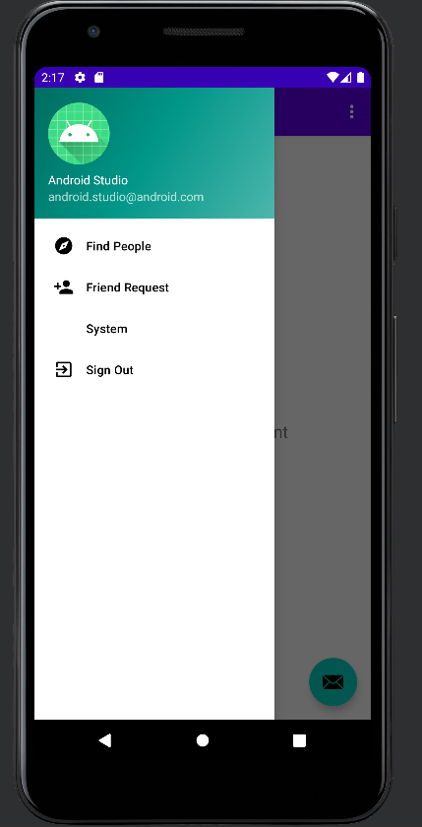
Find email id
Send Request through mail id

Slide 15
Conclusions
We developed a mobile application to act as an interface between the user and the IoT device from the beginning.
The project helped us to know how we connect with real world entities.
Also we became familiar with different technologies, and learnt how to write Android-compatible Application and interact with IOT devices.

Slide 16
Bibliography
Nitin Kumar, “Use of Wireless Access Point ID for position determination”, US Patent, No. US2014/ 0243014 A1, 28th August 2014
Robert Eisenman, “Identification Card holder with personal locator”, US Patent, No. US2016/0240075 A1, 18th August 2016
https://www.javatpoint.com/android-tutorial
https://source.android.com/devices/architecture
https://www.youtube.com/watch?v=HyU4vkZ2NB8&list=PLjVLYmrlmjGdDps6HAwOOVoAtBPAgIOXL
https://www.geeksforgeeks.org/android-tutorial/

Slide 17


