Slide 1






Please respect the following house rules:
Put yourself on mute and turn your camera off.
If you have any questions or comments, please use the chat box during the presentation. Only use the raise your hand button during the Q&A after the talk.
If your connection drops, please leave the meeting and reconnect using the link on the plenary platform.
This talk will be recorded.
Notes:
Voice-over: Please note that we will record this session, so we can distrubute afterwards to the participants.

Slide 2
Explainability of ML models Violeta Misheva, PhD
Notes:
Welcome to this session on Explainability of Machine learning models (or XAI in short). My name is Violeta Misheva and I will be your instructor for this session.

Slide 3
Agenda
What is XAI?
When XAI and when not?
Types of explanations
Explainability in the ML development cycle
Brief review of approaches
The data scientist user journey
XAI applied in Python
Notes:
What’s on the agenda today? I will first define what XAI is. Then I will continue with discussion of reasons for implementing explainability and some scenarios where we should be cautious about it. The next topic is the various types of explainability. Last but not least, we will talk about where XAI fits in the machine learning development cycle and how to do that successfully.

Slide 4
Who is this session for?
Data scientists and analysts, engineers and other practitioners familiar with ML but with little to no knowledge of explainability
Data scientists with some XAI knowledge
For data scientists and practitioners with more experience in the field, hopefully still novel topics: example use journey of a data scientist

Slide 5
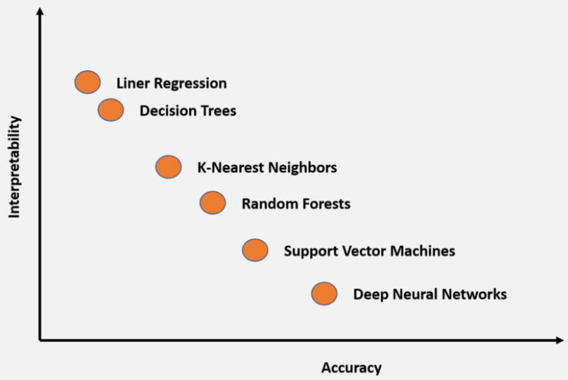
Accuracy-explainability trade-off
Disclaimer: Some research disputes its scientific validity
Notes:
However, there is no free lunch. In general, as you may know simpler and inherently transparent models - such as linear and logistic regression, decision trees- tend to generalize more poorly and thus be less precise - in most contexts, of course, there are exceptions to this. And more complex models such as ensemble-based and deep learning methods tend to perform better but are difficult to explain.

Slide 6
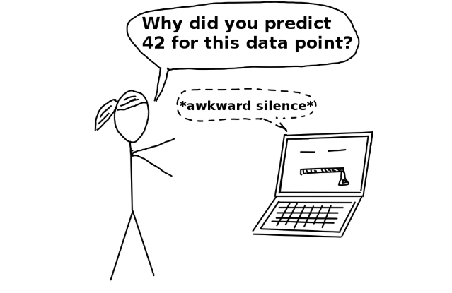
What is explainable ML?
“Methods and models that make the behaviour and predictions of a machine learning model understandable to humans.”
Source: https://christophm.github.io/interpretable-ml-book/terminology.html
Notes:
So let’s dive straight in. What do I mean when I say ‘explainability’ or ‘explainable ML’? These are ‘methods and models that make the behavior and predictions of a machine learning model understandable to humans’. This is not the only definition, of course. In fact, the definition of XAI is more contested than the definition of AI itself. So that’s something to keep in mind.

Slide 7
Explainability vs. interpretability
Intepretable ML: the degree to which a human can understand the cause of a decision (of a model)
Interpertable ML: using a model which is not a black box

Slide 8
Explainability vs. interpretability
Intepretable ML: the degree to which a human can understand the cause of a decision (of a model)
Interpertable ML: using a model which is not a black box
Explainable ML: explaining the decision and behavior of a model post hoc
Explainable ML: using a black box and explaining it afterwards

Slide 9
Why explain ML models?
As ‘challengers’ for strictly regulated models
‘Why was I rejected for a loan?’
Notes:
Why do we want to explain Machine Learning models?
In certain industries, models are limited to being simpler and easier to explain: banking is a case in point where especially in the credit risk domain, the majority of models are limited to linear and logistic regressions. However, if more sophisticated models are explainable enough, they can successfully challenge the standard simpler models; therefore, it is especially important to understand why a model made a certain decision; we want to be able to explain to a customer, for example, why they were rejected for a loan’.

Slide 10
Why explain ML models?
As ‘challengers’ for strictly regulated models
‘Why was I rejected for a loan?’
To increase trust and social acceptance
Notes:
From my experience in working with stakeholder with different backgrounds – depending on their experience with ML models in the past – they might have different level of trust they have in a model. Having a transparent model which makes clear why a model made a certain prediction for a concrete instance, or how our features impact the outcome is a good place to start; It will also increase the social acceptance of machine learning, and laypeople will not be afraid of the opacity of machine-made decisions

Slide 11
Why explain ML models?
As ‘challengers’ for strictly regulated models
‘Why was I rejected for a loan?’
To increase trust and social acceptance
To increase transparency and detection of bias
Notes:
A pure black box model is one which cannot be audited easily because it is not transparent, and often, we cannot detect bias and cannot ensure the opaque model in question is not making a decision, discriminating against a certain population group

Slide 12
Why explain ML models?
As ‘challengers’ for strictly regulated models
‘Why was I rejected for a loan?’
To increase trust and social acceptance
To increase transparency and detection of bias
To increase robustness and reliability of the model
Notes:
A black box model cannot be audited that easily, which means it will be more difficult to detect errors; what we do NOT want is to have a scenario where small changes in the input lead to large changes in the output, and with interpretable models this problem is somewhat minimized;

Slide 13
Why explain ML models?
As ‘challengers’ for strictly regulated models
‘Why was I rejected for a loan?’
To increase trust and social acceptance
To increase transparency and detection of bias
To increase robustness and reliability of the model
Helps data scientists understand their work better (better grasp of the domain, the interaction of the features and the decision-making process of the model)
Notes:
Last but not least, explainability helps data scientists understand and do their job better as they gain more in-depth domain knowledge and build a better understanding on how different features interact with each other, for example.

Slide 14

Why not explainability?
Paradoxically: distrust (if uncovering complex, opaque processes and algorithms)
Notes:
However, explainability should be employed and deployed with caution. There are some good reasons why we may NOT want to explain our models and/or their decisions. Paradoxically, explainability could lead to distrust. And I say ‘paradoxically’ because increased trust in the model was one of the reason to have explainability in a system.
However, if we uncover some complex features, and very opaque processes, stakeholders are not likely to trust the AI system more, but actually less.

Slide 15


Why not explainability?
Paradoxically: distrust (if uncovering complex, opaque processes and algorithms)
Commercial sensitivity and ‘gaming the system’
‘If my transaction behaviour is flagged as suspicious because I sent many small amounts to specific accounts, if I do it more subtly, then I will be fine.’
Notes:
A second and more poignant example is from the domain of fraud detection. For example, we have detected suspicious activity on a client’s bank account. If they are committing fraud, we don’t want to tell them exactly why we suspect that is the case because malicious parties will only use this information to continue their suspicious activities- but in a subtler way.

Slide 16
What is a good explanation?*
Contrastive : why a prediction was made instead of another prediction
Why was my loan application rejected, i.e. what factors should I change to make it successful?
*Robnik-Sikonja and Bohanec (2018), ‘Perturbation-based explanations of prediction models,’ Human and machine learning, Springe. ;
*Interpretable ML by Christoph Molnar
Notes:
What makes an explanation good (at least for humans)? And this is a list with only a few important factors, not an exhaustive one.
First of all, a good explanation is one which is contrastive - or it tells us why a prediction was made instead of another prediction. For example; if we are rejected for a mortgage or a loan, we are interested in what factors should I change to make my successive application successful;

Slide 17
What is a good explanation?*
Contrastive : why a prediction was made instead of another prediction
Why was my loan application rejected, i.e. what factors should I change to make it successful?
Selective: a list of important drivers that explain an outcome
*Robnik-Sikonja and Bohanec (2018), ‘Perturbation-based explanations of prediction models,’ Human and machine learning, Springe. ;
*Interpretable ML by Christoph Molnar
Notes:
Second, a good explanation is one that is selective.
Selective has to do with the fact that even with a complex event, humans usually are interested in knowing the main drivers of an outcome; we cannot process how the 300 features we might have in the model contribute to the prediction, and/or how they interact with each other. Thus even if we have a transparent model such as a linear or a logistic regression or a decision tree, but we have many features in the model, and assuming we also have domain knowledge in an area - we can still understand how a few of the features impact the target and interact with each other.

Slide 18
What is a good explanation?*
Contrastive : why a prediction was made instead of another prediction
Why was my loan application rejected, i.e. what factors should I change to make it successful?
Selective: a list of important drivers that explain an outcome
Consistent with prior beliefs: in accordance with intuition; in other words it is believable for the receiver of the explanation
*Robnik-Sikonja and Bohanec (2018), ‘Perturbation-based explanations of prediction models,’ Human and machine learning, Springe. ;
*Interpretable ML by Christoph Molnar
Notes:
Last but not least, a good explanation is one that is in accordance with prior beliefs. There is a term for that and it is called ‘confirmation bias’. People tend to disbelief explanations that do not agree with their beliefs.

Slide 19
What is a good explanation?*
Social : part of the conversation between the explainer and the receiver of the explanation
Various users of the model/system will need various level of detail in the explanations
*Robnik-Sikonja and Bohanec (2018), ‘Perturbation-based explanations of prediction models,’ Human and machine learning, Springe. ;
*Interpretable ML by Christoph Molnar

Slide 20
What is a good explanation?*
Social : part of the conversation between the explainer and the receiver of the explanation
Various users of the model/system will need various level of detail in the explanations
Focus on the abnormal: humans focus on abnormal causes to explain events
Include abnormal features in the explanation (even if rare)
*Robnik-Sikonja and Bohanec (2018), ‘Perturbation-based explanations of prediction models,’ Human and machine learning, Springe. ;
*Interpretable ML by Christoph Molnar

Slide 21
What is a good explanation?*
Social : part of the conversation between the explainer and the receiver of the explanation
Various users of the model/system will need various level of detail in the explanations
Focus on the abnormal: humans focus on abnormal causes to explain events
Include abnormal features in the explanation (even if rare)
General and probable: if it can explain many events
In the absence of an abnormal event, a general event is considered a good explanation
*Robnik-Sikonja and Bohanec (2018), ‘Perturbation-based explanations of prediction models,’ Human and machine learning, Springe. ;
*Interpretable ML by Christoph Molnar

Slide 22
Types of explainability
Intrinsic methods (restricting the complexity of the model) and post-hoc (after the model training)
Notes:
When it comes to explanations, what can we actually explain?
We can differentiate between intrinsic and post-hoc methods. Intrinsic methods have to do with limiting the complexity of the model or features before the model training. Post hoc methods are applied after the model has been built.

Slide 23
Types of explainability
Intrinsic methods (restricting the complexity of the model) and post-hoc (after the model training)
Model-specific (limited to specific classes of models) and model-agnostic(can be used on any model)
Notes:
We can also distinguish between model-specific and model-agnostic methods. Model-specific focus on explaining the decisions and behavior of certain classes of models. For example, there are many approaches focused on explaining deep learning models. And there are model agnostic methods, which can be applied to any class of a model.

Slide 24
Types of explainability
Intrinsic methods (restricting the complexity of the model) and post-hoc (after the model training)
Model-specific (limited to specific classes of models) and model-agnostic(can be used on any model)
Local (explain an individual prediction) or global(explain the whole model behavior)
Notes:
Last but not least, there are local and global methods. Local methods explain how the model reached a decision for any instance. Global approaches explain the overall model behavior.

Slide 25
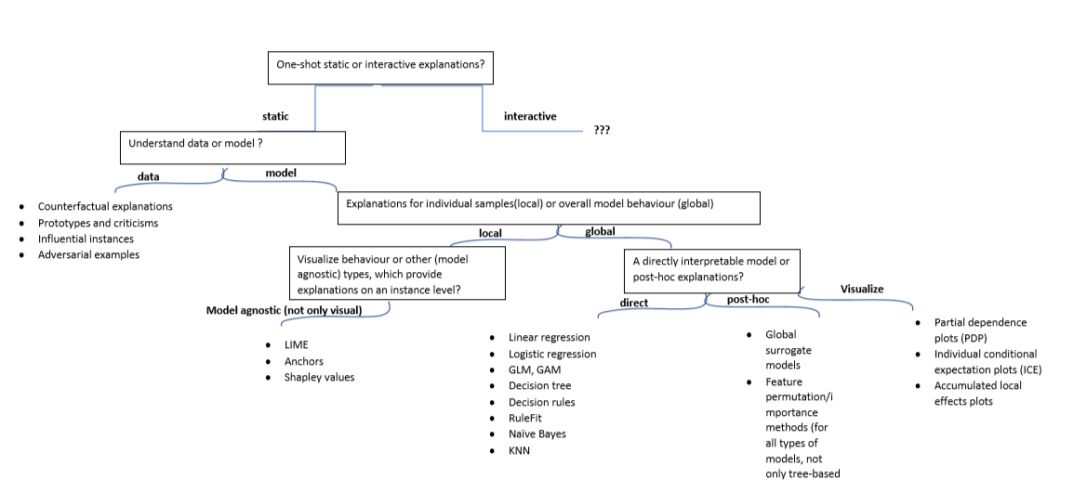
XAI taxonomy/flowchart
Notes:
Here is a flowchart, or a taxonomy, I designed with the various approaches. It’s not an exhaustive chart but it contains the most important and popular current methods. For instance, we see depending on what we want explained - the data or the model- and if the model - then we have options provided whether we want a global or a local explanation. This tool is handy to keep in mind and have when having conversations with your stakeholders and when we want to understand their needs and requirements in terms of explainability.

Slide 26
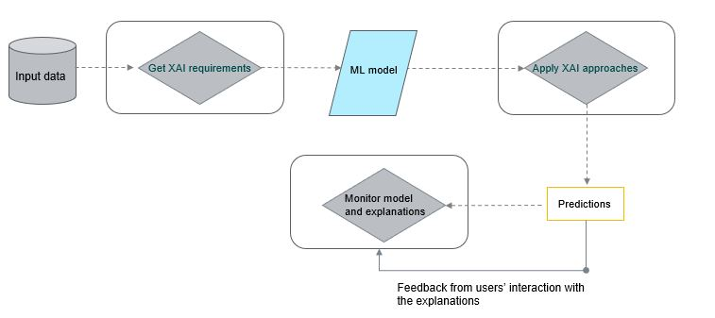
Notes:
Where does XAI fit into the standard Machine learning development cycle? Say we have a clear business problem already and have collected the data. The next - before we go into development of the model - is to get the XAI requirements of all the stakeholders. Depending on the use case and context, there could be various stakeholders. Common stakeholders are the technical teams, training the models; the business team or lead who accept the risks of the AI system, we may have legal, compliance, privacy, audit teams. In some industries we have external regulating parties. There could be clients/consumers of a product or a service who are being evaluated or advised by the model. It could be that each stakeholder may demand different type of explainability approach or a combination of approaches.
Then we train a ML model. The next step is apply the XAI approaches that have been selected in the first step. And let’s assume the model has been deployed in production. Then we collect the predictions from the model and monitor the model and the explanations. We also collect feedback from the users’ interaction with the explanations. However, I need to stress that there are currently not many monitoring requirements for explainability approaches. It’s an active area of research. Another note is that it is not easy to select a most appropriate explanation methods, as there are not many evaluation metrics of XAI. But it’s a very active area of research, so I hope we see some solid quantitative measures which allows such comparison.

Slide 27

Important takeaways
First important requisite task is to define the explainability needs and requirements of different stakeholders (if there are any, transparency not applicable in all scenarios)
Notes:
That was a lot of information, so let me reiterate it in a few key takeaways. First of all, it’s super important to define the needs and XAI requirements of different stakeholders (if there are any, as explainability is not a requirement in every single use case).

Slide 28
Important takeaways
First important requisite task is to define the explainability needs and requirements of different stakeholders (if there are any, transparency not applicable in all scenarios)
Integrate it as early as possible in the development process (should not be an ‘afterthought’)
Notes:
Second, it’s important to integrate XAI as early as possible in the development process (it should never be an ‘afterthought’ because if it is, it will most certainly not be done properly, or could mean we need to completely scratch off the algorithm we have trained and build a completely new one).

Slide 29
Important takeaways
First important requisite task is to define the explainability needs and requirements of different stakeholders (if there are any, transparency not applicable in all scenarios)
Integrate it as early as possible in the development process (should not be an ‘afterthought’)
One can provide different levels of explanation depending on the context, needs and end-user (one explanation for credit risk manager, a different one for a client, a third for a technical team)
Notes:
Thirdly, one can provide different levels of explanation depending on the context, needs and end-user (so we’d provide one explanation for a risk manager, another for a client, a third one for a technical team, etc.)

Slide 30
Important takeaways
First important requisite task is to define the explainability needs and requirements of different stakeholders (if there are any, transparency not applicable in all scenarios)
Integrate it as early as possible in the development process (should not be an ‘afterthought’)
One can provide different levels of explanation depending on the context, needs and end-user (one explanation for credit risk manager, a different one for a client, a third for a technical team)
A combination of methods could be provided, it’s not either/or
Notes:
Last but not least, a combination of methods could be provided, it’s not either/or

Slide 31
No one-size-fits-all approach, it’s a process rather than single product
Notes:
When it comes to explainability, it’s much more of a process, than a one-size-fits-all process.

Slide 32





A word of caution on interpretable models
Total area
House sale price
Total number of rooms
Notes:
Before I show you some possible explanations, let me introduce a use case. Imagine we want to predict the sale price of a house and some of the features we may have are the total area of the house and the total number of rooms. Now imagine we have a linear regression to predict the sale price of a house.
With a linear regression, the effect of the features on the target is explained by the coefficient of the features, holding everything else the same. However, that assumption is not very realistic. It’s difficult to imagine that the square meters will increase from 40 to 200 square meters, for example, and the total number of rooms will stay the same or vice versa.

Slide 33
Rulefit
Creates new features (in the form of decision rules) and builds a transparent model using these features
Example in the paper (Boston median house prediction):
IF number of rooms > 6.64 AND concentration of nitric oxide <0.67 THEN 1 ELSE 0

Slide 34
Rulefit
Creates new features (in the form of decision rules) and builds a transparent model using these features
Example in the paper (Boston median house prediction):
IF number of rooms > 6.64 AND concentration of nitric oxide <0.67 THEN 1 ELSE 0
In the first step, the algorithm trains a tree-based model predicting the target and uses it to create these decision rules (Result: many rules, not all informative)
Second step: train a sparse linear model, such as a LASSO to select among the original and newly created features.

Slide 35
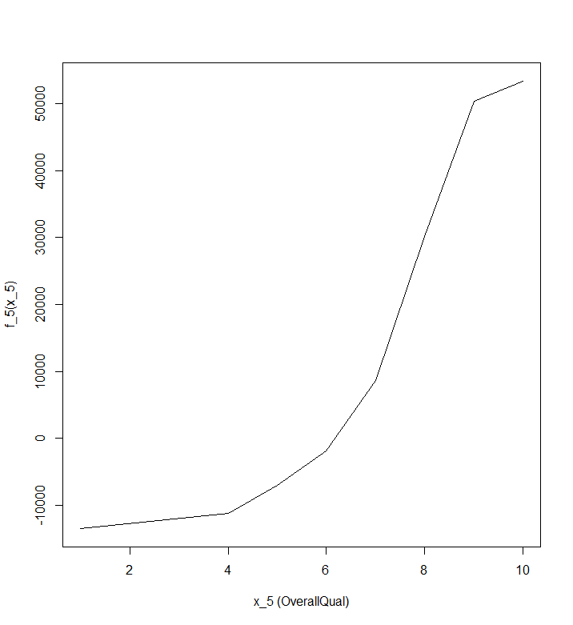
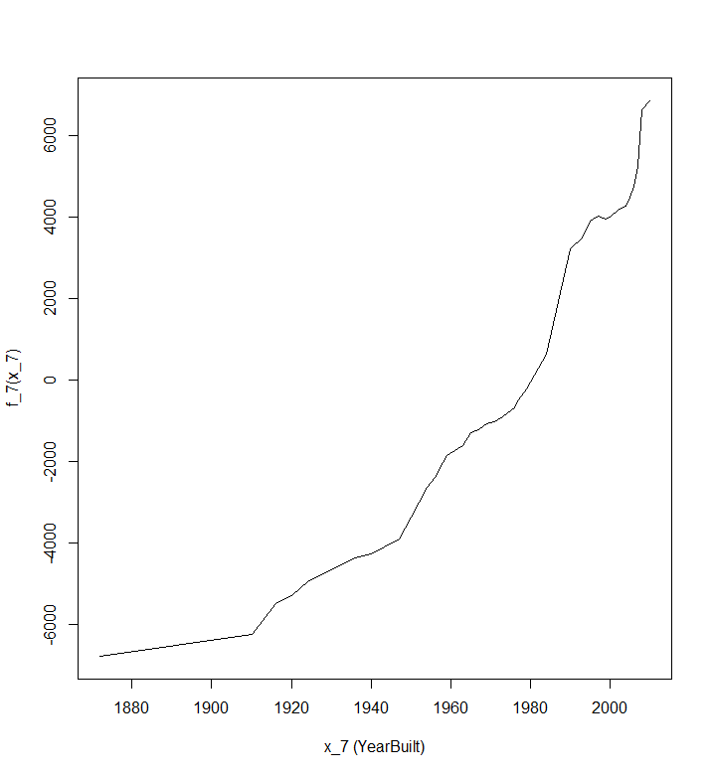
Example explanations: Visual approaches: ALE plots
Value at each point of the plot: difference to the mean prediction
Notes:
ALE plots: Accumulated local effects. If features are correlated or dependent, some better known approaches such as PDPs are less reliable. ALE plots calculate – based on conditional prob of features – differences in predictions instead of averages
Example: the effect on prices of a house of size 30m^2, ALE uses houses with that size, gets the model predictions pretending they were 31m^2 minus the prediction pretending they were 29m^2
They are similar to PDP plots and show us how the model predictions change in a small ‘window’ of the feature for data instances in that window
PDPs: shows what the model predicts on average when each data instance has the value v for that feature, ignoring whether the value v makes sense for all instances
intuitively ALEs can be interpreted as the main effect of the feature at a certain value compared to the average prediction of the data; for example, an ALE of -2 at xi =3 means that when the i-th feature has a value of 3, then the prediction is lower by 2 compared to the average prediction

Slide 36
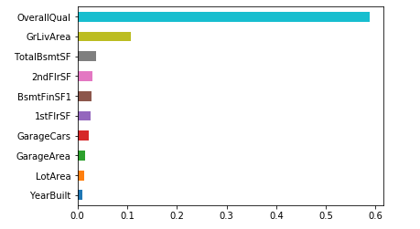
Example explanations: Global explanations
Notes:
A second example is of a global feature permutation method, which you may have seen after any tree-based model. You can obtain such a plot with any other model though, not limited only to tree-based ones. Here I have plotted the top 10 most important features after a random forest model. How it works is that you permute the value of a feature and measure the model error as you do so. If permuting a feature results in high model error, then the feature of interest is important.

Slide 37
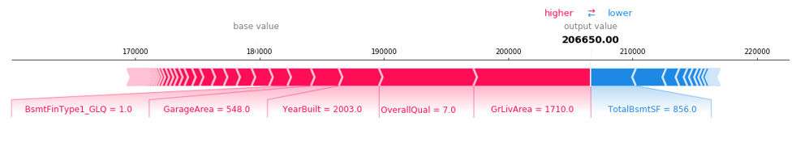
Example explanations: Local explanations
Notes:
Last but not least, a quick example of a local explanation. Remember that local explanation explain the decision of the model for each instance in the data. The method showed here is the so-called Shapley values. It plots the first instance in the data. The number we see are the concrete feature values for this instance. We see that it’s overall quality is 7, it was built in 2003 and so forth. The base value in the top is the average prediction across the data. The output value is the predicted sale price for this particular house. Shapley values show how much each feature pushes the instance prediction to be higher or lower than the base prediction. And features colored in red push the predicted price higher, those colored in blue, push it lower.

Slide 38
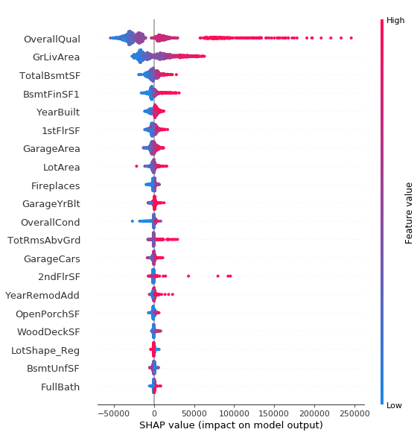
Notes:
This plot shows the SHAP values of every feature for every sample. It sorts features by the sum of SHAP value magnitudes over all samples, and uses SHAP values to show the distribution of the impacts each feature has on the model output. The color represents the feature value (red high, blue low). This reveals for example that a high overall quality increases the predicted sale price.

Slide 39
Shapash
Open-source web app that allows for and incorporates multiple explanation types
The authors claim it is easy to integrate in production and complete every prediction with an explanation summary
It can work for both regression and classification problems
Computes feature contributions with Shap or LIME backend

Slide 40
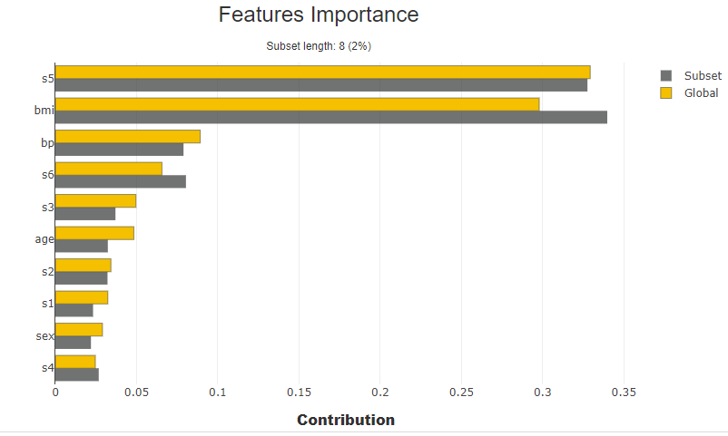
Shapash: example plots
Notes:
Here we see the overall feature importance (in yellow); and in grey, I have provided a subset of features which I want to have explained. We can thus compare if we’d like the overall feature importance and the feature importance in a subset of interest

Slide 41
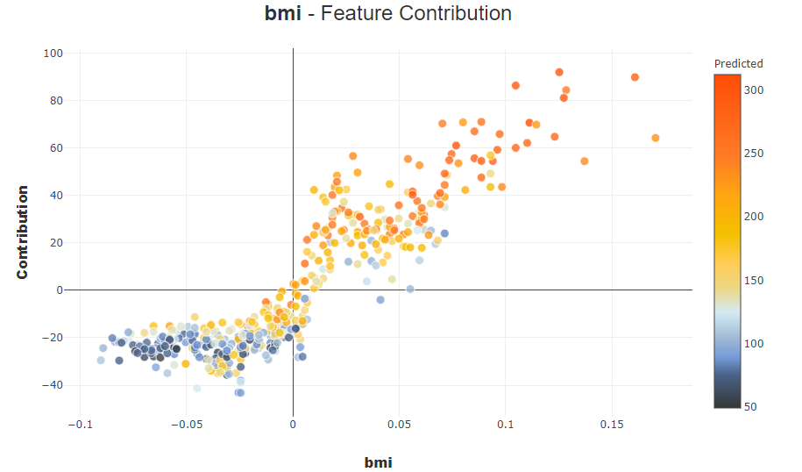
Shapash: example plots
Notes:
IN this plot, we see the contributions for a feature of interest. Each dot is an instance in the dataset. For continuous variables, we see a scatter plot, for categorical, we will see a violin plot.

Slide 42
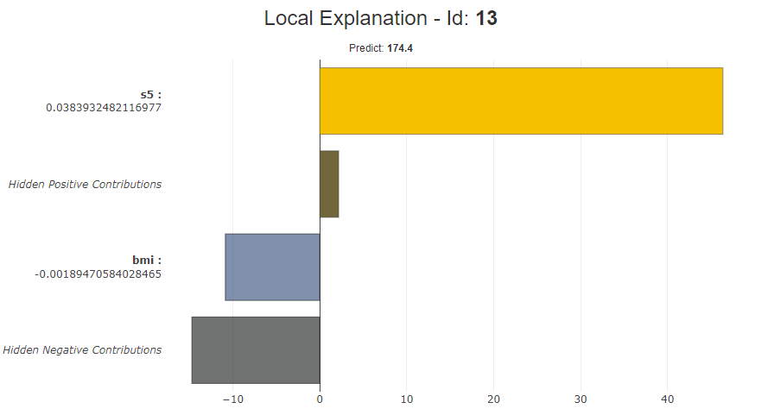
Shapash: example plots
Notes:
IN this plot, we see the contributions for a feature of interest. Each dot is an instance in the dataset. For continuous variables, we see a scatter plot, for categorical, we will see a violin plot.

Slide 43
Find more details
https://www.udemy.com/course/xai-explain-ml-models/learn/lecture/22390048#overview
https://aiplus.odsc.com/courses/hands-on-machine-learning-explainability
Notes:
Going through the technical details on how each methods works and how to apply it in Python is out of scope for this session. But if you want to know more about any of the approaches I talked about here today, you can do so either by going to the Udemy course, of checking my GitHub repository which I link here.

Slide 44
How to pick the right explanation?
A data scientist’s user journey
Goal: Predict whether we should grant a client a loan (i.e. likelihood of default)
Option 1: Inherently transparent model
Option 2: ‘Black box’ model and explain it with a post-hoc method

Slide 45

How to pick the right explanation?
A data scientist’s user journey
Many of the examples come from this paper:

Slide 46
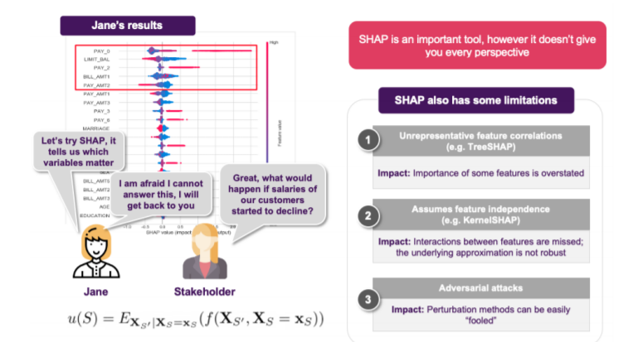
Start with Shapley values

Slide 47
What if many, many features in the model?
Perhaps explore LIME (specify X number of features for each explanation)

Slide 48
What if many, many features in the model?
Perhaps explore LIME (specify X number of features for each explanation)
Stick to Shapley but again select top X number of features per instance

Slide 49
What if many, many features in the model?
Perhaps explore LIME (specify X number of features for each explanation)
Stick to Shapley but again select top X number of features per instance
Beware that with many features, higher likelihood of dependence (and permutation-based methods less reliable)

Slide 50
What if many features related to a factor/characteristic
Feature selection
Feature agglomeration (merges together similar features)
Dimensionality reduction: PCA, select only features correlated with the component of interest
Notes:
In some scenarios, you may have many features related to a similar measure or a factor. For example, in transaction monitoring, you may have features for the number of daily transactions, the min and max volume on a daily level per client, etc. You may have other features for the relationship between say the client and the bank, a group of features for network of the client, etc. It could very well be that all features with highest Shapley values are related to one of this groups. A fraud analyst may want to look at a number of groups of features.
There are multiple ways to address this. First of all - and following best data science practices - we may want to spend more time on feature selection and eliminate redundant features.
Second of all, we may consider feature agglomeration - which merges together similar features. This technique is similar to clustering, but we are clustering the transposed data

Slide 51
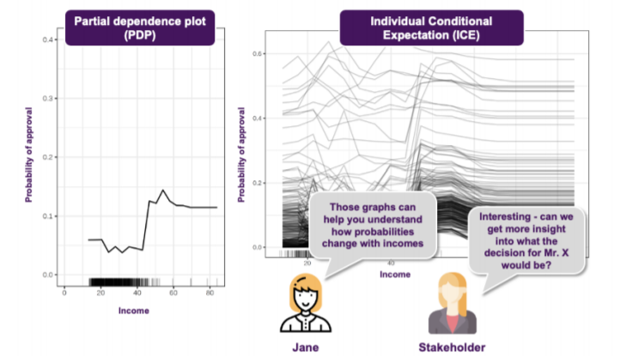
Explore predictions with a feature of interest
Notes:
Visual approaches, such as ICE and PDP plots can be quite helpful in getting more insight between the model’s behavior and a feature of interest. For example, if we want to know how the predictions will move with the income of clients, we can explore such visualizations.

Slide 52
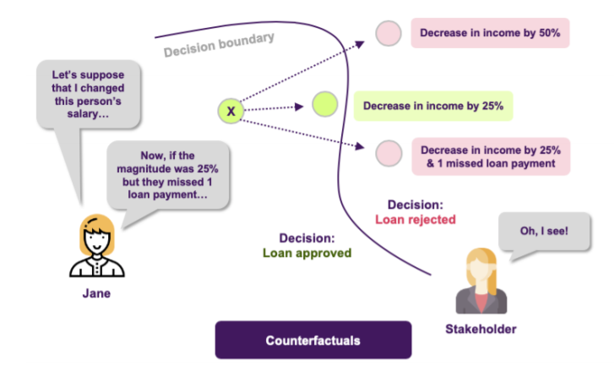
What should I change to make my next application successful?
Notes:
Let’s say we have rejected a client for a loan. The loan officer or relationship manager may want to explain to the client what they need to change to make their next application successful. Or just more broadly, they may want to know what will happen with a model’s prediction for a client if we change some of their factors. Here is where counterfactual explanations can be very handy. They show the minimum amount of change in factors needed, so that we have observe a different outcome.
One downside though is the so-called ‘Rashmonoff effect’: there could be quite many possibilities that result in a change in the prediction and often it’s difficult to choose between the many possibilities.

Slide 53
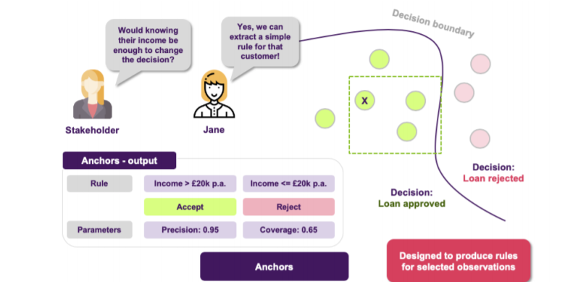
Produce rules for observations
Notes:
We can also produce rules for certain observations using Anchors. They find simple and short ‘if-then-else’ rules. They aim to find rules which apply to many observations (so, they have high coverage) but also rules that are precise. They should help us answer the following question, for example: ‘Would knowing their income be enough to change the decision’?

Slide 54
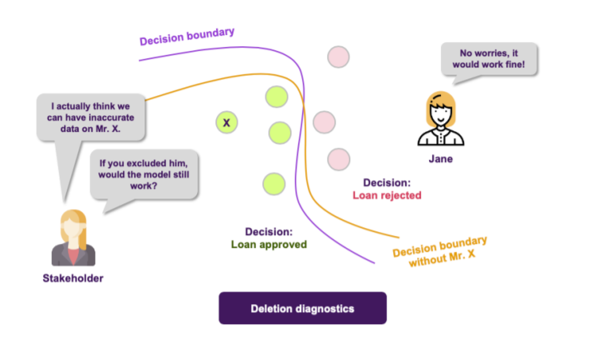
Influential instances
Notes:
To test the robustness of a model, we may perform deletion diagnostics, where we delete certain features and check how well the performance of the model holds up.
The idea of influential instances is similar but we look at single instances and not features. It allows us to detect which observations are very important for the decision boundary of the model, or what happens if we drop a certain observation. This helps us build a better picture of the model’s reasoning and its robustness. It can be a bit computationally taxing though with large datasets.

Slide 55
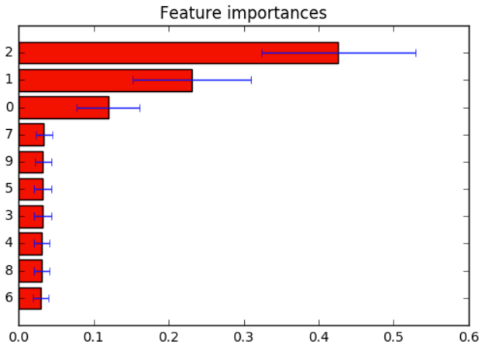
Which features matter for all(many) customers?
Notes:
We may want to get an insight into the model’s global behavior. One favorite approach of data scientists is to utilize feature importances after a decision-tree based model. One novel thing to know is that we can calculate such permutation-based feature importances after any type of a model, not only tree-based models. Here is an example of a feature importance plot in the case of loan application.

Slide 56
Focusing just on a single stakeholder, we see picking explanations to provide the right answers can be quite a long process

Slide 57
Focusing just on a single stakeholder, we see picking explanations to provide the right answers can be quite a long process
Similar conversations with other stakeholders

Slide 58
Focusing just on a single stakeholder, we see picking explanations to provide the right answers can be quite a long process
Similar conversations with other stakeholders
No single and easy way out (i.e. only Shap may not be sufficient on its own)

Slide 59
Challenges in explainability
Difficult to quantitatively assess and compare different methods
Lack on understanding on validity and monitoring of explanations
Lack of user control of the explanations
Often, difficult to collect and provide feedback to the explanations
In organizations, difficult to align all the numerous stakeholders and find the most suitable approach for them
Post-hoc explanations can be misleading (not always reflected)

Slide 60

Github link : https://github.com/VioletaMisheva/DSFC_XAI_workshop

Slide 61
Thank you for your attention!
Feel free to reach out.
Q&A

Slide 62
Appendix
Explore more XAI methods

Slide 63
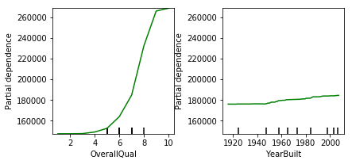
Visual explanations: Partial dependency plots
Notes:
Partial dependency plots show:
The average marginal effect of a feature on the target
It shows whether the relationship between the feature and the target is linear, monotonous or more complex
A main assumption is that the features not included in the PDP are NOT correlated with the one included

Slide 64
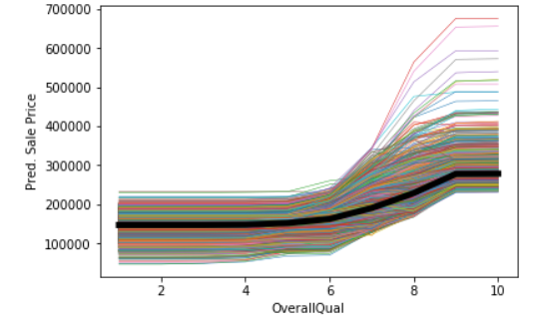
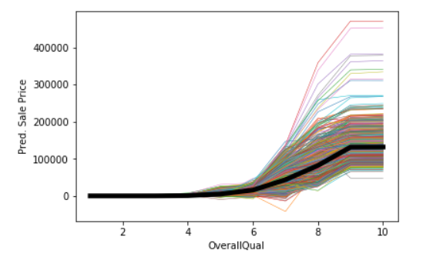
Visual explanation: ICE plots
Standard ICE plot
Centered ICE plot
Notes:
Similar to PDPs are ICE plots, or individual conditional expectations. I have predicted the sale price of a house using a random forest regression model. I then constructed an ICE plot for the most important feature - Overall Quality. It is measured on the scale from 1 to 10 where 10 means the highest quality possible. On the left side, I have a standard ICE plot. What we see is one line per instance in the data. And it shows the effect of a feature of interest on the target. However, the left plot is a bit difficult to read, so you want to center it, which is what we see on the right plot. We have ensured that all values start from the same zero level.
How PDP plots work is that values of a line (and one instance) can be computed by keeping all other features the same, creating variants of this instance by replacing the feature’s value with values from a grid and making predictions with a black box model of choice for these newly created instances.
PDPs are like an average of all ICE lines since PDP shows average effect of a feature; thus ICE’s have an advantage over PDPs that they show heterogenous effects;

Slide 65

Example explanations: Global surrogate
An interpretable model trains to explain a ‘black box’ model
It’s a model-agnostic approach
Trains an interpretable model on the dataset of choice and the predictions of the black box model
Keeps track of how well the new model replicates the predictions of the black box model
Notes:
It does not require information about the black box model itself, only access to the data and the predictions made by the black box model..

Slide 66
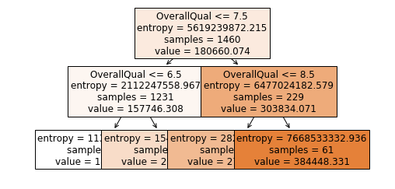
DT surrogate after a RF regressor
R-squared = 0.6985
Notes:
The prediction of a decision tree built as a surrogate of a random forest model. The default is a tree of max depth of 2 in order to improve interpretability.
In this case, the tree uses only the overall quality to make a split and splits the predictions by it.
In this case, the surrogate decision tree model has an R-squared of around 0.7 (which means it has a relatively high variance explained), so it approximates the underlying black box model relatively well but it’s also questionable what is relatively well.

Slide 67
Local interpretable model-agnostic explanations (LIME)
Explains individual predictions
LIME: 1 ) generates a new dataset of permuted samples and corresponding predictions of the black box model; 2) trains an interpretable model on the new dataset, weighted by the proximity of the sampled instances to the instance of interest;
The interpretable model should be a good LOCAL approximation but not a global one
In most implementations, need to select number of features in the surrogate model
Notes:
With tabular data, LIME samples are not taken from around the sample but from the training data’s mass center.
LIME currently uses an exponential smoothing kernel to define the neighbourhood around a point.

Slide 68

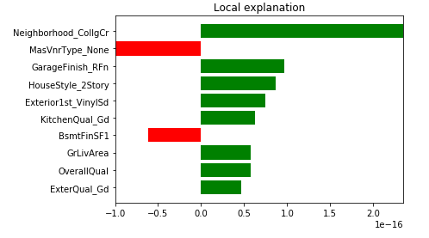
Notes:
This graph shows the LIME explanations for the first instance in the dataset. We see the contribution of the top 10 features and which features have positive and which negative effects for each of the instances. The features will look different for the second instance in the dataset, though. Here note as well that red means negative effect and green means a positive effect.
One difficulty is that you need to also select the number of features to include in your explanation;

Slide 69
Advantages:
You can replace the black box model and still use the same local interpretable model
Can provide short, human-friendly explanations
The explanations can use other features than the model
Disadvantages:
Definition of the neighbourhood still not a solved problem
Sampling could also be improved (correlation between features ignored)
Notes:
LIME though providing human-friendly approach, is not appropriate in compliance scenarios where you might need to provide a full explanation (the LIME explanations are short and selective).
The last point can be a big advantage in cases where other features cannot be interpreted.
There is currently no best way to find the neighbourhood for each instance. The best one can do is try different kernel settings and see whether the explanations make sense.
In current packages, sampling is done from a Gaussian distribution and the correlation between features is ignored.
DIFFERENCES b/n LIME and Shapley: Lime is inherently local whereas Shapley decomposes the prediction into the contribution of each features.

Slide 70
Anchors
Designed by the authors of LIME
Work on an instance level
Can be used with tabular data, text and images
They work with classification problem only
An anchor is a rule that sufficiently ‘anchors’ the prediction locally – such that changes to the rest of the feature values of the instance do not matter; for instances on which the anchor holds, the prediction is (almost) always the same.

Slide 71

Anchors
Example anchor for the first instance in the data set

Slide 72
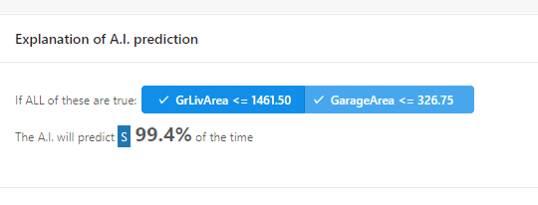
Anchors
Example of a snippet of interactive explanation for the first instance

