Slide 1
A100 Architecture

Slide 2
CUDA core

Slide 3
FLOPS
Arithmetic Intensity

Slide 4
N
CUDA core v0: naive
blockDim: (16, 16)
1 thread responsible for 1 output element
1 output element takes (2*K) global memory read
1 output element takes (0) shared memory read
K
K
Matrix B
M
TFLOPS: 2.41 / 18.38= 13.11%
Matrix A
Matrix C
Arithmetic Intensity:
2K / (2K * sizeof(float)) = 0.25 FLOP/byte

Slide 5
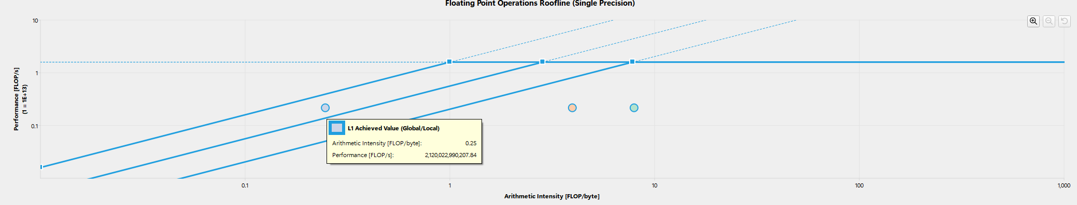
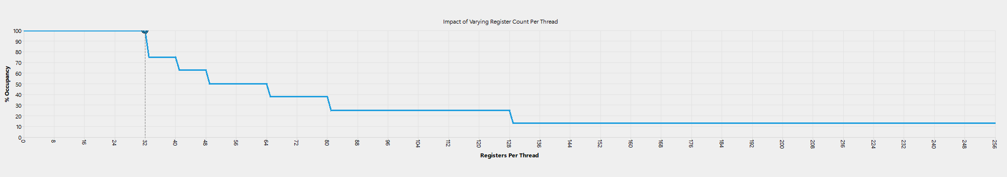
Roofline for v0
Occupancy: 100%, Occupancy Limiter: None

Slide 6
blockTileN
N
CUDA core v1: block tile
blockDim: (16, 16)
blockTileCDim/blockTileDim: (16, 16)
blockTileADim: (16, 16)
blockTileBDim: (16, 16)
blockTileK
1 thread responsible for 1 output element
1 output element takes (2*K / blockTileK) global memory read
1 output element takes (2*K) shared memory read
K
Matrix B
blockTileK
K
blockTileM
M
TFLOPS: 4.517 / 18.38 = 24.54%
Arithmetic Intensity(Global):
2K / (2K / TileK * sizeof(float)) = 4 FLOP/byte
Matrix A
Matrix C
Arithmetic Intensity(Shared):
2K / (2K * sizeof(float)) = 0.25 FLOP/byte

Slide 7
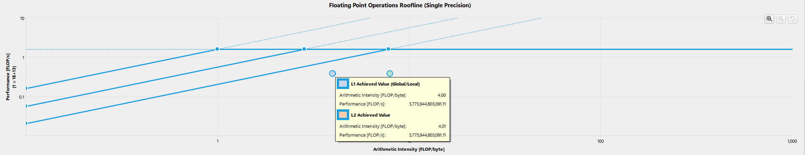
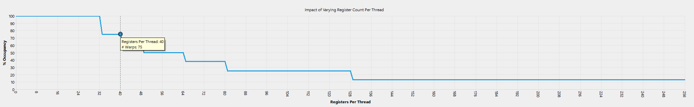
Roofline for v1
Occupancy: 75%, Occupancy Limiter: Registers Per Thread

Slide 8
blockTileN
N
CUDA core v2: block tile + corsen
blockTileK
blockDim: (16, 16)
blockTileCDim/blockTileDim: (16, 16)
blockTileADim: (16, 16)
blockTileBDim: (16, 16)
1 thread responsible for 4 output element
4 output element takes (4*K / blockTileK) global memory read
4 output element takes (4*K) shared memory read
K
Matrix B
blockTileK
K
blockTileM
M
TFLOPS: 8.774 / 18.38 = 47.73%
Arithmetic Intensity(Global):
(4 * 2K) / (4K / TileK * sizeof(float)) = 8 FLOP/byte
Matrix A
Matrix C
Arithmetic Intensity(Shared):
(4 * 2K) / (4K * sizeof(float)) = 0.5 FLOP/byte

Slide 9
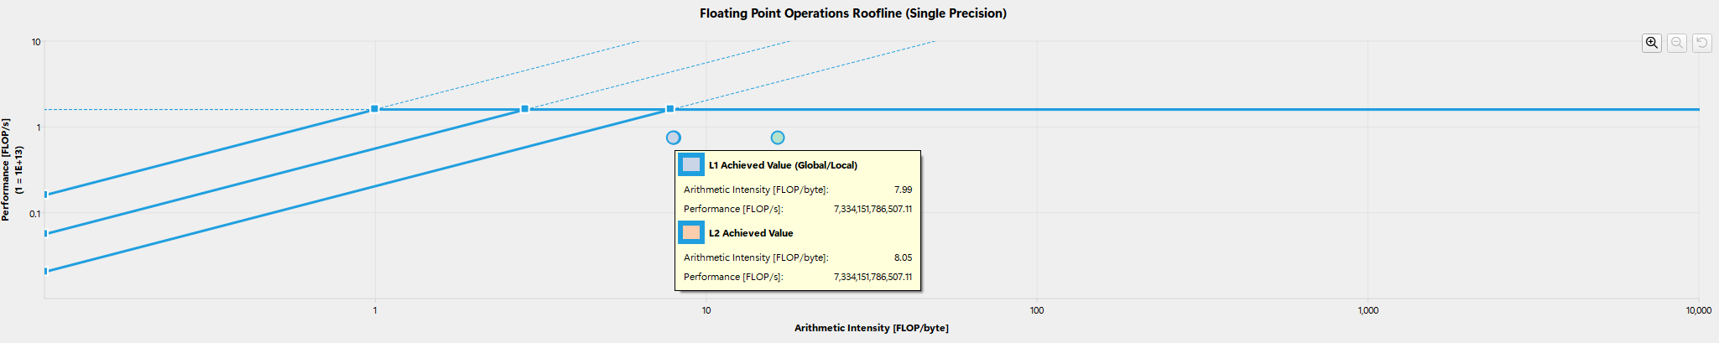
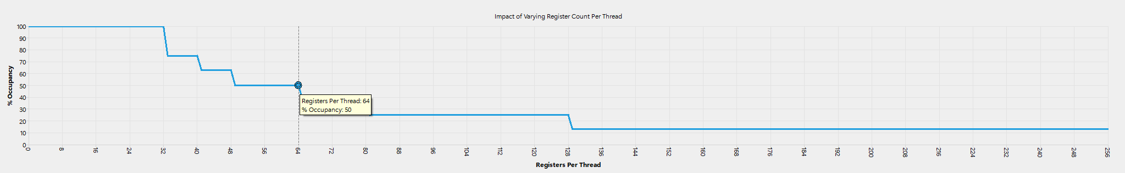
Roofline for v2
Occupancy: 50%, Occupancy Limiter: Registers Per Thread

Slide 10
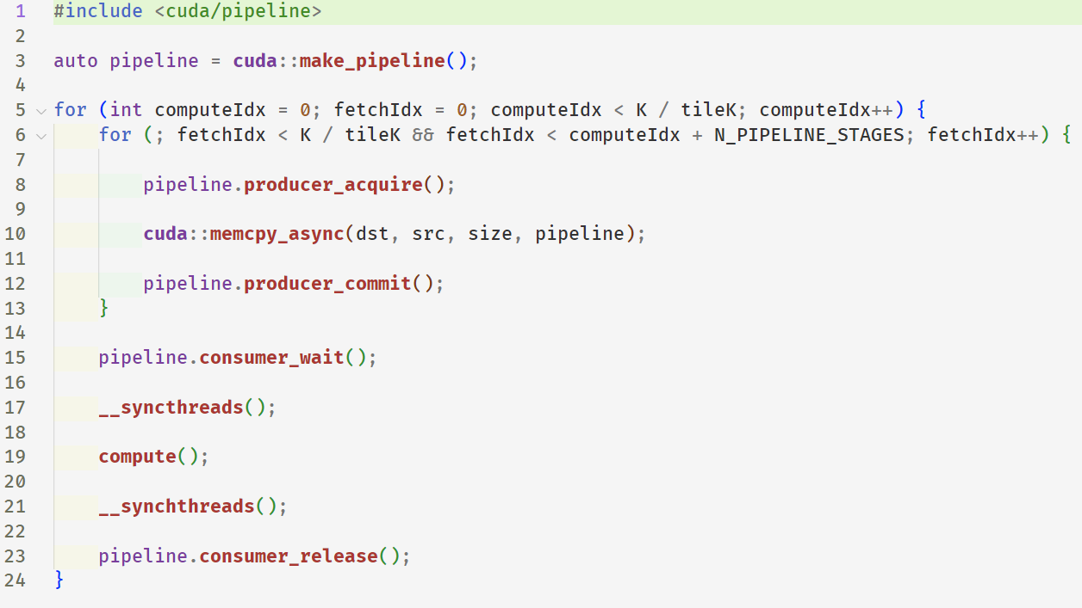
CUDA core v3: block tile + corsen + pipeline

Slide 11
blockTileN
N
blockTileK
blockDim: (16, 16)
blockTileCDim/blockTileDim: (16, 16)
blockTileADim: (16, 32)
blockTileBDim: (16, 32)
K
computeIdx
fetchIdx
K
Matrix B
blockTileK
blockTileM
M
TFLOPS: 9.094 / 18.38 = 49.47%
Arithmetic Intensity(Global):
(4 * 2K) / (4K / TileK * sizeof(float)) = 16 FLOP/byte
Matrix A
Matrix C
Arithmetic Intensity(Shared):
(4 * 2K) / (4K * sizeof(float)) = 0.5 FLOP/byte

Slide 12
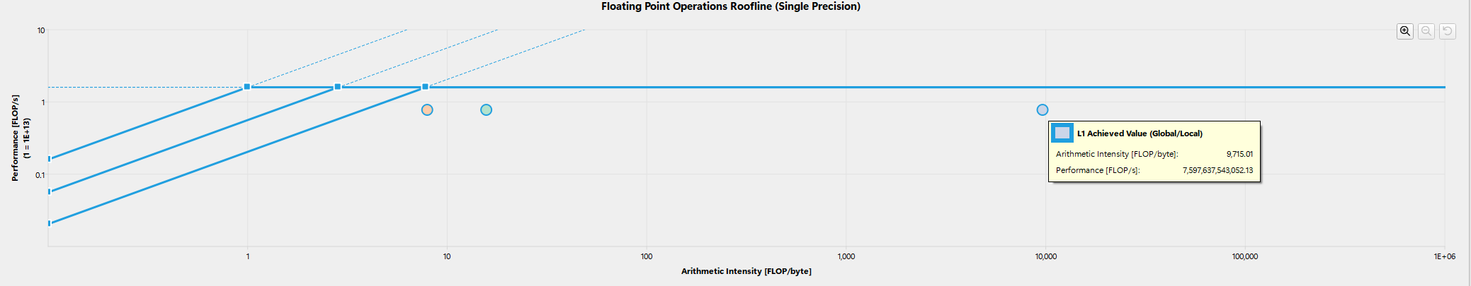
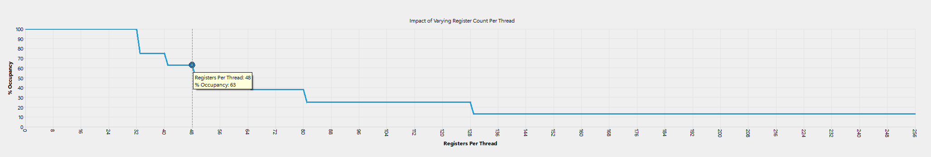
Roofline for v3
Occupancy: 63%, Occupancy Limiter: Registers Per Thread

Slide 13
blockTileN
N
CUDA core v4: block tile + thread tile
blockDim: (16, 16)
blockTileDim: (128, 128)
threadTileDim: (8, 8)
blockTileADim: (128, 8)
blockTileBDim: (128, 8)
threadTileADim: (8, 8)
threadTileBDim: (8, 8)
(based on v1)
blockTileK
1 thread responsible for 64 output element
64 output element takes (2*K / blockTileK) global memory read
K
(each time, read (blockTileSize / threadNum) = (128 * 8 * 2 / 256 ) = 8 elements)
Matrix B
blockTileK
K
blockTileM
M
TFLOPS: 12.129 / 18.38 = 65.94%
Arithmetic Intensity(Global):
(64 * 2K) / (2K / TileK * 8 * sizeof(float)) = 16 FLOP/byte
Matrix A
Matrix C

Slide 14
threadTileN=8
threadTileN
blockTileN
i-j-k-loop:
blockTileK=threadTileK=8
threadTileK
Block Tile B
threadTileM=8
threadTileM
1 output element takes (2* threadTileK) shared memory read
blockTileM
threadTileN
k-i-j-loop:
threadTileK
threadTileM
Block Tile C
Block Tile A
(threadTileM * threadTileN) output element takes
(threadTileM + threadTileN) * threadTileK shared memory read

Slide 15
threadTileN
i-j-k-loop:
1 output element takes (2* threadTileK) shared memory read
threadTileK
Arithmetic Intensity:
(2 * threadTileK) / (2 * threadTileK * sizeof(float)) = 0.25 FLOP/byte
threadTileM
threadTileN
(threadTileM * threadTileN) output element takes
(threadTileM + threadTileN) * threadTileK shared memory read
k-i-j-loop:
threadTileK
Arithmetic Intensity:
(threadTileM * threadTileN) * 2 * threadTileK /
((threadTileK + threadTileN) * threadTileK * sizeof(float))
= (8 * 8) * 2 * 8 /
((8 + 8) * 8 * 4)
= 2 FLOP/byte
threadTileM

Slide 16
blockTileN
N
CUDA core v4: block tile + thread tile
blockDim: (16, 16)
blockTileDim: (128, 128)
threadTileDim: (8, 8)
blockTileADim: (128, 8)
blockTileBDim: (128, 8)
threadTileADim: (8, 8)
threadTileBDim: (8, 8)
(based on v1)
blockTileK
1 thread responsible for 64 output element
K
64 output element takes (threadTileM + threadTileN) * K shared memory read
Matrix B
blockTileK
K
blockTileM
TFLOPS: 12.129 / 18.38 = 65.94%
M
Arithmetic Intensity(Global):
(64 * 2K) / (2K / TileK * 8 * sizeof(float)) = 16 FLOP/byte
Arithmetic Intensity(Shared):
(64 * 2K) /
((threadTileM + threadTileN) * K * sizeof(float))
= 2 FLOP/byte
Matrix A
Matrix C

Slide 17
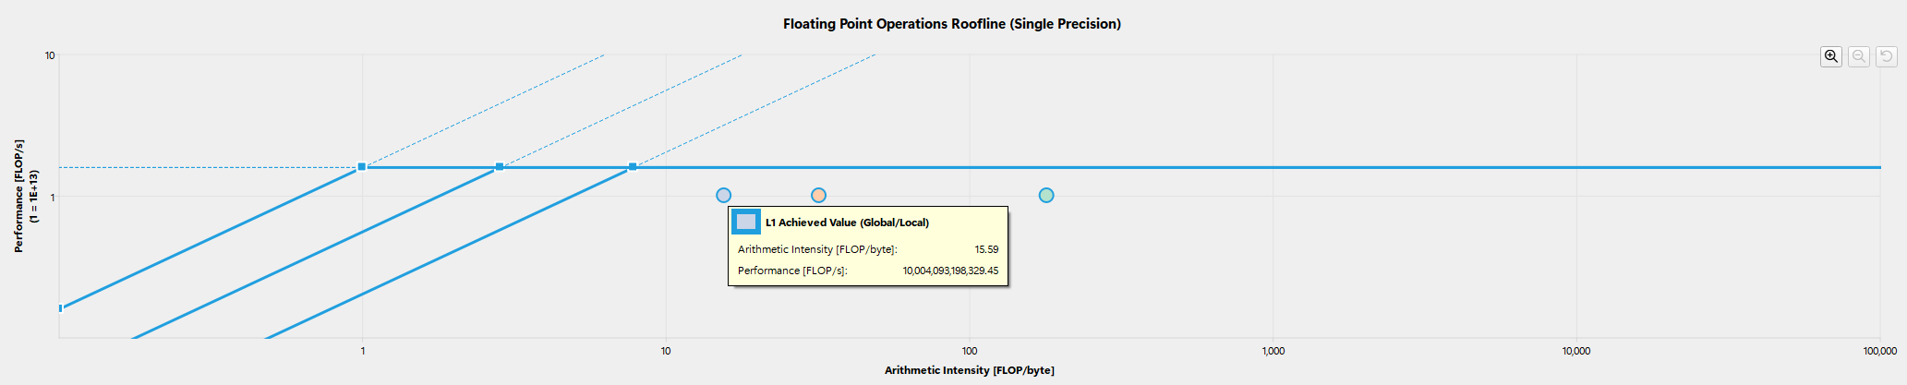
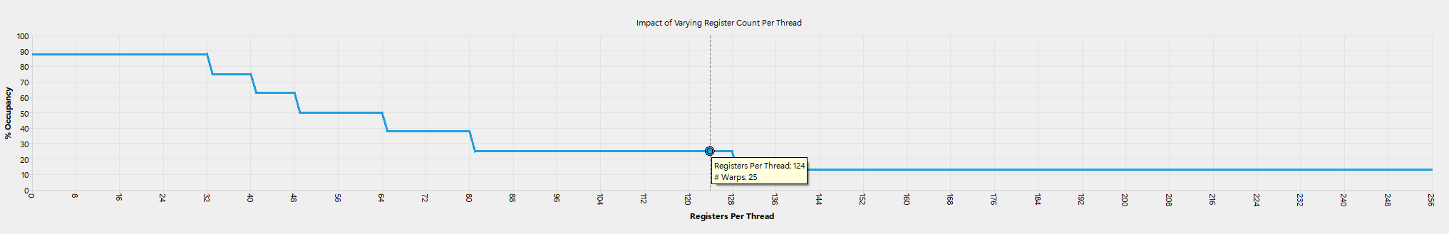
Roofline for v4
Occupancy: 25%, Occupancy Limiter: Registers Per Thread

Slide 18
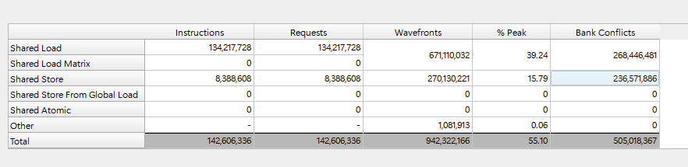
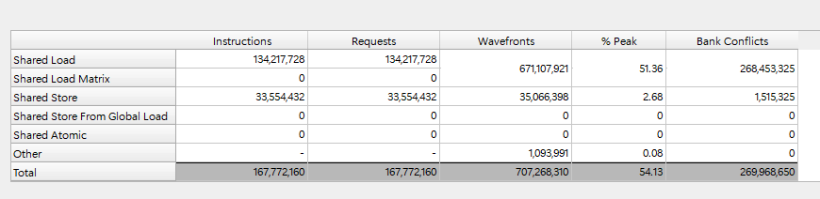
CUDA core v5: block tile + thread tile + global to shared optimization
blockDim: (16, 16)
blockTileDim: (128, 128)
threadTileDim: (8, 8)
blockTileADim: (128, 8)
blockTileBDim: (128, 8)
threadTileADim: (8, 8)
threadTileBDim: (8, 8)
Shared memory table of v4
Shared to Registers
Global to Shared
Shared memory table of v5
TFLOPS: 16.05 / 18.38 = 87.32%

Slide 19
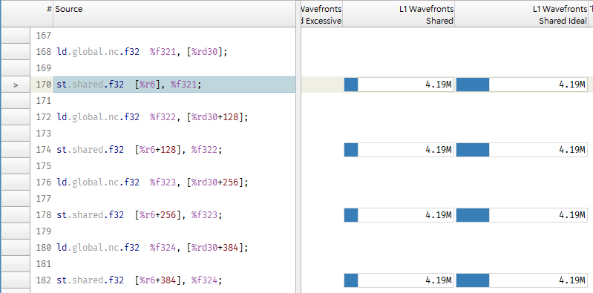

Slide 20
Global to Shared pattern of v5:
8
There are 256 / 32 = 8 warps in block
Each warp is responsible for fetching an entire row, in the simplest coalesced pattern, for 128 / 32 = 4 times
32
Shared memory: 32 bank, 32bits/4 bytes per bank
sizeof(float) = 4 bytes
128
For a warp in one iteration, one thread fetches 1 float = 4 byte to one bank
The entire warp in one iteration fetches 32 floats to 32 bank
Global to Shared store should be bank conflict free
blockTileA

Slide 21
CUDA core v6: Larger blockTileK
blockTileK from 8 to 16
TFLOPS: 16.58 / 18.38 = 90.20%
CUDA core v7: 2 stage pipeline
TFLOPS: 16.72 / 18.38 = 90.96%

Slide 22
Tensor core

Slide 23
blockTileN
N
Tensor core v0: block tile + warp tile
blockDim: (16, 16)
blockTileDim: (256, 128)
blockTileADim: (256, 16)
blockTileBDim: (128, 16)
warpTileDim: (64, 64)
warpTileADim: (64, 16)
warpTileBDim: (16, 64)
blockTileK
1 warp responsible for 64 * 64 = 4096 output element
K
Matrix B
blockTileK
K
blockTileM
block tile
M
TFLOPS: 48.48 / 222.11 = 21.82%
Matrix A
Matrix C

Slide 24
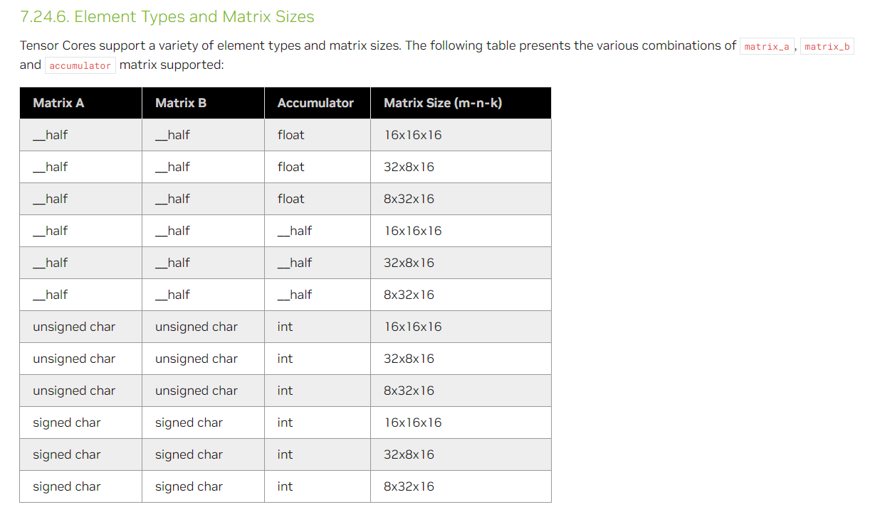
blockTileDim: (256, 128)
warpTileDim: (64, 64)
N_WARP_PER_BLK = 8
warpTileDim: (64, 64)
warpTileADim: (64, 16)
warpTileBDim: (16, 64)
block tile B
16
64
64
Warp0
Warp1
Warp2
wmma API support sizes for __half data:
16 x 16 x 16 → (16, 16) @ (16, 16) + (16, 16) = (16, 16)
32 x 8 x 16 → (32, 16) @ (16, 8) + (32, 8) = (32, 8)
8 x 32 x 16 → (8, 16) @ (16 ,32) + (8, 32) = (8, 32)
block tile A
block tile

Slide 25
FragB
16
WarpTileB
16
FragA
16
Frag0
WarpTileA
WarpTile

Slide 26
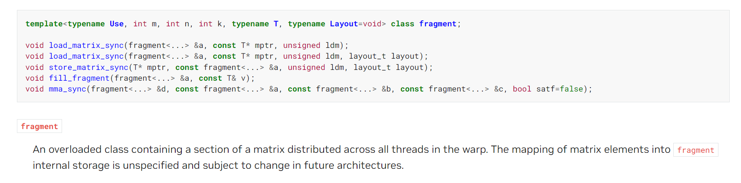
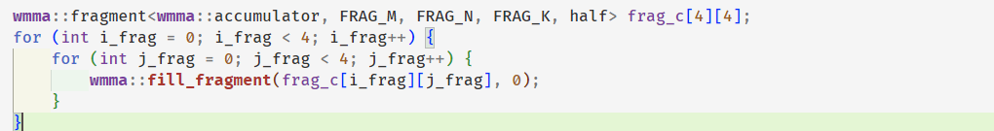
D = A @ B + C
Initialize:

Slide 27
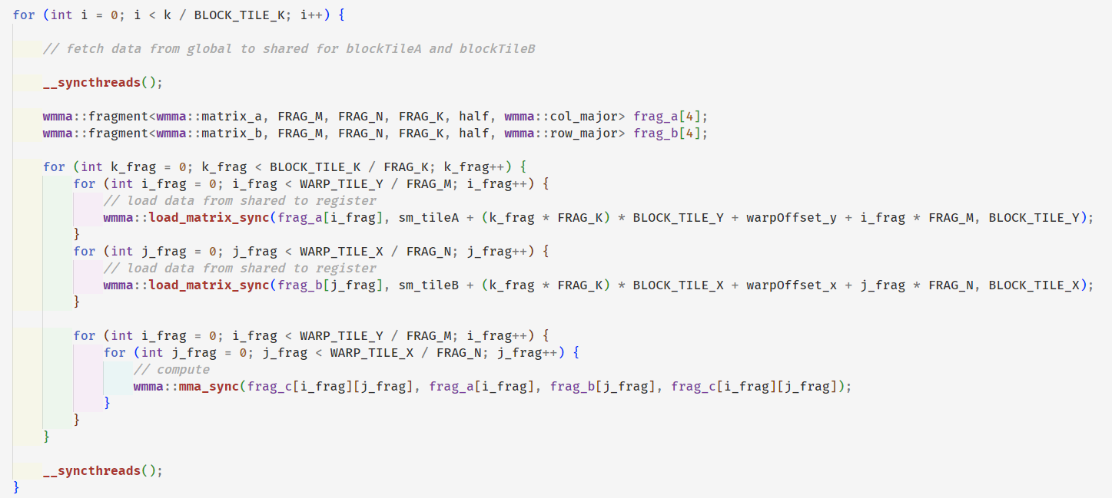
Load:
Compute:

Slide 28
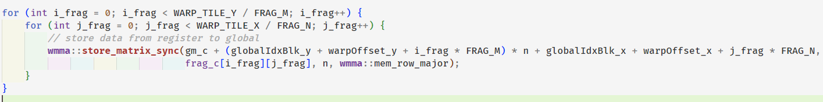
Store:

Slide 29
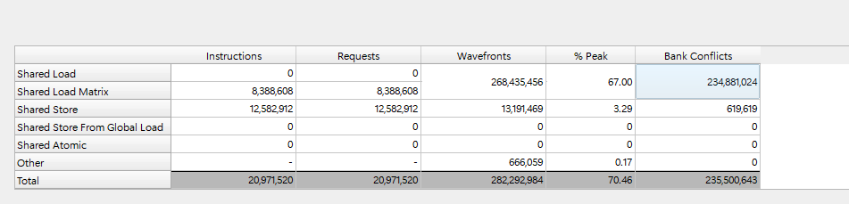
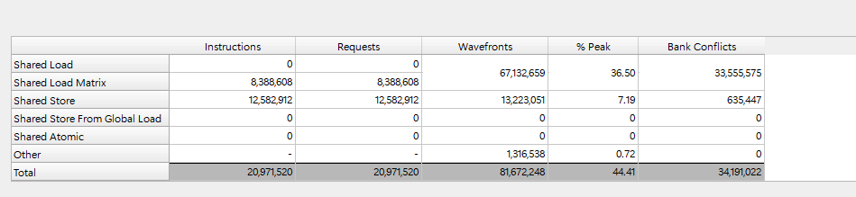
Tensor core v1: block tile + warp tile + padding(shared to register optimization)
Shared memory table of v0
Shared memory table of v1
TFLOPS: 99.54 / 222.11 = 44.81%

Slide 30
16
16
2
bank0
bank0
to
bank7
bank8
to
bank15
16
16
FragA
FragA
bank8
padding
blockTileA
16
bank0-7
blockTileA

Slide 31
Tensor core v2: block tile + warp tile + padding(shared to register optimization) + pipeline
TFLOPS: 110.32 / 222.11 = 49.67%

Slide 32
Tensor core v3: block tile + warp tile + Swizzle + mma
1 ^ 0 == 1, 0 ^ 0 == 0 → same
1 ^ 1 == 0, 0 ^ 1 == 1 → flip
Swizzle
(0, 0) | (0, 1) | (0, 2) | (0, 3) | (0, 4) | (0, 5) | (0, 6) | (0, 7)
(1, 0)
(2, 0)
(3, 0)
(4, 0)
(5, 0)
(6, 0)
(7, 0)
row in [0, 2^n – 1]
col in [0, 2^n -1]
TFLOPS: 128.11 / 222.11 = 57.67%
Original coordinate: (row, col) → Swizzled coordinate: (row, row ^ col)

Slide 33
Swizzle
(0, 0)
 | (1, 0)
 |  | (2, 0)
 |  |  | (3, 0)
 |  |  |  | (4, 0)
 |  |  |  |  | (5, 0)
 |  |  |  |  |  | (6, 0)
 |  |  |  |  |  |  | (7, 0)
Original coordinate: (row, col) → Swizzled coordinate: (row, row ^ col)

Slide 34
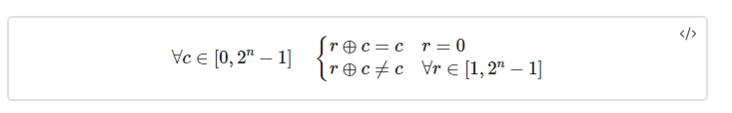
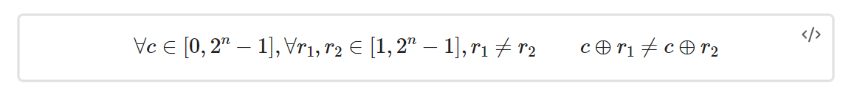
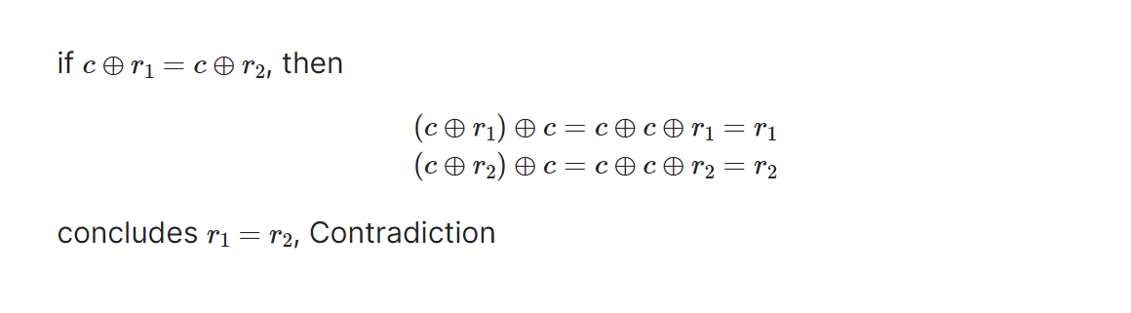
1. As long as r != 0, c^r != c
r1= 1010101010101010000
r2= 1010101010101010001
c= 1111111111111111111111
2. Different r gives different r^c for the same c
proof:
Swizzle change columns(banks)

Slide 35
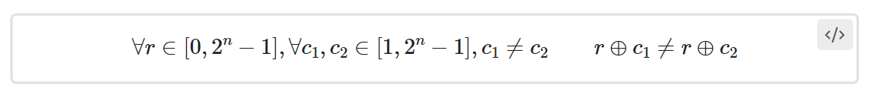
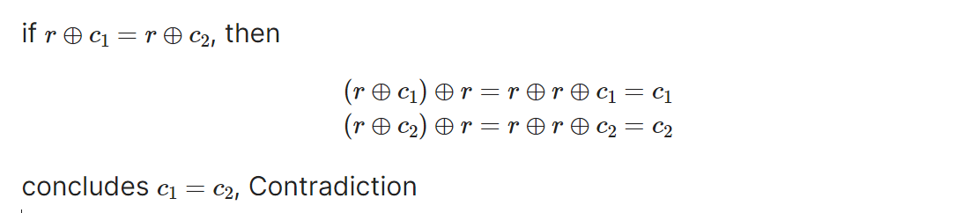
3. Different c gives different r^c for the same r
proof:
no conflict

Slide 36
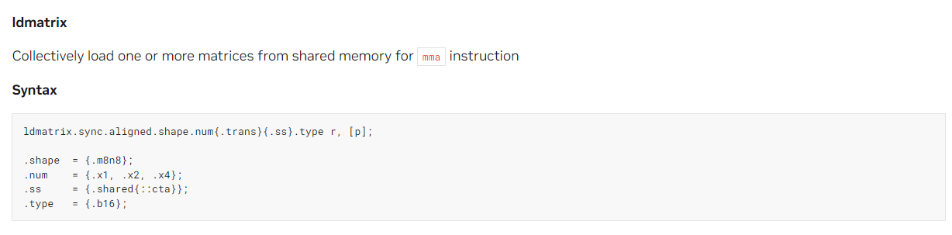
Process for using mma instructions to compute matrix multiply-accumulate
1. Load data: ldmatrix

Slide 37
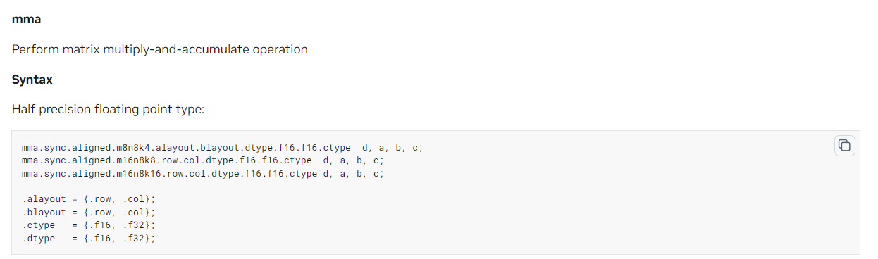
2. compute:
mma.m8n8k4
mma.m16n8k8
mma.m16n8k16
3. store

Slide 38
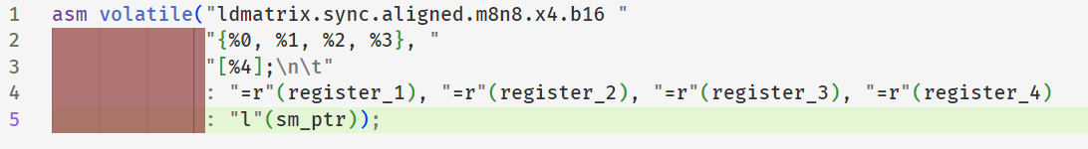
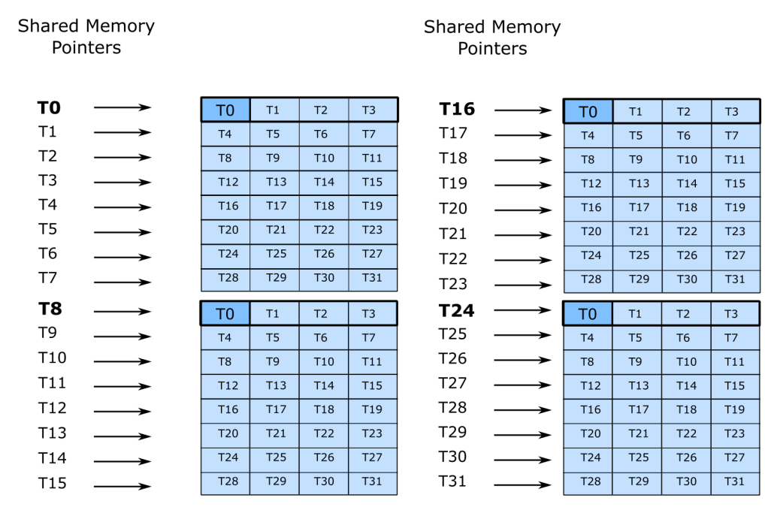
ldmatrix: every thread provides a pointer, which points to 128bit/16byte(8 _half) continuous data
8
16

Slide 39
blockTileK = 32
T0
T1
T4
8

Slide 40
blockTileK = 32
T0
T1
T4
8

Slide 41
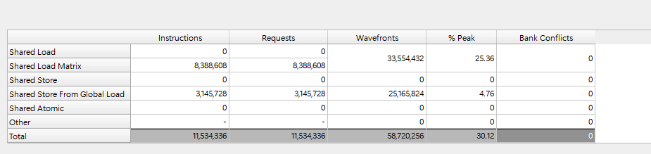
Shared memory table of v3

Slide 42
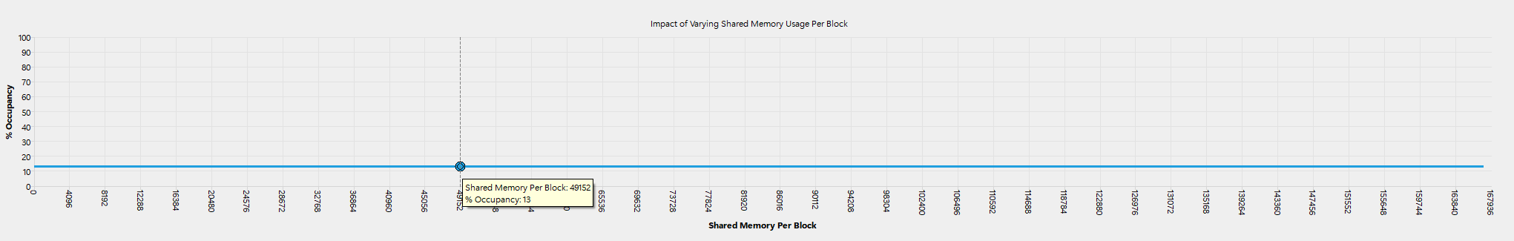
Occupancy: 13%, Occupancy Limiter: user shared memory per block
(128 +128) * 16 * sizeof(half) * 2 = 49152 bytes

Slide 43
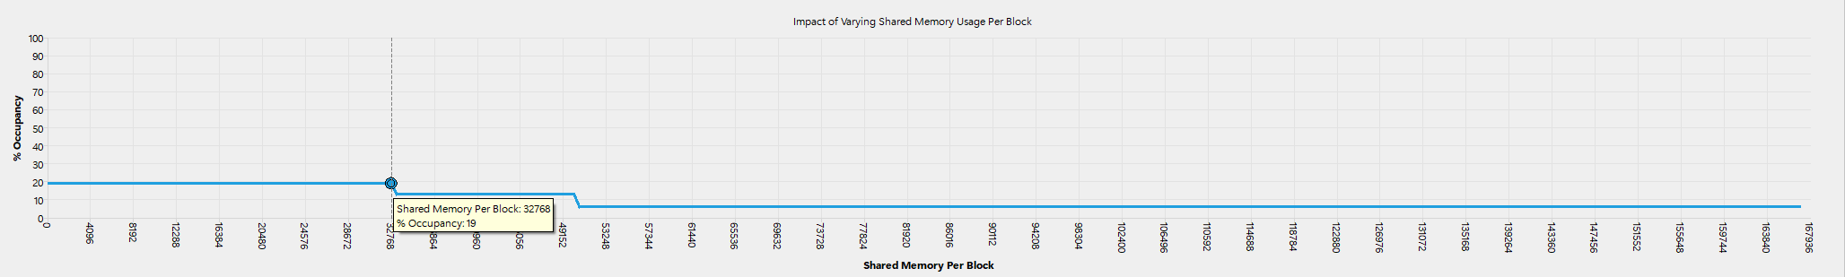
Tensor core v4: block tile + warp tile + Swizzle + mma
Change blockTileDim from (256, 128) to (128, 128)
TFLOPS: 152.64 / 222.11 = 68.72%

Slide 44
谢谢

