Slide 1
Проектирование мобильных приложений
Android: Activity & Intent
Кузнецов
Андрей Николаевич
Санкт-Петербургский Государственный
Политехнический Университет

Slide 2
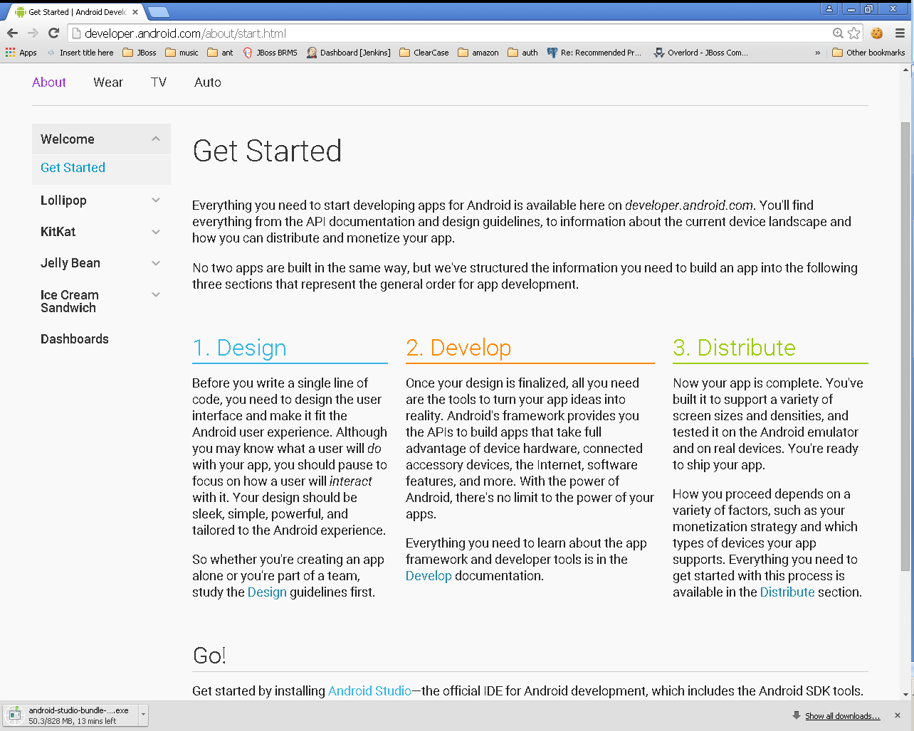

Slide 3
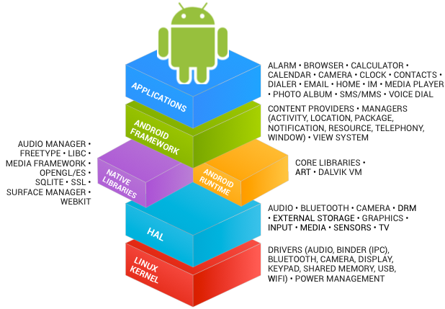
В предыдущих лекциях...
See https://source.android.com/source/index.html

Slide 4
В предыдущих лекциях...
Android Studio
Android SDK
http://developer.android.com/sdk/index.html
Eclipse IDE for Mobile Developers
http://eclipse.org/mobile/
ADT Plugin для Eclipse
https://dl-ssl.google.com/android/eclipse/
Java SE Development Kit 7
http://www.oracle.com/technetwork/java/javase/downloads/jdk7-downloads-1880260.html

Slide 5
В предыдущих лекциях...
Activities
Services
Content Providers
Broadcast Receivers
As a developer we need only to call and extend these already defined classes to use in our application.

Slide 6
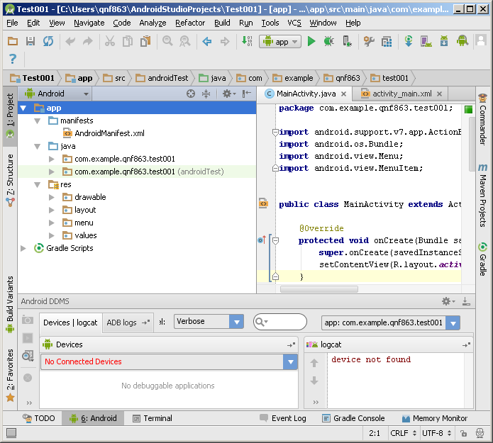
В предыдущих лекциях...

Slide 7
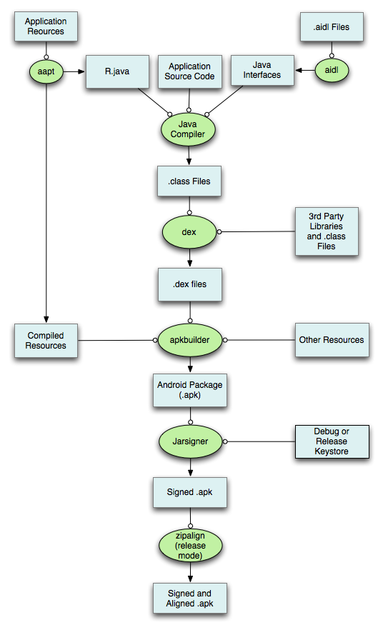

Slide 8
В предыдущих лекциях...
<?xml version="1.0" encoding="utf-8"?> <manifest> <uses-permission /> <permission /> <permission-tree /> <permission-group /> <instrumentation /> <uses-sdk /> <uses-configuration /> <uses-feature /> <supports-screens /> <compatible-screens /> <supports-gl-texture /> <application> <activity> <intent-filter> <action /> <category /> <data /> </intent-filter> <meta-data /> </activity>
<activity-alias> <intent-filter> . . . </intent-filter> <meta-data /> </activity-alias> <service> <intent-filter> . . . </intent-filter> <meta-data/> </service> <receiver> <intent-filter> . . . </intent-filter> <meta-data /> </receiver> <provider> <grant-uri-permission /> <meta-data /> <path-permission /> </provider> <uses-library /> </application> </manifest>

Slide 9
В предыдущих лекциях...
./animator/*
./anim/*
./xml/*
./drawable/*
Bitmap files (png, 9.png, jpg, gif)
State lists
Shapes
Other drawables

Slide 10
В предыдущих лекциях...
./layout/*
./menu/*
./raw/*
./values/*
arrays.xml
colors.xml
dimens.xml
strings.xml
styles.xml

Slide 11
В предыдущих лекциях...
<resources_name>-<config_qualifier>
resources_name := anim, drawable, layout, menu, raw, value, xml
config_qualifier := qualifier1[-qualifier2[…]]
Примеры:
drawable-ldpi
drawable-en-notouch-12key
values-land-mdpi-v11

Slide 12
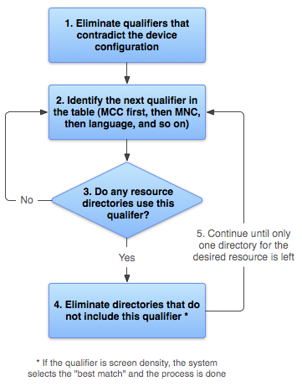
http://developer.android.com/guide/topics/resources/providing-resources.html

Slide 13
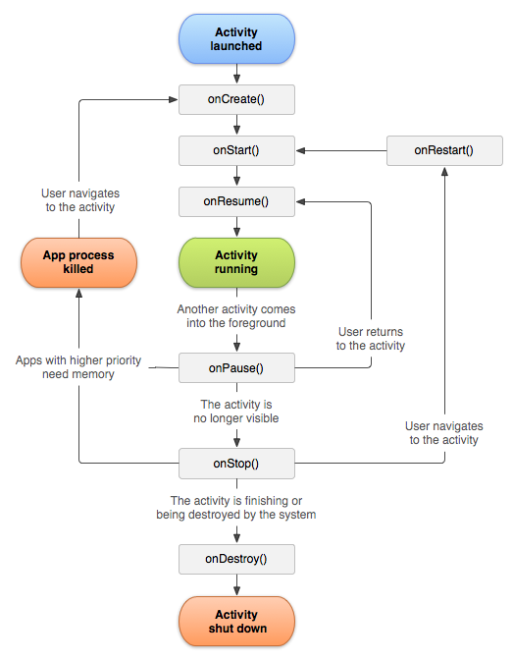
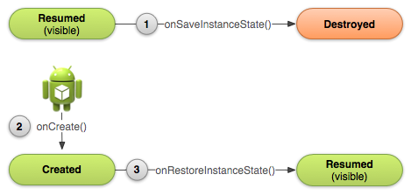
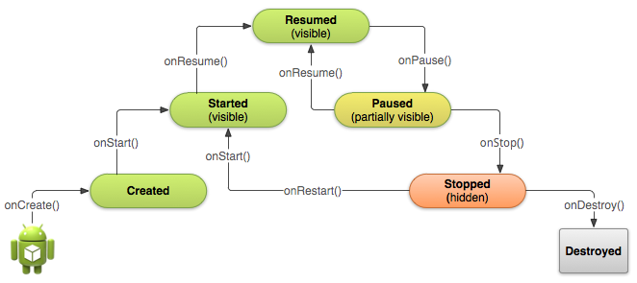

Slide 14
Activity: API Overview

Slide 15
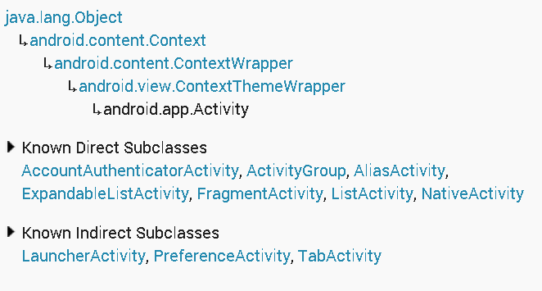
Activity: API Overview (1)

Slide 16
Activity: Lifecycle Callbacks
protected void onCreate (Bundle savedInstanceState)
protected void onStart ()
protected void onPause ()
protected void onResume ()
protected void onRestart ()
protected void onStop ()
protected void onDestroy ()

Slide 17
Activity: State Callbacks
protected void onSaveInstanceState (Bundle outState)
protected void onRestoreInstanceState (Bundle savedInstanceState)

Slide 18
Activity: Content
public void setContentView (int layoutResID)
Вспомните R.layout.my_layout
public void setContentView (View view)
public View findViewById (int id)
Вспомните android:id=“@+id/my_id”

Slide 19
Button Обработка событий (В1)
<Button xmlns:android="http://schemas.android.com/apk/res/android" android:id="@+id/button_send" android:layout_width="wrap_content" android:layout_height="wrap_content" android:text="@string/button_send“ />
Button button = (Button) findViewById(R.id.button_send); button.setOnClickListener(new View.OnClickListener() { public void onClick(View v) { // Do something in response to button click } });

Slide 20
Button Обработка событий (В2)
<Button xmlns:android="http://schemas.android.com/apk/res/android" android:id="@+id/button_send" android:layout_width="wrap_content" android:layout_height="wrap_content" android:text="@string/button_send" android:onClick="onButtonClicked" />
public class MyActivity extends Activity {
// . . .
public void onButtonClicked(View view) { // Какая кнопка была нажата? switch(view.getId()) { case R.id.button_send: // . . . break; case R.id.button_forward: // . . . } }
}

Slide 21
CheckBox Обработка событий
public void setOnCheckedChangeListener (CompoundButton.OnCheckedChangeListener listener)
public void setOnClickListener (View.OnClickListener l)
<CheckBox android:id="@+id/checkbox_meat“ android:layout_width="wrap_content“ android:layout_height="wrap_content“ android:text="@string/meat“ android:onClick="onCheckboxClicked"/>

Slide 22
CheckBox Обработка событий
<?xml version="1.0" encoding="utf-8"?> <LinearLayout xmlns:android="http://schemas.android.com/apk/res/android" android:orientation="vertical" android:layout_width="fill_parent" android:layout_height="fill_parent"> <CheckBox android:id="@+id/checkbox_meat" android:layout_width="wrap_content" android:layout_height="wrap_content" android:text="@string/meat" android:onClick="onCheckboxClicked"/> <CheckBox android:id="@+id/checkbox_cheese" android:layout_width="wrap_content" android:layout_height="wrap_content" android:text="@string/cheese" android:onClick="onCheckboxClicked"/> </LinearLayout>

Slide 23
CheckBox Обработка событий
public void onCheckboxClicked(View view) { // Is the view now checked? boolean checked = ((CheckBox) view).isChecked(); // Check which checkbox was clicked switch(view.getId()) { case R.id.checkbox_meat: if (checked) // Put some meat on the sandwich else // Remove the meat break; case R.id.checkbox_cheese: if (checked) // Cheese me else // I'm lactose intolerant break; // TODO: Veggie sandwich } }

Slide 24
ToggleButton Обработка событий
public void setOnCheckedChangeListener (CompoundButton.OnCheckedChangeListener listener)
public void setOnClickListener (View.OnClickListener l)
<ToggleButton android:id="@+id/togglebutton" android:layout_width="wrap_content" android:layout_height="wrap_content" android:textOn="Vibrate on" android:textOff="Vibrate off" android:onClick="onToggleClicked"/>

Slide 25
RadioButton Обработка событий
public void setOnCheckedChangeListener (RadioGroup.OnCheckedChangeListener listener)
public void setOnClickListener (View.OnClickListener l)
<RadioButton android:id="@+id/radio_ninjas" android:layout_width="wrap_content" android:layout_height="wrap_content" android:text="@string/ninjas" android:onClick="onRadioButtonClicked"/>

Slide 26
Activity: Inflaters (инстанциирование layout)
public LayoutInflater getLayoutInflater ()
public View inflate (int resource, ViewGroup root)
public MenuInflater getMenuInflater ()
public void inflate (int menuRes, Menu menu)

Slide 27
Activity доступ к ресурсам
public Resources getResources ()
public boolean getBoolean (int id)
public int getColor (int id)
public float getDimension (int id)
public Drawable getDrawable (int id)
public int getInteger (int id)
public String getQuantityString (int id, int quantity, Object... formatArgs)
public String getString (int id)
public String getString (int id, Object... formatArgs)
public String[] getStringArray (int id)
public XmlResourceParser getLayout (int id)
http://developer.android.com/reference/android/content/res/Resources.html

Slide 28
Activity: Preferences
public SharedPreferences getPreferences (int mode)
Use this if you need only one preferences file for your Activity
public abstract SharedPreferences getSharedPreferences (String name, int mode)
Use this if you need multiple preferences files identified by name.
getDefaultSharedPreferences()

Slide 29
Intents
http://developer.android.com/guide/components/intents-filters.html

Slide 30
Зачем нужен Intent
3 основных элемента приложения: activities, services и broadcast receivers – активируются сообщениями, называемыми intent
Context.startActivity()
Context.startService()
Context.sendBroadcast()

Slide 31
Что такое Intent
Java класс
Сообщение (приложению или ОС) :
Component
Action
Data
Category
Extras
Flags

Slide 32
Типы Intent
Explicit Intent
Implicit intent
Component
Package + Class Name
Action
Data
Category
Extras
Flags
Action
Data
Category
Extras
Flags

Slide 33
Intent: Component Name
Имя компонента, который должен обработать интент.
Имя приложения (package)
Имя класса com.example.helloworld .SecondActivity (extends Activity)
Если указан – будет запущен новый экземпляр указанного класса.
Если не указан – Intent Resolution Process (implicit intent)

Slide 34
Intent: Extras (не обязательно)
Дополнительная информация в виде «key:value» (Bundle).
Примеры (Broadcast Receivers)
ACTION_TIMEZONE_CHANGED
“time-zone”:<NEW_TIME_ZONE>
ACTION_HEADSET_PLUG
“state”:<plugged/unplugged>
"name“:<headset_type>

Slide 35
Intent: Flags (не обязательно)
Указания операционной системе как запускать компонент
Если вас устраивает поведение компонента, флаги вам не нужны

Slide 36
Activity & Intents (1) Методы класса Activity
public void startActivity (Intent intent)
public Intent getIntent ()

Slide 37
Activity & Intents (2) Методы класса Activity
public void startActivityForResult (Intent intent, int requestCode)
protected void onActivityResult (int requestCode, int resultCode, Intent data)
public void finishActivity (int requestCode)

Slide 38
Activity & Intents (3) Методы класса Activity
public void finish ()
public void finishActivity (int requestCode)
public final void setResult (int resultCode)
public final void setResult (int resultCode, Intent data)
public static final int RESULT_OK, RESULT_CANCELED
public static final int RESULT_FIRST_USER

Slide 39
Implicit Intent Resolution

Slide 40
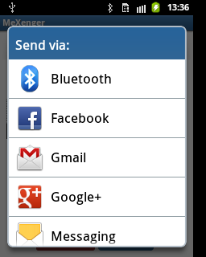
Implicit Intents Назначение
Имя компонента не известно, но известно намерение пользователя, например
Открыть URL в браузере
Отправить письмо

Slide 41
Intent Resolution: Implicit Intent
Используются только 3 поля:
action
category
data

Slide 42
Intent: Action Philosophy
The action largely determines how the rest of the intent is structured — particularly the data and extras fields — much as a method name determines a set of arguments and a return value.
Instead of defining an action in isolation, define an entire protocol for the Intent objects your components can handle.

Slide 43
Intent: Action Философия
Action во многом определяет остальную структуру Intent, в частности содержимое полей data и extras.
Можно провести аналогию с именем метода класса, определяющим набор аргументов и возвращаемое значение.
Рекомендуется определять не только Action, а полностью протокол взаимодействия с компонентом.

Slide 44
Intent: Action
Строка (String)
Имя действия (или имя события для Broadcast Receivers)
Значение
Одно из стандартных
Можно объявить собственное (просто строка!)
Пример: “com.example.project.SHOW_COLOR”

Slide 45
Intent: Action Some Standard Actions
Constant | Target component | Action
ACTION_CALL | activity | Initiate a phone call.
ACTION_EDIT | activity | Display data for the user to edit.
ACTION_MAIN | activity | Start up as the initial activity of a task, with no data input and no returned output.
ACTION_SYNC | activity | Synchronize data on a server with data on the mobile device.
ACTION_BATTERY_LOW | broadcast receiver | A warning that the battery is low.
ACTION_HEADSET_PLUG | broadcast receiver | A headset has been plugged into the device, or unplugged from it.
ACTION_SCREEN_ON | broadcast receiver | The screen has been turned on.
ACTION_TIMEZONE_CHANGED | broadcast receiver | The setting for the time zone has changed.

Slide 46
Intent: Category
Строка (String)
Доп. информация о типе компонента, на который направлено действие
Значение
Одно из стандартных
Можно объявить собственное (просто строка!)
Пример: “com.example.project.MY_CATEGORY”

Slide 47
Intent: Category Some Standard Categories
Constant | Meaning
CATEGORY_BROWSABLE | The target activity can be safely invoked by the browser to display data referenced by a link — for example, an image or an e-mail message.
CATEGORY_GADGET | The activity can be embedded inside of another activity that hosts gadgets.
CATEGORY_LAUNCHER | The activity can be the initial activity of a task and is listed in the top-level application launcher.
CATEGORY_PREFERENCE | The target activity is a preference panel.

Slide 48
AndroidManifest.xml (напоминание)
<manifest> <uses-permission /> <uses-sdk /> <uses-configuration /> <uses-feature /> <application> <activity> <intent-filter> <action /> <category /> <data /> </intent-filter> <meta-data /> </activity>
<service> <intent-filter> . . . </intent-filter> <meta-data/> </service> <receiver> <intent-filter> . . . </intent-filter> <meta-data /> </receiver> <provider> <grant-uri-permission /> <meta-data /> <path-permission /> </provider> </application> </manifest>

Slide 49
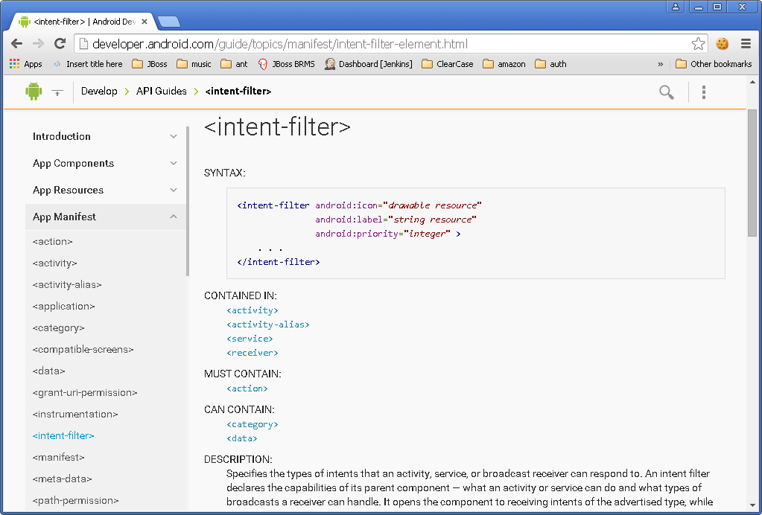

Slide 50
Intent Filters
См. AndroidManifest.xml
Сообщает ОС какие неявные intent может обрабатывать компонент.

Slide 51
Intent Filters Пример фильтра Action
<intent-filter . . . > <action android:name="com.example.project.SHOW_CURRENT" /> <action android:name="com.example.project.SHOW_RECENT" /> <action android:name="com.example.project.SHOW_PENDING" /> . . . </intent-filter>
Список не может быть пустым
Чтобы фильтр сработал в Intent должен быть указан один из Actions, объявленных в манифесте

Slide 52
Intent Filters Пример фильтра Category
<intent-filter . . . > <category android:name="android.intent.category.DEFAULT" /> <category android:name="android.intent.category.BROWSABLE" /> . . . </intent-filter>
Чтобы фильтр сработал в манифесте должны быть перечислены, как минимум, все категории, указанные в Intent
Все Implicit Intents, как минимум, имеют категорию android.intent.category.DEFAULT

Slide 53
Intent: Data
URI данных, над которыми производится действие и MIME этих данных
Например, контакт в телефонной книжке

Slide 54
Intent: Data
Data = URI + MIME
URI= scheme://host:port/path
content://com.example.project:200/folder/subfolder/etc
URI authority = host:port
MIME (Multipurpose Internet Mail Extensions)
text/plain
audio/mpeg

Slide 55
Intent Filters Синтаксис фильтра Data
<intent-filter . . . >
<data android:scheme="string" android:host="string" android:port="string" android:path="string" android:pathPattern="string" android:pathPrefix="string" android:mimeType="string" /> . . . </intent-filter>
<scheme>://<host>:<port>/[<path>|<pathPrefix>|<pathPattern>]

Slide 56
Intent Filters Data Test
Intent
Filter
Нет URI, нет MIME
Есть URI, нет MIME. MIME не вычисляем из URI
Нет URI, есть MIME
Есть URI, есть MIME
Нет URI, нет MIME
URI совпадает, нет MIME
Нет URI, MIME совпадает
MIME совпадает и (одно из двух):
URI совпадает, или
нет URI и в запросе схема content: или file:

Slide 57
Intent Filters Data Test. Уточнения
MIME
В фильтре может использоваться маска
image/*
URI
В сравнении участвуют только части URI, указанные в фильтре
Если в фильтре не указан путь, URI из Intent считается совпадающим, если совпала схема и authority.

Slide 58
Примеры комбинаций Action/Data
ACTION_VIEW content://contacts/people/1 -- Display information about the person whose identifier is "1".
ACTION_DIAL content://contacts/people/1 -- Display the phone dialer with the person filled in.
ACTION_VIEW tel:123 -- Display the phone dialer with the given number filled in. Note how the VIEW action does what is considered the most reasonable thing for a particular URI.
ACTION_DIAL tel:123 -- Display the phone dialer with the given number filled in.

Slide 59
Примеры комбинаций Action/Data
ACTION_EDIT content://contacts/people/1 -- Edit information about the person whose identifier is "1".
ACTION_VIEW content://contacts/people/ -- Display a list of people, which the user can browse through. This example is a typical top-level entry into the Contacts application, showing you the list of people. Selecting a particular person to view would result in a new intent { ACTION_VIEW content://contacts/N } being used to start an activity to display that person.

Slide 60
Intent: API Конструкторы класса
Intent()
Intent(Intent o)
Intent(String action)
Intent(String action, Uri uri)
Intent(Context packageContext, Class<?> cls)
Intent(String action, Uri uri, Context packageContext, Class<?> cls)

Slide 61
Intent: API Некоторые методы (Explicit)
public Intent setComponent (ComponentName component)
ComponentName(String pkg, String cls)
public Intent setClass (Context packageContext, Class<?> cls)
public Intent setClassName (Context packageContext, String className)

Slide 62
Intent: API Некоторые методы (Implicit)
public Intent setAction (String action)
public Intent addCategory (String category)
public void removeCategory (String category)
public Intent setData (Uri data)
public Intent setDataAndType (Uri data, String type)
public Intent setType (String type)

Slide 63
Intent: API Некоторые методы (Extras)
public Intent putExtra (String name, Bundle value)
public Bundle getExtras ()
public Intent putExtra (String name, int value)
public int getIntExtra (String name, int defaultValue)
public Intent putExtra (String name, CharSequence value)
public String getStringExtra (String name)
и т.п.
public void removeExtra (String name)

Slide 64
Intent: API Некоторые методы (Flags)
public Intent setFlags (int flags)
public Intent addFlags (int flags)
public int getFlags ()

Slide 65
Using Intent Matching
PackageManager has a set of query...()
all components that can accept a particular intent
queryIntentActivities()
queryIntentServices()
…
PackageManager has a set of resolve...()
the best component to respond to an intent
resolveActivity()
resolveServices()
…

Slide 66
Android: Threads and Processes
http://developer.android.com/guide/components/processes-and-threads.html

Slide 67
Процессы и Потоки
По умолчанию все компоненты одного приложения работают в одном процессе
М.б. изменено с помощью AndroidManifest.xml
android:process
По умолчанию все компоненты одного приложения работают в одном потоке
В т.ч. сервисы!
UI-Thread = Main-Thread
М.б. изменено с помощью Worker Threads

Slide 68
Жизненный Цикл Процесса
ОС создает 1 процесс с 1 потоком при первом запуске любого из компонентов приложения
ОС выстраивает “importance hierarchy” процессов
В случае нехватки ресурсов (памяти) ОС убивает наименее важные процессы

Slide 69
Типы Процессов (1)
Foreground process – A process that is required for what the user is currently doing.
It hosts an Activity that the user is interacting with (the Activity's onResume() method has been called).
It hosts a Service that's bound to the activity that the user is interacting with.
It hosts a Service that's running "in the foreground"—the service has called startForeground().
It hosts a Service that's executing one of its lifecycle callbacks (onCreate(), onStart(), or onDestroy()).
It hosts a BroadcastReceiver that's executing its onReceive() method.

Slide 70
Типы Процессов (2)
Visible process – A process that doesn't have any foreground components, but still can affect what the user sees on screen. A process is considered to be visible if either of the following conditions are true:
It hosts an Activity that is not in the foreground, but is still visible to the user (its onPause() method has been called). This might occur, for example, if the foreground activity started a dialog, which allows the previous activity to be seen behind it.
It hosts a Service that's bound to a visible (or foreground) activity.

Slide 71
Типы Процессов (3)
Service process – A process that is running a service that has been started with the startService() method and does not fall into either of the two higher categories. Although service processes are not directly tied to anything the user sees, they are generally doing things that the user cares about (such as playing music in the background or downloading data on the network), so the system keeps them running unless there's not enough memory to retain them along with all foreground and visible processes.

Slide 72
Типы Процессов (4)
Background process – A process holding an activity that's not currently visible to the user (the activity's onStop() method has been called).
These processes have no direct impact on the user experience, and the system can kill them at any time to reclaim memory for a foreground, visible, or service process.
Background process are kept in an LRU (least recently used).
If an activity implements its lifecycle methods correctly, and saves its current state, killing its process will not have a visible effect on the user experience.

Slide 73
Типы Процессов (5)
Empty process – A process that doesn't hold any active application components.
caching purposes, to improve startup time the next time a component needs to run in it.
The system often kills these processes in order to balance overall system resources between process caches and the underlying kernel caches.

Slide 74
Значимость процессов
Foreground process
Visible process
Service process
Background process
Empty process

Slide 75
Потоки в Приложении
По умолчанию все компоненты одного приложения работают в одном потоке (Main Thread)
При запуске приложения создается main looper (android.os.Looper)
http://developer.android.com/reference/android/os/Looper.html
main looper перенаправляет (dispatch) сообщения другим компонентам:
Activity, Widget, пр.

Slide 76
Потоки и Android UI Toolkit (1)
UI toolkit
android.widget.*, android.view.*
НЕ thread-safe
Все взаимодействия с UI только из UI Thread
Все callback происходят в UI Thread

Slide 77
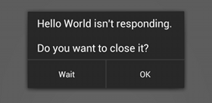
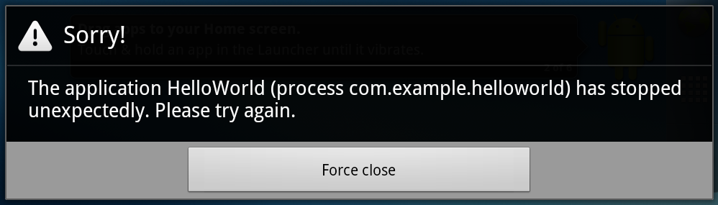
Потоки и Android UI Toolkit (2)
Do not block the UI thread
"application not responding" (ANR) dialog
Do not access the Android UI toolkit from outside the UI thread

Slide 78
Worker Threads (1)
public void onClick(View v) { Bitmap b = loadImageFromNetwork("http://example.com/image.png"); mImageView.setImageBitmap(b); }

Slide 79
Worker Threads (1)
public void onClick(View v) { Bitmap b = loadImageFromNetwork("http://example.com/image.png"); mImageView.setImageBitmap(b); }

Slide 80
Worker Threads (2)
public void onClick(View v) { new Thread(new Runnable() { public void run() { Bitmap b = loadImageFromNetwork("http://example.com/image.png"); mImageView.setImageBitmap(b); } }).start(); }

Slide 81
Worker Threads (2)
public void onClick(View v) { new Thread(new Runnable() { public void run() { Bitmap b = loadImageFromNetwork("http://example.com/image.png"); mImageView.setImageBitmap(b); } }).start(); }

Slide 82
Способы Доступа к UI Thread (1)
Activity.runOnUiThread(Runnable)
View.post(Runnable)
View.postDelayed(Runnable, long)

Slide 83
Способы Доступа к UI Thread (2)
public void onClick(View v) { new Thread(new Runnable() { public void run() { final Bitmap bitmap =
loadImageFromNetwork("http://example.com/image.png"); mImageView.post(new Runnable() { public void run() { mImageView.setImageBitmap(bitmap); } }); } }).start(); }

Slide 84
Способы Доступа к UI Thread: AsyncTask
private class MyTask extends AsyncTask<Params, Progress, Result> { ... }
http://developer.android.com/reference/android/os/AsyncTask.html

Slide 85
AsyncTask: 3 Types
android.os.AsyncTask<Params, Progress, Result>
Params
parameters sent to the task upon execution.
Progress
progress units published during the background computation.
Result
result of the background computation.

Slide 86
AsyncTask 4 Шага исполнения
void onPreExecute()
invoked on the UI thread
Result doInBackground(Params...)
invoked on the background
void publishProgress(Progress...)
void onProgressUpdate(Progress...)
invoked on the UI thread
void onPostExecute(Result)
invoked on the UI thread

Slide 87
AsyncTask Пример
public void onClick(View v) { new DownloadImageTask().execute("http://example.com/image.png"); } private class DownloadImageTask extends AsyncTask<String, Void, Bitmap> { /** The system calls this to perform work in a worker thread and * delivers it the parameters given to AsyncTask.execute() */ protected Bitmap doInBackground(String... urls) { return loadImageFromNetwork(urls[0]);
// publishProgress(...); } /** The system calls this to perform work in the UI thread and delivers * the result from doInBackground() */ protected void onPostExecute(Bitmap result) { mImageView.setImageBitmap(result); } }

Slide 88
Некоторые полезные методы AsyncTask
final AsyncTask<Params, Progress, Result> execute(Params... params)
final boolean cancel (boolean mayInterruptIfRunning)
final Result get (long timeout, TimeUnit unit)
final Result get ()
final AsyncTask.Status getStatus ()

Slide 89
Общие правила использования AsyncTask
Экземпляр объекта должен быть создан в UI потоке.
execute(Params...) должен быть вызван в UI потоке.
Не вызывать вручную onPreExecute(), onPostExecute(Result), doInBackground(Params...), onProgressUpdate(Progress...).
AsyncTask может быть запущен только один раз (при повторном использовании возникнет исключение)

Slide 90
SharedPreferences
To write values:
Call edit() to get a SharedPreferences.Editor.
Add values with methods such as putBoolean() andputString().
Commit the new values with commit()
To read values
use SharedPreferences methods such as getBoolean() and getString().

Slide 91
Activity: Dialog
Deprecated:
protected Dialog onCreateDialog (int id, Bundle args)
protected void onPrepareDialog (int id, Dialog dialog, Bundle args)
public final void showDialog (int id)
public final void dismissDialog (int id)

Slide 92
Activity: API Overview
И многое другое!
http://developer.android.com/reference/android/app/Activity.html

