Slide 1
Beta HTTP Brute Forcer
By Frans Vorster

Slide 2
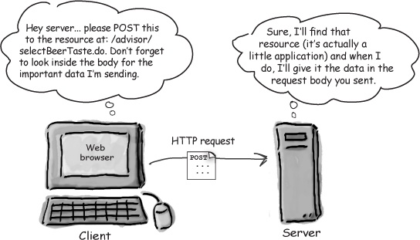
Basics of HTTP Post Request
https://tools.ietf.org/html/rfc2616#page-54 regarding post requests.

Slide 3
Code Breakdown
First off what is the required to brute force a login form:
Targets
Input Tags
Usernames
Passwords
Cookies
So the question is how do you GET them ?

Slide 4
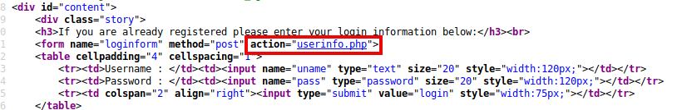
Targets
As shown above is a possible valid target for the application, it can be supplied with cmd input or from a file.
Example of this will be: http://testphp.vulnweb.com/userinfo.php

Slide 5
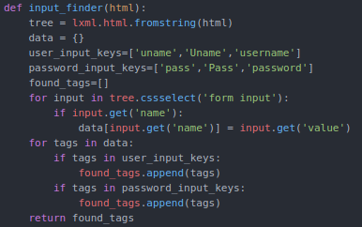
Input Tags
By using CSS selectors for parsing with some list magic that needs to be built out.

Slide 6
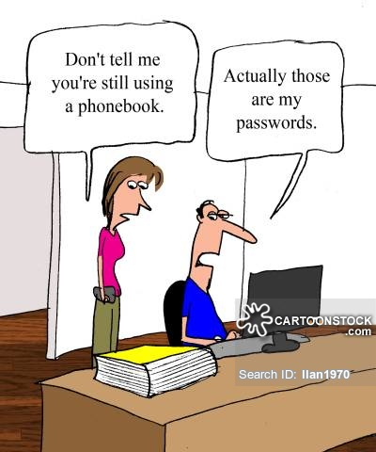
Usernames & Passwords
Can be supplied via file or cmd.
Examples: test, admin

Slide 7
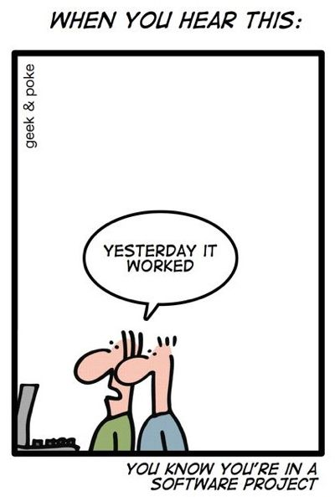
Demo

Slide 8
Future Functions
Include a link bruteforcer, then parse that for login forms.
Improve scanning functions.
Don’t use list or dictionaries.
Output to a file without the >> operator.
More error handling.
Introduction of classes might be nice.

Slide 9

Problems
Not all websites are the same.

Slide 10

Questions
Be honest and brutal.

