Slide 1
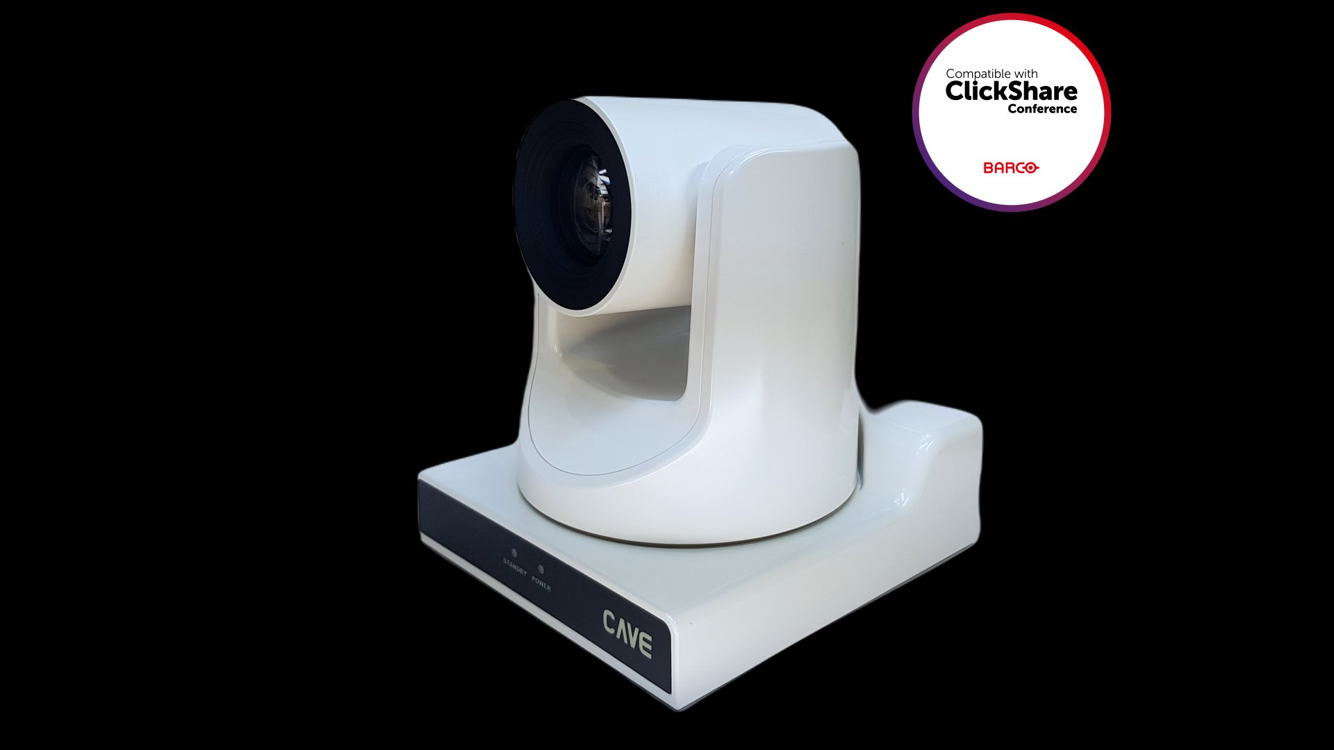
LIZWELL
International Trading Co.
解 綺 禎
Sales Person
✉ lizwellai@gmail.com
☎ +886 958 411 988
📍 台北市松山區復興北路57號2樓之1
Taipei, Taiwan
🌐 lizwell-ai.com

Slide 2

LIZWELL
International Trading Co. | 力日企業社
Advanced Alliance & Intelligent Integration

