Slide 1


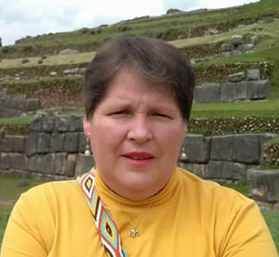
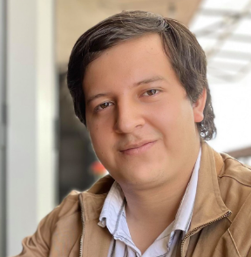
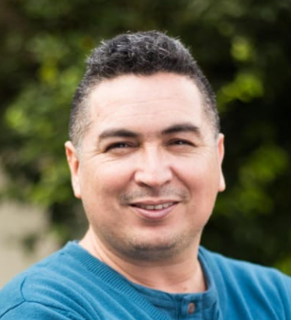

JCPF Celular Proliferation Framework
J
C
P
F
Alba Lorena Silva
Oscar Fernando Hoyos
Julio Ariel Hurtado

Slide 2
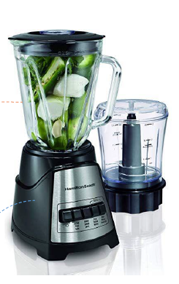
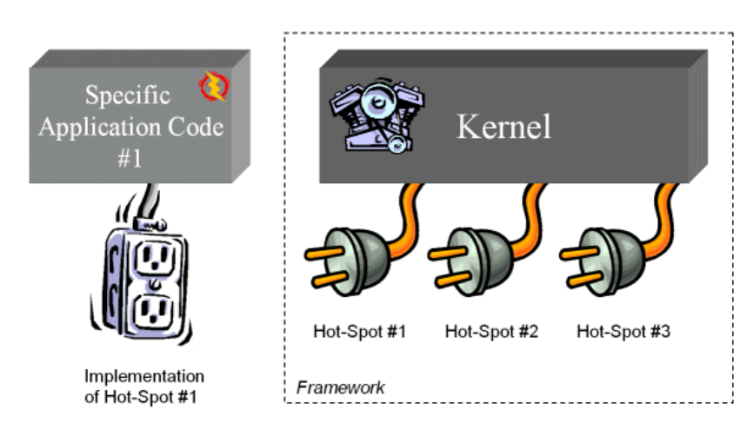
What a framework is?
Hollywood Principle: Don’t call us, we call you

Slide 3
Principles
Abstraction → Stage, Bridge, Observer and Command Patterns
Tissue Representation
Event Rules (Division) and Algorithms (Computational Geometry)
Tissue Visualización
Event Driven System → Template Method Pattern
Events
Division
Dead
Others
This events are located in a timetable (Scheduler)
The program jump to the next event

Slide 4
Essential Concepts
Shape: Circle, Polygon, Polyhedron
Cell: abstraction of a biological cellule with a defined shape
Tissue: a collection of cells
Event: born, dead
Visual Cell: visual representation of a cell
Visual Tissue: visual representation of a Tissue
Rule: logical for attending an event
Proliferation Model set of rules driven the cell population in a tissue

Slide 5
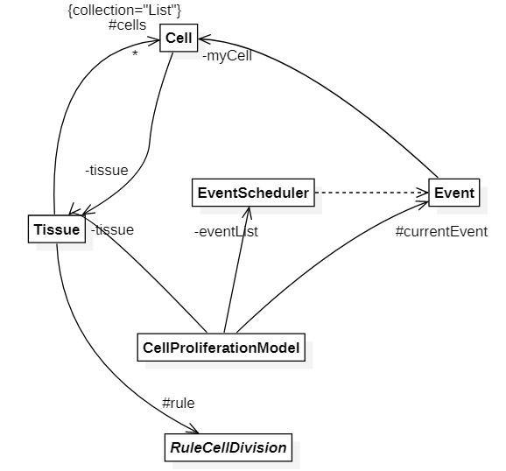
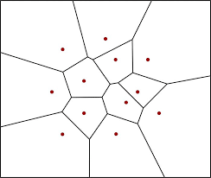
UML General Model

Slide 6
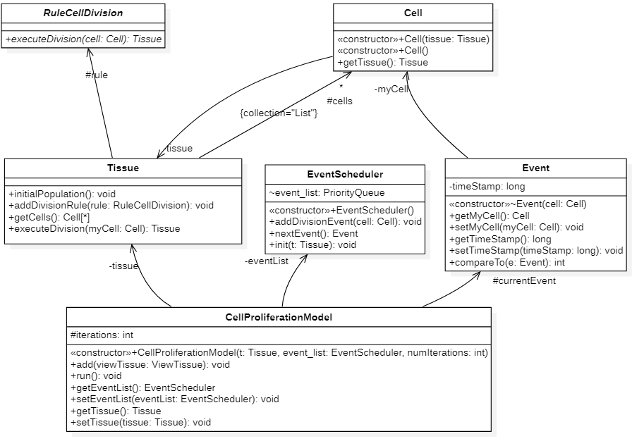
UML Detailed Class Diagram

Slide 7
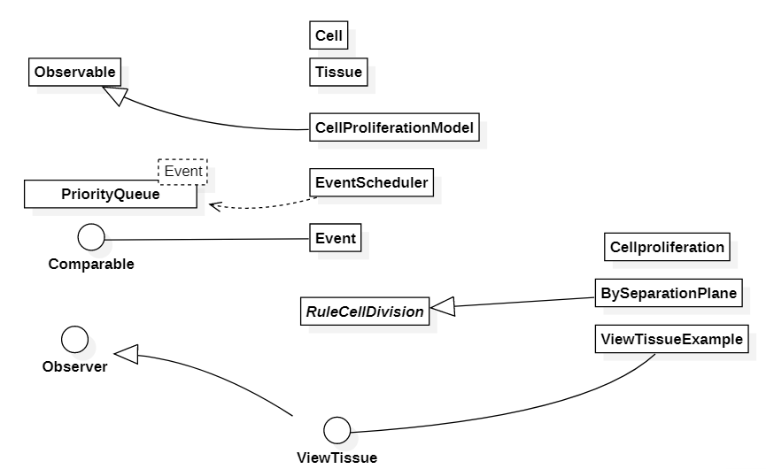
Type Hierarchy

Slide 8
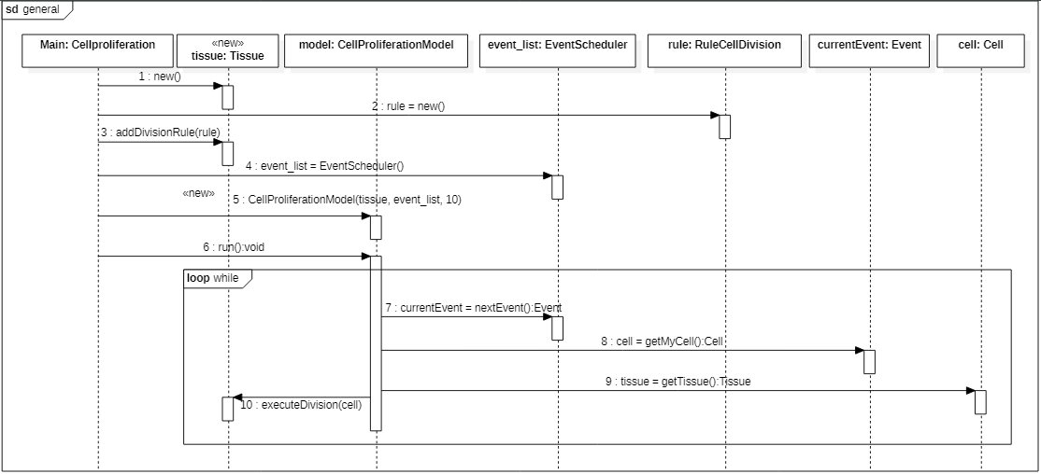
UML Sequence Diagram

Slide 9
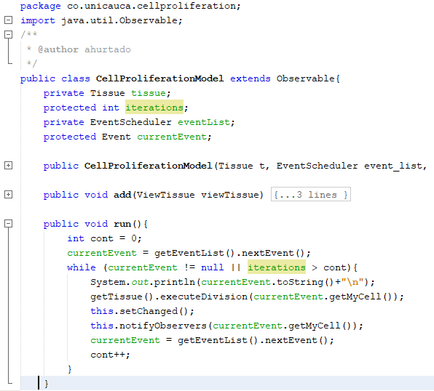
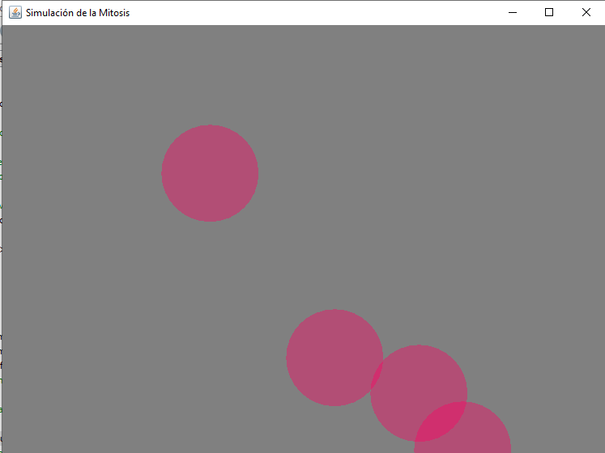
Let’s go to code A Simple Example

Slide 10
JCPF Celular Proliferation Framework
J
C
P
F
Alba Lorena Silva
Oscar Fernando Hoyos
Julio Ariel Hurtado

