Slide 1
Statistics for Managers
Using Microsoft® Excel
4th Edition
Chapter 14
Multiple Regression Model Building
Statistics for Managers Using Microsoft Excel, 4e © 2004 Prentice-Hall, Inc.
Chap 14-<number>

Slide 2
Chapter Goals
After completing this chapter, you should be able to:
use quadratic terms in a regression model
use transformed variables in a regression model
measure the correlation among the independent variables
build a regression model using either the stepwise or best-subsets approach
explain the pitfalls involved in developing a multiple regression model
Statistics for Managers Using Microsoft Excel, 4e © 2004 Prentice-Hall, Inc.
Chap 14-<number>

Slide 3
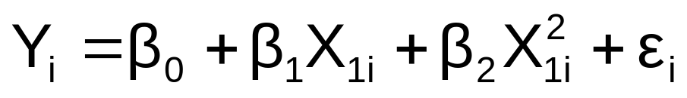
Nonlinear Relationships
The relationship between the dependent variable and an independent variable may not be linear
Can review the scatter diagram to check for non-linear relationships
Example: Quadratic model
  The second independent variable is the square of the first variable
Statistics for Managers Using Microsoft Excel, 4e © 2004 Prentice-Hall, Inc.
Chap 14-<number>

Slide 4

Quadratic Regression Model
Model form:
where:
β₀ = Y intercept
β₁ = regression coefficient for linear effect of X on Y
β₂ = regression coefficient for quadratic effect on Y
ε_{i} = random error in Y for observation i
Statistics for Managers Using Microsoft Excel, 4e © 2004 Prentice-Hall, Inc.
Chap 14-<number>

Slide 5

Linear vs. Nonlinear Fit
Y
Y
X
X
residuals
X
X
residuals
Linear fit does not give random residuals
Nonlinear fit gives random residuals
✓
Statistics for Managers Using Microsoft Excel, 4e © 2004 Prentice-Hall, Inc.
Chap 14-<number>

Slide 6
Quadratic Regression Model
Quadratic models may be considered when the scatter diagram takes on one of the following shapes:
Y
Y
Y
Y
X₁
X₁
X₁
X₁
β₁ < 0
β₁ > 0
β₁ < 0
β₁ > 0
β₂ > 0
β₂ > 0
β₂ < 0
β₂ < 0
β₁ = the coefficient of the linear term
β₂ = the coefficient of the squared term
Statistics for Managers Using Microsoft Excel, 4e © 2004 Prentice-Hall, Inc.
Chap 14-<number>

Slide 7
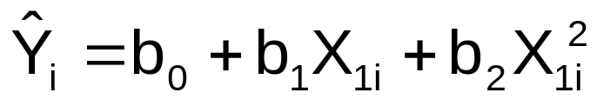
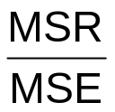
Testing the Overall
Quadratic Model
Estimate the quadratic model to obtain the regression equation:
Test for Overall Relationship
  H₀: β₁ = β₂ = 0 (no overall relationship between X and Y)
  H₁: β₁ and/or β₂ ≠ 0 (there is a relationship between X and Y)
  F test statistic =
Statistics for Managers Using Microsoft Excel, 4e © 2004 Prentice-Hall, Inc.
Chap 14-<number>

Slide 8
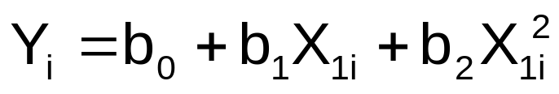
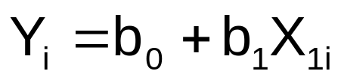
Testing for Significance: Quadratic Effect
Testing the Quadratic Effect
  Compare quadratic regression equation
with the linear regression equation
Statistics for Managers Using Microsoft Excel, 4e © 2004 Prentice-Hall, Inc.
Chap 14-<number>

Slide 9
Testing for Significance: Quadratic Effect
(continued)
Testing the Quadratic Effect
  Consider the quadratic regression equaiton
Hypotheses
    (The quadratic term does not improve the model)
    (The quadratic term improves the model)
H₀: β₂ = 0
H₁: β₂ ≠ 0
Statistics for Managers Using Microsoft Excel, 4e © 2004 Prentice-Hall, Inc.
Chap 14-<number>

Slide 10
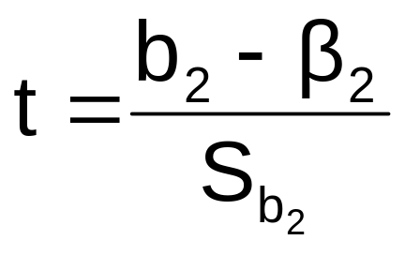

Testing for Significance: Quadratic Effect
(continued)
Testing the Quadratic Effect
Hypotheses
    (The quadratic term does not improve the model)
    (The quadratic term improves the model)
The test statistic is
H₀: β₂ = 0
H₁: β₂ ≠ 0
where:
b₂ = squared term slope
coefficient
β₂ = hypothesized slope (zero)
S_{b} = standard error of the slope
2
Statistics for Managers Using Microsoft Excel, 4e © 2004 Prentice-Hall, Inc.
Chap 14-<number>

Slide 11
Testing for Significance: Quadratic Effect
(continued)
Testing the Quadratic Effect
Compare r² from simple regression to
adjusted r² from the quadratic model
If adj. r² from the quadratic model is larger than the r² from the simple model, then the quadratic model is a better model
Statistics for Managers Using Microsoft Excel, 4e © 2004 Prentice-Hall, Inc.
Chap 14-<number>

Slide 12
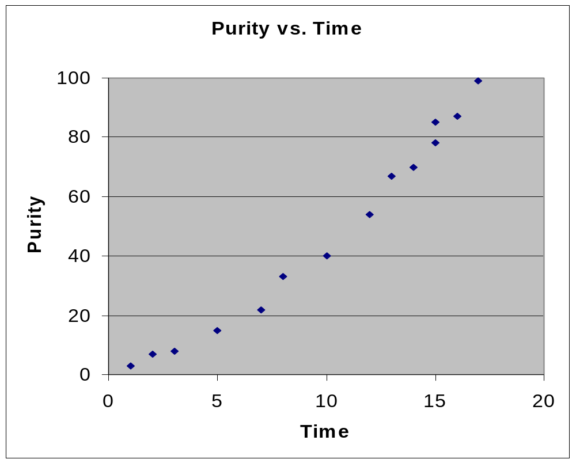
Example: Quadratic Model
Purity | Filter Time
3 | 1
7 | 2
8 | 3
15 | 5
22 | 7
33 | 8
40 | 10
54 | 12
67 | 13
70 | 14
78 | 15
85 | 15
87 | 16
99 | 17
Purity increases as filter time increases:
Statistics for Managers Using Microsoft Excel, 4e © 2004 Prentice-Hall, Inc.
Chap 14-<number>

Slide 13
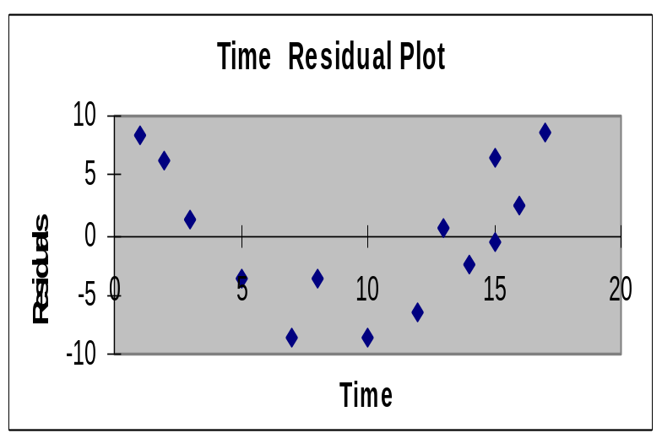
Example: Quadratic Model
(continued)
Simple regression results:
Y = -11.283 + 5.985 Time
^
 | Coefficients | Standard Error | t Stat | P-value
Intercept | -11.28267 | 3.46805 | -3.25332 | 0.00691
Time | 5.98520 | 0.30966 | 19.32819 | 2.078E-10
t statistic, F statistic, and r² are all high, but the residuals are not random:
Regression Statistics
R Square | 0.96888
Adjusted R Square | 0.96628
Standard Error | 6.15997
F | Significance F
373.57904 | 2.0778E-10
Statistics for Managers Using Microsoft Excel, 4e © 2004 Prentice-Hall, Inc.
Chap 14-<number>

Slide 14
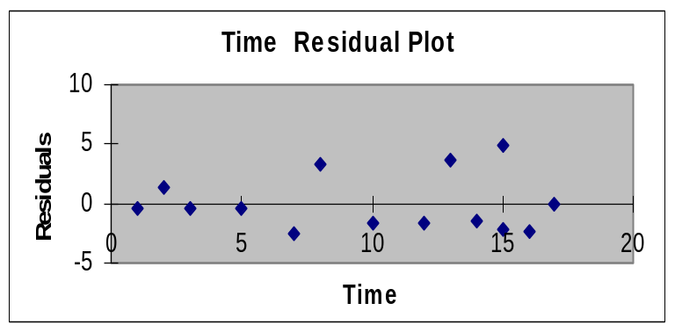
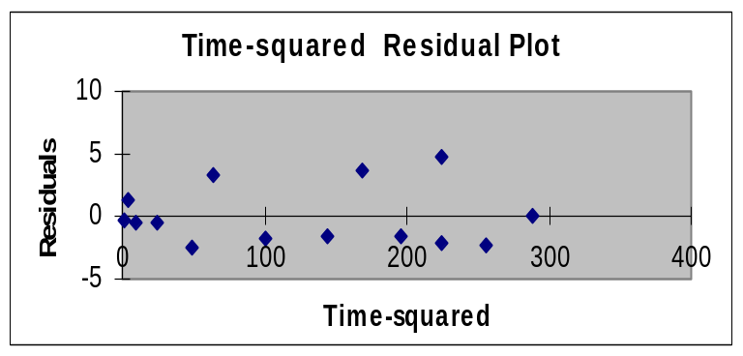
Example: Quadratic Model
(continued)
Quadratic regression results:
Y = 1.539 + 1.565 Time + 0.245 (Time)²
^
 | Coefficients | Standard Error | t Stat | P-value
Intercept | 1.53870 | 2.24465 | 0.68550 | 0.50722
Time | 1.56496 | 0.60179 | 2.60052 | 0.02467
Time-squared | 0.24516 | 0.03258 | 7.52406 | 1.165E-05
Regression Statistics
R Square | 0.99494
Adjusted R Square | 0.99402
Standard Error | 2.59513
F | Significance F
1080.7330 | 2.368E-13
The quadratic term is significant and improves the model: adj. r² is higher and S_{YX} is lower, residuals are now random
Statistics for Managers Using Microsoft Excel, 4e © 2004 Prentice-Hall, Inc.
Chap 14-<number>

Slide 15
Using Transformations in Regression Analysis
Idea:
non-linear models can often be transformed to a linear form
  Can be estimated by least squares if transformed
transform X or Y or both to get a better fit or to deal with violations of regression assumptions
Can be based on theory, logic or scatter diagrams
Statistics for Managers Using Microsoft Excel, 4e © 2004 Prentice-Hall, Inc.
Chap 14-<number>

Slide 16
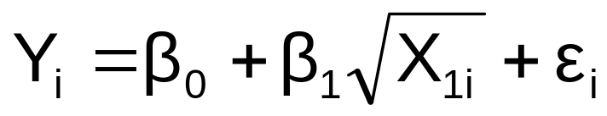
The Square Root Transformation
The square-root transformation
Used to
  overcome violations of the homoscedasticity assumption
  fit a non-linear relationship
Statistics for Managers Using Microsoft Excel, 4e © 2004 Prentice-Hall, Inc.
Chap 14-<number>

Slide 17


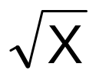
The Square Root Transformation
(continued)
Shape of original relationship
Relationship when transformed
Y
Y
b₁ > 0
X
Y
Y
b₁ < 0
X
Statistics for Managers Using Microsoft Excel, 4e © 2004 Prentice-Hall, Inc.
Chap 14-<number>

Slide 18
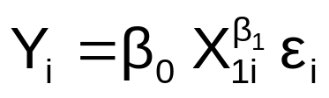

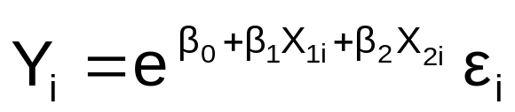
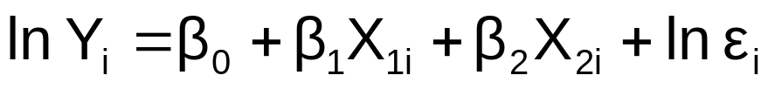
The Log Transformation
The Multiplicative Model:
Original multiplicative model
Transformed multiplicative model
The Exponential Model:
Original multiplicative model
Transformed exponential model
Statistics for Managers Using Microsoft Excel, 4e © 2004 Prentice-Hall, Inc.
Chap 14-<number>

Slide 19
Interpretation of coefficients
For the multiplicative model:
When both dependent and independent variables are logged:
  The coefficient of the independent variable X_{k} can be interpreted as : a 1 percent change in X_{k} leads to an estimated b_{k} percentage change in the average value of Y. Therefore b_{k} is the elasticity of Y with respect to a change in X_{k} .
Statistics for Managers Using Microsoft Excel, 4e © 2004 Prentice-Hall, Inc.
Chap 14-<number>

Slide 20
Collinearity
Collinearity: High correlation exists among two or more independent variables
This means the correlated variables contribute redundant information to the multiple regression model
Statistics for Managers Using Microsoft Excel, 4e © 2004 Prentice-Hall, Inc.
Chap 14-<number>

Slide 21
Collinearity
(continued)
Including two highly correlated explanatory variables can adversely affect the regression results
  No new information provided
  Can lead to unstable coefficients (large standard error and low t-values)
  Coefficient signs may not match prior expectations
Statistics for Managers Using Microsoft Excel, 4e © 2004 Prentice-Hall, Inc.
Chap 14-<number>

Slide 22
Some Indications of Strong Collinearity
Incorrect signs on the coefficients
Large change in the value of a previous coefficient when a new variable is added to the model
A previously significant variable becomes insignificant when a new independent variable is added
The estimate of the standard deviation of the model increases when a variable is added to the model
Statistics for Managers Using Microsoft Excel, 4e © 2004 Prentice-Hall, Inc.
Chap 14-<number>

Slide 23
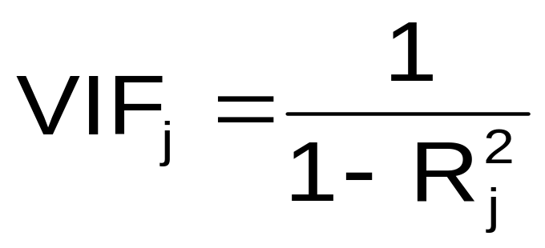
Detecting Collinearity
(Variance Inflationary Factor)
VIF_{j} is used to measure collinearity:
where R²_{j} is the coefficient of determination of variable X_{j} with all other X variables
If VIF_{j} > 5, X_{j} is highly correlated with the other explanatory variables
Statistics for Managers Using Microsoft Excel, 4e © 2004 Prentice-Hall, Inc.
Chap 14-<number>

Slide 24

Example: Pie Sales
Week | Pie Sales | Price ($) | Advertising ($100s)
1 | 350 | 5.50 | 3.3
2 | 460 | 7.50 | 3.3
3 | 350 | 8.00 | 3.0
4 | 430 | 8.00 | 4.5
5 | 350 | 6.80 | 3.0
6 | 380 | 7.50 | 4.0
7 | 430 | 4.50 | 3.0
8 | 470 | 6.40 | 3.7
9 | 450 | 7.00 | 3.5
10 | 490 | 5.00 | 4.0
11 | 340 | 7.20 | 3.5
12 | 300 | 7.90 | 3.2
13 | 440 | 5.90 | 4.0
14 | 450 | 5.00 | 3.5
15 | 300 | 7.00 | 2.7
Recall the multiple regression equation of chapter 13:
Sales = b₀ + b₁ (Price)
+ b₂ (Advertising)
Statistics for Managers Using Microsoft Excel, 4e © 2004 Prentice-Hall, Inc.
Chap 14-<number>

Slide 25
Detect Collinearity in PHStat
PHStat / regression / multiple regression …
  Check the “variance inflationary factor (VIF)” box
Regression Analysis
Price and all other X
Regression Statistics
Multiple R | 0.030438
R Square | 0.000926
Adjusted R Square | -0.075925
Standard Error | 1.21527
Observations | 15
VIF | 1.000927
Output for the pie sales example:
  Since there are only two explanatory variables, only one VIF is reported
    VIF is < 5
    There is no evidence of collinearity between Price and Advertising
Statistics for Managers Using Microsoft Excel, 4e © 2004 Prentice-Hall, Inc.
Chap 14-<number>

Slide 26
Model Building
Goal is to develop a model with the best set of independent variables
  Easier to interpret if unimportant variables are removed
  Lower probability of collinearity
Stepwise regression procedure
  Provide evaluation of alternative models as variables are added
Best-subset approach
  Try all combinations and select the best using the highest adjusted r² and lowest standard error
Statistics for Managers Using Microsoft Excel, 4e © 2004 Prentice-Hall, Inc.
Chap 14-<number>

Slide 27
Stepwise Regression
Idea: develop the least squares regression equation in steps, adding one explanatory variable at a time and evaluating whether existing variables should remain or be removed
The coefficient of partial determination is the measure of the marginal contribution of each independent variable, given that other independent variables are in the model
Statistics for Managers Using Microsoft Excel, 4e © 2004 Prentice-Hall, Inc.
Chap 14-<number>

Slide 28
Best Subsets Regression
Idea: estimate all possible regression equations using all possible combinations of independent variables
Choose the best fit by looking for the highest adjusted r² and lowest standard error
Stepwise regression and best subsets regression can be performed using PHStat
Statistics for Managers Using Microsoft Excel, 4e © 2004 Prentice-Hall, Inc.
Chap 14-<number>

Slide 29
Alternative Best Subsets Criterion
Calculate the value C_{p} for each potential regression model
Consider models with C_{p} values close to or below k + 1
  k is the number of independent variables in the model under consideration
Statistics for Managers Using Microsoft Excel, 4e © 2004 Prentice-Hall, Inc.
Chap 14-<number>

Slide 30
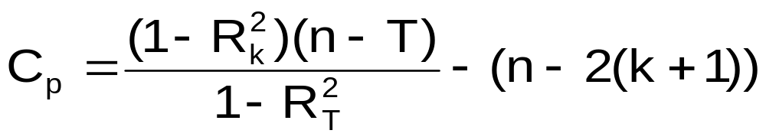


Alternative Best Subsets Criterion
(continued)
The C_{p} Statistic
Where k = number of independent variables included in a
particular regression model
T = total number of parameters to be estimated in the
full regression model
= coefficient of multiple determination for model with k
independent variables
= coefficient of multiple determination for full model with
all T estimated parameters
Statistics for Managers Using Microsoft Excel, 4e © 2004 Prentice-Hall, Inc.
Chap 14-<number>

Slide 31
10 Steps in Model Building
1. Choose explanatory variables to include in the model
2. Estimate full model and check VIFs
3. Check if any VIFs > 5
4.
  If no VIF > 5, go to step 5
  If one VIF > 5, remove this variable
  If more than one, eliminate the variable with the highest VIF and go back to step 2
5. Perform best subsets regression with remaining variables …
Statistics for Managers Using Microsoft Excel, 4e © 2004 Prentice-Hall, Inc.
Chap 14-<number>

Slide 32
10 Steps in Model Building
(continued)
6. List all models with C_{p} close to or less than (k + 1)
7. Choose the best model
  Consider parsimony
  Do extra variables make a significant contribution?
8. Perform complete analysis with chosen model, including residual analysis
9. Transform the model if necessary to deal with violations of linearity or other model assumptions
10. Use the model for prediction
Statistics for Managers Using Microsoft Excel, 4e © 2004 Prentice-Hall, Inc.
Chap 14-<number>

Slide 33
Model Building Flowchart
Choose X₁,X₂,…X_{k}
Run subsets regression to obtain “best” models in terms of C_{p}
No
Run regression to find VIFs
Any VIF>5?
Yes
Do complete analysis
Remove variable with highest VIF
Yes
More than one?
Add quadratic term and/or transform variables as indicated
No
Remove this X
Perform predictions
Statistics for Managers Using Microsoft Excel, 4e © 2004 Prentice-Hall, Inc.
Chap 14-<number>

Slide 34
Pitfalls and Ethical Considerations
To avoid pitfalls and address ethical considerations:
Understand that interpretation of the estimated regression coefficients are performed holding all other independent variables constant
Evaluate residual plots for each independent variable
Evaluate interaction terms
Statistics for Managers Using Microsoft Excel, 4e © 2004 Prentice-Hall, Inc.
Chap 14-<number>

Slide 35
Additional Pitfalls and Ethical Considerations
(continued)
To avoid pitfalls and address ethical considerations:
Obtain VIFs for each independent variable before determining which variables should be included in the model
Examine several alternative models using best-subsets regression
Use other methods when the assumptions necessary for least-squares regression have been seriously violated
Statistics for Managers Using Microsoft Excel, 4e © 2004 Prentice-Hall, Inc.
Chap 14-<number>

Slide 36
Chapter Summary
Developed the quadratic regression model
Discussed using transformations in regression models
  The multiplicative model
  The exponential model
Described collinearity
Discussed model building
  Stepwise regression
  Best subsets
Addressed pitfalls in multiple regression and ethical considerations
Statistics for Managers Using Microsoft Excel, 4e © 2004 Prentice-Hall, Inc.
Chap 14-<number>

