Slide 1
Project Presentation of Industry Oriented Hands on Experience (22CS422)
On
JamReviewer
Vipin Attri 2211985056 Supervised by
Divyansh Sharma 2211985019 Dr. Rajat Takkar
Akash 2211985002
Department of Computer Science and Engineering,
Chitkara University, Punjab

Slide 2
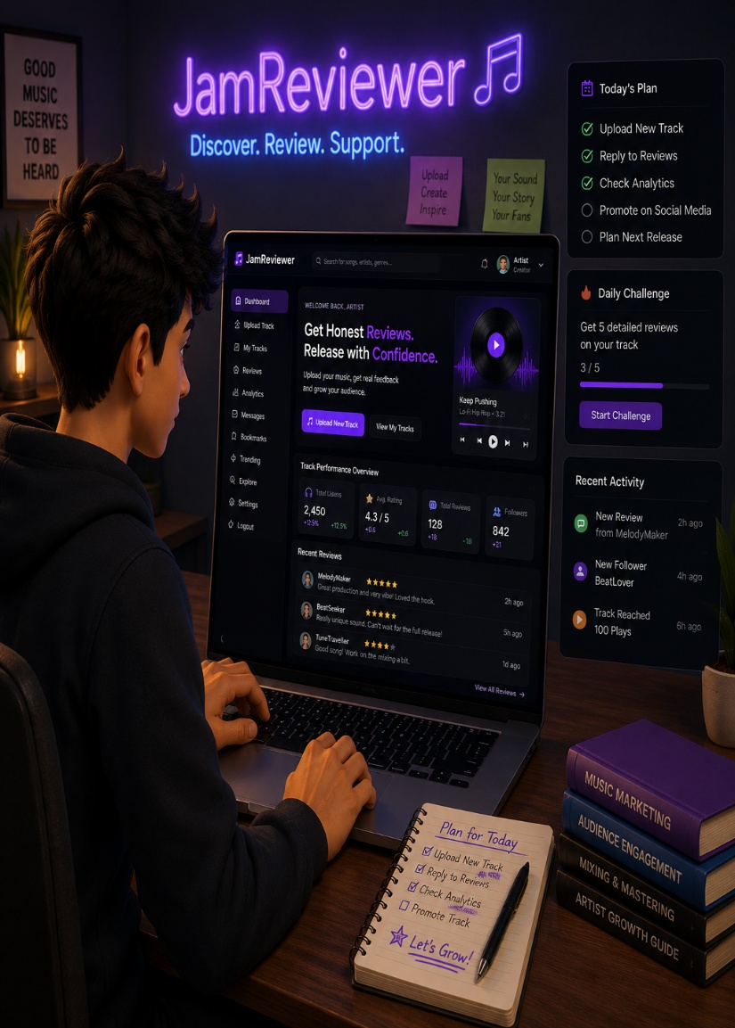
.
Welcome to JamReviewer
Introducing JamReviewer: JamReviewer is a web-based music review platform designed for emerging and independent artists to share their songs and receive honest audience feedback before official release. The system allows users to stream music, rate tracks, and post reviews, while creators can analyze audience response through analytics. It promotes underground talent discovery, constructive criticism, and informed music publishing decisions.

Slide 3
.
The Problem: Why JamReviewer?
Lack of honest Pre-release feedback
Independent and emerging artists often release music without knowing how audiences will react. Existing platforms mainly focus on publishing rather than constructive feedback, making it difficult for creators to improve their work before launch.
Limited visibility of ground talent
Small creators struggle to gain exposure because major music platforms prioritize already popular artists. As a result, many talented musicians fail to reach listeners, receive recognition.

Slide 4
.
Our Solution: Centralized Platform
1
Centralized music Review platform
2
Community driven feedback system
Listeners can rate tracks, share honest reviews, and help creators improve their music through constructive feedback.
JamReviewer provides a single platform where artists can upload songs, receive reviews, and analyze audience reactions before official release.
3
Artist growth and analytics
The platform offers engagement insights, ratings, and listener activity analytics to help artists make informed release decisions.

Slide 5
.
Key Features of JamReviewer
Music upload and streaming
Artists can upload and share their songs for listeners to stream directly on the platform.
Review and rating system
Users can provide ratings and detailed feedback to help creators improve their music.
Analytics Dashboard
Creators can track engagement, ratings, and audience response through performance analytics.

Slide 6
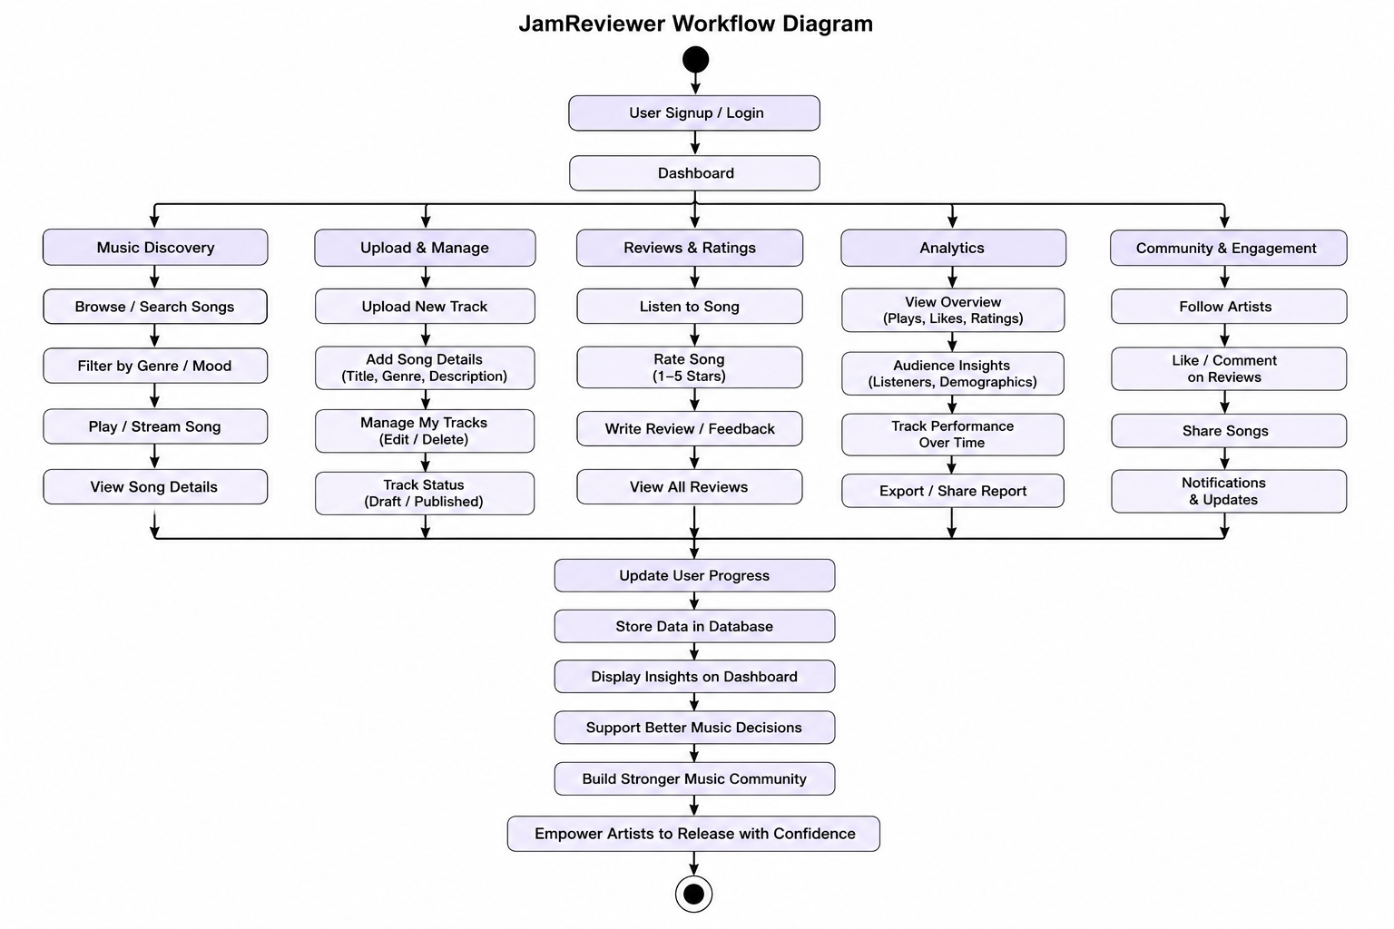
-
WORKFLOW Diagram

Slide 7
.
Thank You

