Slide 1

A
PRESENTATION ON
ONLINE PIZZA SHOP
HOD OF CSE
Dr. C.L.P Gupta
GUIDED BY
Prof. Hannan Ansari
SUBMITTED BY:-
VIPIN KUMAR YADAV (1842210118)
VIVEK PRAKASH PRAJAPATI(1842210121)
BANSAL INSTITUTE OF ENGINEERING & TECHNOLOGY, LUCKNOW DEPARTMENT OF COMPUTER SCIENCE AND ENGINEERING

Slide 2
Contents
1
What is online delivery system
Objective
2
3
Proposed Methodology
4
Requirements
Tools
6
5
Future Scope
7
References

Slide 3
1
What is Online Delivery System?
Online Pizza Delivery is a process of ordering pizza from a website. A customer will search for a favorite pizza ,usually filtered is type of pizza and choose from available items, and choose to delivery.

Slide 4
Objective
2
The main objective of “Online Pizza Shop” is to provide an essence of Online Pizza via a simple and yet powerful medium to customer.
Reduce the time of delivery.

Slide 7
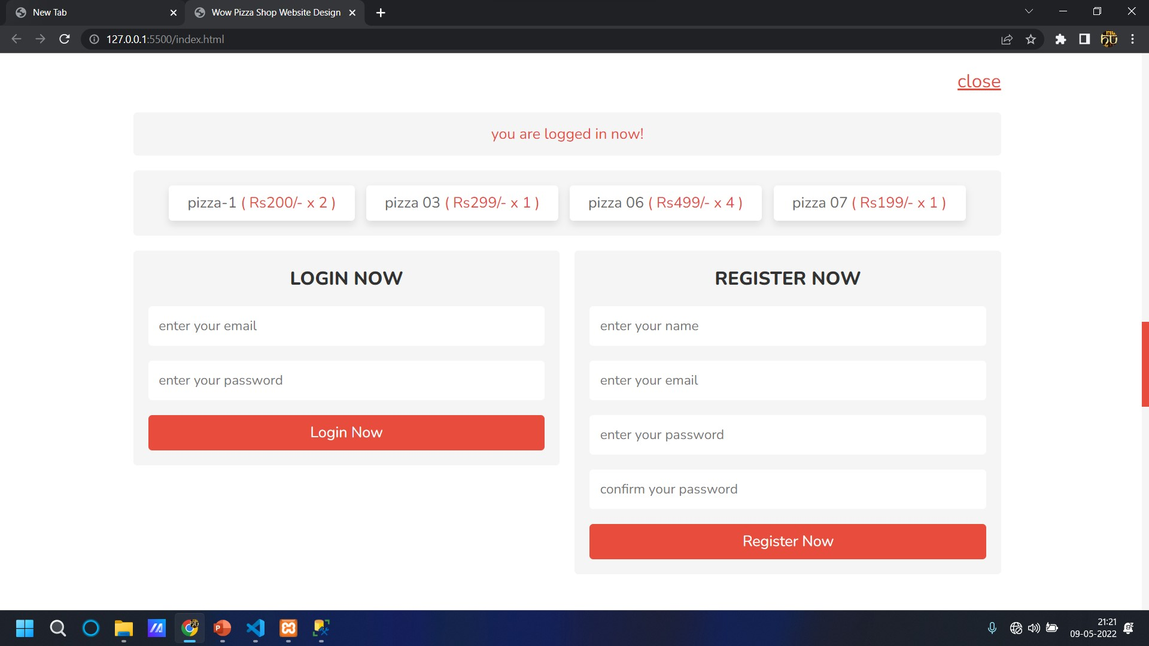

Slide 8
Proposed Methodology
3
The main purpose of the Online Pizza Shop System is to reach to wider range of customers and to educate them about existing and new packages and discounts offered by pizza shop.
One more purpose is to allow customers to place order online using interactive men so that they can receive order at home.
Allow customer to pay online.
This system reduce the time consumption.

Slide 9
Requirements
4
Hardware requirements(min.)
• 512 MB of RAM.
• i3 processor or higher.
Software Requirements(min.)
• Microsoft Visual Studio Code 2010 or any editor.

Slide 10
5
Tools
Front-end
HTML
CSS
BOOTSTRAP
Back-end
PHP
MySQL

Slide 11
5
Use-case diagram
A use case diagram is a visual representation of how a user might interact with a program.
A use case diagram depicts the system’s numerous use cases and different sorts of users.
The circles or ellipses are used to depict the use cases.

Slide 12

Future Scope
6
Collaboration with Other Restaurant and Pizza Shop.

Slide 14
References
References
5
12
HTML Tutorial (https://www.w3schools.com/html/)
SASS Tutorial (https://www.w3schools.com/sass/)
HTML Tutorial - Tutorialspoint

Slide 15
13
Thank You …

