Slide 1

Social Distancing Detector
Under The Guidance Of:
Submitted By:
Ankit Yadav (17JE003538)
Vipin Pal (17JE003235)
Prof Haider Banka
Indian Institute of Technology(ISM),Dhanbad

Slide 2
ABSTRACT
In addressing the worldwide Covid-19 pandemic situation, the process of flattening the curve for coronavirus cases will be difficult if the citizens do not take action to prevent the spread of the virus. One of the most important practices in these outbreaks is to ensure a Safe Social distance between people in public. This project presents the detection of people with social distance monitoring as a precautionary measure in reducing physical contact between people. Project focuses on detecting people in areas of interest using the Yolo Object detector object tracking model and OpenCV library for image processing. The distance will be computed between the persons detected in the captured footage and then compared to a fixed pixels' values. The distance is measured between the central points and the overlapping boundary between persons in the segmented tracking area. With the detection of unsafe distances between people, alerts or warnings can be issued to keep the distance safe.

Slide 3
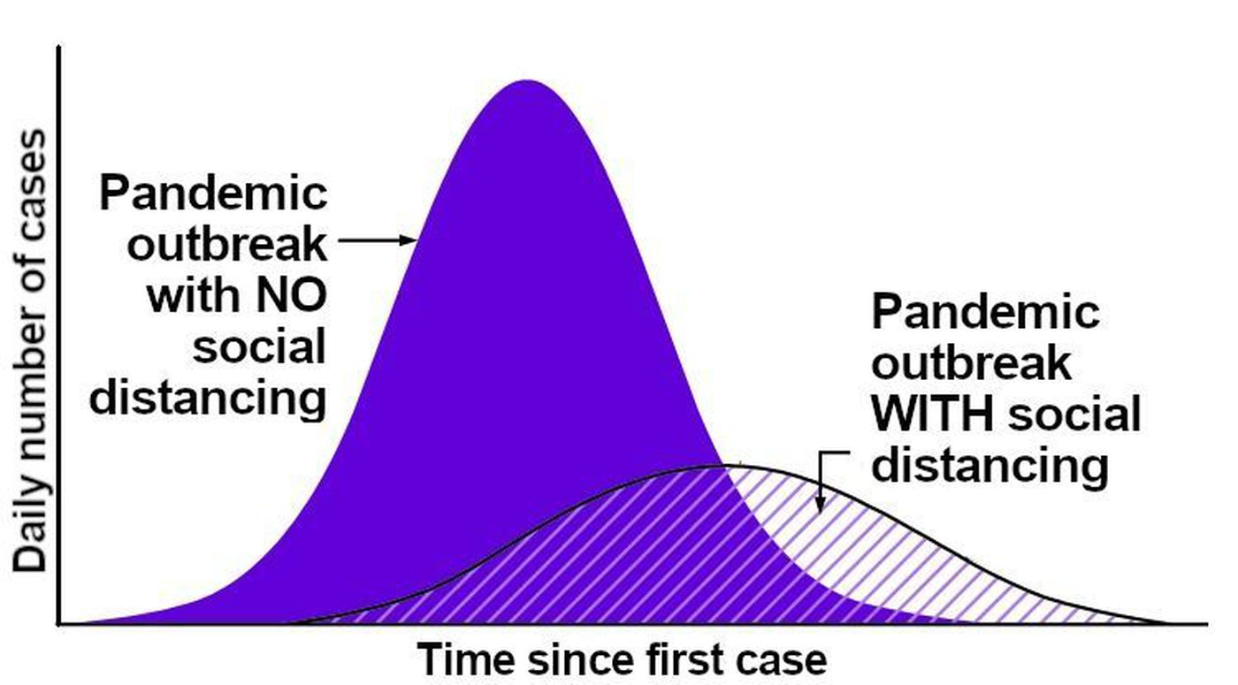
INTRODUCTION
Why social distancing is imporant ?

Slide 4
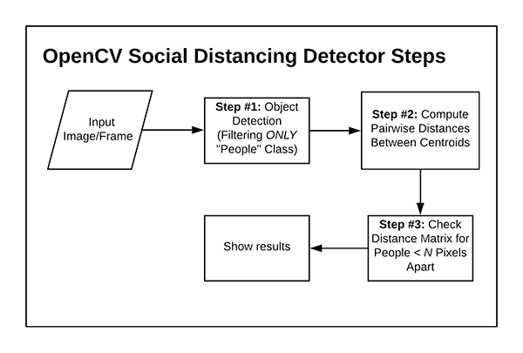
PROPOSED SOLUTION
In this study, the proposed idea is development based in Python3,OpenCV and Yolo object detector.OpenCV is used to utilize the image processing methods that will be explained further while YOLO object detector is used to detect peoples in image or video stream.

Slide 5
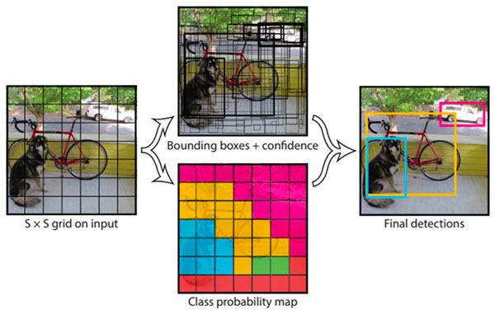
    Object Detection Model
YOLO object detector is used to detect the people in video stream.
It splits the input into a SX S grid of cells and each cell directly predicts a bounding box and object classification. The result is a large number of candidate bounding boxes that are consolidated into a final prediction by a post-processing step.

Slide 6
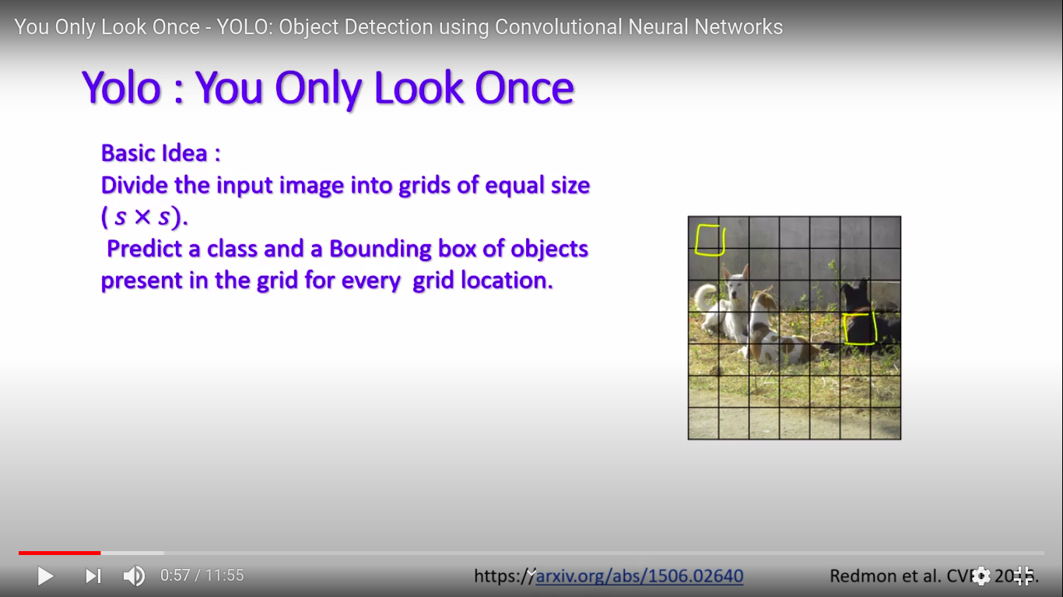

Slide 7
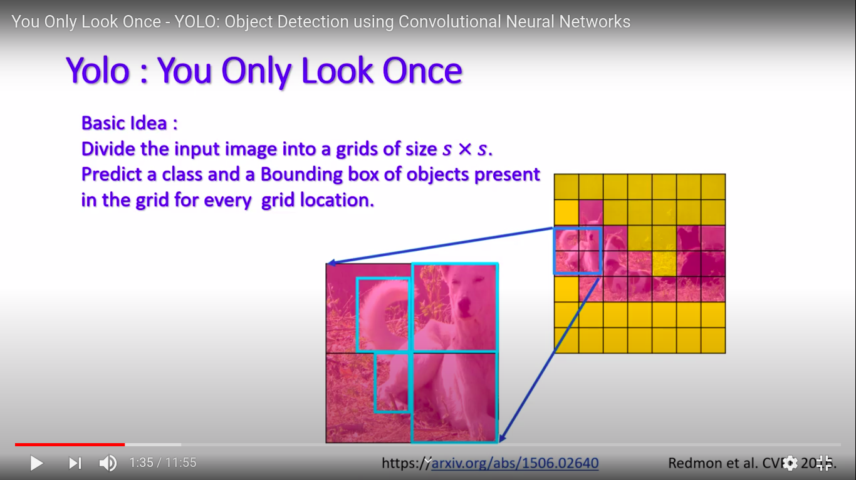

Slide 8
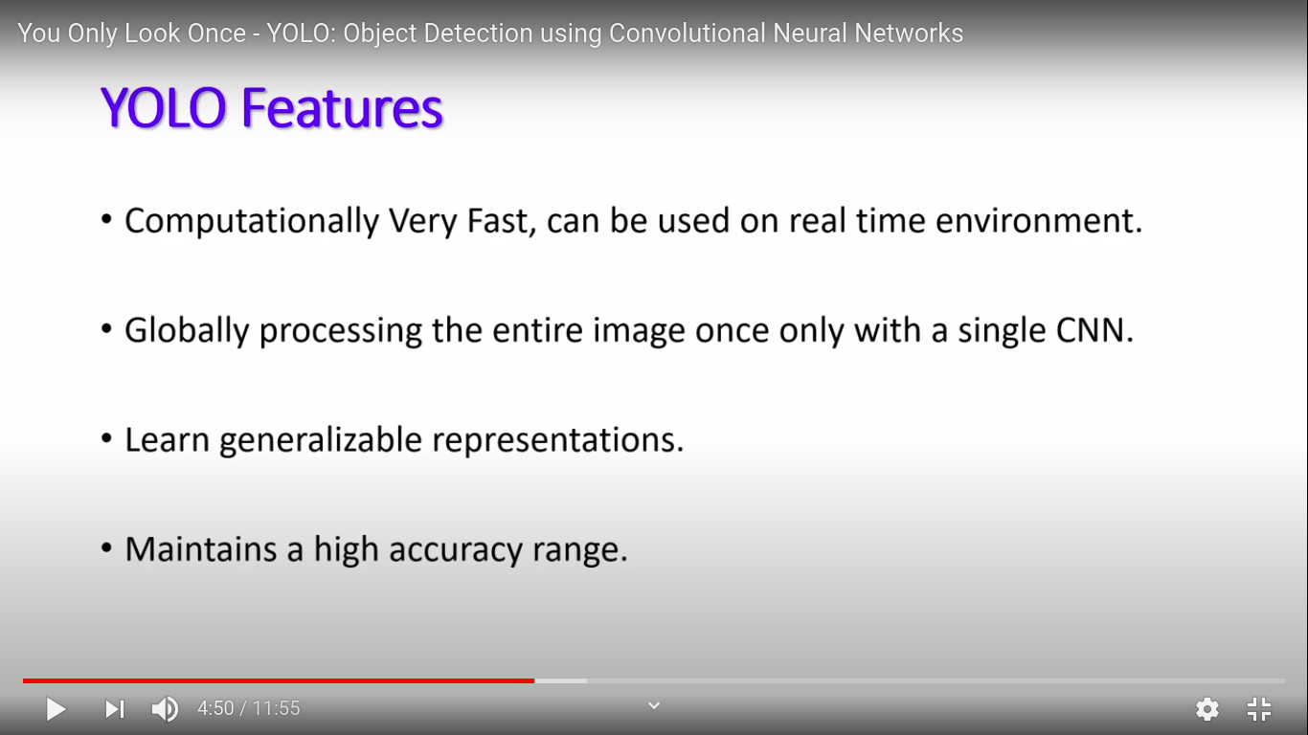

Slide 9
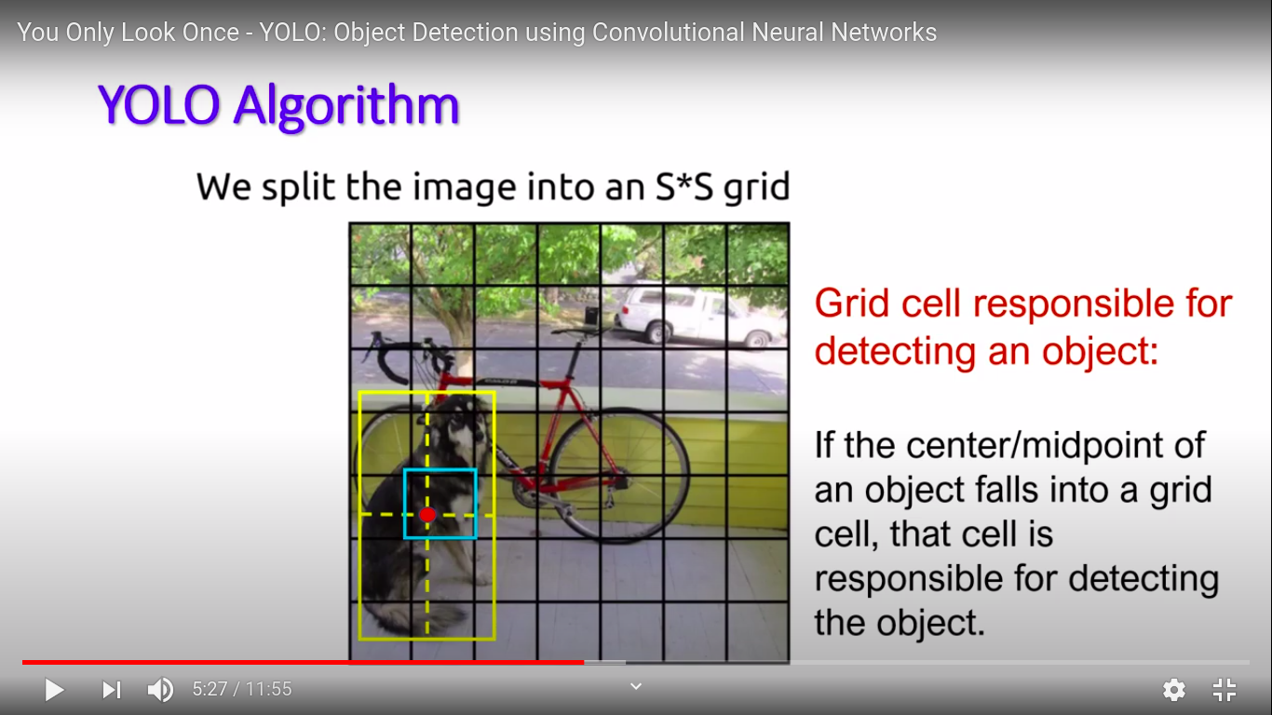

Slide 10
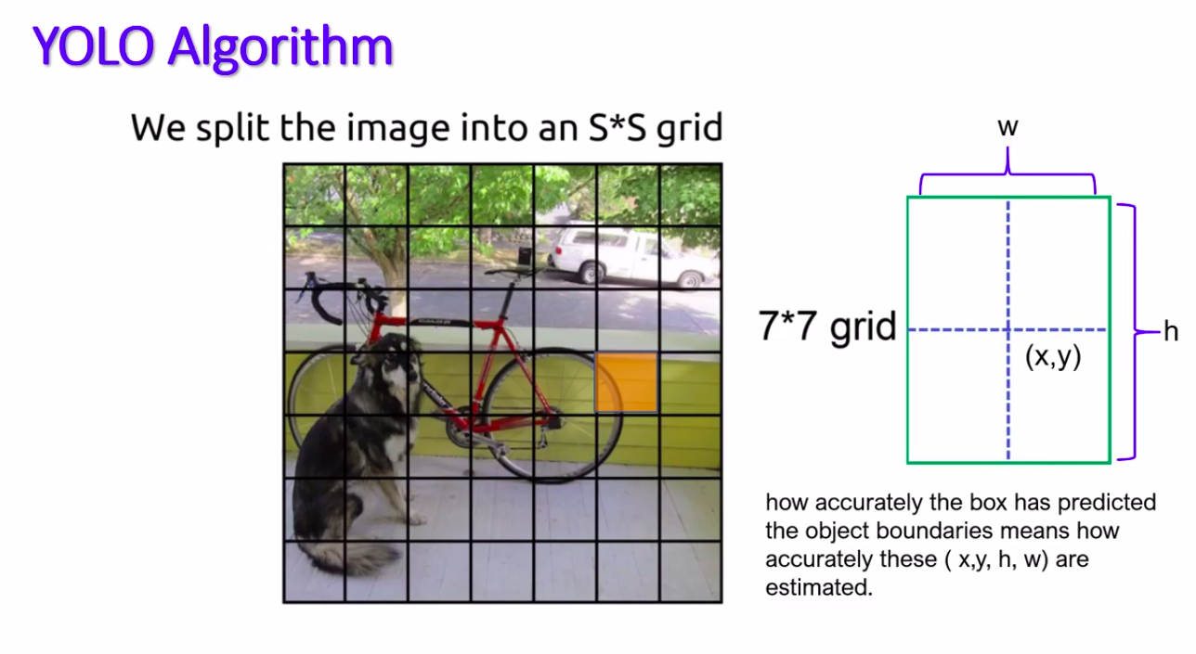

Slide 11
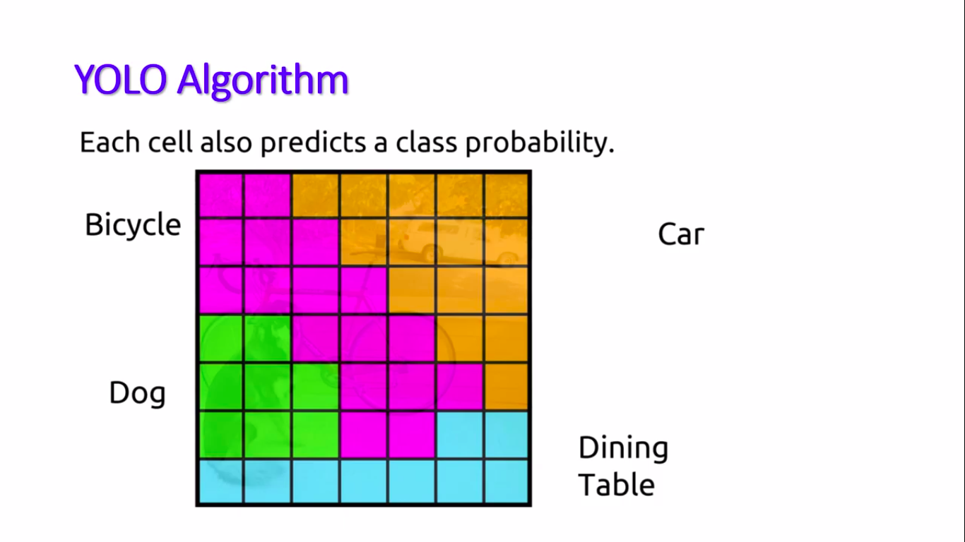

Slide 12
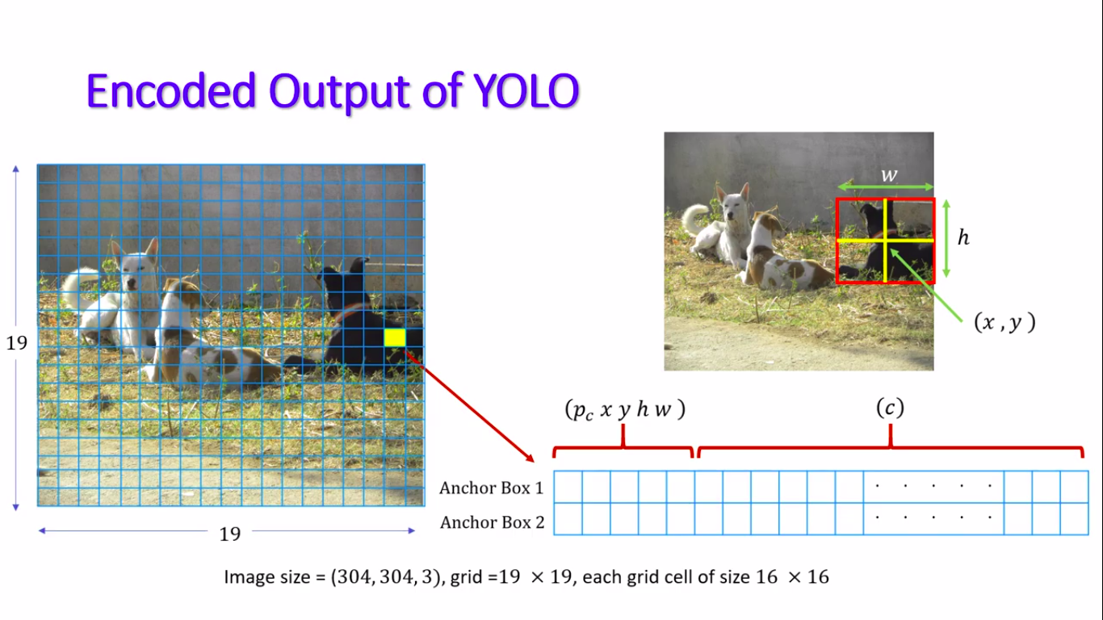

Slide 13
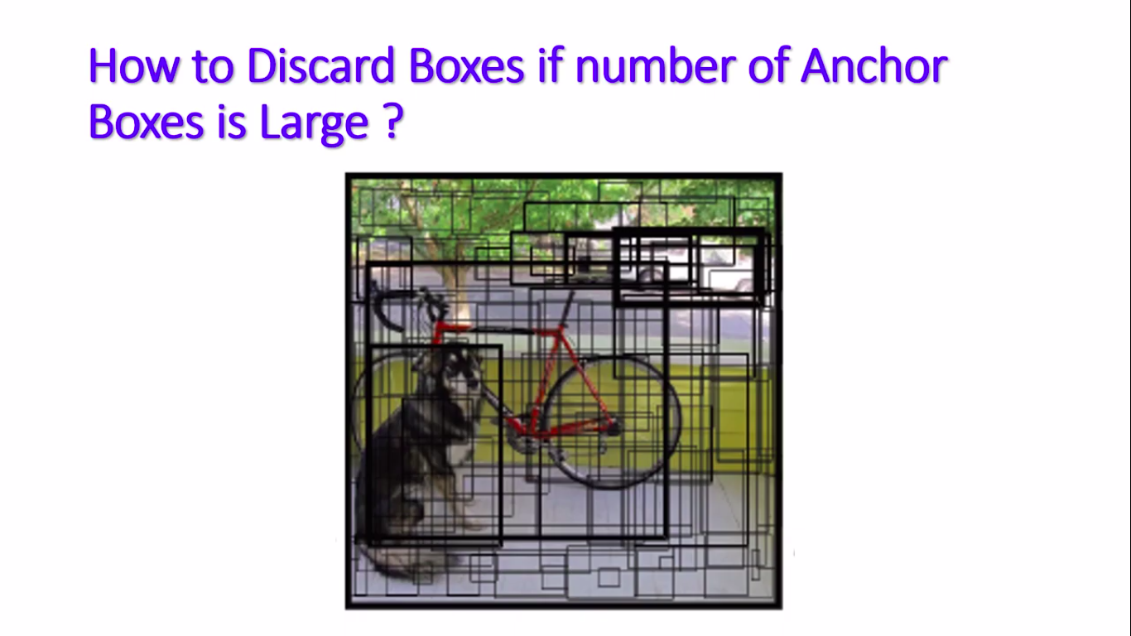

Slide 14
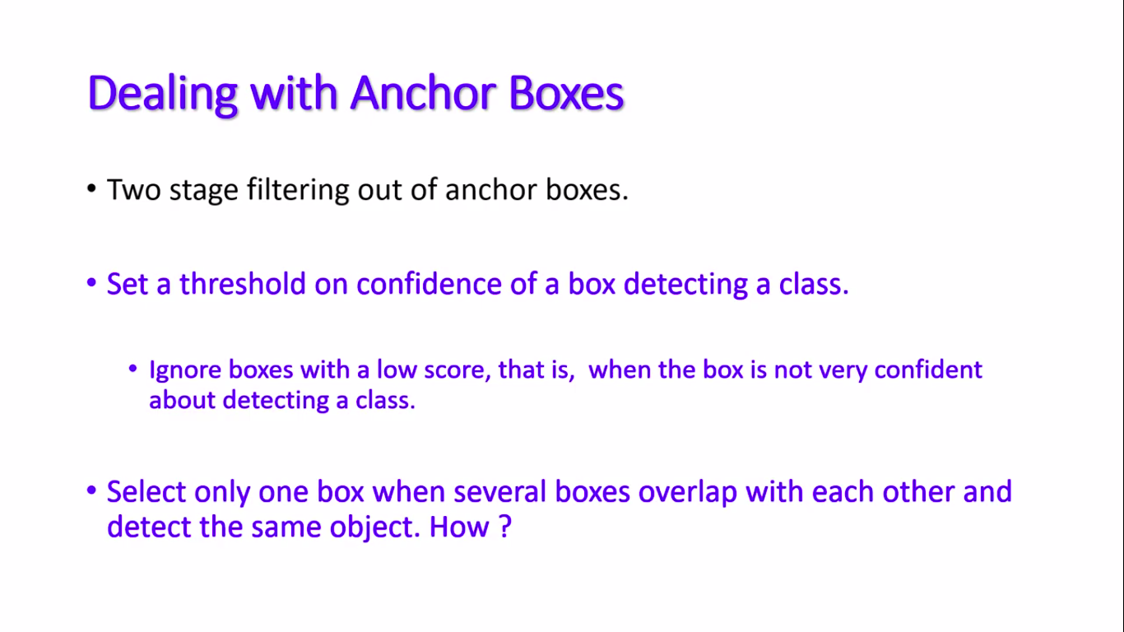

Slide 15
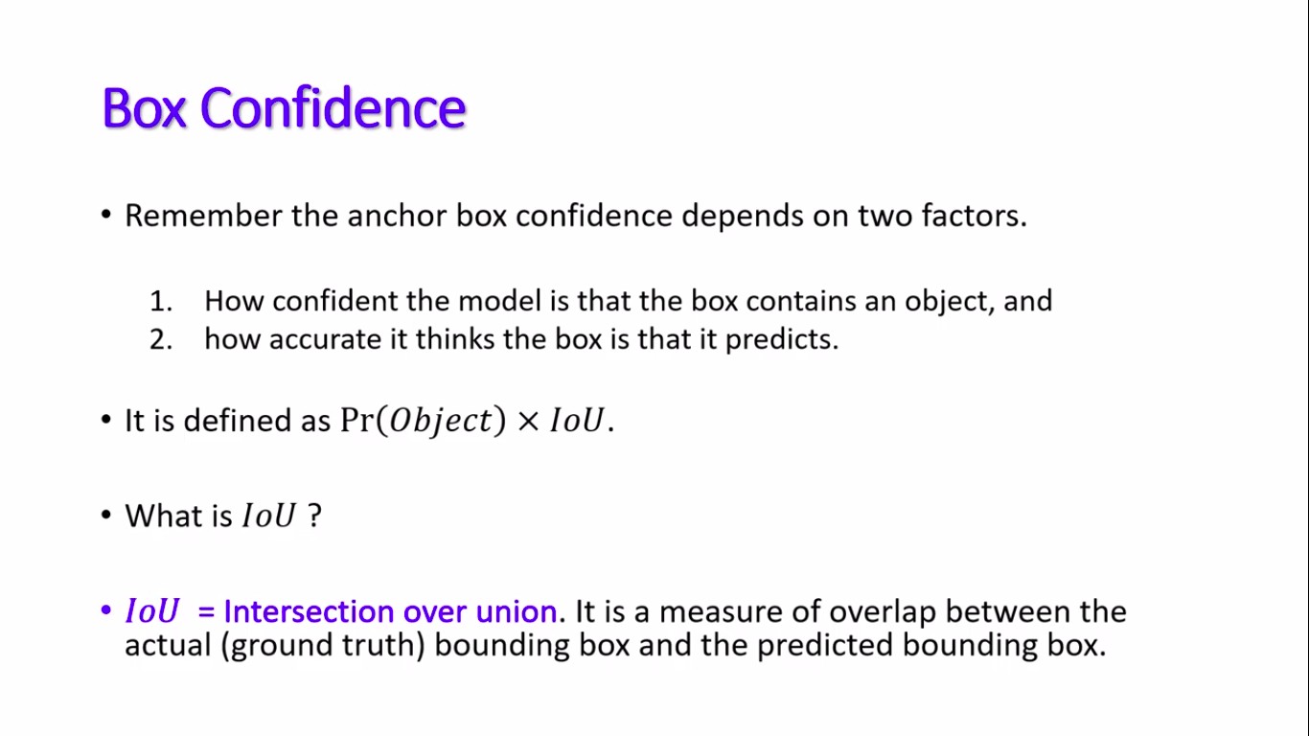

Slide 16
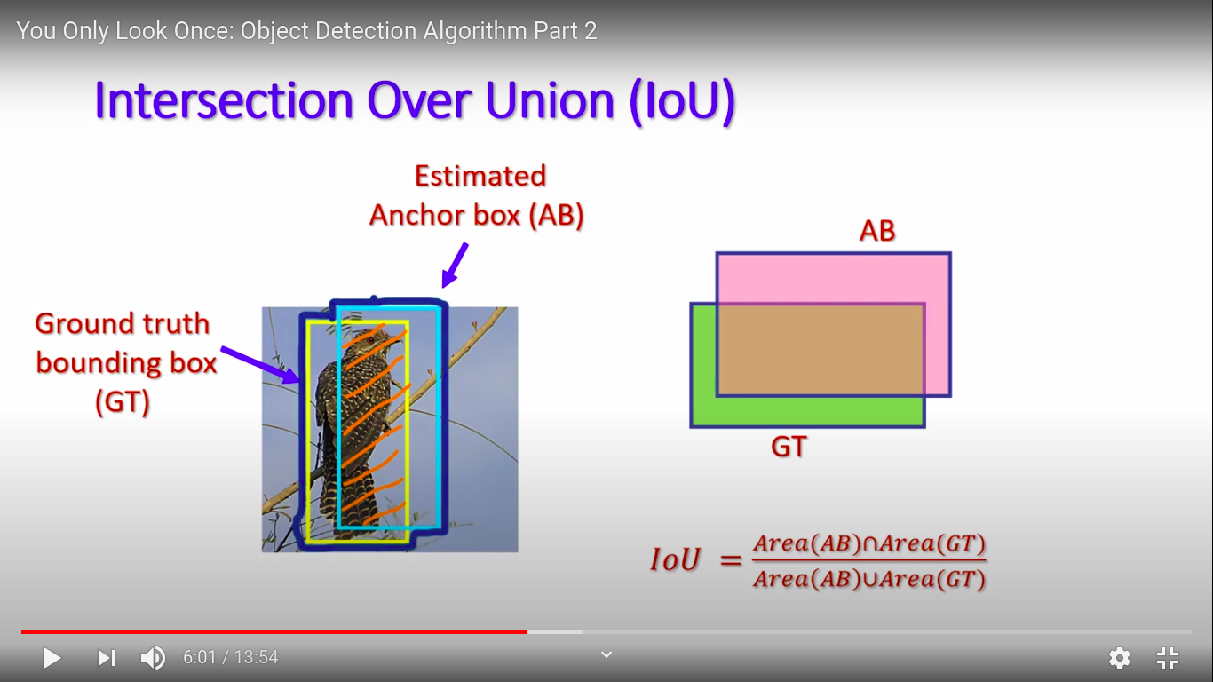

Slide 17
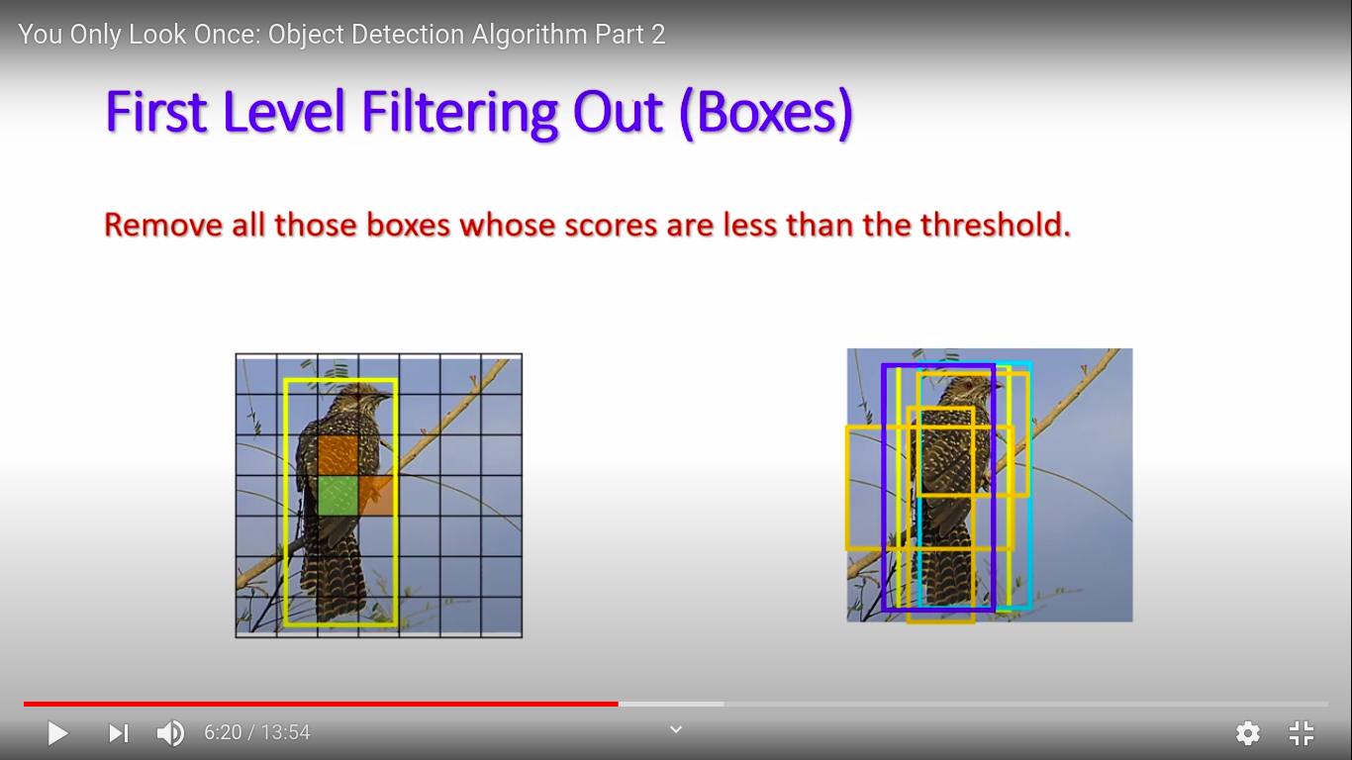

Slide 18
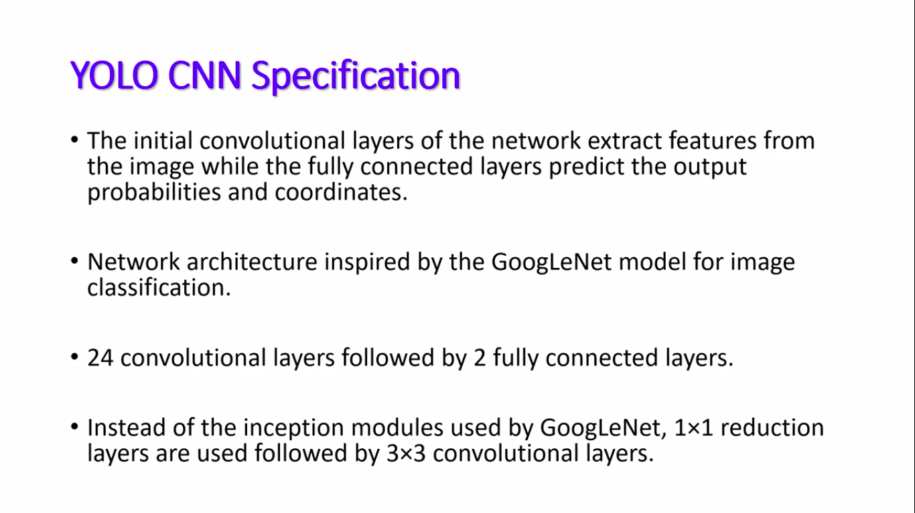

Slide 19
    Calculate the center point of a bounding box
To measure the center point,C(x, y), of the bounding box for the detected person, midpoint equation is used below.
C(x,y)=( (xmin+xmax)/2, (ymin+ymax2)/2 )
Each of the minimum and maximum value for the corresponding width,xmin and xmax,
height,ymin and ymax, of the bounding box will be used to calculate the center point of the bounding box
    Calculate distance between bounding box
To measure the distance,C1(xmin,ymin)and C2(xmax , ymax), between each of the detected person in the frame,
distance equation is used below.
d(C1′C2)=((xmax−xmin)2+(ymax−ymin)^2)^(1/2)
The center point of the bounding boxes is taken to determine between two different locations of the bounding boxes.
After getting the center points value, the algorithm will calculate if the distance is lower or higher than 50 pixels.

Slide 20
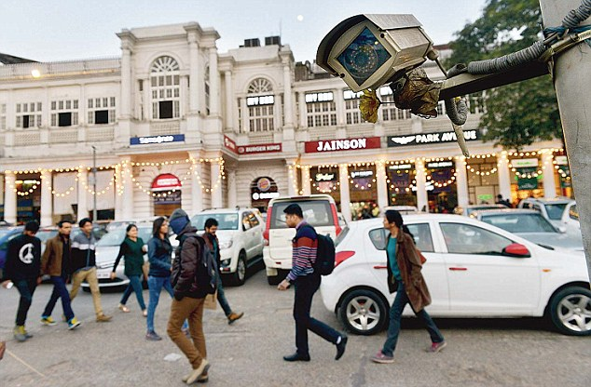
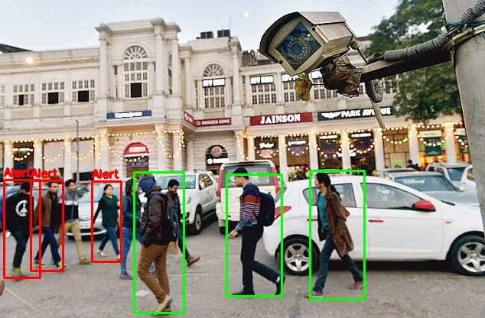
RESULT

Slide 21
RESULT

Slide 22
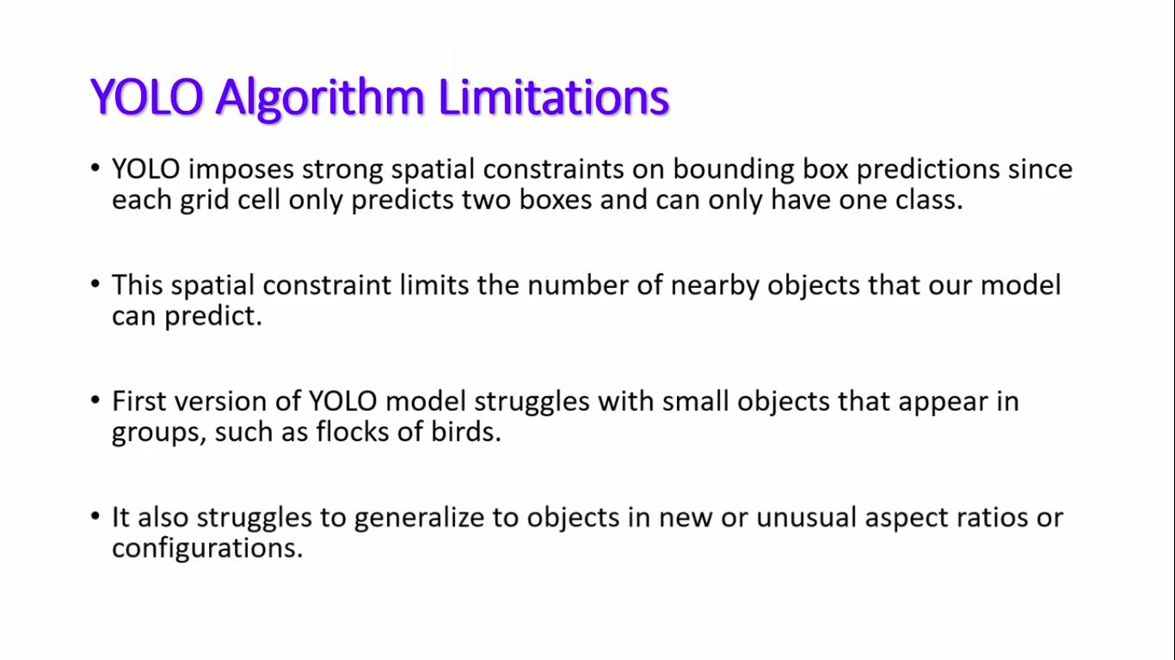

Slide 23
Future Scope of Work
→ We can use a better object detection algorithm like RCNN and more faster versions of RCNN for real time object detection.
→ In future we are looking forward to build a cloud-based application which apply our technique to live cam video inputs.
→ We can use view transformation to locate objects using bird view because that fits better
in our problem description.

Slide 24
REFERENCES:
"Coronavirus Disease 2019",Coronavirus disease (COVID-19) pandemic, Jun. 2020, [online] Available: https://www.who.int/emergencies/diseases/novel-coronavirus-2019
"YOLO object detection with OpenCV”: https://www.pyimagesearch.com/2018/11/12/yolo-object-detection-with-opencv/
“Person Detection for Social Distancing and Safety Violation Alert based on Segmented ROI” https://ieeexplore.ieee.org/document/9204934/authors#authors

