Slide 1



LENDING CLUB CASE STUDY
Group Members:
VIpin Jaguri
Deepak Kalarikkal

Slide 2
Problem Statement
Lending Club is the largest online matketplace facilitating personal as well as business loans.
It is a consumer finance company which specialises in lending various types of loans to urban customers.
There are two types of risks associated with the bank’s decision to approve or decline loan request:
1. If the applicant is likely to repay the loan, then not approving the loan results in a loss of business to the company
2. If the applicant is not likely to repay the loan, i.e. he/she is likely to default, then approving the loan may lead to a financial loss for the company
The purpose of our analysis is to look for patterns which could indicate if a person is likely to default, which may be used for taking actions such as denying the loan, reducing the amount of loan, lending (to risky applicants) at a higher interest rate, etc.
The analysis has to be performed using EDA (Exploratory Data Analysis).

Slide 3

PROBLEM SOLVING METHODOLOGY
Data understanding and domain knowledge
Data cleaning
Datatype treatment
Derived metrics
Univariate analysis
Bivariate analysis
Data Visualisation and correlation

Slide 4
Data Understanding and Cleaning
Loading our dataset and understanding its columns.
Going through the dataset to understand relevant columns and their interpretations. Domain knowledge is applied to extract some of the insights.
Fixing Columns:
Delete unnecessary columns.
Remove columns that have high percentage of missing values.
Drop unnecessary columns with string names.
Drop columns having only 1 unique values.
Drop customer behavior variables as these are not available at time of loan application.
FIXING ROWS:
Removing Irrelevant rows.
Imputing missing values with suitable representative values

Slide 5
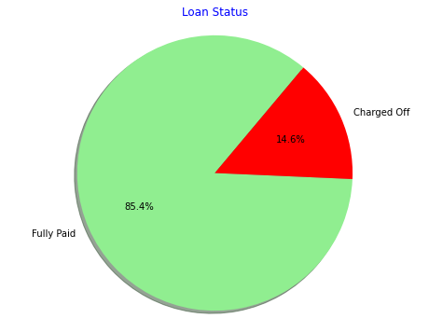
Univariate Analysis
Plotting Loan_status to visualize distribution of Fully paid and charged off loans.
We can see that around 15% of the loans resulted in defaults.

Slide 6
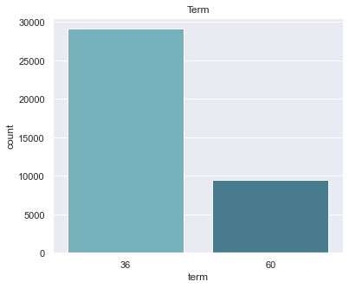
Univariate Analysis
Plotting terms to visualize distribution of terms across dataset.
We can see that loans with term 36 months are around 3 times loans with 60 months.

Slide 7
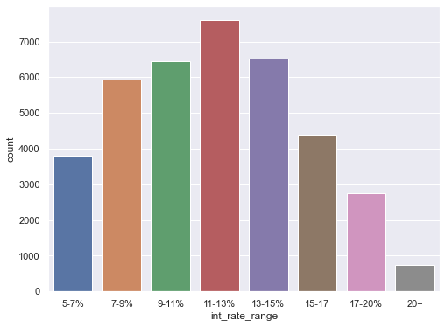
Univariate Analysis
Plotting interest rates ranges to visualize distribution of interest rates across dataset.
We can observe that loans are maximum in the interest range 11-13% and loans with higher interest rates are lesser.

Slide 8
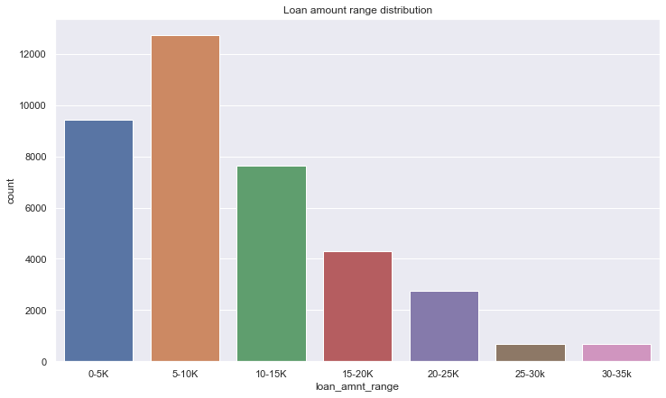
Univariate Analysis
Plotting loan ammount ranges to visualize distribution of loan ammount range across dataset.
We can observe that loans are maximum in the loan ammount are maximum in the range 5-10K.

Slide 9
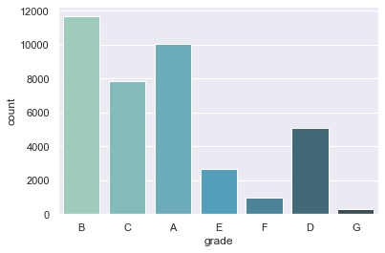
Univariate Analysis
Plotting grades to visualize distribution of grades across dataset.
We can observe that maximum loans are of B grades and G grades has minimum loan counts.

Slide 10
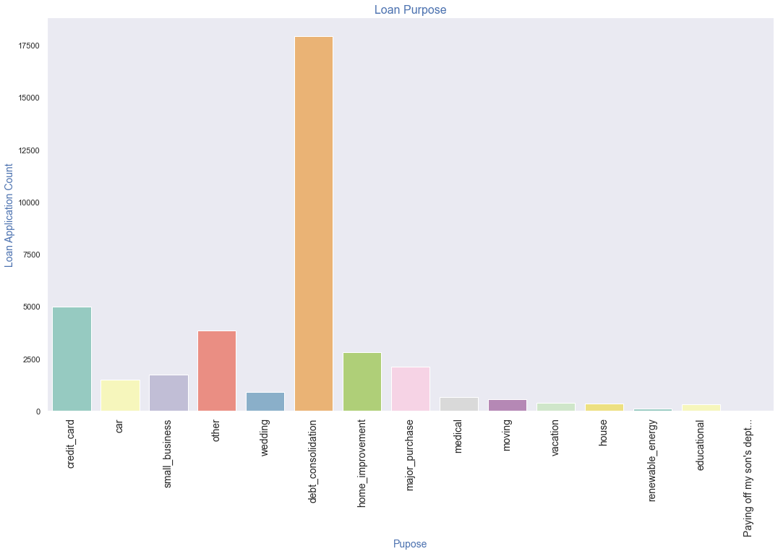
Univariate Analysis
Plotting purpose of loans to visualize distribution of purpose across dataset.
We can observe that maximum loans are taken for debt consolidation purpose.

Slide 11
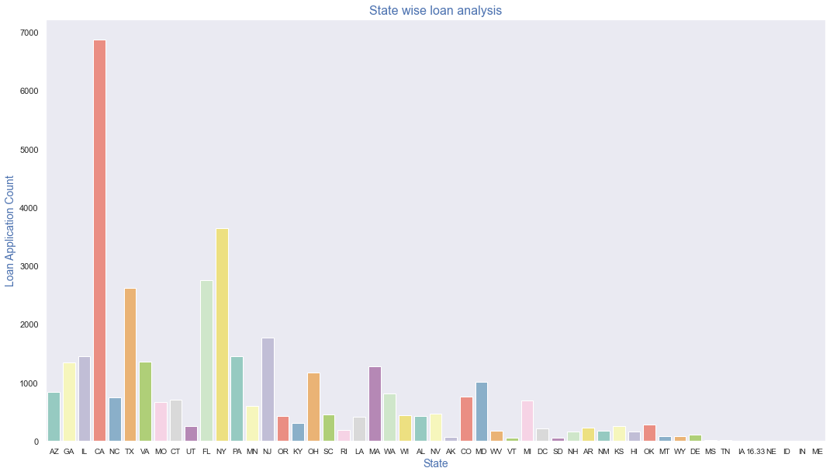
Univariate Analysis
Plotting purpose of State to visualize distribution of State across dataset.
We can observe that maximum loans have been from the state of California.

Slide 12
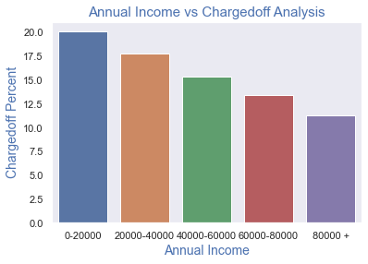
Bivariate Analysis
Plotting Annual income range against Chargedoff Percentage of loan_status shows that with increase in annaul income, percentage of charged off decreases.

Slide 13
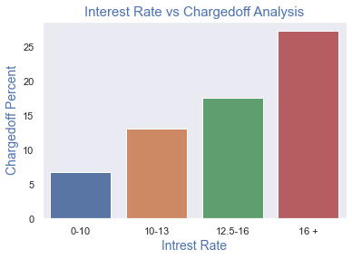
Bivariate Analysis
Plotting interest range against Chargedoff Percentage of loan_status shows that with increase in interest rates, percentage of charged off increases.

Slide 14
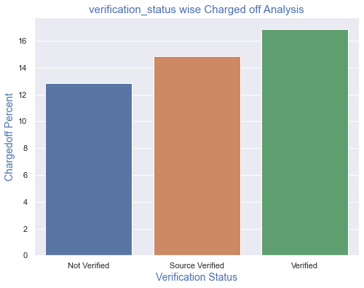
Bivariate Analysis
Plotting verification status against Chargedoff Percentage of loan_status shows surprising results.
Loans where verification is done actually have more charged off percentage than those where verification were done at source verification or which were not verified.

Slide 15
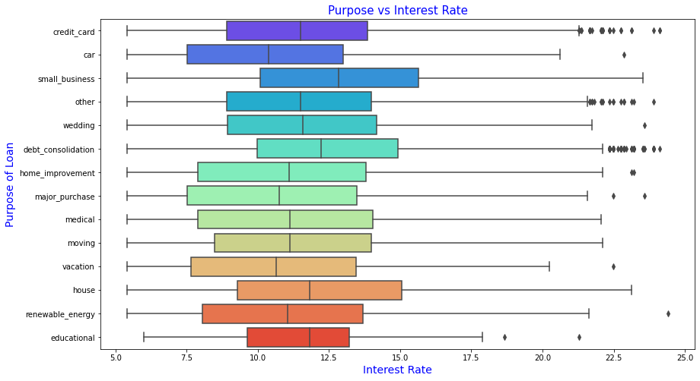
Bivariate Analysis
We can observe that higher interest rates are charged for small business loan and house loan.

Slide 16
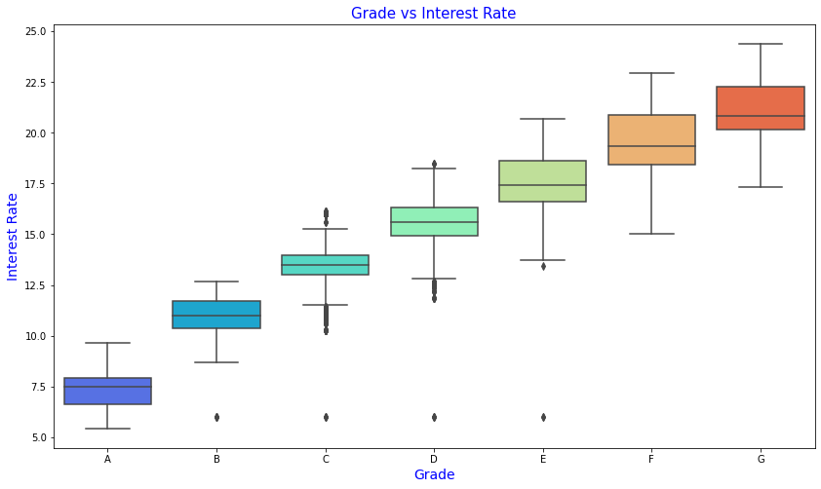
Bivariate Analysis
Interest Rate increases as we move from Grade A to Grade G

Slide 17
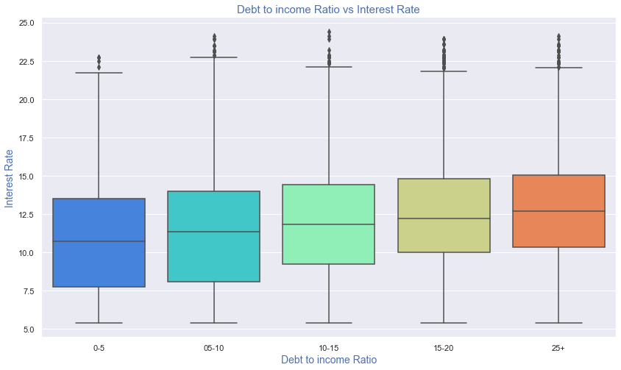
Bivariate Analysis
Interest rates decrease with increase in dti which seems a fair observation.

Slide 18
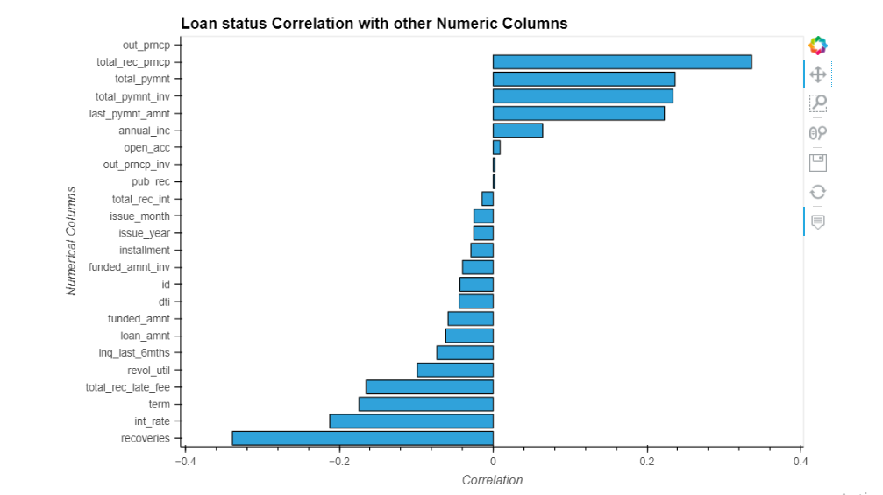
Correlations

Slide 19
Conclusions from correlations
Loans with more annual income range have lesser chances of charge off than those with lower annual income.
Loans with 60 moths term have more chances of default.
As the revolving credit utilization percentages of borrowers increases the loan default chances increases
With increase in Term of loan, chances of default also increases.

Slide 20
Final Conclusions
Out of all the borrowers, around 15% of the borrowers defaulted and 85% of the loans were fully paid.
As we move from Grade A to Grade G, interest rate increases and so does the chances of loan defaults.
Another thing to observe is that with increase in annual income, the chances of defaulting of loan decreases.
With increase in Term of loan, chances of default also increases..

Slide 21
Final Conclusions
As the revolving credit utilization percentages of borrowers increases the loan default chances increases
Loans taken for the purpose of Debt consolidation and credit card have more chances of default.
State CA ,NY, FL have high chances of getting defaulted.
DTI is of great relevance and chances of default increases with increse in dti.

