Slide 1

MALIGNANT COMMENT CLASSIFICATION
Milignant Comment Classifier
By:
Vipin Singh

Slide 2
INTRODUCTION
People use online comment section to express their opinions and views.
They do this freely and without any reluctance.
With it comes the risk of cyber abuse and harassment, which can put an end to people expressing themselves and giving up on seeking opinions.
To protect the users from cyberbullying, every organization should have an automated system in place to identify such malicious comments and suitable actions against the same.

Slide 3

OBJECTIVE
We have undertaken this project to classify the comments made by different users on social media platforms, like the comments from comment in this case, to build a model that is capable of detecting and classifying these comments into various classes like threat, obscene, insult and identity-based hate.

Slide 4

DATA EXTRACTION
We started out by using the API, in Python to extract the comments from dataset.
We collected the comments containing cuss words using the track parameter to gather relevant data to perform our analysis.
We saved the data gathered from comment in a CSV file.

Slide 5
DATA EXTRACTION
META DATA
ID
Comment
comment
screen_name
full_name
name
source

Slide 6

PREPROCESSING OF THE DATA
We have performed the following preprocessing on the data:
Removed punctuations
Removed the stop words
Stemming and lemmatization
Applied counter vectorizer

Slide 7
DATA MODELLING
Problem Transformation Method
We used the Multinomial Naïve Bayes classifier for classification.
We used this classifier, since it is suitable for classification with discrete features.
The algorithm estimates the conditional probability of a particular word given a class as the relative frequency of term t in documents belonging to class(c).
The variation takes into account the number of occurrences of term t in training documents from class (c),including multiple occurrences.

Slide 8
Algorithm Used
Logistic Classification
Linear Support Vector classifier
Multinomial naïve bayes

Slide 9
DATA VISUALIZATIONS

Slide 10
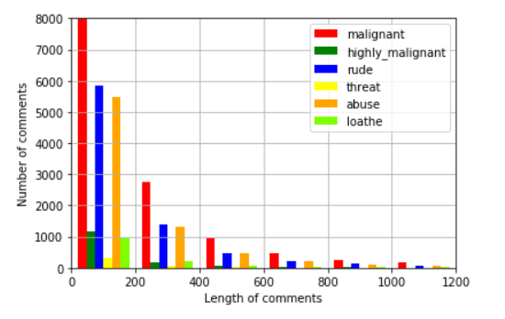
DATA VISUALIZATIONS

Slide 11
ANALYSIS OF RESULTS
Upon testing the models, on the malignant comments we have analyzed the following:
Most of the comments are up to 200 characters long.
Most of the comments fell under the “malignant” class.

Slide 12
CHALLENGES
Multiple labels – For Binary classification we have many models available but for multilabel classification the selection of models decreases drastically.
Collection of USABLE DATA – although we extracted over 100000 records, only 14000 records were usable among them.
Cleaning the data – Due to the character limit contain a lot of short forms which are different to classify using bag of words model.
RATE LIMIT – Data is so huge so it will take time to execute model on the data set especially CNN

Slide 13
FUTURE SCOPE
The current project predicts the type or malignantity in the comment.
We are planning to add the following features in the future:
Add feature to automatically sensitize words which are classified as malignant.
Automatically send alerts to the concerned authority if threats are classified as severe.
Build a feedback loop to further increase the efficiency of the model.
Handle mistakes and short forms of words to get better accuracy of the result.

Slide 14
REFERENCES
Wikipedia : https://en.wikipedia.org/wiki/Multi-label_classification
Kaggle challenge page for datasets and ideas : https://www.kaggle.com/c/
jigsaw-malignant-comment-classification-challenge
Conversation AI git page : https://conversationai.github.io/
Research Paper titled “Multi-label Classification: Problem Transformation methods - classification” : https://ac.els-cdn.com/ S1877050917319440/1-s2.0-S1877050917319440-main.pdf? _tid=eced1a38-f8fa-11e7- b8ef-00000aab0f27&acdnat=1515914406_0f244d3e6313bb049c435bf43 504bd52
Research Paper titled “Benchmarking Multi-label Classification Algorithms” :
http://ceur-ws.org/Vol-1751/AICS_2016_paper_33.pdf
Problem Transformation Methods : https://www.analyticsvidhya.com/blog/ 2017/08/introduction-to-multi-label-classification/
Research Paper on BP-MLL : http://citeseerx.ist.psu.edu/viewdoc/ download?doi=10.1.1.507.910&rep=rep1&type=pdf
GridsearchCV on Sequential Models : https://dzubo.github.io/machinelearning/2017/05/25/increasing-model-accuracy-by-tuning-parameters.html

Slide 15
THANK YOU

